Slide 1
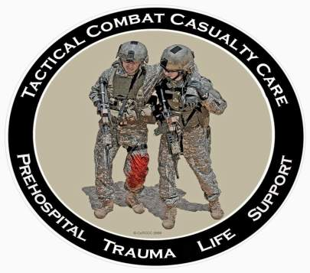
Direct from the Battlefield: Tactical Combat Casualty Care Performance Improvement Items
28 October 2013

Slide 2
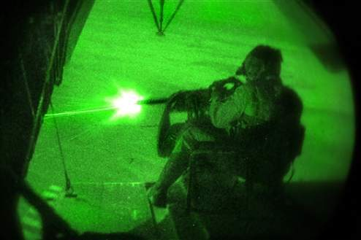
TCCC Opportunities to Improve: Sources
Reports from Joint Trauma System (JTS) weekly Trauma Telecons – every Thursday morning
Worldwide telecon to discuss every serious casualty admitted to a Role 3 hospital from that week
Published medical reports
Armed Forces Medical
Examiner’s System
Theater AARs
Feedback from doctors,
PAs, corpsmen, medics,
and PJs

Slide 3
The Forgotten Tourniquet
Notes:
Tactical Combat Casualty Care (TCCC)
4/1/2014
DRAFT
3

Slide 4
The Forgotten Tourniquet
There was a recent adverse outcome from a tourniquet that was left in place for approximately 8 hours.
Be aggressive about putting tourniquets on in Care Under Fire for any life-threatening extremity hemorrhage BUT
Reassess the casualty in Tactical Field Care – remove it if it is not needed unless the casualty is in shock.
Always re-evaluate tourniquets at two hours and remove if possible.

Slide 5
Tourniquet Mistakes to Avoid!
Not using a tourniquet when you should
Using a tourniquet for minimal bleeding
Leaving the TQ too high--if placed "high and tight" during care under fire, move to just above the wound during TFC
Not taking it off when indicated during TFC
Taking TQ off when the casualty is in shock or has only a short transport time to the hospital
Not making it tight enough – the tourniquet should both stop the bleeding and eliminate the distal pulse if the distal extremity is intact
Not using a second tourniquet if needed
Waiting too long to put the tourniquet on
Periodically loosening the tourniquet to allow blood flow to the injured extremity
Failing to reassess to make sure the bleeding is still stopped

Slide 6
Opioid Analgesics for Casualties in Shock
Notes:
Tactical Combat Casualty Care (TCCC)
4/1/2014
DRAFT
6

Slide 7
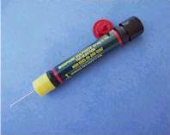
NO Opioid Analgesia for Casualties in Shock
Narcotics (morphine and fentanyl) are CONTRAINDICATED for casualties
who are in shock or who are likely to
go into shock; these agents may worsen
their shock and increase the risk of death
Four casualties in two successive weekly telecons were noted to have received narcotics and were in shock during transport or on admission to the MTFs
Use ketamine for casualties who are in shock or at risk of going into shock but are still having significant pain
Notes:
Great airway save

Slide 8
Untreated Pain on the Battlefield
Notes:
Tactical Combat Casualty Care (TCCC)
4/1/2014
DRAFT
8

Slide 9
Slide courtesy of MAJ
John Robinson
Data from JTS/JTTS
TCCC AARs and PHTR

Slide 10
Case Report
Male casualty with GSW to thigh
Bleeding controlled by tourniquet
In shock – alert but hypotensive
Severe pain from tourniquet
Repeated pleas to PA to remove the tourniquet
PA did not want to use opioids because of the shock
Perfect candidate for ketamine analgesia
Ketamine not fielded at the time with this unit
50 mg ketamine autoinjectors would help - but approval from the FDA is needed to use ketamine in that mode
Notes:
Read text

Slide 11
Opioid Analgesics Given in Combination with Benzodiapines
Notes:
Tactical Combat Casualty Care (TCCC)
4/1/2014
DRAFT
11

Slide 12
Warning: Opioids and Benzos
Ketamine can safely be given
after a fentanyl lozenge
Some practitioners use
benzodiazepine medications
such as midazolam to avoid
ketamine side effects BUT
Midazolam may cause respiratory depression, especially when used with opioids
Avoid giving midazolam to casualties who have previously gotten fentanyl lozenges or morphine
Notes:
12

Slide 13
Penetrating Eye Injuries
Notes:
Tactical Combat Casualty Care (TCCC)
4/1/2014
DRAFT
13

Slide 14
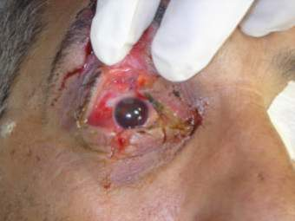
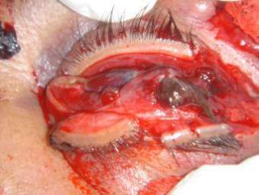
Penetrating Eye Trauma
Rigid eye shield for obvious or suspected eye wounds - often not being done – SHIELD AND SHIP!
Not doing this may cause permanent loss of vision – use a shield for any injury in or around the eye
Eye shields not always in IFAKs. Can use eye pro instead.
IED + no eye pro + facial wounds = Suspected Eye Injury!
Shield after injury
No shield after injury
Notes:
The eye on the left has a good chance of recovering vision.
The eye on the right will have to be surgically removed.

Slide 15
Patched Open Globe
Shrapnel in right eye from IED
Had rigid eye shield placed
Reported as both pressure patched and as having a gauze pad placed under the eye shield without pressure
Extruded uveal tissue (intraocular contents) noted at time of operative repair of globe
Do not place gauze on injured eyes! COL Robb Mazzoli: Gauze can adhere to iris tissue and cause further extrusion when removed even if no pressure is applied to eye.
At least two other recent occurrences of patching
Notes:
COL Robb Mazzoli was formerly the Army Surgeon General’s Consultant for Ophthalmology
Reminder: Rigid eye shields GOOD, pressure patch BAD for eye trauma
Should put no gauze underneath the shield at all – may cause problems as noted above

Slide 16
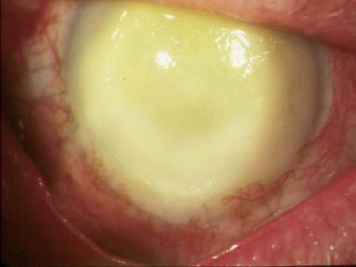
Antibiotics after Eye Injuries
2010 casualty with endophthalmitis (blinding infection inside the eye)
Reminder – shield and moxifloxacin in the field
for penetrating eye injuries – use combat pill pack!
Also – need to continue
moxi both topically and
systemically in the MTFs
Many antibiotics do not
penetrate well into the
eye
Notes:
Eye infections can cause permanent loss of vision after eye injury.
Give antibiotics in the Combat Pill Pack to help prevent!

Slide 17
Tension Pneumothorax
Notes:
Tactical Combat Casualty Care (TCCC)
4/1/2014
DRAFT
17

Slide 18
The Missed Tension
Pneumothorax
A recent U.S. combat fatality was found to have a
died with a tension pneumothorax
NO evidence of attempted needle decompression
Monitor anyone with torso trauma or polytrauma
for respiratory distress – perform needle
decompression when indicated
ALWAYS do bilateral NDC for a casualty with
torso trauma who loses vital signs on the battlefield
– may be lifesaving

Slide 19
Combat Gauze
Notes:
Tactical Combat Casualty Care (TCCC)
4/1/2014
DRAFT
19

Slide 20
External Hemorrhage – No Combat Gauze
Casualty with gunshot wound in the left infraclavicular area with external hemorrhage
“Progressive deterioration”
External hemorrhage noted to increase as casualty resuscitated in ED
No record of Combat Gauze use
All injuries noted to be extrapleural
Lesson learned: see following slide
Notes:
Read text

Slide 21
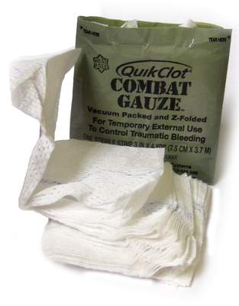
Combat Gauze™
It doesn’t work if you don’t use it.
Notes:
Read text

Slide 22
Junctional Hemorrhage
Notes:
Tactical Combat Casualty Care (TCCC)
4/1/2014
DRAFT
22

Slide 23
Junctional Hemorrhage
A recent U.S. combat casualty sustained a GSW
to the inguinal area
The CASEVAC platform did not have junctional
tourniquets aboard
The subsequent junctional hemorrhage was only
partially controlled with Combat Gauze
Casualty went into hemorrhagic shock and had to
be transfused

Slide 24
IED Blast Injury
3 of 5 casualties had complex blast injuries
All 3 with high traumatic LE amputations and reported difficulty with hemorrhage control despite tourniquet use
Combat Gauze reportedly not used
All 3 would have been excellent candidates for a junctional tourniquet – none were fielded with this unit
All 3 casualties required massive transfusions upon arrival at the Role 2 MTF

Slide 25
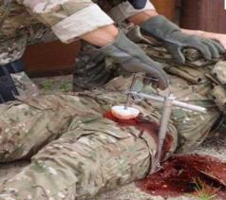
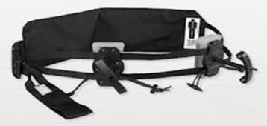
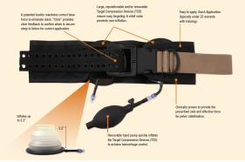
Junctional Tourniquets
Combat Ready Clamp JETT Sam Junctional Tourniquet
Junctional tourniquets: They don’t
work if your unit doesn’t field them.

Slide 26
TCCC Training
Notes:
Tactical Combat Casualty Care (TCCC)
4/1/2014
DRAFT
26

Slide 27
TCCC Training for ALL combatants: Self and buddy aid should be part of the Warrior Culture in all combat units
Notes:
Tactical Combat Casualty Care (TCCC)
4/1/2014
DRAFT
27

Slide 28
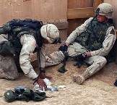
Eliminating Preventable Death on the Battlefield
Kotwal et al – Archives of Surgery 2011
All Rangers and docs trained in TCCC
U.S. military preventable deaths: 24%
Ranger preventable death incidence: 3%
Almost a 90% decrease in preventable deaths

Slide 29
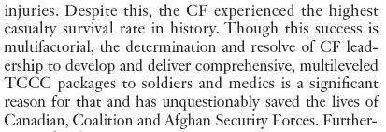
TCCC in Canadian Forces Savage et al: Can J Surg 2011

Slide 30
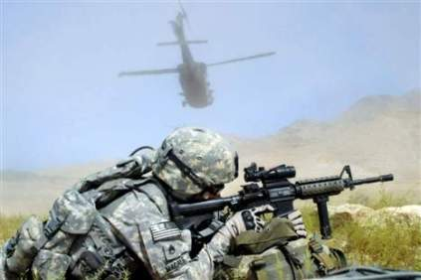
Train ALL Combatants in TCCC
Service medical departments responsible for training combat medical personnel only
Line commanders must take the lead to have an effective TCCC training program for all combatants
Ranger First Responder Course is the best model
Notes:
Some units have almost ELIMINATED preventable deaths by training everyone in TCCC.
Kotwal – Archives of Surgery 2011
Savage – Journal of Trauma 2011

Slide 31
Documentation of TCCC Care
Notes:
New Generation VI C-A-T has the white time band
Also a new manufacturer and date stamp
Tactical Combat Casualty Care (TCCC)
4/1/2014
DRAFT
31

Slide 32
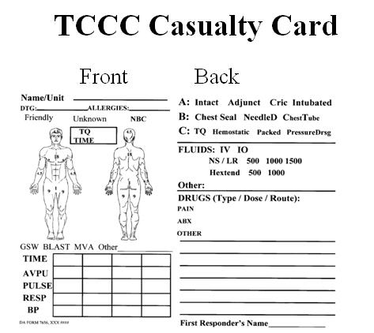
TCCC Card – Fill It Out!
You’re not done taking care of your casualty until this is done
USFOR-A FRAGO 13-39 directs the use of the TCCC Casualty Card and electronic AAR
Mission Commanders – this is a leadership issue!
Notes:
Read text

Slide 33
New TCCC Card
33

Slide 34
New TCCC AAR
34

Slide 35
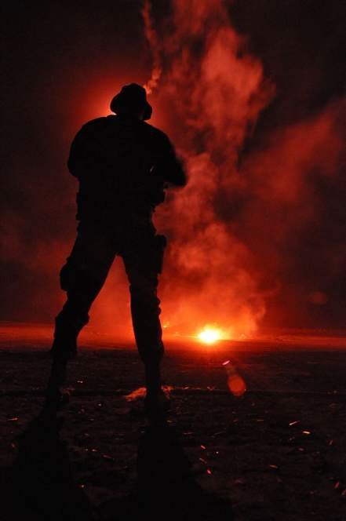
Questions?
Questions?

