Slide 1
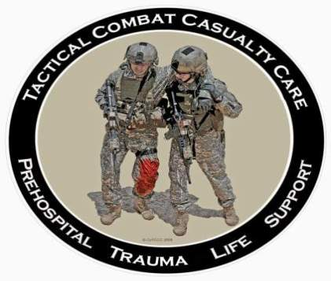
Tactical Combat Casualty Care
28 October 2013
Tactical Field Care
Notes:
Next we’ll be moving into the Tactical Field Care phase of TCCC

Slide 2
Objectives
STATE the common causes of altered states of consciousness on the battlefield.
STATE why a casualty with an altered state of consciousness should be disarmed.
DESCRIBE airway control techniques and devices appropriate to the Tactical Field Care phase.
Notes:
Read text

Slide 3
Objectives
DEMONSTRATE the recommended procedure for surgical cricothyroidotomy.
LIST the criteria for the diagnosis of tension pneumothorax on the battlefield.
DESCRIBE the diagnosis and initial treatment of tension pneumothorax on the battlefield.
Notes:
Read text

Slide 4
Objectives
DEMONSTRATE the appropriate procedure for needle decompression of the chest.
DESCRIBE the progressive strategy for controlling hemorrhage in tactical field care.
DEMONSTRATE the correct application of Combat Gauze.
Notes:
Read text

Slide 5
Objectives
DEMONSTRATE the appropriate procedure for initiating a rugged IV field setup.
STATE the rationale for obtaining intraosseous access in combat casualties.
DEMONSTRATE the appropriate procedure for initiating an intraosseous infusion.
Notes:
Read text

Slide 6
Objectives
STATE the tactically relevant indicators of shock in combat settings.
DESCRIBE the pre-hospital fluid resuscitation strategy for hemorrhagic shock in combat casualties.
DESCRIBE the management of penetrating eye injuries in TCCC.
DESCRIBE how to prevent blood clotting problems from hypothermia.
Notes:
Read text

Slide 7
Objectives
DESCRIBE the appropriate use of pulse oximetry in pre-hospital combat casualty care
STATE the pitfalls associated with interpretation of pulse oximeter readings.
LIST the recommended agents for pain relief in tactical settings along with their indications, dosages, and routes of administration.
DESCRIBE the rationale for early antibiotic intervention in combat casualties.
Notes:
Read text

Slide 8
Objectives
LIST the factors involved in selecting antibiotic drugs for use on the battlefield.
DISCUSS the management of burns in TFC.
EXPLAIN why cardiopulmonary resuscitation is not generally used for cardiac arrest in battlefield trauma care.
DESCRIBE the procedure for documenting TCCC care with the TCCC Casualty Card.
Notes:
Read text

Slide 9
Objectives
DESCRIBE the three ISAF categories for evacuation priority
LIST the nine items in a MEDEVAC request
DISCUSS the rules of thumb for calling for Tactical Evacuation and the importance of careful calculation of the risk/benefit ratio prior to initiating the call
DESCRIBE the appropriate procedures for providing trauma care for wounded hostile combatants.
Notes:
Read text

Slide 10
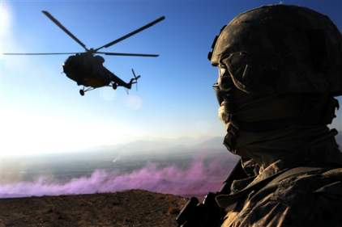
Tactical Field Care
Distinguished from Care Under Fire by:
  A reduced level of hazard from hostile fire
  More time available to provide care based on the tactical situation
Medical gear is still limited to that carried by the medic or corpsman
or unit members (may
include gear in tactical
vehicles)
Notes:
Now the shooting has stopped – or the fire is ineffective.
Does not mean that the danger is over – could be in Care Under Fire phase again anytime in the tactical setting.

Slide 11
Tactical Field Care
May consist of rapid treatment of the most serious wounds with the expectation of a re-engagement with hostile forces at any moment, or
There may be ample time to render whatever care is possible in the field.
Time to evacuation may vary from minutes to several hours or longer.
Notes:
This phase of care may be very prolonged.

Slide 12
Battlefield Priorities in the
Tactical Field Care Phase
This section describes the recommended care to be provided in TFC.
This sequence of priorities shown assumes that any obvious life-threatening bleeding has been addressed in the Care Under Fire phase.
If this is not the case – address the massive bleeding first.
After that – care is provided in the sequence shown. This sequence is compatible with the MARCH algorithm found in the USSOCOM Tactical Trauma Protocols.
Notes:
You may have multiple casualties with multiple problems.
What problems do you address first?
Before we show you – we have to note one assumption.

Slide 13
MARCH
Massive hemorrhage – control life-threatening bleeding.
Airway – establish and maintain a patent airway.
Respiration – decompress suspected tension pneumothorax, seal open chest wounds, and support ventilation/oxygenation as required.
Notes:
The MARCH algorithm is a guide to the sequence of treatment priorities in caring for combat casualties.

Slide 14
MARCH
Circulation – establish IV/IO access and administer fluids as required to treat shock.
Head injury/Hypothermia – prevent/treat hypotension and hypoxia to prevent worsening of traumatic brain injury and prevent/treat hypothermia.
Notes:
Read text

Slide 15
Tactical Field Care Guidelines
1. Casualties with an altered mental status should be disarmed immediately.
Notes:
(Note: All of the slides entitled “Tactical Field Care Guidelines” - as this one is - should be read verbatim.)
Automatic weapons and shock (and/or narcotics) are a potentially lethal combination!

Slide 16
Disarm Individuals with Altered Mental Status
Armed combatants with an altered mental status may use their weapons inappropriately.
Secure long gun, pistols, knives, grenades, explosives.
Possible causes of altered mental status are Traumatic Brain Injury (TBI), shock, hypoxia, and pain medications.
Explain to casualty: “Let me hold your weapon for you while the doc checks you out.”
Notes:
Casualty may resist being disarmed.
The proposed comment in the last bullet may help him to better accept your taking his weapon.

Slide 17
Tactical Field Care Guidelines
2. Airway Management
a. Unconscious casualty without airway obstruction:
- Chin lift or jaw thrust maneuver
- Nasopharyngeal airway
- Place casualty in recovery position
Notes:
Read text

Slide 18
Tactical Field Care Guidelines
2. Airway Management
b. Casualty with airway obstruction or impending airway obstruction:
- Chin lift or jaw thrust maneuver
- Nasopharyngeal airway
- Allow casualty to assume any position that best protects the airway, to include sitting up.
- Place unconscious casualty in recovery position.
- If previous measures unsuccessful:
- Surgical cricothyroidotomy (with lidocaine if conscious)
Notes:
Read text

Slide 19
Nasopharyngeal Airway
The “Nose Hose,” “Nasal Trumpet,” “NPA”
Excellent success in GWOT
Well tolerated by the conscious patient
Lube before inserting
Insert at 90 degree angle to the face NOT along the axis of the external nose
Tape it in
Don’t use oropharyngeal airway (‘J’ Tube)
  Will cause conscious casualties to gag
  Easily dislodged
Notes:
The oropharyngeal airway is more easily dislodged and more likely to cause gagging in a conscious casualty.
NPA is better tolerated by a conscious patient

Slide 20
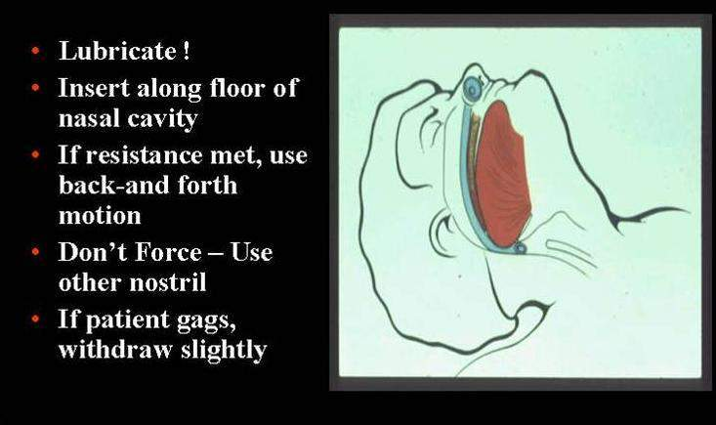
Nasopharyngeal Airway
Notes:
Lubricate!
Gentle insertion with rotary or back and forth motion
Don’t start a big nosebleed
Some people have deviated nasal septums – try the other side if it doesn’t go in the first side of the nose tried.

Slide 21
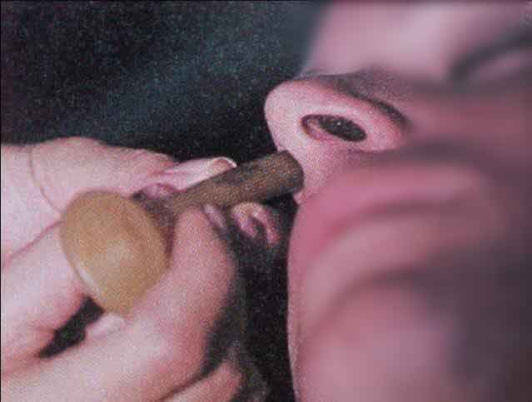
Nasopharyngeal Airway
What’s wrong with this NPA insertion?
Notes:
This nasopharyngeal airway is being inserted towards the brain and may end up there if there are craniofacial or basilar skull fractures!
The correct angle for insertion is 90 degrees to the frontal plane of the face. NOT along the long axis of the nose.

Slide 22
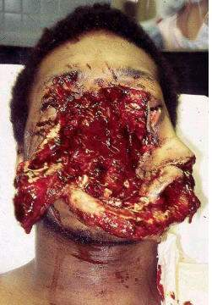
Maxillofacial Trauma
Casualties with severe facial injuries can often protect their
own airway by sitting up and leaning forward.
Let them do it if they can!
Notes:
It would be almost impossible to intubate a casualty with this kind of injury, especially on the battlefield at night.
If his larynx and trachea are intact, he may do well.
This casualty was treated with an emergency surgical airway.
The only way they got this casualty alive to the ER was to let him sit up and lean forward.
May have to do a surgical airway with casualty in the sitting position.

Slide 23
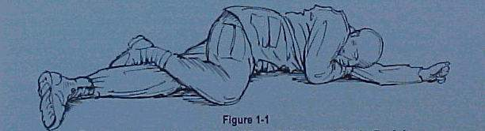
Airway Support
Place unconscious casualties in the recovery position after the airway has been opened.
Notes:
Recovery position helps to protect against vomiting and aspiration.
Again, note that C-spine immobilization is not required in penetrating head and neck trauma.

Slide 24
Surgical Airway
(Cricothyroidotomy)
The following series of slides and the video demonstrate a horizontal (transverse) incision technique for performing a surgical airway.
A vertical (mid-sagittal) incision technique is preferred by many trauma specialists and is recommended in the Iraq/Afghanistan War Surgery textbook.
Steps are the same except for the orientation of the incision.
Use a 6.0 tube for the airway
Notes:
So how do you do a surgical airway?

Slide 25
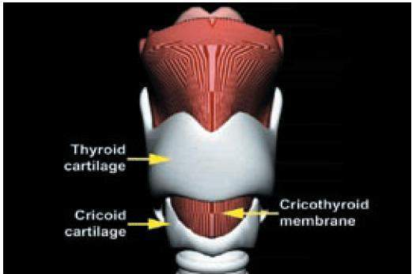
Surgical Airway
(Cricothyroidotomy)
Notes:
Here are the landmarks.
You want to make the incision right over the cricothyroid membrane.
The thyroid cartilage is the “Adam’s Apple” in men.

Slide 26
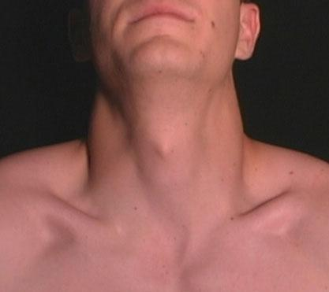
Surface Landmarks for Cricothyrotomy
Thyroid prominence – Adam’s apple usually visible only in males
Top of thyroid cartilage
Bottom of thyroid cartilage
Cricothyroid membrane
Cricoid cartilage
Notes:
Combat medic students should be able to demonstrate to an instructor the surface landmarks used to locate the cricothyroid membrane. These landmarks should be identified on a buddy.

Slide 27
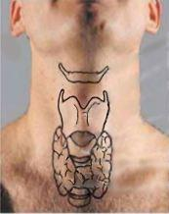
Beneath the Surface Landmarks
Hyoid Bone
Thyroid prominence (Adam’s apple ) - usually visible only in males
Thyroid cartilage
Cricothyroid membrane
Cricoid cartilage
Thyroid gland
Notes:
Here are the critical structures underlying the key surface landmarks.

Slide 28
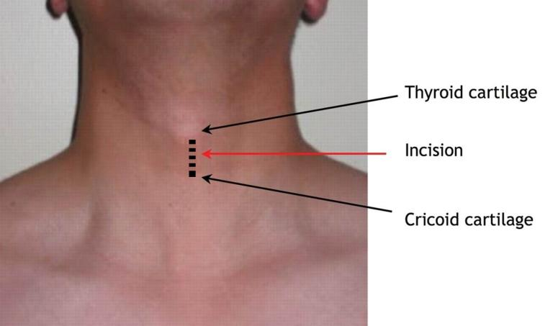
Locating the Cric Incision Line
Macdonald J C , Tien H C CMAJ 2008;178:1133-1135
Notes:
Once the combat medic student has identified the pertinent landmarks, s/he should be required to draw a dashed vertical (mid-sagittal) line on his/her buddy's neck over the cricothyroid membrane where the incision should be made.

Slide 29
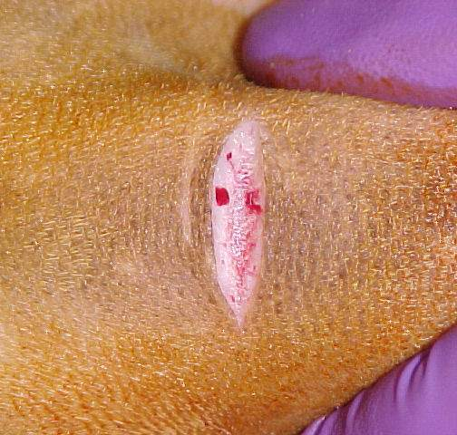
Surgical Incision over
Cricothyroid Membrane
Notes:
Make a surgical incision over the cricothyroid membrane. These slides show a transverse incision, but many experts recommend making a longitudinal incision overlying the trachea in the midline. A longitudinal incision has two advantages: first, it avoids the recurrent laryngeal nerves which run parallel along each side of the trachea, and second, unlike a transverse incision, it can be extended up or down if needed to get over the cricothyroid membrane if the initial incision is in the wrong place.

Slide 30
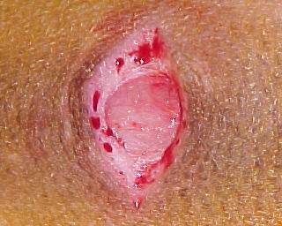
Surgical Airway
Incise through the epidermis & dermis
Cricothyroid
membrane
Epidermis
Dermis
Notes:
Get through the skin layers.

Slide 31
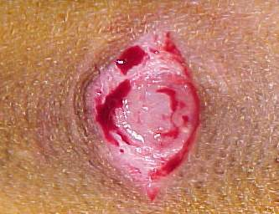
Surgical Airway
Epidermis
Cricothyroid
membrane
Notes:
This is a higher magnification view.
Use digital palpation to double-check the location of the cricothyroid membrane.

Slide 32
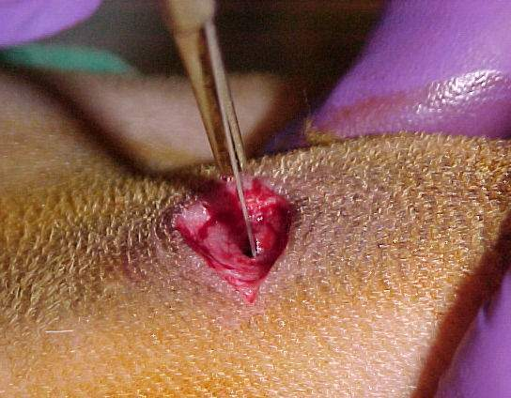
Surgical Airway
Single stabbing incision through cricothyroid membrane
Notes:
Straight in with the scalpel for this step.

Slide 33
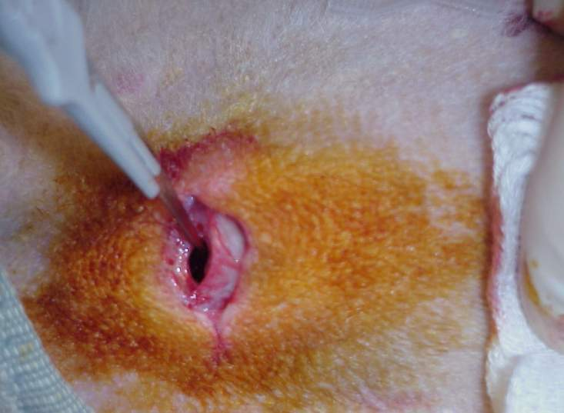
Surgical Airway
***You do not slice, you stab, the membrane***
Notes:
Should get an opening into an air space.

Slide 34
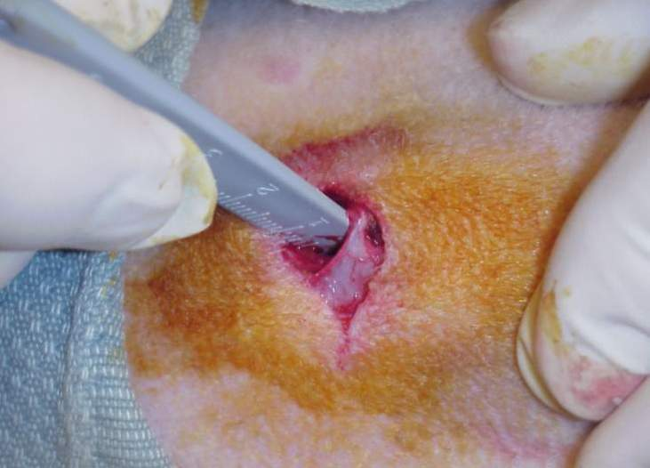
Surgical Airway
Insert the scalpel handle and rotate 90 degrees
Notes:
Enlarge the hole bluntly by doing this.

Slide 35
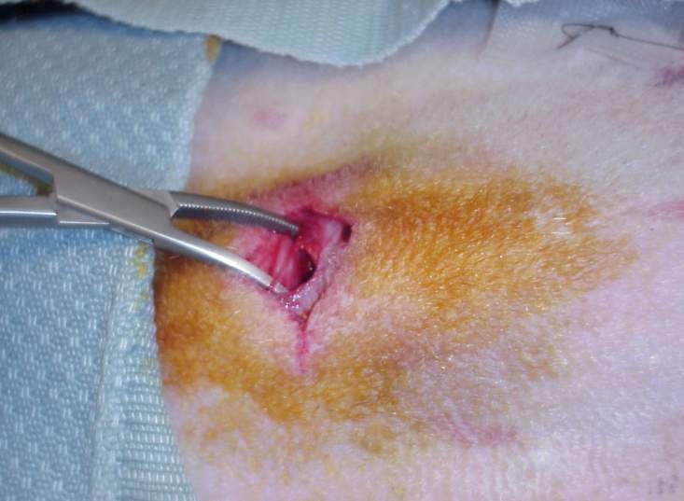
Surgical Airway
Insert Mosquito hemostat into incision and dilate
Notes:
Cric hook might work better here than mosquito forceps.
The tips of the mosquito forceps might also tear the cuff of the endotracheal tube

Slide 36
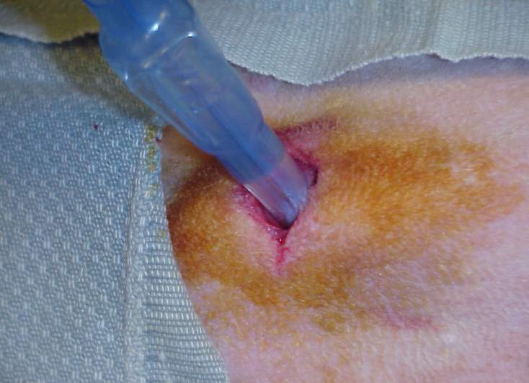
Insert ET Tube
Insert Endotracheal Tube –
direct the tube into the trachea and towards the chest.
Notes:
Direct posteriorly on entry, then aim towards the chest to assure tracheal positioning of the tube.

Slide 37
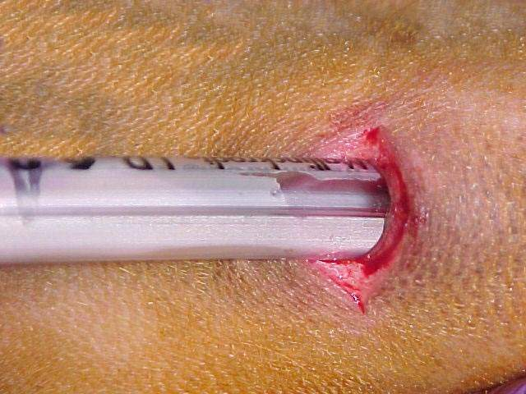
Check Placement
Misting in tube
Notes:
Auscultation is difficult in the tactical setting.
Misting in the tube provides evidence that air is moving through the tube. You may not, however, be able to appreciate misting in the tube in situations where visibility is low and you can’t use a white light. Also, be sure to inflate the cuff before you check for misting inside the tube – this assures that air is traveling only inside the tube given that the tube is correctly placed.

Slide 38
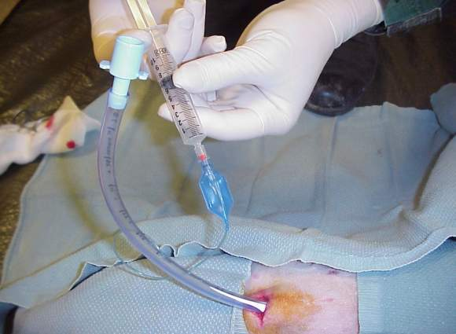
Inflating the Cuff
Inflate cuff and REMOVE SYRINGE
Note: Corpsman/medic may wish to cut ET tube off just above the inflation tube so it won’t be sticking out so far.
Notes:
Make sure the inflation tube is not cut!

Slide 39
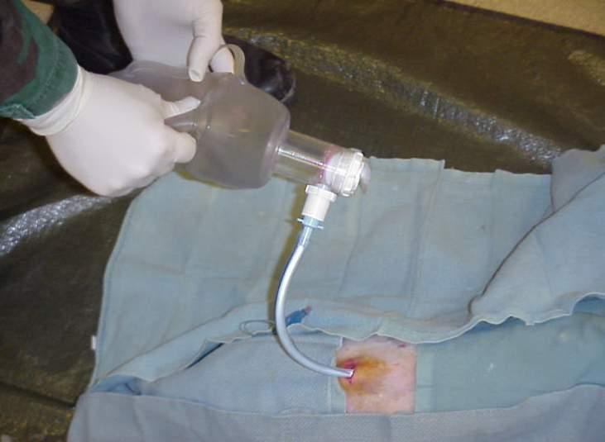
Ventilate
Attach Bag
Notes:
No need for ventilation if casualty is breathing spontaneously.
Most casualties will not require ventilation.
In those who do, ”when you need a breath, they need a breath.”
Don’t hyperventilate – use your own breathing rate as a guide to ventilation frequency.
(Note: Hyperventilation to reduce intracranial pressure in casualties with moderate/severe TBI and signs of cerebral herniation will be discussed in Tactical Evacuation Care.)

Slide 40
Secure the Tube
At this point, the tube should be taped securely in place with surgical tape.
Notes:
The tube will come out if you don’t tape it in place.
If neck is wet with blood, tape around the tube then around the neck. (Not too tight around neck.)

Slide 41
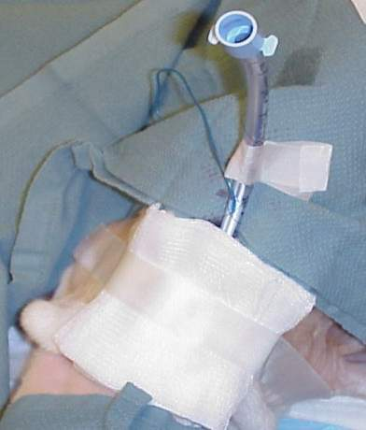
Dress the Wound
Tape a gauze dressing over the surgical airway site.
Notes:
Be sure to tape securely – skin is slippery when wet.

Slide 42
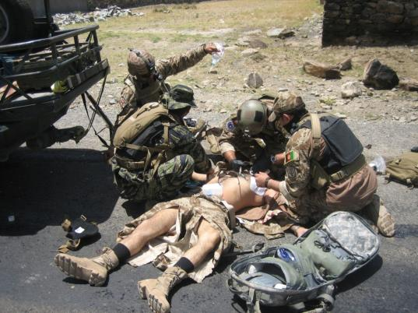
Repetition and Realism in Cric Training
To prepare for scenarios like this one, combat medics should perform cricothyrotomy at least five times during training on an anatomically realistic model.
Notes:
Cricothyrotomy is a difficult procedure even under the best of circumstances. Under stress, the combat medic will fall back on his training. Repetition and realism (both clinical and tactical) during training enhances skill development and knowledge retention in combat trauma care. Cricothyrotomy is a critical skill that should be practiced repeatedly on a realistic model.

Slide 43

Video: Surgical Airway
Notes:
Let’s watch a video on how to do a surgical airway.
Again – this shows a transverse incision. Many prefer an in-line incision.
Video File: 0203V05 Surgical Airway 120917

Slide 44
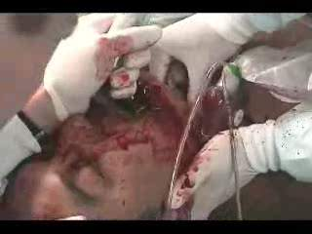
Video: An Actual Cricothyroidotomy
Courtesy Dr. Peter Rhee,
Univ. of Arizona
Notes:
This is video of a cricothyroidotomy performed in an actual emergency situation.
Video File: 0203V06 Actual Cricothyroidotomy 120917

Slide 45
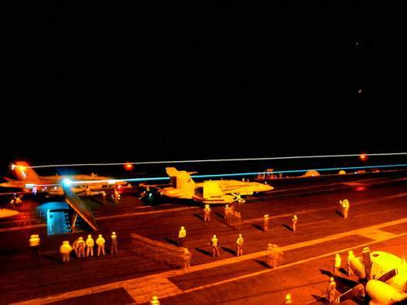
Questions
Airway Practical
Nasopharyngeal Airway
Surgical Airway
Notes:
Nasopharyngeal airway skill sheet
Surgical airway skill sheet

Slide 46
Tactical Field Care Guidelines
3. Breathing
a. In a casualty with progressive respiratory distress and known or suspected torso trauma, consider a tension pneumothorax and decompress the chest on the side of the injury with a 14-gauge, 3.25-inch needle/catheter unit inserted in the second intercostal space at the midclavicular line. Ensure that the needle entry into the chest is not medial to the nipple line and is not directed towards the heart. An acceptable alternate site is the 4th or 5th intercostal space at the anterior axillary line (AAL).
Notes:
Read text

Slide 47
Management of Open Pneumothorax
3. Breathing
b. All open and/or sucking chest wounds should be treated by immediately applying a vented chest seal to cover the defect. If a vented chest seal is not available, use a non-vented chest seal. Monitor the casualty for the potential development of a subsequent tension pneumothorax. If the casualty develops increasing hypoxia, respiratory distress, or hypotension and a tension pneumothorax is suspected, treat by burping or removing the dressing or by needle decompression.

Slide 48
Tactical Field Care Guidelines
3. Breathing
c. Casualties with moderate/severe TBI should be given supplemental oxygen when available to maintain an oxygen saturation > 90%.
Notes:
48
In the presence of moderate or severe TBI, hypoxia is associated with worse outcomes, and should be prevented if possible.

Slide 49
Tension Pneumothorax
Tension pneumothorax is another common cause of preventable death encountered on the battlefield.
Easy to treat.
Tension pneumo may occur with entry wounds in abdomen, shoulder, or neck.
Blunt (motor vehicle accident) or penetrating trauma (GSW) may also cause.
Notes:
Two things about a tension pneumothorax:
- It is a very common cause of preventable death on the battlefield.
- It can be effectively treated by combat medics, corpsmen, and PJs.

Slide 50
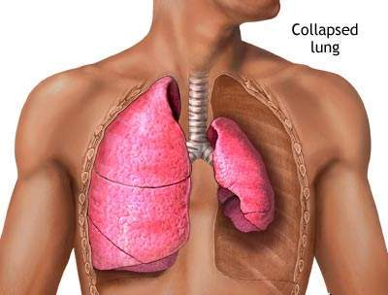
Pneumothorax
A pneumothorax is a collection of air between the lung and chest wall due to an injury to the chest and/or lung. The lung then collapses as shown.
Notes:
Normally the lung fills up the entire chest cavity.
With injury, air may get between the chest wall and the lung and cause the lung to collapse.
Air is supposed to be INSIDE the lung.
Here the air is inside the chest but OUTSIDE the lung – does not help get oxygen to the body.

Slide 51
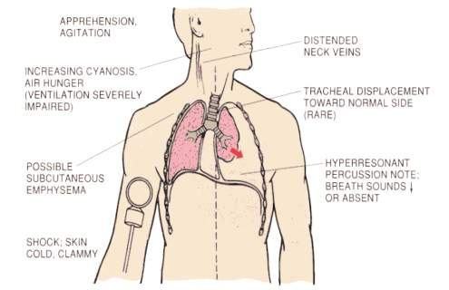
Tension Pneumothorax
Side with
gunshot
wound
A tension pneumothorax is worse. Injured lung tissue
acts as a one-way valve, trapping more and more
air between the lung and the chest wall. Pressure builds
up and compresses both lungs and the heart.
Notes:
Every breath adds more air to the air space outside the lung.
The air can’t be exhaled because it’s outside the lung – no way to escape - pressure builds up.

Slide 52
Tension Pneumothorax
Both lung function and heart function are
impaired with a tension pneumothorax, causing
respiratory distress and shock.
Treatment is to let the trapped air under
pressure escape.
Done by inserting a needle into the chest.
14 gauge and 3.25 inches long is the
recommended needle size.
Notes:
One collapsed lung should not kill you, but the elevated air pressure OUTSIDE the collapsed lung in a tension pneumothorax can impair the function of the good lung and the heart by preventing them from expanding normally.
This CAN kill you.
Study by Dr. Harcke in 2008:
Published in Military Medicine
Several casualties died from needles being too short to get through the chest wall.
Old 2 inch needles were too short.
3.25 inch needles will get through the chest wall in 99% of individuals.

Slide 53
Tension Pneumothorax
Question: “What if the casualty does not have a tension pneumothorax when you do your needle decompression?”
Answer:
  If he has penetrating trauma to that side of the chest, there is already a collapsed lung and blood in the chest cavity.
  The needle won’t make it worse if there is no tension pneumothorax.
  If he DOES have a tension pneumothorax, you will save his life.
Notes:
Let’s ask a question here.

Slide 54
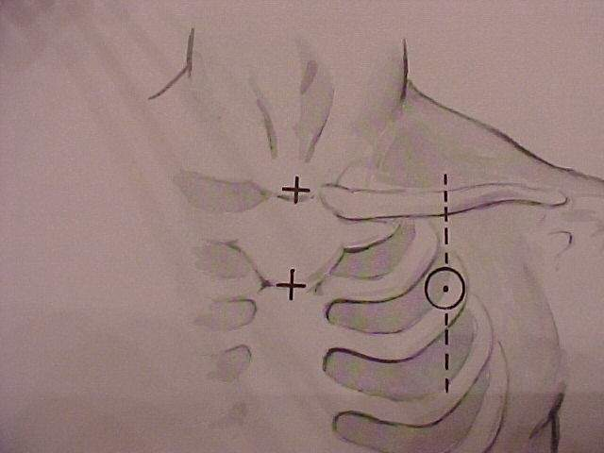
Picture of general location for needle insertion
Location for Needle Entry
2nd intercostal space in the
midclavicular line
2 to 3 finger widths below
the middle of the collar
bone
This is a general location for needle insertion
Notes:
WHERE exactly does the needle go?
First – it goes on the SAME SIDE OF THE CHEST AS THE INJURY.

Slide 55
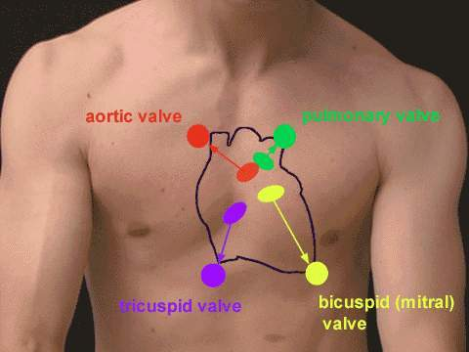
Warning!
The heart and great vessels are nearby
Do not insert needle medial to the nipple line
or point it towards the heart.
Notes:
This is an outline of the location of the heart drawn on the surface of the chest.

Slide 56
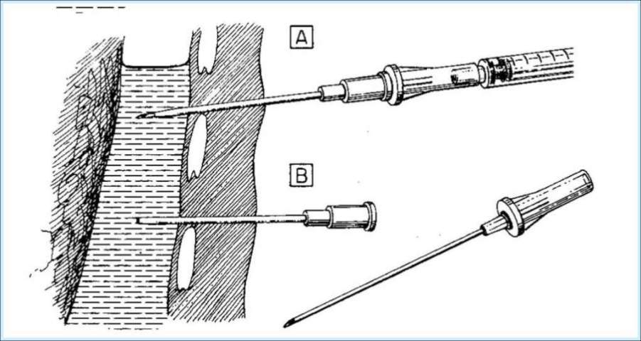
Needle Decompression – Enter
Over the Top of the Third Rib
Lung
Rib
Air collection
Chest wall
Intercostal artery &vein
Needle
Catheter
This avoids the artery and vein on the bottom of the second rib.
Notes:
Emphasis on 90-degree angle to chest wall on entry
Above the rib

Slide 57
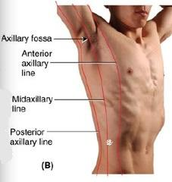
Alternate Site for Needle Decompression
An acceptable alternate site is the 4th or 5th intercostal space at the anterior axillary line.
The 5th intercostal space is located at the level of the nipple in young, fit males.
The AAL is located at approximately the lateral aspect of the pectoralis major muscle.
X
Notes:
The 5th intercostal space at the anterior axillary line is more remote from the heart and great vessels, and using this site may reduce the risk of complications from needle decompression. In a tactical situation, the lateral approach may be faster and safer given body armor configuration and ability to reassess.
The procedure is the same as used at the 2nd intercostal space at the mid-clavicular line.

Slide 58
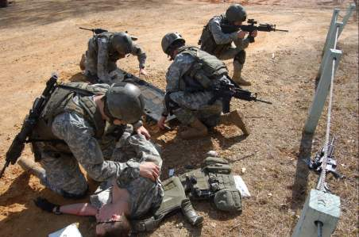
Remember!!!
Tension pneumothorax is a common but easily
treatable cause of preventable death on the
battlefield.
Diagnose and treat aggressively!
Notes:
DO NOT MISS THIS INJURY!

Slide 59
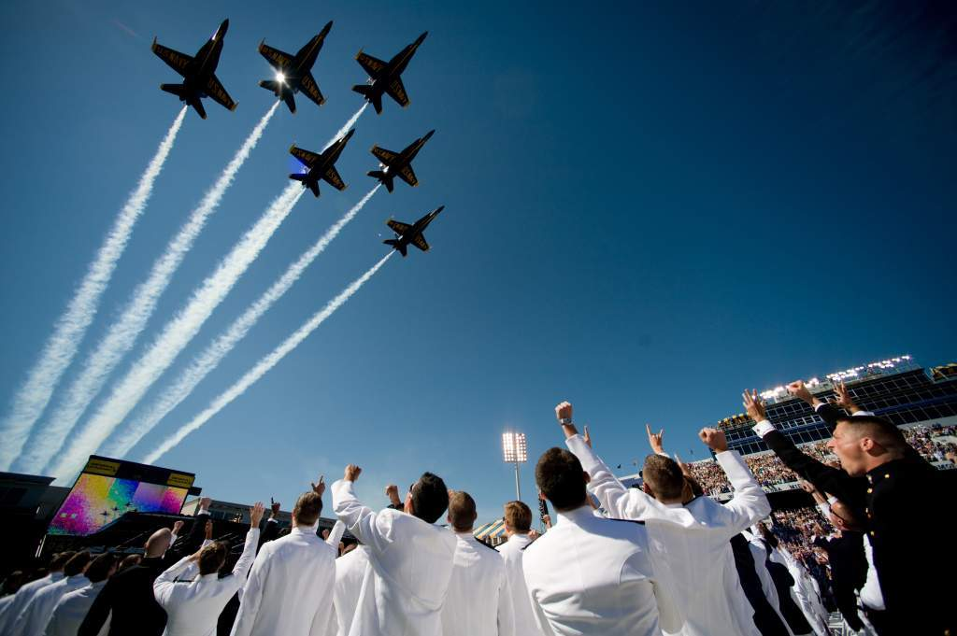
Needle Decompression Practical
Notes:
Needle Decompression Skill Sheet

Slide 60
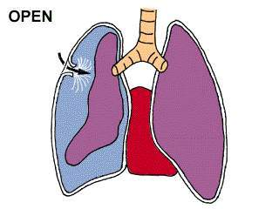
Sucking Chest Wound
(Open Pneumothorax)
Takes a hole in the chest the size of a nickel
or bigger for this to occur.
Notes:
In a sucking chest wound, air enters the pleural space through a wound in the chest wall.
The elastic lung deflates and pulls away from the chest wall.
On inspiration, the air now enters the chest THROUGH THE HOLE instead of INTO THE LUNGS.
The affected lung cannot be fully re-inflated by inhalation.

Slide 61
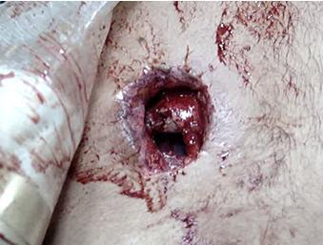
Open Pneumothorax

Slide 62
Management of Open Pneumothorax
Input from the USCENTCOM/JTS assessment of prehospital trauma care in Afghanistan questioned the use of unvented chest seals in the treatment of open pneumothorax
New animal research from both USAISR and Naval Medical Center Portsmouth has shown that vented chest seals work reliably to prevent a tension pneumothorax in the presence of an open pneumothorax and an ongoing air leak from the lung but non-vented chest seals do not

Slide 63
Sucking Chest Wound
May result from large defects in the chest wall and may interfere with ventilation
Treat by applying a vented occlusive dressing completely over the defect during expiration.
Monitor for possible development of subsequent tension pneumothorax.
Allow the casualty to adopt the sitting position if breathing is more comfortable.
Notes:
Apply during expiration.
At this point in the breathing cycle, there is relatively less air in the pleural space.

Slide 64
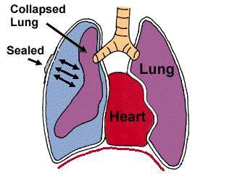
Sucking Chest Wound
(Treated)
Key Point: If signs of a tension pneumothorax develop
– lift one edge of the seal and allow the tension
pneumothorax to decompress. (“burping” the seal).
Alternatively, remove the seal for a few seconds to
accomplish the decompression, then re-apply.
Notes:
Once the wound has been occluded with a dressing, air can no longer enter (or exit) the pleural space.
The injured lung will remain partially collapsed, but the mechanics of respiration will be better.
You have to be alert for the possible development of tension pneumothorax because air can still leak into the pleural space from the injured lung.
Monitor these patients with observation and a pulse ox.

Slide 65
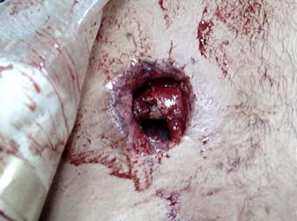
Video: Sucking Chest Wound
Notes:
Video of a sucking chest wound.
Note the large open hole in the chest wall.
Video File: 0203V07 Sucking Chest Wound #1 120917

Slide 66
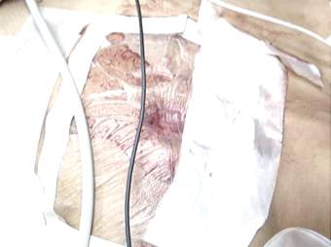
Sucking Chest Wound
(Treated) Video
Notes:
Negative pressure during inhalation retracts the dressing over the wound.
The lung now has a better chance of re-inflating.
Video File: 0203V08 Sucking Chest Wound #2 120917
No evidence to show that these dressings or a three-sided dressing are more effective than a simple occlusive dressing.
Simple occlusive dressings are easier to apply than constructing 3-sided dressings.

Slide 67
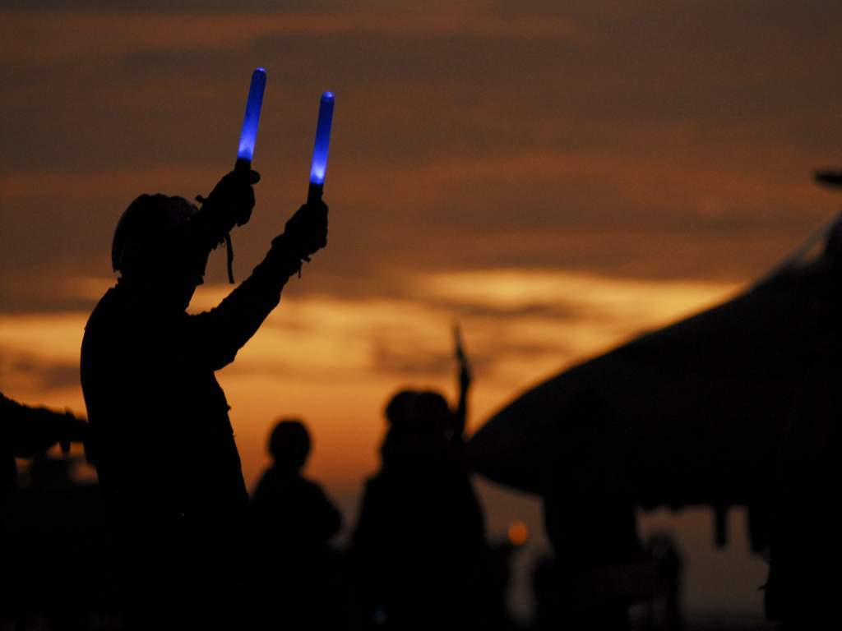
Questions?

Slide 68
Tactical Field Care Guidelines
4. Bleeding
a. Assess for unrecognized hemorrhage and control all sources of bleeding. If not already done, use a CoTCCC-recommended tourniquet to control life-threatening external hemorrhage that is anatomically amenable to tourniquet application or for any traumatic amputation. Apply directly to the skin 2-3 inches above wound.
Notes:
68
Read text

Slide 69
Tactical Field Care Guidelines
4. Bleeding
b. For compressible hemorrhage not amenable to tourniquet use or as an adjunct to tourniquet removal (if evacuation time is anticipated to be longer than two hours), use Combat Gauze as the hemostatic agent of choice. Combat Gauze should be applied with at least 3 minutes of direct pressure. Before releasing any tourniquet on a casualty who has been resuscitated for hemorrhagic shock, ensure a positive response to resuscitation efforts (i.e., a peripheral pulse normal in character and normal mentation if there is no traumatic brain injury (TBI). If the bleeding site is appropriate for use of a junctional tourniquet, immediately apply a CoTCCC-recommended junctional tourniquet. Do not delay in the application of the junctional tourniquet once it is ready for use. Combat Gauze applied with direct pressure should be used if a junctional tourniquet is not available or while the junctional tourniquet is being readied for use.

Slide 70
Tactical Field Care Guidelines
4. Bleeding
c. Reassess prior tourniquet application. Expose wound and determine if tourniquet is needed. If so, replace tourniquet over uniform with another applied directly to skin 2-3 inches above wound. If tourniquet is not needed, use other techniques to control bleeding.
Notes:
70
Tourniquets placed hastily over uniform items may be less effective than tourniquets applied directly to the skin. During reassessment, if a tourniquet needs to be repositioned, remove sufficient uniform materiel to place another tourniquet directly over the skin and tighten it. The initial tourniquet can now be released to assess for continued bleeding control.

Slide 71
Tactical Field Care Guidelines
4. Bleeding
d. When time and the tactical situation permit, a distal pulse check should be accomplished. If a distal pulse is still present, consider additional tightening of the tourniquet or the use of a second tourniquet, side by side and proximal to the first, to eliminate the distal pulse.
Notes:
71
Although a tourniquet may stop the active bleeding, it also prevents venous blood from returning to the heart. If arterial blood continues to flow past the tourniquet, pressure can build up distally in the limb and create a compartment syndrome. This is why the tourniquet should be tightened until there is no longer a distal pulse – to minimize chance of harm from a developing compartment syndrome.

Slide 72
Tactical Field Care Guidelines
4. Bleeding
e. Expose and clearly mark all tourniquet sites with the time of tourniquet application. Use an indelible marker.
Notes:
72
Read text

Slide 73
Tourniquets:
Points to Remember
Damage to the arm or leg is rare if the tourniquet is left on for less than two hours.
Tourniquets are often left in place for several hours during surgical procedures.
In the face of massive extremity hemorrhage, it is better to accept the small risk of damage to the limb than to have a casualty bleed to death.
Notes:
73
Tourniquets have historically been frowned upon in civilian trauma settings.
In combat settings, they are the biggest lifesaver on the battlefield!
They are NOT A PROBLEM if not left in place for too long.

Slide 74
Tourniquets:
Points to Remember
All unit members should have a CoTCCC-approved tourniquet at a standard location on their battle gear.
  Should be easily accessible if wounded – DO NOT bury it at the bottom of your pack
Tourniquets should be left in their protective packaging until needed to treat casualties.
  Harsh environments may contribute to tourniquet failure if not left in packaging
Notes:
74
Each soldier having a tourniquet at the unit’s standardized location is critical, and should be a pre-mission inspection item.

Slide 75
Tourniquets:
Points to Remember
Training tourniquets should never be used as mission tourniquets
Repetitive applications may cause tourniquet failure
Notes:
Only tourniquets within their shelf life and still in their original packaging should be issued for mission use.
75

Slide 76
Tourniquets:
Points to Remember
When a tourniquet has been applied, DO NOT periodically loosen it to allow circulation to return to the limb.
  Causes unacceptable additional blood loss
  It HAS been happening, and caused at least one near fatality in 2005
Notes:
76
Periodically loosening the tourniquet to allow intermittent flow to the limb is an unnecessary practice in the first place, and allows further blood loss in a casualty who cannot afford it.

Slide 77
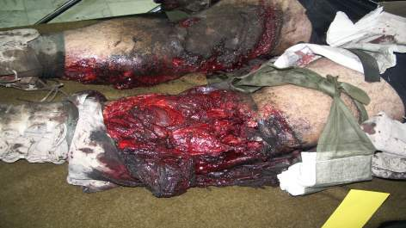
Tourniquets:
Points to Remember
Tightening the tourniquet enough to eliminate the distal pulse will help to ensure that all bleeding is stopped, and that there will be no damage to the extremity from blood entering the extremity
but not being
able to get out.
Notes:
77
This condition is called Compartment Syndrome.
It can cause unnecessary loss of the extremity.

Slide 78
Removing the Tourniquet
Do not remove the tourniquet if:
  The extremity distal to the tourniquet has been traumatically amputated.
  The casualty is in shock.
  The tourniquet has been on for more than 6 hours.
  The casualty will arrive at a medical treatment facility within 2 hours after time of application.
  Tactical or medical considerations make transition to other hemorrhage control methods inadvisable.
  Note: If the casualty will be delayed beyond 2 hours, re-assess the need for the tourniquet at the 2-hour point.
Notes:
78
Pay very close attention to these rules about tourniquet removal.
These are taken from the U.S. Army guidelines on this point.

Slide 79
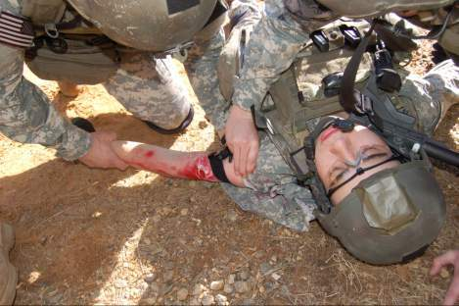
Removing the Tourniquet
Consider removing the tourniquet if bleeding can be controlled by other methods.
Only a combat medic/corpsman/PJ, a PA, or a physician should loosen tourniquets.
Notes:
79
It may become advantageous during TFC to try to use other methods of hemorrhage control, and to try to loosen the tourniquet.
Reasons to consider transitioning to less restrictive bleeding control options:
- Evacuation times will be delayed beyond two hours.
- Tourniquet pain is difficult to treat.

Slide 80
Removing the Tourniquet
Loosen the tourniquet slowly.
  Observe for bleeding.
Apply Combat Gauze to the wound per instructions later in the presentation if wound is still bleeding.
If bleeding remains controlled, cover the Combat Gauze with a pressure dressing.
  Leave loose tourniquet in place.
If bleeding is not controlled without the tourniquet, re-tighten it.
Notes:
80
Don’t take the tourniquet off and discard it.
You may need it if the bleeding starts up again.

Slide 81
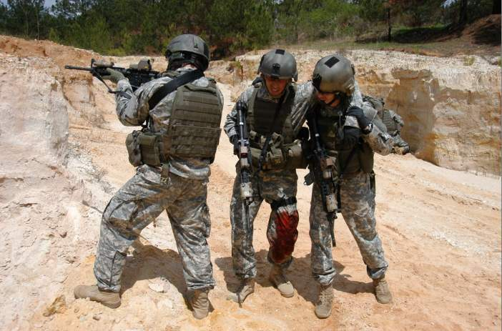
TCCC
Hemostatic Agent
QuikClot® Combat Gauze™
Notes:
81
You may have learned about HemCon® and QuikClot® in previous TCCC courses.

Slide 82
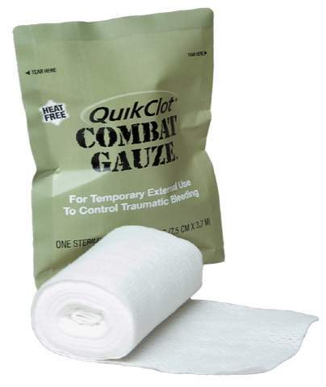
Combat Gauze
Combat Gauze has been
shown in lab studies
to be more effective than
the previous hemostatic agents
HemCon® and QuikClot ®.
Both Army (USAISR)
and Navy (NMRC) studies
confirmed
Notes:
82
Two research studies by the Army and the Navy have demonstrated that Combat Gauze™ is superior to previous agents (HemCon® and QuikClot®) used in TCCC.

Slide 83
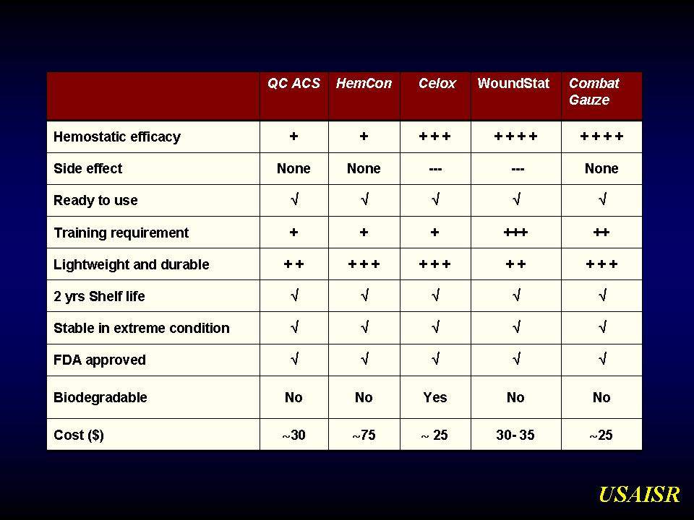
Courtesy Dr. Bijan Kheirabadi
Notes:
83
Notice the efficacy comparison in the top row.
Combat Gauze definitively outperformed HemCon® and QuikClot®.

Slide 84
CoTCCC Recommendation
February 2009
Combat Gauze is the hemostatic agent of choice.
The previously recommended agent WoundStat ® has been removed from the guidelines as a result of concerns about its safety.
Additionally, combat medical personnel preferred a gauze-type agent.
Notes:
84
Gauze-type agents are easier to use on the battlefield than powder-type agents.
This is especially true for wounds with a big bleeder at the bottom of a narrow wound tract.

Slide 85
Combat Gauze
Combat Gauze™ demonstrated an increased ability to stop bleeding over other hemostatic agents.
There is no exothermic (heat generating) reaction when Combat Gauze™ is applied.
The cost is significantly less than the previously recommended HemCon®
Notes:
85
Combat Gauze demonstrated an increased ability to stop bleeding.

Slide 86
Combat Gauze™
NSN 6510-01-562-3325
Combat Gauze™ is a 3-inch x 4-yard roll of sterile gauze impregnated with kaolin, a material that causes blood to clot.
It has been found in lab studies to control bleeding that would otherwise be fatal.
86
Combat Medical Systems, LLC, Tel: 910-426-0003, Fax: 910-426-0009, Website: www.combatgauze.com
Notes:
86
86
Combat Gauze™ is a rolled gauze similar to Kerlix™, but is impregnated with kaolin which helps promote blood clotting.

Slide 87
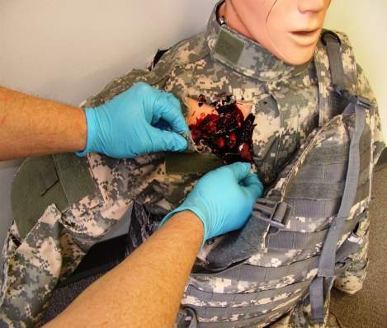
Combat Gauze™ Directions (1)
Expose Wound & Identify Bleeding
Open clothing around the wound.
If possible, remove excess pooled blood from the wound while preserving any clots already formed in the wound.
Locate the source of the most active bleeding.
Combat Medical Systems, LLC, Tel: 910-426-0003, Fax: 910-426-0009, Website: www.combatgauze.com
Notes:
87
87
Read Text

Slide 88
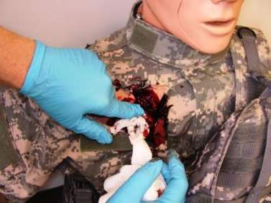





Combat Gauze™ Directions (2)
Pack Wound Completely
Pack Combat Gauze™ tightly into wound and directly onto the source of bleeding.
More than one gauze may be required to stem blood flow.
Combat Gauze™ may be re-packed or adjusted in the wound to ensure proper placement.
Combat Medical Systems, LLC, Tel: 910-426-0003, Fax: 910-426-0009, Website: www.combatgauze.com
Notes:
88
88
Pack CG into wound just like you would plain gauze.
If more than one roll is needed, pack in more CG until the wound is full.

Slide 89
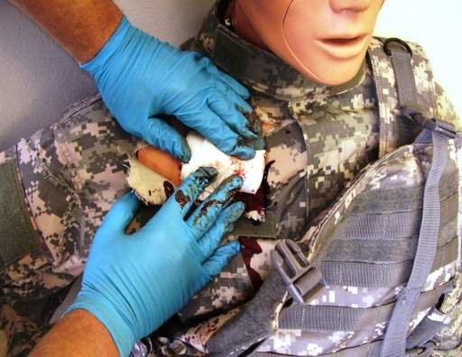
Combat Gauze™ Directions (3)
Apply Direct Pressure
Quickly apply pressure until bleeding stops.
Hold continuous pressure for 3 minutes.
Reassess to ensure bleeding is controlled.
Combat Gauze™ may be repacked or a second gauze used if initial application fails to provide hemostasis.
Combat Medical Systems, LLC, Tel: 910-426-0003, Fax: 910-426-0009, Website: www.combatgauze.com
Notes:
89
89
Although the Combat Gauze™ may become saturated during the initial application process, continue to hold firm pressure for at least three minutes. The kaolin will continue to leach into the wound area and help form a clot even though the bandage is soaked through.

Slide 90
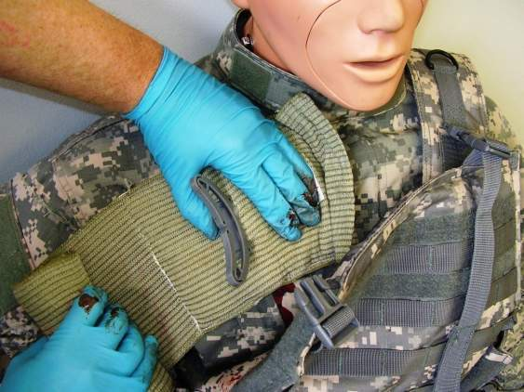
Combat Gauze™ Directions (4)
Bandage over Combat Gauze™
Leave Combat Gauze™ in place.
Wrap to effectively secure the dressing in the wound.
Although the Emergency Trauma Bandage is shown in this picture, the wound may be secured with any compression bandage, Ace™ wrap, roller gauze, or cravat.
Combat Medical Systems, LLC, Tel: 910-426-0003, Fax: 910-426-0009, Website: www.combatgauze.com
Notes:
90
90
The Combat Gauze™ may become saturated. Carefully observe for blood continuing to pool from under the gauze to determine if bleeding has been controlled. Once you are sure the bleeding has stopped, apply a pressure bandage over the Combat Gauze™.

Slide 91
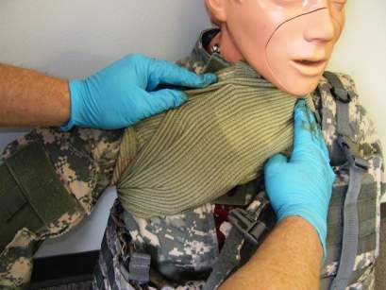
Combat Gauze™ Directions (5)
Transport & Monitor Casualty
Do not remove the bandage or Combat Gauze™.
Transport casualty to next level of medical care as soon as possible.
Combat Medical Systems, LLC, Tel: 910-426-0003, Fax: 910-426-0009, Website: www.combatgauze.com
Notes:
91
91
Re-check the dressing frequently, especially while transporting the casualty to next level of care.
Watch for re-bleeding.

Slide 92
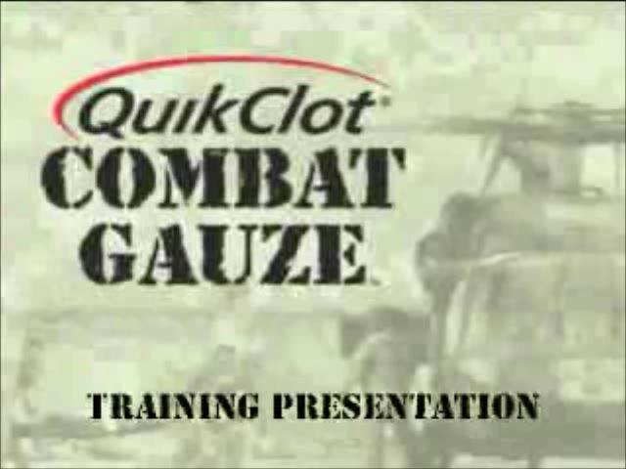
Combat Gauze Video
Notes:
92
This video shows Combat Gauze being used to control severe bleeding.
Video File: 0203V09 Combat Gauze 120917

Slide 93
Direct Pressure
Can be used as a temporary measure.
It works most of the time for external bleeding.
It can stop even carotid and femoral bleeding.
Bleeding control requires very firm pressure.
Don’t let up pressure to check the wound until you are prepared to control bleeding with a hemostatic agent or a tourniquet!
Use for 3 full minutes after applying Combat Gauze.
It is hard to use direct pressure alone to maintain control of big bleeders while moving the casualty.
Notes:
93
Even just a firmly applied thumb may work with big bleeders in small wound tracts.
One combat medic has used a thumb successfully in two casualties.
One had carotid bleeding – the other had femoral bleeding.

Slide 94

Questions?
Notes:
94

Slide 95

Combat Gauze™ Practical
Notes:
95
Break into small groups for practical

Slide 96
Junctional Hemorrhage
Term is used to include:
  Groin
  Buttocks
  Perineum
  Axilla
  Base of neck
Notes:
The areas where the neck and the limbs join the torso are “junctional” areas. Hemorrhage from wounds in these areas cannot be controlled by application of standard tourniquets like the C.A.T.
96

Slide 97
Junctional Tourniquets
Why have these devices only recently been added to TCCC?
This war has been going on for 13 years.

Slide 98

Dr. John Holcomb Brief to Defense Health Board 2011
Increasing Amputation Rates
Sep-Dec 2010
98

Slide 99
- Amputation rates for evacuated Marines have increased from 6 to 18% over the last 10 months (a
200% increase over baseline.)
- The rate in December 2010 was 38%.
- The double amputation rate increased by 3 fold in the last 4 months.
- Increased genitalia injuries
- Most of the amputations are high proximal injuries which are extremely disabling.
Amputation Summary
Dr. John Holcomb
7

Slide 100
IEDS
Iraq vs Afghanistan
Iraq
  Large amount of explosives – recycled 155 shells
  Command or vehicle-detonated
  Destroy vehicles
Afghanistan
  Smaller amount of explosives
  Homemade explosives
  Personnel pressure-detonated
  Designed to maim

Slide 101


Slide 102

Wounds that May Result in Junctional Hemorrhage
Typically caused by dismounted IED attacks
Notes:
These are examples of types of wounds that may result in junctional hemorrhage.
102

Slide 103



103
DCBI Task Force Report – BG Joseph Caravalho Chair

Slide 104
U.S. Combat Fatalities:
Death from Hemorrhage
Extremity [119/888] = 13.5%
Junctional [171/888] = 19.2%
Truncal [598/888] = 67.3%
Eastridge BJ, Mabry RL, Seguin PG, et al. Death on the battlefield (2001-2011): implications for the future of combat casualty care. Journal of Trauma 2012, 73(6) Suppl 5: 431-7.

Slide 105
Junctional Hemorrhage
“Groin hemorrhage is the most common type of junctional bleeding where regular tourniquets cannot work.”
Kelly JF, et al.
J Trauma. 2008; 64(suppl 2)
Notes:
Groin injury is the most common type of junctional injury. Fortunately, there is a way to address hemorrhage from groin injuries.
105

Slide 106

Superficial Anatomy of the Groin
Inguinal Ligament
Anterior Superior
Iliac Spine
Femoral Vessels
Pubic Tubercle

Slide 107

Anatomy of the Inguinal Region
External Iliac Artery
Common Iliac Artery
Anterior Superior Iliac Spine
Internal Iliac Artery
Inguinal Ligament
Pubic
Tubercle
Femoral Artery
Notes:
Effective application of the CRoC depends upon accurate location. Note that the external iliac artery becomes the femoral artery as it passes under the inguinal ligament.
107

Slide 108

Anatomy of the Iliac Arteries
Common Iliac
External iliac
Internal iliac

Slide 109
TCCC Management of Junctional Hemorrhage
The three CoTCCC-recommended junctional tourniquets are:
  The Combat Ready Clamp (CRoC)
  The Junctional Emergency Treatment Tool
  (JETT)
  The SAM Junctional Tourniquet (SJT)

Slide 110



TCCC Management of Junctional Hemorrhage
Combat Ready Junctional Emergency Sam Junctional
Clamp Treatment Tool Tourniquet
Training materials for all 3 devices are contained
in separate modules of the TCCC curriculum

Slide 111

Abdominal Aortic Junctional Tourniquet
The Abdominal Aortic Tourniquet (a truncal tourniquet) is another option for junctional hemorrhage control.
It previously had a shorter maximum length of application (1 hour) than the 3 junctional tourniquets listed above. It was also relatively contraindicated in the presence of penetrating abdominal injuries.
These restrictions have now
been removed in a new FDA
clearance for the device.
CoTCCC re-evaluation
pending

Slide 112
Continued Reassessment!
Once applied, the junctional tourniquet, as well as the casualty’s other hemorrhage control interventions, must be frequently reassessed to assure continued hemorrhage control.
  DO NOT EVER APPLY IT AND FORGET IT!
Notes:
Read text
112

Slide 113

Thank You!
Questions?
113

Slide 114
Tactical Field Care Guidelines
5. Intravenous (IV) access
Start an 18-gauge IV or saline lock if indicated.
If resuscitation is required and IV access is not obtainable, use the intraosseous (IO) route.
Notes:
Read text

Slide 115
IV Access – Key Point
NOT ALL CASUALTIES NEED IVs!
  IV fluids not required for minor wounds
  IV fluids and supplies are limited – save them for the casualties who really need them
  IVs take time
  Distract from other care required
  May disrupt tactical flow – waiting 10 minutes to start an IV on a casualty who doesn’t need it may endanger your unit unnecessarily
Notes:
DO NOT start IVs on casualties who are unlikely to need fluid resuscitation for shock or IV medications.
The alleged need to start two large-bore IVs on every casualty is a medical “urban myth.”
That concept is outdated on the modern battlefield.
Combat leaders need to know this fact.

Slide 116
IV Access
Indications for IV access
Fluid resuscitation for hemorrhagic shock or
  Significant risk of shock – GSW to torso
Casualty needs medications, but cannot take them PO:
  Unable to swallow
  Vomiting
  Shock
  Decreased state of consciousness
Notes:
Here are the casualties who really need IVs.
Casualties with a gunshot wound to the torso may not be in shock at first, BUT they may continue to bleed internally and go into shock later.

Slide 117
IV Access
A single 18ga catheter is recommended for access:
Easier to start than larger catheters
Minimizes supplies that must be carried
All fluids carried on the battlefield can be given rapidly through an 18 gauge catheter.
Two larger gauge IVs will be started later in hospitals if needed.
Notes:
You do not need a 14 gauge IV in the field – they are harder to start.

Slide 118
IV Access – Key Points
Don’t insert an IV distal to a significant wound!
A saline lock is recommended instead of an IV line unless fluids are needed immediately.
  Much easier to move casualty without the IV line and bag attached
  Less chance of traumatic disinsertion of IV
  Provides rapid subsequent access if needed
  Conserve IV fluids
Flush saline lock with 5cc NS immediately and then every 1-2 hours to keep it open
Notes:
Don’t hang fluids unless the casualty really needs them.

Slide 119

Video: Rugged Field IV Setup (1)
Start a Saline Lock and Cover with Tegoderm® or Equivalent
Notes:
Here’s is an excellent way to ruggedize an IV developed by the Army Rangers.
Video File: 0203V11 Saline Lock - Step #1 120917

Slide 120

Video: Rugged Field IV Setup (2)
Flush Saline Lock with 5 cc of IV Fluid
Saline lock must be flushed immediately (within 2-3 minutes),
and then flushed every 2 hours if IV fluid is not running.
Notes:
Don’t forget to flush the saline lock!
It will clot off if you don’t.
Video File: 0203V12 Saline Lock - Step #2 120917

Slide 121

Video: Rugged Field IV Setup (3)
Insert Second Needle/Catheter and Connect IV
Notes:
Insert 2nd catheter right through Tegaderm.
Insert IV line after flushing with fluid to get the air out of the line.
Video File: 0203V13 Saline Lock - Step #3 120917

Slide 122

Video: Rugged Field IV Setup (4)
Secure IV Line with Velcro Strap
Notes:
Velcro strap helps prevent traumatic disinsertion of IV line.
Video File: 0203V14 Saline Lock - Step #4 120917

Slide 123

Video: Rugged Field IV Setup (5)
Remove IV as Needed for Transport
Notes:
Even if the IV line is pulled out, the saline lock will remain in place.
This ruggedized IV technique has worked very well on the battlefield.
Vieo File: 0203V15 Saline Lock - Step #5 120917

Slide 124

Questions?
Questions?
Notes:
Care Under fire
4/1/2014
DRAFT
124

Slide 125


Intraosseous (IO) Access
If unable to start an IV and fluids or meds are needed
urgently, insert a sternal I/O line to provide fluids.
Notes:
The current IO device in most military medical sets is the Pyng FAST1®. The FAST1® was selected due to concerns about multiple extremity trauma precluding adequate site selection for extremity IV devices. Body armor use also generally protects the sternal insertion site.
Hand out the FAST1® device. You’ll go through the contents on the next slide.

Slide 126

FAST1® IO Device
Notes:
Go though the various components of the FAST1® as shown.

Slide 127
FAST1® Warnings
FAST1® NOT RECOMMENDED IF:
Patient is of small stature:
  Weight of less than 50 kg (110 pounds)
  Less than 12 years old
Fractured manubrium/sternum – flail chest
Significant tissue damage at site – trauma, infection
Severe osteoporosis
Previous sternotomy and/or scar
NOTE: FAST1® infusion tube SHOULD NOT BE LEFT IN PLACE FOR MORE THAN 24 HOURS
Notes:
A few things to be aware of about the FAST1®.

Slide 128
FAST1® Flow Rates
30-80 ml/min by gravity
120 ml/min utilizing pressure infusion
250 ml/min using syringe forced infusion
Notes:
How fast do fluids flow through the FAST1®?
Note that IO space connects directly with the intravenous space.
Use pressure to force in the Hextend fluid bolus, for instance, that we will discuss later.

Slide 129

FAST1® Insertion (1)
Prepare site using
aseptic technique:
  Betadine
  Alcohol
Notes:
Show them where the suprasternal notch is on yourself.
It is important to sterilize the site before inserting the IO device. Introduction of bacteria from dirty skin into the medullary cavity of the sternum can lead to infection inside the bone (osteomyelitis). This is a particularly undesirable complication because treatment may require removal of the sternum with resultant loss of the very important protection it provides for the heart.

Slide 130

FAST1® Insertion (2)
Remove backing labeled #1
Put index finger in sternal notch
Notes:
The Target Patch has a two-piece peel-off backing.

Slide 131

FAST1® Insertion (3)
Place Target Patch notch under index finger in sternal notch
Press down firmly over top of Patch
Remove backing labeled #2, press Patch down firmly
Notes:
Recheck position of notch and apply target patch.

Slide 132

FAST1® Insertion (4)
Place introducer needle cluster in target area
Assure firm grip
Introducer device must be perpendicular to the surface of the manubrium!
Notes:
The manubrium is the top part of the sternum – this is where infuser will go.
Introducer MUST be perpendicular to the manubrium, or it won’t work.

Slide 133

FAST1® Insertion (5)
Align introducer perpendicular to the manubrium.
Insert using increasing pressure till device releases. (~60 pounds)
Maintain 90-degree alignment to the manubrium throughout.
Notes:
Slow, steady pressure….

Slide 134


FAST1® Insertion (6)
Following device release, infusion tube separates from introducer
Remove introducer by pulling straight back
Cap introducer using post-use sharps plug and cap supplied
Notes:
Careful with sharp introducer when done.

Slide 135

FAST1® Insertion (7)
Connect infusion tube to tube on the target patch
NOTE: Must flush bone plug with 5 cc of fluid to get flow.
Assure patency by using syringe to aspirate small bit of marrow.
Notes:
KEY POINT – MUST FLUSH BONE PLUG WITH 5cc of IV fluid run through the infuser.
Use more if needed.

Slide 136

FAST1® Insertion (8)
Connect IV line to target patch tube
Open IV and assure good flow
Place dome to protect infusion site
Notes:
Run fluid through IV line before connecting to remove air from line.

Slide 137
FAST1® Insertion (9)
Potential Problems:
  Infiltration
    Usually due to insertion not perpendicular to sternum
  Inadequate flow or no flow
    Infusion tube occluded with bone plug
    Use additional saline flush to clear the bone plug
Notes:
What are some of the things that can go wrong when you are inserting the FAST1®?

Slide 138
FAST1® Access –
Key Points
DO NOT insert the FAST1® on volunteers as part of training – use the training device provided.
Should not have to remove in the field – it can be removed at the medical treatment facility.
Notes:
More key things to know about the FAST1®.
(Note: A slide describing the removal process is in the back-up slides for this presentation.)

Slide 139

FAST1® Insertion Video
Key Point Not Shown in Video
Remember to run IV fluids through the IV line before connecting.
Notes:
Read the additional key point.
Video File: 0203V16 FAST1 120917

Slide 140

EZ-IO®
After Pyng FAST1 ®, Vidacare’s EZ-IO ® is the next most commonly used IO device in combat.
Overall experience with these devices has been favorable.
Multiple EZ-IO devices are available. It is absolutely essential to use the right device for the chosen anatomical location.
Notes:
The device made for sternal insertion has a green plastic hub and 7.5mm-long needle.
The EZ-IO device made for long bone insertion (humerus, tibia) has a blue hub and its needle is 25mm long. There are also pediatric and large patient devices.
The packaging for these devices is markedly different. The long bone device package is marked “NOT FOR STERNAL USE.”
Intraosseous needles designed for long bone insertion have the potential to perforate the sternum, a thinner and less dense bone. In this situation, IV fluids may be introduced into the mediastinum. MAKE SURE YOU USE THE CORRECT DEVICE FOR THE SITE CHOSEN!
(NOTE TO INSTRUCTORS): Slides showing the procedure for placement of the EZ-IO sternal device are appended to the end of this presentation.)

Slide 141

Questions
Questions?
IV/IO Practical
Notes:
IV Practical Skill Sheet
IO Practical Skill Sheet

Slide 142


Slide 143
ASDHA Letter
9 October 2013
“Traumatic hemorrhage remains the leading cause of death on the battlefield….. Joint Theater Trauma experts recommended adding TXA as an adjunct to severe hemorrhage management. Presently, TXA is not FDA-approved for this indication, and as such is considered an off-label use subject to a provider‘s clinical judgment in a practitioner-patient relationship.”
Notes:
143

Slide 144
ASDHA Letter
9 October 2013
“The Military Services and the Combatant Commands may authorize such use of TXA in the combat environment, consistent with current clinical practice guidelines and appropriate clinical oversight. The Services will accumulate outcome data and monitor adverse events. The Services will establish Service-specific policies regarding TXA administration, develop training and education plans, and assume all costs for implementation. TXA may be obtained through normal class VIII channels.”
Notes:
144

Slide 145
Tactical Field Care Guidelines
6. Tranexamic Acid (TXA)
If a casualty is anticipated to need significant blood transfusion (for example: presents with hemorrhagic shock, one or more major amputations, penetrating torso trauma, or evidence of severe bleeding)
  Administer 1 gram of tranexamic acid (TXA) in 100 cc Normal Saline or Lactated Ringer’s as soon as possible but NOT later than 3 hours after injury.
  Begin second infusion of 1 gm TXA after Hextend or other fluid treatment.
Notes:
Read text
145

Slide 146
TXA
Hemorrhage is the leading cause of preventable death on the battlefield
Tourniquets and Combat Gauze do not work for internal bleeding
TXA does!
Notes:
TXA is the medic’s best tool for stopping internal bleeding!

Slide 147
TXA
TXA does not promote new clot formation
Prevents forming clots from being broken down by the body
Helps stop the bleeding
Helps prevent death from hemorrhage
Two major studies have shown a survival benefit from TXA, especially in casualties that require a massive transfusion of blood products
Notes:
CRASH-2: a very large (20,000 plus) patients in civilian trauma patients.
MATTERS (Military Application of Tranexamic Acid in Traumatic Emergency and Resuscitative Surgery) – 896 casualties treated at the Bastion hospital in Afghanistan.
Both studies showed a significant decrease in mortality with TXA use.

Slide 148
TXA
Survival benefit GREATEST when given within 1 hour of injury
Survival benefit still present when given within 3 hours of injury
DO NOT GIVE TXA if more than 3 hours have passed since the casualty was injured – survival is DECREASED by TXA given after this point
DON’T DELAY WITH TXA!
Notes:
It is just common sense if you are trying to stop bleeding to do that AS SOON AS POSSIBLE.
We do not have a good reason why TXA should cause casualties to do worse after 3 hours.
REINFORCE THAT BLEEDING SHOULD BE STOPPED ASAP – GIVE TXA WTHOUT DELAY!

Slide 149
TXA
Trade name: Cyklokapron®
FDA-approved
Possible side effects:
  Nausea, vomiting, diarrhea
  Visual disturbances
  Possible increase in risk of post-injury blood clots
  Hypotension if given as IV bolus
Notes:
Do not be deterred by possible side effects
The important thing is to stop the bleeding and save the life of the casualty.

Slide 150
TXA
Storage and Handling
Recommended temperature range for storage: 59°-86° F
Must protect this drug from environmental extremes
Store and transport in air conditioned spaces
On missions, carry in small insulated container
In very cold temperatures, carrying TXA next to the body on missions will protect from cold
Carriage in aid bag also acts as insulator against temperature extremes
Return to room temperature storage after each mission
Notes:
Review each point

Slide 151
TXA
Administration – 1st Dose
Supplied in 1 gram (1000 mg) ampoules
Should NOT be given with Hextend or through an IV line with Hextend in it
Inject 1 gram of TXA into a 100-cc bag of normal saline or lactated ringer’s
Infuse slowly over 10 minutes
Rapid IV push may cause hypotension
If there is a new-onset drop in BP during the infusion – SLOW DOWN the TXA infusion
Then administer blood products or Hextend
Notes:
Review each point

Slide 152
TXA
Administration – 2nd Dose
Typically given after the casualty arrives at a Role II/Role III medical facility
May be given in field if evacuation is delayed and fluid resuscitation has been completed before arrival at the medical facility
If still in field or in TACEVAC when fluid resuscitation is complete, give second dose of TXA as directed for the first dose
Notes:
Review each point

Slide 153

Questions?

Slide 154
Tactical Field Care Guidelines
7. Fluid Resuscitation
Assess for hemorrhagic shock; altered mental status (in the absence of head injury) and weak or absent peripheral pulses are the best field indicators of shock.
a. If not in shock:
- No IV fluids necessary
- PO fluids permissible if conscious and can
swallow
Notes:
Read text

Slide 155
Tactical Field Care Guidelines
7. Fluid Resuscitation
b. If in shock:
- Hextend, 500ml IV bolus
- Repeat once after 30 minutes if still
in shock
- No more than 1000ml of Hextend
Notes:
Read text

Slide 156
Tactical Field Care Guidelines
7. Fluid Resuscitation
c. Continued efforts to resuscitate must be weighed against logistical and tactical considerations and the risk of incurring further casualties.
Notes:
Read text

Slide 157
Tactical Field Care Guidelines
7. Fluid Resuscitation
d. If a casualty with an altered mental status due to suspected TBI has a weak or absent peripheral pulse, resuscitate as necessary to maintain a palpable radial pulse.
Notes:
Read text

Slide 158
Blood Loss and Shock
What is “Shock?”
Inadequate blood flow to the body tissues
Leads to inadequate oxygen delivery and cellular dysfunction
May cause death
Shock can have many causes, but on the battlefield, it is typically caused by severe blood loss
Notes:
A lot of people talk about “shock” without really understanding what it is.

Slide 159
Blood Loss and Shock
Question: How does your body react to blood loss?
Answer: It depends – on how much blood you lose.
Notes:
Let’s talk about blood loss and what happens when that occurs.

Slide 160

Normal Adult Blood Volume
5 Liters
5 Liters Blood Volume
1 liter by volume
1 liter by volume
1 liter by volume
1 liter by volume
1 liter by volume
Notes:
For demonstration – this slide shows 5 liters of simulated blood.
Shown in five 1-liter bottles to help with the demo.

Slide 161

500cc Blood Loss
4.5 Liters Blood Volume
Notes:
So – here we have lost the first 500cc of blood.
This is what you lose when you donate a “pint” or a unit of blood at the blood bank.

Slide 162
500cc Blood Loss
Mental State: Alert
Radial Pulse: Full
Heart Rate: Normal or slightly increased
Systolic Blood pressure: Normal
Respiratory Rate: Normal
Is the casualty going to die from this?
No
Notes:
No danger from this level of blood loss.
Keep in mind that factors such as exertion, fear, and pain may affect heart rate and breathing rate, and these factors will affect anyone engaged in combat, especially someone who has been wounded. You have to consider these things when treating casualties on the battlefield. For this demonstration, though, we are ignoring these factors, so the physiologic changes you see here are due solely to blood loss.

Slide 163

1000cc Blood Loss
4.0 Liters Blood Volume
Notes:
So now we lose another 500cc of blood.
How are we doing now?

Slide 164
1000cc Blood Loss
Mental State: Alert
Radial Pulse: Full
Heart Rate: 100 +
Systolic Blood pressure: Normal lying down
Respiratory Rate: May be normal
Is the casualty going to die from this?
No
Notes:
Still basically OK.
Heart rate may be up a little.

Slide 165

1500cc Blood Loss
3.5 Liters Blood Volume
Notes:
Lose another 500cc of blood.
How are we doing now?

Slide 166
1500cc Blood Loss
Mental State: Alert but anxious
Radial Pulse: May be weak
Heart Rate: 100+
Systolic Blood pressure: May be decreased
Respiratory Rate: 30
Is the casualty going to die from this?
Probably not
Notes:
At this point, the casualty is showing some symptoms from his blood loss.
Would probably not die from this.

Slide 167

2000cc Blood Loss
3.0 Liters Blood Volume
Notes:
Lose another 500cc of blood.
On the battlefield, this would represent ongoing uncontrolled hemorrhage.
How is the casualty doing now?

Slide 168
2000cc Blood Loss
Mental State: Confused/lethargic
Radial Pulse: Weak
Heart Rate: 120 +
Systolic Blood pressure: Decreased
Respiratory Rate: >35
Is the casualty going to die from this?
  Maybe
Notes:
Not so good.
At this point, it is quite possible that he or she could die from the blood loss.
This is “hemorrhagic” or “hypovolemic” (meaning “not enough blood volume”) shock.

Slide 169

2500cc Blood Loss
2.5 Liters Blood Volume
Notes:
So let’s take away another 500cc of blood from our simulated casualty.
Casualty is now in big trouble.

Slide 170
2500cc Blood Loss
Mental State: Unconscious
Radial Pulse: Absent
Heart Rate: 140+
Systolic Blood pressure: Markedly decreased
Respiratory Rate: Over 35
Is he going to die from this?
Probably
Notes:
At this point – the casualty has lost HALF of the blood in his/her body.
This level of hemorrhage is likely to be fatal.
YOUR JOB IS NOT TO LET THEM LOSE THIS MUCH BLOOD!
Treating the blood loss after the fact is not as good an option.

Slide 171
Recognition of Shock on the Battlefield
Combat medical personnel need a fast, reliable, low-tech way to recognize shock on the battlefield.
The best TACTICAL indicators of shock are:
  Decreased state of consciousness (if casualty has not suffered TBI)
  and/or
  Abnormal character of the radial pulse (weak or absent)
Notes:
These are the signs you can reliably identify on the battlefield or in a noisy CASEVAC environment.
Note that identification of these signs requires neither stethoscope nor sphygmomanometer.
Medications can also cause an altered state of consciousness (e.g. - if you give too much narcotics).

Slide 172

Palpating for the Radial Pulse
Notes:
Here’s how you find the radial pulse.
Demonstrate and have the class do it on themselves.
Get confirmation from everyone in the class that they were able to feel their own radial pulse.
Everyone take a few moments to appreciate how a normal pulse feels – strong, slow, regular.
Anybody here NOT have a strong, slow, regular pulse???

Slide 173

Fluid Resuscitation Strategy
If the casualty is not in shock:
  No IV fluids necessary – SAVE IV FLUIDS FOR CASUALTIES WHO REALLY NEED THEM.
  PO fluids permissible if casualty can swallow
    Helps treat or prevent dehydration
    OK, even if wounded in abdomen
      Aspiration is extremely rare;
      low risk in light of benefit
      Dehydration increases
      mortality
Notes:
Don’t ever use your IV fluids unless the casualty needs them.
The next person to get shot may die if he or she doesn’t get them.
CONSERVE precious medical supplies on the battlefield.

Slide 174
Hypotensive Resuscitation
Goals of Fluid Resuscitation Therapy
  Improved state of consciousness (if no TBI)
  Palpable radial pulse corresponds roughly to systolic blood pressure of 80 mm Hg
  Avoid over-resuscitation of shock from torso wounds.
  Too much fluid volume may make internal hemorrhage worse by “Popping the Clot.”
Notes:
DO NOT try to restore a normal blood pressure.
As you infuse fluid, the blood pressure goes up.
If it goes up too much, this may interfere with your body’s attempt to clot off an internal bleeding site both by diluting clotting factors and increasing the pressure to the point where the clot is disrupted by the hydrostatic force exerted by the IV fluid.
Bickell study in New England Journal of Medicine 1994:
Patients with shock from uncontrolled hemorrhage did WORSE with aggressive prehospital fluids

Slide 175
Choice of Resuscitation Fluid in the Tactical Environment
Why use Hextend instead of the much less expensive Ringer’s Lactate used in civilian trauma?
1000ml of Ringers Lactate (2.4 pounds) will yield an expansion of the circulating blood volume of only about 200ml one hour after the fluid is given.
The other 800ml of RL has left the circulation after an hour and entered other fluid spaces in the body – FLUID THAT HAS LEFT THE CIRCULATION DOES NOT HELP TREAT SHOCK AND MAY CAUSE OTHER PROBLEMS.
Notes:
Lactated Ringer’s solution and normal saline cost less than a dollar for a 1000cc bag.
Hextend costs more than $100 for the same amount.
Why pay this extra money?
BECAUSE HEXTEND WORKS BETTER FOR COMBAT CASUALTIES WHOSE EVACUATION MAY BE DELAYED.
The increase in circulating blood volume lasts much longer with Hextend than with NS or Lactated Ringers.
“Other problems” noted above include shock lung, cerebral edema, and abdominal compartment syndrome.
All of these may cause late deaths in casualties.

Slide 176
Choice of Resuscitation Fluid
500ml of 6% hetastarch (trade name Hextend®, weighs 1.3lbs) and will yield an expansion of the intravascular volume of 600-800ml.
This intravascular expansion is still present 8 hours later – may be critical if evacuation is delayed.
Hextend®
  Less weight to carry for equal effect
  Stays where it is supposed to be longer and does the casualty more good
  Less likely to cause undesirable side effects
Notes:
In IV fluids, the fluid follows the molecules in it.
NS and LR have salt molecules, which leave the circulation and go to the entire body.
Hextend contains the very large hetastarch molecule – has more “osmotic power.”
What does this mean?
The large size of the hetastarch molecules keeps them in the circulation, so the fluid stays there, too.

Slide 177
Crystalloid Fluid Shifts
IV
W
Water Molecules
VESSEL
CELLS
CELLS
LR
LR
LR
LR
LR
LR
LR
LR
LR
LR
LR
LR
LR Molecules
W
W
W
Small sodium, chloride, potassium, etc. from crystalloids leak through vessel membranes
In 1 hour, only 25% of crystalloid fluid is still in the vascular space
For a 1000ml bag, that’s only 250ml still in the vessels
The rest of the fluid diffuses to the interstitial and intracellular space
W
W
W
W
W
W
W
W
W
W
W
W
W
W
W
W
W
W
W
W
W
W
INTERSTITIAL
W
W
W
W
W
W
W
W
W
W
W
W
W
W
W
W
W
W
W
W
W
W
W

Slide 178
Hextend® Fluid Shifts
IV
W
Water Molecules
H
H
H
H
CELLS
CELLS
H
VESSEL
H
H
Hextend Molecules
W
W
W
W
W
W
Large Hextend particles remain in the vessels for 8 hours
Osmotic pressure pulls additional water from the interstitial and intracellular spaces into the vessels
The expansion resulting from 500ml of Hextend is 500 to 650 ml of blood volume
W
W
W
W
W
W
W
W
W
W
W
W
W
W
W
W
W
W
W
W
INTERSTITIAL
W
W
W
W
W
W
W
W
W
W
W
W
W
W
W
W
W
W
W
W
W
W
Notes:
This volume of fluid pulled from the interstitial and intercellular spaces is of negligible effect on these large fluid spaces.
BUT, THIS EXTRA VOLUME IN THE SMALLER INTRAVASCULAR SPACE CAN BE LIFE SAVING!
CASUALTIES DIE FROM BLOOD LOSS, NOT FROM DEHYDRATION!
(NOTE: The average adult human body contains approximately 42L of water. 2/3 of that water is inside the cells (approximately 28L). 1/3 is inside blood vessels and in the “interstitial space” (approximately 14L). If we have an average of 5L inside blood vessels, this leaves 9 liters within the interstitial space. If a 500cc Hextend bolus was actually able to pull a full 300cc from the interstitial space into the blood vessels, that only represents about 3% of the total available fluid.)

Slide 179


Compare Fluids
Max dose of Hextend is 1,000ml (1,600ml of volume expansion effect)
To get the same effect from crystalloid, it requires 7,000ml PER CASUALTY!
Which would you rather carry?
Hextend is preferred as a weight saving advantage for combat trauma
For hemorrhagic shock, LR is 2nd choice.
Hextend
2.6 lbs
Crystalloid
14.4 lbs
Notes:
179
Normal saline is not listed here because resuscitation with it results in hyperchloremic acidosis that may be associated with systemic vasodilation, increased extravascular lung water, and coagulopathy.
Schreiber, MA: The Use of Normal Saline for Resuscitation in Trauma. J Trauma, 70:5, May Supplement 2011.

Slide 180
Fluid Resuscitation Strategy
If signs of shock are present, CONTROL THE BLEEDING FIRST, if at all possible.
  Hemorrhage control takes precedence over infusion of fluids.
Hextend, 500ml bolus initially
If mental status and radial pulse improve, maintain saline lock – do not give additional Hextend.
Notes:
The most important part of managing shock is to PREVENT it.

Slide 181
Fluid Resuscitation Strategy
After 30 minutes, reassess state of consciousness and radial pulse. If not improved, give an additional 500ml of Hextend
Continued efforts to resuscitate must be weighed against logistical and tactical considerations and the risks of incurring further casualties.
Hextend has no significant effects on coagulation and immune function at the recommended maximum volume of 1000 ml (for adults)
Notes:
If the casualty improves after the first 500cc bolus and stays better, DO NOT give the additional bolus of Hextend.
Doses of Hextend of 1500cc and greater may have an adverse effect on clotting.

Slide 182
TBI Fluid Resuscitation
If a casualty with an altered mental status due to suspected TBI has a weak or absent peripheral pulse :
  Resuscitate with sufficient Hextend® to maintain a palpable radial pulse.
  Shock increases mortality in casualties with head injuries.
  Must give adequate IV fluids to restore adequate blood flow to brain.
Notes:
TBI (traumatic brain injury) – can be either a closed head injury or penetrating head trauma.
In this case, the need to ensure that there is enough blood pressure to pump blood to the brain means that you have to be more aggressive with your fluid resuscitation.
Hextend’s ability to STAY in the circulation rather than leaving it may help to prevent cerebral edema in TBI casualties.

Slide 183

Questions?

Slide 184
Tactical Field Care Guidelines
8. Prevention of hypothermia
a. Minimize casualty’s exposure to the elements. Keep protective gear on or with the casualty if feasible.
b. Replace wet clothing with dry if possible. Get the casualty onto an insulated surface as soon as possible.
c. Apply the Ready-Heat Blanket from the Hypothermia Prevention and Management Kit (HPMK) to the casualty’s torso (not directly on the skin) and cover the casualty with the Heat-Reflective Shell (HRS).

Slide 185
Tactical Field Care Guidelines
8. Prevention of hypothermia (cont)
d. If an HRS is not available, the previously recommended combination of the Blizzard Survival Blanket and the Ready Heat blanket may also be used.
e. If the items mentioned above are not available, use dry blankets, poncho liners, sleeping bags, or anything that will retain heat and keep the casualty dry.
f. Warm fluids are preferred if IV fluids are required.
Notes:
Read text

Slide 186


THE OLD HPMK
Notes:
186
The old HPMK contains a Thermo-Lite Hypothermia Prevention Cap, a Ready-Heat Blanket, and a Blizzard Survival Blanket. The cap can be blown off by rotor wash when loading a casualty in a helicopter, and the Blizzard Rescue Blanket does not provide convenient exposure for tending IVs and tourniquets. Nevertheless, this is still an effective combination.

Slide 187

6 – Cell
“Ready-Heat” Blanket
4- Cell
“Ready-Heat” Blanket
Apply Ready Heat blanket to torso OVER shirt.
Notes:
187
The Ready-Heat blanket generates heat when exposed to the air. It can produce temperatures reaching 104°F for several hours. Works for up to 8 hours.
Avoid direct contact with bare skin as thermal burns are possible.
Ready-Heat blankets may not work as well at high altitudes. The lower partial pressure of oxygen at high altitudes may not be enough to sustain the chemical reaction required to generate heat.

Slide 188
Repeat
Do NOT place the ready-Heat Blanket
directly on the skin
Multiple reports of skin burns from
this being done
Keep cammie top or T-shirt on
Place Ready-Heat over the fabric
Notes:
Read text

Slide 189


NEW HPMK
Notes:
This is the new Hypothermia Prevention and Management Kit with a Ready-Heat Blanket and a Heat Reflective Shell. The HRS will help to retain the heat produced by the Ready-Heat blanket. It has an incorporated hood and Velcro closures down each side to allow exposure of an arm or a leg. Such exposure allows the medic to attend to IVs and tourniquets.
189

Slide 190
Hypothermia Prevention
Key Point: Even a small decrease in body temperature can interfere with blood clotting and increase the risk of bleeding to death.
Casualties in shock are unable to generate body heat effectively.
Wet clothes and helicopter evacuations increase body heat loss.
Remove wet clothes and cover casualty with hypothermia prevention gear.
Hypothermia is much easier to prevent than to treat!
Notes:
Here we’re not talking about hypothermia in the usual sense, which is dying from cold exposure.
Here we are talking about keeping your blood clotting system working!
Hypothermia is a problem for casualties with hemorrhagic shock even with warm ambient temperatures.
Prevention of hypothermia is the key; once established it is difficult to reverse.

Slide 191
Tactical Field Care Guidelines
9. Penetrating Eye Trauma
If a penetrating eye injury is noted or suspected:
a) Perform a rapid field test of visual acuity.
b) Cover the eye with a rigid eye shield (NOT a pressure patch.)
c) Ensure that the 400 mg moxifloxacin tablet in the combat pill pack is taken if possible, or that IV/IM antibiotics are given as outlined below if oral moxifloxacin cannot be taken.
Notes:
Read text

Slide 192
Checking Vision in the Field
Don’t worry about charts
Determine which of the following the casualty can see (start with “Read print” and work down the list if not able to do that.)
  Read print
  Count fingers
  Hand motion
  Light perception
Notes:
Here’s how you quantify vision in the field.
Like everything else, vision measurement has to be simplified for battlefield use.
NOTE: If vision is going down and the eye area is swelling rapidly, there may be a hemorrhage behind the eye and the casualty should be evacuated ASAP.
Can happen with fragments that miss the eye but injure the orbit.
He or she may permanently lose vision due to increased pressure in the eye if they don’t get to a hospital ASAP.

Slide 193

Corneal Laceration
Notes:
This is a laceration to the cornea of the eye – the clear part in front.
Eye contents can leak out if you have an injury like this and bacteria can get into the eye and cause an infection.
EITHER of these two things is very bad.

Slide 194

Small Penetrating Eye Injury
Notes:
Note the dark spot at 10 o’clock in the circle where the clear part of the eye and the white part of the eye come together.
The dark spot is a bit of iris, one of the pigmented parts from inside the eye, that is trapped in the penetrating wound.
Attempts to “wipe” this spot away can cause more of the iris to be pulled out of the eye.

Slide 195

Protect the eye with a SHIELD, not a patch!
Notes:
A rigid shield will protect the eye from any pressure.
Pressure could force the interior contents of the eye to come out – this is a BAD THING!
Rigid shield should be in first aid kits and medical sets.

Slide 196

Eye Protection
Use your tactical eyewear to cover the injured eye if you don’t have a shield.
Using tactical eyewear in the field will generally prevent the eye injury from happening in the first place!
Notes:
Tactical eyeware can be used to protect the eye if no eye shield is available.
Use of tactical eyeware is an excellent way to prevent this type of injury from happening in the first place.

Slide 197

Both injuries can result in eye infections
that cause permanent blindness – GIVE
ANTIBIOTICS!
Notes:
Infection inside the eye is also a BAD THING!
Do you want your buddy’s eye to look like this?
If not, make sure he gets his antibiotics.

Slide 198
Tactical Field Care Guidelines
10. Monitoring
Pulse oximetry should be available as an adjunct to clinical monitoring. All individuals with moderate/severe TBI should be monitored with pulse oximetry. Readings may be misleading in the settings of shock or marked hypothermia.
Notes:
Read text.
Hypoxia is associated with worse clinical outcomes in casualties with moderate/severe TBI. Monitoring the O2 saturation in these casualties with a pulse oximeter will help identify hypoxia so that it can be prevented or treated.

Slide 199

Pulse Oximetry Monitoring
Pulse oximetry – tells you how much oxygen is present in the blood
Shows the heart rate and the percent of oxygenated blood (“O2 sat”) in the numbers displayed
98% or higher is
normal O2 sat
at sea level.
86% is normal at
12,000 feet – lower
oxygen pressure at
altitude
Notes:
Here is what a pulse oximeter looks like and what it tells you.
The device actually tells you the amount of oxygenated hemoglobin in the blood.

Slide 200
Pulse Oximetry Monitoring
Consider using a pulse ox for these types of casualties:
TBI – good O2 sat very important for a good outcome
Unconscious
Penetrating chest
trauma
Chest contusion
Severe blast trauma
Notes:
TBI casualties who become hypoxic have a worse outcome. Must watch them very closely for hypoxia.
Unconscious casualties may experience an airway obstruction.
Chest trauma and blast trauma casualties may not exchange oxygen well in their lungs.

Slide 201
Pulse Oximetry Monitoring
Oxygen saturation values may be inaccurate in the presence of:
Hypothermia
Shock
Carbon monoxide
poisoning
Very high ambient light
levels
Notes:
A normal reading on a pulse oximeter is NOT a good indicator for absence of shock.
Even after significant blood loss, the blood remaining in the intravascular compartment may be normally oxygenated.
Readings on a cold limb may be artificially low.
The pulse ox can mistake carbon monoxide for oxygen in burn patients and give a falsely high reading.
To repeat – a decrease in O2 sat is normal at altitude. This drop in O2 sat is REAL.

Slide 202

Tactical Field Care Guidelines
11. Inspect and dress known wounds.
12. Check for additional wounds.
Notes:
Read text
Expose wounded areas using trauma shears – knives may cut the casualty as clothing is being removed.

Slide 203
Triple-Option Analgesia
The simplified triple-option approach to battlefield analgesia has three primary goals:
1. To preserve the fighting force
2. To achieve rapid and maximal
relief of pain from combat wounds
3. To minimize the likelihood of
adverse effects on the casualty
from the analgesic medication
used

Slide 204
Triple-Option Analgesia
13. Tactical Field and TACEVAC Care
Analgesia on the battlefield should generally be achieved using one of three options depending on the level of the casualty’s pain and the nature of his or her injuries.

Slide 205
Triple-Option Analgesia
Option 1
Tactical Field and TACEVAC Care:
1) Mild to Moderate Pain
Casualty is still able to fight
- TCCC Combat pill pack:
- Tylenol - 650-mg bilayer caplet, 2
PO every 8 hours
- Meloxicam - 15 mg PO once a day

Slide 206
Triple-Option Analgesia
Option 2
2) Moderate to Severe Pain
Casualty IS NOT in shock or respiratory distress
AND
Casualty IS NOT at significant risk of developing either condition
- Oral transmucosal fentanyl citrate
(OTFC) 800 ug
- Place lozenge between the cheek
and the gum
- Do not chew the lozenge

Slide 207
Triple-Option Analgesia
Option 3
3. Moderate to Severe Pain
Casualty IS in hemorrhagic shock or respiratory distress
OR
Casualty IS at significant risk of developing either condition
- Ketamine 50 mg IM or IN
Or
- Ketamine 20 mg slow IV or IO
* Repeat doses q30min prn for IM or IN
* Repeat doses q20min prn for IV or IO
* End points: Control of pain or development of
nystagmus (rhythmic back-and-forth movement of the eyes)

Slide 208
Analgesia Notes
Casualties may need to be disarmed after
being given OTFC or ketamine.
b. Document a mental status exam using the AVPU method prior to administering opioids or ketamine.
c. For all casualties given opiods or ketamine – monitor airway, breathing, and circulation closely

Slide 209
Analgesia Notes
d. Directions for administering OTFC:
- Recommend taping lozenge-on-a-stick to
casualty’s finger as an added safety measure
OR utilizing a safety pin and rubber band to
attach the lozenge (under tension) to the
casualty’s uniform or plate carrier.
- Reassess in 15 minutes
- Add second lozenge, in other cheek, as
necessary to control severe pain
- Monitor for respiratory depression

Slide 210
Analgesia Notes
e. IV Morphine is an alternative to OTFC if IV access has been obtained
- 5 mg IV/IO
- Reassess in 10 minutes.
- Repeat dose every 10 minutes as
necessary to control severe pain.
- Monitor for respiratory depression

Slide 211
Analgesia Notes
f. Naloxone (0.4 mg IV or IM) should be available
when using opioid analgesics.
g. Both ketamine and OTFC have the potential to
worsen severe TBI. The combat medic, corpsman,
or PJ must consider this fact in his or her
analgesic decision, but if the casualty is able to
complain of pain, then the TBI is likely not severe
enough to preclude the use of ketamine or OTFC.

Slide 212
Analgesia Notes
h. Eye injury does not preclude the use of
ketamine. The risk of additional damage to
the eye from using ketamine is low and
maximizing the casualty’s chance for
survival takes precedence if the casualty is
in shock or respiratory distress or at
significant risk for either.

Slide 213
Analgesia Notes
i. Ketamine may be a useful adjunct to reduce the
amount of opioids required to provide effective
pain relief. It is safe to give ketamine to a
casualty who has previously received morphine
or OTFC. IV Ketamine should be given over 1
minute.
j. If respirations are noted to be reduced after using
opioids or ketamine, provide ventilatory support
with a bag-valve-mask or mouth-to-mask
ventilations.

Slide 214
Analgesia Notes
k. Promethazine, 25 mg IV/IM/IO every 6
hours may be given as needed for nausea or vomiting.
l. Reassess – reassess – reassess!

Slide 215
Additional Points on Battlefield Analgesia

Slide 216

Pain Control – Fentanyl Lozenge
Does not require IV/IO access
Able to be administered quickly
  Oral transmucosal fentanyl
  citrate, 800 µg (between cheek and gum)
  VERY FAST-ACTING; WORKS ALMOST AS FAST AS IV MORPHINE
  VERY POTENT PAIN RELIEF
Notes:
216
This medication has been used extensively in Special Operations forces in the GWOT and has worked very well.
Saves the time of starting an IV and works as well as IV morphine.

Slide 217
Pain Control – Fentanyl Lozenge
Safety Note:
    There is an FDA Safety
    Warning regarding the use
    of fentanyl lozenges in
    individuals who are not narcotic tolerant.
    Multiple studies have demonstrated safety when used at the recommended dosing levels.
    Fentanyl lozenges have a well-documented safety record in Afghanistan and Iraq.
    BUT NOTE:
    DON’T USE TWO WHEN ONE WILL DO!
Notes:
217
Important note regarding fentanyl use.
Respiratory depression at the 800 microgram dose level has not been noted in 10 years of combat experience. If it does occur, start an IV and give Narcan.

Slide 218
Ketamine
At lower doses, potent analgesia and mild sedation
At higher doses, dissociative anesthesia and moderate to deep sedation
Unique among anesthetics because pharyngeal-laryngeal reflexes are maintained
Cardiac function is stimulated rather than depressed
Less risk of respiratory depression than morphine and fentanyl
Works reliably by multiple routes
  IM, intranasal, IV, IO
Notes:
“Dissociative” anesthetics distort perceptions of sight and sound and produce feelings of detachment – or dissociation – from environment and self.
218

Slide 219
Ketamine
Ketamine is recommended for battlefield analgesia in:
  The Military Advanced Regional Aesthesia and Analgesia handbook
  USSOCOM Tactical Trauma Protocols
  Ranger Medic Handbook
  Pararescue Procedures Handbook
  Single agent surgical anesthesia in austere settings and developing countries
Notes:
Special operations communities have experience using ketamine in pre-hospital settings.
219

Slide 220
Ketamine - Safety
Very favorable safety profile
Few, if any, deaths attributed to ketamine as a single agent
FDA Insert:
  "Ketamine has a wide margin of safety; several instances of unintentional administration of overdoses of ketamine (up to ten times that usually required) have been followed by prolonged but complete recovery.”
Notes:
Read text
220

Slide 221
Ketamine - Side Effects
Respiratory depression and apnea can occur if IV ketamine is administered too rapidly.
Providing several breaths via bag-valve-mask ventilation is typically successful in restoring normal breathing.
Notes:
Naloxone does not reliably reverse the effects of ketamine. Mechanical ventilatory assistance is preferred over respiratory stimulants.
221

Slide 222
Pain Medications – Key Points
Aspirin, Motrin, Toradol, and other nonsteroidal anti-inflammatory medicines (NSAIDS) other than Mobic should be avoided while in a combat zone because they interfere with blood clotting.
Aspirin, Motrin, and similar drugs inhibit platelet function for approximately 7-10 days after the last dose.
You definitely want to have your platelets working normally if you get shot.
Mobic and Tylenol DO NOT interfere with platelet function – this is the primary feature that makes them the non-narcotic pain medications of choice.
Notes:
222
Nobody who might be going into combat in a week or less should EVER get aspirin, Motrin, or similar drugs.
Mobic is the only NSAID that does not interfere with blood clotting.
Applies to sick call at base as well as in the field.

Slide 223

Warning: Morphine and Fentanyl Contraindications
Hypovolemic shock
Respiratory distress
Unconsciousness
Severe head injury
DO NOT give morphine or fentanyl to casualties with these contraindications.
Notes:
223
You can kill your casualty if you forget this slide.

Slide 224
Warning: Opioids and Benzos
Ketamine can safely be given
after a fentanyl lozenge
Some practitioners use
benzodiazepine medications
such as midazolam to avoid
ketamine side effects BUT
Midazolam may cause respiratory depression, especially when used with opioids
Avoid giving midazolam to casualties who have previously gotten fentanyl lozenges or morphine
Notes:
224
You can kill your casualty if you forget this slide.

Slide 225

Questions?
Notes:
225
Read text

Slide 226

Tactical Field Care Guidelines
14. Splint fractures and recheck pulse.
Notes:
Read text

Slide 227

Fractures:
Open or Closed
Open Fracture – associated with an overlying skin wound
Closed Fracture – no overlying skin wound
Open fracture
Closed fracture
Notes:
Open fractures present a major threat of serious infection.

Slide 228
Clues to a
Closed Fracture
Trauma with significant pain AND
Marked swelling
Audible or perceived snap
Different length or shape of limb
Loss of pulse or sensation distally
Crepitus (“crunchy” sound)
Notes:
What are the warning signs that an arm or leg might be fractured?

Slide 229

Splinting Objectives
Prevent further injury
Protect blood vessels and nerves
  - Check pulse before and after splinting
Make casualty more comfortable
Notes:
Why do we take the time to splint fractures?

Slide 230
Principles of Splinting
Check for other injuries
Use rigid or bulky materials
Try to pad or wrap if using rigid splint
Secure splint with ace wrap, cravats, belts, duct tape
Try to splint before moving casualty
Notes:
Here are some of the things that you want to do when splinting a fracture

Slide 231

Principles of Splinting
Minimize manipulation of extremity before splinting
Incorporate joint above and below
Arm fractures can be splinted to shirt using sleeve
Consider traction splinting
for mid-shaft femur fractures
Check distal pulse and skin
color before and after splinting
Notes:
And a few more.
The splint shown is a traction splint.

Slide 232

Things to Avoid in Splinting
Manipulating the fracture too much and damaging blood vessels or nerves
Wrapping the splint too tight and cutting off circulation below the splint
Notes:
You can do harm with splinting as well.

Slide 233


Commercial
Splints
Notes:
Pneumatic splint and flexible type splint shown

Slide 234

Field-Expedient
Splint Materials
Shirt sleeves/safety pins
Weapons
Boards
Boxes
Tree limbs
ThermaRest pad
Notes:
Remember to pad rigid splints.
If you use a weapon as a splint – don’t forget to unload and safe it first!

Slide 235

Don’t Forget!
Pulse, motor and sensory checks before and after splinting!
Notes:
Most important aspect of splinting is to splint in a way that does not harm the nerves or blood vessels to the extremity.
Check for this by assessing circulation and motor and sensory status before and after splinting.

Slide 236

Splinting Practical

Slide 237
Tactical Field Care Guidelines
15. Antibiotics: recommended for all open combat
wounds:
a. If able to take PO meds:
- Moxifloxacin, 400 mg PO one a day
b. If unable to take PO (shock, unconsciousness):
- Cefotetan, 2 g IV (slow push over 3-5 minutes)
or IM, every 12 hours
or
- Ertapenem, 1 g IV/IM once a day
Notes:
Why not Rocephin? Some people suggest that as an alternative.
Rocephin does not cover for anaerobic bacteria – big hole in its coverage
Should also irrigate wound with clean water if possible – also reduces chance of infection

Slide 238

Outcomes: Without
Battlefield Antibiotics
Mogadishu 1993
Casualties: 58
Wound Infections: 16
Infection rate: 28%
Time from wounding
to Level II care – 15 hrs.
Mabry et al
J Trauma 2000
Notes:
Why bother giving antibiotics?
Why not just wait until they get to the hospital?
ANTIBIOTICS MUST BE GIVEN EARLY TO PREVENT WOUND INFECTIONS.
WOUND INFECTIONS CAN KILL THE CASUALTY OR DELAY HIS RECOVERY.
Let’s look at three examples.

Slide 239
Outcomes: With
Battlefield Antibiotics
Tarpey – AMEDD J 2005:
  32 casualties with open wounds
  All received battlefield antibiotics
  None developed wound infections
  Used TCCC recommendations modified by availability:
    Levofloxacin for an oral antibiotic
    IV cefazolin for extremity injuries
    IV ceftriaxone for abdominal injuries.
Notes:
Huge improvement over the wound infection rate seen in Mogadishu.

Slide 240
Outcomes: With
Battlefield Antibiotics
MSG Ted Westmoreland
Special Operations Medical Association presentation 2004
Multiple casualty scenario involving 19 Ranger and Special Forces WIA as well as 30 Iraqi WIA
11-hour delay to hospital care
Battlefield antibiotics given
No wound infections developed in this group.
Notes:
USE battlefield antibiotics!

Slide 241

Battlefield Antibiotics
Recommended for all open wounds on the battlefield!
Notes:
Even wounds much less severe than this warrant antibiotic coverage.

Slide 242
Battlefield Antibiotics
If casualty can take PO meds
Moxifloxacin 400 mg, one tablet daily
  Broad spectrum – kills most bacteria
  Few side effects
  Take as soon as possible after life-threatening conditions have been addressed
  Delays in antibiotic administration increase the risk of wound infections
Notes:
Moxifloxacin – chosen after a careful review of available choices.
Confirmed by multiple subsequent reviews of this topic.
O’Connor – Military Medicine 2003
If you want to read about why moxifloxacin is the best choice for oral antibiotic in TCCC, this paper spells it out.

Slide 243



Combat Pill Pack
Mobic 15mg
Tylenol ER 650mg, 2 caplets
Moxifloxacin 400mg
Notes:
Best plan - pre-packaged PO pain meds and antibiotics in a foil pouch.
These meds should be carried by EVERYONE in the unit and self-administered as soon as possible after sustaining a wound.

Slide 244

Battlefield Antibiotics
Casualties who cannot take PO meds:
  Ertapenem 1 gm IV/IM once a day
    IM should be diluted with lidocaine
    (1 gm vial ertapenem with 3.2cc lidocaine without epinephrine)
    IV requires a 30-minute infusion time
NOTE: Cefotetan is also a good
alternative, but has been more difficult
to obtain through supply channels
Notes:
For IV use – Reconstitute the contents of a 1 gram vial of ertapenem 10ml of 0.9% saline. Shake well to dissolve and immediately transfer to 50ml of 0.9% saline. Infuse over 30 minutes..
For IM use – Reconstitute the contents of a 1 gram vial of ertapenem with 3.2ml of 1% lidocaine injection (WITHOUT EPINEPHRINE). Shake well to dissolve and administer into a deep muscle mass (gluteal, lateral thigh). The reconstituted solution should be used within 1 hour after preparation.

Slide 245
Medication Allergies
Screen your units for drug allergies!
Patients with allergies to aspirin or other non-steroidal anti-inflammatory drugs should not use Mobic.
Allergic reactions to Tylenol are uncommon.
Patients with allergies to flouroquinolones, penicillins, or cephalosporins may need alternate antibiotics which should be selected by unit medical personnel during the pre-deployment phase. Check with your unit physician if unsure.
Notes:
Mobic should not be given to those who have experienced trouble breathing, hives or other allergic-type reactions after taking aspirin or other NSAIDs.
Severe, rarely fatal, reactions have been reported in these patients.
There are many classes of antibiotics. Individuals with known medication allergies should be identified as they may require a different class of antibiotic. Moxifloxacin (Avelox®) is a member of the flouroquinolone class. It is contraindicated in persons who have known allergic reactions to other flouroquinolones like NegGam® or Cipro®. Ertapenem (Invanz®) is a member of the carbapenem family of the beta lactam class of antibiotics. It is contraindicated in persons with known anaphylactic reactions to other beta lactams including penicillins and cephalosporins. Furthermore, since ertapenem is reconstituted with lidocaine for IM injection, it cannot be given to persons with known hypersensitivity to lidocaine.

Slide 246

Tactical Field Care Guidelines
16. Burns
  a. Facial burns, especially those that occur in closed spaces, may be associated with inhalation injury. Aggressively monitor airway status and oxygen saturation in such patients and consider early surgical airway for respiratory distress or oxygen desaturation.
  b. Estimate total body surface area (TBSA) burned to the nearest 10% using the Rule of Nines. (see third slide)
Notes:
Read text

Slide 247


Degrees of Burns
Superficial burn
“First Degree”
Partial thickness burn
“Second degree”
Notes:
Here are some examples of different degrees of burns

Slide 248


Degrees of Burns
Full-thickness burn
“Third degree”
Deep(subdermal) burn
“Fourth-degree”
Notes:
Here are some examples of different degrees of burns

Slide 249

Rule of Nines for Calculating Burn Area
Notes:
Note: Do not count first –degree burns in calculating TBSA burned.

Slide 250

Tactical Field Care Guidelines
16. Burns (cont)
  c. Cover the burn area with dry, sterile dressings. For extensive burns (>20%), consider placing the casualty in the HRS or the Blizzard Survival Blanket in the Hypothermia Prevention Kit in order to both cover the
  burned areas and prevent
  hypothermia.
Notes:
Read text

Slide 251
Tactical Field Care Guidelines
16. Burns (cont)
  d. Fluid resuscitation (USAISR Rule of Ten)
  If burns are greater than 20% of Total Body Surface Area, fluid resuscitation should be initiated as soon as IV/IO access is established. Resuscitation should be initiated with Lactated Ringer’s, normal saline, or Hextend. If Hextend is used, no more than 1000 ml should be given, followed by Lactated Ringer’s or normal saline as needed.
Notes:
Read text

Slide 252
Tactical Field Care Guidelines
16. Burns (cont)
  Initial IV/IO fluid rate is calculated as %TBSA x 10cc/hr for adults weighing 40-80 kg.
  For every 10 kg ABOVE 80 kg, increase initial rate by 100 ml/hr.
  If hemorrhagic shock is also present, resuscitation for hemorrhagic shock takes precedence over resuscitation for burn shock. Administer IV/IO fluids per the TCCC Guidelines in Section 7.
Notes:
Read text

Slide 253
Tactical Field Care Guidelines
16. Burns (cont)
  e. Analgesia in accordance with TCCC Guidelines in Section 13 may be administered to treat burn pain.
  f. Prehospital antibiotic therapy is not indicated solely for burns, but antibiotics should be given per TCCC guidelines in Section 15 if indicated to prevent infection in penetrating wounds.
Notes:
Read text

Slide 254

Tactical Field Care Guidelines
16. Burns (cont)
  g. All TCCC interventions can be performed on or through burned skin in a burn casualty.
These casualties are “Trauma
casualties with burns” - not the other
way around
US Army ISR Burn Center
Notes:
Read text

Slide 255

Tactical Field Care Guidelines
17. Communicate with the casualty if possible.
- Encourage; reassure
- Explain care
Notes:
Read text

Slide 256
Tactical Field Care Guidelines
18. Cardiopulmonary resuscitation (CPR)
Resuscitation on the battlefield for victims of blast or
penetrating trauma who have no pulse, no ventilations,
and no other signs of life will not be successful and
should not be attempted. However, casualties with torso trauma or polytrauma who have no pulse or respirations during TFC should have bilateral needle decompression performed to ensure they do not have a tension pneumothorax prior to discontinuation of care. The procedure is the same as described in section 3 above.
Notes:
Read text

Slide 257

CPR
NO battlefield CPR
Notes:
Why not???

Slide 258
CPR in Civilian Trauma
138 trauma patients with prehospital cardiac arrest and in whom resuscitation was attempted.
No survivors
Authors recommended that trauma patients in cardiopulmonary arrest not be transported emergently to a trauma center even in a civilian setting due to large economic cost of treatment without a significant chance for survival.
Rosemurgy et al. J Trauma 1993
Notes:
Because CPR done for trauma patients in cardiac arrest DOES NOT WORK!
CPR may work SOMETIMES for cardiac patients without trauma – but not for trauma patients.

Slide 259
The Cost of Attempting
CPR on the Battlefield
CPR performers may get killed
Mission gets delayed
Casualty stays dead
Notes:
In combat, futile attempts at CPR may interfere with caring for casualties who have a chance to survive and may interfere with the unit’s ongoing mission.

Slide 260
CPR on the Battlefield
(Ranger Airfield Operation in Grenada)
Airfield seizure operation
Ranger shot in the head by sniper
No pulse or respirations
CPR attempts unsuccessful
Operation delayed while CPR performed
Ranger PA finally intervened: “Stop CPR and move out!”
Notes:
Real-world example.
A very large-scale operation could have been compromised by a tactical medicine mistake.

Slide 261
CPR in Tactical Settings
Only in the case of cardiac arrests from:
  Hypothermia
  Near-drowning
  Electrocution
  Other non-traumatic causes
should CPR be considered prior to the
Tactical Evacuation Care phase.
Notes:
There are some notable exceptions to this rule.
Individuals with these disorders have a better chance of survival.
Pretty rare for combat troops to have heart attacks in the middle of an op.

Slide 262
Traumatic Cardiac Arrest in TCCC
Mounted IED attack in March 2011
Casualty unconscious from closed head trauma
Lost vital signs prehospital
CPR on arrival at hospital
Bilateral needle decompression done in ER
Rush of air from left-sided tension pneumothorax
Return of vital signs – life saved
This procedure is routinely done by Emergency Medicine physicians and Trauma Surgeons for trauma victims who lose their pulse and heart rate in the hospital Emergency Department.
Notes:
Though CPR for a combat casualty on the battlefield is contraindicated, bilateral needle decompression is not. This should be done before attempts at resuscitation are discontinued in any casualty who suffered polytrauma or torso trauma and lost vital signs. It is done to rule out tension pneumothorax . It could save a life if tension pneumothorax is present, and no harm will be done if it is not.

Slide 263

Questions?

Slide 264
Tactical Field Care Guidelines
19. Documentation of Care:
Document clinical assessments, treatments rendered, and changes in the casualty’s status on a TCCC Casualty Card (DD Form 1380). Forward this information with the casualty to the next level of care.
Notes:
264
Read text

Slide 265
TCCC Casualty Card
Designed by combat medics
Used in combat since 2002
Replacing DD Form 1380
Only essential information
Can be used by hospital to document injuries sustained and field treatments rendered
Heavy-duty waterproof or laminated paper
Notes:
265
Medical documentation may be difficult to accomplish in tactical settings.
It is so important to the casualty’s subsequent care that every effort should be made.

Slide 266

Kotwal et al - 2011
Eliminating Preventable Death on the Battlefield
In order to know if we are doing the right thing, we must first know what we did
This paper was enabled by the Ranger TCCC Card

Slide 267
TCCC Casualty Card
This card is based on the principles of TCCC.
It addresses the initial lifesaving care provided at the point of wounding.
Filled out by whoever is caring for the casualty.
Its format is simple with a circle or “X” in the appropriate block.
Notes:
Read text
267

Slide 268

TCCC Casualty
Card 2014
Front

Slide 269

TCCC Casualty
Card 2014
Back

Slide 270
TCCC Casualty Card
Being staffed as the new DD 1380 by DHA-MEDLOG, the services, and Health Affairs
Notes:
Tactical Combat Casualty Care (TCCC)
4/1/2014
DRAFT
270

Slide 271
Instructions
Follow the instructions on the following slides for how to use this form.
This casualty card should be in each Individual First Aid Kit.
Use an indelible marker to fill it out.
Attach it to the casualty’s belt loop, or place it in their upper left sleeve, or the left trouser cargo pocket.
Include as much information as you can.
Notes:
Read text
271

Slide 272
Documentation
Record each specific intervention in each category.
If you are not sure what to do, the card will prompt you where to go next.
Simply circle the intervention you performed.
Explain any action you want clarified in the remarks area.
Notes:
Read text
272

Slide 273
Documentation
The card does not imply that every casualty needs all of these interventions.
You may not be able to perform all of the interventions that the casualty needs.
The next person caring for the casualty can add to the interventions performed.
This card can be filled out in less than two minutes.
It is important that we document the care given to the casualty.
Notes:
Read text
273

Slide 274
TCCC Card Abbreviations
DTG = Date-Time Group (e.g. – 160010Oct2009)
NBC = Nuclear, Biological, Chemical
TQ = Tourniquet
GSW = Gunshot Wound
MVA = Motor Vehicle Accident
AVPU = Alert, Verbal stimulus, Painful stimulus, Unresponsive
Cric = Cricothyroidotomy
NeedleD = Needle decompression
IV = Intravenous
IO = Intraosseous
NS = Normal Saline
LR = Lactated Ringers
ABX = Antibiotics
Notes:
Review abbreviations
274

Slide 275
TCCC After Action Report
This electronic AAR is intended to be completed when the first responder returns to base.
Somewhat more complete than the TCCC Casualty Card
TCCC AAR should be submitted to the Joint Theater Trauma System Director within 72 hours of casualty evacuation
Both the TCCC Casualty Card and the TCCC AAR are required by USFOR-A FRAGO 13-139
Notes:
Read text
275

Slide 276

TCCC After-
Action Report
March 2014

Slide 277

Questions ?

Slide 278
Further Elements of Tactical Field Care
Reassess regularly.
Prepare for transport.
Minimize removal of uniform and protective gear, but get the job done.
Replace body armor after care, or at least keep it with the casualty. He or she may need it again if there is additional contact.
Notes:
A few final points

Slide 279


Further Elements of Tactical Field Care
Casualty movement in TFC may be better accomplished using litters.
Notes:
Remember that we used carries and drags in Care Under Fire.
We did it that way to get the casualty to cover as quickly as possible.
Now we have time to use litters.
Often better for moving casualty a long distance.
Casualties do NOT have to be placed supine on a litter. The litter exists only to facilitate casualty movement. The casualty can be placed in the best position that facilitates their care and comfort. The casualty must, however, be secured to litter prior to movement.

Slide 280

Litter Carry Video
Secure the casualty on the litter
Bring his weapon
Notes:
(Click on photo to start video.)
Remember - Don’t let the casualty fall off of the litter!
Video File: 0203V17 Litter Carry 120917

Slide 281
Summary of Key Points
Still in hazardous environment
Limited medical resources
Hemorrhage control
Airway management
Breathing
Transition from tourniquet to another form of hemorrhage control when appropriate
Hypotensive resuscitation with Hextend for hemorrhagic shock
Hypothermia prevention
Notes:
TFC takes place in a hazardous environment.
The enemy may be close, and medical care may be far away.
There is more time here than in Care Under Fire, but still, you should do only those aspects of care that are really important.
Remember that your unit may have to move quickly at short notice.

Slide 282
Summary of Key Points
Shield and antibiotics for penetrating eye injuries
Pain control
Antibiotics
Reassure casualties
No CPR
Documentation of care
Notes:
Review

Slide 283

Questions?
Wear your body armor!

Slide 284

Casualty Collection Point
Operations
This section is adapted from:
Kotwal, R., Montgomery, H. (2011). TCCC Casualty Response Planning. In N. McSwain, J. Salamone, P. Pons, B. Butler & S. Giebner (Eds.), PHTLS Prehospital Trauma Life Support: Military Version, Seventh Edition (pp. 719-735). St. Louis: Elsevier.
Notes:
This information on CCP operations was extracted from the chapter on TCCC Casualty Response Planning by Kotwal and Montgomery in the military version of the seventh edition of the Prehospital Life Support Manual.

Slide 285

Casualty Collection Points in the Evacuation Chain
Notes:
If possible, casualty flow should be planned from the point of injury all the way back to a fixed medical facility in CONUS. Tactical medics should understand the casualty flow up two levels above themselves at a minimum, including patient regulating, casualty accountability, and hospitalization requirements. For example, a platoon medic should have a good understanding of where a casualty goes after leaving the tactical CCP or battalion aid station.
There are several questions that need to be answered in order to establish the tactical casualty flow:
To where will the unit’s casualties be evacuated?
Will evacuation be conducted by ground or air (or water) assets to a casualty collection point?
How will evacuation be conducted to casualty transload points?
What are the distances and times of travel?
Will expected casualties be able to make it that far? If not, what parts of the plan need to be corrected?
Who will evacuate the casualties?
Will medical assets be properly positioned to ensure continuity of care?

Slide 286
CCP Site Selection
Should be reasonably close to the fight
Located near areas where casualties are likely to occur
Must provide cover and concealment from the enemy
Inside a building or on hardstand (an exclusive CCP building limits confusion)
Should have access to evacuation routes (foot, vehicle, aircraft)
Proximal to “Lines of Drift” or paths across terrain that are the most likely to be used when going from one place to another.
(continued)
Notes:
This is a checklist for selecting a good location for a tactical CCP.
“Lines of Drift” are paths of least resistance that offer the greatest ease while taking into account obstacles and modes of transit to the objective.

Slide 287
CCP Site Selection
Adjacent to Tactical Choke Points (breeches, HLZ’s, etc…)
Avoid natural or enemy choke points
Choose an area providing passive security (inside the perimeter)
Good drainage
Accessible to evacuation assets
Expandable if casualty load increases
Notes:
Read text.

Slide 288
CCP Operational Guidelines
Typically, a First Sergeant (1SG) or Platoon Sergeant (PSG), or equivalent, is given responsibility for casualty flow and everything outside the CCP:
  Provides for CCP structure and organization (color coded with chemlights)
  Maintains command & control and battlefield situational awareness
  Controls aid & litter teams, and provides security
(continued)
Notes:
Read text

Slide 289
CCP Operational Guidelines
First Sergeant (1SG), Platoon Sergeant (PSG) or equivalent:
  Strips, bags, tags, organizes, and maintains casualties’ tactical gear outside of treatment area
  Accountable for tracking casualties and equipment into and out of CCP and reports to higher command
  Moves casualties through CCP entrance/exit choke point which should be marked with an IR chemlight
Notes:
Read text

Slide 290
CCP Operational Guidelines
Medical personnel are responsible for everything inside the CCP
  Triage officer sorts and organizes casualties at choke point into appropriate treatment categories
  Medical officers and medics organize medical equipment and supplies and treat casualties
  EMTs, First Responders, and Aid &Litter Teams assist with treatment and packaging of casualties
Notes:
Read text

Slide 291
CCP Operational Guidelines
Casualties with minor injuries should remain with original element or assist with CCP security if possible
Those killed in action should remain with original element
Notes:
Read text

Slide 292

CCP Operational Guidelines
Notes:
This is a typical configuration of a CCP receiving casualties from a nearby encounter with hostile forces.

Slide 293

Questions?

Slide 294




Management of Wounded
Hostile Combatants
Notes:
When you are taking care of casualties who were recently fighting for the other side, there are a few additional things to remember.

Slide 295
Objective
DESCRIBE the considerations in rendering trauma care to wounded hostile combatants.
Notes:
Read text

Slide 296
Care for Wounded Hostile Combatants
No medical care during Care Under Fire
Though wounded, enemy personnel may still act as hostile combatants
  May employ any weapons or detonate any ordnance they are carrying
Enemy casualties are hostile combatants until they:
  Indicate surrender
  Drop all weapons
  Are proven to no longer pose a threat
Notes:
Remember that wounded hostile combatants still represent a lethal threat.

Slide 297
Care for Wounded Hostile Combatants
Combat medical personnel should not attempt to provide medical care until sure that wounded hostile combatant has been rendered safe by other members of the unit.
Restrain with flex cuffs or other devices if not already done.
Search for weapons and/or ordnance.
Silence to prevent communication with other hostile combatants.
Notes:
These are just VERY BASIC prisoner handling guidelines.

Slide 298

Care for Wounded Hostile Combatants
Segregate from other captured hostile combatants.
Safeguard from further injury.
Care as per TFC guidelines for U.S. forces after above steps are accomplished.
Speed to the rear as medically
and tactically feasible
Notes:
Once the hostile combatants have been searched and secured, the care provided should be the same as for U.S. and coalition forces per the Geneva Convention.

Slide 299

QUESTIONS ?

Slide 300

Preparing for Evacuation

Slide 301
NATO/ISAF Standard Evacuation Categories
International Security Assistance Force
SOP #312:
Governs operations in Afghanistan
Follows NATO doctrine
Specifies three categories for casualty evacuation:
A - Urgent
B - Priority
C - Routine
Notes:
These are evacuation categories established by ISAF operations pubs – not TCCC.
Must know them when calling on the radio for MEDEVAC/CASEVAC.

Slide 302
NATO/ISAF Standard Evacuation Categories
CAT A – Urgent (denotes a critical, life-threatening injury)
  Significant injuries from a dismounted IED attack
  Gunshot wound or penetrating shrapnel to chest, abdomen or pelvis
  Any casualty with ongoing airway difficulty
  Any casualty with ongoing respiratory difficulty
  Unconscious casualty
Notes:
Casualties with these injuries would be considered Urgent.

Slide 303
NATO/ISAF Standard Evacuation Categories
CAT A – Urgent (continued)
  Casualty with known or suspected spinal injury
  Casualty in shock
  Casualty with bleeding that is difficult to control
  Moderate/Severe TBI
  Burns greater than 20% Total Body Surface Area
Notes:
More examples of injuries in the Urgent category.

Slide 304
NATO/ISAF Standard Evacuation Categories
CAT B – Priority (serious injury)
  Isolated, open extremity fracture with bleeding controlled
  Any casualty with a tourniquet in place
  Penetrating or other serious eye injury
  Significant soft tissue injury without major bleeding
  Extremity injury with absent distal pulses
  Burns 10-20% Total Body Surface Area
Notes:
Casualties with these injuries would be categorized Priority.

Slide 305
NATO/ISAF Standard Evacuation Categories
CAT C – Routine (mild to moderate injury)
  Concussion (mild TBI)
  Gunshot wound to extremity - bleeding controlled without tourniquet
  Minor soft tissue shrapnel injury
  Closed fracture with intact distal pulses
  Burns < 10% Total Body Surface Area
Notes:
These injuries would be assigned an evacuation category of Routine.

Slide 306

Tactical Evacuation:
Nine Rules of Thumb
Notes:
Here’s something that IS particular to TCCC.
If you have a casualty – HOW DO YOU KNOW how delays to evac will impact on him/her?
These slides will help in that respect. Not taught anywhere else.

Slide 307
TACEVAC 9 Rules of Thumb: Assumptions
These Rules of Thumb are designed to help the corpsman or medic determine the true urgency for evacuation.
They assume that the decision is being made at 15-30 minutes after wounding.
Also that care is being rendered per the TCCC guidelines.
Most important when there are tactical constraints on evacuation:
  Interferes with mission
  High risk for team
  High risk for TACEVAC platform
Notes:
Why not just evac all casualties immediately?
May be OK for some situations, but others scenarios may have tactical constraints that must be factored in.
Here is where you would want to use the Rules of Thumb to help you.

Slide 308

TACEVAC Rule of Thumb #1
Soft tissue injuries are common and may look bad, but usually don’t kill unless associated with shock.
Notes:
Casualties do not die acutely from soft tissue wounds alone unless associated with severe bleeding or airway problems.

Slide 309

TACEVAC Rule of Thumb #2
Bleeding from most extremity wounds should be controllable with a tourniquet or hemostatic dressing. Evacuation delays should not increase mortality if bleeding is fully controlled.
Notes:
BUT – long delays to evacuation may cause a limb to be lost if a tourniquet is in place.
Two hours does not seem to be a problem for limbs with tourniquets. As you move past four to six hours, the risk to limb survival increases.

Slide 310

TACEVAC Rule of Thumb #3
Casualties who are in shock should be evacuated as soon as possible.
Gunshot wound to the abdomen
Notes:
This GSW to the torso is an example of a wound that causes internal, non-compressible bleeding.
There is nothing that the combat medic/corpsman/PJ can do to stop internal bleeding. TXA may help, but even so, shock is nothing to sit on in the field.

Slide 311

TACEVAC Rule of Thumb #4
Casualties with penetrating wounds of the chest who have respiratory distress unrelieved by needle decompression of the chest should be evacuated as soon as possible.
Notes:
Usually when you do needle decompression, casualties with a tension pneumo WILL get better.
If they don’t, their main problem may be a large HEMOthorax (blood in the chest).
Needle decompression will not help that. Chest tubes may not, either.

Slide 312

TACEVAC Rule of Thumb #5
Casualties with blunt or penetrating trauma of the face associated with airway difficulty should have an immediate airway established and be evacuated as soon as possible.
REMEMBER to let the casualty sit
up and lean forward if that helps him
or her to breathe better!
Notes:
You can make these casualties much worse if you force them to lie on their backs!

Slide 313
TACEVAC Rule of Thumb #6
Casualties with blunt or penetrating wounds of the head where there is obvious massive brain damage and unconsciousness are unlikely to survive with or without emergent evacuation.
Notes:
There are some casualties you can’t help.

Slide 314

TACEVAC Rule of Thumb #7
Casualties with blunt or penetrating wounds to the head - where the skull has been penetrated but the casualty is conscious - should be evacuated emergently.
Notes:
Some penetrating trauma to the head IS survivable, especially shrapnel injuries.

Slide 315

TACEVAC Rule of Thumb #8
Casualties with penetrating wounds of the chest or abdomen who are not in shock at their 15-minute evaluation have a moderate risk of developing late shock from slowly bleeding internal injuries. They should be carefully monitored and evacuated as
feasible.
Notes:
This photo shows a 7.62mm entrance wound. This single GSW to the torso proved fatal.
The casualties who will die from internal bleeding do not always succumb in the first 15-30 minutes.

Slide 316

TACEVAC Rule of Thumb #9
Casualties with TBI who display “red flag” signs - witnessed loss of consciousness, altered mental status, unequal pupils, seizures, repeated vomiting, visual disturbance, worsening headache, unilateral weakness, disorientation, or abnormal speech – require urgent
evacuation to a medical
treatment facility.

Slide 317

9-Line Evacuation Request
Required if you want an evacuation from another unit
Notes:
The requirements for these may not seem to be optimally designed.
Get over it – this is the format that you have to use.

Slide 318
9-Line Evacuation Request
Request for resources through tactical aircraft channels.
NOT a direct medical communication with medical providers
Significance
  Determines tactical resource allocation
  DOES NOT convey much useful medical information
Notes:
This will help to explain why you are sending what you send on the 9-line.

Slide 319
9-Line Evacuation Request
Line 1: Pickup location
Line 2: Radio frequency, call sign and suffix
Line 3: Number of casualties by precedence (evacuation category)
Line 4: Special equipment required
Notes:
Read text

Slide 320
9-Line Evacuation Request
Line 5: Number of casualties by type (litter,
ambulatory)
Line 6: Security at pickup site
Line 7: Method of marking pickup site
Notes:
Read text

Slide 321

9-Line Evacuation Request
Line 8: Casualty’s nationality and status
Line 9: Terrain Description; NBC contamination
if applicable
Notes:
Read text

Slide 322

Preparing for Evacuation
Summary of Key Points
Evacuation Categories
Tactical Evacuation Rules of Thumb
9-Line Evacuation Request
Notes:
Read text

Slide 323

Questions?

Slide 324
Convoy IED Scenario
Recap from Care Under Fire
Your last medical decision during Care Under Fire:
  Placed tourniquet on left stump
You moved the casualty behind cover and returned fire.
You provided an update to your mission commander
Notes:
OK – let’s go back to our scenario that we started in Care Under Fire.
Your element was in a five-vehicle convoy moving through a small Iraqi village when a command-detonated IED exploded under the second vehicle. The person next to you sustained bilateral mid-thigh amputations.
He had heavy arterial bleeding from the left stump, and the right stump was only mildly oozing blood.
Read text in this slide.

Slide 325
Convoy IED Scenario
Assumptions in discussing TFC in this scenario:
Effective hostile fire has been suppressed.
Team Leader has directed that the unit will move.
Pre-designated HLZ for helicopter evacuation is 15 minutes away.
Flying time to hospital is 30 minutes.
Ground evacuation time is 3 hours.
Enemy threat to helicopter at HLZ estimated to be minimal.
Notes:
Read text
HLZ = helicopter landing zone

Slide 326
Convoy IED Scenario
Next decision (Command Element)?
How to evacuate casualty?
  Helicopter
    Longer time delay for ground evacuation
    Enemy threat at HLZ acceptable
Notes:
Next decision?
CASEVAC by air is chosen because it is significantly faster than ground CASEVAC in this scenario.

Slide 327
Convoy IED Scenario
Next decision (Command Element)?
Load first and treat enroute to HLZ or treat first and load after?
  Load and Go
  Why?
    Can continue treatment enroute
    Avoid potential second attack at ambush site
Notes:
Read text
Get the unit off the X – the enemy now knows where you are.

Slide 328
Convoy IED Scenario
Casualty is still conscious and has no neck or back pain.
Next decision?
  Do you need spinal immobilization?
  No
    Not needed unless casualty has neck or back pain
      Why?
      Low expectation of spinal fracture in the absence of neck or back pain in a conscious casualty
      Speed is critical
      NOTE: Casualties who are unconscious from primary blast trauma should have spinal immobilization if feasible.
Notes:
Read text

Slide 329
Convoy IED Scenario
Ten minutes later, you and the casualty are in a vehicle enroute to HLZ.
Next action?
Reassess casualty
  Casualty is now unconscious
  No bleeding from first tourniquet site
  Other stump noted to have severe bleeding
Notes:
Read text

Slide 330
Convoy IED Scenario
Next action?
  Place tourniquet on 2nd stump
Next action?
  Remove any weapons or ordnance that the casualty may be carrying.
Next action?
  Place nasopharyngeal airway
Next action?
  Make sure he’s not bleeding heavily elsewhere
  Check for other trauma
Notes:
Read text

Slide 331
Convoy IED Scenario
Next action?
  Establish IV access - need to resuscitate for shock
Next action?
  Administer 1 gram of tranexamic acid (TXA) in 100 cc NS or LR
  Infuse slowly over 10 minutes
Notes:
Read text

Slide 332
Convoy IED Scenario
Next action?
  Infuse 500cc Hextend
Next actions
  Hypothermia prevention
  IV antibiotics
  Pulse ox monitoring
  Continue to reassess casualty
Notes:
Read text

Slide 333
Convoy IED Scenario
What is your 9-line?
Line 1: Grid NS 12345678
Line 2: 38.90, Convoy 6
Line 3: 1 Urgent
Line 4: PRBCs, oxygen, advanced airway
Line 5: 1 litter
Line 6: Secure
Line 7: VS-17 (Orange Panel)
Line 8: U.S. Military
Line 9: Flat field
* Some individuals recommend adding a
tenth line: the casualty’s vital signs
Notes:
Line 1: Pickup location
Line 2: Radio frequency, call sign and suffix
Line 3: Number of casualties by precedence (evacuation) category
Line 4: Special equipment required
Line 5: Number of casualties by type (ambulatory vs. litter)
Line 6: Security of pickup site (wartime) or number/type
Line 7: Method of marking pickup site
Line 8: Casualty’s nationality and status
Line 9: Terrain description at Landing Site; NBC contamination if applicable

Slide 334
Convoy IED Scenario
Your convoy has now arrived at the HLZ
Next steps?
Continue to reassess casualty and prep for helo transfer
  Search casualty for any remaining weapons before boarding helo
  Secure casualty’s personal effects
  Document casualty status and treatment
Notes:
At this point, the Flight Medic assumes care of the casualty. Convoy IED Scenario will continue in TACEVAC.

Slide 335

Remember
The TCCC guidelines are not a rigid
protocol.
The tactical environment may require
some modifications to the guidelines.
Think on your feet!
Notes:
Every tactical scenario will have some features that are unique and that may require some change to your plan.

Slide 336

Questions?

Slide 337
Back-Up Slides

Slide 338

FAST1® Removal
Remove Protector Dome
Disconnect Infusion Tube
Pull Infusion Tube perpendicular to the manubrium in one continuous motion. Pull the tube, not the Luer lock. It is normal for the tube to stretch.
Remove Target Patch
Apply pressure over wound, then dress site.
Notes:
Read text

Slide 339

Intraosseous Access with the
Sternal EZ-IO® Needle Set
Notes:
The Sternal EZ-IO® is used to obtain intraosseous vascular access in adults in whom rapid fluid resuscitation or pharmacological treatment is needed emergently, and standard IV access is not readily accessible.

Slide 340


Sternal EZ-IO®
Sternal Needle/Driver
Limb Needle/Driver
GREEN = Sternal Access
Notes:
The Sternal EZ-IO® needle/driver set is green, and comes in green packaging. It is designed for insertion into the manubrium of the sternum, and should not be used for IO access at any other site. Conversely, the manual EZ-IO® needle/driver intended for use on the humerus or tibia is blue, and this needle should never be used on the sternum. The Sternal needle also has a depth limiting “collar” on the catheter which is not present on the catheter of the limb device.

Slide 341
Sternal EZ-IO®
Contraindications:
• Fracture of the manubrium
Previous surgical procedure
Manubrial IO within the past 24 – 48 hours
Infection at the insertion site
Inability to locate landmarks or excessive tissue over the target site
Notes:
If the manubrium is fractured, IO access through it should not be attempted. Fluid follows the path of least resistance. If an IO device is placed in a fractured bone, the fluid would simply extravasate into the surrounding tissue through the fracture site.
You cannot count upon normal anatomy of the manubrium (nor adequate flow of fluids through it) if it has been previously disrupted by injury or surgery such as orthopedic replacement or cardiac procedures. If there is a surgical scar over the sternum, IO access should not be attempted there.
Healing from a previous intraosseous insertion is defined as the point where another IO can be safely placed at the same anatomical site because clotting at the wound is sufficiently strong to prevent extravasation through the previous IO hole. This usually takes 24 to 48 hours.
Placing an IO device through an infection in the tissues overlying the manubrium will likely spread the infection into the medullary cavity of the bone. The resulting osteomyelitis may require surgical removal of the infected bone, and loss of the protection the sternum provides to the heart.
The target site for IO insertion in the manubrium is small, and accuracy with the needle is important. If anatomic landmarks used to guide insertion into the manubrium cannot be located for any reason, including excess subcutaneous fat overlying the sternum, then IO access there should not be attempted.

Slide 342


Sternal EZ-IO®
Notes:
This is the target. With proper insertion, the needle tip should lie in the marrow cavity of the manubrium.

Slide 343

Sternal EZ-IO®
Sternal Notch
Clavicle
Sternal angle (where
Manubrium meets Body of Sternum)
Notes:
Expose the chest and identify the insertion site by palpation. The sternal insertion site is located midline – approximately 1-2cm below the sternal notch. Once the insertion site is identified, clean the area with alcohol or povidone-iodine.

Slide 344

Sternal EZ-IO®
Notes:
Remove tab 1 from the sternal locator. Align the curve at the top of the sternal locator with the suprasternal notch, and adhere the top half of the sternal locator to the patient. Holding the sternal locator in place, pull tab 2 to expose the adhesive on the bottom half of the sternal locator. Press the sternal locator down on the chest to ensure it adheres to the casualty’s skin.

Slide 345

Sternal EZ-IO®
Notes:
Carefully nick the skin over the insertion site with provided lancet through the sternal locator. The length of the nick should not exceed 3mm, which is the width of the finger lancet and the opening in the sternal locator. IT IS IMPERATIVE THAT NICK REACHES all the way down to STERNAL BONE AT THE INSERTION SITE. Failure to do so could lead to improper or failed placement.

Slide 346

Sternal EZ-IO®
Notes:
Keep the casualty still while inserting the needle. Position the Sternal Needle Set at the insertion site with the needle perpendicular to the plane of the manubrium. Gently insert the Needle Set into the incision until the needle touches bone. Penetrate the bone cortex by rotating clockwise and counterclockwise while applying gentle, steady, downward pressure. Stop insertion when a sudden lack of resistance is felt upon entry into the medullary space. Do not rock or bend the Needle Set while you are inserting it - maintain the 90 degree angle.
IMPORTANT: Use gentle steady pressure, not excessive force. Allow catheter tip rotation and gentle downward pressure to provide the penetrating action.

Slide 347

Sternal EZ-IO®
Notes:
Read text

Slide 348

Sternal EZ-IO®
Notes:
Apply the Stabilizer to the catheter hub without removing the sternal locator. Once the Stabilizer is in position, prime the EZ-Connect Extension Set with normal saline, attach it to the catheter hub and tighten it firmly. Tightening of the EZ-Connect “locks” the catheter/stabilizer height into a fixed position. To secure the Stabilizer, hold the catheter still while pulling away each of the numbered tabs.

Slide 349

Sternal EZ-IO®
Confirm Catheter
Placement
  Firmly seated catheter
  Flash of blood or blood on aspiration*
  Pressurized fluids flow freely
  Pharmacologic effects
* May or may not be able to aspirate blood.
Notes:
A firmly seated catheter, the ability to administer pressurized fluids without difficulty, and noting the pharmacologic effects of any fluids or medications given are indicators of successful cannulation of the medullary space.
Confirmation of catheter placement can be achieved by aspiration. Attach a syringe to the primed Extension Set, and slowly retract the plunger to withdraw marrow. If marrow is present, the needle has been successfully placed in the medullary space. Blood may also be noted in the hub of the needle when you remove the stylet. Absence of blood or inability to withdraw aspirate at the catheter hub does not mean the insertion was unsuccessful.
Once catheter placement has been confirmed, the site should be continually re-evaluated for signs of extravasation, fluid leakage, or any other signs that indicate the needle tip is no longer in the medullary space.

Slide 350

Sternal EZ-IO®
Flush the Catheter
Connect syringe to primed
Extension Set
Flush with 10ml normal saline
Multiple flushes may be needed
NO FLUSH = NO FLOW
Notes:
The intraosseous space is occupied by bone marrow which is held in place by a thick fibrin network. In order to obtain maximum flow rates, you must displace this fibrin mesh. This is achieved with a rapid 10ml flush with normal saline. The initial flush will be met with inherent resistance as the fibrin mesh is being displaced. After the first vigorous flush of normal saline, fluid flow through the IO device should be easy and rapid. Occasionally, more than one flush may be required to obtain maximum flow rates. Remember - NO FLUSH, NO FLOW. If this step is omitted, optimal flow rates will not be achieved.

Slide 351

Sternal EZ-IO®
Infuse Fluids with Pressure
The pressure in the medullary space is about 1/3 of the casualty’s arterial pressure.
Pressurizing fluids for infusion is required to achieve maximum flow rates.
Notes:
Read text

Slide 352
Sternal EZ-IO® Removal
Remove the EZ-Connect Extension Set and Stabilizer.
Attach a Luer lock syringe directly to the hub.
Rotate the syringe clockwise while slowly and gently pulling straight back.
Maintain axial alignment – DO NOT rock the syringe.
Remove the Sternal Locator.
Notes:
Read text

