Slide 1
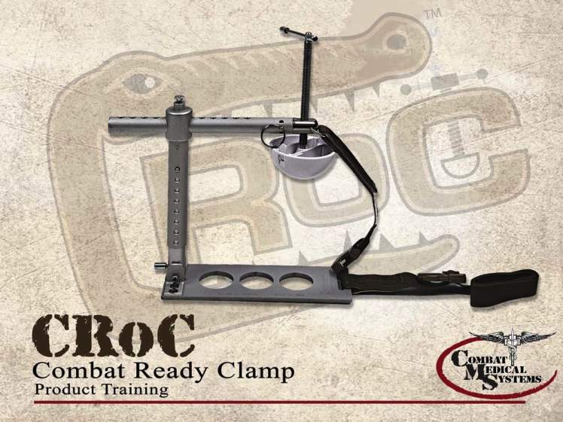
Combat Ready Clamp™
Notes:
The CRoC is a CoTCCC-recommended device for control of junctional hemorrhage in the inguinal area.
1

Slide 2
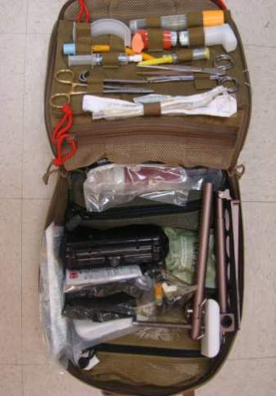
Combat Ready Clamp™
Medic/Corpsman carried device
Aidbag-based
  Partially broken down
  1.5 lbs
Notes:
The CRoC is a light-weight, simple, mechanical device that can be carried in the medic’s aid bag.
2

Slide 3
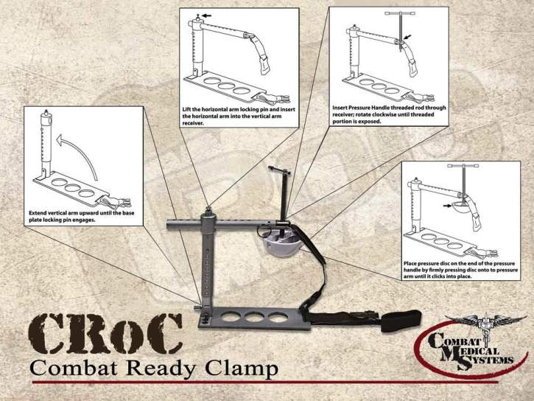
Assembly of the CRoC
Notes:
To assemble the CRoC, first extend the vertical arm upward until the base plate locking pin engages. Then lift the horizontal arm locking pin and insert the horizontal arm into the vertical arm receiver. Next you insert the pressure handle threaded rod through the receiver, and rotate clockwise until threaded portion is exposed. Then place the pressure disc on the end of the pressure handle rod by firmly pressing it on until it clicks into place.
3

Slide 4
FDA-Approved CRoC Application Points
The Combat Ready Clamp is indicated for use on the battlefield to control difficult bleeds in the inguinal area.
(FDA approved indication)
Note: The CRoC should NOT be applied above the inguinal ligament.
There are two modes of use for the CRoC:
  Direct pressure: Use directly on the site of external hemorrhage for bleeding sites below the inguinal ligament
  Proximal Pressure: Use at or just below the inguinal ligament to compress the external iliac/femoral artery
Notes:
The CRoC is not approved by the FDA at this time for application higher in the abdomen, in the axillary region, or at the neck.
4

Slide 5
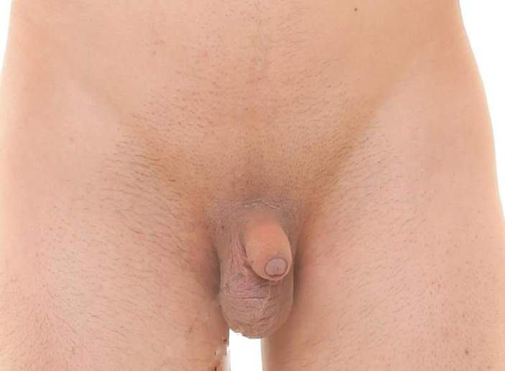
Superficial Anatomy of the Groin
Inguinal Ligament
Anterior Superior
Iliac Spine
Femoral Vessels
Pubic Tubercle

Slide 6
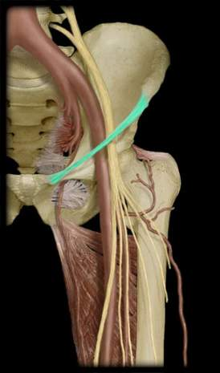
Anatomy of the Inguinal Region
External Iliac Artery
Common Iliac Artery
Anterior Superior Iliac Spine
Internal Iliac Artery
Inguinal Ligament
Pubic
Tubercle
Femoral Artery
Notes:
Effective application of the CRoC depends upon accurate location. Note that the external iliac artery becomes the femoral artery as it passes under the inguinal ligament.
6

Slide 7
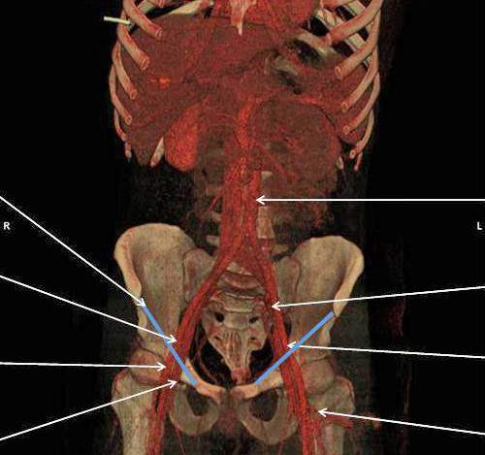
Vascular Anatomy of the Abdomen and Groin
Inguinal Ligament
Aorta posterior on the spine
Ext. iliac a. passing under inguinal lig.
Int. iliac a. bifurcates from common iliac a.
Common femoral a. passing into the leg
Ext. iliac a. rising out of pelvis
Bifurcation of common femoral a. into superficial femoral a. and femoral profunda a.
Common femoral vein passing into the leg

Slide 8
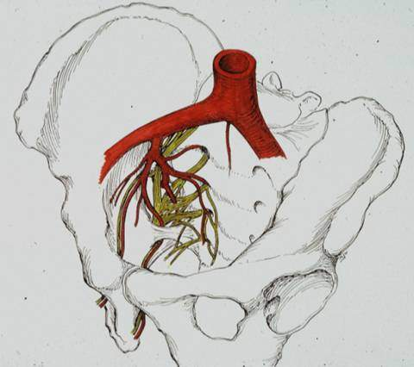
Anatomy of the Iliac Arteries
Common Iliac
External iliac
Internal iliac

Slide 9
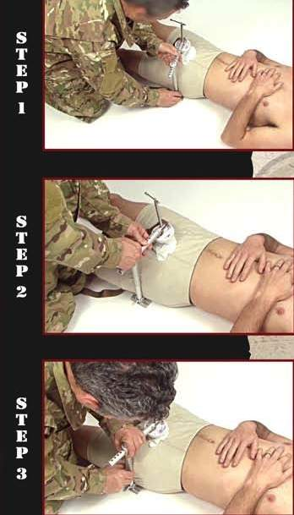
CRoC Application:
Direct Pressure Method
Position the base plate under the casualty beneath the desired pressure point.
Ensure the vertical arm is in contact with the casualty on the wound side in close proximity to the wound location.
Notes:
Read text
9

Slide 10
CRoC Application:
Direct Pressure Method
Adjust the horizontal arm to position the disc head directly on the location of the most severe bleeding.
Notes:
This slide assumes that Combat Gauze™ has been used, if available, and has been left in the wound.
10

Slide 11
CRoC Application:
Direct Pressure Method
Adjust the vertical arm downward to ensure the disc head contacts the casualty directly on the location of the most severe bleeding.
Notes:
Read text
11

Slide 12
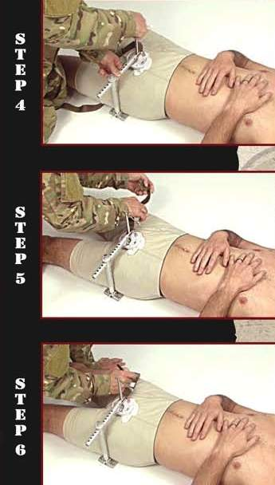
CRoC Application:
Direct Pressure Method
Apply increasing pressure to the most severe bleeding point by turning the “T” handle clockwise.
Continue increasing the pressure until the bleeding stops.
Notes:
Read text
12

Slide 13
CRoC Application:
Direct Pressure Method
Attach securing strap.
Notes:
Read text
13

Slide 14
CRoC Application:
Direct Pressure Method
Write the time of application on the label.
Note time of application on TCCC card.
Notes:
Read text
14

Slide 15
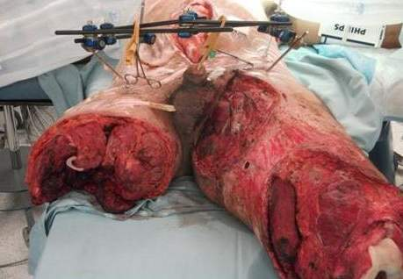
CRoC Application:
Proximal Pressure Method
Notes:
15

Slide 16
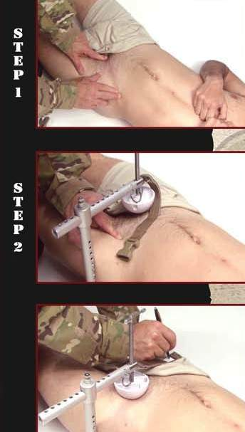
CRoC Application:
Proximal Pressure Method
Locate the pubic tubercle.
Locate the anterior superior iliac spine (ASIS).
Between these points is the inguinal fold. Find the mid-point of the line halfway between these two landmarks.
Notes:
This is how you find the your target pressure point - the midpoint of the inguinal ligament - when applying the CRoC using the proximal pressure method.
Make sure you can feel the femoral artery pulse before placing the disc head.
If you place the device right on the inguinal ligament, it may impinge on the pelvis/abdomen.
16

Slide 17
CRoC Application:
Proximal Pressure Method
Place the disc head of the CRoC just medial and distal to this midpoint (over the femoral pulse).
Tighten as previously directed.
Ensure that the bleeding has stopped.
Notes:
Read text
17

Slide 18
CRoC Application:
Proximal Pressure Method
Write the time of application on the label.
Note time of application on the TCCC card.
Notes:
Read text
18

Slide 19
Litter Positioning of Casualty with CRoC Applied
To get the casualty on a litter:
Roll the casualty onto the side opposite the CRoC.
Position the litter behind the casualty.
Roll or lift casualty onto litter.
Note:
Ensure that the CRoC does not create additional discomfort
for the casualty via his body weight pressing on the
device.
Casualty should be transported on the unaffected side or
with padding under the casualty and around the CRoC to
create a space between the CRoC and the litter.
Notes:
Care should be taken when moving the casualty in order to avoid loosening or displacement of disc head from the desired pressure point.
Continued hemorrhage control should be assessed when the casualty is placed on the litter, and after each movement of the litter.
19

Slide 20
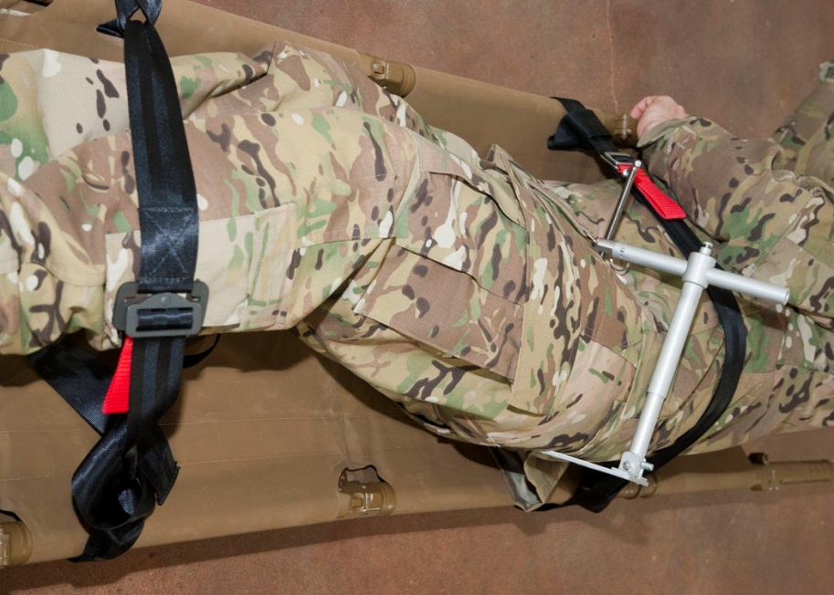
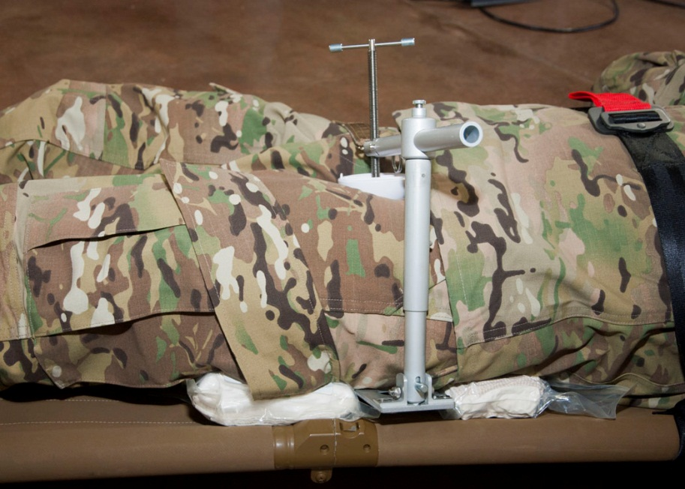
CRoC Properly Applied
Notes:
These photos show the CRoC properly applied and the casualty properly positioned on the litter. Note in the photo on the left that the casualty is rotated onto his right side so that the CRoC applied on his left side is not in contact with the litter. In the right-hand photo, the casualty is positioned on his back, and padding has been used under the casualty to prevent contact between the CRoC and the litter. In both photos, the CRoC has been applied so that its vertical arm is in direct contact with the casualty’s left side.
20

Slide 21
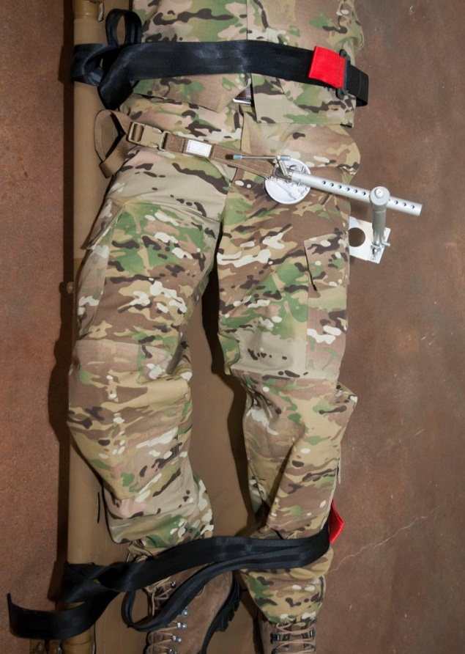
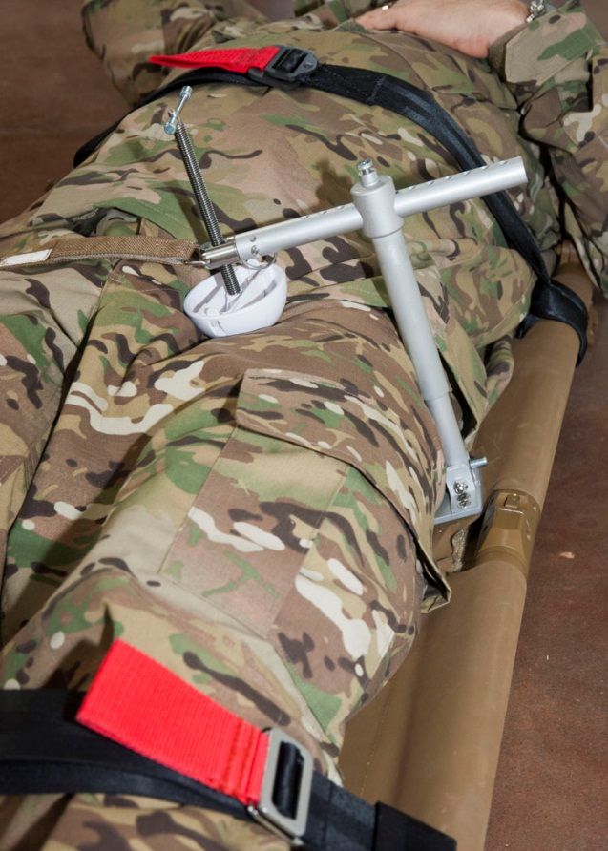
CRoC Improperly Applied
Notes:
In the photo on the left, the casualty is rotated onto his right side so the CRoC does not contact the litter, but what is wrong here? The CRoC has been applied so its vertical arm is not touching the casualty’s side. It can be easily knocked out of position during transport.
What’s wrong in the photo on the right? The CRoC is in direct contact with the litter.
21

Slide 22
Continued Reassessment!
Once applied, the CRoC, as well as the casualty’s other hemorrhage control interventions, must be frequently reassessed to assure continued hemorrhage control.
  DO NOT EVER APPLY IT AND FORGET IT!
Notes:
Read text
22

Slide 23

CRoC Application
Notes:
Click on picture to start video.
Video File: 0203V10 CRoC 120917
Note that, in TCCC, additional guidance is given for selecting the pressure point over which the pressure disc is placed in the Proximal Pressure Method: once the midpoint of the inguinal ligament is identified, the pressure disc just distal to the ligament, just medial to the midpoint, and directly over the femoral pulse.
23

Slide 24

CRoC Practical
Notes:
CRoC Skill Sheet
24

