Slide 1
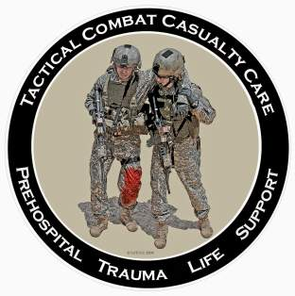
Tactical Combat Casualty Care for All Combatants 03 June 2016
Scenarios
Notes:
We’ve talked about the basic TCCC trauma management plan.
Now let’s apply the guidelines to some selected scenarios.

Slide 2
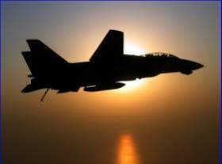
Tactical Casualty Scenarios
If the basic TCCC combat trauma management plan doesn’t work for the specific tactical situation, then for combat medics, corpsmen, PJs and combatants – it doesn’t work.
There are no rigid guidelines for combat tactics – THINK ON YOUR FEET.
Scenario-based planning is critical for success in TCCC
Examples follow:
Notes:
Read the text.

Slide 3
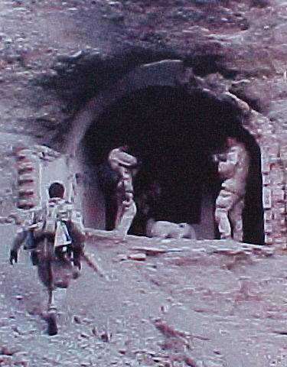
SEAL Casualty - Afghanistan
August 2002
Somewhere in Afghanistan
SEAL element on direct action mission
Story of the casualty as described by the first responder – NOT a
corpsman
Notes:
This is a real story that dramatically illustrates the difficulty of trauma care on the battlefield.

Slide 4
SEAL Casualty - Afghanistan
“There were four people in my team, two had been shot. Myself and the other uninjured teammate low crawled to the downed men. The man I came to was lying on his back, conscious, with his left leg pinned awkwardly beneath him. He was alert and oriented to person, place, time, and event. At that point I radioed C2 (mission control) to notify them of the downed man.”
Notes:
Read the text.

Slide 5
SEAL Casualty - Afghanistan
“Upon closer inspection, his knee was as big as a basketball and his femur had broken. The patient was in extreme pain and did not allow me to do a sweep of his injured leg. He would literally shove me or grab me whenever I touched his leg or wounds. I needed to find the entrance and exit wound and stop any possible arterial bleeding.”
Notes:
Read text

Slide 6
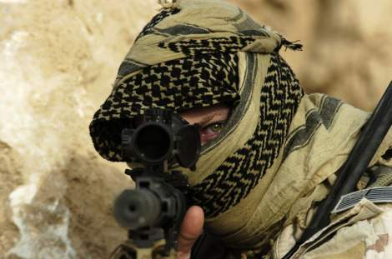
SEAL Casualty - Afghanistan
“But there was zero illumination and he was lying in a wet irrigation ditch. So I couldn’t see blood and I couldn’t feel for blood.”
Notes:
Picture yourself in this situation. You’ve got a casualty who is badly hurt and you can’t see a thing.

Slide 7
SEAL Casualty - Afghanistan
“We were also in danger because our position was in an open field (where the firefight had been) and I had to provide security for him and myself. So, I couldn’t afford to turn on any kind of light to examine his wounds. I told him to point to where he felt the pain. He had to sort through his pains.”
Notes:
Read the text.

Slide 8
SEAL Casualty - Afghanistan
“He had extreme pain in his knee and where his femur had been shattered as well as a hematoma at the site of the entrance wound (interior and upper left thigh). Finally, he pointed to his exit wound (anterior and upper left thigh). Again, I had no way of telling how much blood he had lost. But I did know that he was nonambulatory.”
Notes:
Read the text.

Slide 9
SEAL Casualty - Afghanistan
“So I called C2 again. I gave him the disposition of the patient as well as a request for casevac, a Corpsman, and additional personnel to secure my position and assist in moving the patient to the helicopter. I thought about moving the two of us to some concealment 25 meters away, but we were both really low in a shallow irrigation ditch. I felt safer there than trying to drag or carry a screaming man to concealment.”
Notes:
Read the text.
C2 = Command and Control

Slide 10
SEAL Casualty - Afghanistan
“Between providing security and spending a lot of time on the radio I didn’t get to treat the patient as much as I wanted to. I had given him a Kerlix bandage to hold against his exit wound. When he frantically told me that he was feeling a lot of blood, I went back to trying to treat him. I couldn’t elevate his leg. To move it would mean he’d scream in pain, which wasn’t tactical.”
Notes:
Read the text.

Slide 11
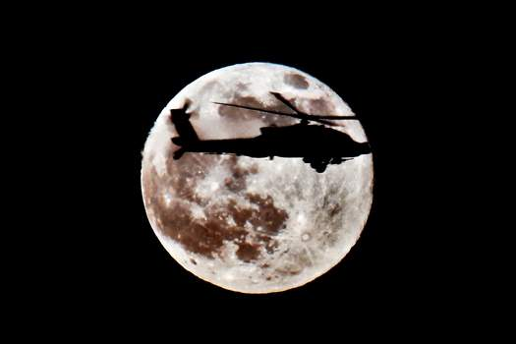
SEAL Casualty - Afghanistan
“There was just no way he would allow me to apply a pressure dressing to the exit wound even if I could locate it and pack it with Kerlix. So, I decided to put a tourniquet on him.”
Notes:
Read the text.

Slide 12
SEAL Casualty - Afghanistan
“His wounds were just low enough on his leg to get the tourniquet an inch or so above the site. I had a cravat and a wooden dowel with 550 cord (parachute cord) attached to it to use as a tourniquet. I told him to expect a lot of pain as I would be tightening the cravat down.“
Notes:
Note the makeshift tourniquet. When we first started the war in Afghanistan, most U.S. forces were not deploying with issued tourniquets.

Slide 13
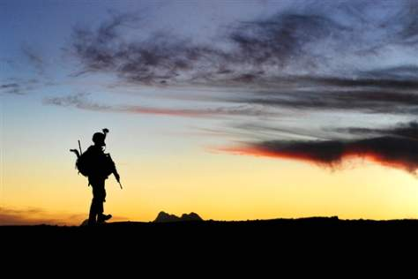
SEAL Casualty - Afghanistan
“At this point he feared for his life so he agreed. Once I got it tightened I had trouble securing it. The 550 cord was hard to get underneath the tightened cravat.”
Notes:
You need to be able to get a tourniquet on a wounded teammate with zero illumination.

Slide 14
SEAL Casualty - Afghanistan
“After over 5 minutes, the Corpsman arrived along with a CASEVAC bird and a security force. Moving the patient was very hard. Four of us struggled to move him and his gear 25 meters to the bird. The patient was over 200 pounds alone and we were moving over very uneven terrain.”
Notes:
Read the text.

Slide 15
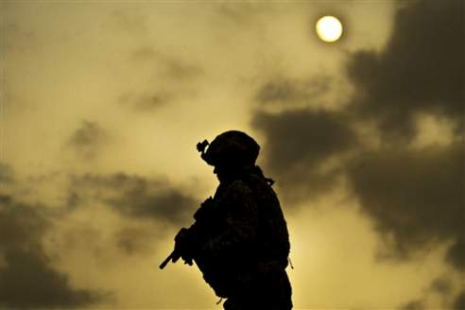
SEAL Casualty - Afghanistan
“We wanted to do a three-man carry with two men under his arms and one under his legs. But again, his leg was flopping around at the thigh and couldn’t be used to lift him.”
Notes:
Experienced combat medical personnel say that moving the casualty is typically the biggest challenge in TCCC.

Slide 16
SEAL Casualty - Afghanistan
“The bird, (a Task Force 160 MH-60) had a 50-cal sniper rifle strapped down, which made it hard for us to get him in. It took us minutes to get him 25 meters into the bird. The Corpsman went with my patient as well as the other downed man in my team and I went back to the op.”
Notes:
Was the tourniquet a good move?
Absolutely – probably saved the casualty’s life.
Would a pressure dressing have been a good idea if tolerated by the patient?
NO – a pressure dressing won’t necessarily stop a big bleeder.

Slide 17
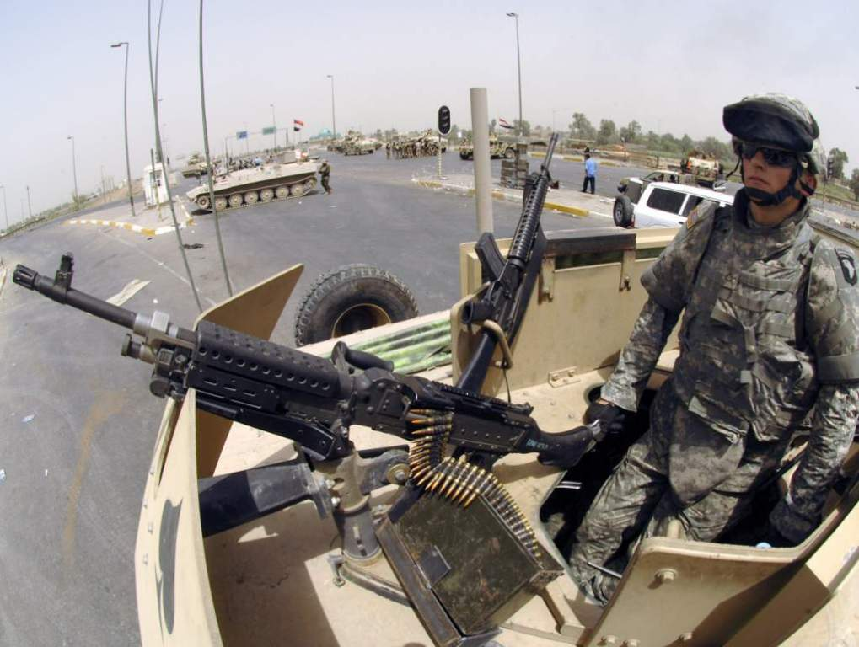
Urban Warfare Scenario
Notes:
Now let’s look at a scenario in urban warfare operations.

Slide 18
Real-World Scenario
High-threat urban environment
16-man Ranger team
70-foot fast rope insertion for a building assault
One man misses the rope and falls
Unconscious on the ground
Bleeding from mouth and ears
Unit is taking sporadic fire from all directions from hostile crowds
Notes:
Anybody recognize this casualty?
This was the first Ranger casualty in Mogadishu.
Has everyone here seen “Blackhawk Down”?

Slide 19
The Battle of Mogadishu
Somalia – Oct 1993
US casualties: 18 dead, 73 wounded
Estimated Somali casualties: 350 dead, 500 wounded
Battle was 15 hours in length
Notes:
At the time, this was the biggest battle involving U.S. forces since Vietnam.

Slide 20
Mogadishu Complicating Factors
Helo CASEVAC not possible because of crowds, narrow streets and RPGs
Vehicle CASEVAC not possible initially because of ambushes, roadblocks, and RPGs
Gunfire support problems
Somali crowds included non-combatants
Somalis able to take cover in buildings
RPG threat to helo fire-support gunships
Notes:
We have talked about factors that make evacuation by helicopter difficult..
We can add narrow streets and RPG fire to that list.
There were LOTS of U.S. helos over Mogadishu, but we were not able to evacuate the casualties with them for these reasons.

Slide 21
Care Under Fire
Return fire?
Move patient to cover right away or wait for long board?
How should he be moved?
Urgency for evacuation?
Notes:
Should the first responder return fire or care for casualty?
It was reasonable to have someone (a medic or corpsman would be preferred, if available) to attend casualty in this scenario.
Why?
Total suppression of hostile fire was not possible.
The crowd was large – the team couldn’t eliminate all the hostiles.
There were a good number of guns on the team – sparing one man for casualty care made little difference in defensive firepower.
The casualty wad critically injured.
Does that break our rule about shooting first and treating later?
Yes - but that’s OK – it’s the right answer for this particular situation.
What’s next?
Move patient to cover right away?
Is he at risk for a spinal cord injury if moved? Yes, but he’s also very much at risk of getting shot.
You probably DO want to get him to cover immediately. (Cover was available at side of road.)
How do you want to move him?
Carefully!!
Cradle head with forearms to stabilize neck and drag
What about his airway?
Chin-lift/jaw-thrust and NP airway
Urgency for evacuation?
There’s little that can be done at a FST (forward surgical team) for this kind of head injury.
Possible ruptured spleen or other internal bleeding may be bigger issue acutely
Tactical commander in Mogadishu split his force rather than wait 30 minutes for evac ground vehicles.
Does he need antibiotics or analgesia?
No – he has no open wounds and he is unconscious. An unconscious casualty doesn’t need pain meds, and you wouldn’t put pills in his mouth anyway.
The actual outcome?
The Ranger survived his injuries.
End of scenario

Slide 22
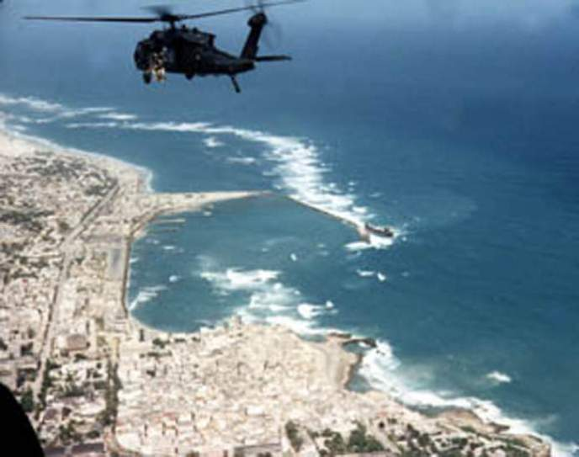
Mogadishu Scenario 2 Helo Hit by RPG Round
Notes:
Here is a second real-world scenario from Mogadishu, presenting a very different tactical situation.

Slide 23
Mogadishu Scenario 2 Helo Hit by RPG Round
Hostile and well-armed (AK-47s, RPG) crowds in an urban environment
Building assault to capture members of a hostile clan
Blackhawk helicopter trying to cover helo crash site
Flying at 300 feet
Notes:
Read the text.

Slide 24
Mogadishu Scenario 2 Helo Hit by RPG Round
Left door gunner manning a 6-barrel M-134 minigun (4000 rpm)
Hit in hand by ground fire
Another crew member takes over the mini-gun
An RPG impacts under the right door gunner
Notes:
Read the text.

Slide 25
Mogadishu Scenario 2 Helo Hit by RPG Round
Windshields all blown out
Smoke filling the aircraft
Right minigun not functioning
Left minigun unmanned and firing uncontrolled
Pilot transiently unconscious - now becoming alert
Notes:
Read the text.

Slide 26
Mogadishu Scenario 2 Helo Hit by RPG Round
Co-pilot unconscious - lying forward on the helo’s controls
Crew Member
Leg blown off
Lying in puddle of his own blood
Femoral bleeding
Notes:
Read the text.

Slide 27
Mogadishu Scenario 2 Helo Hit by RPG Round
YOU are the person providing care in the helo.
What do you do first?
Notes:
What are your options for first actions?
Casualty with femoral bleeding
Unconscious co-pilot
Semi-conscious pilot
Stop the uncontrolled min-gun from firing
Who gets treated first?
Take care of the pilot first
Want to get him back flying the aircraft
Most important thing about medical care in an aircraft is to try to keep the
aircraft in the air
What’s next?
Casualty with the femoral bleeder is next
Needs a tourniquet
He should be able to provide self-care if conscious
The individual in Mogadishu treated himself
Used an improvised tourniquet
Survived
What can you do for the unconscious co-pilot?
Get him off the controls
Supine position and establish airway with NPA
Check for external bleeding – none seen
Next action?
Check casualty with injured hand
Stop any severe bleeding
What else?
Radio for help
Prepare for impact if crash landing anticipated
After impact – security for weapons and ordnance
End of scenario

Slide 28
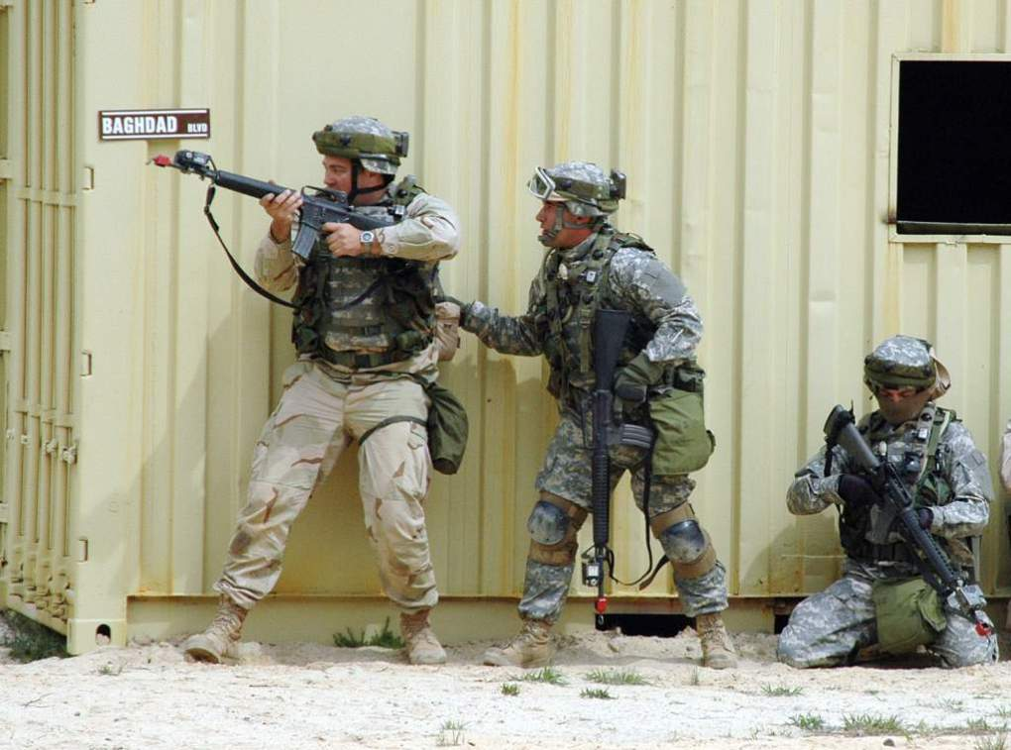
Military Operations in Urban Terrain
Notes:
Now let’s look at a couple of scenarios that are representative of what we are seeing in Afghanistan at present.

Slide 29
MOUT Scenario 1
A U.S. ground element is moving on a high-value target in an urban environment.
The first two men in a 8-man patrol are shot by an individual with an automatic weapon while moving down a hallway in a building.
The attacker follows this burst with a grenade.
Notes:
Read the text.

Slide 30
MOUT Scenario 1
One casualty is shot in the abdomen, but conscious.
The second casualty is shot in the shoulder with severe external bleeding.
The third casualty is unconscious from the grenade blast.
The attacker withdraws around a corner.
Notes:
Read the text.

Slide 31
MOUT Scenario 1
YOU are the person providing medical care.
What do you do?
Notes:
What are the tactical considerations here?
How many other hostiles in are in house?
All pursue hostile – leave casualties for later?
All withdraw to care for casualties?
Set security and treat casualties there?
Split force – have some pursue and others treat?
Split force most often chosen as the best option from previous
groups.
Who gets treated first?
Casualty with Shoulder Injury
Most important to treat immediately – could bleed to death quickly
Stop bleeding with Combat Gauze dressing
Apply with direct pressure for 3 minutes
Airway Management?
OK - conscious
Combat pill pack?
Yes
What next?
Unconscious Casualty with Blast Injury
Airway Management?
Chin-lift/jaw thrust
NP airway
Check for other injuries
Find major bleeding in back of thigh from shrapnel wound
Apply tourniquet
Combat pill pack?
No – needs IV antibiotics – unconscious and can’t swallow – medical personnel
administer when feasible
Next?
Abdominal Wound Casualty
Airway Management?
OK – conscious
Combat pill pack?
Yes – casualty can self-administer
End of scenario

Slide 32
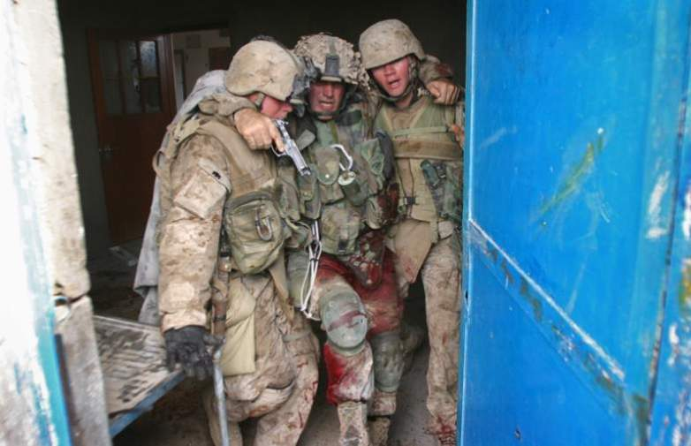
MOUT Scenario 2

Slide 33
MOUT Scenario 2
SCENARIO HISTORY: While on patrol in the city of Tal Afar your platoon receives effective direct small arms fire. A 22-year-old unit member falls to the ground and begins screaming, holding his right leg. The platoon, including you, reacts to the ongoing contact by returning fire.
Notes:
Read the text.

Slide 34
MOUT Scenario 2
You can see that the casualty is bleeding heavily from his leg wound.
YOU are the person providing medical care for this casualty.
What do you do?
Notes:
What phase are you in?
Care Under Fire
What should you do for the casualty?
Yell at him to get under cover if he can.
Tell him to put a tourniquet on his wounded leg.
May have to help him.
Consider movement plan/suppression fire, etc. if you do.
Should he take his Combat Pill Pack meds now?
No. Still in Care Under Fire phase
Priorities are to get to cover and return fire if possible
Scenario continues. Casualty has moved behind a vehicle. All hostiles are eliminated or have retreated. The platoon establishes a secure perimeter. Platoon leader tells you that you have only one casualty, and that you have a few minutes to work on him before the platoon will have to move.
What phase are you in now?
Tactical Field Care
Your casualty is alert, still in severe pain, and clutching his right leg. There is blood all over his leg and hands, and a tourniquet is in place on his right thigh. What is your first concern?
Control of life-threatening bleeding.
What next?
You check the tourniquet.
It is positioned correctly.
The bleeding has been controlled.
You search quickly for any other life-threatening bleeding, and find none.
Should you disarm the casualty?
No. He is alert and wants to stay in the fight.
Next concern?
Airway is patent.
Casualty is conscious and talking – airway is OK.
Next?
Breathing.
Breathing is rapid from pain and the situation, but not labored.
What next?
Check for shock.
Mental status is normal. Radial pulse is strong.
Next?
Assess for other wounds.
You discover a large bruise on his chest and RUQ overlying the liver. You
check his body armor and find corresponding damage compatible with a
bullet strike.
Next?
Prevent hypothermia.
Ready Heat Blanket
Heat Reflective Shell
Next?
Inspect and dress his wound.
Reassess
Platoon leader tells you the unit will move in 10 minutes to a CASEVAC location. No enemy contact is expected. CASEVAC should take about 45-60 minutes.
Casualty has taken his own Combat Pill Pack. He is in significant pain
What else?
Reassure
Document care
You have now moved to the CASEVAC site. The platoon establishes security. You check the patient and notice that he is confused and breathing rapidly. You check his thigh wound and find that his tourniquet has become loose and the dressing is soaked with blood.
What next?
Re-tighten first tourniquet. Use a second CAT if needed.
What next?
Nasopharyngeal airway - casualty is unconscious.
Recovery position
Transport ASAP
End of scenario

Slide 35
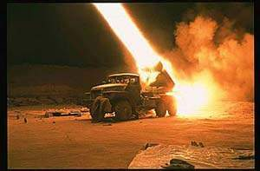
Questions?

Slide 36
Tactical Combat Casualty Care
Casualty scenarios on the battlefield usually entail both medical and tactical problems.
Emergency actions must address both.
Medical personnel should be involved in mission planning.
Notes:
In summary:
Good tactical medicine HAS to be a combination of good tactics and good medicine.
Bring your leadership into the medical plan.
Combat leaders must understand combat medicine.

Slide 37
Scenario-Based Planning
The TCCC guidelines for combat trauma scenarios are advisory rather than directive in nature.
Rarely does an actual tactical situation exactly reflect the conditions described in planning scenarios.
Those providing casualty care will typically need to modify the medical care plan to optimize it for the real scenario.
Notes:
Read the text.

Slide 38
The 3 Objectives of TCCC
Treat the casualty
Prevent additional casualties
Complete the mission
Notes:
Once more…..

Slide 39
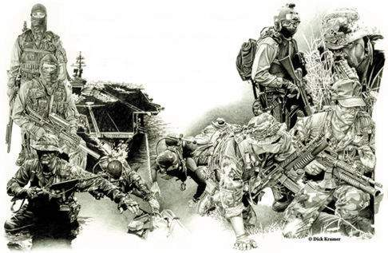
Post-Test
Pretest
Notes:
Pass out pre-tests.
Collect them when done.
The syllabus allows time to review the test when all students have finished.
Compare the pre-test grade to the post-test grade to gauge assimilation of the information.

Slide 40
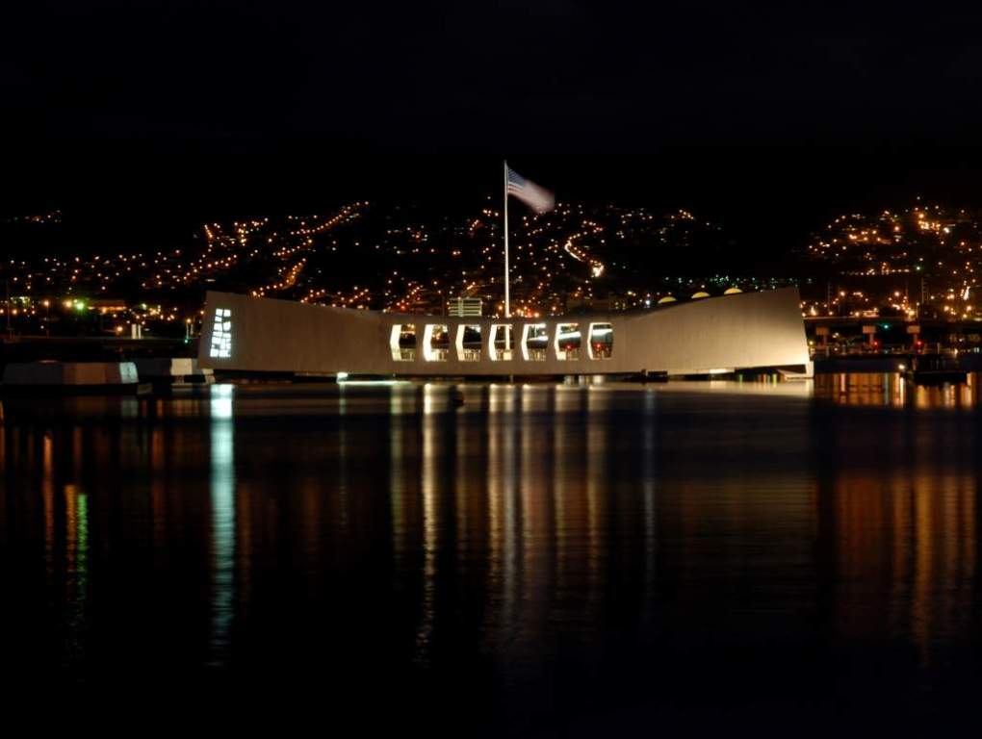
The End
The U.S.S. Arizona Memorial
Notes:
This is a photo of the Arizona Memorial in Pearl Harbor.

