Slide 1
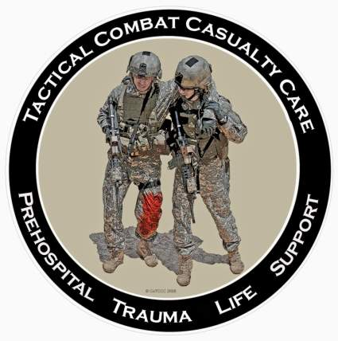
Tactical Combat Casualty Care for All Combatants August 2017 (Based on TCCC-MP Guidelines 170131)
Care Under Fire
Notes:
The first phase of TCCC is Care Under Fire.

Slide 2
Objectives
DESCRIBE the role of firepower supremacy in the prevention of combat trauma.
DEMONSTRATE techniques that can be used to quickly move casualties to cover while the unit is engaged in a firefight.
EXPLAIN the rationale for early use of a limb tourniquet to control life-threatening extremity bleeding during Care Under Fire.
Notes:
Read the text.

Slide 3
Objectives
DEMONSTRATE the appropriate application of a CoTCCC-recommended limb tourniquet on an arm and a leg.
EXPLAIN why stabilization of the cervical spine is not a critical need in combat casualties with penetrating trauma to the neck.
Notes:
Read the text.

Slide 4
Care Under Fire Guidelines
1. Return fire and take cover.
2. Direct or expect casualty to remain engaged as a combatant if appropriate.
3. Direct casualty to move to cover and apply self-aid if able.
4. Try to keep the casualty from sustaining additional wounds.
Notes:
Read the guidelines.
(Note: All of the slides entitled “Care Under Fire Guidelines” - as this one is - should be read verbatim. Every slide with this title shows an excerpt from the Guidelines document.)

Slide 5
Care Under Fire Guidelines
5. Casualties should be extricated from burning vehicles or buildings and moved to relative safety. Do what is necessary to stop the burning process.
6. Stop life-threatening external hemorrhage if tactically feasible:
a. Direct casualty to control hemorrhage by self-aid if able.
b. Use a CoTCCC-recommended limb tourniquet for hemorrhage that is anatomically amenable to tourniquet use.
c. Apply the limb tourniquet over the uniform clearly proximal to the bleeding site(s). If the site of the life-threatening bleeding is not readily apparent, place the tourniquet “high and tight” (as proximal as possible) on the injured limb and move the casualty to cover.
Notes:
Read the guidelines.

Slide 6
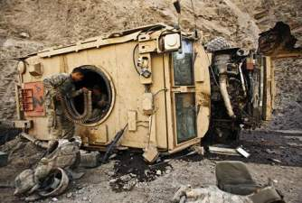
Care Under Fire Guidelines
7. Airway management is generally best deferred until the Tactical Field Care phase.
Notes:
Care Under fire
10/10/2017
DRAFT
6
Read the guideline.

Slide 7
Care Under Fire
Prosecuting the mission and caring for the casualties may be in direct conflict.
What’s best for the casualty may NOT be what’s best for the mission.
When there is conflict, which takes precedence?
Scenario dependent
Consider the following example:
Notes:
In the hospital, the casualty IS the mission.
In TCCC, you have the casualty AND the mission.
Read text.

Slide 8
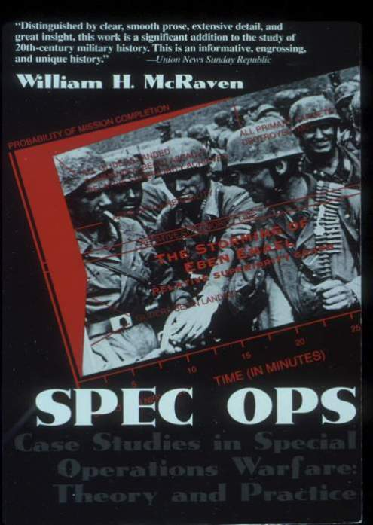
Notes:
Let’s examine a scenario from this book by ADM McRaven. The scenarios in this book are all Special Ops, but the PRINCIPLES discussed apply to all combat units.

Slide 9
Raid on Entebbe by ADM Bill McRaven
The most successful hostage rescue operation in history
27 June 1976
Air France Flight 139 hijacked
Flown to Entebbe (Uganda)
106 hostages held in Old Terminal at airport
7 terrorists guarding hostages
100 Ugandan troops perimeter security
Israeli commando rescue planned
Notes:
Background information for Instructors (excerpt from Wikipedia): Operation Thunderbolt was a counter-terrorist hostage-rescue mission carried out by the Special Forces of the Israel Defense Forces (IDF) at Entebbe Airport in Uganda on 4 July 1976. A week earlier, on 27 June, an Air France plane with 248 passengers was hijacked by Palestinian and German terrorists and flown to Entebbe, near Kampala, the capital of Uganda. Shortly after landing, all non-Israeli passengers, except one French citizen, were released. The IDF acted on intelligence provided by the Israeli intelligence agency Mossad. In the wake of the hijacking by members of the militant organizations Revolutionary Cells and the Popular Front for the Liberation of Palestine, and the hijackers' threats to kill the hostages if their prisoner release demands were not met, a rescue operation was planned. The plan included preparation for armed resistance from Ugandan military troops. The operation took place at night, as Israeli transport planes carried 100 commandos over 2,500 miles (4,000 km) to Uganda for the rescue operation. The operation, which took a week of planning, lasted 90 minutes and 102 hostages were rescued. Five Israeli commandos were wounded and one, the commander, Lt. Col. Yonatan Netanyahu, was killed. All the hijackers, three hostages and 45 Ugandan soldiers were killed, and thirty Soviet-built MiG-17s and MiG-21s of Uganda's air force were destroyed. A fourth hostage was killed by Ugandan army officers at a nearby hospital. The rescue, named Operation Thunderbolt, is sometimes referred to retroactively as Operation Jonathan in memory of the unit's leader, Yonatan Netanyahu. He was the older brother of Benjamin Netanyahu, who served as the two-time Prime Minister of Israel from 1996 to 1999 and from 2009- the present. The operation is widely considered one of the greatest and daring special forces operations in history considering the high-risk nature of the commando raid, distance from home territory, and casualty and hostage rescue ratio.

Slide 10
Raid on Entebbe by ADM Bill McRaven
Rescue - 4 July 1976
Exit from C-130 in a Mercedes and 2 Land Rovers to mimic mode of travel of Idi Amin – the Ugandan dictator at the time
Israeli commandos dressed as Ugandan soldiers
Drove up to the terminal - shot the Ugandan sentry
Assaulted the terminal through 3 doors
Notes:
The tactics used were ingenious: DECEPTION, SURPRISE, and VIOLENCE.

Slide 11
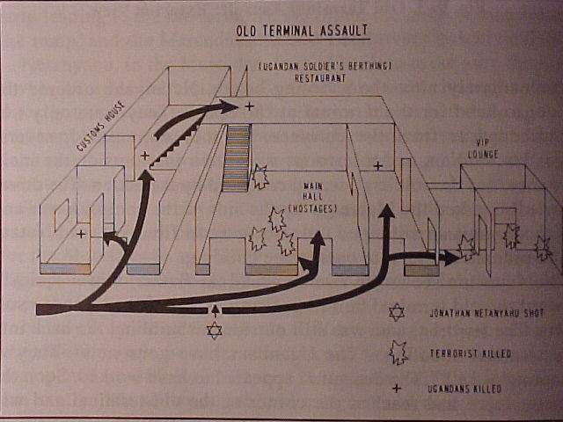
Notes:
This is a diagram of the Old Terminal showing the conduct of the assault.
Black arrows show the entry paths of the Israeli commandos.

Slide 12
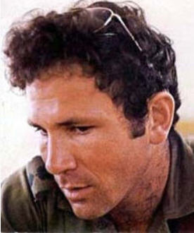
Raid on Entebbe by ADM Bill McRaven
LTC Netanyahu – the ground commander – was shot in the chest at the beginning of the assault.
What would you have done?
Disengaged from the assault?
Assessed his breathing?
Inserted a nasopharyngeal airway?
Notes:
Imagine that YOU were on this operation.
What would you have done at this point?
(Ask several people in the audience what THEY would have done.)
Note that LTC Netanyahu was the brother of the future Prime Minister of Israel.

Slide 13
Raid on Entebbe by ADM Bill McRaven
“As previously ordered, the three assault elements disregarded Netanyahu and stormed the building.”
“At this point in the operation, there wasn’t time to attend to the wounded.”
Notes:
NO medical care was rendered at that moment.
Establishing control of the tactical situation was the first priority.

Slide 14
Do seconds really matter in combat?
Notes:
LTC Netanyahu died from his wounds.
The assault phase of the operation took 90 seconds.
Did the 90-second treatment delay affect his chances of survival? Probably not.
Would a 90-second delay in continuing the assault phase of the operation have made a difference? Absolutely.

Slide 15
Ma’a lot Rescue Attempt by ADM Bill McRaven
15 May 1974
3 PLO terrorists took 105 hostages
Schoolchildren and teachers
When the assault commenced, the terrorists began killing hostages.
22 children killed, 56 wounded
The difference between a dramatic success and a disaster may be measured in seconds.
Notes:
Look what even a momentary delay can mean to a hostage rescue operation OR OTHER TACTICAL ENGAGEMENTS.
Background information for Instructors (Excerpt from Wikipedia article “Ma’a lot Massacre”): The Ma'alot massacre was a terrorist attack that included a two-day hostage-taking of 115 people and ended in the deaths of over 25 hostages. It began when three armed Palestinian terrorists of the Democratic Front for the Liberation of Palestine entered Israel from Lebanon. Soon afterwards they attacked a van, killing two Israeli Arab women and entered an apartment building in the town of Ma'alot, where they killed a couple and their four-year-old son. From there, they headed for the Netiv Meir elementary school, where they took more than 115 people (including 105 children) hostage on 15 May 1974. The hostage-takers soon issued demands for the release of 23 Palestinian militants from Israeli prisons, or else they would kill the students. On the second day of the standoff, a unit of the Golani Brigade stormed the building. During the takeover, the hostage-takers killed the children with grenades and automatic weapons. Ultimately, 25 hostages, including 22 children, were killed and 68 more were injured.

Slide 16
Recent Feedback from a TCCC Student
“I have never even heard of the Raid on Entebbe. Why do we need to learn about military history?”
Notes:
Read the text.

Slide 17
History’s Lesson
There are only two times that you can plan for what to do in a tactical casualty situation –
Before it happens
or
After it happens
Notes:
It’s better to be prepared ahead of time, and we do that by studying lessons we have learned in the past.

Slide 18
SEAL Hostage Rescue Mission – Afghanistan 2012
Quick-reaction hostage rescue
Helicopter insert
4-hour patrol to target
Point man shot in the head on building entry
Do you stop and treat the casualty?
Or do you rescue the hostage and neutralize the terrorists first?
Notes:
Here’s another example:
Read the text.
The questions in the last two bullets here are better decided BEFORE the op than in the after-action analysis.

Slide 19
SEAL Hostage Rescue – Afghanistan 2012
Second assaulter killed one hostile
Secured the hostage (an American physician)
Held a second hostile by the throat until he could be neutralized by another team member
Room cleared - hostage passed off
THEN the second assaulter, a corpsman, began to treat the casualty.
Notes:
Read the text.
This is Care Under Fire. The second assaulter knew to address the tactical situation first, and then see to the casualty.

Slide 20
SCPO Ed Byers – The Second Assaulter
Notes:
The second assaulter in this real-life scenario was SCPO Ed Byers. He was awarded the Congressional Medal of Honor for his actions.

Slide 21
The Tactical Imperative:
Senior SOF Leader Quote
“I watched with tremendous pain as the (nation
redacted) failed in a mission because they stopped
mid-assault to care for one of their wounded.
It ended up costing them three more lives and
a failed rescue attempt. We should never forget
that you have to secure the target quickly so you
don't lose more lives and you can then save the
ones that are injured.”
Notes:
Read the text.

Slide 22
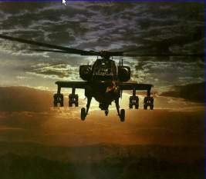
Care Under Fire
If the firefight is ongoing - don’t try to treat your casualty in the Kill Zone!
Suppression of enemy fire and moving casualties to cover are the major concerns.
Notes:
Not every casualty scenario is a hostage rescue, but these basic principles apply.
It is imperative to get your casualty “Off the X” and behind cover if you can.

Slide 23
Care Under Fire
Suppression of hostile fire will minimize the risk of both new casualties and additional injuries to the existing casualties.
The firepower contributed by medical personnel and the casualties themselves may be essential to tactical fire superiority.
The best medicine on the battlefield is Fire Superiority!
Notes:
Sustaining a minor wound in a firefight does not mean that you should disengage from the fight.

Slide 24
Moving Casualties in CUF
If a casualty is able to move to cover, he should do so to avoid exposing others to enemy fire.
If casualty is unable to move and unresponsive, the casualty is likely beyond help and moving him while under fire may not be worth the risk.
If a casualty is responsive but can’t move, a rescue plan should be devised if tactically feasible.
The next sequence of slides shows the hazards of moving casualties before hostile fire is suppressed.
Notes:
Unit members should be TRAINED to move themselves to point of first cover if they are able.
Don’t put two people at risk if it can be avoided.

Slide 25
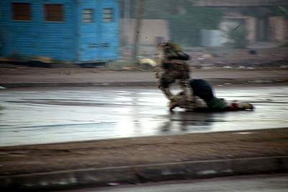
1) While under fire and without a weapon, Gunnery Sgt. Ryan P. Shane runs to Sgt. Lonnie Wells, to pull him to safety during USMC combat operations in Fallujah.
Notes:
Here is a dramatic example of casualty movement during Care Under Fire. SGT Wells had sustained a fatal gunshot through his leg that severed his femoral artery. From the moment he was hit, he was unable to conduct self aid and did not respond to calls from his fellow Marines.

Slide 26
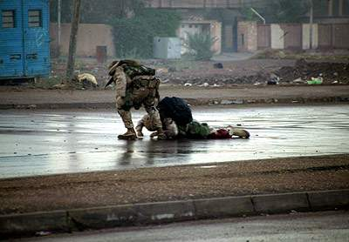
2) Gunnery Sgt Shane attempts to pull a fatally wounded Sgt Wells to cover.
Notes:
Read the text.

Slide 27
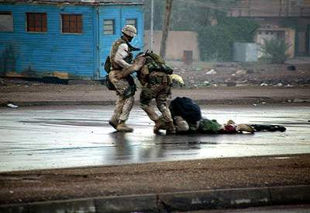
3) Another comes to help.
Notes:
The third man on the left is Hospital Corpsman Joel Lambott, the platoon’s Corpsman.

Slide 28
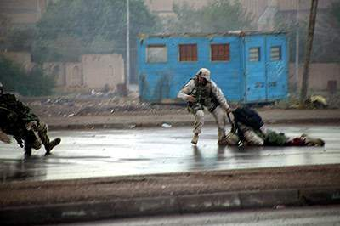
4) Gunnery Sgt. Shane (left) is hit by enemy fire.
Notes:
Read the text.

Slide 29
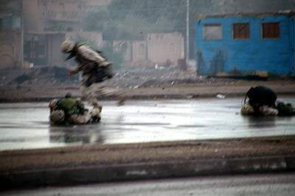
5) Gunnery Sgt Shane, on ground at left, was hit by insurgent sniper fire.
Notes:
HM Lambott was struck in the heel just after GySgt Shane was injured. He provided life-saving care to GySgt Shane, directed his evacuation, and dressed his own injury. He stayed with the platoon and continued his duties during the operation. In this rescue attempt, the fate of the first casualty was unchanged and two additional casualties were sustained because effective enemy fire was not suppressed.

Slide 30
Casualty Movement Rescue Plan
If you must move a casualty under fire, consider the following:
Location of the nearest cover
How best to move him to the cover
The risk to the rescuers
The weight of casualty and rescuer
The distance to be covered
Use suppression fire and smoke to best advantage!
Recover the casualty’s weapons if possible
Notes:
DON”T FORGET COVERING FIRE!
If possible, let the casualty know what you plan.
Consider directing available vehicles to move into positions providing cover.

Slide 31
C-Spine Stabilization
Penetrating head and neck injuries do not require C-spine stabilization like a C-collar.
Gunshot wounds (GSW), shrapnel
In penetrating trauma, the spinal cord is either already compromised or is in relatively less danger than would be the case with blunt trauma.
Either way, you probably won’t hurt the casualty further by moving him.
Notes:
In studies from the Vietnam conflict, of those casualties with penetrating neck trauma, only 1.4% would have benefited from C-spine stabilization.
C-spine stabilization takes 5-6 minutes even for experienced medical providers.
This is too much time to spend in the Care Under Fire phase on an intervention that is rarely needed.

Slide 32
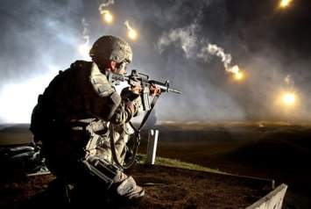
C-Spine Stabilization
Blunt trauma is different!
Neck or back injuries due to falls, fast-roping injuries, or motor vehicle accidents may require C-spine stabilization.
Medic should apply only if the danger of hostile fire does not constitute a greater threat.
Notes:
The medic will not apply C-spine stabilization before moving the casualty if, in his judgment, the danger of hostile fire constitutes a greater threat.

Slide 33
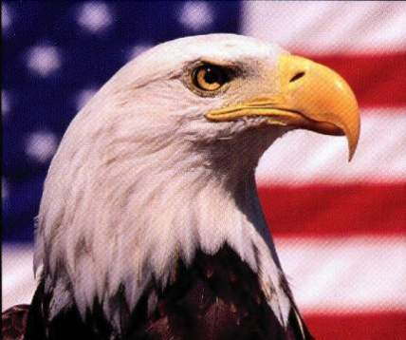
Types of Carries and Drags for Care Under Fire
One-person drag with/without line
Two-person drag with/without line
SEAL Team Three Carry
Hawes Carry
Notes:
Read the text.

Slide 34
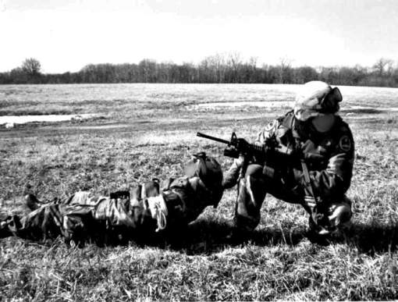
One-Person Drag
Notes:
Advantages: No equipment required
Only one rescuer exposed to fire
Disadvantages: Relatively slow
Not optimal body position for dragging the casualty
(Have other Instructors or students demonstrate)

Slide 35
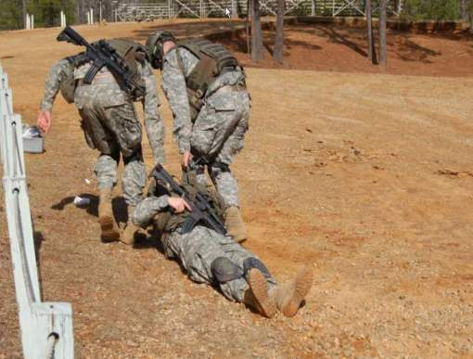
Two-Person Drag
Notes:
Advantage : Gets casualty to cover faster than with one-person drag
Disadvantage: Exposes two rescuers to hostile fire instead of one
(Have other Instructors or students demonstrate the drag.)
Care Under fire
10/10/2017
DRAFT
35

Slide 36
Video: Two-Person Drag
Courtesy 75th Ranger Regiment
Notes:
Click on the photo to play the video.
Care Under fire
10/10/2017
DRAFT
36

Slide 37
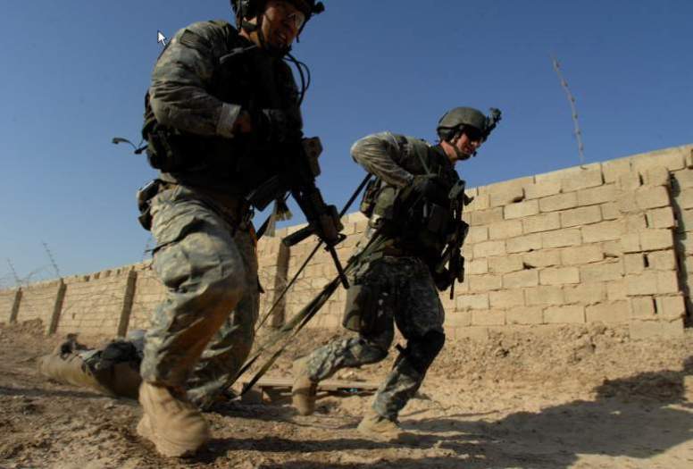
Two-Person Drag Using Lines
Notes:
Advantages: Can shoot while dragging
Faster than dragging without lines
Faster movement of the casualty to cover
Disadvantage: Exposes two rescuers to hostile fire instead of one
Care Under fire
10/10/2017
DRAFT
37

Slide 38
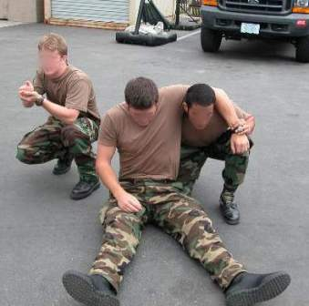
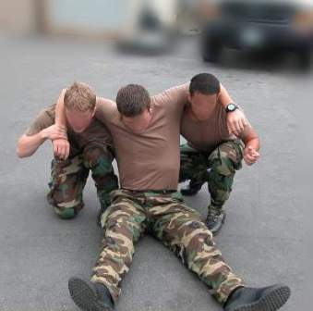
SEAL Team Three Carry (1)
Notes:
Advantages: May be useful in situations where drags do not work well
Less painful for the casualty than dragging
Disadvantages: Exposes two rescuers to hostile fire
May be slower than dragging
May be difficult in kit and with an unconscious casualty
Care Under fire
10/10/2017
DRAFT
38

Slide 39
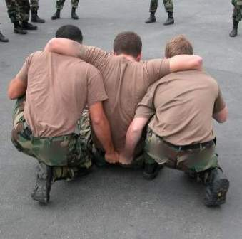
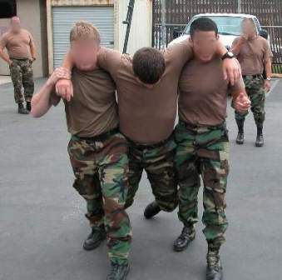
SEAL Team Three Carry (2)
Notes:
The casualty’s arms are wrapped around the shoulders of both rescuers.
The casualty uses his arms to hold onto the rescuers if he’s able to.
The rescuers hold the casualty’s arms around their necks if the casualty can’t.
Both rescuers grab the casualty’s web belt in back.
Lift and go.

Slide 40
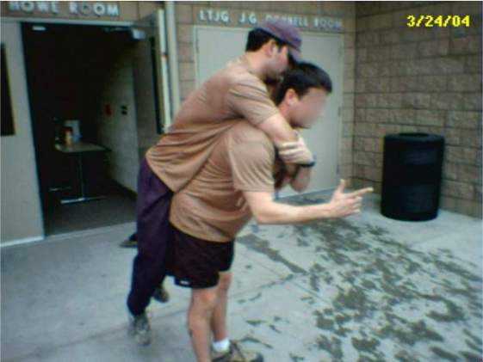
Hawes Carry
Notes:
Technique: The rescuer squats; the casualty’s arms are wrapped around rescuer’s neck; The casualty’s free arm is trapped under the held arm; the rescuer lifts with his legs.
Advantages: Only one rescuer
May be useful in situations where a drag is not a good option
Works much better than the fireman’s carry
Disadvantages: Hard to accomplish with the rescuer’s and/or the casualty’s kit in place
Difficult when rescuer is small and casualty is large
Often slower than dragging
Presents a high profile for both rescuer and casualty

Slide 41
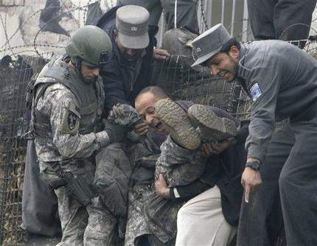
Carries Practical
How Not to Do It
Notes:
This is a good example of how NOT to carry your casualty.
For the practical exercise: Break up into groups of 6 or fewer students per instructor.
Use the Drags and Caries Skill Sheet.
Practice all the carries covered.
Care Under fire
10/10/2017
DRAFT
41

Slide 42
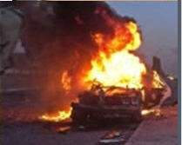
Burn Prevention in CUF
Remove casualties from burning vehicles or structures ASAP and move them to cover.
Stop the burning with any non-flammable fluids readily accessible, by smothering, or by rolling on the ground.
Notes:
Care Under fire
10/10/2017
DRAFT
42
If flammable liquids like petroleum products cause a fire on the casualty’s clothing that you can’t put out, then you’ll have to cut the burning garments off.

Slide 43
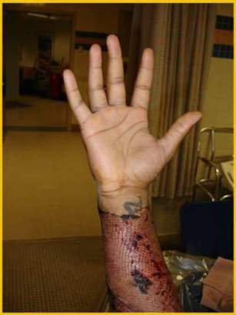
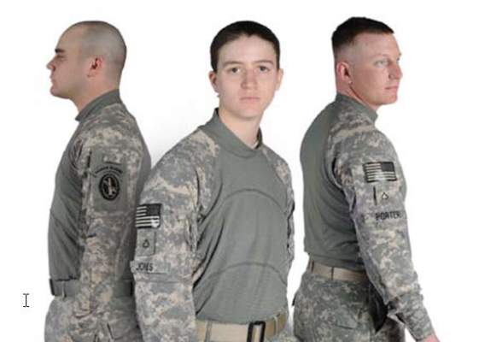
Burn Prevention in CUF
Wear fire-retardant Nomex gloves and uniform!
Right hand of a burn casualty
spared by a fire-resistant glove
Fire-Resistant Army Combat Shirt
Notes:
Care Under fire
10/10/2017
DRAFT
43
Flame-resistant clothing can protect you from burn injuries.
Your unit should acquire these clothing items if you don’t have them already.

Slide 44
The Number One Medical Priority in CUF
Early control of severe hemorrhage is critical.
In the past, extremity hemorrhage was the most frequent cause of preventable battlefield deaths.
Over 2500 deaths occurred in Vietnam secondary to hemorrhage from extremity wounds.
Injury to a major vessel can quickly lead to shock and death.
Only life-threatening bleeding warrants intervention during Care Under Fire.
Notes:
If you can only do ONE thing for the casualty – stop him from bleeding to death.
Do not treat minor bleeding during Care Under Fire.

Slide 45
When is bleeding life-threatening?
1. There is pulsing or steady bleeding from the wound.
Courtesy Dr. Lenworth Jacobs, Hartford Consensus Group
Notes:
Read the text.

Slide 46
When is bleeding life-threatening?
2. Blood is pooling on the ground.
Courtesy Dr. Lenworth Jacobs, Hartford Consensus Group
Notes:
Read the text.

Slide 47
When is bleeding life-threatening?
3. The overlying clothes are soaked with blood.
Courtesy Dr. Lenworth Jacobs, Hartford Consensus Group
Notes:
Read the text.

Slide 48
When is bleeding life-threatening?
4. Bandages or makeshift bandages used to cover the wound are ineffective and steadily becoming soaked with blood.
Courtesy Dr. Lenworth Jacobs, Hartford Consensus Group
Notes:
Read the text.

Slide 49
When is bleeding life-threatening?
5. There is a traumatic amputation of an arm or leg.
Courtesy Dr. Lenworth Jacobs, Hartford Consensus Group
Notes:
Read the text.

Slide 50
When is bleeding life-threatening?
6. There was prior bleeding, and the patient is now in shock (unconscious, confused, pale).
Courtesy Dr. Lenworth Jacobs, Hartford Consensus Group
Notes:
Read the text.

Slide 51
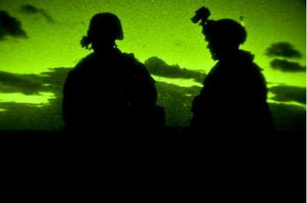
Question
How long does it take to bleed to death from a complete femoral artery and vein disruption?
Answer:
Casualties with such an injury can bleed to death in as little as 3 minutes.
Notes:
The femoral artery and vein are the large vessels in the thigh starting at the groin.
Without hemorrhage control measures, 10% of animals that had these vessels transected in lab studies died within 3 minutes.

Slide 52
Video: Femoral Artery Bleeding
Notes:
(Click on the photo to play the video.)
This is FEMORAL ARTERTY bleeding in a pig.
It does not take long to die from this.

Slide 53
Care Under Fire
The need for immediate access to a tourniquet in such situations makes it clear that all personnel on combat missions should have a CoTCCC-recommended tourniquet readily available at a standard location on their battle gear and be trained in its use.
- Casualties should be able to easily and quickly reach their own tourniquet.
Notes:
Read the text.
DO NOT bury your tourniquet at the bottom of your pack.

Slide 54
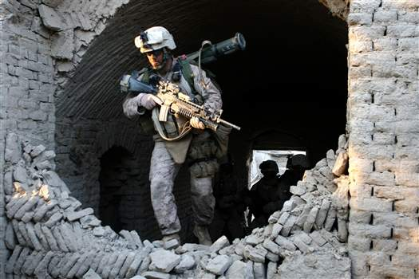
Care Under Fire
Where a tourniquet can be applied, it is the first choice for control of life-threatening hemorrhage in Care Under Fire.
Notes:
If you have severe extremity bleeding in Care Under Fire, forget about direct pressure, pressure dressings, or anything else. Go directly to a tourniquet.

Slide 55
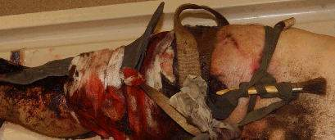
A Preventable Death
This casualty did not have an effective tourniquet applied – he bled to death from a leg wound.
Notes:
The medic in this Army unit was killed in the battle in which this soldier was wounded.
Others in the unit attempted to control the bleeding from this soldier’s wound just below his left knee.
These improvised tourniquets were ineffective, and the soldier bled to death.
DON”T LET THIS HAPPEN TO YOUR BUDDIES!

Slide 56
Tourniquet Application
Apply without delay if indicated.
Both the casualty and the medic are in grave danger while a tourniquet is being applied in this phase – don’t use tourniquets for wounds with only minor bleeding.
The decision regarding the relative risk of further injury versus that of bleeding to death must be made by the person rendering care.
Notes:
Read the text.

Slide 57
Tourniquet Application
Non-life-threatening bleeding should be ignored until the Tactical Field Care phase.
Apply the tourniquet without removing the uniform – make sure it is clearly proximal to the bleeding site.
If you are uncertain about exactly where the major bleeding site is on the extremity (night operations, multiple wounds), apply the tourniquet “high and tight” (as proximal as possible) on the arm or leg.
Notes:
Read the text.

Slide 58
Tourniquet Application
Tighten the tourniquet until bleeding is controlled.
If the first tourniquet fails to control the bleeding, apply a second tourniquet just above (proximal to) the first.
Don’t put a tourniquet directly over the knee or elbow.
Don’t put a tourniquet directly over a holster or a cargo pocket that contains bulky items.
Notes:
Read text.

Slide 59
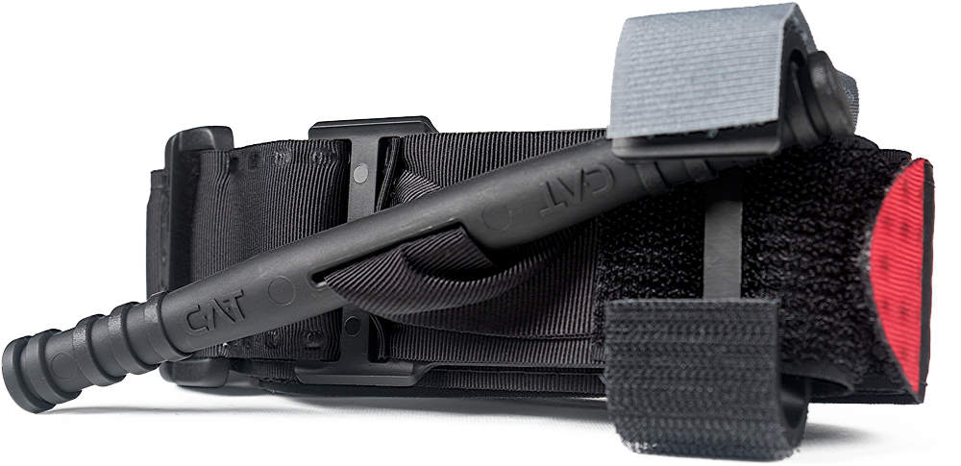
Instructions for One-Handed Application
GEN 7
Courtesy of North American Rescue
Notes:
The following series of slides shows how to apply the CAT with one hand to your own arm.

Slide 60
Step 1
Insert the injured limb through the loop in the band and position tourniquet 2-3" above the bleeding site. If the most proximal bleeding site is not readily identifiable, place the tourniquet as high as possible on the limb.
Notes:
Read text.

Slide 61
Step 2
Pull band TIGHTLY and fasten it back on itself all the way around the limb, but not over the rod clips. Band should be tight enough that tips of three (3) fingers cannot be slid between the band and the limb. If the tips of three (3) fingers slide under band, retighten and re-secure.
Notes:
Read text.
It is important to stress here that all the slack in the band must be pulled through the buckle before the band is fastened back on itself and the windlass is twisted. If the slack is not removed, it may not be possible to get the tourniquet tight enough to stop arterial bleeding.

Slide 62
Step 3
Twist the rod until bleeding has stopped.
Notes:
Read the text.

Slide 63
Step 4
Snap the rod inside a clip to lock it in place. Check for bleeding and distal pulse. If bleeding is not controlled, or distal pulse is present, consider more tightening or applying a second tourniquet above and side-by-side to the first. Reassess.
Notes:
Read the text.

Slide 64
Step 5
Route the band over the rod and between the clips. Secure with the grey securing strap. Record time of application.
Notes:
Read the text.

Slide 65
Video: C-A-T One-Handed
Application to an Arm
Notes:
Click on the photo to play the video.

Slide 66
Instructions for Two-Handed Application
GEN 7
Courtesy of North American Rescue
Notes:
The following series of slides shows how to apply the CAT using both your hands.

Slide 67
Step 1
Route the band around the limb, pass the red tip through the slit of the buckle, and position tourniquet 2-3" above the bleeding site. If the most proximal bleeding site is not readily identifiable, place the tourniquet as high as possible on the limb.
Notes:
Read the text.

Slide 68
Step 2
Pull band TIGHTLY and fasten it back on itself all the way around the limb, but not over the rod clips. Band should be tight enough that tips of three (3) fingers cannot be slid between the band and the limb. If the tips of three (3) fingers slide under band, retighten and re-secure.
Notes:
Read the text.
It is important to stress here that all the slack in the band must be pulled through the buckle before the band is fastened back on itself and the windlass is twisted. If the slack is not removed, it may not be possible to get the tourniquet tight enough to stop arterial bleeding.

Slide 69
Step 3
Twist the rod until bleeding has stopped.
Notes:
Read the text.

Slide 70
Step 4
Snap the rod inside a clip to lock it in place. Check for bleeding and distal pulse. If bleeding is not controlled, or distal pulse is present, consider more tightening or applying a second tourniquet above and side-by-side to the first. Reassess.
Notes:
Read the text.

Slide 71
Step 5
Route the band over the rod and between the clips. Secure with the grey securing strap. Record time of application.
Notes:
Read the text.

Slide 72
Video: C-A-T Two-Handed
Application to a Leg
Notes:
Click on the photo to play the video.

Slide 73
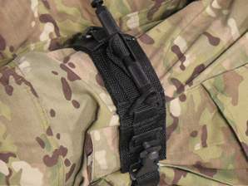
Other Tourniquets
The SOF Tactical Tourniquet (SOFTT) by Tactical Medical Solutions, Inc.
Equally recommended with the C.A.T. for carriage by Combat Medics on the battlefield.
Photo courtesy TMS, Inc.
Notes:
The SOFTT is also recommended by the ISR and the CoTCCC. It was found to be 100% effective in stopping arterial flow in arms and legs in laboratory testing. Anecdotal reports say the SOFTT may be more effective than the C-A-T in individuals with large legs. It is not fielded as widely as the C-A-T at present, but feedback from medics regarding its use has been good.
(NOTE: Instructional slides and a video for the SOFTT may be found in the Supplementary Modules folder.)

Slide 74
Tourniquet Mistakes to Avoid!
Not using one when you should, or waiting too long to put it on.
Not pulling all the slack out before tightening
Using a tourniquet for minimal bleeding
Putting it on too proximally if the bleeding site is clearly visible
Not making it tight enough – the tourniquet should both stop the bleeding AND eliminate the distal pulse
Not using a second tourniquet if needed
* These lessons learned have been written in blood. *
Notes:
These are common mistakes made by first responders applying tourniquets.

Slide 75
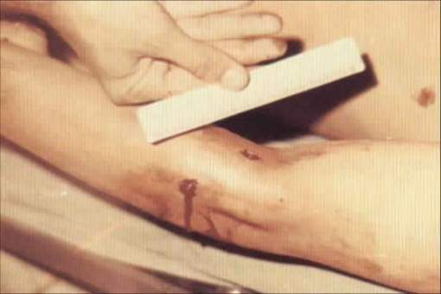
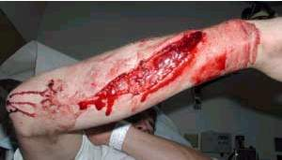
Examples of Extremity Wounds That Do NOT Need a Tourniquet
Use a tourniquet ONLY
for severe bleeding!
Notes:
Neither wound here is life threatening because the bleeding is minimal.
A tourniquet should not be used on these two wounds or other wounds like them where the bleeding is not severe.

Slide 76
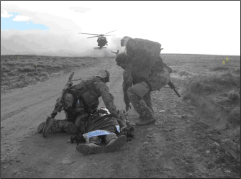
Tourniquet Pain
Tourniquets HURT when applied effectively.
Pain does not necessarily indicate a mistake in application.
It doesn’t mean you should take it off!
Manage pain with pain
meds.
Notes:
It is expected that tourniquet application will cause some pain, but it will also save your casualty’s life.

Slide 77
After a Tourniquet has been Applied
After ANY tourniquet application, monitor the casualty closely to ensure that the tourniquet remains tight and that bleeding remains controlled.
Reassess – reassess- reassess!
Notes:
Read the text.

Slide 78
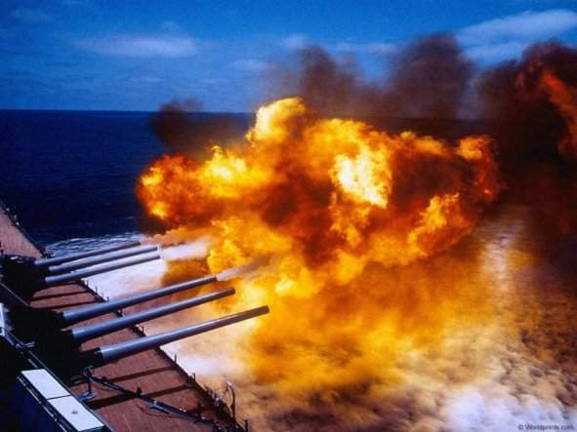
Questions?

Slide 79
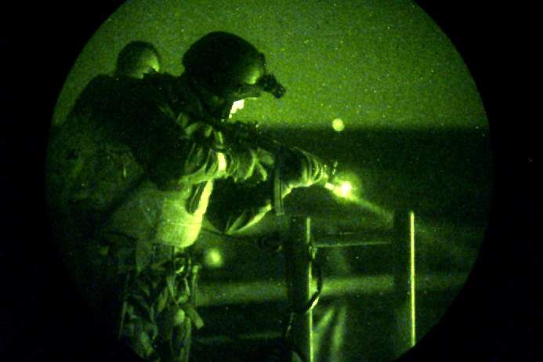
Limb Tourniquet Practical
Notes:
For the tourniquet practical, break up into small groups of 6 or 7 students per instructor.
If you are training the CAT, use the CAT skill sheet.
If you are training the SOFTT, use the files in that module.

Slide 80
Hemorrhage Control
Some wounds are located in places where a tourniquet cannot be applied, such as the:
Neck
Axilla (armpit)
Groin
The use of a hemostatic agent (e.g., Combat Gauze) is generally not tactically feasible in CUF because of the requirement to hold direct pressure for 3 minutes.
Notes:
If a tourniquet cannot be used to control the bleeding because the wound is in a place where the tourniquet will not be effective, then there is nothing that can be done in Care Under Fire, EXCEPT the casualty may be able to get to cover and hold direct pressure over his own wound as self-aid.

Slide 81
Airway – Covered in TFC
No immediate management of the airway is anticipated while in the Care Under Fire phase.
Don’t take time to establish an airway while under fire.
Defer airway management until you have moved casualty to cover.
Combat deaths from compromised airways are relatively infrequent.
If casualty has no airway in the Care Under Fire phase, chances for survival are minimal.
Notes:
We will address airway care in the Tactical Field Care phase.

Slide 82
Summary of Key Points
Return fire and take cover!
Direct or expect the casualty to remain engaged as a combatant if appropriate.
Direct the casualty to move to cover if able.
Try to keep the casualty from sustaining additional wounds.
Get casualties out of burning vehicles or buildings.
Notes:
(Ask questions to cover key points.)

Slide 83
Summary of Key Points
Stop life-threatening external hemorrhage if tactically feasible.
Use a tourniquet for hemorrhage that is anatomically amenable to tourniquet application.
Direct the casualty to control hemorrhage by self-aid if able.
Airway management is generally best deferred until the Tactical Field Care phase.
Notes:
(Ask questions to cover key points.)

Slide 84
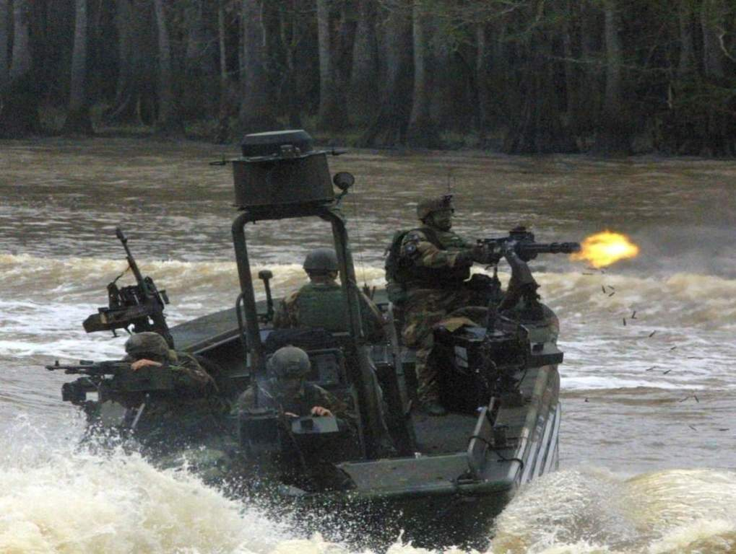
Questions?
Questions?

Slide 85
Scenario Based Planning
If the basic TCCC combat trauma management plan for Care Under Fire doesn’t work for your specific tactical situation – then it doesn’t work.
Scenario-based planning is critical for success.
Incorporate likely casualty scenarios into unit mission planning!
The following is one example:
Notes:
The TCCC guidelines are not designed to be a rigid protocol.
Nothing in combat is fixed in stone.
Think on your feet!

Slide 86
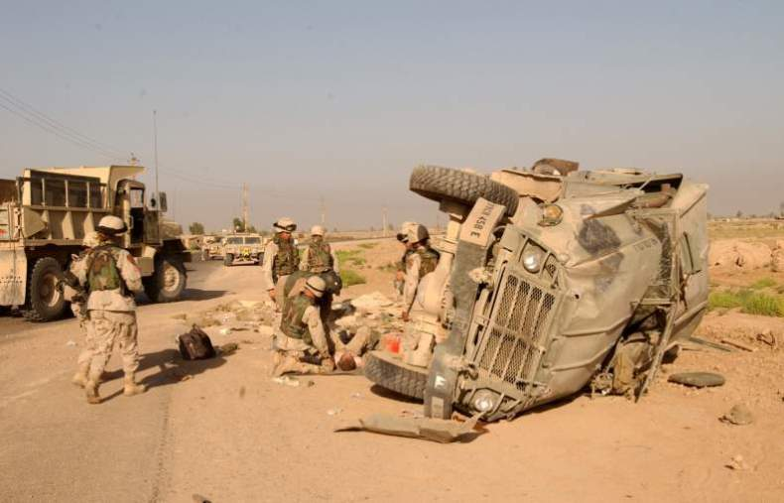
Convoy IED Scenario
Notes:
Let’s consider a scenario commonly encountered in Iraq and Afghanistan.
Improvised Explosive Devices (IEDs) are a very common cause of injury in these two theaters.

Slide 87
Convoy IED Scenario
Your element is in a five-vehicle convoy moving through a small Iraqi village.
A command-detonated IED explodes under the second vehicle.
Moderate sniper fire follows.
The rest of the convoy is suppressing sniper fire.
Notes:
Read the text.

Slide 88
Convoy IED Scenario
You are a survivor in the disabled vehicle.
The person next to you has bilateral mid-thigh amputations. He is your only medic!
There is heavy arterial bleeding from the left stump.
The right stump has only mild oozing of blood.
Notes:
Read the text.

Slide 89
Convoy IED Scenario
The casualty is conscious and in moderate pain.
The vehicle is not on fire and is right side up.
You are uninjured and able to assist.
Notes:
Read the text.

Slide 90
Convoy IED Scenario
First decision:
Return fire or treat casualty?
You treat the immediate threat to the casualty’s life.
Why?
The rest of the convoy is providing suppressive fire.
The treatment is effective and QUICK.
First action?
You put a tourniquet on the left stump with arterial bleeding.
Notes:
Read the text in sequence.
(Ask individuals in the audience to answer the questions.)

Slide 91
Convoy IED Scenario
Next action?
Put a tourniquet on second stump?
Not until Tactical Field Care
It’s not bleeding much right now
Next actions?
Drag the casualty out of the vehicle and move him to the best cover
Return fire if needed
Communicate with the team leader regarding the casualty’s status.
Notes:
Read the text in sequence.
(Ask individuals in the audience to answer the questions.)

Slide 92
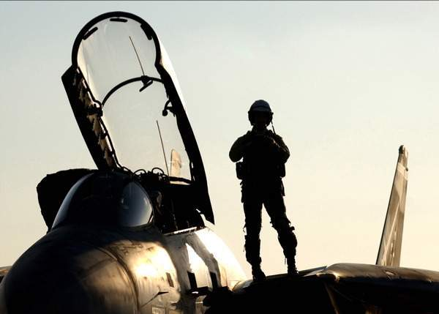
Questions?
Notes:
This is the end of Care Under Fire. The scenario will be continued in Tactical Field Care.

