Slide 1
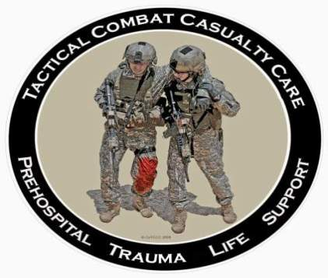
Tactical Combat Casualty Care for All Combatants
August 2017
(Based on TCCC-MP Guidelines 170131)
Tactical Evacuation Care
Notes:
Next we’ll be moving into the Tactical Field Care phase of TCCC.

Slide 2
OBJECTIVE
DISCUSS the special considerations that apply to care for the wounded during evacuation.
Notes:
Read text

Slide 3
Tactical Evacuation
Casualties need evacuation as soon as feasible after significant injuries.
Evacuation asset may be a ground vehicle, aircraft, or boat.
Evacuation time is highly variable – significant delays may be encountered.
The tactical situation and any hostile threat to evacuation platforms may differ markedly from one casualty scenario to another.
The Tactical Evacuation phase usually allows for additional medical personnel and equipment to be used.
Notes:
Casualty movement/evacuation may occur as a separate moving portion of the operation while the main assault force continues tactical operations, or the casualties may be evacuated along with the main assault force as it exfiltrates from the main objective.
Pre-mission planning should identify medical facilities and capabilities within the area of operations. Transport times to these facilities by various types of vehicles should also be identified.
Planning for loading casualties onto mission vehicle assets is important. A single litter patient may occupy space within a tactical vehicle normally occupied by 4 uninjured combatants. Take this into account during planning. It may come down to you and your unit evacuating casualties, and not Pedro or Dustoff.

Slide 4
Tactical Evacuation
Normally, Tactical Evacuation Care is managed by a medic, corpsman, or flight paramedic.
  Extra medical equipment and special training for medical personnel usually allows for more advanced medical care during evacuation.
Notes:
When the Joint Theater Trauma System is deployed, the goal we strive for is to provide medical personnel with advanced trauma care training and more sophisticated medical gear to manage casualty care on evacuation platforms.

Slide 5
Tactical Evacuation
It is possible that casualty care during evacuation may fall to you, especially in an immature theater or on a remote operation:
  Planned evacuation platform disabled
  Your medic or corpsman disabled
If this happens, continue to care for casualties as you have been trained.
Notes:
Read the text.

Slide 6
Tactical Evacuation Care Guidelines
1. Tactical force personnel should establish evacuation point security and stage casualties for evacuation.
2. The care you can give a casualty during evacuation is the same as Tactical Field Care.
3. For casualties with chest and abdominal trauma watch closely for tension pneumothorax, especially if evacuating by air or crossing mountainous terrain.
4. Watch for renewed bleeding from any wound. If it occurs, control it.
5. Keep the casualty warm.
6. Document the care you give.
Notes:
These are the things to remember if you should have to care for a casualty during evacuation.
Read the guidelines.

Slide 7
Tactical Evacuation Care
Casualty care during evacuation is the same as the care you delivered in the field.
  Render care in accordance with your training.
  Reassess casualties frequently.
Notes:
Read the text.

Slide 8
Breathing in TACEVAC
Watch for tension pneumothorax as casualties with a chest wound ascend into the lower pressure at altitude.
  For any penetrating chest wound treated with a chest seal, “burp” or remove and re-apply the seal.
  It may help to reduce altitude if possible.
Notes:
Consider tension pneumothorax in casualties with chest or abdominal injuries and progressive respiratory distress.
If a helicopter is your evacuation platform, or if you have to drive over mountainous terrain, the ambient atmospheric pressure will drop as you ascend. This will allow air trapped in a casualty’s chest cavity to expand, possibly resulting in a tension pneumothorax. If a chest seal has been used to dress a penetrating chest wound, you can try burping or temporarily removing the chest seal to relieve the trapped air. Moving to a lower altitude can help by reducing the volume of the trapped air.

Slide 9
Hemorrhage Control in TACEVAC
All sources of bleeding should have been addressed in Care Under Fire and Tactical Field Care, but don’t take this for granted.
Tourniquets, hemostatics dressings, and pressure dressings are not “apply-and-forget” treatments.
Continually reassess for control of bleeding.
  Look for new sources of bleeding, too.
Notes:
Any dressing or tourniquet that has been applied to control bleeding may fail at any time. For example, tourniquets may loosen or the casualty’s blood pressure may improve. Any treatment that you apply to control bleeding must be checked again and again until you turn the casualty over to a higher level of medical care.

Slide 10
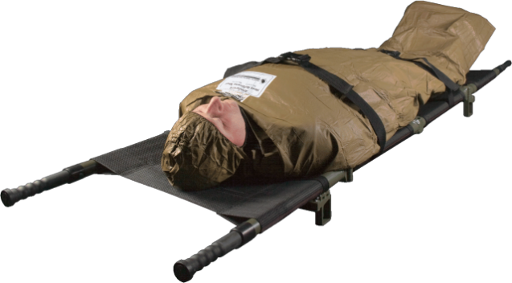
Hypothermia Prevention
in TACEVAC
Remember to keep the casualty on an insulated surface or get him/her on one as soon as possible.
Apply the Ready-Heat Blanket from the Hypothermia Prevention and Management Kit (HPMK), to the casualty’s torso (not directly on the skin) and cover the casualty with the Heat-Reflective Shell (HRS).
Notes:
Read the text.

Slide 11
Remember: Prevention of Hypothermia in Helicopters!
Cabin wind and altitude cold result in cold stress.
Protection is especially important for casualties in shock and for burn casualties.
Notes:
Imagine how cold these casualties are. It is always cold at altitude in helos, but much worse during winter.

Slide 12
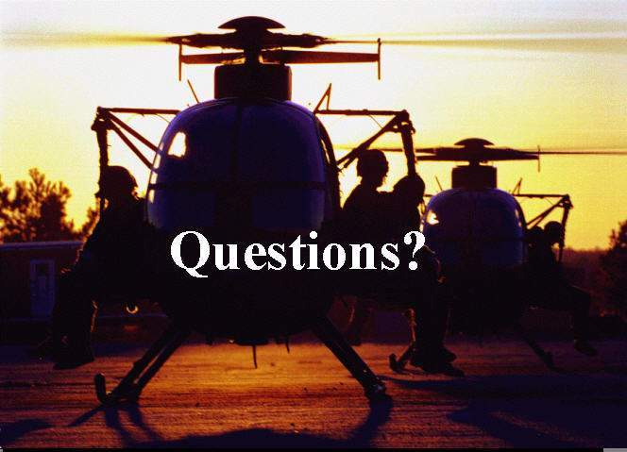

Slide 13
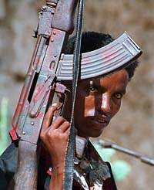
TACEVAC Care for Wounded
Hostile Combatants
Principles of care are the same for all wounded combatants.
Rules of Engagement may dictate evacuation process.
Restrain and provide security.
Remember that each hostile
casualty represents a potential
threat to the provider and the
unit and take appropriate
measures.
They still want to kill you!
Notes:
We talked about this in TFC.
Maintain proper prisoner handling procedures.

Slide 14
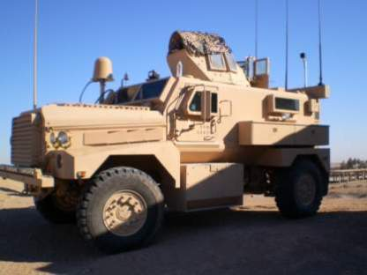
Tactical Evacuation Care
Summary of Key Points
Evacuation time is highly variable.
Thorough planning is key, but things may go wrong and you may wind up managing casualty care.
Care is the same as Tactical Field Care.
Notes:
Read the text.

Slide 15
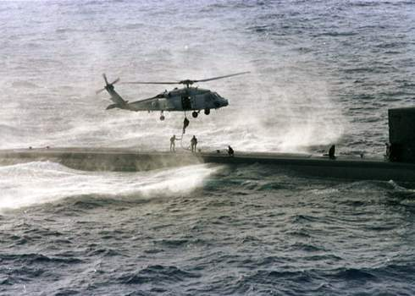
Questions/Comments?

