Slide 1
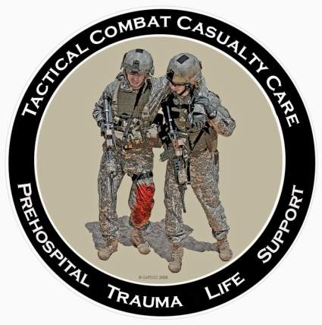
Tactical Combat Casualty Care for All Combatants
August 2017
(Based on TCCC-MP Guidelines 170131)
Scenarios
Notes:
We’ve talked about the basic TCCC trauma management plan.
Now let’s apply the guidelines to some selected scenarios.

Slide 2
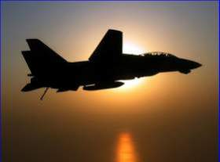
Tactical Casualty Scenarios
If the basic TCCC combat trauma management plan doesn’t work for your specific tactical situation, then it doesn’t work.
There are no rigid guidelines for combat tactics – THINK ON YOUR FEET.
Scenario-based planning is critical for success in TCCC.
Examples follow:
Notes:
Read the text.

Slide 3
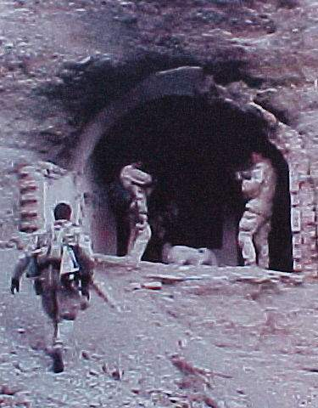
SEAL Casualty - Afghanistan
August 2002
Somewhere in Afghanistan
SEAL element on direct action mission
Story of the casualty as described by the first responder who was NOT a
corpsman
Notes:
This is a verbatim account of a real scenario that clearly illustrates the difficulty of trauma care on the battlefield.

Slide 4
SEAL Casualty - Afghanistan
“There were four people in my team, two had been shot. Myself and the other uninjured teammate low crawled to the downed men. The man I came to was lying on his back, conscious, with his left leg pinned awkwardly beneath him. He was alert and oriented to person, place, time, and event. At that point I radioed C2 (mission control) to notify them of the downed man.”
Notes:
Read the text.

Slide 5
SEAL Casualty - Afghanistan
“Upon closer inspection, his knee was as big as a basketball and his femur had broken. The patient was in extreme pain and did not allow me to do a sweep of his injured leg. He would literally shove me or grab me whenever I touched his leg or wounds. I needed to find the entrance and exit wound and stop any possible arterial bleeding.”
Notes:
Read the text.

Slide 6
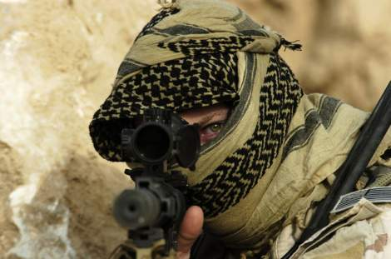
SEAL Casualty - Afghanistan
“But there was zero illumination and he was lying in a wet irrigation ditch. So I couldn’t see blood and I couldn’t feel for blood.”
Notes:
Picture yourself in this situation. You’ve got a casualty who is badly hurt and you can’t see a thing.

Slide 7
SEAL Casualty - Afghanistan
“We were also in danger because our position was in an open field (where the firefight had been) and I had to provide security for him and myself. So, I couldn’t afford to turn on any kind of light to examine his wounds. I told him to point to where he felt the pain. He had to sort through his pains.”
Notes:
Read the text.

Slide 8
SEAL Casualty - Afghanistan
“He had extreme pain in his knee and where his femur had been shattered as well as a hematoma at the site of the entrance wound (interior and upper left thigh). Finally, he pointed to his exit wound (anterior and upper left thigh). Again, I had no way of telling how much blood he had lost. But I did know that he was nonambulatory.”
Notes:
Read the text.

Slide 9
SEAL Casualty - Afghanistan
“So I called C2 again. I gave him the disposition of the patient as well as a request for casevac, a Corpsman, and additional personnel to secure my position and assist in moving the patient to the helicopter. I thought about moving the two of us to some concealment 25 meters away, but we were both really low in a shallow irrigation ditch. I felt safer there than trying to drag or carry a screaming man to concealment.”
Notes:
Read the text.
C2 = Command and Control

Slide 10
SEAL Casualty - Afghanistan
“Between providing security and spending a lot of time on the radio I didn’t get to treat the patient as much as I wanted to. I had given him a Kerlix bandage to hold against his exit wound. When he frantically told me that he was feeling a lot of blood, I went back to trying to treat him. I couldn’t elevate his leg. To move it would mean he’d scream in pain, which wasn’t tactical.”
Notes:
Read the text.

Slide 11
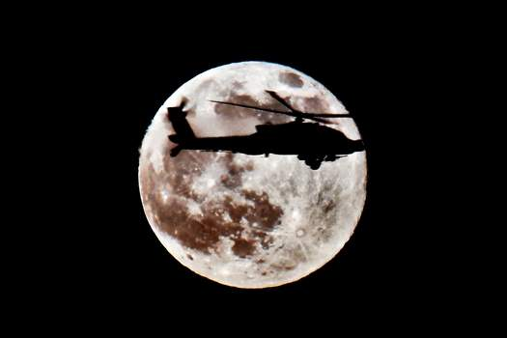
SEAL Casualty - Afghanistan
“There was just no way he would allow me to apply a pressure dressing to the exit wound even if I could locate it and pack it with Kerlix. So, I decided to put a tourniquet on him.”
Notes:
Read the text.

Slide 12
SEAL Casualty - Afghanistan
“His wounds were just low enough on his leg to get the tourniquet an inch or so above the site. I had a cravat and a wooden dowel with 550 cord (parachute cord) attached to it to use as a tourniquet. I told him to expect a lot of pain as I would be tightening the cravat down.“
Notes:
Note the makeshift tourniquet. When we first started the war in Afghanistan, most U.S. forces were not deploying with issued tourniquets.

Slide 13
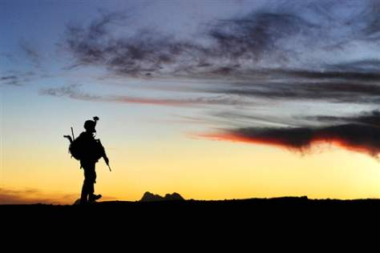
SEAL Casualty - Afghanistan
“At this point he feared for his life so he agreed. Once I got it tightened I had trouble securing it. The 550 cord was hard to get underneath the tightened cravat.”
Notes:
You need to be able to get a tourniquet on a wounded teammate with zero illumination.

Slide 14
SEAL Casualty - Afghanistan
“After over 5 minutes, the Corpsman arrived along with a CASEVAC bird and a security force. Moving the patient was very hard. Four of us struggled to move him and his gear 25 meters to the bird. The patient was over 200 pounds alone and we were moving over very uneven terrain.”
Notes:
Read the text.

Slide 15
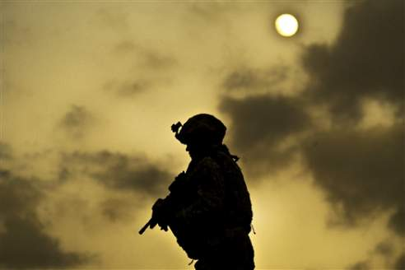
SEAL Casualty - Afghanistan
“We wanted to do a three-man carry with two men under his arms and one under his legs. But again, his leg was flopping around at the thigh and couldn’t be used to lift him.”
Notes:
Experienced combat medical personnel say that moving the casualty is typically the biggest challenge in TCCC.

Slide 16
SEAL Casualty - Afghanistan
“The bird, (a Task Force 160 MH-60) had a 50-cal sniper rifle strapped down, which made it hard for us to get him in. It took us minutes to get him 25 meters into the bird. The Corpsman went with my patient as well as the other downed man in my team and I went back to the op.”
Notes:
Was the tourniquet a good move?
Absolutely – probably saved the casualty’s life.
Would a pressure dressing have been a good idea if tolerated by the patient?
NO – a pressure dressing won’t necessarily stop a big bleeder.

Slide 17
Scenario Discussions –
Suggested Format
Break up into groups of six
Present the background for the scenario on the screen.
The Instructor will lead the group’s discussion through to the end of the scenario.
Instructor should have a printout of the speaker notes to lead the session.
10 minutes per scenario
Stop after 10 minutes and present next scenario on screen
Notes:
Here’s is a suggested format for the scenario discussions
Get the class talking and thinking about these!

Slide 18
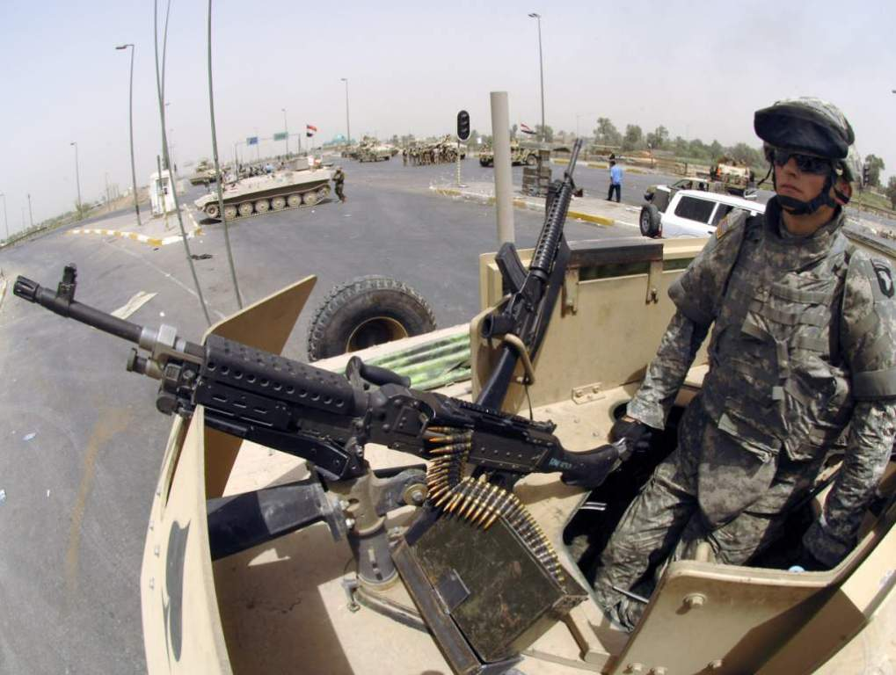
Urban Warfare
Scenario
Notes:
Now let’s look at a scenario in urban warfare operations.

Slide 19
Real-World Scenario
High-threat urban environment
16-man Ranger team
70-foot fast rope insertion for a building assault
One man misses the rope and falls, landing on his back.
Unconscious on the ground
Bleeding from mouth and ears
Unit is taking sporadic fire from all directions from hostile crowds
Notes:
Anybody recognize this casualty?
This was the first Ranger casualty in Mogadishu.
Has everyone here seen “Blackhawk Down”?

Slide 20
The Battle of Mogadishu
Somalia – Oct 1993
US casualties: 18 dead, 73 wounded
Estimated Somali casualties: 350 dead, 500 wounded
Battle was 15 hours in length
Notes:
At the time, this was the biggest battle involving U.S. forces since Vietnam.

Slide 21
Mogadishu Complicating Factors
Helo CASEVAC not possible because of crowds, narrow streets and RPGs
Vehicle CASEVAC not possible initially because of ambushes, roadblocks, and RPGs
Gunfire support problems
  Somali crowds included non-combatants
  Somalis able to take cover in buildings
  RPG threat to helo fire-support gunships
Notes:
We have talked about factors that make evacuation by helicopter difficult..
We can add narrow streets and RPG fire to that list.
There were LOTS of U.S. helos over Mogadishu, but we were not able to evacuate the casualties with them for these reasons.

Slide 22
Mogadishu Scenario 1
Fast Rope Fall
Should the first responder return fire or care for casualty?
  It was reasonable to have someone (a medic or corpsman would be preferred, if available) to attend the casualty in this scenario.
Why?
  Total suppression of hostile fire was not possible.
  The crowd was large – the team couldn’t eliminate all the hostiles.
  There were a good number of guns on the team – sparing one man for casualty care made little difference in defensive firepower.
  The casualty was critically injured.
Notes:
Read the text.

Slide 23
Mogadishu Scenario 1
Fast Rope Fall
Does that break our rule about shooting first and treating later?
  Yes - but that’s OK – it’s the right answer for this particular situation.
What’s next?
  Move patient to cover right away?
  Cover would be good, but is he at risk for a spinal cord injury if moved?
  Yes, but he’s also very much at risk of getting shot.
  You probably DO want to get him to cover immediately. (Cover was available at the side of the road.)
Notes:
Read the text.

Slide 24
Mogadishu Scenario 1
Fast Rope Fall
How do you want to move him?
  Carefully!!
  Cradle head with forearms to stabilize neck and drag
What about his airway?
  Chin-lift/jaw-thrust followed by NPA
Notes:
Read the text.

Slide 25
Mogadishu Scenario 1
Fast Rope Fall
Urgency for evacuation?
  Possible ruptured spleen or other internal bleeding from blunt force trauma puts him at risk for hemorrhagic shock.
  Need for evacuation is urgent.
  Tactical commander in Mogadishu split his force in order to effect immediate evacuation by ground vehicle and to pursue other aspects of the mission.
Notes:
Read the text.

Slide 26
Mogadishu Scenario 1
Fast Rope Fall
Does he need antibiotics or analgesia?
  No – he has no open wounds and he is unconscious.
  An unconscious casualty doesn’t need pain meds, and you wouldn’t put pills in his mouth anyway.
The actual outcome?
  The Ranger survived his injuries.
Notes:
Read the text.

Slide 27
Mogadishu Scenario 1
Fast Rope Fall
End of Scenario

Slide 28
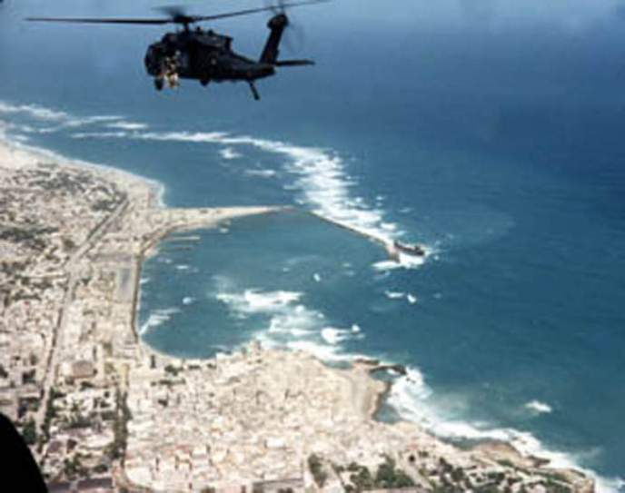
Mogadishu Scenario 2
Helo Hit by RPG Round
Notes:
Here is a second real-world scenario from Mogadishu, presenting a very different tactical situation.

Slide 29
Mogadishu Scenario 2
Helo Hit by RPG Round
Hostile and well-armed (AK-47s, RPGs) crowds in an urban environment
Building assault to capture members of a hostile clan
Blackhawk helicopter trying to cover helo crash site
Flying at an altitude of 300 feet
Notes:
Read the text.

Slide 30
Mogadishu Scenario 2
Helo Hit by RPG Round
Left door gunner manning a 6-barrel M-134 minigun (4000 rpm)
Hit in left hand by ground fire
Another crew member takes over the mini-gun
An RPG round impacts under the right door gunner
Notes:
Read the text.

Slide 31
Mogadishu Scenario 2
Helo Hit by RPG Round
Windshields are all blown out
Smoke is filling the aircraft
Right minigun is not functioning
Left minigun is without a gunner and is firing uncontrolled
Pilot:
  Transiently unconscious - now becoming alert
Notes:
Read the text.

Slide 32
Mogadishu Scenario 2
Helo Hit by RPG Round
Co-pilot
  Unconscious - lying forward on the helo’s controls
Crew Member
  Right leg blown off above the knee
  Lying in puddle of his own blood
  Pulsatile bleeding from the stump
Notes:
Read the text.

Slide 33
Mogadishu Scenario 2
Helo Hit by RPG Round
YOU are the person providing care in the helo.
  Casualty with femoral bleeding
  Unconscious co-pilot
  Semi-conscious pilot
  Unmanned min-gun firing
What do you do first?
Notes:
Read the text.

Slide 34
Mogadishu Scenario 2
Helo Hit by RPG Round
Who gets treated first?
  Take care of the pilot first.
    You want to get him back to flying the aircraft.
    The most important thing about medical care in an aircraft is to keep the aircraft in the air.
  Stimulate the pilot by shaking him or performing a sternal rub.
Notes:
Advance through these points sequentially. Read (and discuss if appropriate) each point as it appears.

Slide 35
Mogadishu Scenario 2
Helo Hit by RPG Round
Who’s next?
  The casualty with the femoral bleeder is next.
  He needs a tourniquet.
  He should be able to provide self-care if he’s conscious.
  The individual in Mogadishu treated himself.
    He used an improvised tourniquet.
    He survived.
Notes:
Advance through these points sequentially. Read (and discuss if appropriate) each point as it appears.

Slide 36
Mogadishu Scenario 2
Helo Hit by RPG Round
What can you do for the unconscious co-pilot?
  First, get him off the controls to keep the aircraft flying.
  Get him into a supine position.
  Check for massive hemorrhage.
    You see none.
  Establish a protected airway with an NPA.
Notes:
Advance through these points sequentially. Read (and discuss if appropriate) each point as it appears.

Slide 37
Mogadishu Scenario 2
Helo Hit by RPG Round
Next action?
  Check the casualty with the hand injury.
  Stop any severe bleeding.
Notes:
Advance through these points sequentially. Read (and discuss if appropriate) each point as it appears.

Slide 38
Mogadishu Scenario 2
Helo Hit by RPG Round
What else?
  Radio for help.
  Prepare for impact if a crash landing is anticipated.
  After impact – secure weapons and ordnance.
Notes:
Advance through these points sequentially. Read (and discuss if appropriate) each point as it appears.

Slide 39
Mogadishu Scenario 2
Helo Hit by RPG Round
End of Scenario

Slide 40
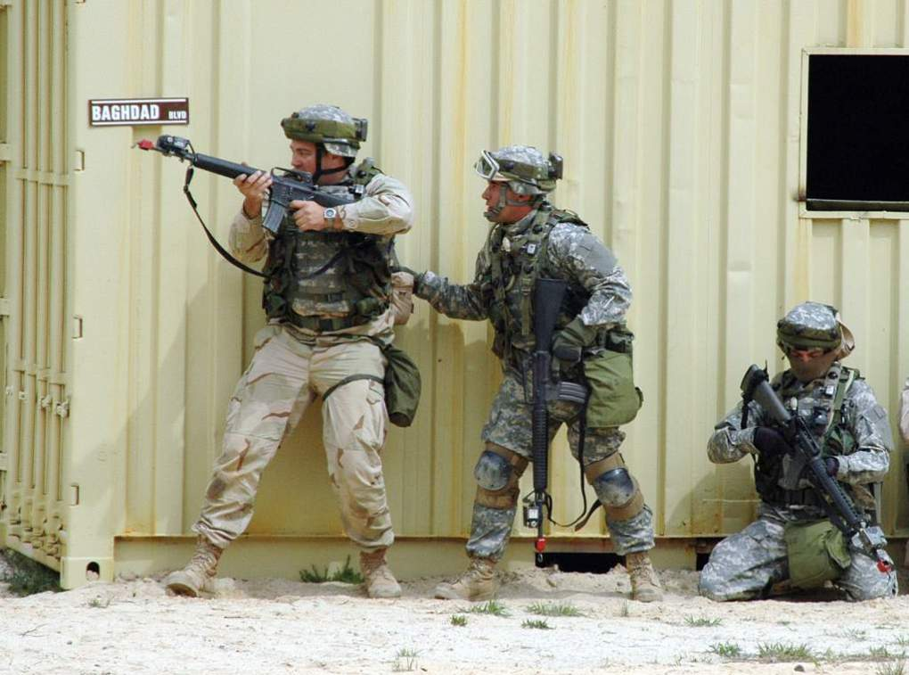
Military Operations in Urban Terrain
Notes:
Now let’s look at a few scenarios that are representative of what we saw more recently in Afghanistan.

Slide 41
MOUT Scenario 1
A U.S. ground element is moving on a high-value target in an urban environment.
The first two men in a 8-man patrol are shot by an individual with an automatic weapon while moving down a hallway in a building.
The attacker follows this burst with a grenade.
Notes:
Read the text.

Slide 42
MOUT Scenario 1
One casualty is shot in the abdomen, but conscious.
The second casualty is shot in the shoulder with severe external bleeding.
The third casualty is unconscious from the grenade blast.
The attacker withdraws around a corner.
Notes:
Read the text.

Slide 43
MOUT Scenario 1
YOU are the person providing medical care.
What do you do?
Notes:
Read the text.

Slide 44
MOUT Scenario 1
What are the tactical considerations here?
  How many other hostiles in are in house?
  Should everyone pursue the hostile(s) and leave care of the casualties for later?
  Should the whole unit withdraw to care for casualties?
  Should the unit set security and treat casualties there?
  Should the unit split up and have some pursue and others treat?
    Splitting the force is most often chosen by previous groups as the best option.
  So, you are left with the casualties to proceed with care as per Tactical Field Care Guidelines.
Notes:
Advance through these points sequentially. Read (and discuss if appropriate) each point as it appears.

Slide 45
MOUT Scenario 1
Who gets treated first?
  The casualty with the shoulder injury and massive external bleeding.
  He’s the most important to treat immediately – he could bleed to death quickly.
What do you do for him?
  Stop the bleeding with Combat Gauze
    Apply with direct pressure for at least 3 minutes.
  Bleeding is controlled
  Casualty is alert.
Notes:
Advance through these points sequentially. Read (and discuss if appropriate) each point as it appears.

Slide 46
MOUT Scenario 1
Casualty with shoulder injury: what next?
Airway Management?
  He’s conscious and breathing OK.
Respirations?
  He’s breathing OK.
  Beware of the risk for tension pneumothorax.
Combat Wound Medication Pack?
  Yes
Notes:
Advance through these points sequentially. Read (and discuss if appropriate) each point as it appears.

Slide 47
MOUT Scenario 1
Who’s next?
Unconscious Casualty
He has no penetrating head trauma.
What do you do first?
  Check for massive hemorrhage
    You find major bleeding in back of one thigh from a shrapnel wound. Treatment?
    Apply a limb tourniquet.
Notes:
Advance through these points sequentially. Read (and discuss if appropriate) each point as it appears.

Slide 48
MOUT Scenario 1
Unconscious casualty: What else?
Airway Management
  Chin-lift/jaw thrust
  NPA
Next?
  Assess for shock
    You find a rapid, thready radial pulse
    Unconscious (from blast injury)
    He needs a medic/corpsman for treatment for shock
Notes:
Advance through these points sequentially. Read (and discuss if appropriate) each point as it appears.

Slide 49
MOUT Scenario 1
Unconscious casualty: Next?
  Hypothermia prevention
Next?
Analgesia?
  None required since he’s unconscious.
Antibiotics?
  Yes. Thigh wound.
  He’s unconscious and can’t swallow, so he’ll need a medic/corpsman for IV abx.
Notes:
Advance through these points sequentially. Read (and discuss if appropriate) each point as it appears.

Slide 50
MOUT Scenario 1
Unconscious casualty: Next?
  Check for other injuries:
    There are none.
Conscious casualty with abdominal GSW is last. What do you do?
  Check for massive hemorrhage
    Minimal oozing from abdominal GSW
    No exit wound
Notes:
Advance through these points sequentially. Read (and discuss if appropriate) each point as it appears.

Slide 51
MOUT Scenario 1
Conscious casualty with abdominal GSW: Next?
Airway Management
  He’s conscious and breathing OK.
Circulation
  His radial pulse is strong.
  He’s not in shock yet, but he is probably bleeding internally, so he’s at high risk for shock later.
  He needs a medic for IV access.
Notes:
Advance through these points sequentially. Read (and discuss if appropriate) each point as it appears.

Slide 52
MOUT Scenario 1
Conscious casualty with abdominal GSW: what else can you do?
Hypothermia prevention?
  You bet
Analgesia?
  Yes
  In CWMP
Notes:
Advance through these points sequentially. Read (and discuss if appropriate) each point as it appears.

Slide 53
MOUT Scenario 1
Conscious casualty with abdominal GSW: what else?
Antibiotics?
  Yes
  Also in CWMP
Anything else?
  Keep talking to the casualty
  Check his status repeatedly until you can get him to a medic.
Notes:
Advance through these points sequentially. Read (and discuss if appropriate) each point as it appears.

Slide 54
MOUT Scenario 1
End of Scenario

Slide 55
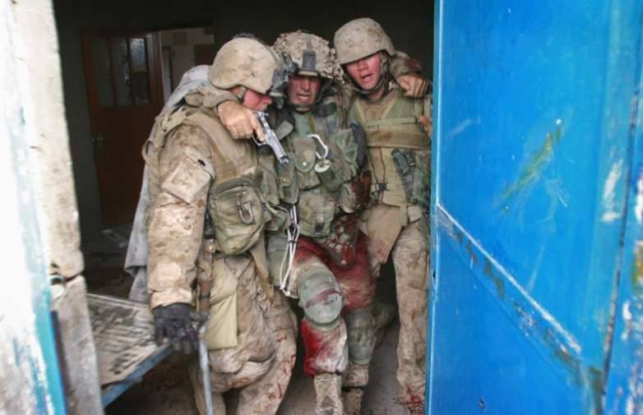
MOUT Scenario 2

Slide 56
MOUT Scenario 2
SCENARIO HISTORY: While on patrol in a city in Iraq, your platoon receives effective direct small arms fire. A unit member falls to the ground, holding his right thigh. The platoon, including you, reacts to the ongoing contact by returning fire.
Notes:
Read the text.

Slide 57
MOUT Scenario 2
You can see that the casualty is bleeding heavily from his thigh wound.
YOU are the person providing medical care for this casualty.
What do you do?
Notes:
Read the text.

Slide 58
MOUT Scenario 2
What phase are you in?
  Care Under Fire
What should you do for the casualty?
  Yell at him to get under cover if he can.
  Tell him to put a tourniquet “high and tight” on his wounded leg.
If he can’t control the bleeding, you may have to help him.
  If you do, consider a movement plan, suppression of fire, etc.
Notes:
Advance through these points sequentially. Read (and discuss if appropriate) each point as it appears.

Slide 59
MOUT Scenario 2
Should he take his Combat Wound Medication Pack meds now?
  No. You are still in Care Under Fire.
  Your priorities are to get to cover and return fire if possible.
Notes:
Advance through these points sequentially. Read (and discuss if appropriate) each point as it appears.

Slide 60
MOUT Scenario 2
Scenario continues:
The casualty has moved behind a vehicle.
All hostiles are eliminated or have retreated.
The platoon establishes a secure perimeter.
The platoon leader tells you that you have only one casualty, and that you have a few minutes to work on him before the platoon will have to move.
Notes:
Advance through these points sequentially. Read (and discuss if appropriate) each point as it appears.

Slide 61
MOUT Scenario 2
What phase are you in now?
  Tactical Field Care.
Your casualty is alert, in moderate pain, and clutching his right leg. There is blood all over his leg and hands, and a tourniquet is in place on his right thigh.
Notes:
Advance through these points sequentially. Read (and discuss if appropriate) each point as it appears.

Slide 62
MOUT Scenario 2
What is your first concern?
  Should you disarm the casualty and take his comms gear?
  Yes. He is already distracted by the pain and you anticipate he will soon need strong pain relief.
What’s next?
  Is massive hemorrhage controlled?
Notes:
Advance through these points sequentially. Read (and discuss if appropriate) each point as it appears.

Slide 63
MOUT Scenario 2
What do you do to assess hemorrhage control?
  Expose the wound.
Blood is oozing from the wound. What next?
  Check the tourniquet to make sure it is tight.
It is tight. What next?
  Apply another tourniquet next to the first one.
The bleeding has now stopped and distal pulse has been eliminated.
Notes:
Advance through these points sequentially. Read (and discuss if appropriate) each point as it appears.

Slide 64
MOUT Scenario 2
What’s next?
  You search quickly for any other life-threatening bleeding, and find none.
Next concern?
  Airway management
    He is conscious and talking – his airway is OK.
Notes:
Advance through these points sequentially. Read (and discuss if appropriate) each point as it appears.

Slide 65
MOUT Scenario 2
Next?
  Breathing.
    Breathing is rapid from pain and the situation, but not labored.
What next?
  Check for shock.
    Mental status is normal. Radial pulse is strong.
Notes:
Advance through these points sequentially. Read (and discuss if appropriate) each point as it appears.

Slide 66
MOUT Scenario 2
Next?
  Prevent hypothermia?
    Yes.
    Use the platoon’s HPMK if available, or alternative materials if it is not.
Notes:
Advance through these points sequentially. Read (and discuss if appropriate) each point as it appears.

Slide 67
MOUT Scenario 2
Next?
  Inspect and dress his leg wound.
  Reassess for hemorrhage control.
Next?
  Assess for other wounds.
    You discover tenderness over his anterior lower right chest.
    You check his body armor and find corresponding damage compatible with a bullet strike.
    The medic needs to know about this and you should monitor his breathing.
Notes:
Advance through these points sequentially. Read (and discuss if appropriate) each point as it appears.

Slide 68
MOUT Scenario 2
Scenario continues:
Your platoon leader tells you the unit will move in 10 minutes to a CASEVAC location.
  No enemy contact is expected.
  CASEVAC should take about 45-60 minutes.
What’s next?
  Analgesia
    CWMP
Notes:
Advance through these points sequentially. Read (and discuss if appropriate) each point as it appears.

Slide 69
MOUT Scenario 2
Anything else?
  Antibiotics
    CWMP
What else do you want to accomplish before TACEVAC?
  Reassure the casualty
  Document care
Notes:
Advance through these points sequentially. Read (and discuss if appropriate) each point as it appears.

Slide 70
MOUT Scenario 2
End of Scenario

Slide 71
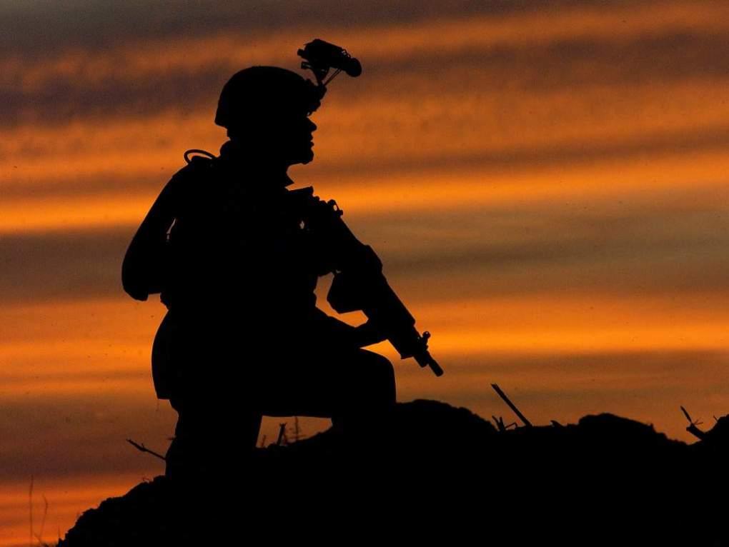
Questions?

Slide 72
Tactical Combat Casualty Care
Casualty scenarios on the battlefield usually entail both medical and tactical problems.
Emergency actions must address both.
Medical personnel should be involved in mission planning.
Notes:
In summary:
Good tactical medicine HAS to be a combination of good tactics and good medicine.
Bring your leadership into the medical plan.
Combat leaders must understand combat medicine.

Slide 73
Scenario-Based Planning
The TCCC guidelines for combat trauma scenarios are advisory rather than directive in nature.
Rarely does an actual tactical situation exactly reflect the conditions described in planning scenarios.
Those providing casualty care will typically need to modify the medical care plan to optimize it for the real scenario.
Notes:
Read the text.

Slide 74
The 3 Objectives of TCCC
Treat the casualty
Prevent additional casualties
Complete the mission
Notes:
Once more…..

Slide 75
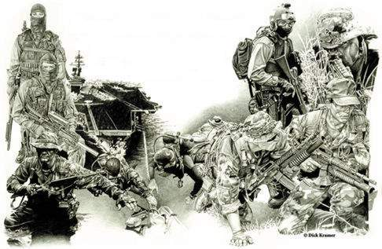
Post-Test
Pretest
Notes:
Pass out pre-tests.
Collect them when done.
Review the test with the students.
Compare pre-test grades to post-test grades to gauge assimilation of the information.

Slide 76
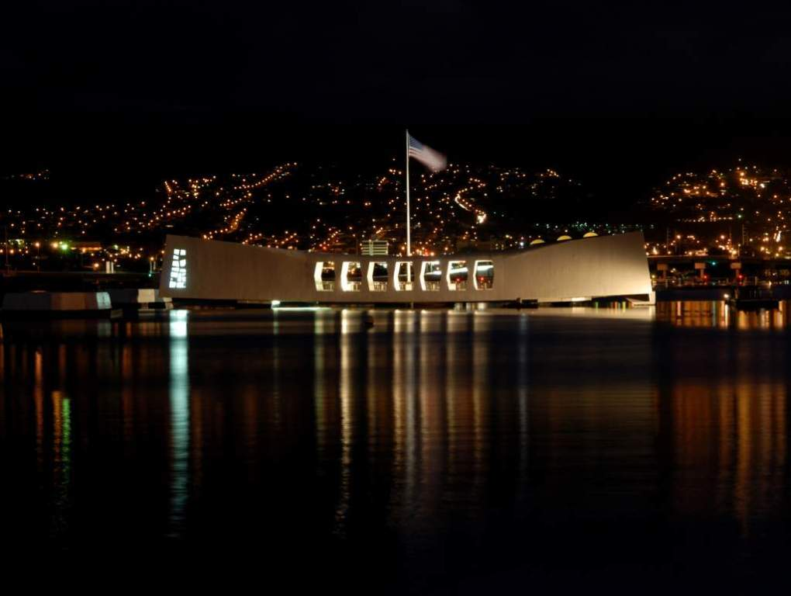
The End
The U.S.S. Arizona Memorial

