Slide 1
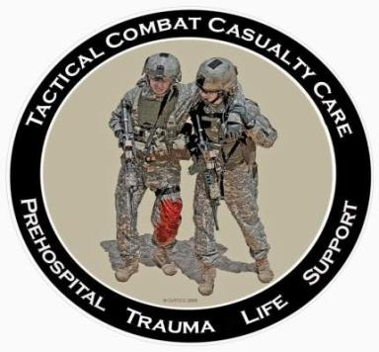
Introduction to TCCC
Tactical Combat Casualty Care for Medical Personnel August 2018 (Based on TCCC-MP Guidelines 180801)
Notes:
Tactical Combat Casualty Care is the standard of care in battlefield prehospital medicine. If you have not been trained in TCCC, then your previous medical training may not have contained the material presented in the following lessons. Medical care in combat is significantly different than that provided on the streets of Anywhere, USA.

Slide 2
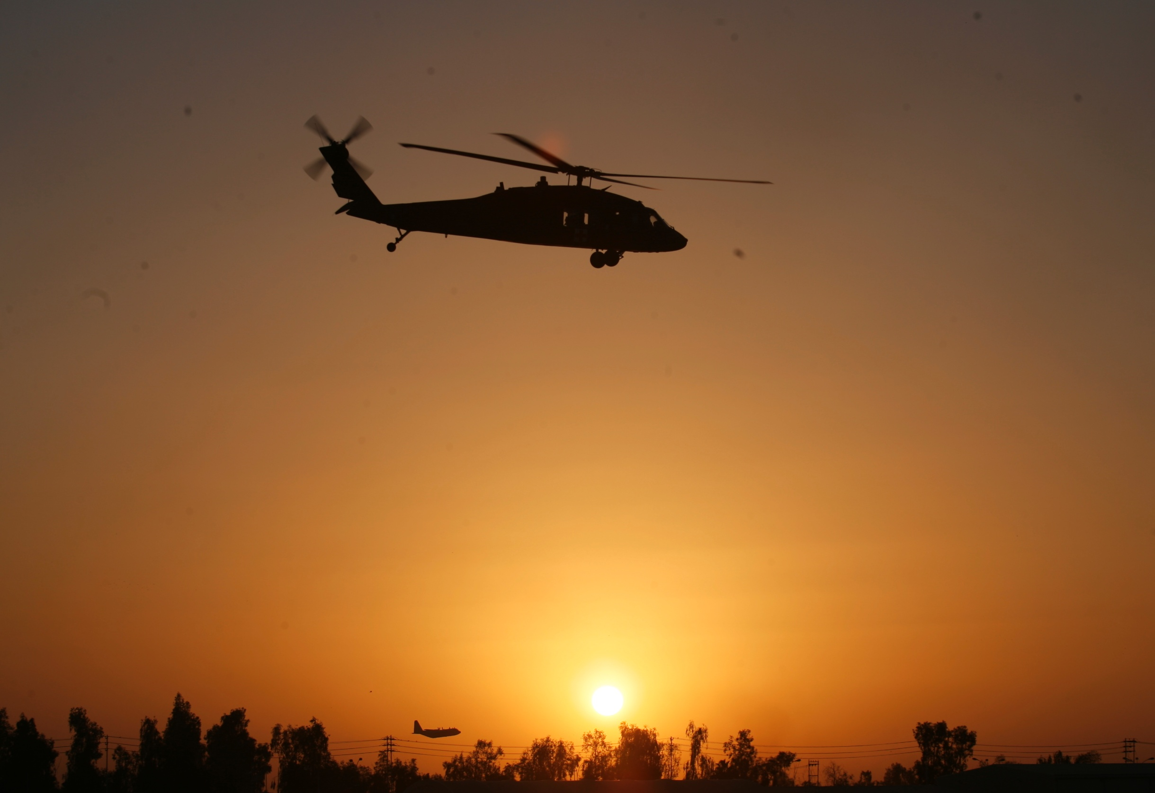
Disclaimer
“The opinions or assertions contained herein are the private views of the authors and are not to be construed as official or as reflecting the views of the Departments of the Army, Air Force, Navy or the Department of Defense.”
There are no conflict of interest disclosures.
Notes:
Read the disclaimer.

Slide 3
Learning Objectives
IDENTIFY the three objectives of TCCC.
DESCRIBE the key factors influencing combat casualty care.
IDENTIFY the evidence that documents the lifesaving impact of TCCC use.
DESCRIBE the three phases of care in TCCC.
IDENTIFY the most common causes of preventable death among combat casualties.
Notes:
Read the text.

Slide 4
TCCC
Notes:
Click on the photo to play the video.

Slide 5
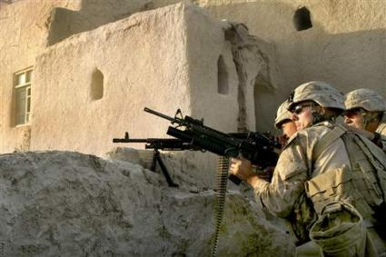
What is TCCC and Why Do I Need to Learn about it??
Military units that have trained all of their members in TCCC have documented the lowest incidence of preventable deaths among their casualties in the history of modern warfare. TCCC is now used by all services in the U.S. Military and many allied nations as well to care for their combat wounded. TCCC-based prehospital trauma training is now becoming widespread in the US civilian sector as well.
Notes:
TCCC has been remarkably successful at keeping our wounded warriors alive.
Today we are going to teach you how to do it.

Slide 6
Trauma Care: Military vs Civilian
Prehospital trauma care is very different in the military vs the civilian settings.
TCCC was developed to address these differences.
Military units that have trained all unit members in TCCC have achieved the lowest incidence of preventable combat deaths in history.
TCCC has now been made the standard for the US military and TCCC training is required for everyone in the Department of Defense.
Notes:
Read the text.

Slide 7
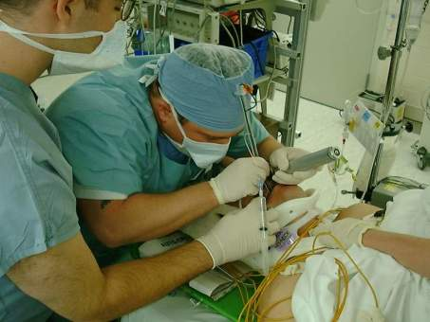
Trauma Care Setting
Notes:
If you are injured and taken to a civilian trauma center, you will be treated by a skilled team of medical professionals using the latest technology and working in a well-lighted, climate-controlled, secure area.
What about trauma that occurs in a tactical combat setting?

Slide 8
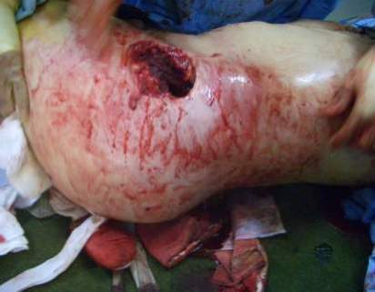
Berator
Tactical Trauma Care Setting –
Shrapnel Wound in the Hindu Kush
Notes:
This is a good example of where the combat corpsmen and medics live and practice.
This picture was taken at about 10,000 feet altitude in the Hindu Kush mountains in Afghanistan.
The wound is a shrapnel wound of the hip.
In this setting, care is much more difficult.
Common sense tells you that the management plan will need to be different here.
TCCC helps to define how it’s different.

Slide 9
Battlefield Trauma Care Prior to 9/11
Combat medical training historically was modeled on civilian courses.
Emergency Medical Technician
Advanced Trauma Life Support
The US military trained medics to the standard of care in non-tactical (civilian) settings.
Tactical factors were not considered.
Notes:
These are the training programs that are used to teach trauma care in the civilian community.
They are all EXCELLENT training programs.
However, they are designed for the civilian trauma setting - the principles they reflect often need to be modified for the tactical setting.
Emerging civilian guidelines/programs are only recently beginning to address providing care in conjunction with an ongoing threat.

Slide 10
Battlefield Trauma Care: 2001
Based on trauma courses NOT developed for combat
Medics taught NOT to use tourniquets
No hemostatic agents
No junctional tourniquets
Large volume crystalloid fluid resuscitation for shock
Civil War-vintage technology for battlefield analgesia (IM morphine)
SOF medics – IV cutdowns for difficult venous access
No tactical context for the care rendered
2 large bore IVs on all casualties with significant trauma
No focus on prevention of trauma-related coagulopathy
Heavy emphasis on endotracheal intubation
10
Notes:
Read the text.
Show of hands – how many people in the audience were trained on these concepts of care?

Slide 11
Tourniquets: The Primary Driver for TCCC
“The striking feature was to see healthy young Americans with a single injury of the distal extremity arrive at the magnificently equipped field hospital, usually within hours, but dead on arrival. In fact there were 193 deaths due to wounds of the upper and lower extremities, …… of the 2600.”
CAPT J.S. Maughon
Mil Med 1970
* Extremity hemorrhage math in Vietnam:
193 of 2600 = 7.4% x 46,233 fatalities = 3,421
preventable US deaths from extremity hemorrhage
11
11
Notes:
3,421 is a staggering number when all these deaths were potentially preventable.
How would a Medical Center react if you had a meningitis or a pyelonephritis patient come in and you didn’t get around to starting antibiotics and the patient died?

Slide 12
Different Trauma Requires Different Care Strategies
It is intuitive that combat and civilian trauma are different, BUT…
It is difficult to devise and implement needed changes.
No one group of medical professionals has all of the necessary skills and experience.
Trauma docs and combat medical personnel have different skill sets. Both are needed to optimize battlefield trauma care strategies.
Tourniquets are one striking example of how battlefield trauma care has sometimes been slow to change.
Notes:
TCCC principles are now determined by physicians and combat medical personnel working as a team.
In the past, the failure of these two groups to communicate well slowed the implementation of critical trauma care measures.
We will look at a dramatic example of this.

Slide 13
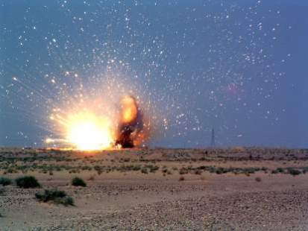
Prehospital Trauma Care: Military vs. Civilian
Hostile fire
Darkness
Environmental extremes
Different wounding
epidemiology
Limited equipment
Need for tactical maneuver
Long delays to hospital care
Different medic training and experience
Notes:
What factors must we think about when defining combat trauma care?

Slide 14
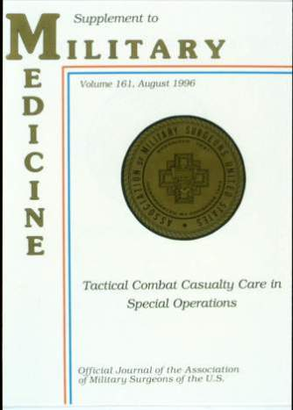
Tactical Combat Casualty Care in Special Operations
Military Medicine Supplement
August 1996
Trauma care guidelines
customized for the battlefield
Notes:
In the mid-90s, the Special Operations medical community began looking for some better answers for combat trauma and Tactical Combat Casualty Care was born. TCCC has always focused on the most common causes of preventable death on the battlefield. The common causes of preventable death from combat trauma are shown in the following slides.

Slide 15
Extremity Hemorrhage
Notes:
Here is a classic example of a preventable cause of death - arterial hemorrhage from a leg wound, in this case, a pig.
Forget about the “Golden Hour” – bleeding like this will kill you in a few minutes.
If no one controls this type of bleeding in a casualty, that casualty is going to die very quickly.
Click on the photo to play the video.

Slide 16
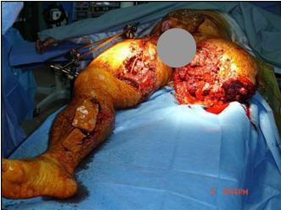
Junctional Hemorrhage
These types of wounds are often caused by IEDs and may result in junctional hemorrhage.
Notes:
Junctional hemorrhage (bleeding from wounds where the limbs or neck join the trunk) is another common cause of preventable death on the battlefield.

Slide 17
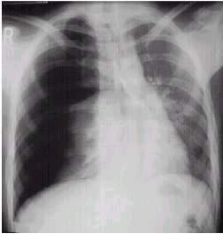
Tension Pneumothorax
Air escapes from injured lung – pressure builds
up in chest
Air pressure collapses lung
and pushes on
heart
Heart compressed - not able to pump well
Notes:
This X-ray shows a tension pneumothorax, which, in combat, is usually secondary to a penetrating injury to the chest.
This condition may be quickly fatal if not identified and treated.
Tension pneumothorax is the SECOND LEADING cause of preventable death on the battlefield after hemorrhage.

Slide 18
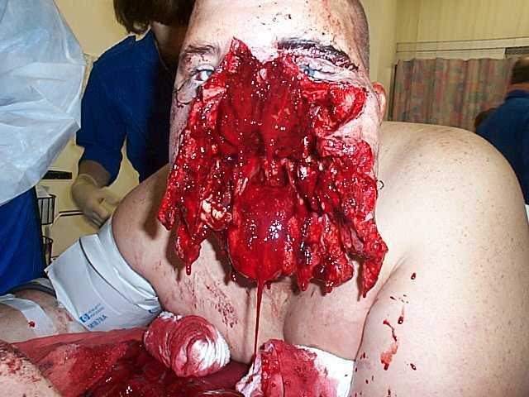
Airway Trauma
Notes:
Deaths from airway trauma are a small percentage of combat fatalities, but many of these deaths are preventable.
If the casualty is conscious, he will instinctively protect his own airway.
While this patient has a significant injury to his airway, he is able to breathe on his own reasonably well if he is sitting up and leaning forward.
This casualty survived and did well after reconstructive surgery.
Could you lay this casualty down on a litter on his back to transport him?
Probably a bad idea - all that blood and mucus would funnel right into his airway.

Slide 19
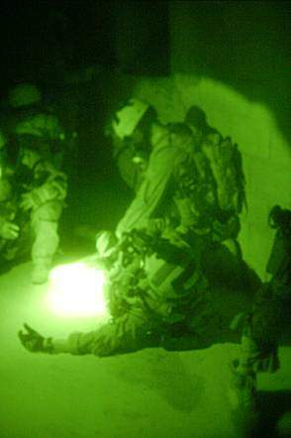
The Three Objectives of TCCC
Treat the casualty
Prevent additional casualties
Complete the mission
Notes:
The ongoing mission does not stop just because there is a casualty.
The 3 objectives of TCCC are to provide lifesaving care to the injured combatant, to limit the risk of taking further casualties, and to enable the unit to achieve mission success.

Slide 20
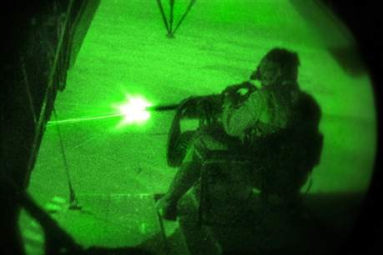
Changes in TCCC: How Are They Made?
The Committee on Tactical Combat Casualty Care
Notes:
The DoD has a group with a charter to keep the TCCC Guidelines updated.

Slide 21
Committee on Tactical Combat Casualty Care
The prehospital arm of the Joint Trauma System
42 members from all services in the DoD and civilian sector
Trauma Surgeons, Emergency Medicine, and Critical Care physicians, combatant unit physicians; medical educators; combat medics, corpsmen, and PJs
100% deployed experience as of 2018
Meet periodically; update TCCC as needed
Notes:
Read the text.
The CoTCCC continuously updates the TCCC guidelines.

Slide 22
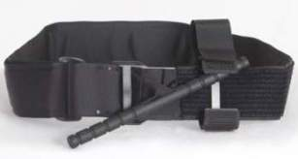
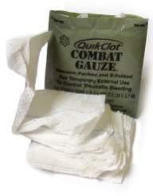
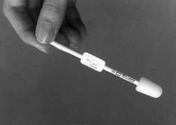
Battlefield Trauma Care Today
Phased care in TCCC
Aggressive use of tourniquets in CUF
Combat Gauze as hemostatic agent
Aggressive needle thoracostomy
Sit up and lean forward airway positioning
Surgical airways for maxillofacial trauma
Hypotensive resuscitation with blood products
IVs only when needed/IO access if required
PO meds, OTFC, ketamine as “Triple Option”
for battlefield analgesia
Hypothermia prevention; avoid NSAIDs
Battlefield antibiotics
Tranexamic acid
Junctional Tourniquets/XStat/Pelvic binding
22
Notes:
These are the advances made by the CoTCCC since it began updating the TCCC guidelines in 2001.

Slide 23
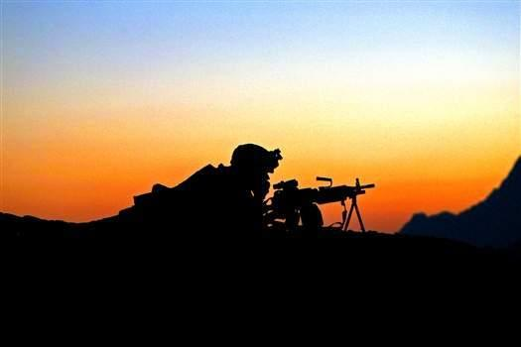
TCCC: How Do We Know That It’s Working?
Notes:
One way to assess the impact of TCCC is to examine the results attained when the guidelines are put into practice.

Slide 24
TCCC Early in the
Iraq and Afghanistan Conflicts
NOT widely used at the start of the wars
Increased use by both Special Operations and
conventional units beginning in 2005
The Drivers:
Early reports of success with TCCC, especially TQs
Holcomb study: “Causes of SOF Deaths 2001-
2004”
USAISR tourniquet study by Walters et al (2005)
USSOCOM TCCC message - March 2005
USCENTCOM tourniquet and hemostatic agents
(HemCon) message - 2005
Notes:
Even though recommended in the TCCC guidelines, there were few tourniquets on the battlefield before 2005.
Some were homemade; some were commercially manufactured.
The performance of these tourniquets was variable.
Tourniquet implementation was not gradual from the start. It happened through a series of discrete events, starting with an ISR study identifying the best tourniquets.

Slide 25
Preventable Combat Deaths from Not Using Tourniquets
Maughon – Mil Med 1970: Vietnam
193 of 2,600
7.4% of total combat fatalities
Kelly – J Trauma 2008: OEF + OIF (2003/4 and 2006)
77 of 982 (in both cohorts of fatalities)
7.8% of total fatalities – no better then Vietnam
Tourniquets became widely used in 2005-2006
Eastridge – J Trauma 2012: OEF + OIF (to Jun 2011)
119 of 4,596
2.6% of total fatalities – a 67% decrease
25
Notes:
Once limb tourniquets were broadly trained, distributed, and used, their efficacy became apparent. Before limb tourniquets were widely used on the battlefield, more than 7% of combat fatalities were due to extremity hemorrhage that could have been controlled by a tourniquet. After tourniquets became widely used on the battlefield, deaths due to extremity hemorrhage fell to 2.6%.

Slide 26
Tourniquet Outcomes in TCCC Transition Initiative Report
Sixty-seven successful tourniquet applications identified in 2005 and 2006
No avoidable loss of limbs due to tourniquet use identified
Butler, Greydanus, Holcomb
2006 USAISR Report
“TCCC: Combat Evaluation 2005”
Notes:
The USSOCOM TCCC Transition Initiative was a program that provided just-in-time TCCC training and equipage to Special Operations forces about to deploy. It included an after-action analysis of trauma care delivered during the unit’s deployment. Early indications were that limb tourniquets were effective at controlling extremity hemorrhage, and were also safe.

Slide 27
TCCC: Success in Combat 3rd Infantry Division
“The adoption and implementation of the principles of TCCC by the medical platoon of TF 1-15 IN in OIF 1 resulted in overwhelming success. Over 25 days of continuous combat with 32 friendly casualties, many of them serious, we had 0 KIAs and 0 Died From Wounds, while simultaneously caring for a significant number of Iraqi civilian and military casualties.”
CPT Michael Tarpey
Battalion Surgeon 1-15 IN
AMEDD Journal 2005
27
Notes:
Read the text.

Slide 28
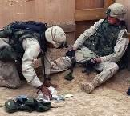
Tourniquets – Kragh et al: Two Landmark Papers
Published in 2008/2009
Tourniquets are saving lives on the battlefield
31 lives saved in 6 months by tourniquets
Author estimated 2000 lives saved with tourniquets
in this conflict up to that date (2009)
No arms or legs lost because of tourniquet use
Notes:
28
COL Kragh and his colleagues examined battlefield limb tourniquet use, and compiled the two most important tourniquet papers ever published. The most important lesson from these papers was that when a tourniquet is needed, it should be applied AS SOON AS POSSIBLE because survival is improved when hemorrhagic shock is prevented.
NOBODY is arguing about whether tourniquets save lives any more.

Slide 29
Eliminating Preventable Death on the Battlefield
TCCC in the 75th Ranger Regiment
All Rangers and docs trained in TCCC
Ranger preventable death incidence: 3%
Overall U.S. military preventable deaths: 24%
Notes:
The Army Rangers have achieved the lowest preventable death rate ever reported in a major conflict. They did it by training everyone in TCCC, not just their medics. Their success in eliminating preventable combat deaths is remarkable.

Slide 30
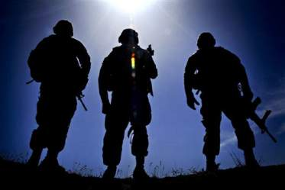
What Do the Soldiers Say?
A recent U.S. Army Training and Doctrine Command survey of Soldiers in combat units found that TCCC is the second most valued element of their training, exceeded only by training in the use of their individual weapons.
COL Karen O’Brien
TRADOC Surgeon
CoTCCC Meeting April 2010
Notes:
Medics and doctors are not the only ones who appreciate the life-saving potential of TCCC practiced by every member of the unit. Non-medical combatants trained in TCCC recognize the possibility that it may enable them to save their own lives or the lives of their wounded teammates.

Slide 31
TCCC in Canadian Forces Savage et al: Can J Surg 2011
Conclusion:
“For the first time in decades, the CF has been involved in a war in which its members have participated in sustained combat operations and have suffered increasingly severe injuries. Despite this, the CF experienced the highest casualty survival rate in history. Though this success is multifactorial, the determination and resolve of CF leadership to develop and deliver comprehensive, multileveled TCCC packages to soldiers and medics is a significant reason for that and has unquestionably saved the lives of Canadian, Coalition and Afghan Security Forces…..”
Notes:
Canadian Forces also train medics and non-medics in TCCC. Savage and others reporting on the implementation of TCCC in the Canadian Forces gave much of the credit for the highest casualty survival rate in their history to TCCC training.

Slide 32
Limb Tourniquets in the U.S. Military
In 2001, almost nobody in the U.S. Military had a tourniquet.
In 2018, thanks to TCCC, no American Soldier, Sailor, Airman, or Marine goes onto the battlefield without a tourniquet.
Notes:
Because limb tourniquets have been so effective at controlling extremity hemorrhage, and because they have proven safe when properly applied and monitored, they have become standard battlefield issue.

Slide 33
Hartford Consensus 2 April 2013
Working group organized by American College of Surgeons Board of Regents and FBI
In response to Sandy Hook shootings
Excerpt from findings:
Notes:
Read the text.
The life-saving lessons learned from TCCC are being adopted into civilian trauma care.

Slide 34
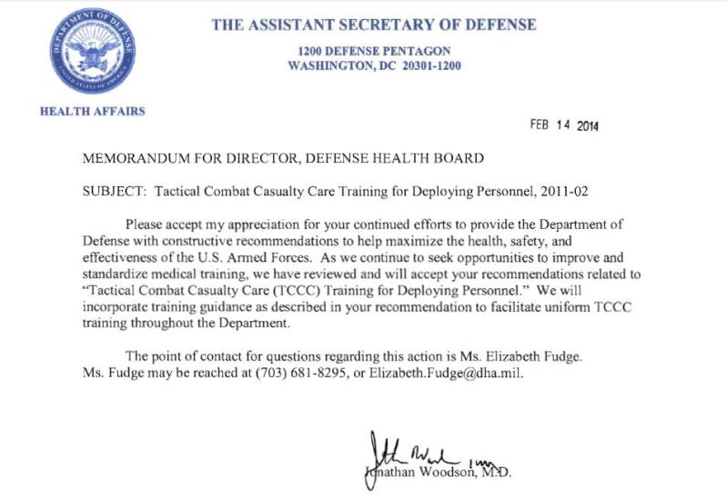
ASDHA TCCC Letter 14 February 2014
Notes:
In February 2014 the Assistant Secretary of Defense for Health Affairs gave notice that uniform TCCC training would be directed throughout the Department.
Tactical Combat Casualty Care (TCCC)

Slide 35
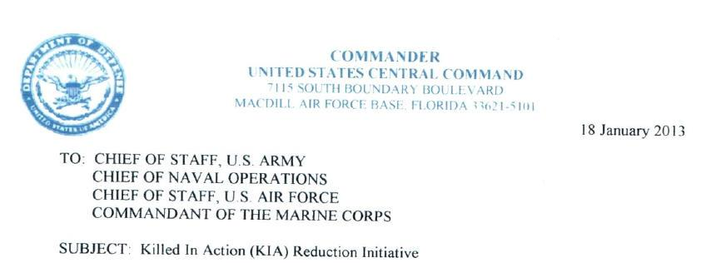
Secretary of Defense James Mattis
General Mattis letter to Service Chiefs
Written during his time as CENTOM Commander
Highlights Ranger success with TCCC
Stresses importance of TCCC training
35
Notes:
When Secretary Mattis was CENTCOM Commander, be recognized that TCCC as practiced by the Rangers saves lives….

Slide 36
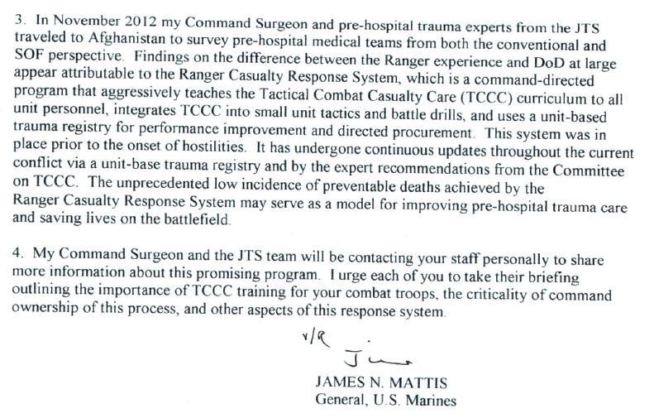
Secretary of Defense James Mattis
36
Notes:
…. and supported its adoption.

Slide 37
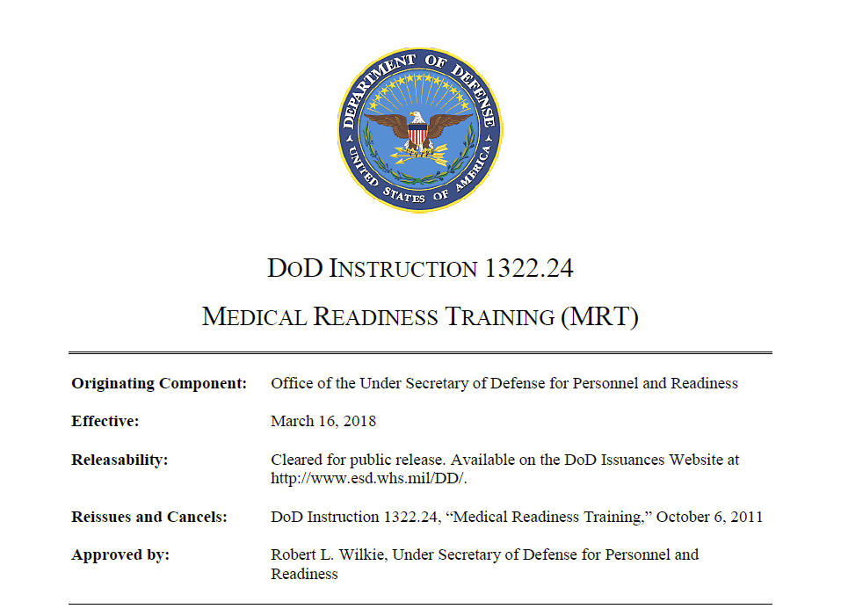
DOD Instruction on Medical Readiness Training
16 March 2018
Notes:
On 16 March 2018, DoD Instruction 1322.24 was officially published.
Tactical Combat Casualty Care (TCCC)

Slide 38
DOD Instruction on Medical Readiness Training
Section 2.a.b Policy
“TCCC is the DoD standard of care for first
responders (medical and non-medical) …..All
Service members receive role based TCCC training
and certification in accordance with the skill level
(i.e., All Service Members, Combat Lifesaver,
Combat Medic/Corpsmen, and Combat
Paramedic/Provider) outlined by the Joint Trauma
System, the DoD’s Center of Excellence for trauma
as designated in DoD Instruction (DoDI) 6040.47.
Thanks to: Mr. Ed Whitt, Ms. Elizabeth Fudge,
Mr. Kevin Kelley, CDR Tara Cozzarelli
Notes:
This instruction:
1) Makes TCCC the standard for battlefield trauma care in the US military
2) Mandates that everyone in the US military be trained in TCCC at his or her appropriate level
(All Service Member, Combatant, Combat Lifesaver, Medical Personnel)
Tactical Combat Casualty Care (TCCC)

Slide 39
Summary of Key Points
Prehospital trauma care in tactical settings is very different from civilian settings.
Tactical and environmental factors have a profound impact on trauma care rendered on the battlefield.
Good medicine can be bad tactics.
Up to 24% of combat deaths today are potentially preventable.
Good first responder care is critical.
TCCC will give you the tools you need!
Notes:
TCCC is different from civilian trauma care training you may have received in the past.
This improvement in how we approach the combat casualty has resulted in significantly lower death rates in combat.
Good battlefield care is paramount in avoiding preventable deaths.

Slide 40
Summary of Key Points
Three phases of care in TCCC
Care Under Fire
Tactical Field Care
TACEVAC Care
Notes:
Care Under Fire is the very limited care that can be provided while the casualty and the provider are under effective enemy fire.
Tactical Field Care is performed on the battlefield, but not under effective enemy fire.
TACEVAC Care is rendered during transport off the battlefield on the way to more definitive care.

Slide 41
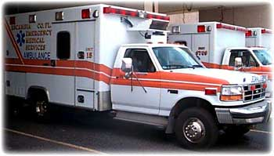
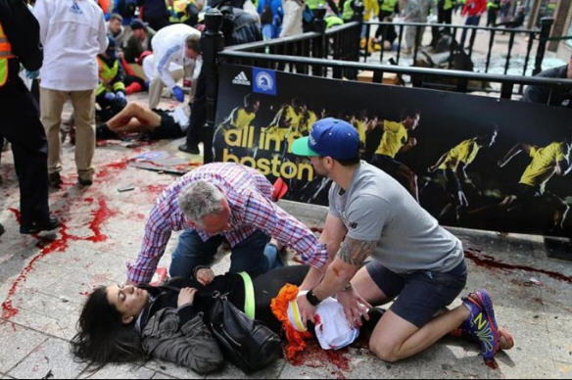
Summary of Key Points
TCCC was designed for combat.
BUT many of these concepts have excellent applicability in civilian prehospital settings, too.
Notes:
TCCC is NOT necessarily the standard of care in civilian prehospital settings.
For those of you who practice in civilian EMS settings, you should follow the guidance established by your Emergency Medical Services Director.

Slide 42
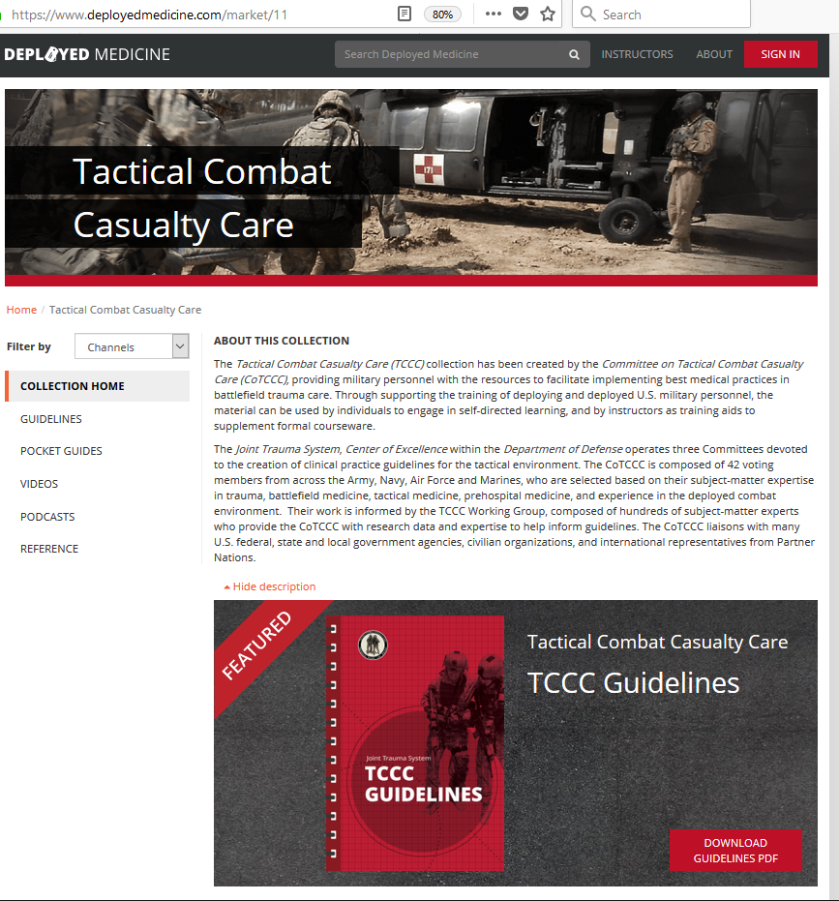
Official TCCC Education Website
www.deployedmedicine.com
Current Guidelines
Videos
Podcasts
Reference Material
Study Guides
TCCC Updates
Coming Soon:
Scenarios
Quizzing
Checklists
Instructor Materials
Notes:
Deployed Medicine is the official website to get the most up-to-date TCCC materials.
Deployed Medicine is a platform used by the Defense Health Agency to trial new, innovative learning models aimed at improving readiness and performance of deployed military medical personnel.
Even though it is a .com website, it is an official site owned and managed by the Department of Defense.
You can view the updated guidelines, educational and procedural videos and TCCC reference material.

Slide 43
TCCC Mobile App “Deployed Medicine”
https://itunes.apple.com/us/app/deployed-medicine/id1203051672?mt=8
https://play.google.com/store/apps/details?id=com.allogy.deployedmedicine
Current Guidelines
Videos
Podcasts
Reference Material
Study Guides
TCCC Updates
Notes:
The Deployed Medicine website is synchronized with a mobile app you can download to smartphones or tablets. The same material is available on both the website and the app.
You can watch the TCCC How-To videos or listen to the latest TCCC podcast. You will also be able to receive notifications of significant TCCC updates or availability of new training material.

Slide 44
TCCC in Social Media
@CommitteeonTCCC
tc3committee
@CoTCCC
Channel Name: CoTCCC Committee-on-TCCC
https://www.linkedin.com/company/jointtraumasystem
Join the LinkedIn Discussion Groups:
TCCC (https://www.linkedin.com/groups/12036508)
Notes:
TCCC is active in social media. All major TCCC announcements, like guideline updates or a new video release, are broadcast on our social media platforms.
Follow us on Facebook, Twitter, or Instagram. The TCCC training videos are also available on the TCCC YouTube channel and you can join TCCC discussions on LinkedIn.
Beware of fake or alternative social sites. These are the ONLY official TCCC social media sites.

Slide 45
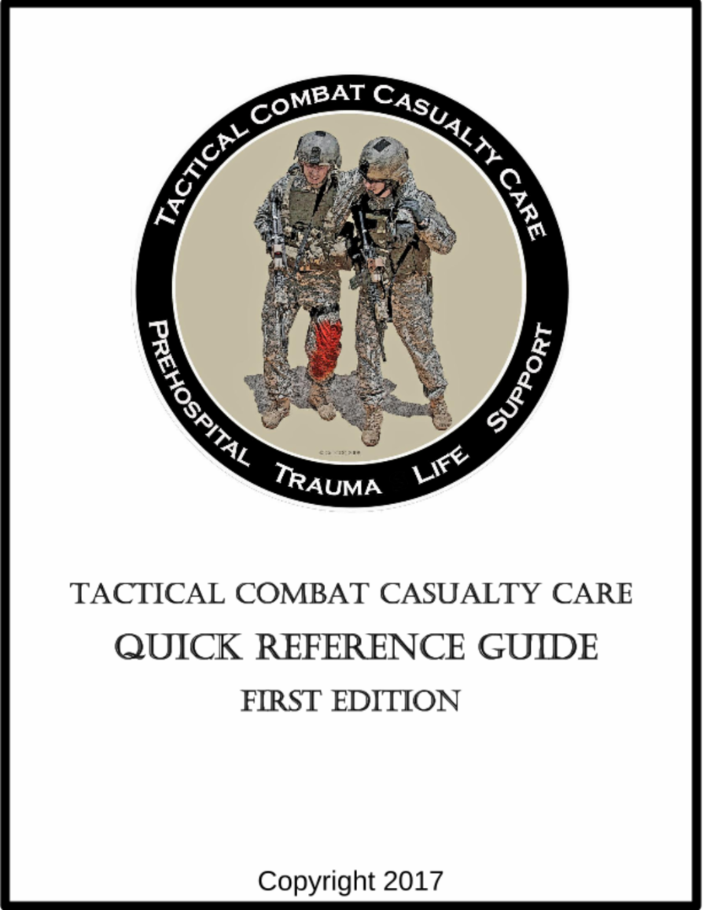
TCCC Quick Reference Guide
Download an authorized copy of the Tactical Combat Casualty Care (TCCC) Quick Reference Guide
Current abbreviated guidelines
TCCC algorithms
Pharmacology references
Planning considerations.
Download At:
https://www.deployedmedicine.com/market/11/content/87
Notes:
You can also download a copy of the TCCC Quick Reference Guide. The QRG has various versions of the TCCC guidelines including an abbreviated version and a TCCC algorithm for easy reference and learning of appropriate TCCC-based decision making.
This item is copyrighted but you have permission to download and print it or use it on a smartphone or tablet.

Slide 46
TCCC Engagement
Provide TCCC feedback
Ask a TCCC question
Get on the TCCC Distribution List
usarmy.jbsa.medcom-aisr.mbx.jts-cotccc@mail.mil
Notes:
You can engage with the TCCC staff and the Committee on Tactical Combat Casualty Care (CoTCCC). Make a suggestion, submit an idea, ask a question, or get on the TCCC e-mail distribution list.

Slide 47
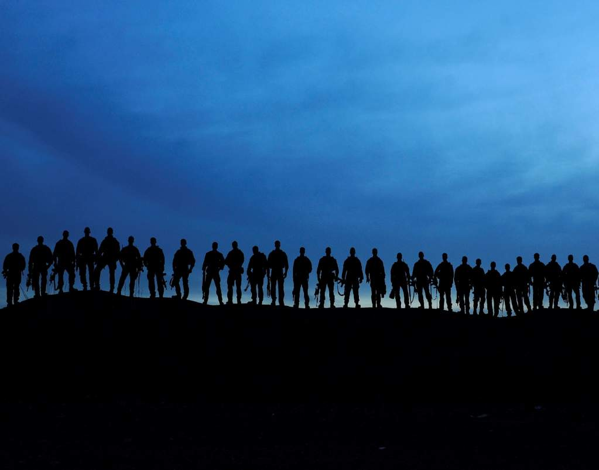
Questions?
Photo courtesy MSG (Ret) Harold Montgomery
75th Ranger Regiment

