Slide 1
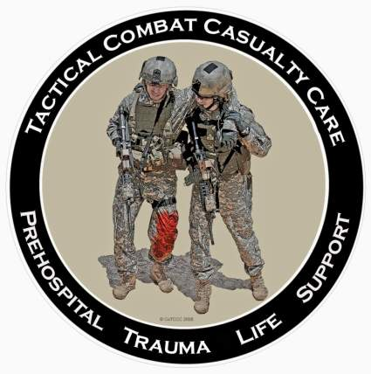
Tactical Combat Casualty Care for Medical Personnel August 2018 (Based on TCCC-MP Guidelines 180801)
Care Under Fire
Notes:
The first phase of TCCC is Care Under Fire.

Slide 2
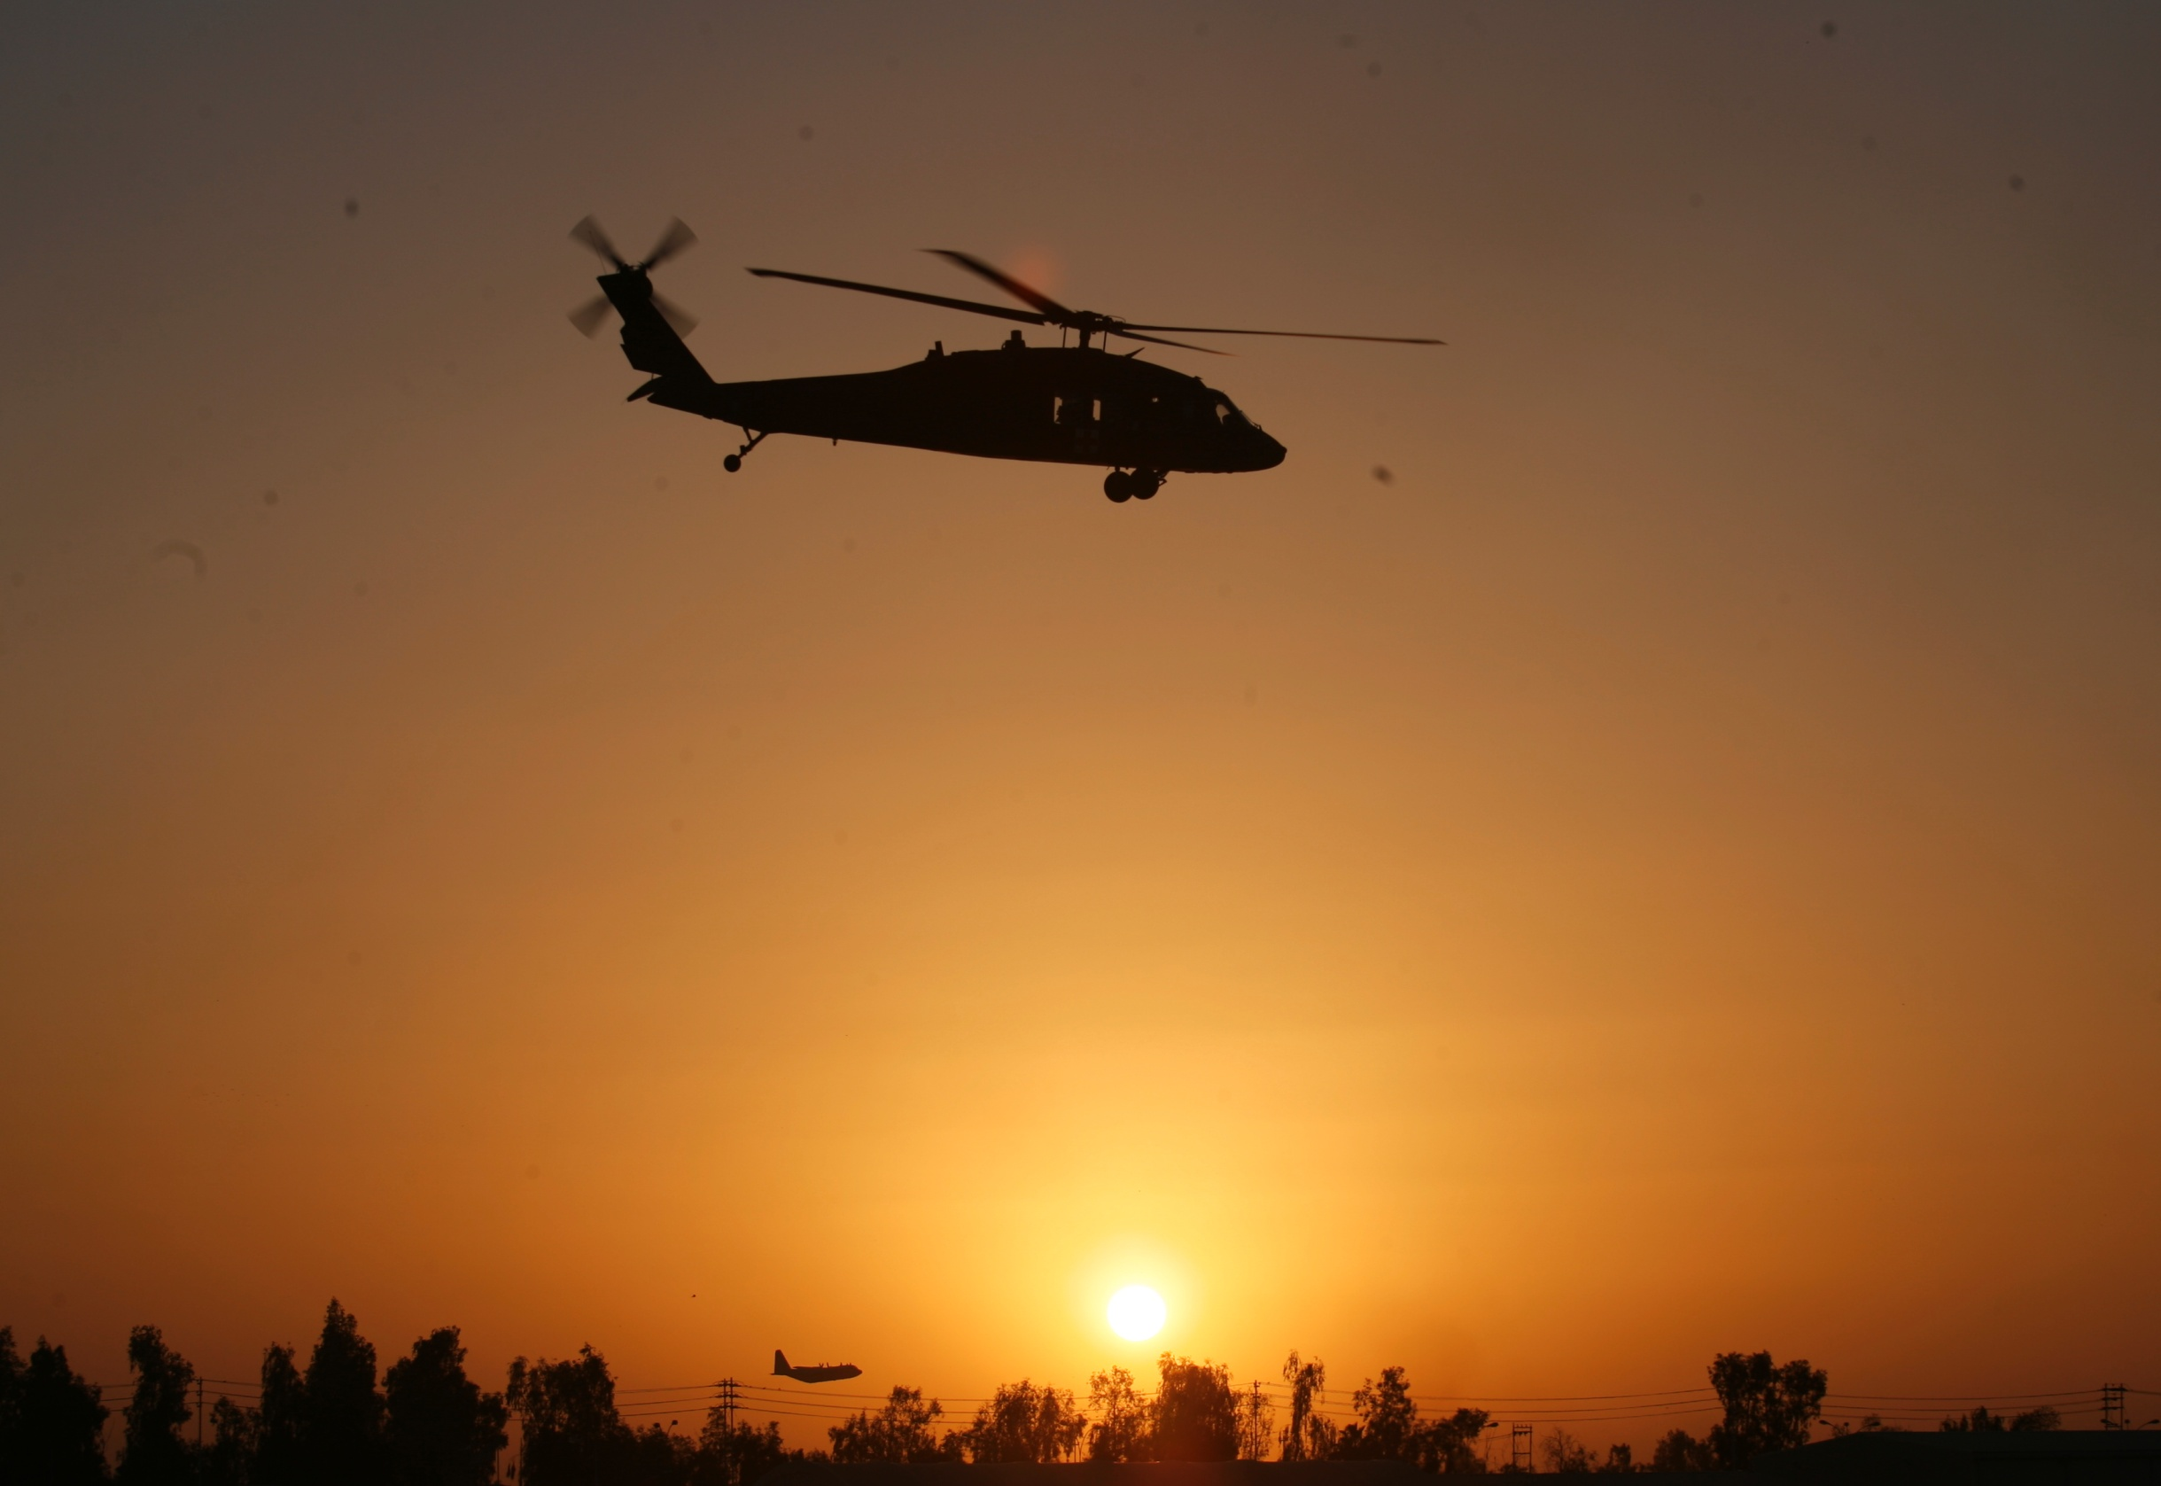
Disclaimer
“The opinions or assertions contained herein are the private views of the authors and are not to be construed as official or as reflecting the views of the Departments of the Army, Air Force, Navy or the Department of Defense.”
There are no conflict of interest disclosures
Notes:
Read the text.

Slide 3
Learning Objectives
DESCRIBE the role of firepower supremacy in the prevention of combat trauma.
IDENTIFY actions appropriate in caring for casualties in the Care Under Fire phase.
DEMONSTRATE techniques that can be used to quickly move casualties to cover while the unit is engaged in a firefight.
EXPLAIN the rationale for early use of a limb tourniquet to control life-threatening extremity bleeding during Care Under Fire.
Notes:
Read the text.

Slide 4
Learning Objectives
RECOGNIZE life-threatening bleeding in the tactical combat setting.
DEMONSTRATE the appropriate application of a CoTCCC-recommended limb tourniquet to an arm and a leg.
EXPLAIN why immobilization of the cervical spine is not a critical need in combat casualties with penetrating trauma to the neck.
DESCRIBE why spinal immobilization is not a
critical need in combat casualties with only
penetrating trauma.
Notes:
Read the text.

Slide 5
Care Under Fire Guidelines
1. Return fire and take cover.
2. Direct or expect casualty to remain engaged as a combatant if appropriate.
3. Direct casualty to move to cover and apply self-aid if able.
4. Try to keep the casualty from sustaining additional wounds.
Notes:
Read the guidelines.

Slide 6
Care Under Fire Guidelines
5. Casualties should be extricated from burning vehicles or buildings and moved to relative safety. Do what is necessary to stop the burning process.
6. Stop life-threatening external hemorrhage if tactically
feasible:
a. Direct casualty to control hemorrhage by self-aid if able.
b. Use a CoTCCC-recommended limb tourniquet for hemorrhage that is anatomically amenable to tourniquet use.
c. Apply the limb tourniquet over the uniform clearly proximal to the bleeding site(s). If the site of the life-threatening bleeding is not readily apparent, place the tourniquet “high and tight” (as proximal as possible) on the injured limb and move the casualty to cover.
Notes:
Read the guidelines.

Slide 7
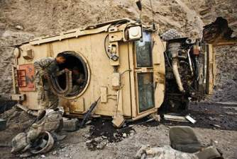
Care Under Fire Guidelines
7. Airway management is generally best deferred until the Tactical Field Care phase.
Notes:
Care Under fire
7/24/2018
DRAFT
7
Read the guideline.

Slide 8
Care Under Fire
Prosecuting the mission and caring for the casualties may be in direct conflict.
What’s best for the casualty may NOT be what’s best for the mission.
When there is conflict, which takes precedence?
Scenario dependent
Consider the following example:
Notes:
In the hospital, the casualty IS the mission.
In TCCC, you have the casualty AND the mission.

Slide 9
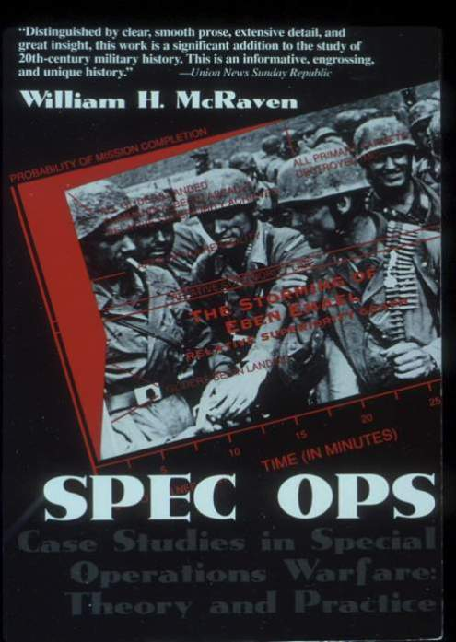
Notes:
Let’s examine a scenario from this book by ADM McRaven. The scenarios in this book are all Special Ops, but the PRINCIPLES discussed apply to all combat units.

Slide 10
Raid on Entebbe by ADM Bill McRaven
27 June 1976
Air France Flight 139 hijacked
Flown to Entebbe (Uganda)
106 hostages held in Old Terminal at airport
7 terrorists guarding hostages
100 Ugandan troops perimeter security
Israeli commando rescue planned
Notes:
This is one of the most famous hostage situations in history.
Background information for Instructors (excerpt from Wikipedia): Operation Thunderbolt was a counter-terrorist hostage-rescue mission carried out by the Special Forces of the Israel Defense Forces (IDF) at Entebbe Airport in Uganda on 4 July 1976. A week earlier, on 27 June, an Air France plane with 248 passengers was hijacked by Palestinian and German terrorists and flown to Entebbe, near Kampala, the capital of Uganda. Shortly after landing, all non-Israeli passengers, except one French citizen, were released. The IDF acted on intelligence provided by the Israeli intelligence agency Mossad. In the wake of the hijacking by members of the militant organizations Revolutionary Cells and the Popular Front for the Liberation of Palestine, along with the hijackers' threats to kill the hostages if their prisoner release demands were not met, the rescue operation was planned. These plans included preparation for armed resistance from Ugandan military troops. The operation took place at night, as Israeli transport planes carried 100 commandos over 2,500 miles (4,000 km) to Uganda for the rescue operation. The operation, which took a week of planning, lasted 90 minutes and 102 hostages were rescued. Five Israeli commandos were wounded and one, the commander, Lt. Col. Yonatan Netanyahu, was killed. All the hijackers, three hostages and 45 Ugandan soldiers were killed, and thirty Soviet-built MiG-17s and MiG-21s of Uganda's air force were destroyed. A fourth hostage was killed by Ugandan army officers at a nearby hospital. The rescue, named Operation Thunderbolt, is sometimes referred to retroactively as Operation Jonathan in memory of the unit's leader, Yonatan Netanyahu. He was the older brother of Benjamin Netanyahu, who served as the two-time Prime Minister of Israel from 1996 to 1999 and from 2009- the present. The operation is widely considered one of the greatest and daring special forces operations in history considering the high-risk nature of the commando raid, distance from home territory, and casualty and hostage rescue ratio.

Slide 11
Raid on Entebbe by ADM Bill McRaven
Rescue 4 July 1976
Exit from C-130 in a Mercedes and 2 Land Rovers to mimic the mode of travel of Idi Amin – the Ugandan dictator at the time.
Israeli commandos were dressed as Ugandan soldiers.
Drove up to the terminal - shot the Ugandan sentry.
Assaulted the terminal through 3 doors.
Notes:
The tactics used were ingenious: DECEPTION, SURPRISE, and VIOLENCE.

Slide 12
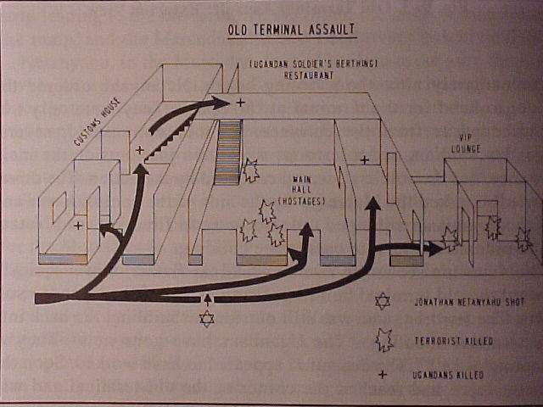
Notes:
Here’s what the layout looked like.
Black arrows show the entry paths of the Israeli commandos.

Slide 13
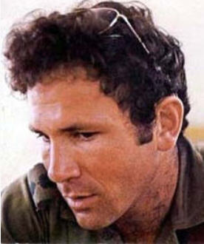
Raid on Entebbe ADM Bill McRaven
LTC Yoni Netanyahu – the
ground commander – shot
in the chest at the beginning
of the assault
What should the medic do?
Disengage from the assault?
Start an IV?
Immediate needle decompression of chest?
Notes:
Imagine YOU are the combat medic on this operation.
What would you do now?
(Ask several people in the audience what THEY would do.)
Note that LTC Netanyahu was the brother of the future Prime Minister of Israel.

Slide 14
Raid on Entebbe by ADM Bill McRaven
“As previously ordered, the three assault elements disregarded Netanyahu and stormed the building.”
“At this point in the operation, there wasn’t time to attend to the wounded.”
Notes:
NO medical care was rendered at this point.
Israeli commandoes had to establish control of the tactical situation first.

Slide 15
Do seconds really matter in combat?
Notes:
LTC Netanyahu died from his wounds.
The assault phase of the operation took 90 seconds.
Did the 90-second treatment delay affect his chances of survival? Probably not.
Would a 90-second delay in continuing the assault phase of the operation have made a difference? Absolutely.

Slide 16
Ma’a lot Rescue Attempt by ADM Bill McRaven
15 May 1974
3 PLO terrorists take 105 hostages
Schoolchildren and teachers
When assault commenced, terrorists began killing hostages
22 children killed, 56 wounded
The difference between a dramatic success and a disaster may be measured in seconds.
Notes:
Look what even a momentary delay can mean to a hostage rescue operation OR OTHER TACTICAL ENGAGEMENT.
Background information for Instructors (Excerpt from Wikipedia article “Ma’a lot Massacre”): The Ma'alot massacre was a terrorist attack which included a two-day hostage-taking of 115 people which ended in the deaths of over 25 hostages. It began when three armed Palestinian terrorists of the Democratic Front for the Liberation of Palestine entered Israel from Lebanon. Soon afterwards they attacked a van, killing two Israeli Arab women and entered an apartment building in the town of Ma'alot, where they killed a couple and their four-year-old son. From there, they headed for the Netiv Meir elementary school, where they took more than 115 people (including 105 children) hostage on 15 May 1974, in Ma'alot. The hostage-takers soon issued demands for the release of 23 Palestinian militants from Israeli prisons, or else they would kill the students. On the second day of the standoff, a unit of the Golani Brigade stormed the building. During the takeover, the hostage-takers killed the children with grenades and automatic weapons. Ultimately, 25 hostages, including 22 children, were killed and 68 more were injured.

Slide 17
Recent Feedback from a TCCC Student
“I have never even heard of the Raid on Entebbe. Why do we need to learn about military history?”
Notes:
Read the text.

Slide 18
History’s Lesson
There are only two times that you can plan for what to do in a tactical casualty situation
Before it happens
OR…
After it happens
Notes:
It’s better to be prepared ahead of time, and we do that by studying lessons we have learned in the past.

Slide 19
SEAL Hostage Rescue Mission – Afghanistan 2012
Quick-reaction hostage rescue
Helicopter insert
4-hour patrol to target
Point man shot in the head on building entry
Do you stop and treat the casualty?
Or do you rescue the hostage and neutralize the terrorists first?
Notes:
Read the text.
The questions in the last two bullets here is better decided BEFORE the op than in the after-action analysis.

Slide 20
SEAL Hostage Rescue – Afghanistan 2012
Second assaulter killed one hostile
Secured the hostage (an American physician)
Held a second hostile by the throat until he could be neutralized by another team member
Room cleared - hostage passed off
THEN the second assaulter, a corpsman, began to treat the casualty
Notes:
Read the text.
This is Care Under Fire. The second assaulter knew to address the tactical situation first, and then see to the casualty.

Slide 21
SCPO Ed Byers – The Second Assaulter
Notes:
The second assaulter in this real-life scenario was SCPO Ed Byers. He was awarded the Congressional Medal of Honor for his actions.

Slide 22
The Tactical Imperative:
Senior SOF Leader Quote
“I watched with tremendous pain as the (nation
redacted) failed in a mission because they stopped
mid-assault to care for one of their wounded.
It ended up costing them three more lives and
a failed rescue attempt. We should never forget
that you have to secure the target quickly so you
don't lose more lives and you can then save the
ones that are injured.”
Notes:
Read the text.

Slide 23
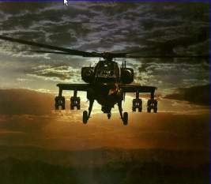
Care Under Fire
If the firefight is ongoing - don’t try to treat your casualty in the Kill Zone!
Suppression of enemy fire and moving casualties to cover are the major concerns.
Notes:
Not every casualty scenario is a hostage rescue, but these basic principles apply.
It is imperative to get your casualty “Off the X” and behind cover if you can.

Slide 24
Care Under Fire
Suppression of hostile fire will minimize the risk of both new casualties and additional injuries to the existing casualties.
The firepower contributed by medical personnel and the casualties themselves may be essential to tactical fire superiority.
The best medicine on the battlefield is Fire Superiority.
Notes:
Sustaining a minor wound in a firefight does not mean that you should disengage from the fight.

Slide 25
Moving Casualties in CUF
If a casualty is able to move to cover, he should do so to avoid exposing others to enemy fire.
If casualty is unable to move and unresponsive, the casualty is likely beyond help and moving him while under fire may not be worth the risk.
If a casualty is responsive but can’t move, a rescue plan should be devised if tactically feasible.
The next sequence of slides shows the hazards of moving casualties before hostile fire is suppressed.
Notes:
Unit members should be TRAINED to move themselves to the point of first cover if able.
Don’t put two people at risk if it can be avoided.

Slide 26
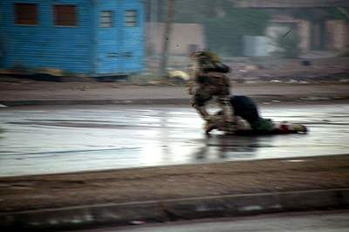
1) While under fire and without a weapon, Gunnery Sgt. Ryan P. Shane runs to Sgt. Lonnie Wells, to pull him to safety during USMC combat operations in Fallujah.
Notes:
Here is a dramatic example of casualty movement during Care Under Fire. SGT Wells had sustained a fatal gunshot through his leg, which severed his femoral artery. From the moment he was hit, he was unable to conduct self aid and did not respond to calls from his fellow Marines.

Slide 27
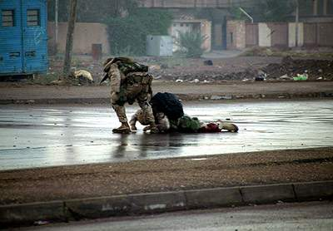
2) Gunnery Sgt Shane attempts to pull a fatally wounded Sgt Wells to cover.
Notes:
Read the text.

Slide 28
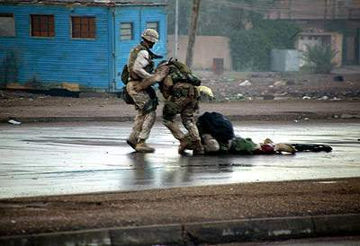
3) Another man comes to help.
Notes:
The third man on the left is Hospital Corpsman Joel Lambott, the platoon’s Corpsman.

Slide 29
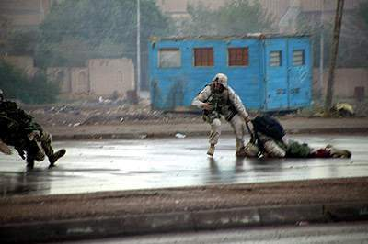
4) Gunnery Sgt. Shane (left) is hit by enemy fire.
Notes:
Read the text.

Slide 30
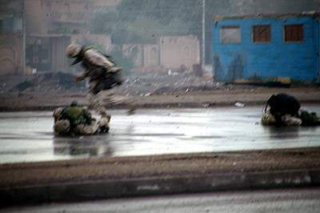
5) Gunnery Sgt Shane, on ground at left, was hit by insurgent sniper fire.
Notes:
HM Lambott was struck in the heel just after GySgt Shane was injured. He provided life-saving care to GySgt Shane, directed his evacuation, and dressed his own injury. He stayed with the platoon and continued his duties during the operation. In this rescue attempt, the fate of the first casualty was unchanged and two additional casualties were sustained because effective enemy fire was not suppressed.

Slide 31
Casualty Movement Rescue Plan
If you must move a casualty under fire, consider the following:
Location of nearest cover
How best to move him to the cover
The risk to the rescuers
Weight of casualty and rescuer
Distance to be covered
Use suppression fire and smoke to best advantage!
Recover casualty’s weapons if possible
Notes:
DON”T FORGET COVERING FIRE!
If possible, let the casualty know what you plan.
Consider directing available vehicles to move into a position to provide cover.

Slide 32
C-Spine Stabilization
Penetrating head and neck injuries do not require C-spine stabilization
Gunshot wounds (GSW), shrapnel
In penetrating trauma, the spinal cord is either already compromised or is in relatively less danger than would be the case with blunt trauma.
Notes:
In studies from the Vietnam conflict, of those casualties with penetrating neck trauma, only 1.4% would have benefited from C-spine stabilization.
C-spine stabilization takes 5-6 minutes even for experienced medical providers.
This is too much time to spend in Care Under Fire on an intervention that is not proven to be necessary.

Slide 33
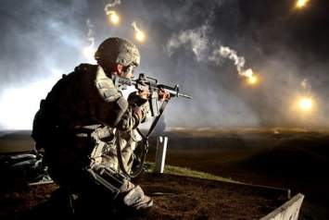
C-Spine Stabilization
Blunt trauma is different!
Neck or spine injuries due to falls, fast-roping injuries, or motor vehicle accidents may require C-spine stabilization.
Apply only if the danger of hostile fire does not constitute a greater threat.
Notes:
Do not provide C-spine stabilization if the danger of hostile fire constitutes a greater threat in the judgment of the medic.

Slide 34
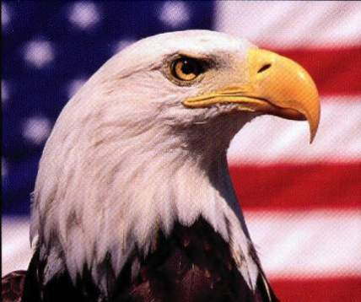
Types of Carries for Care Under Fire
One-person drag with/without a line
Two-person drag with/without a line
SEAL Team Three Carry
Hawes Carry
Notes:
Read the text.

Slide 35
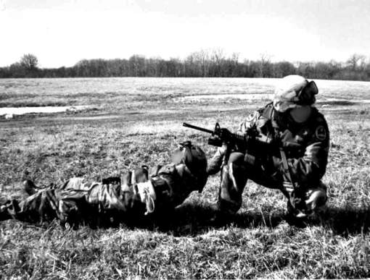
One-Person Drag
Notes:
Advantages: No equipment required
Only one rescuer exposed to fire
Disadvantages: Relatively slow
Not optimal body position for dragging the casualty
(Have other Instructors or students demonstrate)

Slide 36
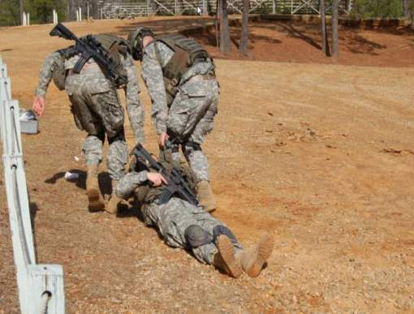
Two-Person Drag
Notes:
Advantage : Gets casualty to cover faster than with one-person drag
Disadvantage: Exposes two rescuers to hostile fire instead of one
(Have other Instructors or students demonstrate)
Care Under fire
7/24/2018
DRAFT
36

Slide 37
Video: Two-Person Drag
Courtesy 75th Ranger Regiment
Notes:
Click on the photo to play the video.
Care Under fire
7/24/2018
DRAFT
37

Slide 38
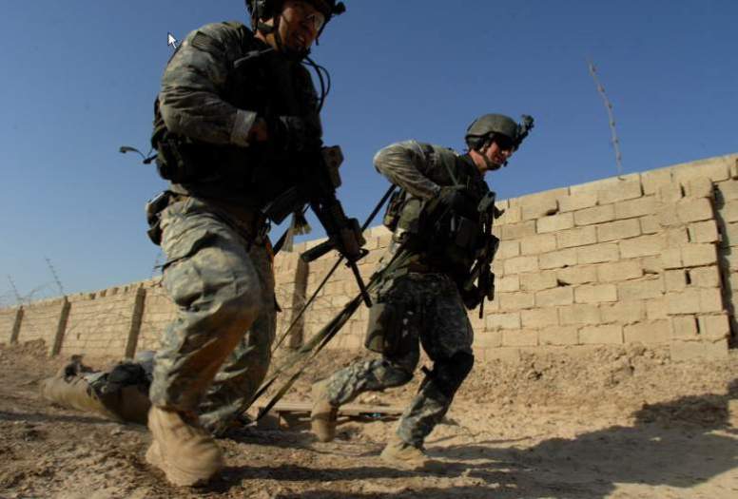
Two-Person Drag Using Lines
Notes:
Advantages: Can shoot while dragging
Faster than dragging without lines
Faster movement of the casualty to cover
Disadvantage: Exposes two rescuers to hostile fire instead of one
Care Under fire
7/24/2018
DRAFT
38

Slide 39
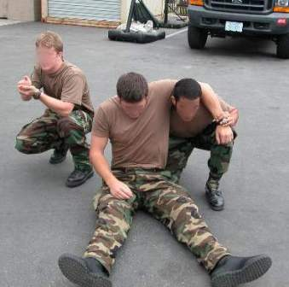
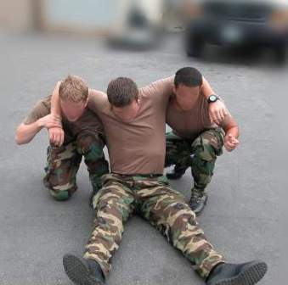
SEAL Team Three Carry (1)
Also called the Shoulder-Belt carry.
Notes:
Advantages: May be useful in situations where drags do not work well
Less painful for casualty than dragging
Disadvantages: Exposes two rescuers to hostile fire
May be slower than dragging
May be difficult in kit and with an unconscious casualty
Care Under fire
7/24/2018
DRAFT
39

Slide 40
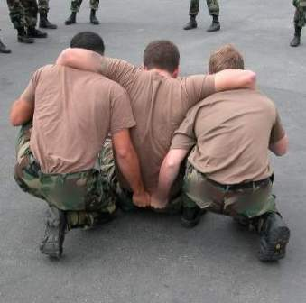
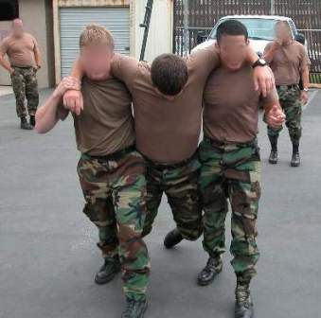
SEAL Team Three Carry (2)
Also called the Shoulder-Belt carry.
Notes:
The casualty’s arms are wrapped around the shoulders of both rescuers.
The casualty holds onto the rescuers if he’s able to.
The rescuers will have to hold the casualty’s arms around their necks if the casualty can’t.
Both rescuers grab the casualty’s web belt in back.
Lift and go.

Slide 41
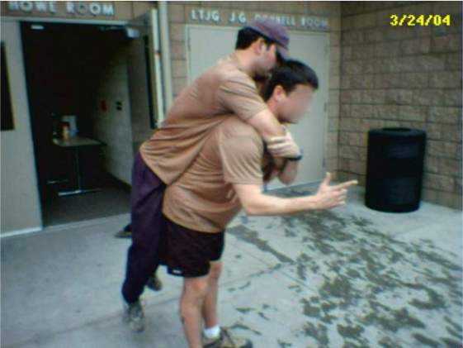
Hawes Carry
Also called the Modified Firemen’s carry
or Pack Strap Carry.
Notes:
Technique: The rescuer squats; the casualty’s arms are wrapped around the rescuer’s neck and the rescuer holds one arm locked down under the other; the rescuer lifts with his legs.
Advantages: Only one rescuer is exposed to hostile fire.
May be useful in situations where a drag is not a good option.
Works much better than the fireman’s carry.
Disadvantages: Hard to accomplish with rescuer’s or casualty’s kit in place.
Difficult when the rescuer is small and the casualty is large.
Often slower than dragging.
High profile for both rescuer and casualty.

Slide 42
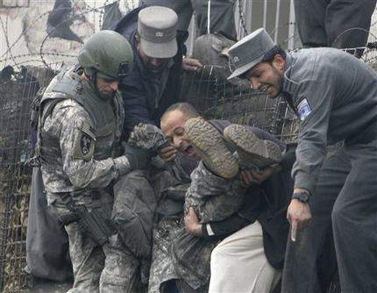
Carries - Practical
How Not to Do It
Notes:
This is a good example of how NOT to carry your casualty.
For practical exercise: Break up into groups of 6 or fewer students per instructor.
Practice all the carries covered.
Care Under fire
7/24/2018
DRAFT
42

Slide 43
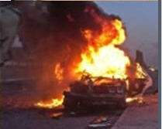
Burn Prevention in CUF
Remove the casualty from burning vehicles or structures ASAP and move to cover.
Stop burning with any non-flammable fluids readily accessible, by smothering, or by rolling on the ground.
Notes:
Care Under fire
7/24/2018
DRAFT
43
If flammable liquids like petroleum products cause a fire on the casualty’s clothing that you can’t put out, then you’ll have to cut the burning garments off.

Slide 44
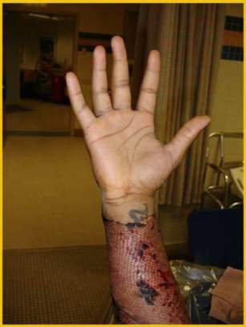
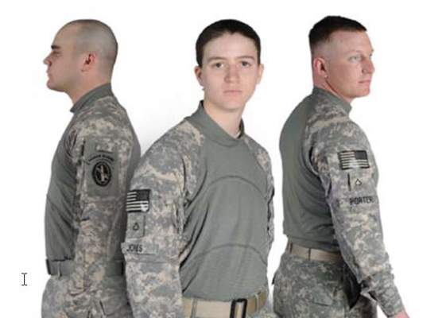
Burn Prevention in CUF
Wear fire-retardant Nomex gloves and uniform!
Right hand of a burn casualty
spared by fire-resistant glove
Fire-Resistant Army Combat Shirt
Notes:
Care Under fire
7/24/2018
DRAFT
44
Flame-resistant clothing can protect you from burn injuries.
Your unit should acquire these clothing items if you don’t have them already.

Slide 45
The Number One Medical Priority in CUF
Early control of severe hemorrhage is critical.
In the past, extremity hemorrhage was the most frequent cause of preventable battlefield deaths.
Over 2500 deaths occurred in Vietnam secondary to hemorrhage from extremity wounds.
Injury to a major vessel can quickly lead to shock and death.
Only life-threatening bleeding warrants intervention during Care Under Fire.
Notes:
If you can only do ONE thing for the casualty – stop him from bleeding to death.
Do not treat minor bleeding during Care Under Fire.

Slide 46
When is bleeding life-threatening?
Courtesy Dr. Lenworth Jacobs,
Hartford Consensus Group
1. There is pulsing or steady bleeding from the wound.
Notes:
Read the text.

Slide 47
When is bleeding life-threatening?
Courtesy Dr. Lenworth Jacobs,
Hartford Consensus Group
2. Blood is pooling on the ground.
Notes:
Read the text.

Slide 48
When is bleeding life-threatening?
Courtesy Dr. Lenworth Jacobs,
Hartford Consensus Group
3. The overlying clothes are soaked with blood.
Notes:
Read the text.

Slide 49
When is bleeding life-threatening?
Courtesy Dr. Lenworth Jacobs,
Hartford Consensus Group
4. Bandages or makeshift bandages used to cover the wound are ineffective and steadily becoming soaked with blood.
Notes:
Read the text.

Slide 50
When is bleeding life-threatening?
Courtesy Dr. Lenworth Jacobs,
Hartford Consensus Group
5. There is a traumatic amputation of an arm or leg.
Notes:
Read the text.

Slide 51
When is bleeding life-threatening?
Courtesy Dr. Lenworth Jacobs,
Hartford Consensus Group
6. There was prior bleeding, and the patient is now in shock (unconscious, confused, pale).
Notes:
Read the text.

Slide 52
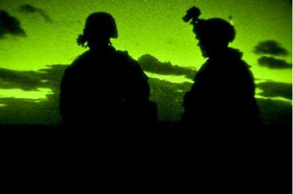
Question
How long does it take to bleed to death from a complete femoral artery and vein disruption?
Answer:
Casualties with such an injury can bleed to death in as little as 3 minutes
Notes:
10% of animals in lab studies died within 3 minutes without hemorrhage control measures.

Slide 53
Video: Femoral Artery Bleeding
Video courtesy COL (ret) John Holcomb
Notes:
This is FEMORAL ARTERTY bleeding in a pig.
It does not take long to die from this.
Click on the photo to play the video.

Slide 54
Care Under Fire
The need for immediate access to a tourniquet in such situations makes it clear that all personnel on combat missions should have a CoTCCC-recommended limb tourniquet readily available at a standard location on their battle gear, and be trained in its use.
- Casualties should be able to easily and quickly reach their own tourniquets.
Notes:
Read the text.
DO NOT bury your tourniquet at the bottom of your pack.

Slide 55
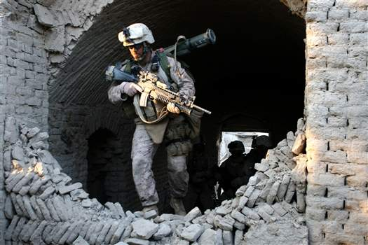
Care Under Fire
Where a tourniquet can be applied, it is the first choice for control of life-threatening extremity hemorrhage in Care Under Fire.
Notes:
If you have severe extremity bleeding in Care Under Fire, forget about direct pressure, pressure dressings, or anything else. Go directly to a tourniquet.

Slide 56
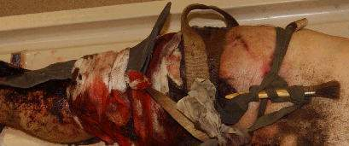
A Preventable Death in a US Soldier
Did not have an effective tourniquet applied - bled to death from a leg wound
Notes:
The medic in this casualty’s unit was killed in the battle in which this casualty was wounded.
Others in the unit attempted to control the bleeding from this soldier’s wound just below his left knee.
These improvised tourniquets were ineffective, and the soldier bled to death.
DON’T LET THIS HAPPEN TO YOUR BUDDIES!

Slide 57
Limb Tourniquet Application
Apply without delay if indicated.
Both the casualty and the medic are in grave danger while a tourniquet is being applied in this phase – don’t use tourniquets for wounds with only minor bleeding.
The decision regarding the relative risk of further injury versus that of bleeding to death must be made by the person rendering care.
Notes:
Read the text.

Slide 58
Tourniquet Application
Non-life-threatening bleeding should be ignored until the Tactical Field Care phase.
Apply the tourniquet without removing the uniform – make sure it is clearly proximal to the bleeding site.
If you are not sure exactly where the major bleeding site is on the extremity (night operations, multiple wounds), apply the tourniquet “high and tight” (as proximal as possible) on the arm or leg.
Notes:
Read the text.

Slide 59
Hemorrhage Control in Care Under Fire - Video
Notes:
Click on the photo to play the video.

Slide 60
Hemorrhage Control Notes
The video shows bandages and pressure dressings being
applied or replaced during Care Under Fire. Tourniquets
are the only CoTCCC-recommended hemostatic
intervention in the Care Under Fire phase of care.
The video mentions the use of ketamine to control
tourniquet pain. This is a good medication choice,
but analgesia should not be undertaken until the Tactical
Field Care phase.
Comments on the Video from the CoTCCC Staff
Notes:
Read the text.

Slide 61
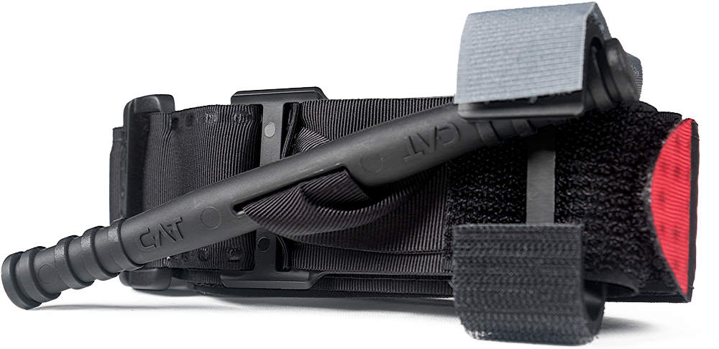
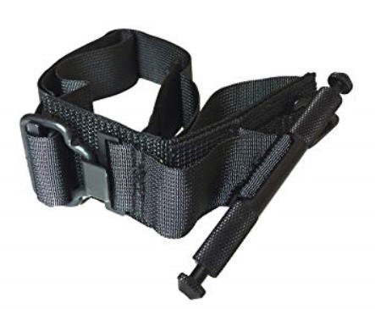
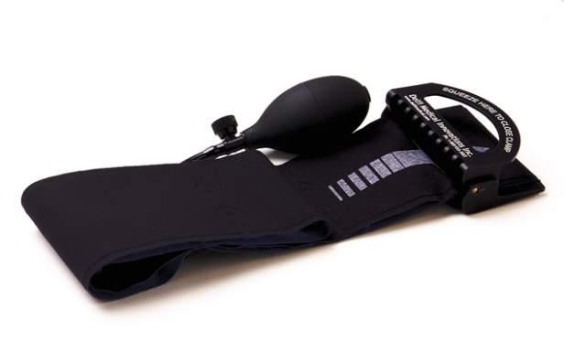
CoTCCC-Recommended Tourniquets
Combat Application Tourniquet
C.A.T.
Special Operations Forces
Tourniquet – Tactical
SOFT-T
Emergency and Military
Tourniquet (EMT)
* The EMT is an excellent tourniquet and is recommended by the CoTCCC for use in evacuation platforms and medical treatment facilities, but not for carriage by medics on the battlefield at this point.
Notes:
The EMT from Delfi was found to be as effective as the C.A.T. in testing at the ISR. It was found to be better than the C.A.T. in reports from Military Treatment Facilities in theater. The EMT is significantly more expensive.

Slide 62
C.A.T. Video 1
Buddy-Applied to Arm: Looped
Notes:
Click on the photo to play the video.

Slide 63
C.A.T. Video 2
Buddy-Applied to Leg: Routed
Notes:
Click on the photo to play the video.

Slide 64
C.A.T. Video 3
Self-Applied to Arm: Looped
Notes:
Click on the photo to play the video.

Slide 65
C.A.T. Video 4
Self-Applied to Leg: Routed
Notes:
Click on the photo to play the video.

Slide 66
SOFT-T Video 1
Buddy-Applied to Arm: Looped
Notes:
Click on the photo to play the video.

Slide 67
SOFT-T Video 2
Buddy-Applied to Leg: Routed
Notes:
Click on the photo to play the video.

Slide 68
SOFT-T Video 3
Self-Applied to Arm: Looped
Notes:
Click on the photo to play the video.

Slide 69
SOFT-T Video 4
Self-Applied to Leg: Routed
Notes:
Click on the photo to play the video.

Slide 70
Tourniquet Use Notes
Checking a distal pulse and marking time of application are not recommended during Care Under Fire. Simply tighten the tourniquet until the bleeding stops. Add a second tourniquet if necessary to control bleeding.
Tourniquets should be applied at the “High-and-Tight”
location only when the bleeding site cannot be clearly
identified. Otherwise, they should be placed 2-3
inches above the bleeding site.
Comments on the Videos from the CoTCCC Staff
Notes:
Read the text.

Slide 71
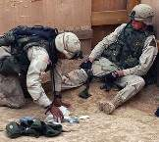
Impact of Tourniquet Use Kragh - Ann Surg 2009
Ibn Sina Hospital, Baghdad, 2006
Tourniquets are saving lives on the
battlefield.
Survival was better when tourniquets
were applied BEFORE casualties
went into shock.
31 lives were saved in this study by applying tourniquets in prehospital settings rather than in the Emergency Department.
An estimated 1000-2000 lives had been saved by tourniquets as of 2008 (data provided to Army Surgeon General via an internal communication)
Notes:
Most importantly – apply tourniquets ASAP when they are needed.
Survival is improved if shock is prevented.

Slide 72
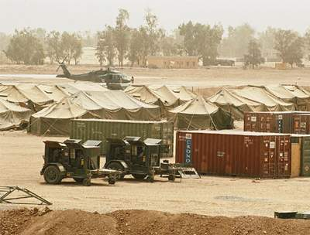
Tourniquet Safety Kragh - J Trauma 2008
Combat Support Hospital in Baghdad
232 patients with tourniquets on 309 limbs
CAT was the best field tourniquet
No amputations were caused by tourniquet use
Approximately 3% had transient nerve palsies
Notes:
Remember at the start of the GWOT, we were still losing casualties to extremity hemorrhage.
We’re doing much better now.
This study documented 232 LIVES SAVED in this ONE hospital in a ONE-YEAR period.
There were MINIMAL complications from tourniquet use.

Slide 73
Tourniquet Mistakes to Avoid!
Not using one when you should, or waiting too long to put it on.
Not pulling all the slack out before tightening.
Using a tourniquet for minimal bleeding.
Not making it tight enough – the tourniquet should STOP the bleeding.
Not using a second tourniquet if needed.
Periodically loosening the tourniquet to allow blood flow to the injured extremity.
Putting it on too proximally if the bleeding site is clearly visible.
Not taking it off when indicated during TFC.
Taking it off when the casualty is in shock or has only a short transport time to the hospital.
* These lessons learned have been written in blood. *
Notes:
These are common mistakes made by first responders applying tourniquets.

Slide 74
Summary of Key Points in Care Under Fire
Return fire and take cover!
Direct or expect the casualty to remain engaged as a combatant if appropriate.
Direct the casualty to move to cover if able.
Try to keep the casualty from sustaining additional wounds.
Get casualties out of burning vehicles or buildings.
Notes:
Ask questions to cover key points.

Slide 75
Summary of Key Points in Care Under Fire
Stop life-threatening external hemorrhage if tactically feasible.
Use a CoTCCC-recommended limb tourniquet for hemorrhage that is anatomically amenable to its application.
Direct the casualty to control hemorrhage by self-aid if able.
Airway management is generally best deferred until the Tactical Field Care phase.
Notes:
Ask questions to cover key points.

Slide 76
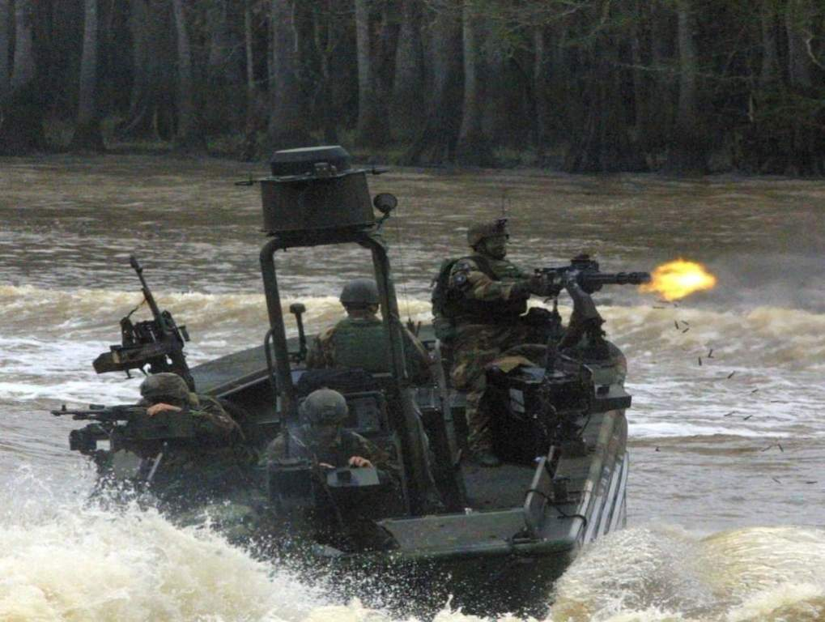
Questions?
Questions?

Slide 77
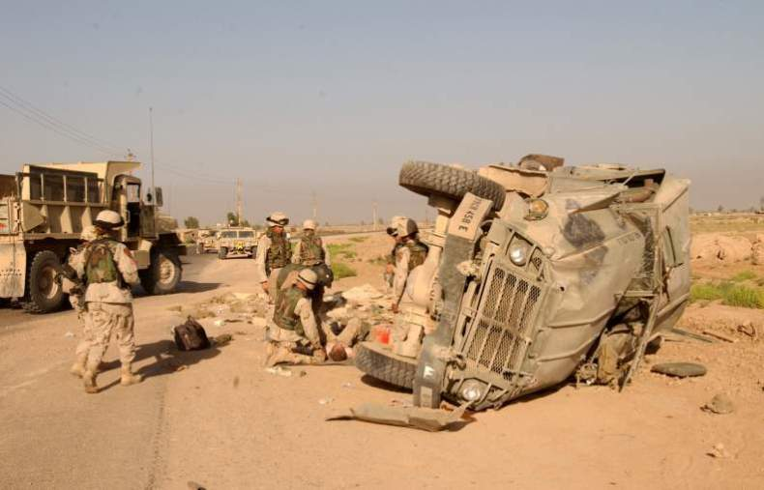
Convoy IED Scenario
Notes:
Let’s consider a scenario commonly encountered in Iraq and Afghanistan.
Improvised Explosive Devices (IEDs) are a very common cause of injury in these two theaters.

Slide 78
Convoy IED Scenario
Your element is in a five-vehicle convoy moving through a small Iraqi village.
A command-detonated IED explodes under the second vehicle.
There is incoming sniper fire.
The rest of the convoy is suppressing the sniper fire.
Notes:
Read the text in the action sequence.

Slide 79
Convoy IED Scenario
You are a medic in the disabled vehicle.
The person next to you has sustained bilateral mid-thigh amputations.
There is heavy arterial bleeding from the left stump.
The right stump exhibits only mild oozing of blood.
Notes:
Read the text in the action sequence.

Slide 80
Convoy IED Scenario
The casualty is conscious and in moderate pain.
Your vehicle is not on fire, and is right side up.
You are uninjured and able to assist.
Notes:
Read the text in the action sequence.

Slide 81
Convoy IED Scenario
First decision:
Return fire or treat the casualty?
Treat the immediate threat to life.
Why?
The rest of convoy is providing suppressive fire.
The treatment is effective and QUICK.
First action?
You put a tourniquet on the stump with arterial bleeding.
Notes:
Read the text in the action sequence.
Ask individuals in the audience to answer the questions.

Slide 82
Convoy IED Scenario
Next action?
Should you put a tourniquet on the other stump?
Not until Tactical Field Care.
It is not bleeding right now.
Next actions?
Drag the casualty out of the vehicle and move to your best cover.
Return fire if needed.
Communicate info on the casualty to the team leader.
Notes:
Read the text in the action sequence.
Ask individuals in the audience to answer the questions.

Slide 83
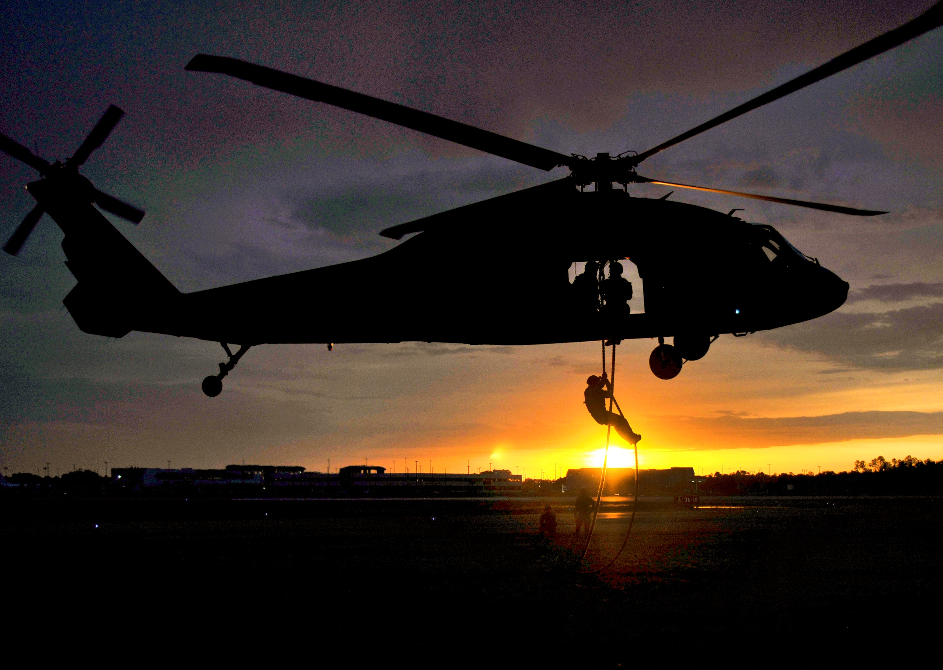
Questions?
Notes:
The scenario will be continued in Tactical Field Care.

Slide 84
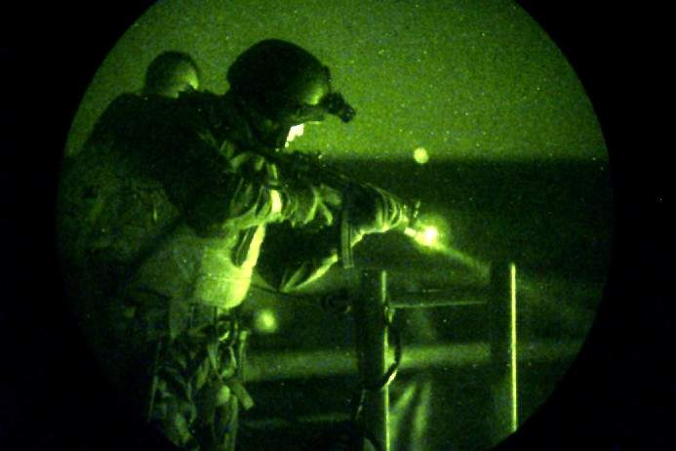
Limb Tourniquet Practical
Notes:
For practicals:
Break up into small groups of 6 or fewer students per instructor.
Use the skill sheet for the tourniquet you are teaching.

