Slide 1
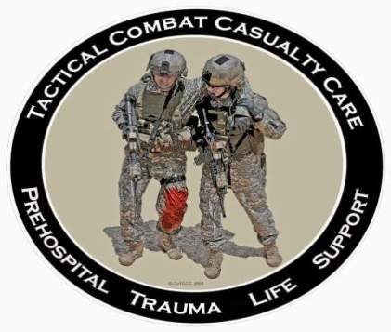
Tactical Combat Casualty Care for Medical Personnel August 2018 (Based on TCCC-MP Guidelines 180801)
Tactical Field Care 1c
Airway
Notes:
Now let’s discuss management of the airway.

Slide 2
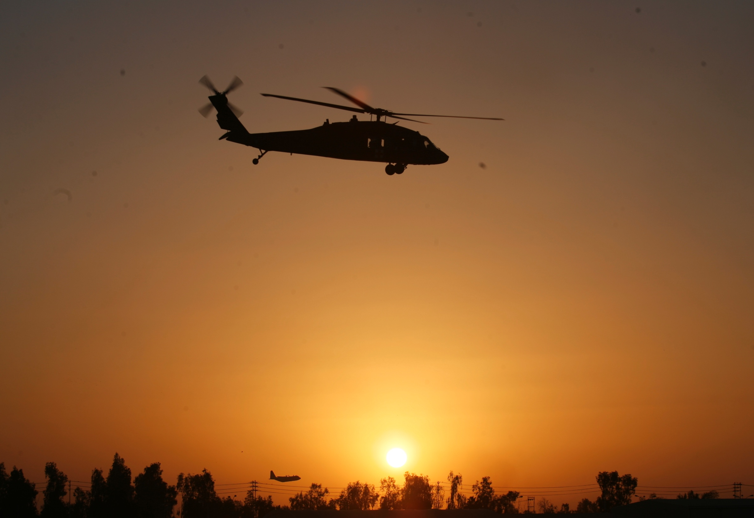
Disclaimer
“The opinions or assertions contained herein are the private views of the authors and are not to be construed as official or as reflecting the views of the Departments of the Army, Air Force, Navy or the Department of Defense.”
There are no conflict of interest disclosures
Notes:
Read the disclaimer.

Slide 3
LEARNING OBJECTIVES
Terminal Learning Objective
Perform Airway Management in Tactical Field Care.
Enabling Learning Objectives
Describe the progressive strategies, indications, and limitations of airway management techniques in tactical field care.
Describe the spinal precaution considerations for penetrating vs blunt trauma.
Notes:
Read the text.

Slide 4
LEARNING OBJECTIVES
Enabling Learning Objectives
Describe the importance of the sit-up and lean-forward maneuver to manage airway trauma in conscious casualties
Demonstrate opening the airway with the chin-lift/jaw-thrust maneuver.
Demonstrate the insertion of a nasopharyngeal airway.
Demonstrate the insertion of an extraglottic airway.
Notes:
Read the text.

Slide 5
LEARNING OBJECTIVES
Enabling Learning Objectives
Identify the indications for cricothyroidotomy and the preferred methods.
Identify the correct site for cricothyroidotomy.
Demonstrate the recommended procedure for a surgical crycothyroidotomy.
Identify the importance and application of pulse oximetry monitoring in TFC airway management.
Notes:
Read the text.

Slide 6
Tactical Field Care Guidelines
4. Airway Management
a. Conscious casualty with no airway problem identified
- No airway intervention required
* New material in red text
Notes:
Read the guideline.

Slide 7
Tactical Field Care Guidelines
4. Airway Management
b. Unconscious casualty without airway obstruction:
- Place casualty in the recovery position
- Chin lift or jaw thrust maneuver or
- Nasopharyngeal airway or
- Extraglottic airway
* New material in red text
Notes:
Read the guideline.

Slide 8
Chin Lift and Jaw Thrust Maneuvers
Notes:
Click on the photo to play the video.

Slide 9
Nasopharyngeal Airway
The “Nose Hose,” “Nasal Trumpet,” “NPA”
Excellent success in Afghanistan and Iraq
Well tolerated by the conscious patient
Lube before inserting
Insert at 90-degree angle to the face, NOT along the axis of the external nose
Tape it in
Don’t use an oropharyngeal airway (‘J’ Tube)
Will cause conscious casualties to gag
Easily dislodged
Notes:
The oropharyngeal airway is more easily dislodged and more likely to cause gagging in a conscious casualty.
The NPA is better tolerated by a conscious patient

Slide 10
Nasopharyngeal Airway: (Note that the NPA is positioned at a 90º angle to the front plane of the face.)
Notes:
Lubricate!
Insert gently with a rotary or back and forth motion.
Don’t start a big nosebleed.
Some people have a deviated nasal septum – try the other nostril if the NPA doesn’t go in the first side you try.

Slide 11
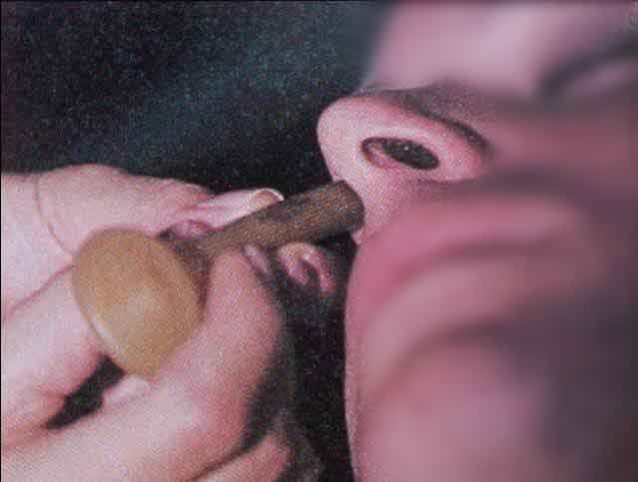
Nasopharyngeal Airway
What’s wrong with this NPA insertion?
Notes:
This nasopharyngeal airway is being inserted towards the brain and may end up there if there are craniofacial or basilar skull fractures!
The correct angle for insertion is 90 degrees to the frontal plane of the face - NOT along the long axis of the nose.

Slide 12
Nasopharyngeal Airway Insertion
Notes:
The correct insertion angle for the NPA will cause it to track along the base of the nasal cavity and will not upward toward the brain.
Click on the photo to play the video.

Slide 13
Recovery Position
Place unconscious casualties in the recovery position after the airway has been opened.
Notes:
The recovery position helps to protect against vomiting and aspiration.
Note that C-spine stabilization is not required with penetrating head and neck trauma.

Slide 14
Tactical Field Care Guidelines
4. Airway Management (continued)
c. Casualty with airway obstruction or impending airway obstruction:
- Allow a conscious casualty to assume any position that best protects the airway, to include sitting up
- Use a chin lift or jaw thrust maneuver
- Use suction if available and appropriate
- Nasopharyngeal airway or
- Extraglottic airway (if the casualty is unconscious)
- Place an unconscious casualty in the recovery position
* New material in red text
Notes:
Read the guideline.

Slide 15
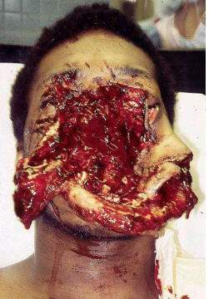
Maxillofacial Trauma
Casualties with severe facial injuries can often protect their own airway by sitting up and leaning forward.
Let them do it if they can!
Notes:
It would be almost impossible to intubate a casualty with this kind of injury, especially on the battlefield at night.
If his larynx and trachea are intact, he may do well.
This casualty was treated with an emergency surgical airway.
The only way they got this casualty to the ER alive was to let him sit up and lean forward.
With an injury like this, you may have to do a surgical airway with casualty in the sitting position.

Slide 16
Tactical Field Care Guidelines
Notes:
* The i-gel is the preferred extraglottic airway because its gel-filled cuff makes it simpler to use and avoids the need for cuff inflation and monitoring. If an extraglottic airway with an air-filled cuff is used, the cuff pressure must be monitored to avoid overpressurization, especially during TACEVAC on an aircraft with the accompanying pressure changes.
*Extraglottic airways will not be tolerated by a casualty who is not deeply unconscious. If an unconscious casualty without direct airway trauma needs an airway intervention, but does not tolerate an extraglottic airway, consider the use of a nasopharyngeal airway.
* New material in red text
Notes:
Read the guidelines.

Slide 17
The i-gel® Extraglottic Airway
Notes:
Click on the photo to play the video.

Slide 18
Tactical Field Care Guidelines
Notes:
* For casualties with trauma to the face and mouth, or facial burns with suspected inhalation injury, nasopharyngeal airways and extraglottic airways may not suffice and a surgical cricothyroidotomy may be required.
* Surgical cricothyroidotomies should not be performed on unconscious casualties who have no direct airway trauma unless use of a nasopharyngeal airway and/or an extraglottic airway have been unsuccessful in opening the airway.
* New material in red text
Notes:
Read the guidelines.

Slide 19
Tactical Field Care Guidelines
4. Airway Management (continued
c. If the previous measures are unsuccessful, perform a surgical cricothyroidotomy using one of the following:
- Cric-Key technique (preferred option)
- Bougie-aided open surgical technique using a flanged and cuffed airway cannula of less than 10 mm outer diameter, 6-7 mm internal diameter, and 5-8 cm of intratracheal length
- Standard open surgical technique using a flanged and cuffed airway cannula of less than 10mm outer diameter, 6-7 mm internal diameter, and 5-8 cm of intratracheal length (least desirable option)
- Use lidocaine if the casualty is conscious.
Notes:
Read the guideline.

Slide 20
Tactical Field Care Guidelines
4. Airway Management (continued
e. Cervical spine stabilization is not necessary for casualties who have sustained only penetrating trauma.
f. Monitor the hemoglobin oxygen saturation in casualties to help assess airway patency.
g. Always remember that the casualty’s airway status may change over time and requires frequent reassessment.
* New material in red text
Notes:
Read the guidelines.

Slide 21
The Need for Cricothyroidotomy
4,596 battlefield fatalities in Operation Iraqi Freedom and Operation Enduring Freedom combat casualties from October 2001 to June 2011
87.3% of all injury mortality occurred in the prehospital environment (n = 4013)
Of the prehospital deaths, 24.3% were deemed potentially survivable. (n = 976)
The second most common cause (8%) of potentially preventable deaths was upper airway obstruction due mostly to direct injury to the airway structures of the face and neck. (n = 78)
Eastridge, et al. Death on the battlefield (2001Y2011): Implications for the future of combat casualty care. J Trauma Acute Care Surg. 73; 6: Supplement 5
Notes:
Why should medics be able to do a surgical airway on the battlefield?
Because upper airway obstruction is the second most common cause of potentially preventable deaths on the battlefield.

Slide 22
Battlefield Cricothyroidotomy
“Military medics have a 33% failure rate when performing this procedure.”*
This is the most technically difficult procedure we ask medics, Corpsmen, and PJs to do.
* Mabry RL, Frankfurt A. An Analysis of Battlefield Cricothyrotomy in Iraq and Afghanistan
J Spec Oper Med. 2012 Spring;12(1):17-23.
Notes:
The problem with cricothyroidotomy is that it is hard to do. Historically, combat medics have often failed to get it right on the battlefield.

Slide 23
Video: An Actual Cricothyroidotomy Using Standard Open Surgical Technique
Courtesy Dr. Peter Rhee
Univ. of Arizona
Notes:
This is video of a cricothyroidotomy performed in an actual emergency situation after an attempt to intubate failed. Even in the Emergency Department cricothyroidotomy is a very difficult, time-consuming procedure.
Click on the photo to play the video.

Slide 24
Preferred Surgical Airway Technique – The CricKey
Cric-Key evaluation
Fifteen military medics with minimal training performed one Cric-Key technique and one open surgical technique on cadavers.
Medics were able to insert the Cric-Key in significantly less time (34 sec vs 65 sec.)
Though not statistically significant, there were three failures with the open surgical technique, and none with the Cric-Key.
Mabry, et al. A Comparison of Two Open Surgical Cricothyroidotomy Techniques by Military Medics Using a Cadaver Model. Ann Emerg Med. 2014 Jan;63(1):1-5.
Notes:
Under test conditions, medics were faster and more successful using the Cric-Key technique compared to the open surgical technique.

Slide 25
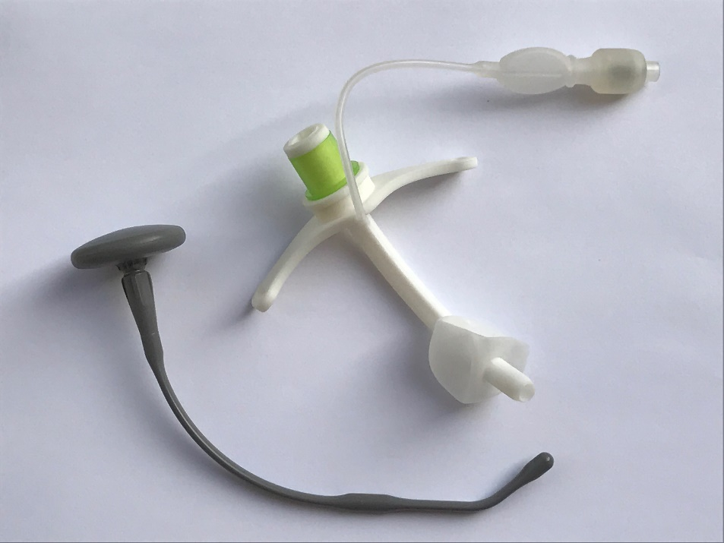
Cric-Key
The Cric-Key introducer is curvilinear, with an overall length of 19 cm, and an anteriorly directed distal tip.
Designed to guide insertion of a 5.0 cuffed Melker cricothyroidotomy airway cannula.
Combines the functions of a tracheal hook, stylet, dilator, and bougie when incorporated with the Melker airway.
Notes:
As tested, the Cric-Key technique requires a scalpel, a Cric-Key introducer, a Melker airway, and a 10-cc syringe.

Slide 26
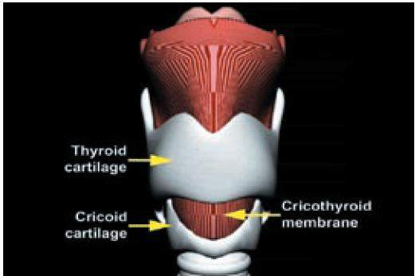
Cricothyroid Membrane
Notes:
Through the cricothyroid membrane is the correct path for a cricothyroidotomy. You want to make the skin incision right over this membrane. The most anterior prominence of the thyroid cartilage is the “Adam’s Apple” in men.

Slide 27
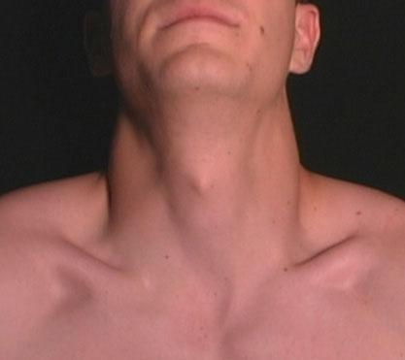
Surface Landmarks for Cricothyrotomy
Thyroid prominence – Adam’s apple usually visible only in males
Top of thyroid cartilage
Bottom of thyroid cartilage
Cricothyroid membrane
Cricoid cartilage
Notes:
Combat medic students should be able to demonstrate to an instructor the surface landmarks used to locate the cricothyroid membrane. These landmarks should be identified on a buddy.

Slide 28
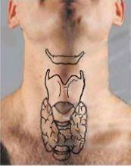
Beneath the Surface Landmarks
Hyoid Bone
Thyroid prominence (Adam’s apple ) - usually visible only in males
Thyroid cartilage
Cricothyroid membrane
Cricoid cartilage
Thyroid gland
Notes:
Here are the critical structures underlying the key surface landmarks.

Slide 29
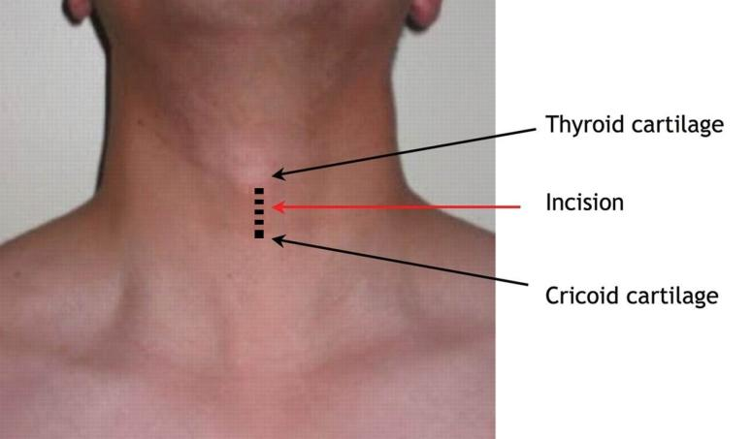
Locating the Cric Skin Incision with a Dotted Line
Macdonald JC , Tien HC. Emergency Battlefield Cricothyrotomy. CMAJ 2008;178:1133-1135
Bennett BL, Cailteux-Zevallos B, Kotora J. Cricothyroidotomy bottom-up training review: battlefield lessons learned. Mil Med. 2011 Nov;176(11):1311-9.
Notes:
In the practical, once the combat medic student has identified the pertinent landmarks, s/he should be required to draw a dashed vertical (mid-sagittal) line on his/her buddy's neck over the cricothyroid membrane where the incision should be made.

Slide 30
Cricothyroidotomy Technique: CricKey
Notes:
Click on the photo to play the video.

Slide 31
Cricothyroidotomy Technique: Bougie
Notes:
Click on the photo to play the video.

Slide 32
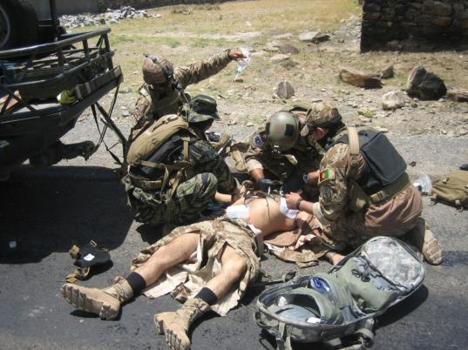
Repetition and Realism in Cric Training
To prepare for scenarios like this one, combat medics should perform cricothyrotomy at least five times during training on an anatomically realistic model.
Notes:
Cricothyrotomy is a difficult procedure even under the best of circumstances. Under stress, the combat medic will fall back on his training. Repetition and realism (both clinical and tactical) during training enhances skill development and knowledge retention in combat trauma care. Cricothyrotomy is a critical skill that should be practiced repeatedly on a realistic model.

Slide 33
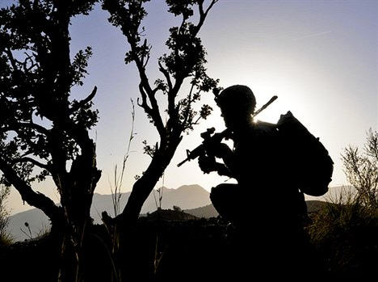
Questions?

Slide 34
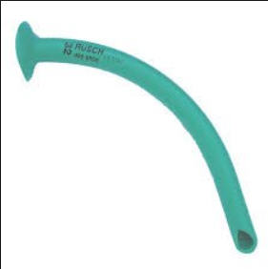
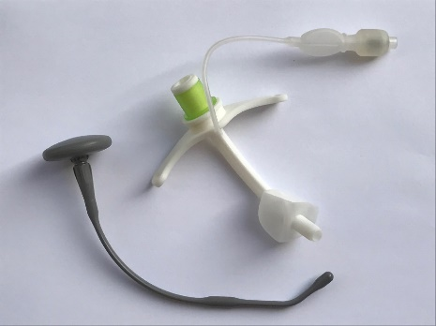
Airway Practical
1. Identify the cricothyroid membrane
-Use a skin marker to mark site
2. Nasopharyngeal Airway
3. i-gel
4. Surgical Airway
- 5 reps per student
Notes:
Nasopharyngeal airway skill sheet
i-gel skill sheet
Cric-Key sheet

