Slide 1

Tactical Combat Casualty Care for Medical Personnel
August 2018
(Based on TCCC-MP Guidelines 180801)
Tactical Field Care 1d
Respiration/Breathing
Notes:
Our topic here is Respiration and Breathing – specifically Tension Pneumothorax and Open Pneumothorax.

Slide 2

Disclaimer
“The opinions or assertions contained herein are the private views of the authors and are not to be construed as official or as reflecting the views of the Departments of the Army, Air Force, Navy or the Department of Defense.”
There are no conflict of interest disclosures
Notes:
Read the disclaimer.

Slide 3
LEARNING OBJECTIVES
Terminal Learning Objective
Perform management of respiration and chest trauma in Tactical Field Care.
Enabling Learning Objectives
Describe the progressive strategies, indications, and limitations of chest trauma treatment techniques in tactical field care.
Identify the signs, symptoms and initial treatment of tension pneumothorax in TCCC.
Notes:
Read the text.

Slide 4
LEARNING OBJECTIVES
Enabling Learning Objectives
Describe the strategy for treating tension pneumothorax when initial needle decompression (NDC) is unsuccessful.
Describe the strategy for treating recurring tension pneumothorax after successful initial NDC.
Demonstrate a needle chest decompression at the 5th intercostal space in the anterior axillary line.
Demonstrate a needle chest decompression at the 2nd intercostal space in mid-clavicular line.
Notes:
Read the text.

Slide 5
LEARNING OBJECTIVES
Enabling Learning Objectives
Identify the signs, symptoms and initial treatment of open pneumothorax (sucking chest wound) in TCCC.
Identify the importance and implications of vented and non-vented chest seals.
Identify the importance of pulse oximetry monitoring in chest trauma management in tactical field care and important aspects of interpreting pulse oximetry readings.
Notes:
Read the text.

Slide 6
Tactical Field Care Guidelines
5. Respiration/Breathing
a. Assess for tension pneumothorax and treat as necessary
1. Suspect a tension pneumothorax and treat when a casualty has significant torso trauma or primary blast injury and one or more of the following:
- Severe or progressive respiratory distress
- Severe or progressive tachypnea
- Absent or markedly decreased breath sounds on one side of the chest
- Hemoglobin oxygen saturation < 90% on pulse oximetry
Shock
Traumatic cardiac arrest without obviously fatal wounds
* Note: If not treated promptly, tension pneumothorax may progress from respiratory distress to shock and traumatic cardiac arrest.
* New Text in red
Notes:
Read the guideline.

Slide 7
Tactical Field Care Guidelines
5. Respiration/Breathing
a. Assess for tension pneumothorax and treat as necessary
2. Initial treatment of suspected tension pneumothorax:
- If the casualty has a chest seal in place, burp or remove the chest seal.
- Establish pulse oximetry monitoring.
- Place the casualty in the supine or recovery position unless he or she is conscious and needs to sit up to help keep the airway clear as a result of maxillofacial trauma.
Notes:
Read the guideline.

Slide 8
Tactical Field Care Guidelines
5. Respiration/Breathing
a. Assess for tension pneumothorax and treat as necessary
2. Initial treatment of suspected tension pneumothorax: (cont)
- Decompress the chest on the side of the injury with a 14-gauge or a 10-gauge, 3.25-inch needle/catheter unit.
If a casualty has significant torso trauma or primary blast injury and is in traumatic cardiac arrest (no pulse, no respirations, no response to painful stimuli, no other signs of life), decompress both sides of the chest before discontinuing treatment.
Notes:
Read the guideline.

Slide 9
Tactical Field Care Guidelines
5. Respiration/Breathing
a. Assess for tension pneumothorax and treat as necessary
2. Initial treatment of suspected tension pneumothorax: (cont)
Notes:
* Either the 5th intercostal space (ICS) in the anterior axillary line (AAL) or the 2nd ICS in the mid-clavicular line (MCL) may be used for needle decompression (NDC.) If the anterior (MCL) site is used, do not insert the needle medial to the nipple line.
* The needle/catheter unit should be inserted at an angle perpendicular to the chest wall and just over the top of the lower rib at the insertion site. Insert the needle/catheter unit all the way to the hub and hold it in place for 5-10 seconds to allow decompression to occur.
* After the NDC has been performed, remove the needle and leave the catheter in place.
Notes:
Read the guideline.

Slide 10
Tactical Field Care Guidelines
5. Respiration/Breathing
a. Assess for tension pneumothorax and treat as necessary
3. The NDC should be considered successful if:
- Respiratory distress improves, or
- There is an obvious hissing sound as air escapes from the chest when NDC is performed (this may be difficult to appreciate in high-noise environments), or
- Hemoglobin oxygen saturation increases to 90% or greater (note that this may take several minutes and may not happen at altitude), or
- A casualty with no vital signs has return of consciousness and/or radial pulse.
Notes:
Read the guideline.

Slide 11
Tactical Field Care Guidelines
5. Respiration/Breathing
a. Assess for tension pneumothorax and treat as necessary
4. If the initial NDC fails to improve the casualty’s signs/symptoms from the suspected tension pneumothorax:
- Perform a second NDC on the same side of the chest at whichever of the two recommended sites was not previously used. Use a new needle/catheter unit for the second attempt.
- Consider, based on the mechanism of injury and physical findings, whether decompression of the opposite side of the chest may be needed.
Notes:
Read the guideline.

Slide 12
Tactical Field Care Guidelines
5. Respiration/Breathing
a. Assess for tension pneumothorax and treat as necessary
5. If the initial NDC was successful, but symptoms later recur:
- Perform another NDC at the same site that was used previously. Use a new needle/catheter unit for the repeat NDC.
Continue to re-assess!
6. If the second NDC is also not successful:
- Continue on to the Circulation section of the TCCC Guidelines.
Notes:
Read the guidelines.

Slide 13
Tension Pneumothorax
Tension pneumothorax is another common cause of preventable death encountered on the battlefield.
It’s easy to treat.
Tension pneumothorax may occur with entry wounds in the chest, abdomen, back, shoulder, or neck.
Blunt (motor vehicle crash) or penetrating trauma (GSW) or primary blast injury may cause tension pneumothorax.
Notes:
Two things about a tension pneumothorax:
- It is a very common cause of preventable death on the battlefield.
- It can be effectively treated by combat medics, corpsmen, and PJs.

Slide 14
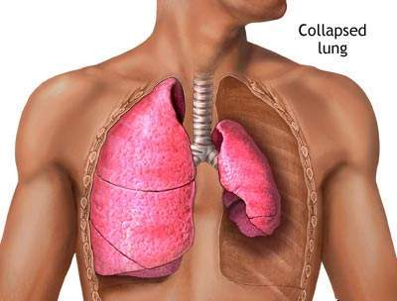
Pneumothorax
Pneumothorax
A pneumothorax is a collection of air between the lung and chest wall due to an injury to the chest wall and/or lung. The lung then collapses as shown above.
Notes:
Normally the lung fills up the entire chest cavity.
With injury, air may get between the chest wall and the lung and cause the lung to collapse.
Air is supposed to be INSIDE the lung.
Here the air is inside the chest but OUTSIDE the lung – this does not help get oxygen to the body and may compress the heart and other lung.

Slide 15
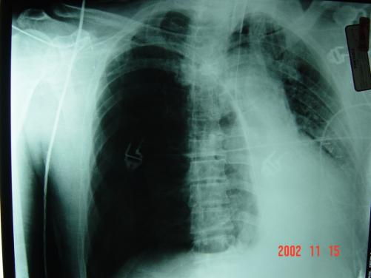
Tension Pneumothorax
Side with
gunshot
wound and
air under
increased
pressure in
pleural space
Photo:
COL Matt Martin
Heart and lung
shifted from
increased pressure
on right side
Injured lung tissue acts as a one-way valve, trapping more and more air between the lung and the chest wall. Pressure builds up and compresses both lungs and the heart.
Notes:
Every breath adds more air to the air space outside the lung.
The air can’t be exhaled because it’s outside the lung – there’s no way for it to escape, so pressure builds up.

Slide 16
When Should You Suspect a Tension Pneumothorax?
Suspect a tension pneumothorax and treat when a casualty has significant torso trauma or primary blast injury and one or more of the following:
Severe or progressive respiratory distress
Severe or progressive tachypnea
Absent or markedly decreased breath sounds on one side of the chest
Hemoglobin oxygen saturation < 90% on pulse oximetry
Shock
Traumatic cardiac arrest without obviously fatal wounds
Notes:
Read the text.

Slide 17
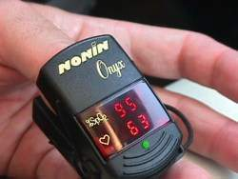
Pulse Oximetry Monitoring
Pulse oximetry tells you how much oxygen is present in the blood.
It shows the heart rate and the percent of oxygenated blood (“O2 sat”) in the numbers displayed.
98% or higher is
normal O2 sat
at sea level.
86% O2 sat is
normal at 12,000
feet due to the lower lower atmospheric pressure at that
altitude.
Notes:
This is what a pulse oximeter looks like.
What it tells you is actually the percentage of the hemoglobin in the blood that is oxygenated.

Slide 18
Pulse Oximetry Monitoring
Consider using a pulse ox for these types of casualties:
A casualty with severe penetrating, blunt , or blast
chest trauma at risk for developing a tension
pneumothorax.
TBI – good O2 sat is
very important for a
good outcome
Unconscious
casualty
Reassess often!
Notes:
Hypoxia is associated with worse clinical outcomes in casualties with moderate/severe TBI. Monitoring the O2 saturation in these casualties with a pulse oximeter will help identify hypoxia so that it can be prevented or treated.
Unconscious casualties may experience an airway obstruction.
Chest trauma and blast trauma casualties may not exchange oxygen well in their lungs.

Slide 19
Pulse Oximetry Monitoring
Oxygen saturation values as shown on pulse ox may be inaccurate in the presence of:
Hypothermia
Carbon monoxide poisoning
Very high ambient light levels
Notes:
A normal reading on a pulse oximeter is NOT a good indicator for the absence of shock.
Even after significant blood loss, the blood remaining in the intravascular compartment may be normally oxygenated.
Readings on a cold limb may be artificially low.
The pulse ox can mistake carbon monoxide for oxygen in burn patients and give a falsely high reading.
To repeat – a decrease in O2 sat is normal at altitude. This drop in O2 sat is REAL.

Slide 20
Tension Pneumothorax
Both lung function and heart function may be impaired with a tension pneumothorax, causing respiratory distress and possible shock.
Traumatic cardiac arrest may ensue if the tension pneumothorax is not treated promptly.
The treatment is to let the trapped air under pressure in the pleural space escape.
Notes:
One collapsed lung should not kill you, but the elevated air pressure OUTSIDE the collapsed lung in a tension pneumothorax can impair the function of the good lung and the heart by preventing them from functioning normally.
This CAN kill you.

Slide 21
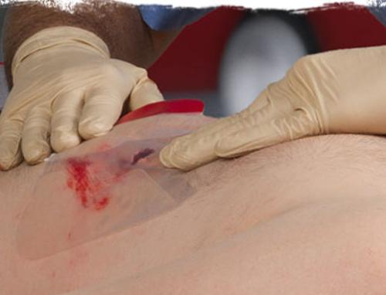
Management of Suspected Tension Pneumothorax
If a chest seal has previously been applied to the casualty – burp or remove the chest seal.
This allows air to escape from the chest.
Notes:
Read the text.

Slide 22
Tension Pneumothorax
If a tension pneumothorax is suspected and a chest seal is not present, the treatment is to let the trapped air under pressure escape by performing needle decompression or “NDC.”
This is done by inserting a needle into the chest.
The recommended needle size is either a 14- or a 10 -gauge, 3.25-inch needle/catheter unit.
Notes:
In a study by Dr. Harcke published in Military Medicine in 2008, several casualties died from needles being too short to get through the chest wall.
The old 2-inch needles were too short. 3.25-inch needles will get through the chest wall in 99% of individuals.

Slide 23
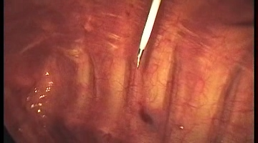
Needle Decompression Works
Video courtesy of Dr. Oleksandr Linchevskyy
Medical Director, Patriot Defence
Ukraine
Notes:
This video presents a pleuroscopic (inside the chest) view of a needle decompression performed on a trauma victim with tension pneumothorax and a collapsed lung. The re-expansion of the collapsed lung is dramatic. The catheter may inflict minor trauma on the lung, but this is acceptable given the benefit accrued from the removal of air from the pleural space and the returned function of the re-inflated lung and the decompressed heart.
Click on the photo to play the video.

Slide 24
Tension Pneumothorax
Question: “What if the casualty does not have a tension pneumothorax when you do your needle decompression?”
Answer:
  If he or she has penetrating trauma to that side of the chest, there is already a collapsed lung and blood in the chest cavity.
  The needle won’t make it worse if there is no tension pneumothorax.
  If he DOES have a tension pneumothorax, you will save his life.
Notes:
Note: If the trauma is BLUNT and there is no pre-existing pneumothorax when NDC is performed, a simple pneumothorax may be created by the procedure, but this not life-threatening.
***There have been NO reported life-threatening complications caused by NDC in Iraq or Afghanistan.***

Slide 25
Needle Decompression
Two acceptable sites:
Lateral site
  The 5th intercostal space (ICS) in the anterior axillary line (AAL)
or
Anterior site
  The 2nd ICS in the mid-clavicular line (MCL)
Notes:
These are the two recommended sites for NDC.

Slide 26
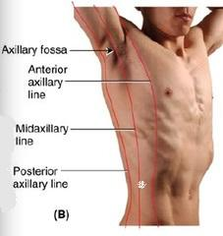
Lateral Site for Needle Decompression - Males
The first site that can be used for NDC is the 5th intercostal space at the anterior axillary line.
The 5th intercostal space is located at the level of the nipple in young, fit males.
The AAL is located at approximately the lateral aspect of the pectoralis major muscle.
Easily located in males.
X
Notes:
The 5th intercostal space at the anterior axillary line is more remote from the heart and great vessels and using this site may reduce the risk of complications from needle decompression. In a tactical situation, the lateral approach may be faster and safer given body armor configuration and ability to reassess.

Slide 27
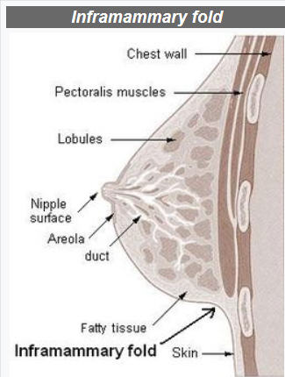
Lateral Site for Needle Decompression - Females
Nipple level is variable in females – but you can lift the breast and use the level of the infra-mammary fold.
Measure four fingers down from the axilla (measure the width of your hand placed under the patient's axilla with their arm down) at the lateral aspect of the breast/pectoral muscle.
Another option - two finger breadths below the bottom of the axillary hairline. Can see even if just shaved.
Notes:
Here are 3 options for locating the 5th ICS on a woman.

Slide 28
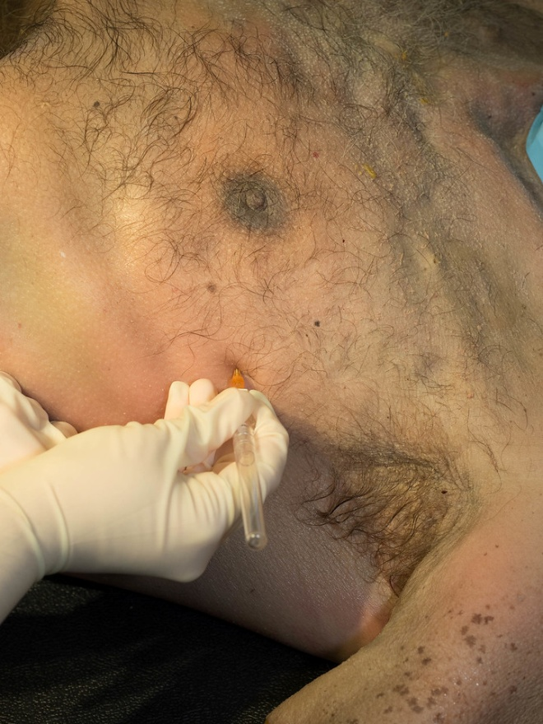
Lateral Site for Needle Decompression
Photo
Courtesy
Maj Andrew
Hall
This photo shows NDC being performed at the lateral site in a cadaver model.
Notes:
Read the text.

Slide 29
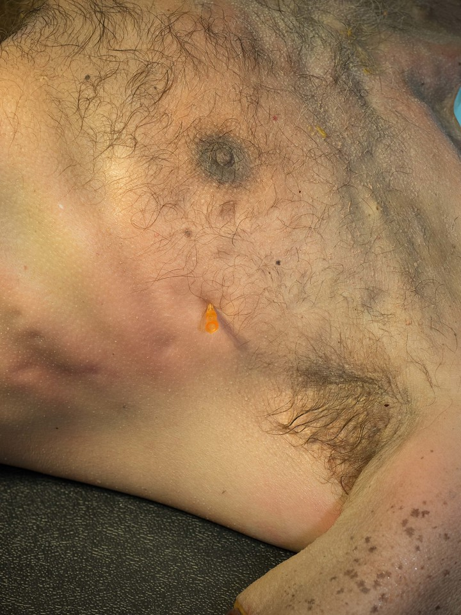
Lateral Site for Needle Decompression
Photo
Courtesy
Maj Andrew
Hall
This photo shows the catheter left in place at the lateral site after the needle was removed.
Notes:
Read the text.

Slide 30
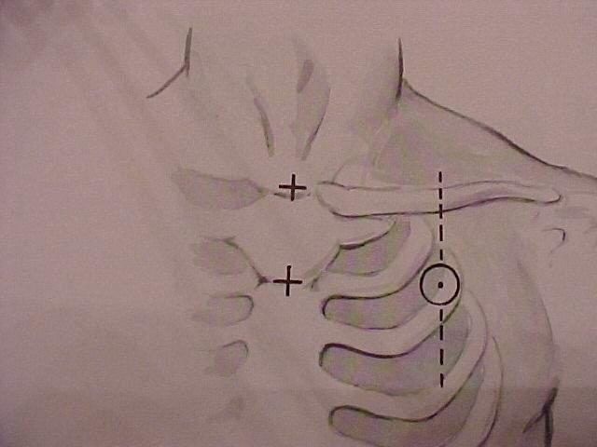
Picture of general location for needle insertion
Anterior Site for Needle Decompression
2nd intercostal space in the
mid-clavicular line
Start at the middle of the
clavicle
Go 2-3 finger widths below
this point
Do NOT insert the needle
medial to the nipple line!
Notes:
The anterior site is equally acceptable for NDC.

Slide 31
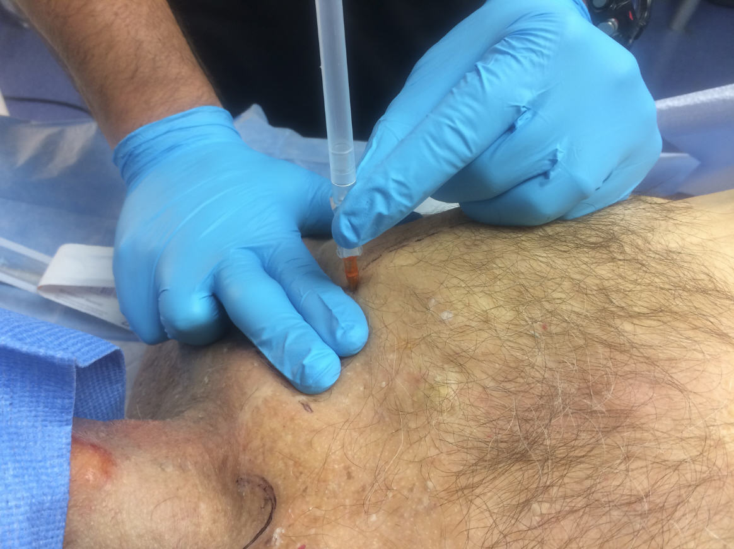
Anterior Site for Needle Decompression
Photo
Courtesy
LTC Mark
Buzzelli
This photo shows NDC being performed at the anterior site.
Notes:
Read the text.

Slide 32
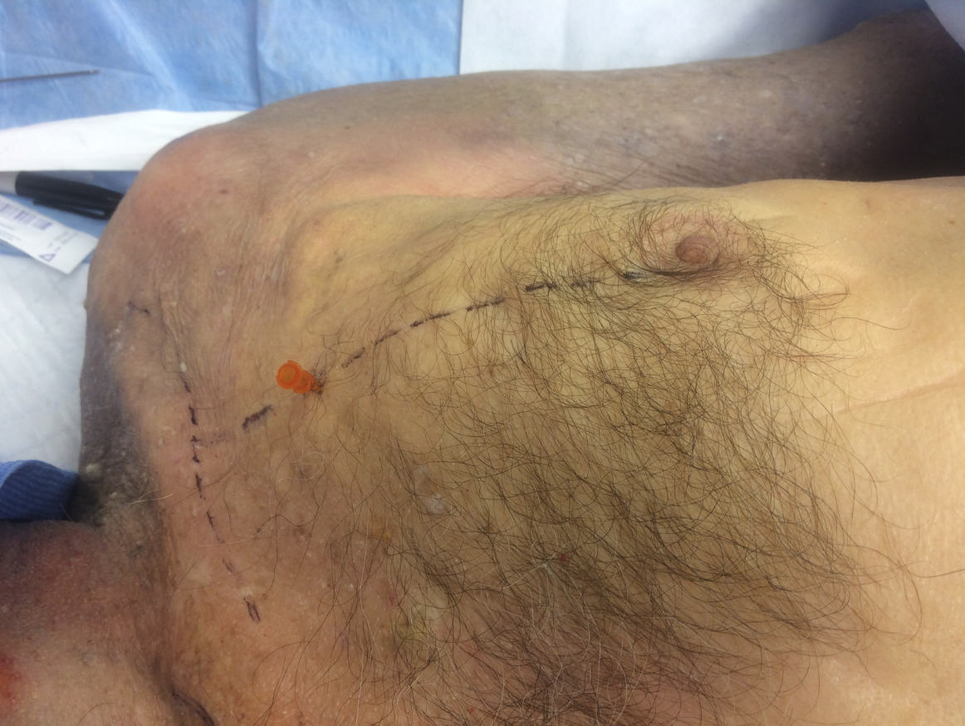
Anterior Site for Needle Decompression
Photo
Courtesy
LTC Mark
Buzzelli
This photo shows the catheter left in place at the anterior site after the needle was removed.
Notes:
Read the text.

Slide 33
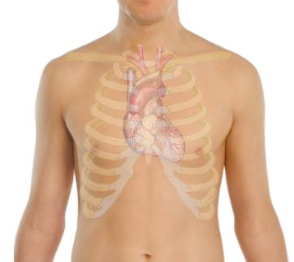
CAUTION!
At the anterior site, the heart and great vessels are nearby.
Never insert the needle medial to the nipple line.
Do not point the needle towards the heart.
Notes:
This is an outline of the location of the heart drawn on the surface of the chest.

Slide 34
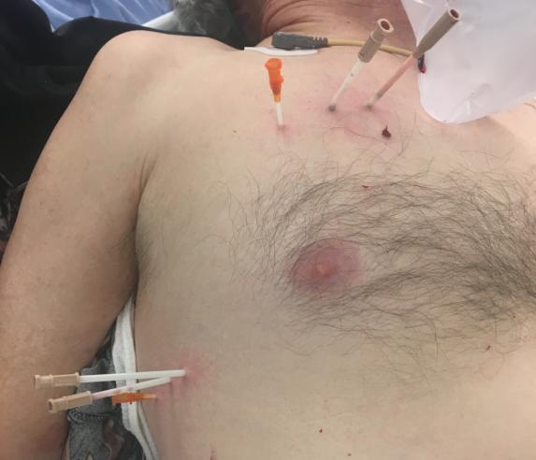
CAUTION!
Photo:
Dr. Warren Dorlac
The two needles circled are TOO MEDIAL!
Notes:
This clinical photo from a civilian trauma center shows multiple needle decompressions in both the anterior and the lateral locations.
Note that two of the needles in the anterior site have been inserted at locations medial to the nipple line.

Slide 35
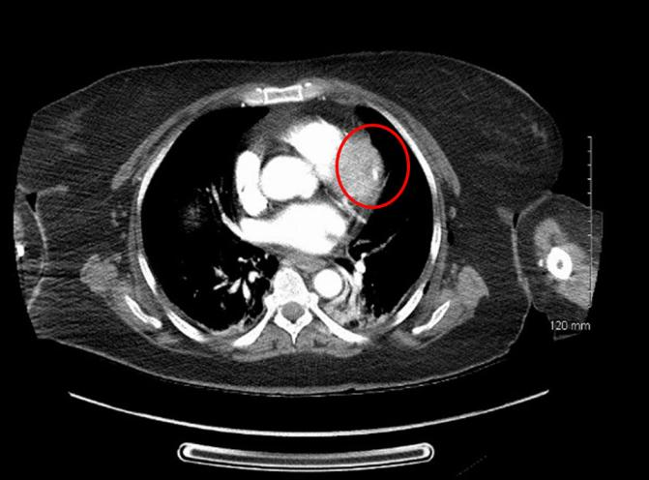
CAUTION!
Photo:
Dr. Jay
Johannigman
The circle shows an NDC catheter in the heart.
Again – the NDC was performed too medially.
Notes:
This CT image from a civilian trauma center shows a catheter that was used to perform needle decompression located in the myocardium.

Slide 36
NDC Technique
Insert the needle/catheter unit perpendicular (90-degree angle) to the chest wall and insert it just over the top of the lower rib at the insertion site.
Insert the needle/catheter unit all the way to the hub.
Hold both the needle and the catheter in place for 5-10 seconds to allow full decompression to occur.
After the NDC has been performed, remove the needle and leave the catheter in place.
Notes:
If you use a 14- or 10-gauge needle/catheter unit intended for IVs, you will have to remove the plug from the needle flash chamber before inserting the needle/catheter into the chest.

Slide 37
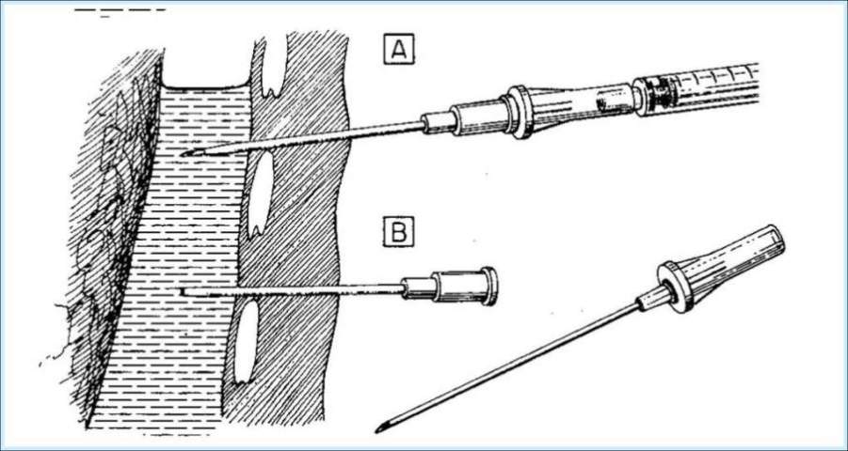
Enter Just Over the Top of the Rib Below
Lung
Air collection
Rib
Chest wall
Needle
Catheter
This avoids the artery and vein at the bottom of the rib above.
Notes:
The needle should make a 90-degree angle to the chest wall, and it should slide in just over the top of the rib. An intercostal artery and vein run along the bottom edge of each rib.
Note that the catheter is not inserted all the way to the hub in the lower needle/catheter unit. It should have been.

Slide 38
Successful Needle
Decompression
The NDC should be considered successful if:
Respiratory distress improves, or
There is an obvious hissing sound as air escapes from the chest when NDC is performed (this may be difficult to appreciate in high-noise environments), or
Hemoglobin oxygen saturation increases to 90% or greater (note that this may take several minutes and may not happen at altitude), or
A casualty with no vital signs has return of consciousness and/or radial pulse.
Notes:
Read the text.

Slide 39
Unsuccessful Needle
Decompression – Next Step
If the initial NDC fails to improve the casualty’s signs/symptoms from the suspected tension pneumothorax:
Perform a second NDC - on the same side of the chest - at whichever of the two recommended sites was not previously used. Use a new needle/catheter unit for the second attempt.
Consider, based on the mechanism of injury and physical findings, whether decompression of the opposite side of the chest may be needed.
Notes:
Read the text.

Slide 40
Recurrent
Tension Pneumothorax
If the initial NDC was successful, but symptoms later recur:
Perform another NDC at the same site that was used previously. Use a new needle/catheter unit for the repeat NDC.
Continue to re-assess!
Notes:
Even if the catheter is still in place, it may have become plugged. You MUST use a new needle/catheter unit.

Slide 41
If Two NDCs Fail to
Produce Improvement
If the second NDC is also not successful:
Continue to the Circulation section of the TCCC Guidelines.
Notes:
After two needle decompressions, do not continue to persevere with NDC – move on to evaluating and treating for shock.

Slide 42
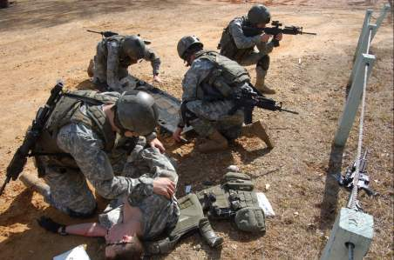
Remember!!!
Tension pneumothorax is a common but
easily treatable cause of preventable death
on the battlefield.
Diagnose and treat aggressively!
Notes:
DO NOT MISS THIS INJURY!

Slide 43
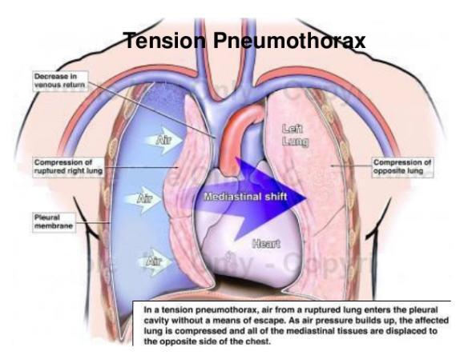
Needle Decompression Practical
Notes:
Needle Decompression Skill Sheet

Slide 44
Tactical Field Care Guidelines
5. Respiration/Breathing
b. All open and/or sucking chest wounds should be treated by immediately applying a vented chest seal to cover the defect. If a vented chest seal is not available, use a non-vented chest seal. Monitor the casualty for the potential development of a subsequent tension pneumothorax. If the casualty develops increasing hypoxia, respiratory distress, or hypotension and a tension pneumothorax is suspected, treat by burping or removing the dressing or by needle decompression.
Notes:
Read the guideline.

Slide 45
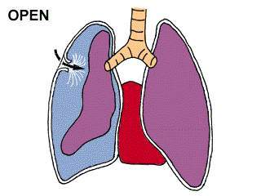
Sucking Chest Wound
(Open Pneumothorax)
It takes a hole in the chest the size of a nickel
or bigger for this to occur.
Notes:
In a sucking chest wound, air enters the pleural space through a wound in the chest wall.
The elastic lung deflates and pulls away from the chest wall.
On inspiration, the air now enters the chest THROUGH THE HOLE instead of INTO THE LUNGS via the mouth and airways.
The affected lung cannot be fully re-inflated by inhalation.

Slide 46
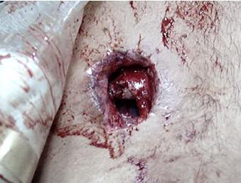
Open Pneumothorax
Notes:
In this wound you can see into the chest cavity.

Slide 47
Management of Open Pneumothorax
Input from the USCENTCOM/JTS assessment of prehospital trauma care in Afghanistan questioned the use of unvented chest seals in the treatment of open pneumothorax.
New animal research from both USAISR and Naval Medical Center Portsmouth has shown that vented chest seals work reliably to prevent a tension pneumothorax in the presence of an open pneumothorax and an ongoing air leak from the lung, but non-vented chest seals do not.
Notes:
Read the text.

Slide 48
Sucking Chest Wound
May result from large defects in the chest wall and may interfere with ventilation
Treat it by applying a vented occlusive dressing completely over the defect at the end of one of the casualty’s exhalations.
Monitor for possible development of subsequent tension pneumothorax.
Allow the casualty to adopt the sitting position if breathing is more comfortable.
Notes:
Apply a vented chest seal at the end of an exhalation.
At this point in the breathing cycle, there is relatively less air in the pleural space.

Slide 49
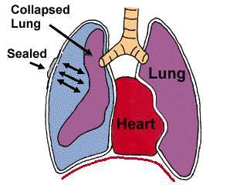
Sucking Chest Wound
(Treated)
Key Point: If signs of a tension pneumothorax develop
– lift one edge of the seal and allow the tension
pneumothorax to decompress (“burping” the seal).
Alternatively, remove the seal for a few seconds to
accomplish the decompression, then re-apply.
Notes:
Once the wound has been occluded with a dressing, air can no longer enter (or exit) the pleural space through the wound in the chest wall.
The injured lung will remain partially collapsed, but the mechanics of respiration will be better.
You have to be alert for the possible development of tension pneumothorax because air can still leak into the pleural space from the injured lung.
Monitor these patients with observation and a pulse oximeter.

Slide 50
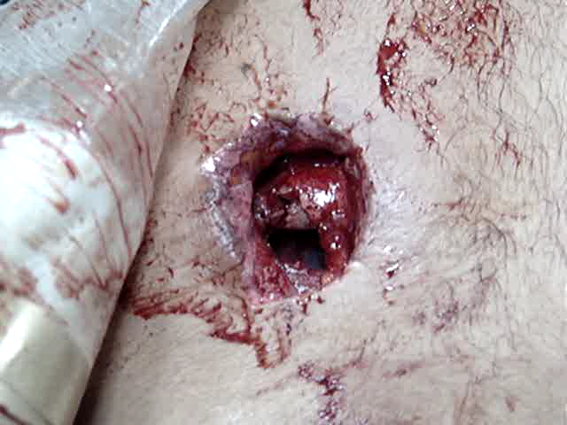
Video: Sucking Chest Wound
Notes:
This is a video of a sucking chest wound.
Note the large open hole in the chest wall.
Click on the photo to play the video.

Slide 51
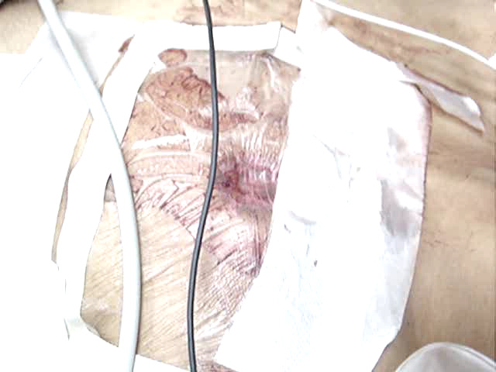
Video: Sucking Chest Wound
(Treated)
Notes:
This video shows a sucking chest wound after the defect in the chest wall has been sealed. Negative pressure during inhalation retracts the dressing over the wound.
The lung now has a better chance of re-inflating.
Click on the photo to play the video.

Slide 52
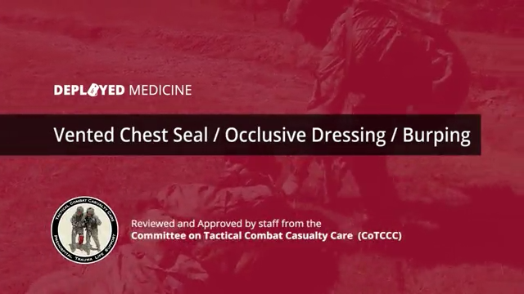
Sucking Chest Wound
Treatment Video
* Note: The vented chest seal IS the occlusive dressing.
Notes:
Click on the photo to play the video.

Slide 53
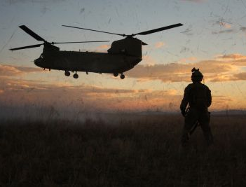
Questions?

