Slide 1
Tactical Combat Casualty Care for Medical Personnel August 2018 (Based on TCCC-MP Guidelines 180801)
Tactical Field Care 2a
Circulation - Bleeding
Notes:
Now we’ll discuss the management of bleeding in TFC.

Slide 2
Disclaimer
“The opinions or assertions contained herein are the private views of the authors and are not to be construed as official or as reflecting the views of the Departments of the Army, Air Force, Navy or the Department of Defense.”
There are no conflict of interest disclosures
Notes:
Read the disclaimer.

Slide 3
LEARNING OBJECTIVES
Terminal Learning Objective
Perform Hemorrhage Control in Tactical Field Care.
Enabling Learning Objectives
Describe the progressive strategies, indications, and limitations of controlling external hemorrhage in tactical field care.
Identify the indications for and application methods of pelvic binding devices in Tactical Field Care.
Notes:
Read the text.

Slide 4
LEARNING OBJECTIVES
Enabling Learning Objectives
Demonstrate the application of a CoTCCC-recommended pelvic compression device in Tactical Field Care.
Describe the technique for tourniquet repositioning in Tactical Field Care.
Identify the indications and methods of tourniquet conversion in Tactical Field Care.
Notes:
Read the text.

Slide 5
Tactical Field Care Guidelines
6. Circulation
a. Bleeding
● A pelvic binder should be applied for cases of suspected pelvic fracture:
⁃ Severe blunt force or blast injury with one or more of the following indications:
◦ Pelvic pain
◦ Any major lower limb amputation or near
amputation
◦ Physical exam findings suggestive of a pelvic
fracture
◦ Unconsciousness
◦ Shock
Notes:
Read the guideline.

Slide 6
The Bones of the Pelvis
http://www.celebritydiagnosis.com/wp-content/uploads/2015/03/Pelvis.png
Notes:
The pelvis is a butterfly-shaped group of bones at the base of the spine. The pelvis consists of the pubis, ilium and ischium bones and the sacrum held together by tough ligaments to form one major ring and two smaller rings of bone that support and protect the bladder, intestines and rectum.

Slide 7
Treatment of Suspected Pelvic Fractures in TCCC
Notes:
Fractures of the pelvis are uncommon and range widely from mild (if the minor ring is broken) to severe (if the major ring is broken). Pelvic rings often break in more than one place.
When you suspect the casualty may have a pelvic fracture, you should apply a pelvic binder. The binder is the field treatment.

Slide 8
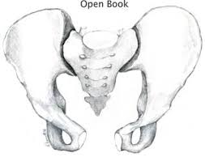
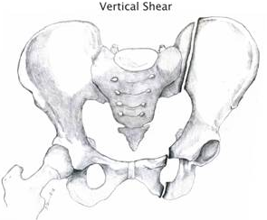
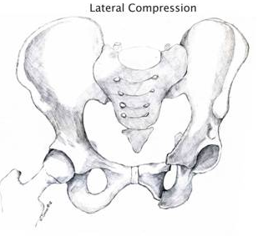
Life-Threatening Pelvic Fractures
http://www.aast.org/pelvis-injuries
Notes:
In an open book pelvis injury, the front of the pelvis opens like a book. This injury results in tears of the strong pelvic ligaments that hold the pelvis bones together at the symphysis pubis and the sacroiliac joints.
In a vertical shear pelvis injury, one half of the pelvis is forcefully shifted upward.
In a lateral crush injury, half of the pelvis is crushed either inward or outward.
In each of these types of injury, large arteries and veins can get torn resulting in massive blood loss that can threaten the casualty’s life.

Slide 9
Pelvic Fractures in Combat Casualties
Most commonly associated with dismounted IED attacks accompanied by amputations
May also occur in severe blunt trauma (such as
motor vehicle crashes, aircraft mishaps, hard parachute landings, and falls from a height)
26% of service members who died in OEF/OIF had a pelvic fracture.
Bleeding pelvic fractures with hemodynamic instability have up to 40% mortality.
Notes:
Read the text.

Slide 10
Pelvic Fractures and Lower Limb Amputations due to Dismounted IEDs
77 consecutive patients with traumatic lower limb amputation after stepping on an IED
Associated pelvic fracture:
Unilateral amputation: 10%
Bilateral amputation: 30%
Bilateral above-knee amputation: 39%
Overall, 22% had associated pelvic fractures
“This study demonstrates a high incidence of pelvic fractures in patients with traumatic lower limb amputations, supporting routine pre-hospital application of pelvic binders in this patient group”
Cross: J R Nav Med Serv, 2014
Notes:
This study by Cross in 2014 is based upon data from the United Kingdom’s Joint Theater Trauma Registry.

Slide 11
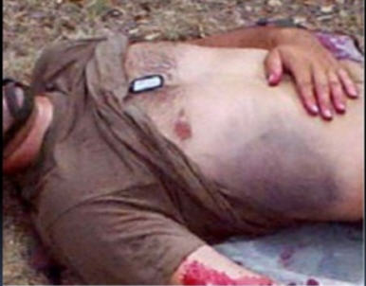
What Exam Findings Are Suggestive of a Pelvic Fracture?
Exam Findings:
Pelvic pain
Laceration or bruising at bony
prominences of the pelvic ring
Deformed or unstable pelvis
Unequal leg length
Scrotal, perineal, or perianal bruising
Blood at the urethral meatus
Massive hematuria
Blood in the rectum or vagina
Neurologic deficits in lower extremities
Notes:
Durkin A, Sagi HC, Durham R, et al. Contemporary
management of pelvic fractures. Am J Surg. 2006;192:222.

Slide 12
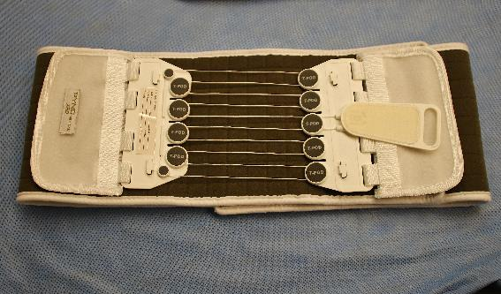
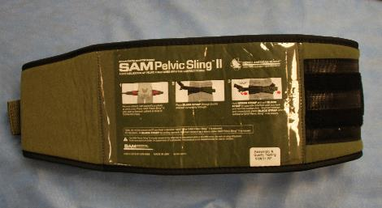
What Type of Pelvic Binding Device Should Be Used?
There are 3 commercially available pelvic binders:
The Pelvic Binder
The T-POD
The SAM Pelvic Sling II
Notes:
Read the text.

Slide 13
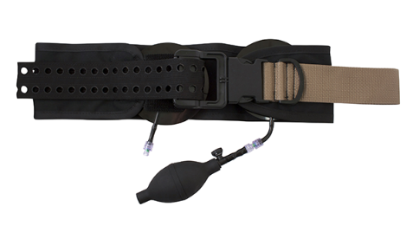
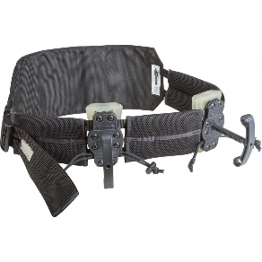
What Type of Pelvic Binding Device Should Be Used?
Two types of junctional tourniquets may also serve as pelvic binders:
The SAM Junctional Tourniquet
The Junctional Emergency Treatment Tool
Notes:
Read the text.

Slide 14
What Type of Pelvic Binding Device Should Be Used?
Any of these five devices may be used as a pelvic binder:
Pelvic Binder
T-Pod
SAM Pelvic Sling II
SAM Junctional Tourniquet
Junctional Emergency Treatment Tool
Notes:
Read the text.

Slide 15
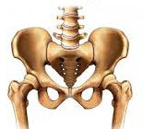
Placement of a Pelvic Binding Device
At the level of greater trochanters, NOT the iliac wings (top of the hip bone.)
In one study 40% of the pelvic binders were placed too high, resulting in inadequate reduction of the pelvic fracture and possibly increased bleeding.
Iliac wing – WRONG!
Greater
Trochanters
* Note that this
is also the level of
the pubic symphysis.
Notes:
A note on placement: pelvic binders should be placed at the level of the greater trochanters of the femurs, and not up around the iliac wings.

Slide 16
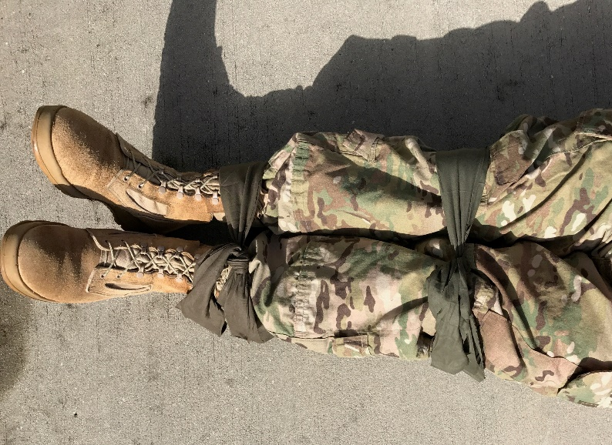
Don’t Forget!
External rotation of the lower extremities is commonly seen in persons with displaced pelvic fractures.
This may increase the dislocation of pelvic fragments.
External rotation can be prevented or reduced by securing the knees or feet together, improving the effect achieved by the pelvic binder.
Don’t logroll casualties with
suspected pelvic fractures –
this may increase internal bleeding.
Notes:
Read the text.

Slide 17
Don’t Forget!
Once a binder is on, if additional procedures at the Role II require access to the abdomen or groin (i.e., REBOA), the binder may be moved down to the upper thigh. This will limit external rotation and minimize the reopening of the pelvis.
If definitive care is delayed beyond approximately 8-12 hours, the need for a binder should be reassessed and the binder loosened if the patient remains hemodynamically stable.
Notes:
Reminder for physicians and anyone providing prolonged care in the field.

Slide 18
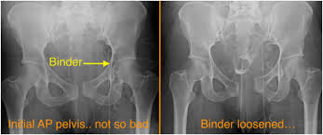
Don’t Forget!
Pelvic binders may mask the presence of a pelvic fracture on CT scanning.
Notes:
This is a reminder for physicians receiving casualties.

Slide 19
Pelvic Binding Device Practical
DoD Photo by SSgt Ryan Crane, USA
Notes:
Separate into small groups of up to six students per instructor.
Practice with the device that your unit will be using.

Slide 20
Thank You!
Questions?
20

Slide 21
Tactical Field Care Guidelines
6. Circulation
a. Bleeding (continued)
● Reassess prior tourniquet application. Expose the wound and determine if a tourniquet is needed. If it is needed, replace any limb tourniquet placed over the uniform with one applied directly to the skin 2-3 inches above the bleeding site. Ensure that bleeding is stopped. If there is no traumatic amputation, a distal pulse should be checked. If bleeding persists or a distal pulse is still present, consider additional tightening of the tourniquet or the use of a second tourniquet side-by-side with the first to eliminate both bleeding and the distal pulse. If the reassessment determines that the prior tourniquet was not needed, then remove the tourniquet and note time of removal on the TCCC Casualty Card.
Notes:
21
Read the guideline.

Slide 22
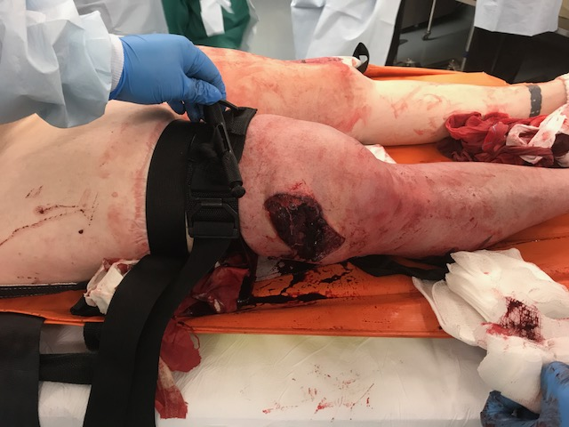
Tourniquets: Points to Remember
Tightening the tourniquet enough to eliminate the distal pulse will help to ensure that all bleeding is stopped, and that there will be no damage to the extremity from blood entering the extremity
but not being
able to get out.
Photo courtesy Dr. Warren Dorlac
Notes:
22
Although a tourniquet may stop the active bleeding, it also prevents venous blood from returning to the heart. If arterial blood continues to flow past the tourniquet, pressure can build up distally in the limb and create a compartment syndrome. This is why the tourniquet should be tightened until there is no longer a distal pulse even if bleeding is controlled – to minimize the chance of harm from a developing compartment syndrome.
Compartment Syndrome can cause unnecessary loss of the extremity.

Slide 23
Tourniquet Repositioning
Notes:
Click on the photo to play the video.
The video is entitled Tourniquet Replacement, but the slide is entitled Tourniquet Repositioning. You are technically replacing the high-and-tight tourniquet with a second closer to the bleeding site, but the clinical significance lies in repositioning the point of blood flow occlusion so that the limb above the second tourniquet has its circulation restored.

Slide 24
Tourniquet Repositioning
It is better to wait to route the self-adhering strap of the second tourniquet through its securing clips and securing it with the safety strap until you have loosened the first tourniquet and assured the bleeding is controlled by the second tourniquet.
You may have to further tighten the second tourniquet.
Comments on the Video from the CoTCCC Staff
Notes:
Don’t lock down the rod of the second tourniquet until you loosen the first tourniquet and see that the second is tight enough to control the bleeding.

Slide 25
Tourniquets: Points to Remember
Damage to the arm or leg is rare if the tourniquet is left on for less than two hours.
Tourniquets are often left in place for several hours during surgical procedures.
In the face of massive extremity hemorrhage, it is better to accept the small risk of damage to the limb than to have a casualty bleed to death.
Notes:
25
Tourniquets have historically been frowned upon in civilian trauma settings.
In combat settings, they are the biggest lifesaver on the battlefield!
They are NOT A PROBLEM if not left in place for too long.

Slide 26
Tactical Field Care Guidelines
6. Circulation
Bleeding (continued)
● Limb tourniquets and junctional tourniquets should be converted to hemostatic or pressure dressings as soon as possible if three criteria are met: the casualty is not in shock; it is possible to monitor the wound closely for bleeding; and the tourniquet is not being used to control bleeding from an amputated extremity. Every effort should be made to convert tourniquets in less than 2 hours if bleeding can be controlled with other means. Do not remove a tourniquet that has been in place more than 6 hours unless close monitoring and lab capability are available.
Notes:
26
Read the guideline.

Slide 27
Tourniquets: Points to Remember
Every effort should be made to convert tourniquets in less than 2 hours if bleeding can be controlled by other means. If bleeding remains controlled with Combat Gauze, leave the loosened tourniquet in place. If the bleeding is not controlled with Combat Gauze, re-tighten the tourniquet until bleeding stops.
Restoring blood flow to the limb by transitioning to Combat Gauze at the 2-hour mark will minimize the chance of ischemic damage due to the tourniquet.
Notes:
27
Read the text.

Slide 28
Tourniquet Conversion
Expose the wound(s).
Notes:
Converting a tourniquet to a hemostatic dressing is a simple stepwise procedure. The first step is to expose the wound by cutting away the overlying uniform. The following sequence of slides shows the conversion of a tourniquet placed “high-and-tight” during Care Under Fire, but the procedure is the same for conversion of a tourniquet placed anywhere.

Slide 29
Tourniquet Conversion
Apply Combat Gauze and a pressure dressing.
Notes:
Read the text.

Slide 30
Tourniquet Conversion
Loosen “high-and-tight” tourniquet and move it down to just above the pressure dressing. (Leave it loose here just in case it’s needed later.)
Monitor for re-bleeding.
Notes:
Read the text.

Slide 31
Tourniquets: Points to Remember
If the transition to Combat Gauze at 2 hours failed, try again at 6 hours using the steps outlined in the previous slides.
Do not release the tourniquet after 6 hours of application unless close monitoring and lab support are available to evaluate for metabolic complications of prolonged tourniquet use.
Notes:
31
Release of a tourniquet that has been in place for some time typically results in acidosis, hyperkalemia, and rhabdomyolysis. These conditions will require monitoring and treatment in a medical treatment facility.

Slide 32
Tourniquets: Points to Remember
Do not convert the tourniquet if:
The casualty is in shock.
You cannot closely monitor the wound for re-bleeding.
The extremity distal to the tourniquet has been traumatically amputated.
The tourniquet has been on for more than 6 hours.
The casualty will arrive at a medical treatment facility within 2 hours after time of application.
Tactical or medical considerations make transition to other hemorrhage control methods inadvisable.
Notes:
32
Pay very close attention to these rules about tourniquet removal.

Slide 33
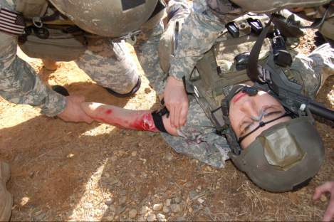
Tourniquets: Points to Remember
Only medics, physician assistants, or physicians should re-position or convert tourniquets.
Notes:
33
Read the text.

Slide 34
Tactical Field Care Guidelines
6. Circulation
Bleeding (continued)
- Expose and clearly mark all tourniquets with the time of tourniquet application. Note tourniquets applied and time of application; time of re-application; time of conversion; and time of removal on the TCCC Casualty Card. Use a permanent marker to mark on the tourniquet and the casualty card.
Notes:
34
Read the guideline.
Documentation of all actions taken with regard to tourniquets is important.

Slide 35
Questions?

