Slide 1
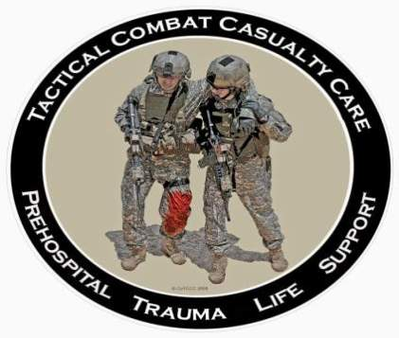
Tactical Combat Casualty Care for Medical Personnel
August 2018
(Based on TCCC-MP Guidelines 180801)
Tactical Field Care 2e
Triple-Option Analgesia and Monitoring
Notes:
In this presentation we will discuss electronic monitoring and TCCC Triple-Option Analgesia in TFC.

Slide 2

Disclaimer
“The opinions or assertions contained herein are the private views of the authors and are not to be construed as official or as reflecting the views of the Departments of the Army, Air Force, Navy or the Department of Defense.”
There are no conflict of interest disclosures
Notes:
Read the disclaimer.

Slide 3
LEARNING Objectives
Terminal Learning Objective
Perform Analgesia Administration in Tactical Field Care.
Enabling Learning Objectives
Describe the indications and considerations of the "Triple Option Analgesia" approach in Tactical Field Care.
Identify the TCCC indications, contraindications, and administration methods of all TCCC-recommended analgesics.
Notes:
Read the text.

Slide 4
LEARNING Objectives
Enabling Learning Objectives
Identify the TCCC indications and administration methods of nalaxone in Tactical Field Care.
Identify the TCCC indications and administration methods of ondansetron in Tactical Field Care.
Demonstrate the preparation and administration of intravenous ketamine.
Notes:
Read the text.

Slide 5
Tactical Field Care Guidelines
9. Monitoring
a. Initiate advanced electronic monitoring if indicated and if monitoring equipment is available.
Notes:
Read the guideline.
Advanced monitoring units are available and sometimes carried forward by mounted units into Tactical Field Care scenarios. Propaq LT, Tempus Pro, and LifePak are examples.

Slide 6
Tactical Field Care Guidelines
10. Analgesia
a. Analgesia on the battlefield should generally be achieved using one of three options:
Notes:
Read the guideline.

Slide 7
Tactical Field Care Guidelines
10. Analgesia (continued)
● Option 1
⁃ Mild to Moderate Pain
Casualty is still able to fight
◦ TCCC Combat Wound Medication Pack (CWMP):
* Tylenol – 650 mg bilayer caplet, 2
PO every 8 hours
* Meloxicam - 15 mg PO once a day
Notes:
Read the guideline.

Slide 8
Tactical Field Care Guidelines
10. Analgesia (continued)
● Option 2
⁃ Moderate to Severe Pain
Casualty IS NOT in shock or respiratory distress
AND
Casualty IS NOT at significant risk of
developing either condition
Oral transmucosal fentanyl citrate (OTFC) 800 ug
* Place lozenge between the cheek and the gum
* Do not chew the lozenge
Notes:
Read the guideline.

Slide 9
Tactical Field Care Guidelines
10. Analgesia (continued)
● Option 3
⁃ Moderate to Severe Pain
Casualty IS in shock or respiratory distress OR
Casualty IS at significant risk of developing either
condition
◦ Ketamine 50 mg IM or IN
Or
◦ Ketamine 20 mg slow IV or IO
* Repeat doses q30min prn for IM or IN
* Repeat doses q20min prn for IV or IO
* End points: Control of pain or development of nystagmus (rhythmic back-and-forth movement of the eyes)
Notes:
Read the guideline.

Slide 10
Tactical Field Care Guidelines
Analgesia Notes
Casualties may need to be disarmed after being given OTFC or ketamine.
Document a mental status exam using the AVPU method prior to administering opioids or ketamine.
For all casualties given opioids or ketamine – monitor airway, breathing, and circulation closely.
Notes:
Read the guideline.

Slide 11
Tactical Field Care Guidelines
Analgesia Notes (cont)
d. Directions for administering OTFC:
- Recommend taping lozenge-on-a-stick to
casualty’s finger as an added safety measure
OR utilizing a safety pin and rubber band to
attach the lozenge (under tension) to the
casualty’s uniform or plate carrier.
- Reassess in 15 minutes
- Add second lozenge, in other cheek, as
necessary to control severe pain
- Monitor for respiratory depression
Notes:
Read the guidelines.

Slide 12
Tactical Field Care Guidelines
Analgesia Notes (cont)
e. IV Morphine is an alternative to OTFC if IV access has been obtained
- 5 mg IV/IO
- Reassess in 10 minutes.
- Repeat dose every 10 minutes as
necessary to control severe pain
- Monitor for respiratory depression
Notes:
Read the guideline.

Slide 13
Tactical Field Care Guidelines
Analgesia Notes (cont)
f. Naloxone (0.4 mg IV or IM) should be available
when using opioid analgesics.
g. Both ketamine and OTFC have the potential to
worsen severe TBI. The combat medic, corpsman,
or PJ must consider this fact in his or her
analgesic decision, but if the casualty is able to
complain of pain, then the TBI is likely not severe
enough to preclude the use of ketamine or OTFC.
Notes:
Read the guideline.

Slide 14
Tactical Field Care Guidelines
Analgesia Notes (cont)
h. Eye injury does not preclude the use of
ketamine. The risk of additional damage to
the eye from using ketamine is low and
maximizing the casualty’s chance for
survival takes precedence if the casualty is
in shock or respiratory distress or at
significant risk for either.
Notes:
Read the guideline.

Slide 15
Tactical Field Care Guidelines
Analgesia Notes (cont)
i. Ketamine may be a useful adjunct to reduce the
amount of opioids required to provide effective
pain relief. It is safe to give ketamine to a
casualty who has previously received morphine
or OTFC. IV Ketamine should be given over 1
minute.
j. If respirations are noted to be reduced after using
opioids or ketamine, provide ventilatory support
with a bag-valve-mask or mouth-to-mask
ventilations.
Notes:
Read the guideline .

Slide 16
Tactical Field Care Guidelines
Analgesia Notes (cont)
k. Ondansetron, 4 mg ODT/IV/IO/IM, every 8 hours as needed for nausea or vomiting. Each 8­hour dose can be repeated once at 15 minutes if nausea and vomiting are not improved. Do not give more than 8 mg in any 8­hour interval. Oral ondansetron is NOT an acceptable alternative to the ODT formulation.
l. Reassess – reassess – reassess!
Notes:
Read the guideline.
Ondansetron is now the drug of choice for treating nausea and vomiting, replacing promethazine.

Slide 17
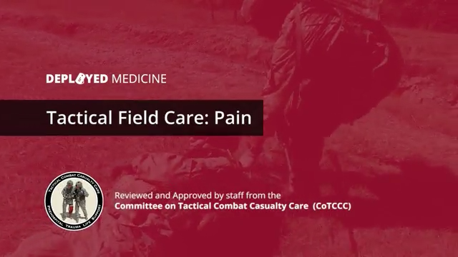
Triple-Option Analgesia
Video
Notes:
Click on the photo to play the video.

Slide 18
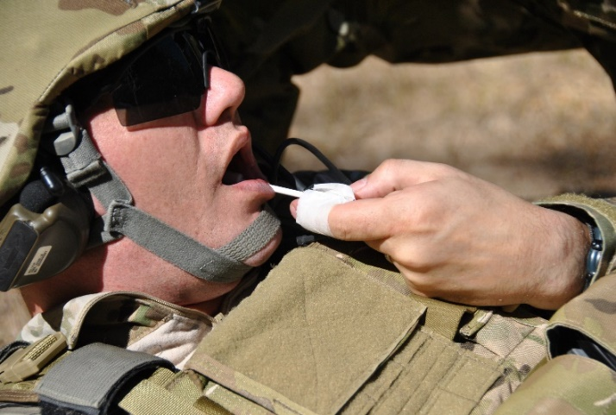
Pain Control – Fentanyl Lozenges
Safety Note:
    There is an FDA Safety
    Warning regarding the use
    of fentanyl lozenges in
    individuals who are not narcotic tolerant.
    Multiple studies have demonstrated safety when used at the TCCC-recommended dosing levels.
    Fentanyl lozenges have a well-documented safety record in Afghanistan and Iraq - BUT NOTE:
    DON’T USE TWO WHEN ONE WILL DO!
Notes:
18
Here is an important note regarding fentanyl use:
Respiratory depression at the 800-microgram dose level has not been noted in 14 years of combat experience. If it does occur, start an IV and give Narcan. Assist respiration as necessary.

Slide 19
Ketamine
At lower doses, potent analgesia and mild sedation
At higher doses, dissociative anesthesia and moderate to deep sedation
Unique among anesthetics because pharyngeal-laryngeal reflexes are maintained
Cardiac function is stimulated rather than depressed
Less risk of respiratory depression than morphine and fentanyl
Works reliably by multiple routes
  IM, intranasal, IV, IO
Notes:
“Dissociative” anesthetics distort perceptions of sight and sound and produce feelings of detachment – or dissociation – from environment and self.
19

Slide 20
Ketamine - Safety
Ketamine has a very favorable safety profile.
Few, if any, deaths have been attributed to ketamine as a single agent.
FDA Insert:
  "Ketamine has a wide margin of safety; several instances of unintentional administration of overdoses of ketamine (up to ten times that usually required) have been followed by prolonged but complete recovery.”
Notes:
Read the text.
20

Slide 21
Ketamine - Side Effects
Respiratory depression and apnea can occur if IV ketamine is administered too rapidly.
Providing several breaths via bag-valve-mask ventilation is typically successful in restoring normal breathing.
Notes:
Naloxone does not reverse the effects of ketamine. Mechanical ventilatory assistance may be required in rare instances if apnea occurs.
21

Slide 22

Warning: Morphine and Fentanyl Contraindications
Hypovolemic shock
Respiratory distress
Unconsciousness
Severe head injury
DO NOT give morphine or fentanyl to casualties with these contraindications.
Notes:
22
As stated in the video, giving morphine or fentanyl to casualties with these conditions can be fatal.

Slide 23
Warning: Opioids and Benzos
Ketamine can safely be given
after a fentanyl lozenge.
Some practitioners use
benzodiazepine medications
such as midazolam to avoid
ketamine side effects BUT:
Midazolam may cause respiratory depression, especially when used with opioids.
Avoid giving midazolam to casualties who have previously gotten fentanyl lozenges or morphine.
Notes:
23
In the doses recommended, you can safely give a casualty ketamine after he has received fentanyl. Midazolam, however, should never be given to a casualty who has fentanyl or morphine in his system.

Slide 24
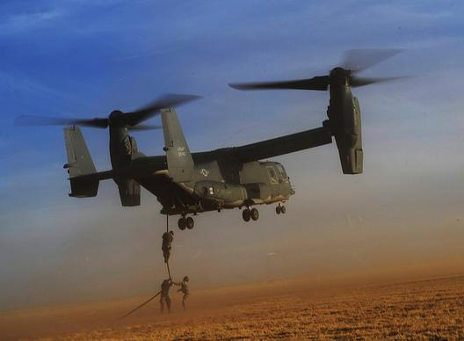
Questions?
Notes:
24

Slide 25
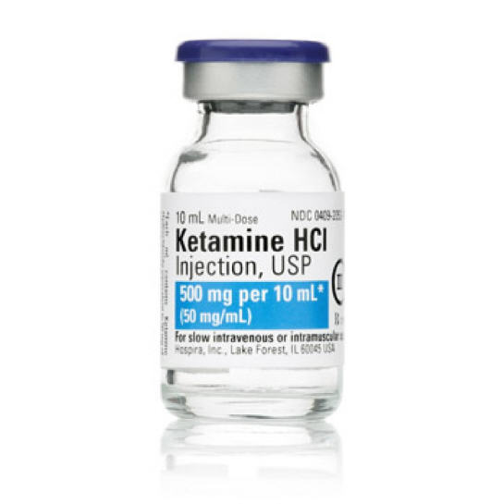
IV Ketamine Practical
Notes:
Break into small groups for the practical.

