Slide 1
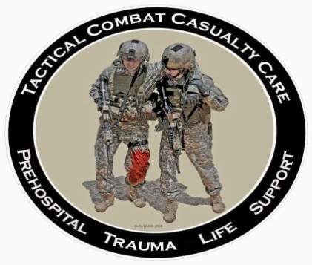
Tactical Combat Casualty Care for Medical Personnel August 2018 (Based on TCCC-MP Guidelines 180801)
Tactical Field Care 3a
Antibiotics and Wound Care
Notes:
Next, we will discuss antibiotics and wound care in TCCC

Slide 2
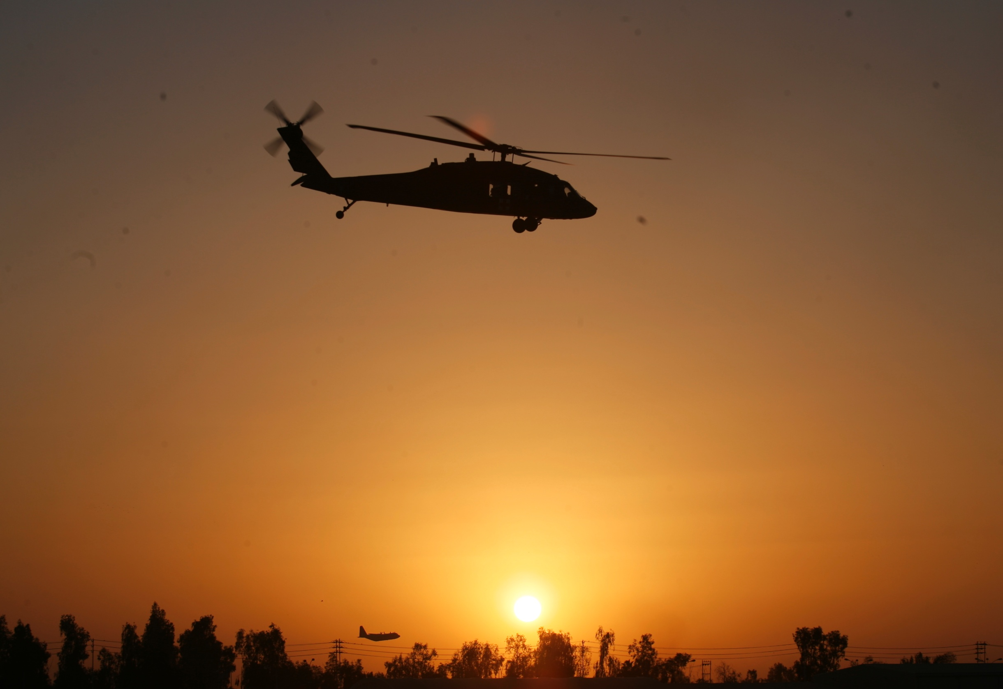
Disclaimer
“The opinions or assertions contained herein are the private views of the authors and are not to be construed as official or as reflecting the views of the Departments of the Army, Air Force, Navy or the Department of Defense.”
There are no conflict of interest disclosures.
Notes:
Read the disclaimer.

Slide 3
LEARNING OBJECTIVES
Terminal Learning Objective
Perform antibiotic administration in TFC
Enabling Learning Objectives
Identify the evidence and considerations for early antibiotic administration in Tactical Field Care.
Identify the TCCC indications, contraindications, and administration methods of moxifloxacin in Tactical Field Care.
Identify the TCCC indications, contraindications, and administration methods of ertapenem in Tactical Field Care.
Notes:
Read the text.

Slide 4
Tactical Field Care Guidelines
11. Antibiotics: recommended for all open combat
wounds:
a. If able to take PO meds:
- Moxifloxacin (from the CWMP), 400 mg PO once a day
b. If unable to take PO (shock, unconsciousness):
- Ertapenem, 1 g IV/IM once a day
Notes:
Read the guideline.
You should irrigate wounds with clean water, if possible, since this also reduces the chance of infection.

Slide 5
Outcomes: Without Battlefield Antibiotics
Mogadishu 1993
Casualties: 58
Wound Infections: 16
Infection rate: 28%
Time from wounding
to Level II care – 15 hrs.
Mabry et al
J Trauma 2000
Notes:
Why bother giving antibiotics in the field?
Why not just wait until they get to the hospital?
ANTIBIOTICS MUST BE GIVEN EARLY TO PREVENT WOUND INFECTIONS.
WOUND INFECTIONS CAN KILL THE CASUALTY OR DELAY HIS RECOVERY.
Let’s look at three examples. This is the first.

Slide 6
Outcomes: With Battlefield Antibiotics
Tarpey – AMEDD J 2005:
32 casualties with open wounds
All received battlefield antibiotics
None developed wound infections
Used TCCC recommendations modified by availability:
Levofloxacin for an oral antibiotic
IV cefazolin for extremity injuries
IV ceftriaxone for abdominal injuries.
Notes:
This is a huge improvement over the wound infection rate seen in Mogadishu.

Slide 7
Outcomes: With Battlefield Antibiotics
MSG Ted Westmoreland
Special Operations Medical Association presentation 2004
Multiple casualty scenario involving 19 Ranger and Special Forces WIA as well as 30 Iraqi WIA
11-hour delay to hospital care
Battlefield antibiotics given
No wound infections developed in this group.
Notes:
USE battlefield antibiotics!

Slide 8
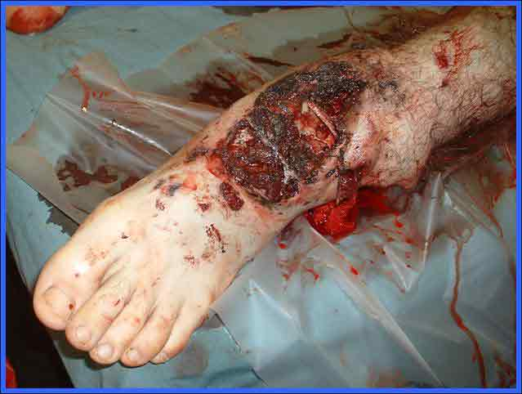
Battlefield Antibiotics
Recommended for all open wounds on the battlefield!
Notes:
Even wounds much less severe than this warrant antibiotic coverage.

Slide 9
Battlefield Antibiotics Video
Notes:
Click on the photo to play the video.

Slide 10
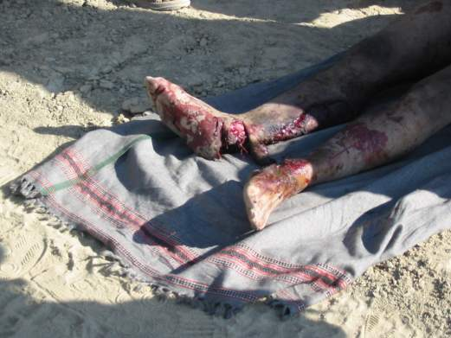
Tactical Field Care Guidelines
12. Inspect and dress known wounds.
13. Check for additional wounds.
Notes:
Read the guidelines.
Expose wounded areas by using trauma shears to cut away the casualty’s clothing. It’s too easy to cut the casualty if you use a knife for this.

Slide 11
Questions?

