Slide 1
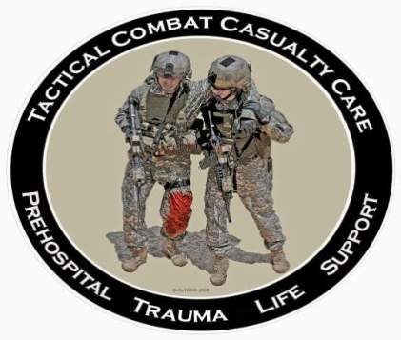
Tactical Combat Casualty Care for Medical Personnel August 2018 (Based on TCCC-MP Guidelines 180801)
Tactical Field Care 3b
Burns and Fractures
Notes:
In this presentation, we will discuss the management of burns and fractures in TFC

Slide 2
Disclaimer
“The opinions or assertions contained herein are the private views of the authors and are not to be construed as official or as reflecting the views of the Departments of the Army, Air Force, Navy or the Department of Defense.”
There are no conflict of interest disclosures.
Notes:
Read the disclaimer.

Slide 3
LEARNING OBJECTIVES
Terminal Learning Objective
Perform assessment and initial treatment of burns in Tactical Field Care.
Enabling Learning Objectives
Identify the different types of burns based on depths.
Describe how to use the Rule of Nines to calculates the total body surface area that has been burned.
Notes:
Read the text.

Slide 4
LEARNING OBJECTIVES
Enabling Learning Objectives
Describe the fluid resuscitation strategy for burned casualties using the USAISR Rule of Tens.
Describe the techniques used to cover burn areas and to protect the casualty from hypothermia.
Identify the airways and pulmonary complications that can ensue from burns and the associated smoke inhalation.
Notes:
Read the text.

Slide 5
LEARNING OBJECTIVES
Terminal Learning Objective
Perform assessment and initial treatment of fractures in Tactical Field Care.
Enabling Learning Objectives
Identify the signs, symptoms, and considerations of a fractured extremity in tactical field care.
Describe the application of a splint to a suspected fracture in Tactical Field Care.
Notes:
Read the text.

Slide 6
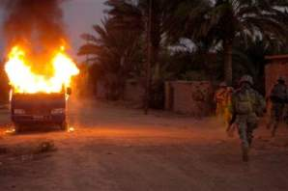
Tactical Field Care Guidelines
14. Burns
a. Facial burns, especially those that occur in closed spaces, may be associated with inhalation injury. Aggressively monitor airway status and oxygen saturation in such patients and consider early surgical airway for respiratory distress or oxygen desaturation.
b. Estimate total body surface area (TBSA) burned to the nearest 10% using the Rule of Nines.
Notes:
Read the guidelines.

Slide 7
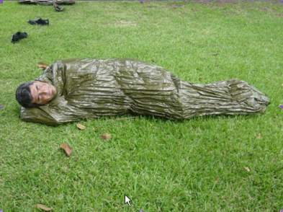
Tactical Field Care Guidelines
14. Burns (cont)
c. Cover the burn area with dry, sterile dressings. For extensive burns (>20%), consider placing the casualty in the Heat Reflective Shell or Blizzard Survival Blanket from the Hypothermia Prevention Kit in order to both cover the burned areas and prevent hypothermia.
Notes:
Read the guideline.

Slide 8
Tactical Field Care Guidelines
14. Burns (cont)
d. Fluid resuscitation (USAISR Rule of Ten)
● If burns are greater than 20% of TBSA, fluid resuscitation should be initiated as soon as IV/IO access is established. Resuscitation should be initiated with Lactated Ringer’s, normal saline, or Hextend. If Hextend is used, no more than 1000 ml should be given, followed by Lactated Ringer’s or normal saline as needed.
Notes:
Read the guideline.

Slide 9
Tactical Field Care Guidelines
14. Burns
d. Fluid resuscitation (USAISR Rule of Ten) (cont)
Initial IV/IO fluid rate is calculated as %TBSA x 10ml/hr for adults weighing 40-80 kg.
For every 10 kg ABOVE 80 kg, increase initial rate by 100 ml/hr.
If hemorrhagic shock is also present, resuscitation for hemorrhagic shock takes precedence over resuscitation for burn shock. Administer IV/IO fluids per the TCCC Guidelines in Section (6).
Notes:
Read the guideline.

Slide 10
Tactical Field Care Guidelines
14. Burns (cont)
e. Analgesia in accordance with TCCC Guidelines in Section (10) may be administered to treat burn pain.
f. Prehospital antibiotic therapy is not indicated solely for burns, but antibiotics should be given per TCCC guidelines in Section (11) if indicated to prevent infection in penetrating wounds.
Notes:
Read the guidelines.

Slide 11
Tactical Field Care Guidelines
14. Burns (cont)
g. All TCCC interventions can be performed on or through burned skin in a burn casualty.
h. Burn patients are particularly susceptible to hypothermia. Extra emphasis should be placed on barrier heat loss prevention methods.
Notes:
Read the guidelines.

Slide 12
Burns in Tactical Field Care Video
Notes:
Click on the photo to play the video.

Slide 13
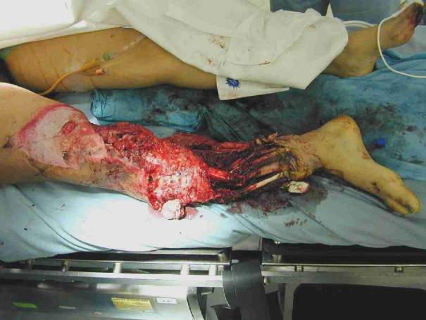
Tactical Field Care Guidelines
15. Splint fractures and recheck pulses.
Notes:
Read the guideline.

Slide 14
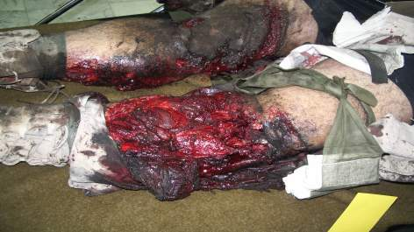
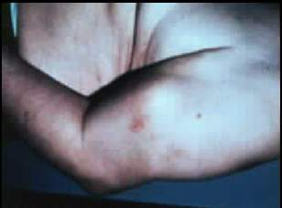
Fractures: Open or Closed
Open Fracture – associated with an overlying skin wound
Closed Fracture – no overlying skin wound
Open fracture
Closed fracture
Notes:
Open fractures present a major threat of serious infection.

Slide 15
Clues to a Closed Fracture
Trauma with significant pain AND
Marked swelling
Audible or perceived “snap”
Different length or shape of limb
Loss of pulse or sensation distally
Crepitus (“crunchy” sound)
Notes:
What are the warning signs that an arm or leg might be fractured?

Slide 16
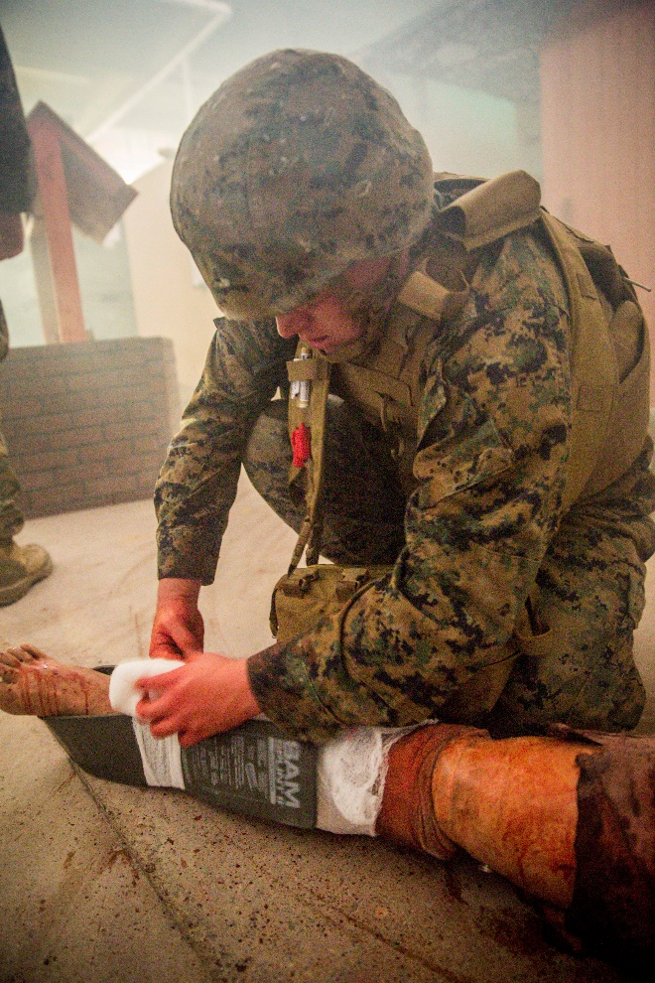
Splinting Objectives
Prevent further injury
Protect blood vessels and nerves
- Check pulse before and after splinting
Make casualty more comfortable
Notes:
Why do we take the time to splint fractures?

Slide 17
Principles of Splinting
Check for other injuries
Use rigid or bulky materials
Try to pad or wrap if using a rigid splint
Secure splint with ace wrap, cravats, belts, duct tape
Try to splint before moving the casualty
Notes:
Here are some of the things that you want to do when splinting a fracture.

Slide 18
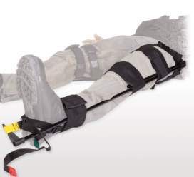
Principles of Splinting
Minimize manipulation of the extremity before splinting.
Incorporate the joint above and below.
Arm fractures can be splinted to the shirt using a sleeve.
Consider traction splinting
for mid-shaft femur fractures.
Check a distal pulse and skin
color before and after splinting.
Notes:
And here are a few more of the things that you want to do when splinting a fracture.
The splint shown here is a traction splint.

Slide 19
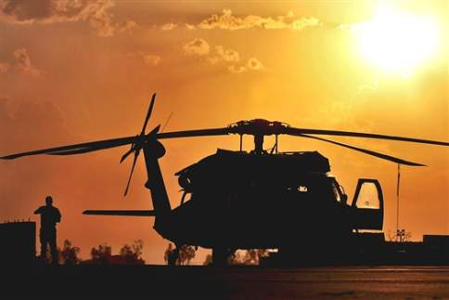
Things to Avoid in Splinting
Manipulating the fracture too much and damaging blood vessels or nerves
Wrapping the splint too tight and cutting off circulation below the splint
Notes:
You can do harm with splinting as well.

Slide 20
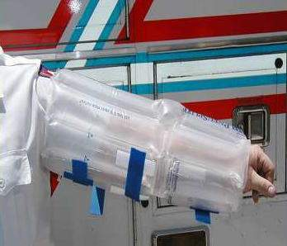
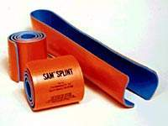
Commercial Splints
Notes:
A pneumatic splint and a flexible type splint are shown here.

Slide 21
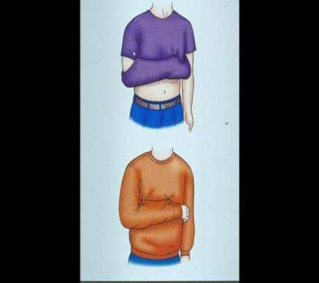
Field-Expedient Splint Materials
Shirt sleeves/safety pins
Weapons
Boards
Boxes
Tree limbs
ThermaRest pad
Notes:
Remember to pad rigid splints.
If you use a weapon as a splint – don’t forget to unload and safe it first!

Slide 22
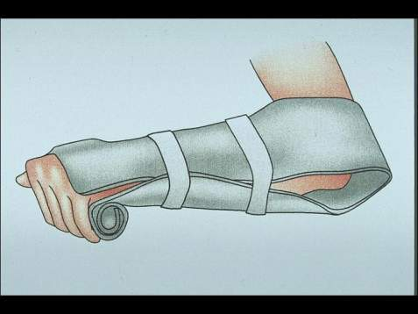
Don’t Forget!
Pulse, motor and sensory checks before and after splinting!
Notes:
The most important aspect of splinting is to splint in a way that does not harm the nerves or blood vessels to the extremity. Check for this by assessing circulation and motor and sensory status before and after splinting.

Slide 23
Questions?

