Slide 1
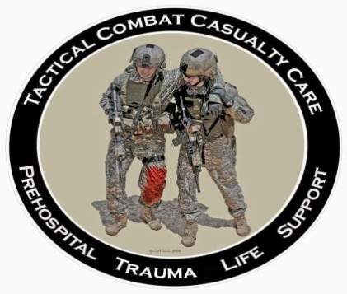
Tactical Combat Casualty Care for Medical Personnel August 2018 (Based on TCCC-MP Guidelines 180801)
Tactical Field Care 3c
Communication, Evacuation Priorities and CPR in Tactical Field Care
Notes:
Next, we will discuss communication, evacuation priorities, and CPR in TFC

Slide 2
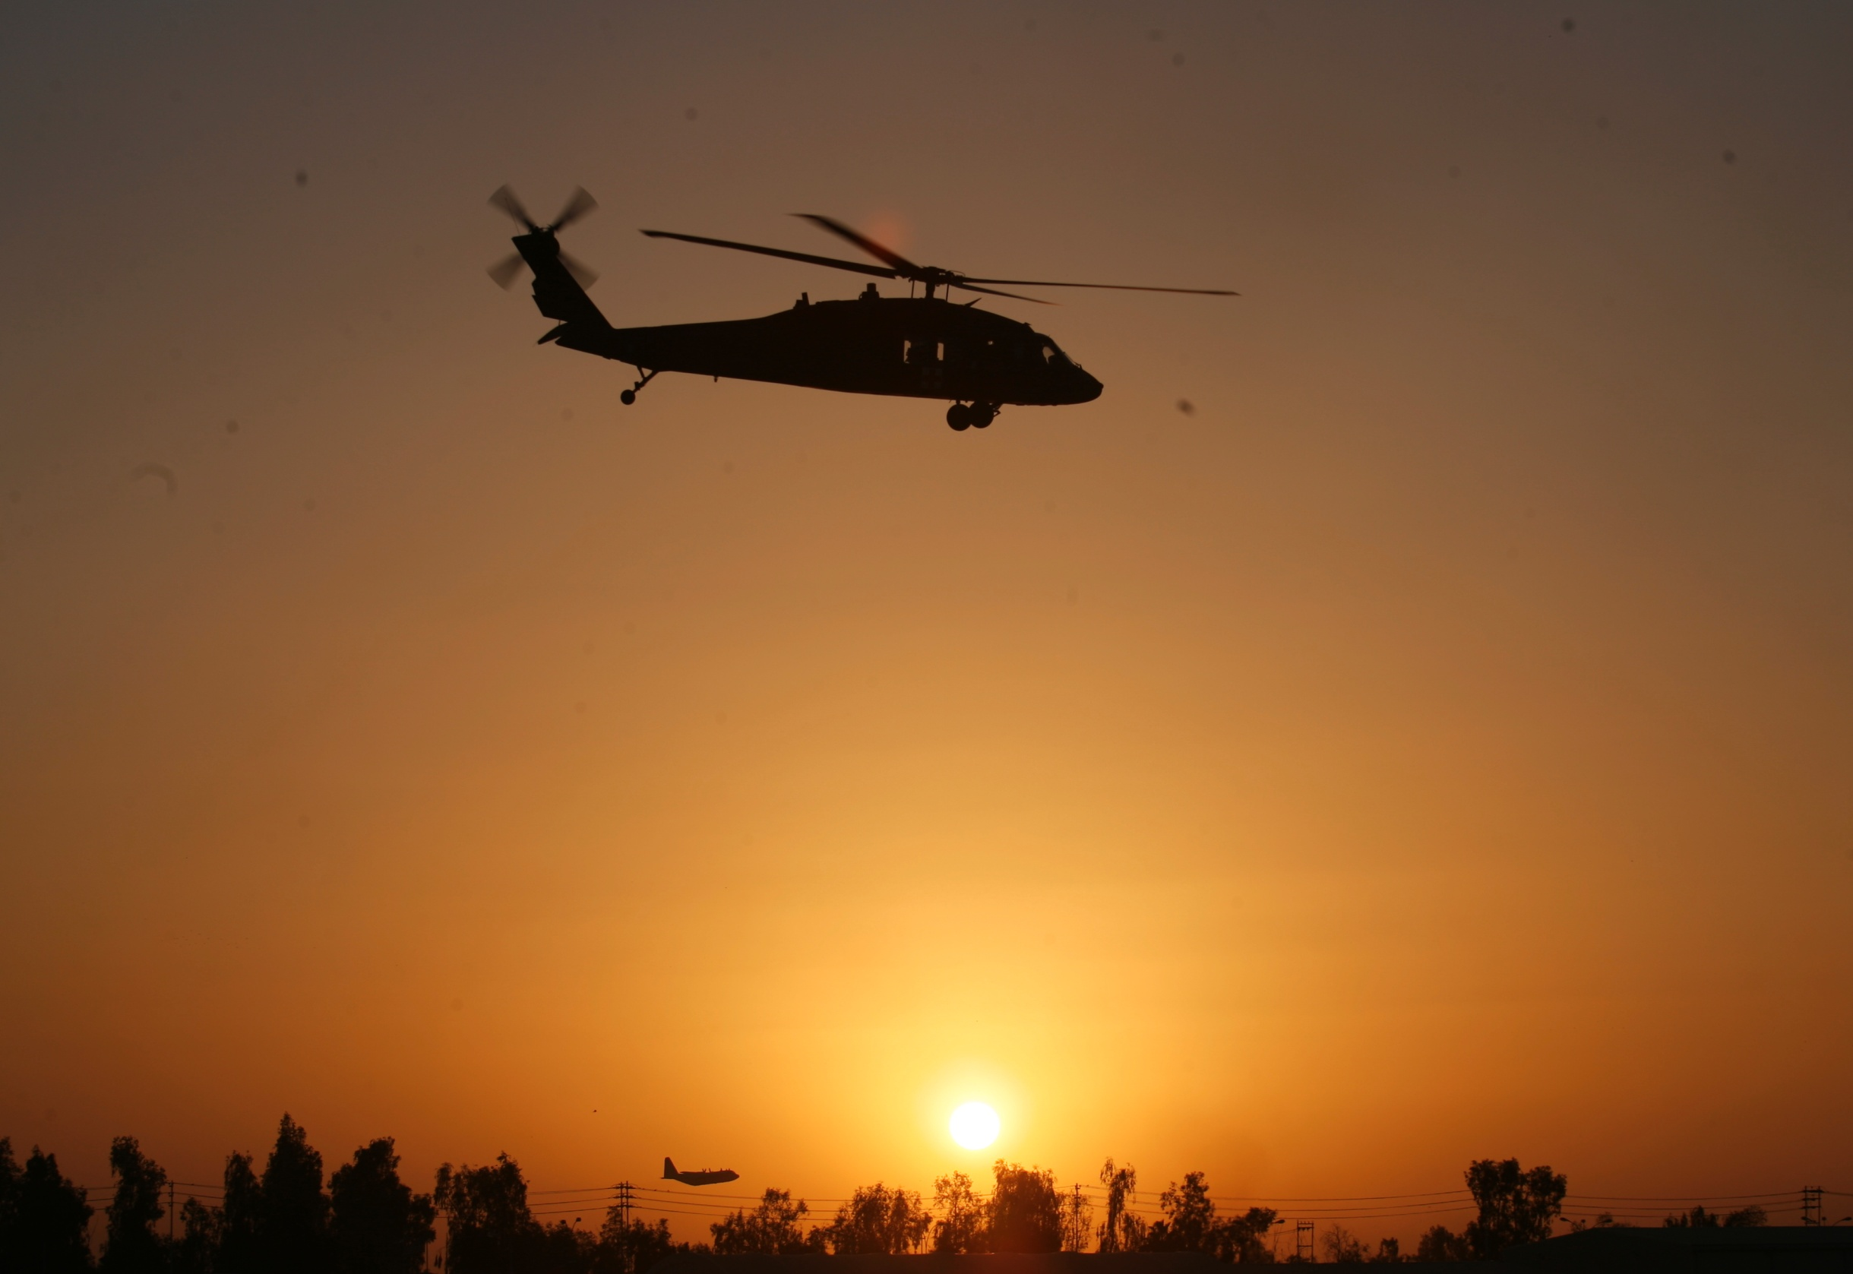
Disclaimer
“The opinions or assertions contained herein are the private views of the authors and are not to be construed as official or as reflecting the views of the Departments of the Army, Air Force, Navy or the Department of Defense.”
There are no conflict of interest disclosures.

Slide 3
LEARNING Objectives
Terminal Learning Objective
Communicate combat casualty care items effectively in Tactical Field Care.
Enabling Learning Objectives
Identify the importance and techniques of communication with a casualty in Tactical Field Care.
Identify the importance and techniques of communicating casualty information with unit tactical leadership.
Notes:
Read the text.

Slide 4
LEARNING Objectives
Enabling Learning Objectives
Identify the importance and techniques of communicating casualty information with evacuation assets or receiving facilities.
Identify the relevant tactical and casualty data involved in communicating casualty information.
Identify the evacuation urgencies recommended in the TCCC TACEVAC “Nine Rules of Thumb” and the JTS evacuation guidelines
Identify the information requirements and format of the 9-Line MEDEVAC Request.
Notes:
Read the text.

Slide 5
LEARNING Objectives
Terminal Learning Objective
Describe cardiopulmonary resuscitation (CPR) considerations in Tactical Field Care.
Enabling Learning Objectives
Identify considerations for cardiopulmonary resuscitation in tactical field care.
Describe why cardiopulmonary resuscitation is not generally used for traumatic cardiac arrest in battlefield trauma care.
Identify the conditions in which CPR should be considered in tactical field care.
Notes:
Read the text.

Slide 6
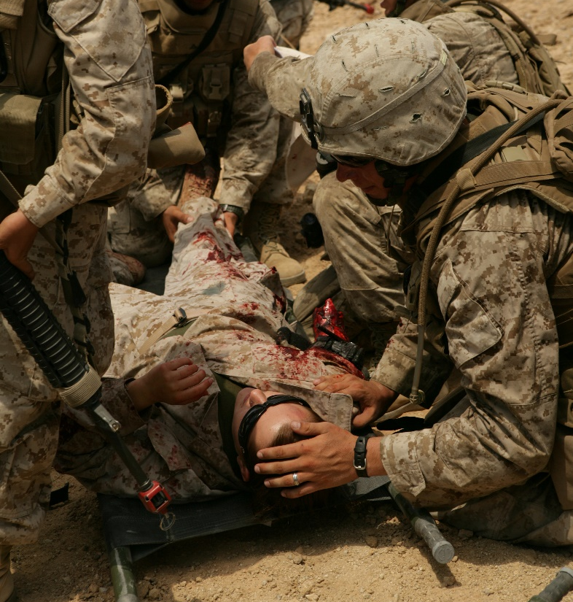
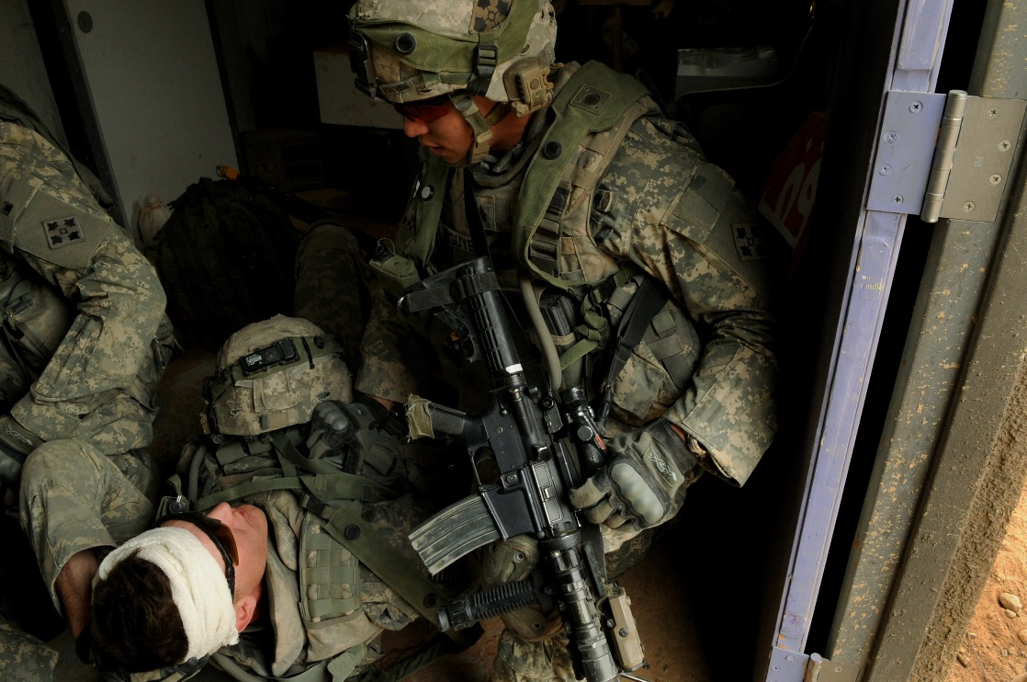
Tactical Field Care Guidelines
16. Communication
a. Communicate with the casualty if possible. Encourage, reassure and explain care
Notes:
Read the guideline.

Slide 7
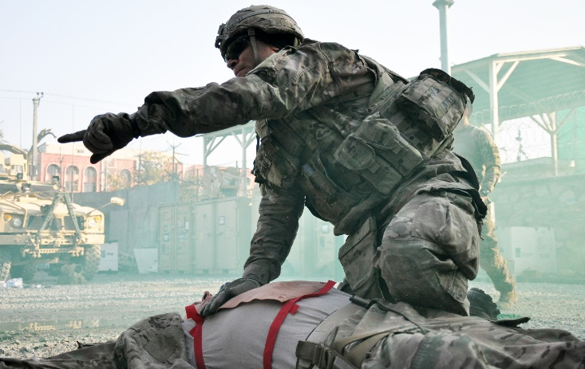
Tactical Field Care Guidelines
16. Communication (cont)
b. Communicate with tactical leadership as soon as possible and throughout casualty treatment as needed. Provide leadership with casualty status and evacuation requirements to assist with coordination of evacuation assets.
Notes:
Read the guideline.

Slide 8
Tactical Field Care Guidelines
16. Communication (cont)
c. Communicate with the evacuation system (the Patient Evacuation Coordination Cell) to arrange for TACEVAC. Communicate with medical providers on the evacuation asset if possible and relay mechanism of injury, injuries sustained, signs/symptoms, and treatments rendered. Provide additional information as appropriate.
Notes:
Read the guideline.
Don’t wait until the end of TFC to begin communicating.
Talk to your patient throughout treatment.
Talk to leadership throughout the TFC process.

Slide 9
Talk to the Casualty
Encourage, reassure and explain care.
Talking with the casualty helps assess his mental status.
Talking through procedures helps maintain your own confidence and the casualty’s confidence in you.
Notes:
Read the text.

Slide 10
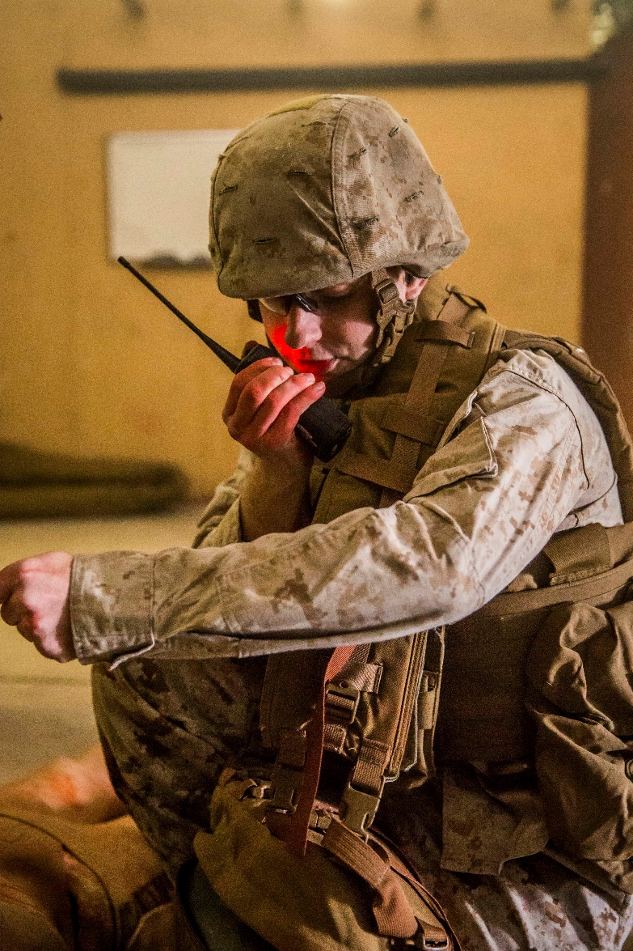
Talk to Leadership
Communicate with tactical leadership ASAP and throughout the treatment process.
Provide the casualty’s status and evacuation requirements.
Develop unit-level casualty reports and rehearse them frequently.
Initiate the MEDEVAC request.
Notes:
Don’t delay in communicating casualty status to leadership.
Tactical leadership needs facts and requirements to better coordinate evacuation.

Slide 11
Tactical Casualty Information
Tactical Data
Medical Data
Threat Identification
Casualty Identification
Casualty Location
Casualty Weapon Systems
Can casualty shoot, move, communicate?
Does casualty need assistance?
C2 notification
Injuries?
Conscious/Unconscious?
Treatment rendered / required?
Get Medic to Casualty OR Casualty to Medic?
Evacuation requirements?
Triage for multiple casualties?
Casualty evac category?
Need more Class VIII?
Notes:
From the tactical perspective, leaders need to know how casualties were inflicted, who is down as a casualty, and whether the casualties can still fight. Has the enemy threat been eliminated? Are weapons systems down or fields of fire not covered because the unit has taken casualties? Is it necessary to have others fill in the casualties’ fighting positions or to move the casualties?
From a medical perspective, medics need to know the injuries sustained; the mental and physical status of each casualty, treatments rendered, and treatments needed. Does the medic need to triage multiple casualties? Should the medic move to a casualty or should the casualty be moved to the medic? Are there enough Class VIII medical supplies? Does the unit need to break out litters or extraction equipment?

Slide 12
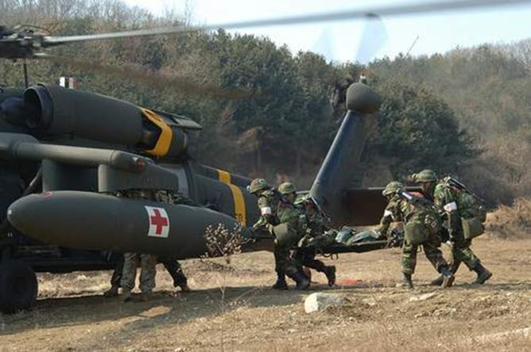
Communicate with Evac System
Evacuation Request (9-Line MEDEVAC)
MIST Report
Notes:
Communicate your evacuation request through your theater’s established communications systems. Here are two examples in wide use.

Slide 13
9-Line Evacuation Request
Required if you need to have a casualty evacuated by another unit.
Notes:
Read the text.

Slide 14
9-Line Evacuation Request
Request for resources through tactical aircraft channels.
NOT a direct medical communication with medical providers
Significance
Determines tactical resource allocation
DOES NOT convey much useful medical information
Notes:
Read the text.
This helps explain why you are sending what you send in the 9-line request.

Slide 15
9-Line Evacuation Request
Line 1: Pickup location
Line 2: Radio frequency, call sign and suffix
Line 3: Number of patients by precedence (evacuation category):
A – Urgent
B – Urgent-Surgical
C – Priority
D – Routine
E – Convenience
Notes:
Line 1: The location of the pick-up site or HLZ. Use 8 or 10-digit military grid reference system or pre-coordinated HLZ names.
Line 2: YOUR operating frequency and callsign. This is the frequency the evacuation vehicle will use to talk to your unit when inbound.
Line 3: this is the number of patients in categories of urgency. Each casualty’s evacuation category is determined by the medic or senior person present based on injuries and medical status.
We’ll discuss placing casualties in evacuation categories in a few moments.

Slide 16
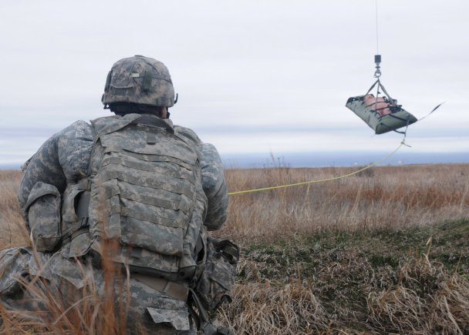
9-Line Evacuation Request
Line 4: Special equipment required
A – None
B – Hoist
C – Extraction equipment
D – Ventilator
* Blood
Notes:
In Line 4, you provide any special equipment needed and any extraction requirements. This includes hoist or specialized extraction equipment as well as things like ventilators.
Though not part of the formal MEDEVAC request, it has become common practice to request blood if needed.

Slide 17
9-Line Evacuation Request
Line 5: Number of casualties by type
L – Number of litter patients
A – Number of ambulatory patients
Line 6: Security at pickup site
N – No enemy troops in area
P – Possible enemy troops in area (approach with caution)
E – Enemy troops in area (approach with caution)
X – Enemy troops in area (armed escort required)
Notes:
Line 5: Number of litter or ambulatory. Said as L-#, A-#.
Line 6 tells evacuation control about the enemy situation near the evacuation point, and whether escort is needed.
Often, lines 1-5 and/or 6 are enough information to initiate a MEDEVAC depending upon pre-planning and coordination between tactical and evacuation units.

Slide 18
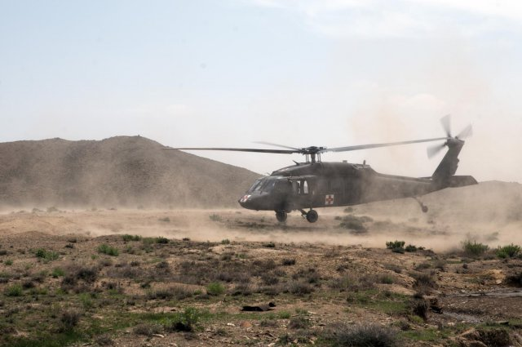
9-Line Evacuation Request
Line 7: Method of marking pickup site
A – Panels
B – Pyrotechnic signal
C – Smoke signal
D – None
E – Other - specify
Line 8: Casualty’s nationality and status
A – US military
B – US civilian
C – Non-US Military
D – Non-US civilian
E – Enemy prisoner of war
Notes:
Line 7 tells the evacuation asset how you will mark the pick-up site; whether VS-17 panels, pyro, or smoke. In recent years, night vision has allowed better night evacuations. For these, IR lighting has been commonly used.
Line 8 indicates the nationality of patients. If mixed, each brevity letter is followed by the appropriate number of casualties in that category.
For Line 8, theater commanders can re-designate the brevity codes. For instance, in Afghanistan, the brevity A was for all ISAF/coalition forces and not just US military.

Slide 19
9-Line Evacuation Request
Line 9 (Wartime): CBRN Contamination
C – Chemical
B – Biological
R – Radiological
N - Nuclear
Line 9 (Peacetime): Terrain Description
Notes:
Line 9 gives different information depending on whether the evacuation is during wartime or peace. However, this has become dependent on the overall combat situation. In a deployed setting in which CBRN is not considered a high threat AND when evacuations frequently occur in rugged terrain, the terrain description has been used more often. The terrain description should include details of terrain features in and around the proposed pick-up site.

Slide 20
MIST Report
Conveys additional evacuation information that may be required by theater commanders.
A MIST report is supplemental to a MEDEVAC request, and should be sent as soon as possible.
MEDEVAC missions should not be delayed while waiting for MIST information.
MIST information helps the receiving MTF better prepare for the specific casualties inbound.
Notes:
MIST reporting was instituted as a standard part of the MEDEVAC request during Operation Enduring Freedom in Afghanistan. Though not a formal part of the NATO and US standard MEDEVAC request, MIST reporting has become a norm in combat theaters. The MIST transmits medical information to the receiving treatment facility and to the evacuation platform.

Slide 21
MIST Report
M: Mechanism of injury
I: Injury type(s)
S: Signs & Symptoms
T: Treatment
Notes:
M: A brief description of the mechanism of injury. For example: IED, GSW, Blast, Rollover, Fall
I: A brief description of the injuries sustained starting with the most serious first. Highlight life-threatening injuries. Example: bilateral lower extremity amputations.
S: Vital signs or significant symptoms. For instance, BP 90/Palp and difficulty breathing.
T: Treatments rendered. For example, tourniquets applied with bleeding controlled; ketamine 50mg IM.

Slide 22
Tactical Evacuation:
Nine Rules of Thumb
Notes:
Here’s something that is particular to TCCC.
If you have a casualty – how do you know how evacuation delays will impact him or her?
These slides will help in that respect.

Slide 23
TACEVAC 9 Rules of Thumb: Assumptions
These Rules of Thumb are designed to help the corpsman or medic determine the true urgency for evacuation.
They assume that the decision is being made at 15-30 minutes after wounding.
They also assume that care is being rendered per the TCCC guidelines.
These considerations are most important when there are tactical constraints on evacuation:
Interferes with mission
High risk for team
High risk for TACEVAC platform
Notes:
Why not just evacuate all casualties immediately?
That may be OK for some situations, but other scenarios may have tactical constraints that must be factored in. In such a situation, these Rules of Thumb can help you decide when to evacuate.

Slide 24
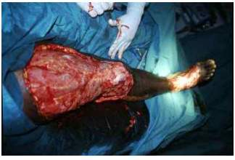
TACEVAC Rule of Thumb #1
Soft tissue injuries are common and may look bad, but usually don’t kill unless associated with shock.
Notes:
Casualties do not die acutely from soft tissue wounds alone unless these wounds are associated with severe bleeding or airway problems.

Slide 25
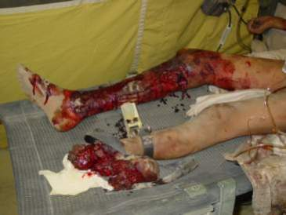
TACEVAC Rule of Thumb #2
Bleeding from most extremity wounds should be controllable with a tourniquet or hemostatic dressing. Evacuation delays should not increase mortality if bleeding is fully controlled.
Notes:
BUT – long delays to evacuation may cause a limb to be lost if a tourniquet is in place.
Two hours does not seem to be a problem for limbs with tourniquets. As you move past four to six hours, the risk to limb survival increases.

Slide 26
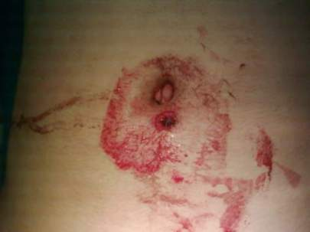
TACEVAC Rule of Thumb #3
Casualties who are in shock should be evacuated as soon as possible.
Gunshot wound to the abdomen – a common
cause of shock in combat casualties.
Notes:
This GSW to the torso is an example of a wound that causes internal, non-compressible bleeding.
There is nothing that the combat medic/corpsman/PJ can do to stop internal bleeding. TXA may help, but even so, shock is nothing to sit on in the field.

Slide 27
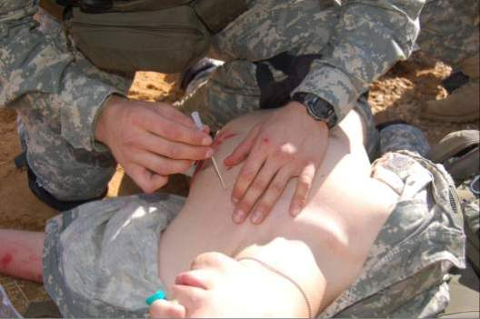
TACEVAC Rule of Thumb #4
Casualties with penetrating wounds of the chest who have respiratory distress unrelieved by needle decompression of the chest should be evacuated as soon as possible.
Notes:
Usually when you do needle decompression, casualties with a tension pneumo WILL get better.
If they don’t, their main problem may be a large HEMOthorax (blood in the chest).
Needle decompression will not help that. Chest tubes may not, either.

Slide 28
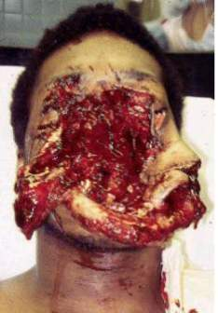
TACEVAC Rule of Thumb #5
Casualties with blunt or penetrating trauma of the face associated with airway difficulty should have an immediate airway established, and should be evacuated as soon as possible.
REMEMBER to let the casualty sit
up and lean forward if that helps him
or her to breathe better!
Notes:
You can make these casualties much worse if you force them to lie on their backs!

Slide 29
TACEVAC Rule of Thumb #6
Casualties with blunt or penetrating wounds of the head where there is obvious massive brain damage and unconsciousness are unlikely to survive with or without emergent evacuation.
Notes:
There are some casualties you can’t help.

Slide 30
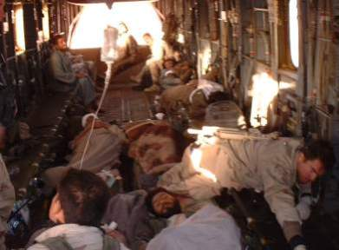
TACEVAC Rule of Thumb #7
Casualties with blunt or penetrating wounds to the head - where the skull has been penetrated but the casualty is conscious - should be evacuated emergently.
Notes:
Some trauma to the head IS survivable, especially shrapnel injuries.

Slide 31
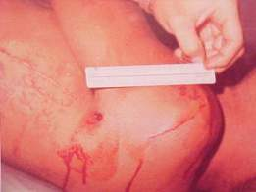
TACEVAC Rule of Thumb #8
Casualties with penetrating wounds of the chest or abdomen who are not in shock at their 15-minute evaluation have a moderate risk of developing late shock from slowly bleeding internal injuries. They should be carefully monitored and evacuated as
soon as feasible.
Notes:
This photo shows a 7.62mm entrance wound. This single GSW to the torso proved fatal.
The casualties who will die from internal bleeding do not always succumb in the first 15-30 minutes.

Slide 32
TACEVAC Rule of Thumb #9
Casualties with TBI who display “red flag” signs - witnessed loss of consciousness, altered mental status, unequal pupils, seizures, repeated vomiting, visual disturbance, worsening headache, unilateral weakness, disorientation, or abnormal speech – require urgent
evacuation to a medical
treatment facility.
Notes:
Read the text.

Slide 33
JTS-Recommended Standard Evacuation Categories
Specifies three categories for casualty evacuation:
A - Urgent
B - Priority
C – Routine
Notes:
You need to know the category for each casualty when calling on the radio for MEDEVAC/CASEVAC.

Slide 34
JTS-Recommended Standard Evacuation Categories
CAT A – Urgent (denotes a critical, life-threatening injury)
Significant injuries from a dismounted IED attack
Gunshot wound or penetrating shrapnel to chest, abdomen or pelvis
Any casualty with ongoing airway difficulty
Any casualty with ongoing respiratory difficulty
Unconscious casualty
Notes:
Casualties with these injuries would be considered Urgent.

Slide 35
JTS-Recommended Standard Evacuation Categories
CAT A – Urgent (continued)
Casualty with known or suspected spinal injury
Casualty in shock
Casualty with bleeding that is difficult to control
Moderate/Severe TBI
Burns greater than 20% Total Body Surface Area
Notes:
More examples of injuries in the Urgent category.

Slide 36
JTS-Recommended Standard Evacuation Categories
CAT B – Priority (serious injury)
Isolated, open extremity fracture with bleeding controlled
Any casualty with a tourniquet in place
Penetrating or other serious eye injury
Significant soft tissue injury without major bleeding
Extremity injury with absent distal pulses
Burns 10-20% Total Body Surface Area
Notes:
Casualties with these injuries would be categorized Priority.

Slide 37
JTS-Recommended Standard Evacuation Categories
CAT C – Routine (mild to moderate injury)
Concussion (mild TBI)
Gunshot wound to extremity - bleeding controlled without tourniquet
Minor soft tissue shrapnel injury
Closed fracture with intact distal pulses
Burns < 10% Total Body Surface Area
Notes:
These injuries would be assigned an evacuation category of Routine.

Slide 38
Questions?

Slide 39
Tactical Field Care Guidelines
17. Cardiopulmonary resuscitation (CPR)
a. Resuscitation on the battlefield for victims of blast or penetrating trauma who have no pulse, no ventilations, and no other signs of life will not be successful and should not be attempted. However, casualties with torso trauma or polytrauma who have no pulse or respirations during TFC should have bilateral needle decompression performed to ensure they do not have a tension pneumothorax prior to discontinuation of care. The procedure is the same as described in section 5.a. above.
Notes:
Read the guideline.

Slide 40
CPR
NO battlefield CPR
Notes:
Why not???

Slide 41
CPR in Civilian Trauma
This is a series of 138 trauma patients with prehospital cardiac arrest and in whom resuscitation was attempted.
There were no survivors.
The authors recommended that trauma patients in cardiopulmonary arrest not be transported emergently to a trauma center even in a civilian setting due to large economic cost of treatment without a significant chance for survival.
Rosemurgy et al. J Trauma 1993
Notes:
CPR for trauma patients in cardiac arrest DOES NOT WORK!
CPR may work SOMETIMES for cardiac patients without trauma – but not for trauma patients.

Slide 42
The Cost of Attempting
CPR on the Battlefield
CPR performers may get killed
Mission gets delayed
Casualty stays dead
Notes:
In combat, futile attempts at CPR may interfere with caring for casualties who have a chance to survive and may interfere with the unit’s ongoing mission.

Slide 43
CPR on the Battlefield (Ranger Airfield Operation in Grenada)
Airfield seizure operation.
A Ranger was shot in the head by a sniper.
Casualty had no pulse or respirations.
CPR attempts were unsuccessful.
The operation was delayed while CPR was performed.
Ranger PA finally intervened: “Stop CPR and move out!”
Notes:
Here is a real-world example.
A very large-scale operation could have been compromised by a tactical medicine mistake.

Slide 44
CPR in Tactical Settings
Only in the case of cardiac arrest due to:
Hypothermia
Near drowning
Electrocution
Other non-traumatic causes
should CPR be considered prior to the
Tactical Evacuation Care phase.
Notes:
There are some notable exceptions to the rule about CPR on the battlefield.
Individuals with these disorders have a better chance of survival than those with cardiac arrest due to trauma.
Myocardial infarction is not on this list because it is pretty rare for combat troops to have heart attacks in the middle of an op.

Slide 45
Traumatic Cardiac Arrest in TCCC
Mounted IED attack in March 2011
Casualty unconscious from closed head trauma
Lost vital signs prehospital
CPR on arrival at hospital
Bilateral needle decompression done in ER
Rush of air from left-sided tension pneumothorax
Return of vital signs – life saved
This procedure is routinely performed by Emergency Medicine physicians and Trauma Surgeons for trauma victims who lose their pulse and heart rate in the hospital Emergency Department.
Notes:
Though CPR for a combat casualty on the battlefield is contraindicated, bilateral needle decompression is not. This should be done before attempts at resuscitation are discontinued in any casualty who suffered polytrauma or torso trauma and lost vital signs. It is done to rule out tension pneumothorax . It could save a life if tension pneumothorax is present, and no harm will be done if it is not.

Slide 46
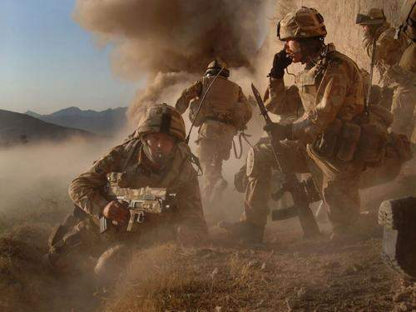
Questions?

