Slide 1
Tactical Combat Casualty Care for Medical Personnel August 2018 (Based on TCCC-MP Guidelines 180801)
Tactical Field Care 3d
Documentation of Care in TFC
Notes:
Let’s talk about documentation of care in TCCC.

Slide 2
Disclaimer
“The opinions or assertions contained herein are the private views of the authors and are not to be construed as official or as reflecting the views of the Departments of the Army, Air Force, Navy or the Department of Defense.”
There are no conflict of interest disclosures.
Notes:
Read the disclaimer.

Slide 3
LEARNING OBJECTIVES
Terminal Learning Objective
Perform documentation of care in Tactical Field Care.
Enabling Learning Objectives
Identify the importance and methods of documenting casualty care in TCCC.
Identify the critical information, relevant abbreviations, and reporting criteria on the TCCC Casualty Care (DD1380.)
Notes:
Read the text.

Slide 4
LEARNING OBJECTIVES
Enabling Learning Objectives
Identify the importance and information considerations of a TCCC casualty After Action Review submission.
Notes:
Read the text.

Slide 5
Tactical Field Care Guidelines
18. Documentation of Care
a. Document clinical assessments, treatments rendered, and changes in the casualty’s status on a TCCC Casualty Card (DD Form 1380). Forward this information with the casualty to the next level of care.
Notes:
5
Read the guideline.

Slide 6
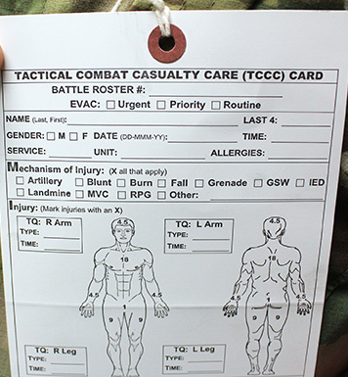
TCCC Casualty Card
Designed by combat medics
Used in combat since 2002
Replaced old DD Form 1380
Only essential information
Can be used by the receiving
hospital to document injuries sustained and field treatments rendered
Heavy-duty waterproof or laminated paper
Notes:
6
Medical documentation may be difficult to accomplish in tactical settings.
It is so important to the casualty’s subsequent care that every effort should be made.

Slide 7
Kotwal et al - 2011
Landmark paper from the wars in Afghanistan and Iraq
In order to know if we are doing the right thing, we must first know what we did.
This paper was made possible by the Ranger TCCC Card.
Notes:
This paper appeared in the Archives of Surgery in December, 2011. It documents prehospital battlefield trauma care and examines outcomes. It could not have been written without data from TCCC Cards.

Slide 8
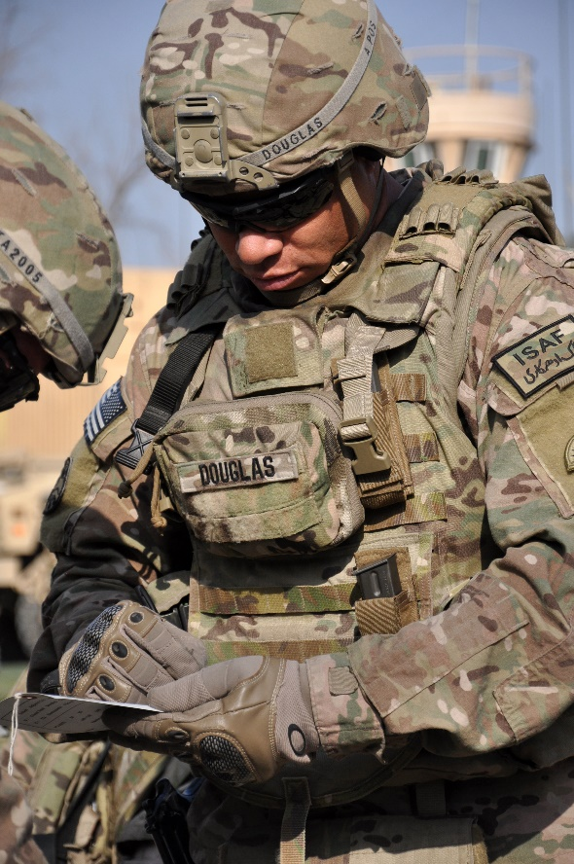
TCCC Casualty Card
This card is based on the principles of TCCC.
It addresses the initial lifesaving care provided at the point of wounding.
It should be filled out by whoever is caring for the casualty.
Its format is simple with a circle or “X” in the appropriate block.
Notes:
Read the text.
8

Slide 9
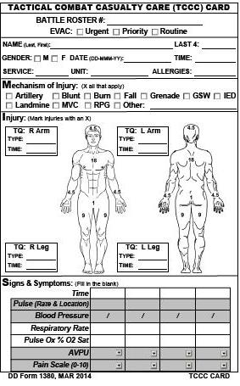
TCCC Casualty Card
(DD 1380)
Front
Notes:
This is the front of the TCCC Card.
The individual’s name and allergies should already be filled in.
This should be done when the card is placed in the individual’s IFAK.

Slide 10
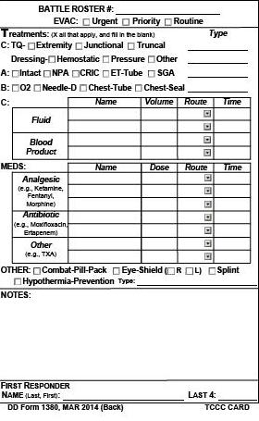
TCCC Casualty Card
(DD 1380)
Back
Notes:
And this is the back of the TCCC Card.

Slide 11
Instructions
A TCCC Casualty Card should be kept in each Individual First Aid Kit.
Use an indelible marker to fill it out.
When used, attach it to the casualty’s belt loop, or place it in their upper left sleeve, or the left trouser cargo pocket.
Include as much information as you can.
Notes:
Read the text.
11

Slide 12
Documentation
Record each intervention in each category.
If you are not sure what to do, the card will prompt you where to go next.
Simply circle the intervention you performed.
Explain any action you want clarified in the remarks area.
Notes:
Read the text.
12

Slide 13
Documentation
The card does not imply that every casualty needs all the interventions listed.
You may not be able to perform all the interventions that the casualty needs.
The next person caring for the casualty can add to the interventions performed.
This card can be filled out in less than two minutes.
It is important that we document the care given to the casualty.
You haven’t finished caring for your casualty until you have documented his or her care!
Notes:
Read the text.
13

Slide 14
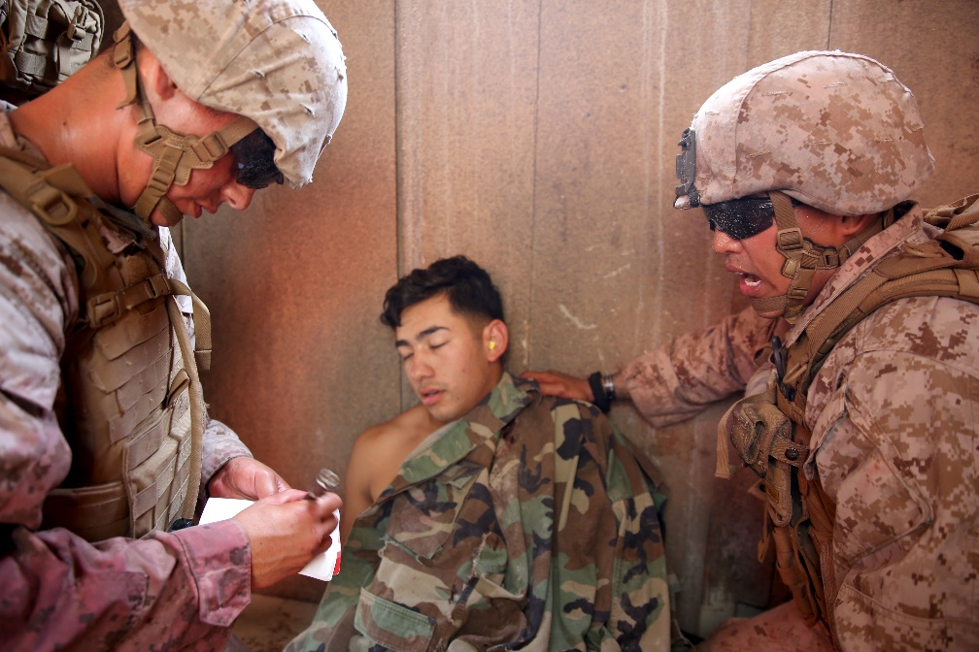
TCCC Card Abbreviations
DTG = Date-Time Group (e.g. – 160010Oct2009)
NBC = Nuclear, Biological, Chemical
TQ = Tourniquet
GSW = Gunshot Wound
MVA = Motor Vehicle Accident
AVPU = Alert, Verbal stimulus, Painful stimulus, Unresponsive
Cric = Cricothyroidotomy
NeedleD = Needle decompression
IV = Intravenous
IO = Intraosseous
NS = Normal Saline
LR = Lactated Ringers
ABX = Antibiotics
Notes:
Review the abbreviations.
14

Slide 15
TCCC After Action Report
This electronic AAR is intended to be completed when the first responder returns to base.
It is more complete than the TCCC Card.
It should be submitted to the Joint Theater Trauma System Director within 72 hours of casualty evacuation.
Both the TCCC Card and the TCCC AAR are required for optimal patient care documentation.
Notes:
Read the text.
15

Slide 16
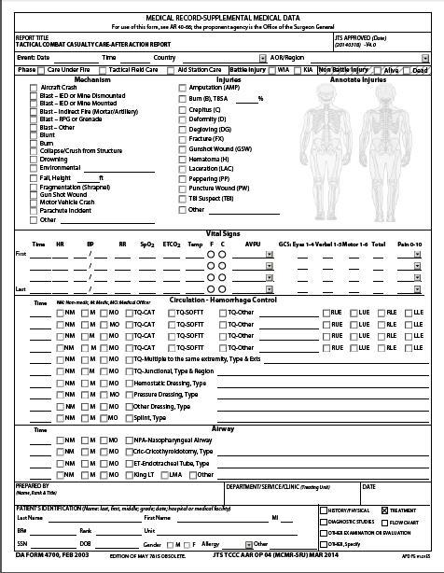
TCCC After-
Action Report
Notes:
This is the format of the TCCC AAR.

Slide 17
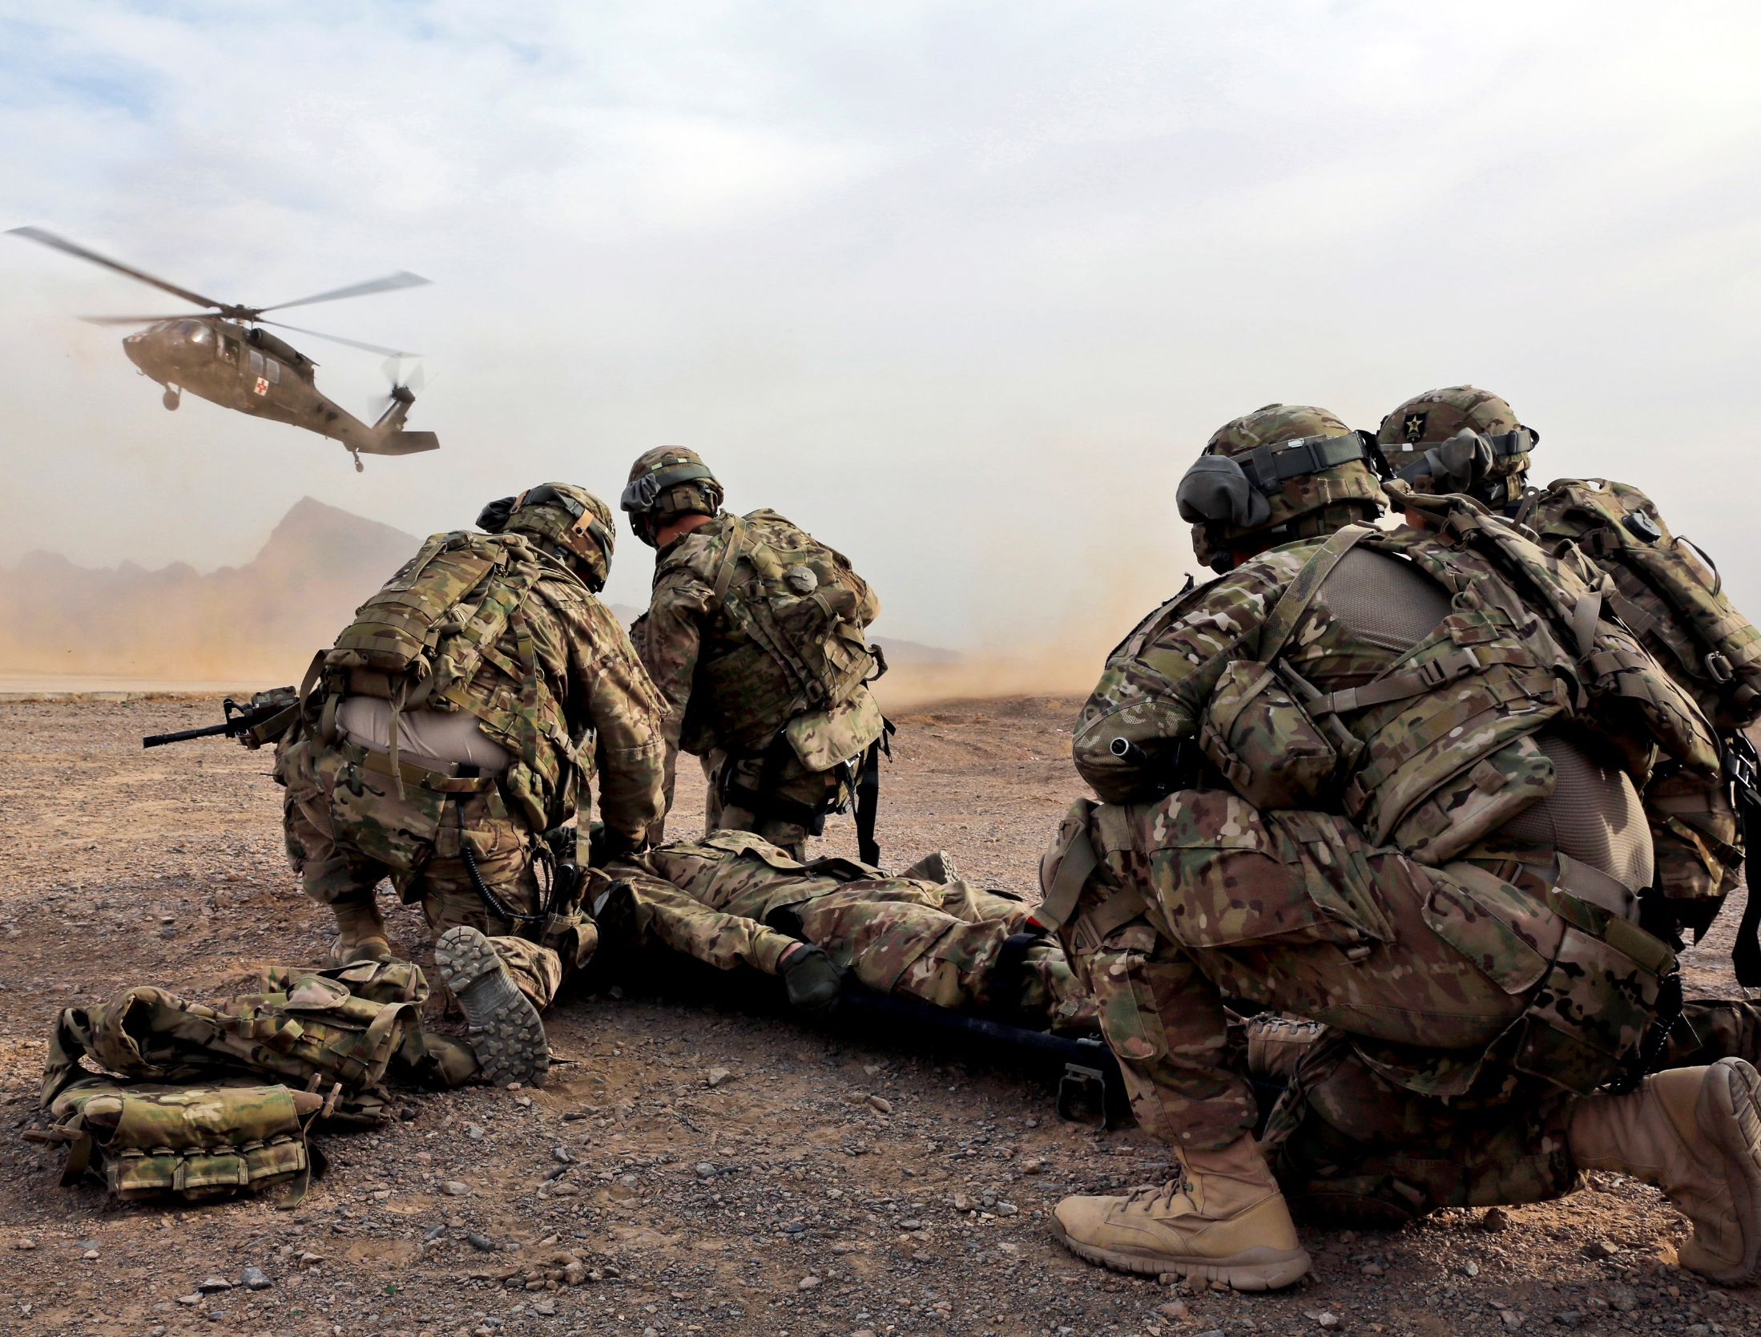
Questions ?

