Slide 1
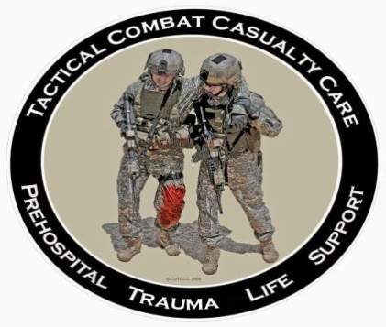
Tactical Combat Casualty Care for Medical Personnel August 2018 (Based on TCCC-MP Guidelines 180801)
Tactical Field Care 3e
Preparing for Casualty Evacuation and Key Points in TFC
Notes:
In this presentation we will discuss preparation for CASEVAC and review some of the key points in TFC.

Slide 2
Disclaimer
“The opinions or assertions contained herein are the private views of the authors and are not to be construed as official or as reflecting the views of the Departments of the Army, Air Force, Navy or the Department of Defense.”
There are no conflict of interest disclosures.
Notes:
Read the disclaimer.

Slide 3
LEARNING OBJECTIVES
Terminal Learning Objective
Perform preparation of casualties for evacuation in Tactical Field Care.
Enabling Learning Objectives
Identify the importance and considerations of preparing casualties for evacuation in tactical field care.
Identify critical actions and checks to prepare casualties for evacuation.
Notes:
Read the text.

Slide 4
LEARNING OBJECTIVES
Enabling Learning Objectives
Identify factors in litter selection and evacuation equipment in Tactical Field Care.
Identify considerations for the evacuation of ambulatory/walking wounded casualties in Tactical Field Care.
Identify considerations and fundamental procedures for staging casualties for evacuation at any location or platform.
Notes:
Read the text.

Slide 5
LEARNING OBJECTIVES
Enabling Learning Objectives
Identify the importance of pre-mission evacuation equipment preparation and rehearsals.
Describe the preparation of a casualty for evacuation in Tactical Field Care.
Notes:
Read the text.

Slide 6
Tactical Field Care Guidelines
19. Prepare for Evacuation
a. Complete and secure the TCCC Card (DD 1380) to the casualty.
b. Secure all loose ends of bandages and wraps.
c. Secure hypothermia prevention wraps/blankets/straps.
d. Secure litter straps as required. Consider additional padding for long evacuations.
Notes:
These are things you should do to get the casualty ready to board the evacuation platform.
Read the guidelines.

Slide 7
Tactical Field Care Guidelines
19. Prepare for Evacuation (cont)
e. Provide instructions to ambulatory patients as needed.
f. Stage casualties for evacuation in accordance with unit standard operating procedures.
g. Maintain security at the evacuation point in accordance with unit standard operating procedures.
Notes:
Read the guidelines.

Slide 8
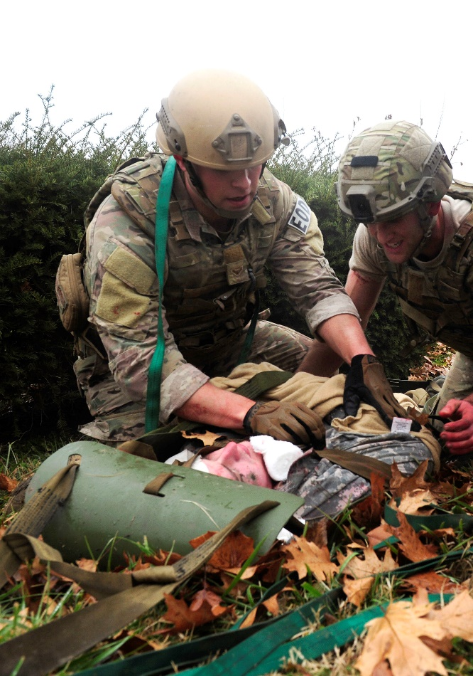
Secure Loose Ends
Secure all loose ends of bandages, wraps and hypothermia prevention materials.
Consider padding for long evacuations.
Notes:
Secure all loose ends of bandages, medical equipment and hypothermia prevention materials. You need to prevent dressings and other medical items from being blown around by rotor wash or becoming entangled with other equipment. Loose materials can catch on everything from tree limbs to body armor of litter bearers to parts of aircraft or vehicles. Any snag like this can cause delays in evacuation or even further injury to patients or providers.
Blankets and foil-based hypothermia materials are especially susceptible to being caught in the wind.

Slide 9
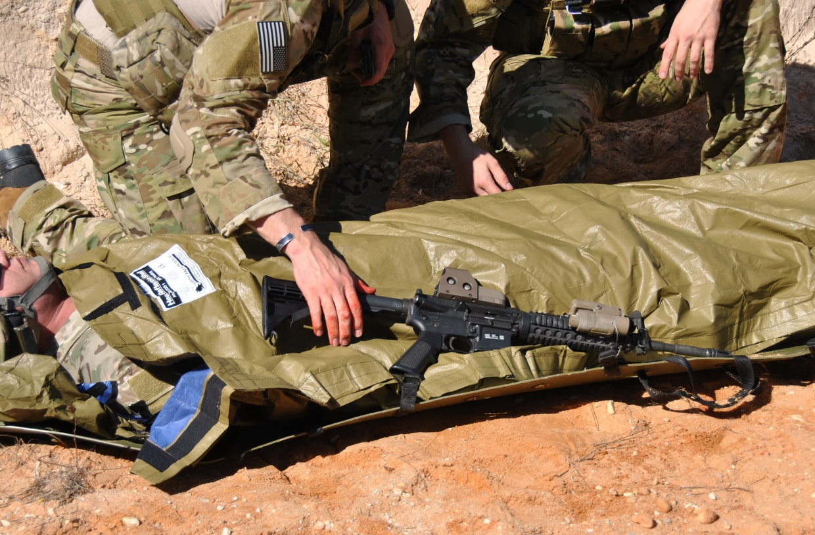
Package the Casualty
Secure the casualty’s weapons/equipment as required.
Notes:
Secure the casualty’s weapon and equipment in accordance with unit SOP or mission requirements.
Clear and render safe any weapons evacuated with the casualty.
Do not evacuate explosives with the casualty if possible.
Keep in mind that receiving medical personnel may not be familiar with the equipment or have a way to secure it.

Slide 10
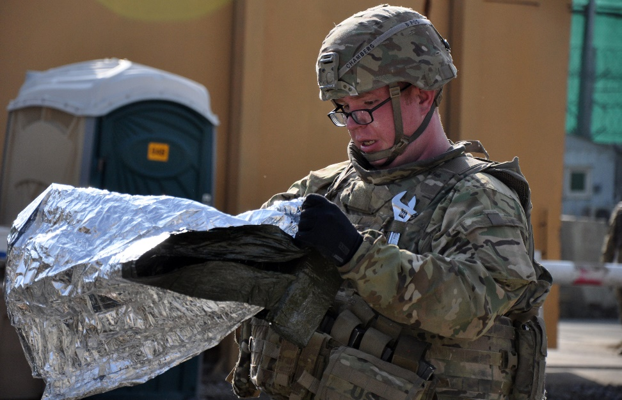
Prep for Evacuation
Evacuation equipment should be prepped by unit personnel while treatment continues.
Notes:
Coordinate activities to save time.
Other unit members can prepare litters and evacuation equipment while you provide treatment.
Do not delay getting casualties onto litters.
You can better prevent hypothermia by getting casualties off of the ground.
If tactical situation developments demand a rapid movement of casualties, it is easier to move them if they’re already on litters.

Slide 11
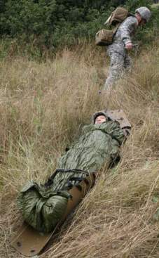
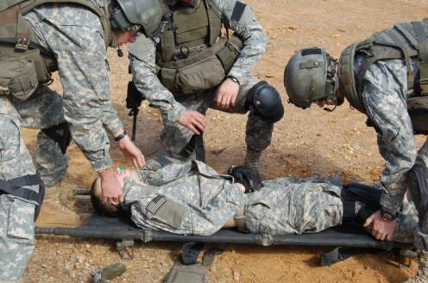
Prep for Evacuation
Casualty movement in TFC may be better accomplished using litters.
Notes:
Remember that we used carries and drags in Care Under Fire.
We did it that way to get the casualty to cover as quickly as possible.
Now we have time to use litters.
Litters are usually better for moving a casualty a long distance.
Casualties do NOT have to be placed supine on a litter. The litter exists only to facilitate casualty movement. The casualty can be placed in the best position that facilitates their care and comfort. The casualty must, however, be secured to litter prior to movement.

Slide 12
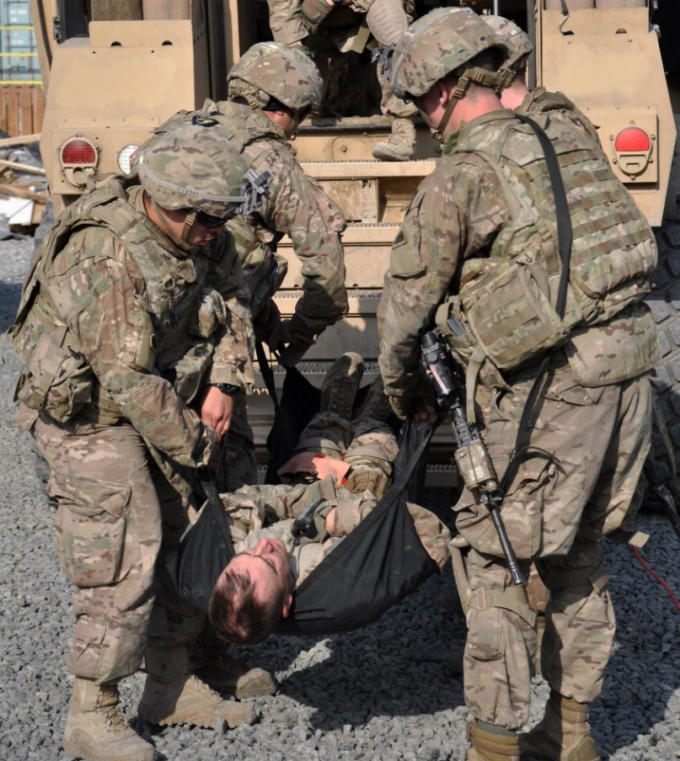
Litter Selection
Selection is based on the mission and the unit type.
Rigid litters work better than pole-less or improvised.
Consider terrain and obstacles in the operating area.
Notes:
The unit should plan for ahead of time for how it will move casualties in the operating environment. Unit members should be trained on the chosen equipment.

Slide 13
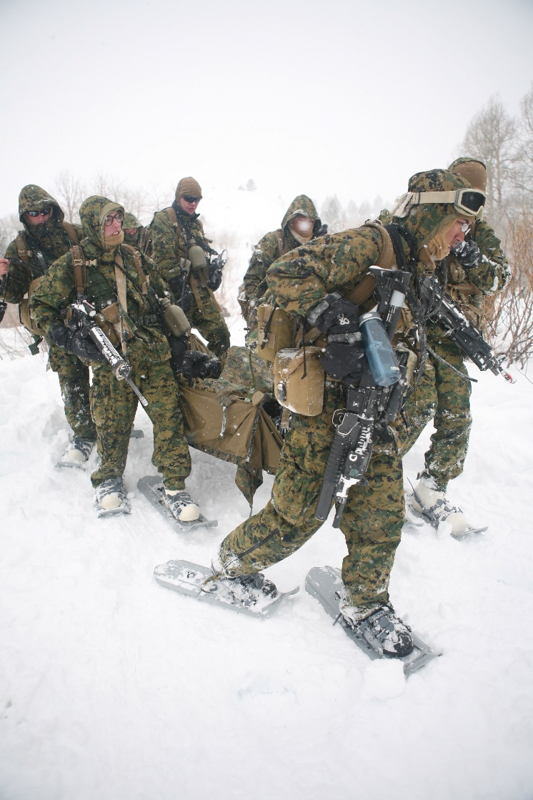
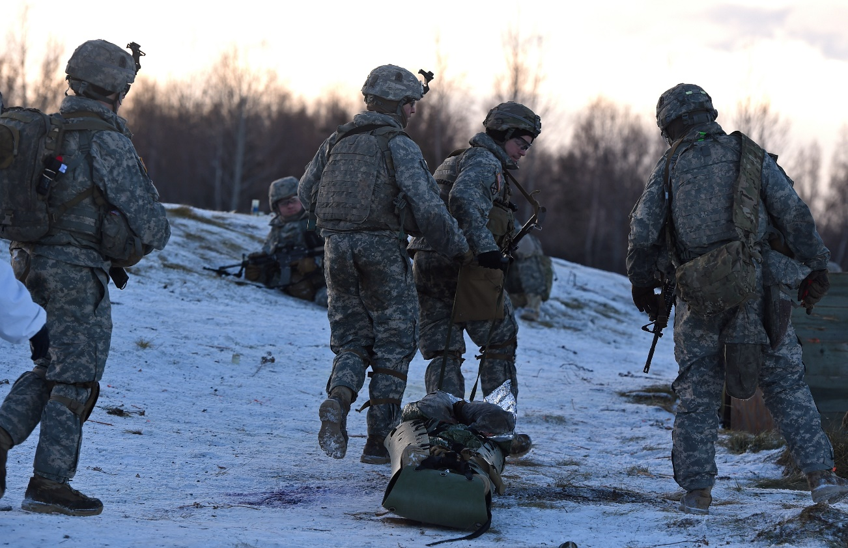
Be Prepared for the Operating Environment
Notes:
A pole-less litter is great as a contingency item in a rucksack, but will not be as efficient as a poled litter in carrying a casualty.
A Skedco is a great tool for moving over land on snow, but can literally become a runaway sled if control is lost.

Slide 14
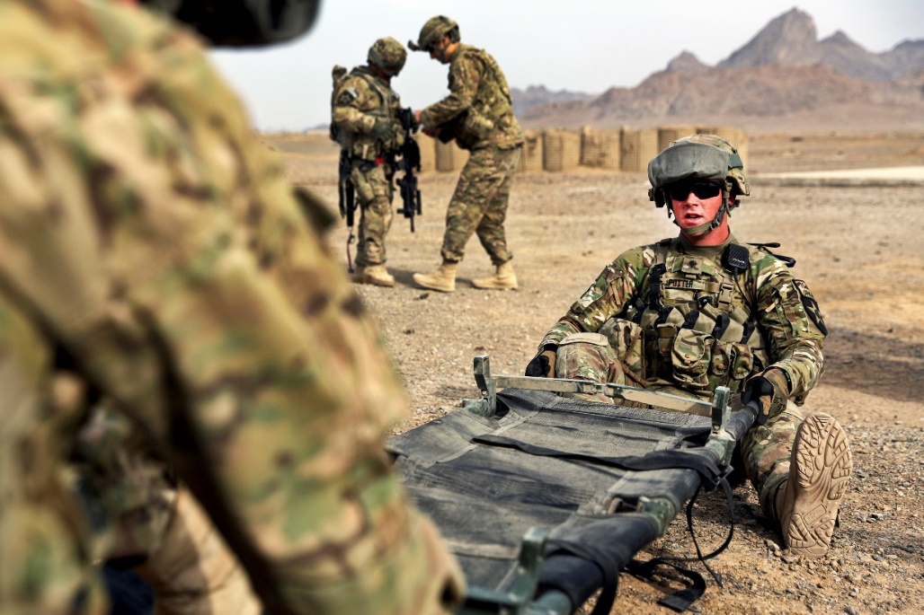
Evacuation Equipment
All unit members should know how to open and set up litters and rehearse their use during pre-mission training.
All unit members should know who will carry litters and/or where litters are located on vehicles.
Notes:
Read the text.

Slide 15
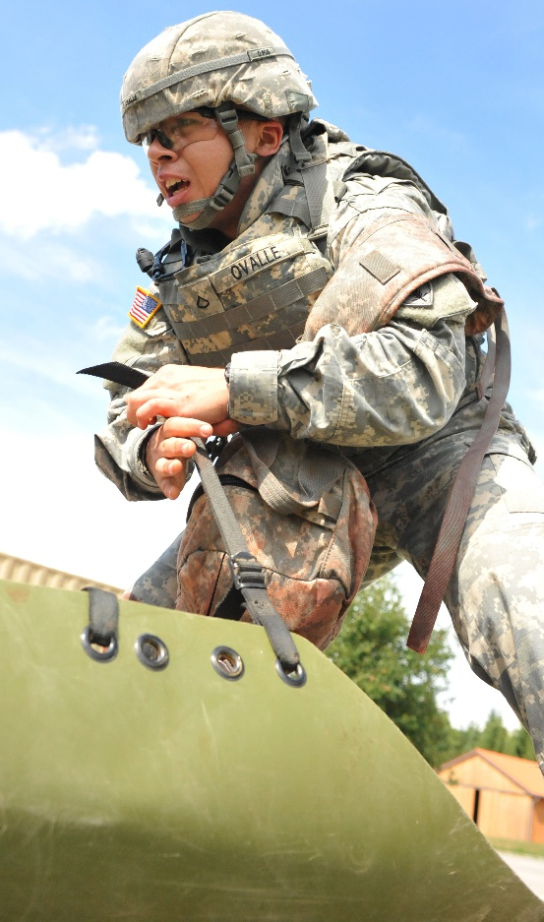
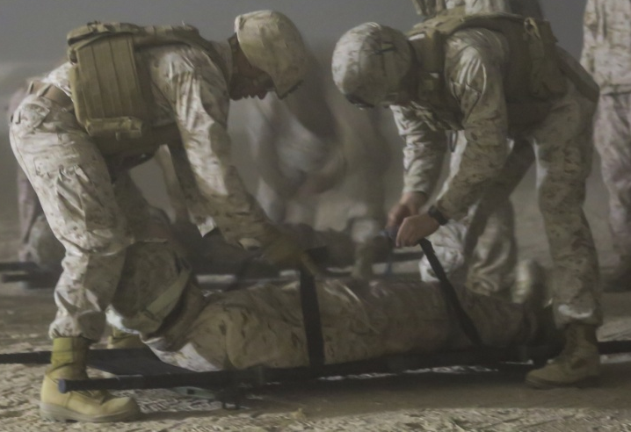
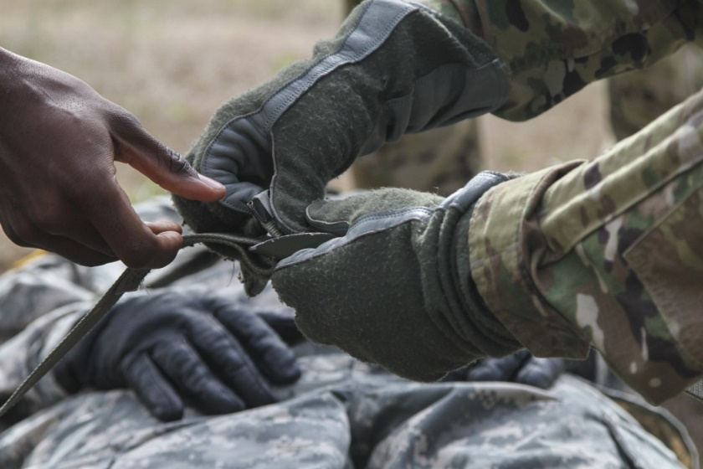
Package the Casualty
Secure litter straps.
Know your litter! Does it have attached straps or does it need supplementary strapping?
Patient Securing Strap
NSN: 6530-00-784-4205
Notes:
Read the text.

Slide 16
Package the Casualty
Notes:
Hypothermia prevention equipment should be tucked and secured beneath the casualty and litter straps. Loose edges can be caught up in wind or rotor wash or snagged on objects in the helicopter as the casualty is loaded aboard.

Slide 17
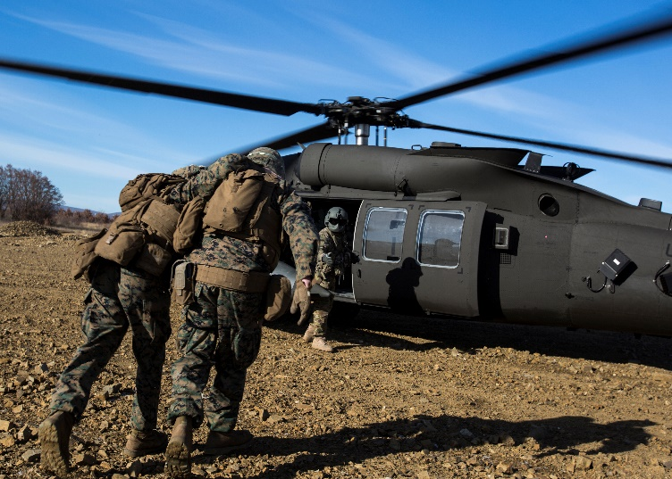
Walking Wounded
Provide instructions or assistance to ambulatory patients as needed.
Depending on the nature of their injuries, they may be able to assist with carrying litters or providing security.
Best to guide disoriented or visually impaired casualties hand-to-shoulder to the evacuation
platform.
Instruct them on repeatedly
checking their own wounds and
dressings to ensure that bleeding
remains controlled.
Notes:
Read the text.

Slide 18
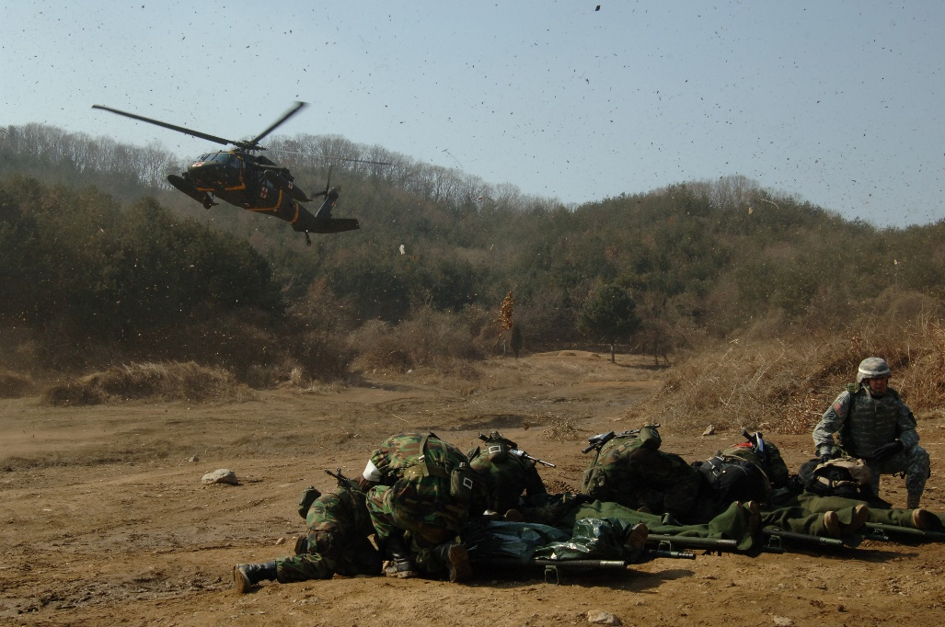
Stage Casualties for Evac
Be prepared for the arrival of the evacuation platform.
Stage the casualties in the loading sequence of the evacuation platform.
Notes:
Many units use tagging or color-coded chemlights to identify casualty evacuation categories.

Slide 19
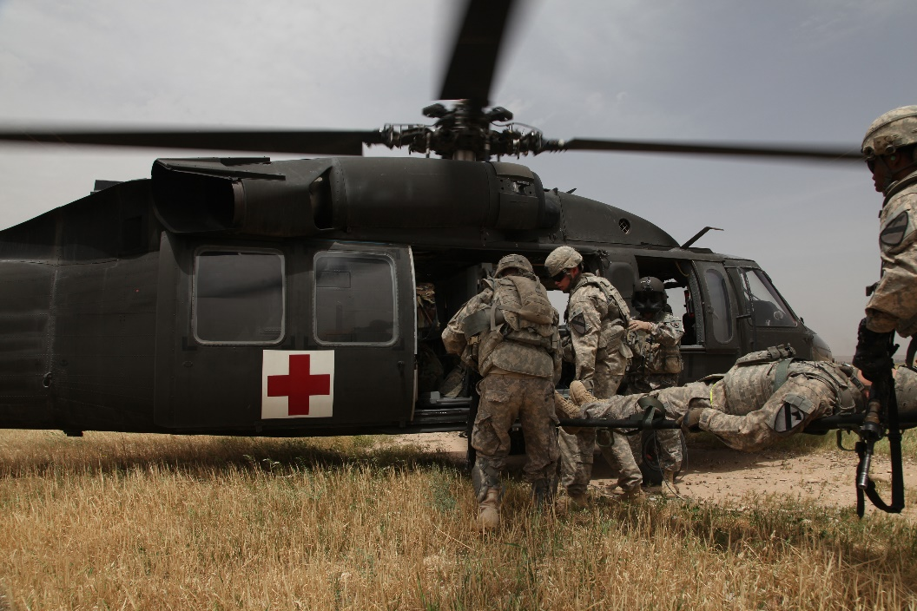
Instructions from Platform Crew
Take direction from the crew of the evacuation platform on approaching the platform, loading casualties, and turnover with receiving medics.
Notes:
Read the text.

Slide 20
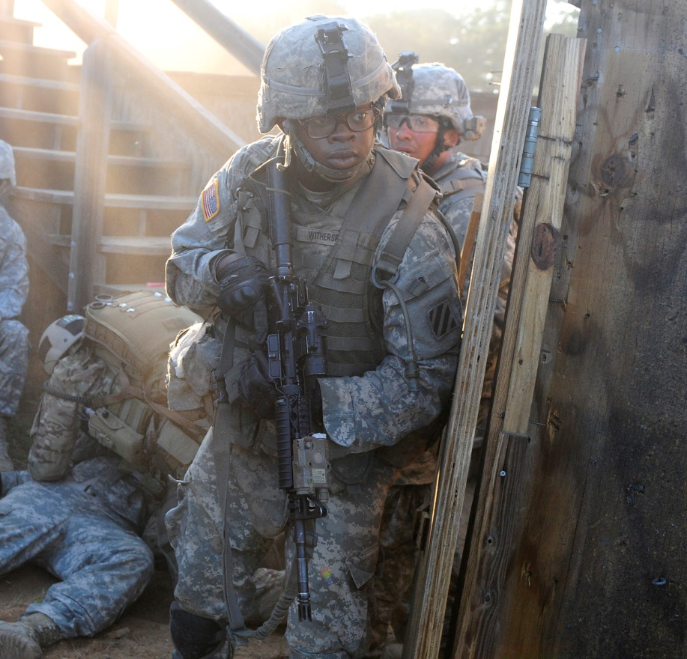
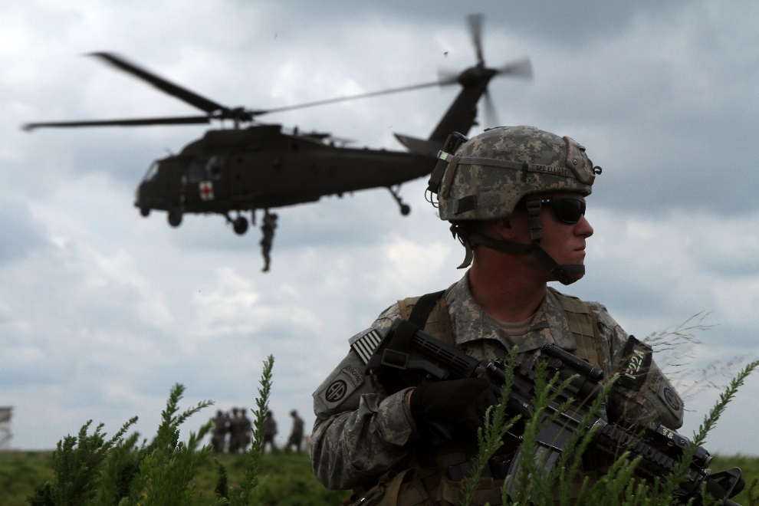
SECURITY
Maintain security at the evacuation point in accordance with unit SOP.
Notes:
Read the text.

Slide 21
Litter Carry Video
Secure the casualty on the litter.
Bring his weapons.
Maintain security.
Courtesy 75th Ranger Regiment
No audio on this video
Notes:
Click on the photo to play the video.
Remember - Don’t let the casualty fall off the litter!

Slide 22
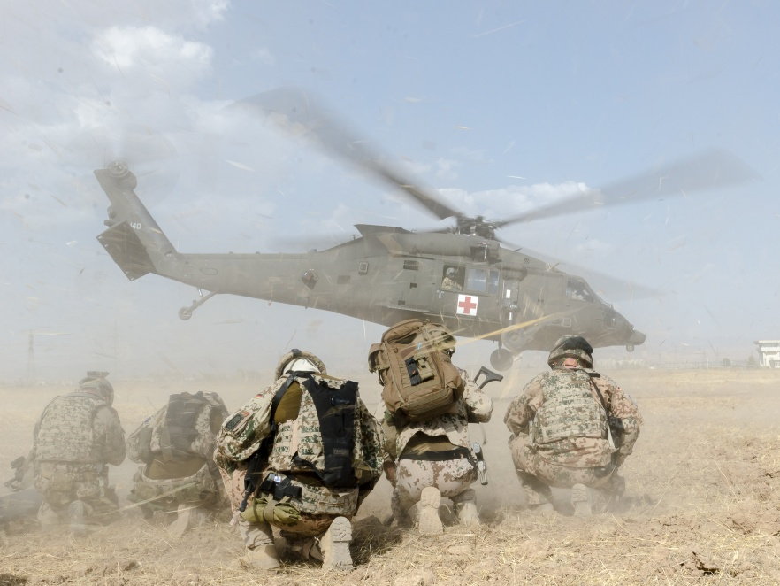
Questions?

Slide 23
Further Elements of Tactical Field Care
Reassess regularly.
Minimize removal of uniform and protective gear, but get the job done.
Replace body armor after care, or at least keep it with the casualty. He or she may need it again if there is additional contact.
Notes:
A few final points…

Slide 24
Summary of Key Points in Tactical Field Care
Still in a hazardous environment
Limited medical resources
Hemorrhage control
Airway management
Breathing – treat suspected tension pneumothorax
Transition from tourniquet to another form of hemorrhage control when appropriate
Use TXA for casualties in or at risk of shock
For hemorrhagic shock, resuscitate with blood products per the TCCC Guidelines when they are available
Hypotensive resuscitation with Hextend for hemorrhagic shock when blood products are not available
Notes:
TFC takes place in a hazardous environment.
The enemy may be close, and medical care may be far away.
There is more time here than in Care Under Fire, but still, you should do only those aspects of care that are really important.
Remember that your unit may have to move quickly at short notice.

Slide 25
Summary of Key Points in Tactical Field Care
Hypothermia prevention
Shield and antibiotics for penetrating eye injuries
Pain control using the TCCC Triple-Option Analgesia strategy
Antibiotics for all open wounds
Treat burns
Reassure casualties
No CPR in this phase of care
Bilateral NDC for casualties with torso trauma who lose vital signs
Documentation of care on the TCCC Casualty Card
Notes:
Review these elements of TFC.

Slide 26
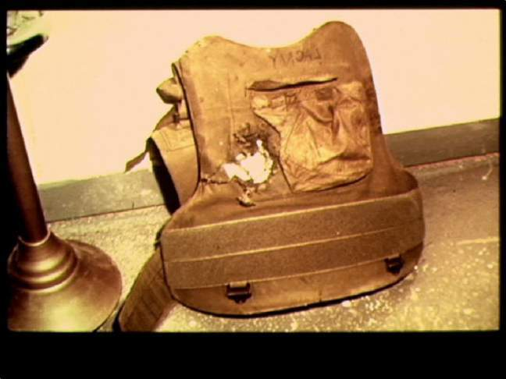
Questions?
Wear your body armor!

