Slide 1
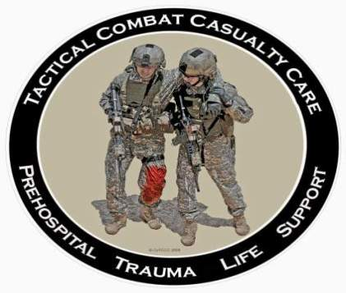
Tactical Combat Casualty Care for Medical Personnel
August 2018
(Based on TCCC-MP Guidelines 180801)
Tactical Field Care 3f
Casualty Collection Point Operations
Caring for Wounded Hostile Combatants
Notes:
Next we will discuss Casualty Collection Point Operations and Caring for Wounded Hostile Combatants.

Slide 2
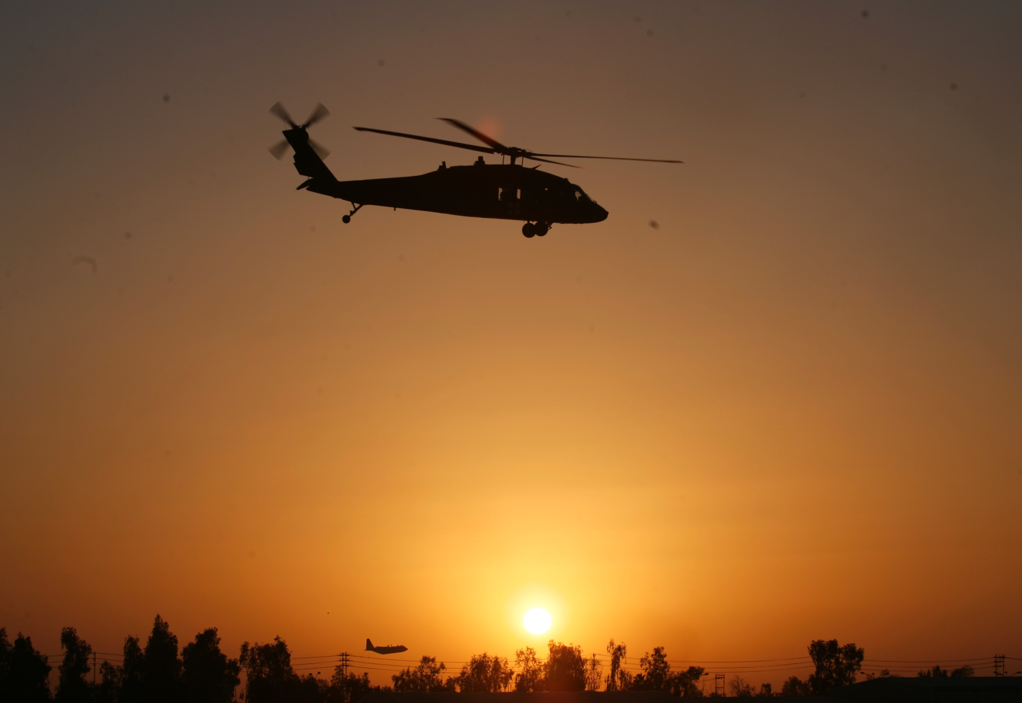
Disclaimer
“The opinions or assertions contained herein are the private views of the authors and are not to be construed as official or as reflecting the views of the Departments of the Army, Air Force, Navy or the Department of Defense.”
There are no conflict of interest disclosures.
Notes:
Read the disclaimer.

Slide 3
LEARNING OBJECTIVES
Terminal Learning Objective
Identify the procedures for setting up and running casualty collection points (CCPs).
Enabling Learning Objectives
Identify the key factors in selecting locations for casualty collection points.
Describe the responsibilities and procedures for operating CCPs.
Notes:
Read the text.

Slide 4
LEARNING OBJECTIVES
Terminal Learning Objective
Identify the correct procedures managing wounded hostile combatants in Tactical Field Care.
Enabling Learning Objectives
Describe the need for proper prisoner handling and security procedures for wounded hostile combatants in TFC.
Describe the ongoing threat from hostile intent.
Identify the need to provide care as to friendly forces once the prisoner is secure.
Notes:
Read the text.

Slide 5
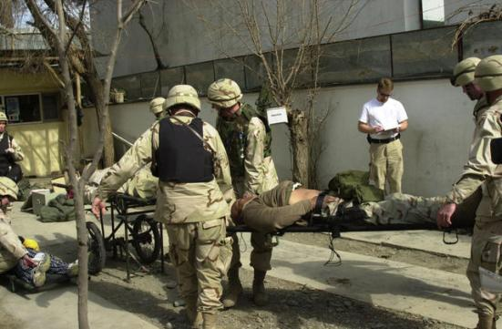
Casualty Collection Point
Operations
This section is adapted from:
Kotwal, R., Montgomery, H. (2011). TCCC Casualty Response Planning. In N. McSwain, J. Salamone, P. Pons, B. Butler & S. Giebner (Eds.), PHTLS Prehospital Trauma Life Support: Military Version, Eighth Edition (pp. 719-735). St. Louis: Elsevier.
Notes:
This information on CCP operations was extracted from the chapter on TCCC Casualty Response Planning by Kotwal and Montgomery in the military version of the Prehospital Life Support Manual.

Slide 6
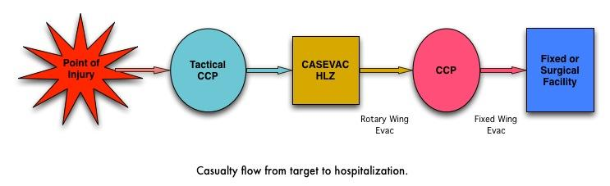
Casualty Collection Points in the Evacuation Chain
Notes:
If possible, casualty flow should be planned from the point of injury all the way back to a fixed medical facility in CONUS. Tactical medics should understand the casualty flow up two levels above themselves at a minimum, including patient regulating, casualty accountability, and hospitalization requirements. For example, a platoon medic should have a good understanding of where a casualty goes after leaving the tactical CCP or battalion aid station.
There are several questions that need to be answered in order to establish the tactical casualty flow:
To where will the unit’s casualties be evacuated?
Will evacuation be conducted by ground or air (or water) assets to a casualty collection point?
How will evacuation be conducted to casualty transload points?
What are the distances and times of travel?
Will expected casualties be able to make it that far? If not, what parts of the plan need to be corrected?
Who will evacuate the casualties?
Will medical assets be properly positioned to ensure continuity of care?

Slide 7
CCP Site Selection
Should be reasonably close to the fight.
Located near areas where casualties are likely to occur.
Must provide cover and concealment from the enemy.
Inside a building or on hardstand (an exclusive CCP building limits confusion).
Should have access to evacuation routes (foot, vehicle, aircraft).
Proximal to “Lines of Drift” or paths across terrain that are the most likely to be used when going from one place to another.
Notes:
This is a checklist for selecting a good location for a tactical CCP.
“Lines of Drift” are paths of least resistance that offer the greatest ease while taking into account obstacles and modes of transit to the objective.

Slide 8
CCP Site Selection
Adjacent to Tactical Choke Points (breeches, HLZ’s, etc.)
Avoid natural or enemy choke points.
Choose an area providing passive security (inside the perimeter).
Good drainage
Accessible to evacuation assets
Expandable if casualty load increases
(continued)
Notes:
Read the text.

Slide 9
CCP Operational Guidelines
Typically, a First Sergeant (1SG) or Platoon Sergeant (PSG), or equivalent, is given responsibility for casualty flow and everything outside the CCP:
  Provides for CCP structure and organization (color coded with chemlights).
  Maintains command & control and battlefield situational awareness.
  Controls aid & litter teams, and provides security.
Continued…
Notes:
Read the text.

Slide 10
CCP Operational Guidelines
First Sergeant (1SG), Platoon Sergeant (PSG) or equivalent:
  Strips, bags, tags, organizes, and maintains casualties’ tactical gear outside of treatment area.
  Accountable for tracking casualties and equipment into and out of CCP and reports to higher command.
  Moves casualties through CCP entrance/exit choke point which should be marked with an IR chemlight.
Continued…
Notes:
Read the text.

Slide 11
CCP Operational Guidelines
Medical personnel are responsible for everything inside the CCP:
  Triage officer sorts and organizes casualties at choke point into appropriate treatment categories.
  Medical officers and medics organize medical equipment and supplies and treat casualties.
  EMTs, First Responders, and Aid &Litter Teams assist with treatment and packaging of casualties.
Continued…
Notes:
Read the text.

Slide 12
CCP Operational Guidelines
Casualties with minor injuries should remain with their original elements or assist with CCP security if possible.
Those killed in action should remain with their original elements.
Notes:
Read the text.

Slide 13
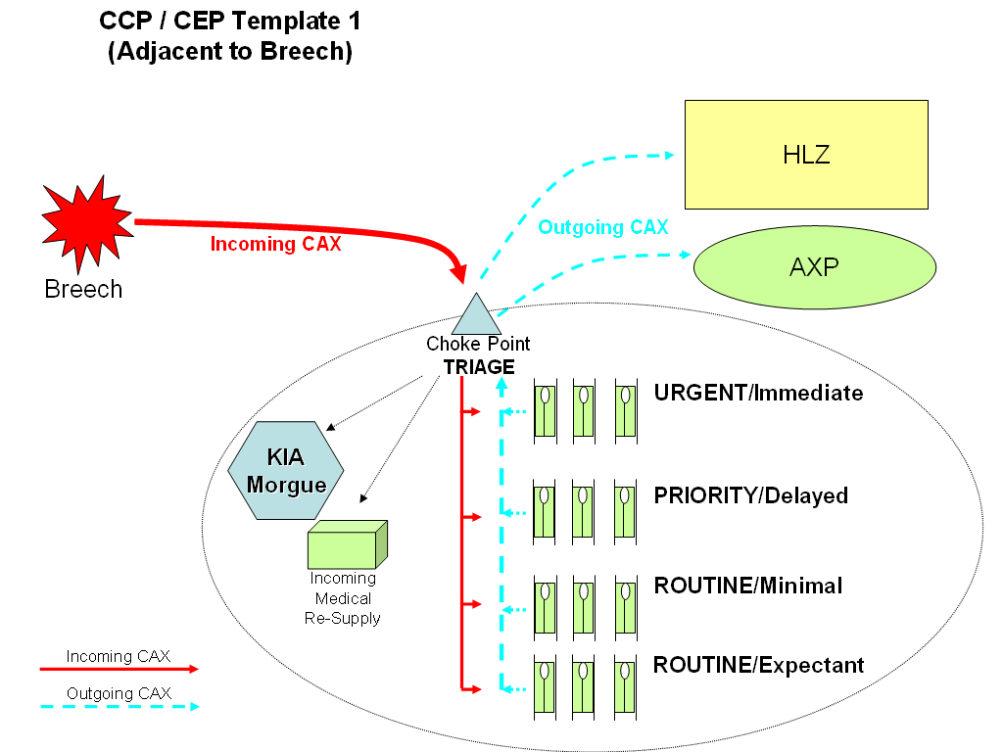
CCP Operational Guidelines
This is a typical configuration of a CCP receiving
casualties from a nearby encounter with hostile forces.
Notes:
Read the text.

Slide 14
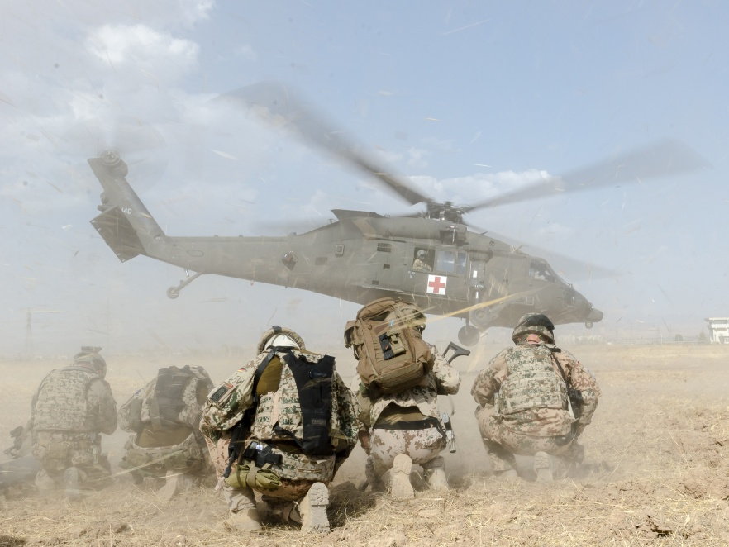
Questions?

Slide 15
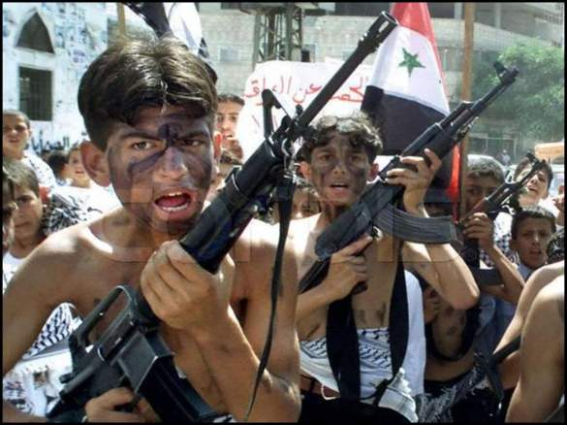
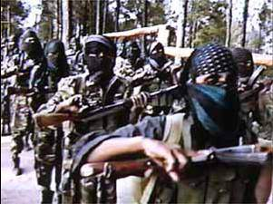
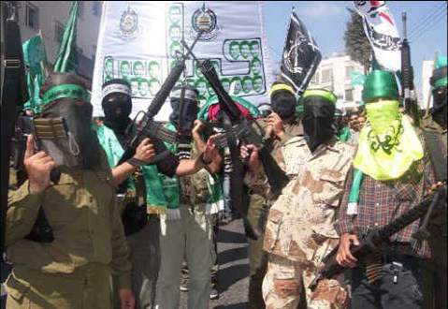
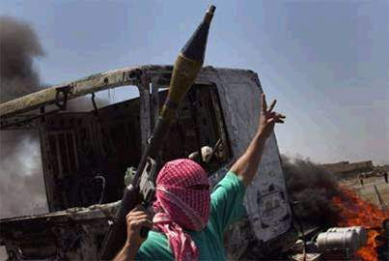
Management of Wounded
Hostile Combatants
Notes:
When you are taking care of casualties who were recently fighting for the other side, there are a few additional things to remember.

Slide 16
Care for Wounded Hostile Combatants
No medical care during Care Under Fire
Though wounded, enemy personnel may still act as hostile combatants.
  May employ any weapons or detonate any ordnance they are carrying
Enemy casualties are hostile combatants until they:
  Indicate surrender
  Drop all weapons
  Are proven to no longer pose a threat
Notes:
Remember that wounded hostile combatants still represent a lethal threat.

Slide 17
Care for Wounded Hostile Combatants
Combat medical personnel should not attempt to provide medical care until sure that the wounded hostile combatant has been rendered safe by other members of the unit.
Restrain with flex cuffs or other devices if not already done.
Search for weapons and/or ordnance.
Silence to prevent communication with other hostile combatants.
Notes:
These are just VERY BASIC prisoner handling guidelines.

Slide 18
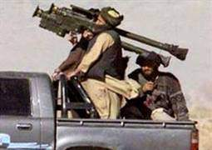
Care for Wounded Hostile Combatants
Segregate from other captured hostile combatants.
Safeguard from further injury.
Care as per TFC guidelines for U.S. forces after the steps above are accomplished.
Speed to the rear as medically
and tactically feasible
Notes:
Once the hostile combatants have been searched and secured, the care provided should be the same as for U.S. and coalition forces in accordance with the Geneva Convention.

Slide 19
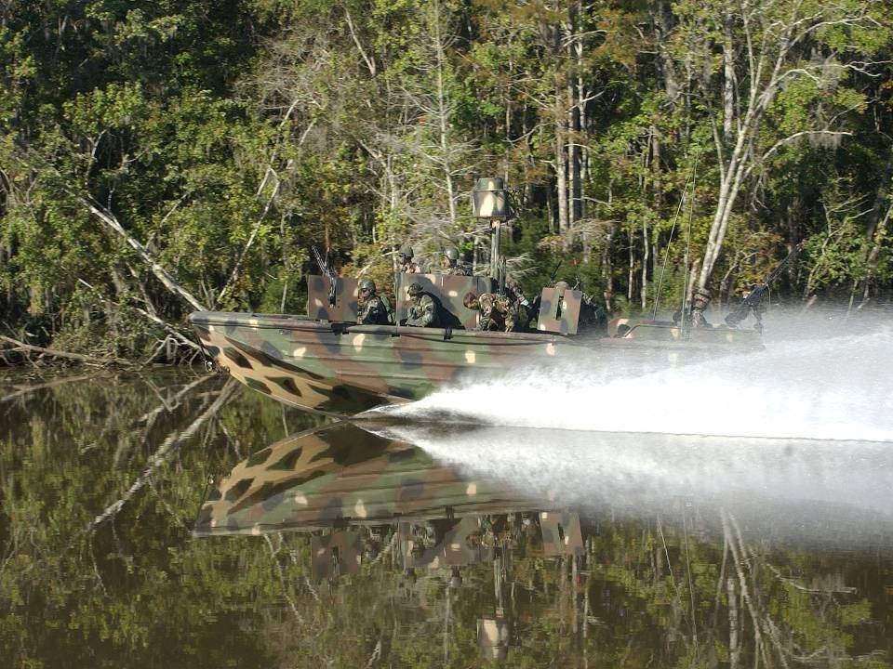
QUESTIONS ?

