Slide 1
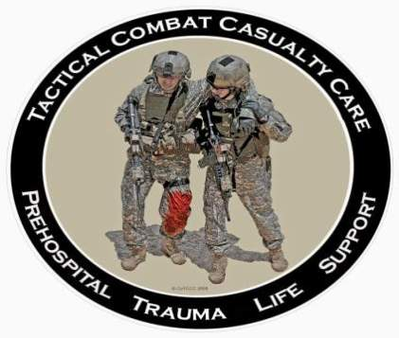
Tactical Combat Casualty Care for Medical Personnel
August 2018
(Based on TCCC-MP Guidelines 180801)
Tactical Field Care 3g
Convoy IED Scenario
Notes:
We will now continue the scenario that we began in Care Under Fire.

Slide 2

Disclaimer
“The opinions or assertions contained herein are the private views of the authors and are not to be construed as official or as reflecting the views of the Departments of the Army, Air Force, Navy or the Department of Defense.”
There are no conflict of interest disclosures.
Notes:
Read the disclaimer.

Slide 3
LEARNING Objectives
Terminal Learning Objective
Describe the application of Tactical Field Care principles to a specific casualty scenario.
Enabling Learning Objectives
Identify the urgency for treatment of various injuries.
Describe the correct treatment for the injuries presented in the scenario.
Notes:
Read the text.

Slide 4
Convoy IED Scenario
Recap from Care Under Fire:
Your last medical decision during Care Under Fire:
  Placed tourniquet on left stump
You moved the casualty behind cover and returned fire.
You provided an update to your mission commander.
Notes:
OK – let’s go back to our scenario that we started in Care Under Fire.
Your element was in a five-vehicle convoy moving through a small Iraqi village when a command-detonated IED exploded under the second vehicle. The person next to you sustained bilateral mid-thigh amputations.
He had heavy arterial bleeding from the left stump, and the right stump was only mildly oozing blood.
Read the text in the slide.

Slide 5
Convoy IED Scenario
Assumptions in discussing TFC in this scenario:
Effective hostile fire has been suppressed.
Team Leader has established a security perimeter.
Pre-designated HLZ for helicopter evacuation is 15 minutes away.
Flying time to the hospital is 30 minutes.
Ground evacuation time is 3 hours.
Enemy threat to helicopter at HLZ estimated to be minimal.
Notes:
Read the text.
HLZ = helicopter landing zone

Slide 6
Convoy IED Scenario
Next decision (Command Element)?
How to evacuate the casualty?
  Helicopter
    Longer time delay for ground evacuation.
    Enemy threat at the HLZ is acceptable.
Notes:
Next decision?
CASEVAC by air is chosen because it is significantly faster than ground CASEVAC in this scenario.

Slide 7
Convoy IED Scenario
Next decision (Command Element)?
Load first and treat enroute to the HLZ or treat first and load after?
  Load and Go
  Why?
    You can continue treatment enroute.
    Avoids potential second attack at the ambush site.
Notes:
Read the text.
Get the unit off the X – the enemy now knows where you are.

Slide 8
Convoy IED Scenario
Casualty is still conscious and has no neck or back pain.
Next decision?
  Do you need spinal immobilization?
  No
    Not needed unless casualty has neck or back pain
      Why?
      There is little expectation of a spinal fracture in the absence of neck or back pain in a conscious casualty.
      Speed is critical.
      NOTE: Casualties who are unconscious from blast trauma should have spinal immobilization if feasible.
Notes:
Read the text.

Slide 9
Convoy IED Scenario
Ten minutes later, you and the casualty are in a vehicle enroute to HLZ.
Next action?
Reassess the casualty.
  Casualty is now unconscious.
  No bleeding from first tourniquet site.
  The other stump is bleeding severely.
Notes:
Read the text.

Slide 10
Convoy IED Scenario
Next action?
  Place a tourniquet on the 2nd stump.
Next action?
  Remove any weapons or ordnance that the casualty may be carrying.
Next action?
  Place a nasopharyngeal airway.
Next action?
  Make sure he’s not bleeding heavily elsewhere.
  Check for other trauma.
Notes:
Read the text.

Slide 11
Convoy IED Scenario
Next actions?
  Pelvic binding device
  Establish IV access - need to give TXA and then resuscitate for shock
Next action?
  Administer 1 gram of tranexamic acid (TXA) in 100 cc NS or LR
  Infuse slowly over 10 minutes
Notes:
Read the text.

Slide 12
Convoy IED Scenario
Next action?
  Begin fluid resuscitation – your convoy carries cold-stored, type O, low-titer whole blood.
Next actions?
  Hypothermia prevention
  IV antibiotics
  Pulse ox monitoring
  Continue to reassess the casualty.
Notes:
Read the text.

Slide 13
Convoy IED Scenario
What is your 9-line?
Line 1: Grid NS 12345678
Line 2: 38.90, Convoy 6
Line 3: 1 Urgent
Line 4: Whole blood, oxygen, advanced airway
Line 5: 1 litter
Line 6: Secure
Line 7: VS-17 (Orange Panel)
Line 8: U.S. Military
Line 9: Flat field
* Some individuals recommend adding a
tenth line: the casualty’s vital signs
Notes:
Line 1: Pickup location
Line 2: Radio frequency, call sign and suffix
Line 3: Number of casualties by precedence (evacuation) category
Line 4: Special equipment required
Line 5: Number of casualties by type (ambulatory vs. litter)
Line 6: Security of pickup site (wartime) or number/type
Line 7: Method of marking pickup site
Line 8: Casualty’s nationality and status
Line 9: Terrain description at Landing Site; NBC contamination if applicable

Slide 14
Convoy IED Scenario
Your convoy has now arrived at the HLZ.
Next steps?
Continue to reassess the casualty and prepare for helo transfer.
  Ensure the casualty has no remaining weapons or comms gear before loading him on the helo.
  Secure the casualty’s personal effects per unit SOP.
  Document casualty status and treatment.
Notes:
At this point, the Flight Medic assumes care of the casualty. The Convoy IED Scenario will continue in TACEVAC.

Slide 15
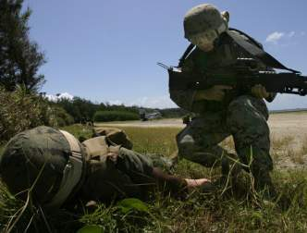
Remember!
The TCCC guidelines are not a rigid
protocol.
The tactical environment may require
some modifications to the guidelines.
Think on your feet!
Notes:
Every tactical scenario will have some features that are unique and may require some change to your plan.

Slide 16
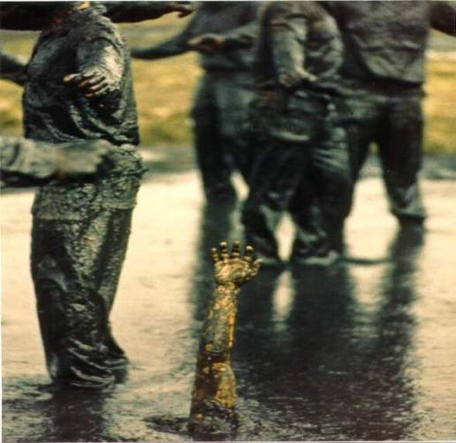
Questions?

