Slide 1
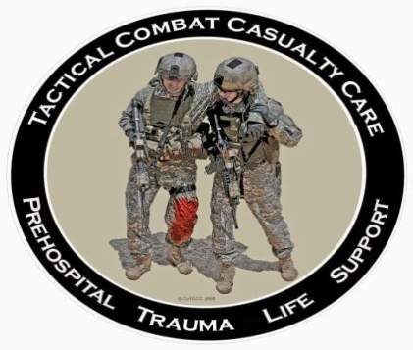
Tactical Combat Casualty Care for Medical Personnel August 2018 (Based on TCCC-MP Guidelines 180801)
Tactical Evacuation Care
Notes:
Tactical Evacuation Care is provided while casualties are moved from the hostile and austere tactical environment in which they were injured to a more secure location capable of providing advanced medical care.
The term “Tactical Evacuation” includes both CASEVAC and MEDEVAC as we will discuss.
This phase may represent the first opportunity to bring in additional medical personnel and equipment.

Slide 2
Disclaimer
“The opinions or assertions contained herein are the private views of the authors and are not to be construed as official or as reflecting the views of the Departments of the Army, Air Force, Navy or the Department of Defense.”
There are no conflict of interest disclosures.
Notes:
Read the disclaimer.

Slide 3
Learning Objectives
DESCRIBE the differences between MEDEVAC and CASEVAC
DESCRIBE the differences between Tactical Field Care and Tactical Evacuation Care
DESCRIBE the additional assets that may be available for airway management and electronic monitoring
KNOW which casualties are most likely to benefit from supplemental oxygen.
Notes:
Read the text.

Slide 4
Learning Objectives
DISCUSS the indications for and administration of Tranexamic Acid during tactical evacuation
DISCUSS the management of moderate/severe TBI during tactical evacuation
KNOW the importance and the methods of documenting casualty care in TCCC
DISCUSS the role of cardiopulmonary resuscitation in combat casualties during the Tactical Evacuation Care phase of TCCC
DESCRIBE the management of wounded hostile combatants during TACEVAC
Notes:
Read the text.

Slide 5
Tactical Evacuation
Casualties need evacuation as soon as feasible after significant injuries.
The evacuation asset may be a ground vehicle, aircraft, or boat.
Evacuation time is highly variable – significant delays may be encountered.
The tactical situation and hostile threats to evacuation platforms may differ markedly from one casualty scenario to another.
The Tactical Evacuation Care phase of TCCC allows for additional medical personnel and equipment to be used.
Notes:
Casualty movement/evacuation may occur as a separate moving portion of the operation while the main assault force continues tactical operations or the casualties may be evacuated along with the main assault force as it exfiltrates from the main objective.
Pre-mission planning should identify medical facilities and capabilities within the area of operations. Transport times to these facilities by various types of vehicles should also be identified.
Planning for loading casualties onto mission vehicle assets is important. A single litter patient may occupy space within a tactical vehicle normally occupied by 4 uninjured combatants. Take this into account during planning.

Slide 6
Evacuation Terminology
MEDEVAC: evacuation using special dedicated medical assets marked with a Red Cross
MEDEVAC platforms are non-combatant assets
CASEVAC: evacuation using non-medical platforms
May carry a Quick-Reaction force and provide close air support as well
Tactical Evacuation (TACEVAC) – this term encompasses both types of evacuation above
Notes:
Any platform can be used to evacuate casualties. You must understand the capabilities and limitations of any vehicle you opt to utilize.
MEDEVAC vehicles and aircraft are specifically configured for casualty care and designated with a Red Cross. These assets are generally minimally armed. They will often NOT evacuate casualties where there is a high threat of hostile fire.
CASEVAC assets are combatant platforms – good firepower, good armor, no Red Cross, designed to go into the fight. You will need CASEVAC assets if you have to evacuate casualties from a tactical situation where the threat level is high.

Slide 7
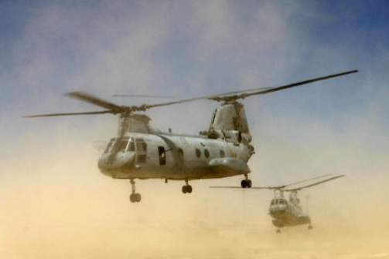
Aircraft Evacuation Planning
Flying rules vary widely among different aircraft and units
Consider:
Distances and altitudes involved
Day versus night
Passenger capacity
Hostile threat
Medical equipment
Medical personnel
Icing conditions
Notes:
In tactical situations where the threat of hostile fire is high, plan to use a CASEVAC asset.
However, in general, if the tactical situation will allow for a MEDEVAC asset to be used, it’s best to use that asset and save the CASEVAC assets for other contingencies that may arise later.
If you use a tactical CASEVAC asset, you may have to make plans to augment its medical capabilities. Plan to have extra medical personnel and equipment on the CASEVAC platform.

Slide 8
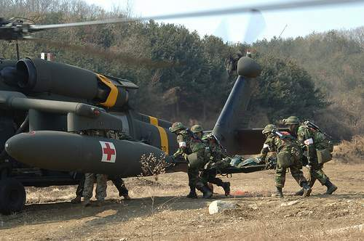
Aircraft Evacuation Planning
Ensure that your evacuation plan includes aircraft capable of flying the missions you need.
Plan for primary, secondary, & tertiary options.
Notes:
Always have a backup plan. Or two.
KNOW the flying rules for all your potential evacuation aircraft.

Slide 9
CASEVAC vs. MEDEVAC: The Battle of the Ia Drang Valley
1st Bn, 7th Cavalry in Vietnam
Surrounded by 2000 NVA - heavy casualties
Called for MEDEVAC
Request refused because landing zone
was not secure
Eventual pickup by 229th Assault
Helo Squadron after long delay
Soldiers died because of this mistake.
We must get this part right!
Notes:
Here’s an example of how preventable deaths can occur from evacuation delays if you don’t understand the difference between a CASEVAC and a MEDEVAC.
Soldiers died because of this planning error.

Slide 10
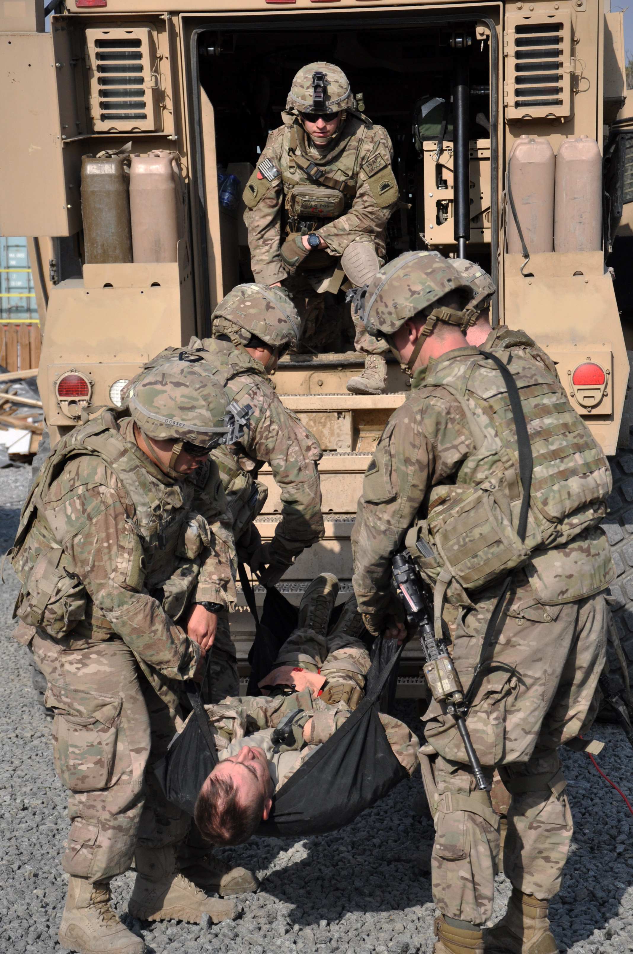
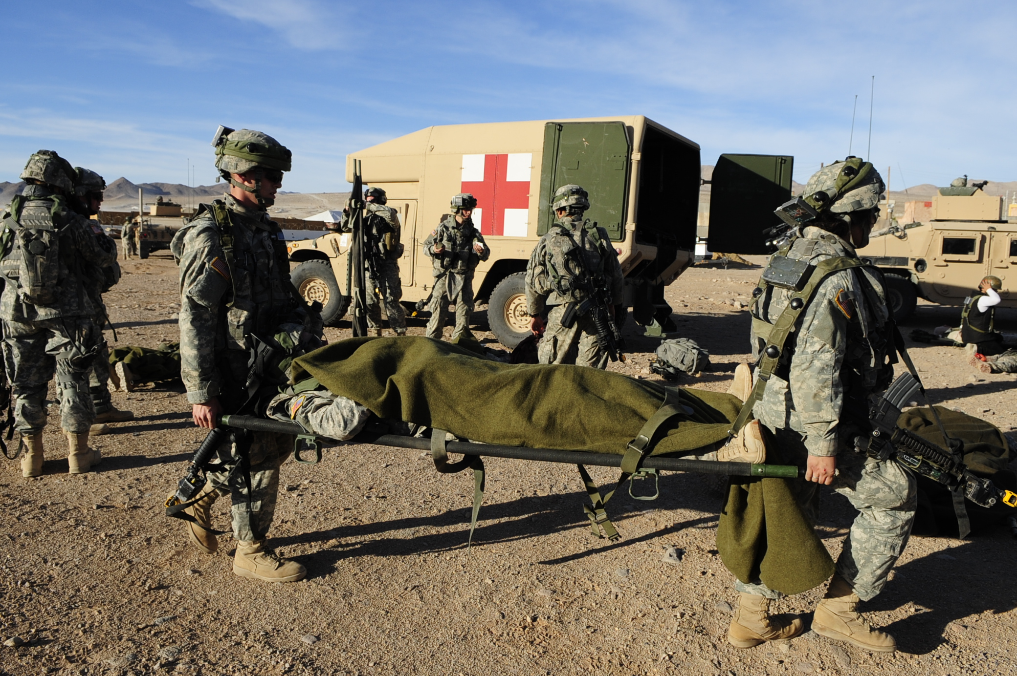
Ground Vehicle Evacuation
More prevalent in urban-centric operations in close proximity to a medical facility.
Vehicles may be organic to the unit or designated MEDEVAC assets.
Notes:
Ground evac typically took too long in Afghanistan.
Also, military vehicles are not designed for comfort. There is usually significant noise and vibration in cargo areas, and overland movement generally provides for an extremely rough ride, which may be hard on the casualty.

Slide 11
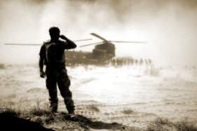
Tactical Evacuation Care
TCCC guidelines for care are largely the same in TACEVAC as they are in Tactical Field Care.
There are some changes that reflect the additional medical equipment and personnel that may be present in the TEC setting.
This section will focus on those differences.
Notes:
The Tactical Evacuation phase may present the first opportunity within the tactical operation to bring additional medical equipment and personnel to bear.
Additional medical personnel should arrive with the evacuation asset. This is important because:
-The unit’s medic or corpsman may be among its casualties
-The unit’s medic or corpsman may be dehydrated, hypothermic, or otherwise debilitated
-The unit’s medic or corpsman may need to continue on the unit’s mission and not get on the evacuation platform
-There may not have been a medic or corpsman at the casualty scene

Slide 12
Tactical Evacuation Care Guidelines
1. Transition of Care
a. Tactical force personnel should establish evacuation point security and stage casualties for evacuation.
b. Tactical force personnel or the medic should communicate patient information and status to TACEVAC personnel as clearly as possible. The minimum information communicated should include stable or unstable, injuries identified, and treatments rendered.
Notes:
Read the guidelines.

Slide 13
Tactical Evacuation Care Guidelines
1. Transition of Care (cont)
c. TACEVAC personnel should stage casualties on evacuation platforms as required.
d. Secure casualties in the evacuation platform in accordance with unit policies, platform configurations and safety requirements.
e. TACEVAC medical personnel should re-assess casualties and re-evaluate all injuries and previous interventions.
Notes:
Read the guidelines.

Slide 14
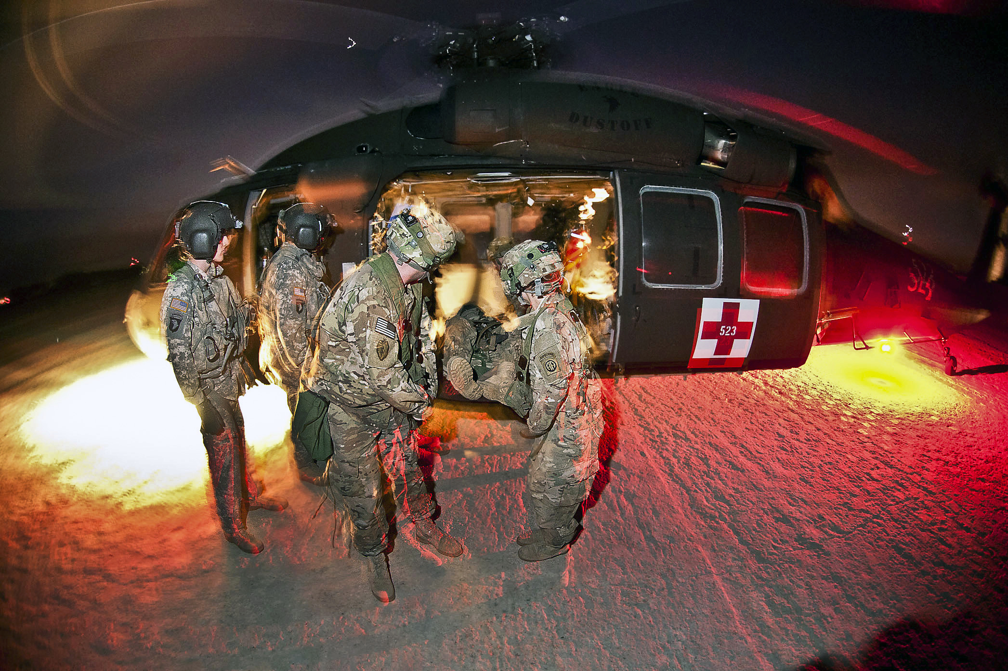
Transition of Care
Involves both the tactical force and the evacuation platform personnel.
Loud environment - making communication difficult.
Hazardous environment and safety concerns.
Preplanned procedures, rehearsals and effective communication can reduce the chaos and risks.
Notes:
Read the text.
Hazards at the site of transfer may include spinning rotor blades, brownout dust, or small boats bobbing on waves.

Slide 15
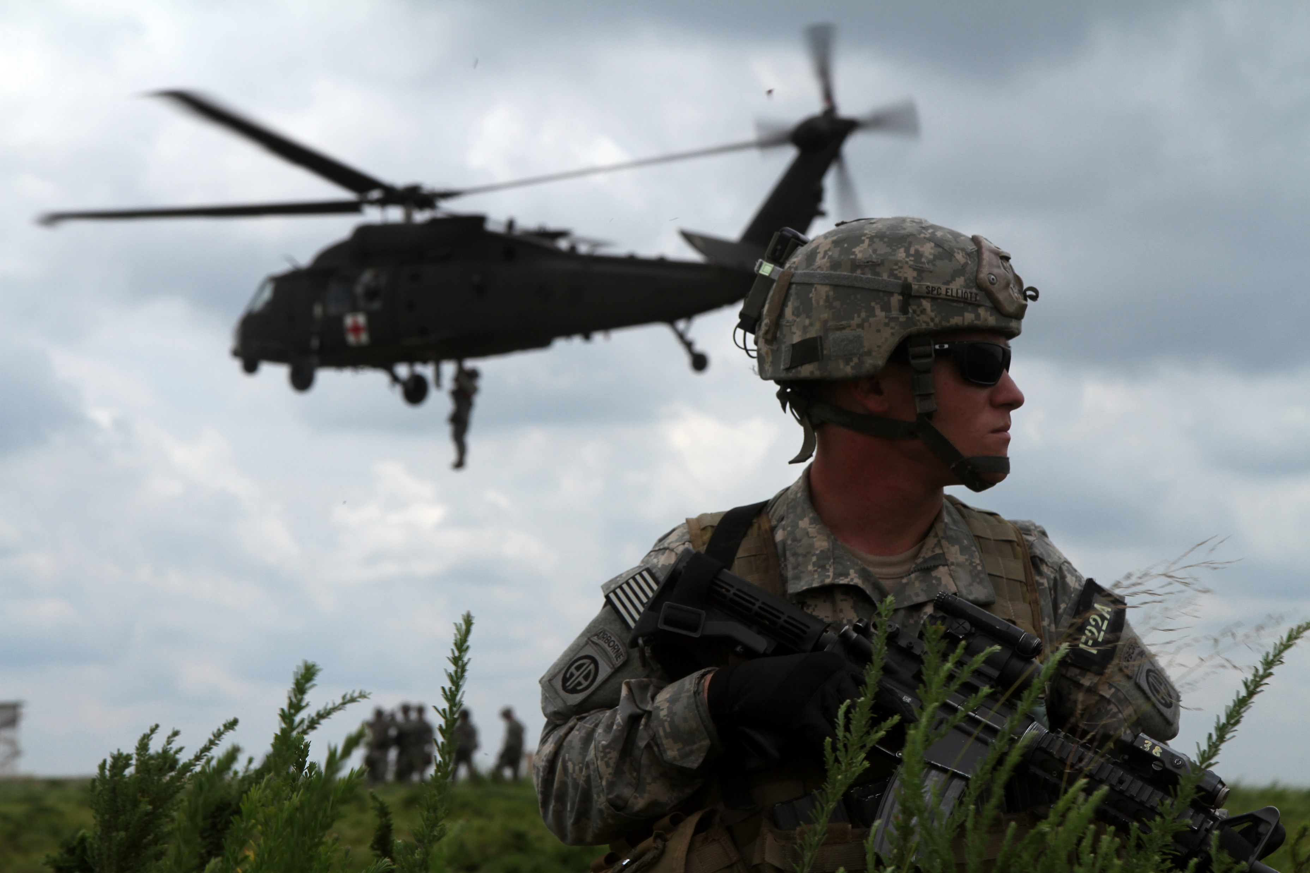
Tactical Force Responsibilities
Ensure appropriate selection, clearing, and securing of evacuation site.
Move casualties to site and stage for loading.
Stage according to specifics of the evacuation platform.
Maintain accountability of personnel.
Notes:
The tactical force must ensure that the evacuation site (helicopter landing zone or ambulance exchange point) is appropriately selected, cleared, and secured prior to the arrival of evacuation platforms.
The tactical force then moves casualties to the evacuation site and stages them for loading.
Staging must be carried out according to the evacuation platform (helicopter, fixed-wing aircraft, ground vehicle or boat) to be employed.
It is imperative for tactical force leaders to account for both casualties and tactical personnel moving casualties onto evacuation platforms to ensure 100% personnel accountability during the transition phase.

Slide 16
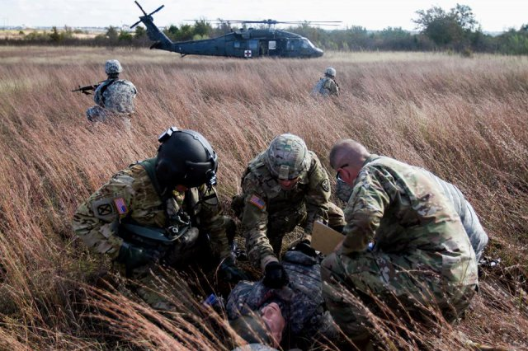
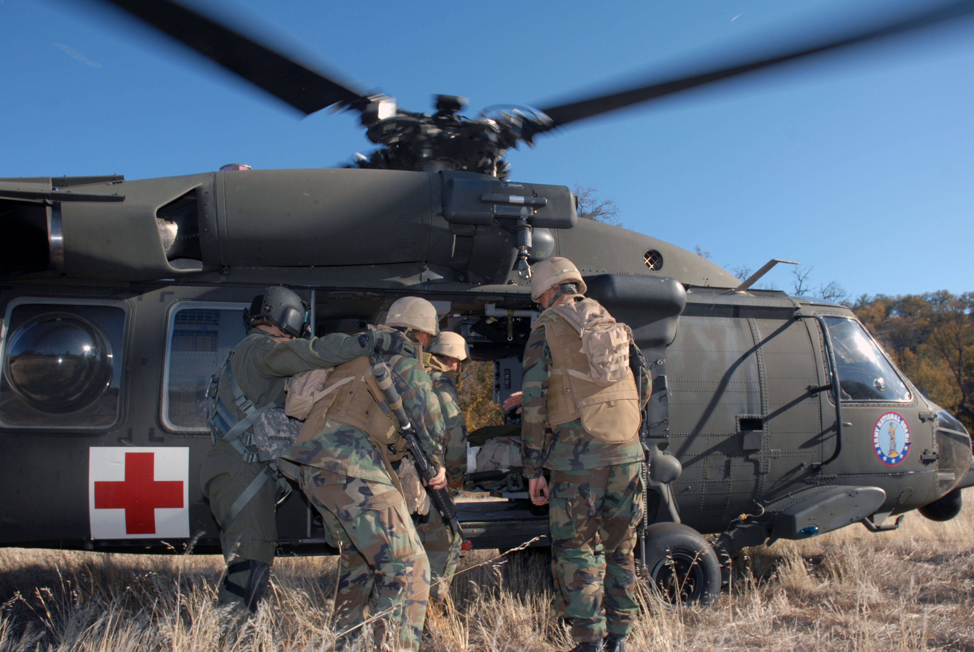
Tactical Force Responsibilities
Communicate casualty information to TACEVAC personnel.
“SIT” Casualty Report
Stable or Unstable
Identify Injuries
Treatments Rendered
Notes:
Tactical force personnel, medical or non-medical, should communicate casualty information and status to TACEVAC personnel if possible. Identify the receiving provider and identify yourself as the relinquishing provider if possible.
The minimum information communicated should include whether the casualties are stable or unstable, injuries identified, and treatments rendered.
All information should be documented on every casualty’s DD 1380 (TCCC Card). Make sure the card is visible.
Reinforcement by physically pointing to injuries and interventions can be critical to relaying information to the next care giver. Use exaggerated motions by pointing to each injury while confirming acknowledgement from the receiving provider.

Slide 17
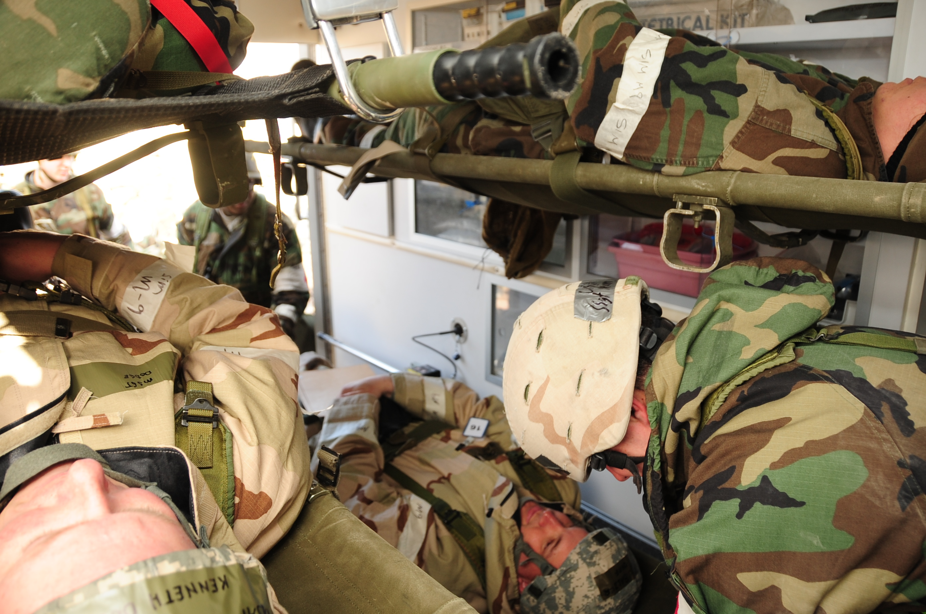
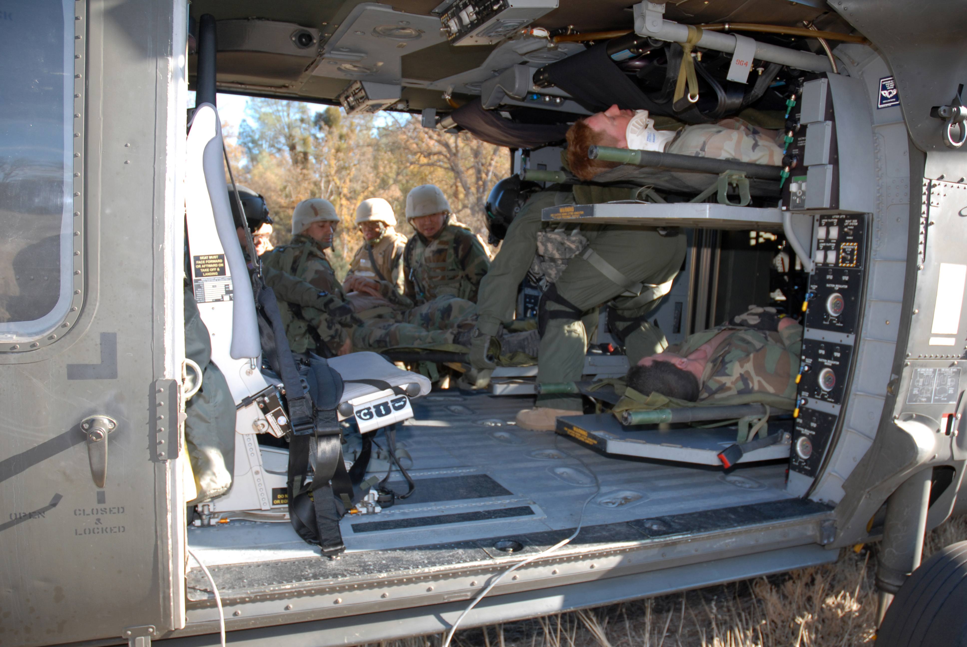
TACEVAC Responsibilities
Triage and ensure appropriate placement during loading.
Notes:
As TACEVAC personnel receive casualties onto their platform, they should triage them and ensure appropriate placement for best access during enroute care.

Slide 18
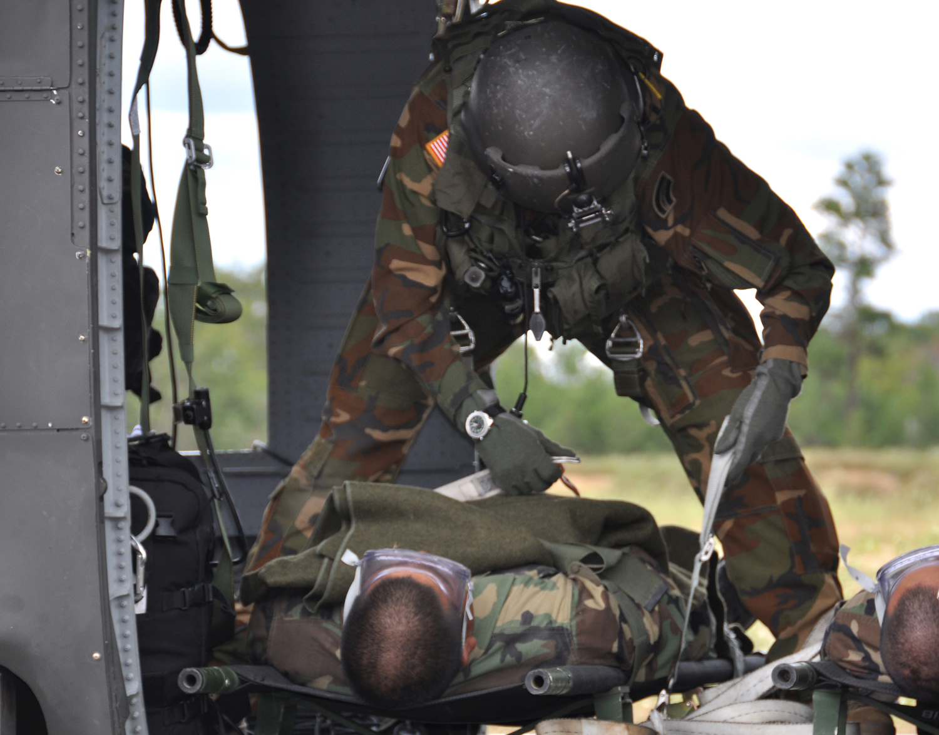
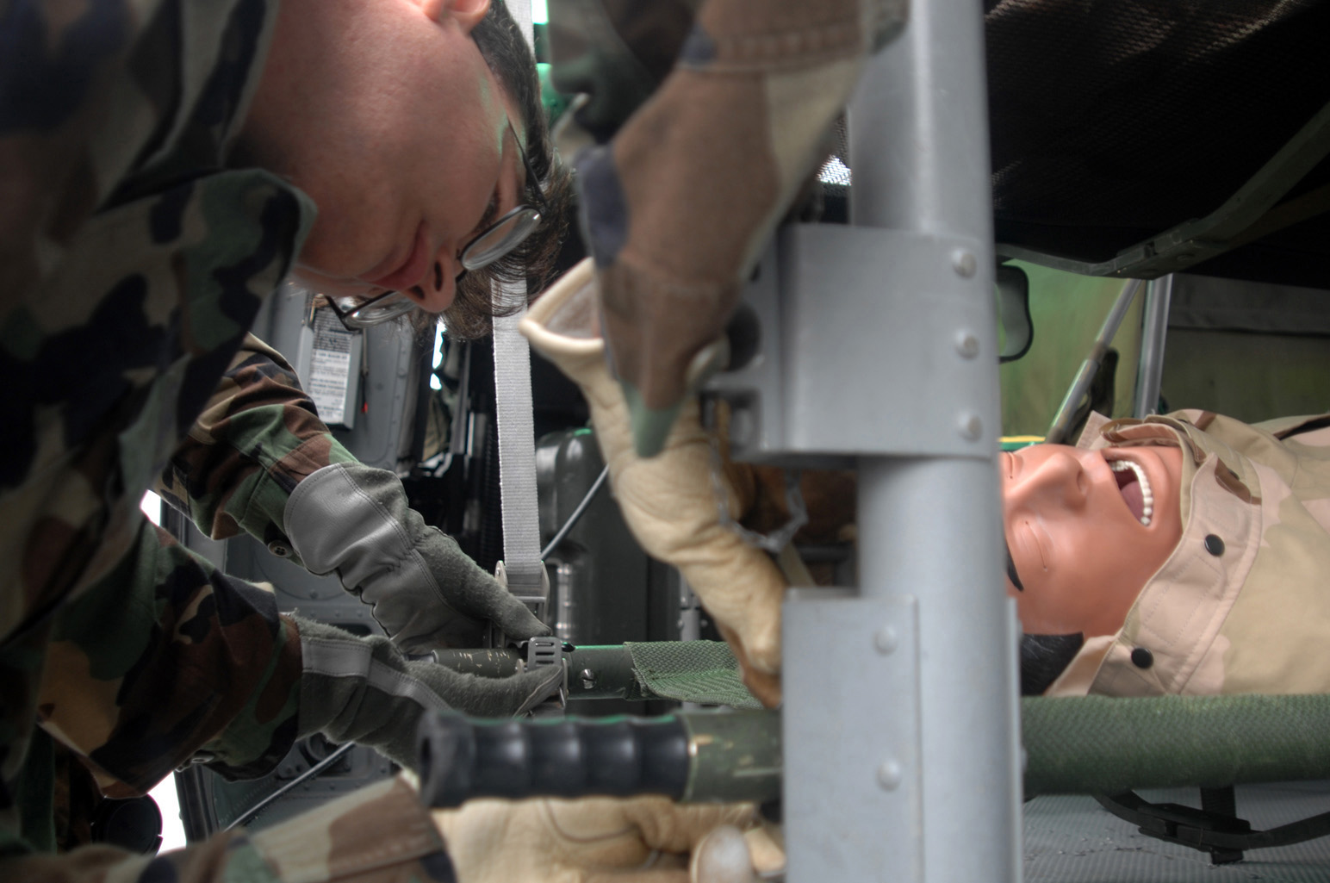
TACEVAC Responsibilities
Secure IAW platform-specific required configurations, policies and safety.
Check and double-check.
Notes:
Casualties must be secured in accordance with platform configurations, unit policies, and safety requirements.
TACEVAC personnel are the experts on their specific evacuation platform.

Slide 19
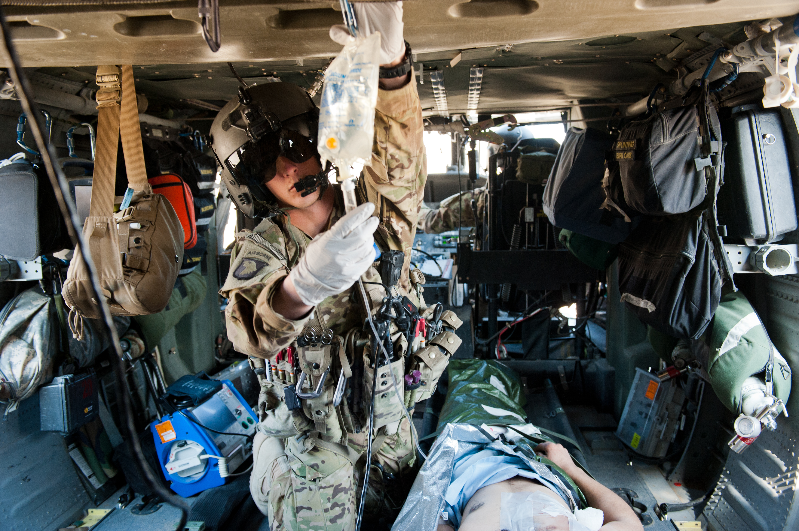
TACEVAC Responsibilities
Re-assess ALL previous interventions and treatments.
Assess all interventions for effectiveness.
Notes:
TACEVAC personnel should re-assess all previous interventions and treatments.

Slide 20
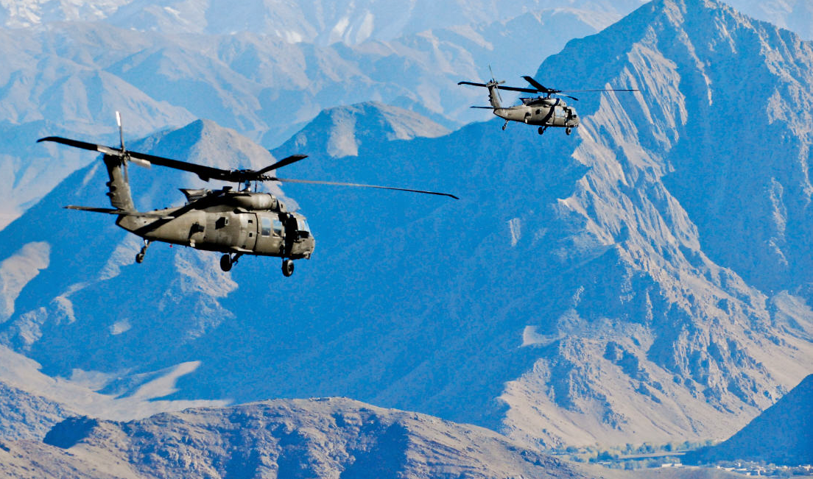
Airway in TACEVAC
If the casualty is conscious with no airway difficulty, no intervention is required.
Allow conscious casualties to assume any positions that best protects the airway, including sitting up and leaning forward.
An extraglottic airway
may be a good choice
for an unconscious
casualty during
TACEVAC.
Notes:
The Nasopharyngeal Airway was described in the Tactical Field Care section. Once a casualty has been secured aboard an evacuation platform, a wider variety of more definitive airway adjuncts and personnel trained to use them may be available, although the NPA should suffice for most patients.

Slide 21
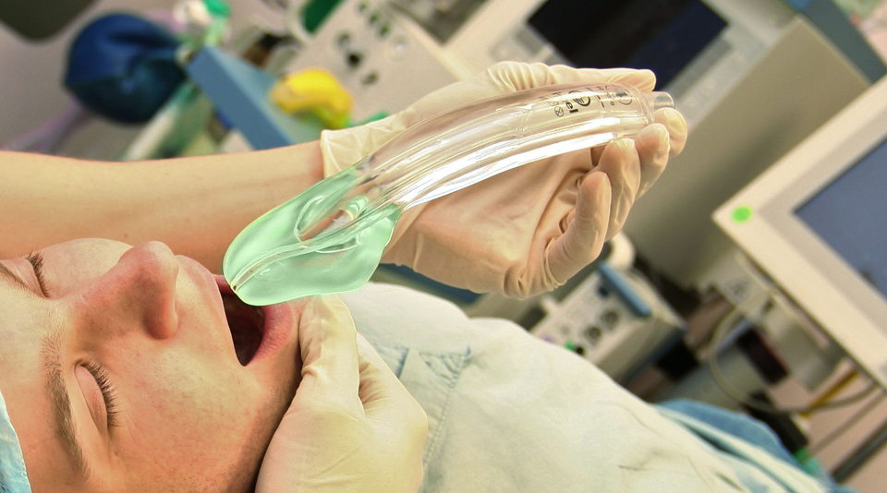
Airway in TACEVAC
The i-gel® is the preferred extraglottic airway in TCCC
The gel-filled cuff eliminates the need to inflate it with air
It also eliminates the need to monitor airway cuff pressure, which will increase at altitude.
Increased cuff pressure
with air-filled cuffs
can cause palsies of
nerves that pass
through the
oropharynx.
Notes:
A number of extraglottic airways can be used in the Tactical Evacuation Care setting. They are easier and faster to insert than an ET tube, are less likely to harm the casualty if not correctly placed, and require less training and experience to use successfully.
The i-gel® is the preferred extraglottic airway in TCCC because of its simplicity of use:
There is no need to fill the cuff with air, as with most
extraglottic airways.
There is also no need to monitor cuff pressure with the
i-gel®, as there is with other extraglottic airways.

Slide 22
Airway in TACEVAC
If an extraglottic airway with an air-filled cuff is used, cuff pressure must be monitored.
Extraglottic airways will not be tolerated unless the casualty is deeply unconscious.
Monitor the hemoglobin oxygen saturation in casualties to help assess airway patency.
Use capnography monitoring in this phase of care if available.
Always remember that the casualty’s airway status may change over time and requires frequent reassessment.
Notes:
Read the text.

Slide 23
Airway in TACEVAC
Endotracheal intubation is an advanced skill and is not taught in the basic TCCC course, but may be useful in this phase of care.
For casualties with trauma to the face and mouth, or facial burns with suspected inhalation injury, nasopharyngeal airways and extraglottic airways may not suffice and a surgical cricothyroidotomy may be required.
Surgical cricothyroidotomies should not be performed on unconscious casualties who have no direct airway trauma unless use of a nasopharyngeal airway and/or an extraglottic airway have been unsuccessful in opening the airway.
Notes:
Do not attempt endotracheal intubation unless you have been trained on this procedure and are proficient in its use.

Slide 24
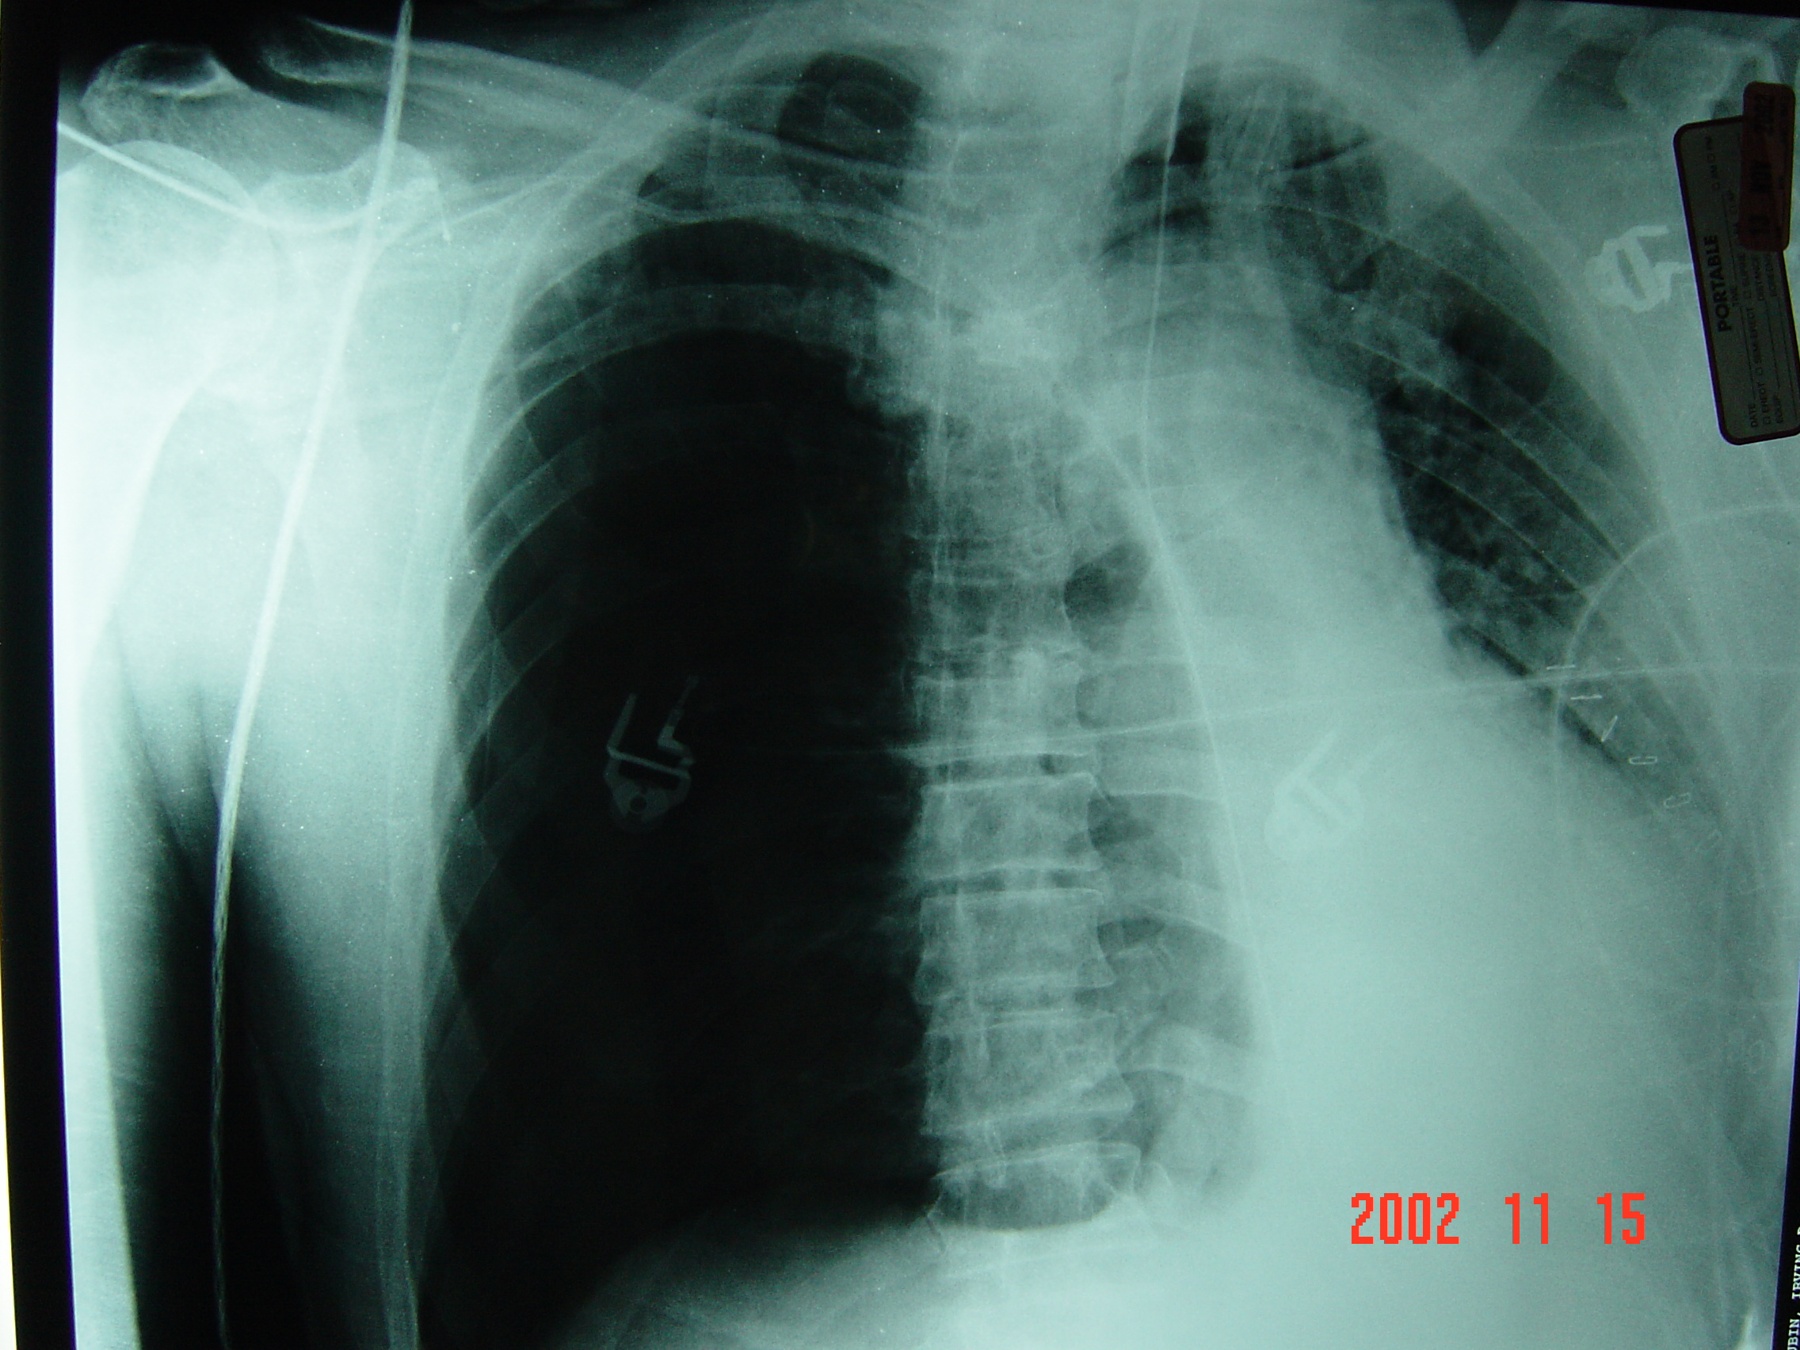
Respiration/Breathing in TACEVAC
Watch for tension pneumothorax as casualties with chest wounds ascend into the lower pressure at altitude.
Pulse ox readings will become lower as casualty ascends unless supplemental oxygen is added.
Photo courtesy
COL Matt Martin
Notes:
Consider tension pneumothorax in casualties with penetrating chest injuries and progressive respiratory distress. Decompress using a 14- or a 10-gauge, 3.25-inch needle.
The photo in this slide shows a very large tension pneumothorax on the right shifting the heart to the left and compressing the left lung.

Slide 25
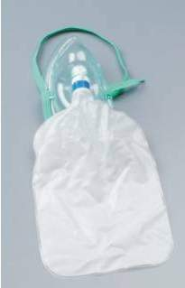
Supplemental Oxygen in Tactical Evacuation Care
Most casualties do not need supplemental oxygen, but have oxygen available and use it for:
Casualties in shock
Low oxygen sat on pulse ox
Unconscious casualties
Casualties with TBI
(maintain oxygen saturation
> 90%)
Chest wound casualties
Notes:
Oxygen should be pre-positioned on evacuation assets.
Oxygen generators or concentrators are preferred over compressed gas cylinders because of the reduced explosive hazard.

Slide 26
Tactical Evacuation Care Guidelines
5. Circulation
c. Tranexamic Acid (TXA)
● If a casualty is anticipated to need significant blood transfusion (for example: presents with hemorrhagic shock, one or more major amputations, penetrating torso trauma, or evidence of severe bleeding):
Administer 1 gram of tranexamic acid in 100 ml Normal Saline or Lactated Ringer’s as soon as possible but NOT later than 3 hours after injury. When given, TXA should be administered over 10 minutes by IV infusion.
Begin second infusion of 1 gm TXA after initial fluid resuscitation has been completed.
Notes:
Read the guideline.
If the casualty meets the criteria for treatment with TXA, and it has not already been given, then give the first dose in Tactical Evacuation Care. Note, though, that TXA should not be initiated if more than three hours have passed since the casualty was injured.

Slide 27
TXA Administration: 2nd Dose
Typically given after the casualty arrives at a Role II/Role III medical facility.
May be given in Tactical Evacuation Care if the first dose was given earlier, and fluid resuscitation has been completed before arrival at the medical facility.
TXA should NOT be given with Hextend or through an IV line with Hextend in it.
Inject 1 gram of TXA into a 100-cc bag of Normal Saline or Lactated Ringer’s.
Infuse slowly over 10 minutes.
Notes:
TXA should not be given together with Hextend is accordance with manufacturer’s instructions to mix it with normal saline or Ringer’s Lactate.
Remember that rapid IV push of TXA may cause hypotension.
If there is a new-onset drop in BP during the infusion – SLOW DOWN the TXA infusion.

Slide 28
Refractory Shock in TACEVAC
If a casualty in shock is not responding to fluid resuscitation, consider untreated tension pneumothorax as a possible cause of refractory shock.
Thoracic trauma, persistent respiratory distress, absent breath sounds, and hemoglobin oxygen saturation < 90% support this diagnosis.
Treat as indicated with repeated NDC or finger thoracostomy/chest tube insertion at the fifth ICS in the AAL, according to the skills, experience, and authorizations of the treating medical provider. Note that if finger thoracostomy is used, it may not remain patent and finger decompression through the incision may have to be repeated.
Consider decompressing the opposite side of the chest if indicated based on the mechanism of injury and physical findings.
Notes:
Consider tension pneumothorax as a possible cause of shock that is not responding to fluid resuscitation.
Chest tubes or simple thoracostomy should be performed only by providers who are trained and skilled at the procedure and authorized by the command to perform them.

Slide 29
Tactical Evacuation Care Guidelines
6. Traumatic Brain Injury
Casualties with moderate/severe TBI should be monitored for:
Decreases in level of consciousness
Pupillary dilation
SBP should be >90 mmHg
O2 sat > 90
Notes:
Read the guidelines.
Unilateral pupillary dilatation accompanied by a decrease in the level of consciousness may indicate that intracranial pressure is rising and that cerebral herniation is imminent. Casualties with moderate/severe TBI should be watched closely for these signs.
Hypotension and hypoxemia may worsen outcomes for casualties with moderate/severe TBI. These conditions should be watched for and prevented or corrected as quickly as possible.

Slide 30
Tactical Evacuation Care Guidelines
6. Traumatic Brain Injury
a. Casualties with moderate/severe TBI should be monitored for:
Hypothermia
End-tidal CO2 (If capnography is available, maintain between 35-40 mmHg)
Penetrating head trauma (if present, administer antibiotics)
Assume a spinal (neck) injury until cleared
Continued…
Notes:
Read the guidelines.
Hypothermia may result in coagulation defects that may be associated with increased mortality in trauma victims with moderate to severe brain injury. It, too, should be prevented or corrected as quickly as possible in these patients.
Hypercapnia (elevated level of CO2 in the blood) contributes to an increase in cerebral blood flow which in turn contributes to elevation of the intracranial pressure (ICP). Elevated ICP must be avoided as this may lead to cerebral herniation. It is important, then, to keep CO2 from rising in casualties with injured brains. On the other hand, hypocapnia leads to cerebral vasoconstriction and decreased cerebral blood flow, which can also be bad for the casualty in that it reduces the amount of oxygen supplied to the brain. It is important, then, to maintain normal CO2 levels in casualties with injured brains (unless signs of cerebral herniation appear – more on that just ahead). Capnography should be used to monitor the casualty’s end-tidal CO2 to make sure that respiration remains adequate to keep the blood level of CO2 in the normal range.
With respect to wound infection, a penetrating injury to the brain is the same as a penetrating injury to any other tissue. Early administration of an antibiotic may help prevent infection.
If an injury to the head is severe enough to cause brain injury, then there was enough energy involved to cause injury to the cervical spine as well. Therefore, in cases of moderate/severe TBI, cervical spine fracture should be presumed, and appropriate precautions taken, until the spine is cleared for injury.

Slide 31
Tactical Evacuation Care Guidelines
6. Traumatic Brain Injury
b. Unilateral pupillary dilation accompanied by a decreased level of consciousness may signify impending cerebral herniation; if these signs occur, take the following actions to decrease intracranial pressure:
Administer 250cc of 3% or 5% hypertonic saline bolus.
Elevate the casualty’s head 30 degrees.
Continued…
Notes:
Read the guidelines.
Rising ICP may lead to cerebral herniation. When signs of herniation are present in a brain-injured casualty, rapid reduction of ICP is needed.
Hypertonic saline may help decrease ICP and improve cerebral perfusion pressure and brain tissue oxygen levels.
Elevation of the casualty’s head may help reduce ICP.

Slide 32
Tactical Evacuation Care Guidelines
6. Traumatic Brain Injury
b. (Continued)
3) Hyperventilate the casualty
Respiratory rate 20
Capnography should be used to maintain the end-tidal CO2 between 30-35 mmHg
The highest concentration of oxygen (FIO2) possible should be used for hyperventilation
Continued…
Notes:
Read the guidelines.
Hyperventilation leads to reduced levels of CO2 in the blood that, in turn, can contribute to cerebral vasoconstriction and lowered ICP. Therefore, hyperventilation can be used as a temporary measure to lower ICP in brain-injured casualties exhibiting signs of cerebral herniation. If capnography is available, it should be used to monitor end-tidal CO2 levels. The target range for CO2 is slightly lower than normal as shown on slide #19 above.
Hyperoxia also contributes to cerebral vasoconstriction that will reduce cerebral blood flow which may help reduce elevated ICP. However, because of the increased amount of oxygen carried by the blood when hyperoxic, it will improve cerebral tissue oxygenation even while reducing cerebral blood flow. If oxygen is available, the highest concentration that can be delivered should be delivered.

Slide 33
Tactical Evacuation Care Guidelines
6. Traumatic Brain Injury
Notes:
Do not hyperventilate unless signs of impending
herniation are present.
Casualties may be hyperventilated with oxygen
using the bag-valve-mask technique.
Notes:
Read the guidelines.
The hypocarbia and cerebral vasoconstriction that result from hyperventilation may be harmful to a brain-injured casualty who is not herniating. These casualties need to maintain their cerebral perfusion. Accordingly, hyperventilation should only be used in casualties who display signs of cerebral herniation, and who need emergency reduction in ICP.

Slide 34
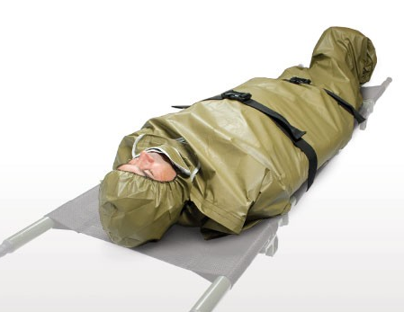
Hypothermia Prevention in TACEVAC
Remember to keep the casualty on an insulated surface or get him/her on one as soon as possible.
Apply the Ready-Heat Blanket from the Hypothermia Prevention and Management Kit (HPMK), to the casualty’s torso (not directly on the skin) and cover the casualty with the Heat-Reflective Shell (HRS).
Notes:
Read the text.

Slide 35
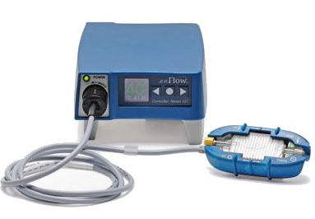
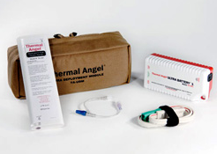
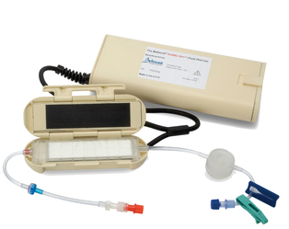
Hypothermia Prevention in TACEVAC
enFlow ™
Thermal Angel™
Buddy Lite ™
Use a portable fluid warmer capable of warming all IV fluids including blood products.
Notes:
Read the text.

Slide 36
Remember: Prevention of Hypothermia in Helicopters!
Cabin wind and altitude cold result in cold stress.
Protection is especially important for casualties in shock and for burn casualties.
Notes:
Imagine how cold these casualties are. It is always cold at altitude in helos, but much worse during winter.
Medics and corpsmen riding in helicopters in winter should bring chemical hand warmers to maintain manual dexterity!

Slide 37
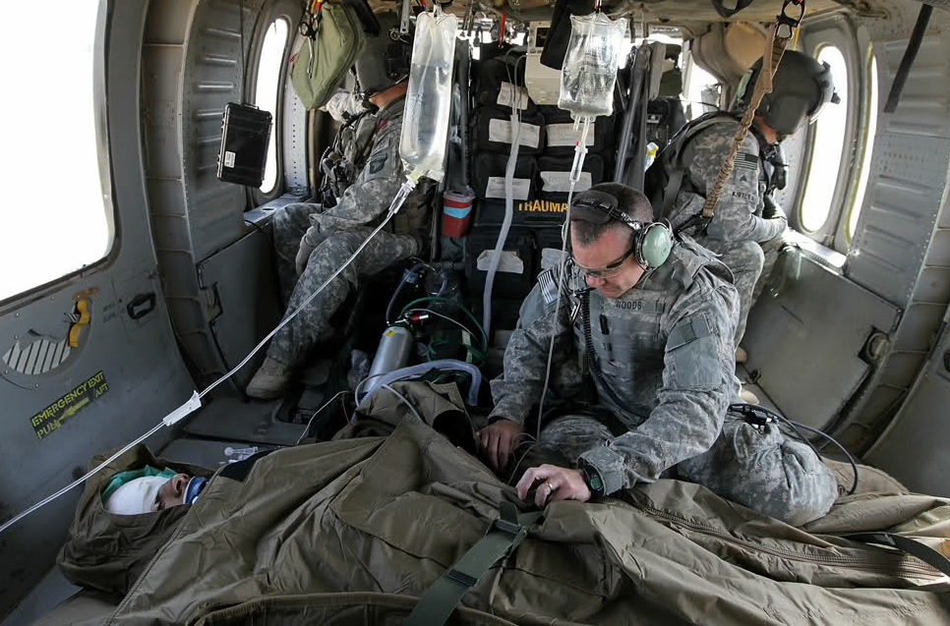
Tactical Evacuation Care Guidelines
14. Burns
h. Burn patients are particularly susceptible to hypothermia. Extra emphasis should be placed on barrier heat loss prevention methods and IV fluid warming in this phase.
http://www.topmilitarysites.net/news/how-becoming-a-doctor-in-the-army-works/
Notes:
Read the guideline.
Hypothermia prevention is especially important for Burn Casualties in TACEVAC.
The Ready Heat Blanket can be placed over burned skin if care is taken to place a barrier between the blanket and the burn.

Slide 38
Tactical Evacuation Care Guidelines
17. CPR in TACEVAC Care
a. Casualties with torso trauma or polytrauma who have no pulse or respirations during TACEVAC should have bilateral needle decompression performed to ensure they do not have a tension pneumothorax. The procedure is the same as described in section (4a) above.
Notes:
As in Tactical Field Care, when a polytrauma or torso trauma victim loses signs of life during resuscitation, bilateral needle decompression of the chest should be performed, if feasible, to rule out tension pneumothorax.

Slide 39
Tactical Evacuation Care Guidelines
17. CPR in TACEVAC Care (cont)
b. CPR may be attempted during this phase of care if the casualty does not have obviously fatal wounds and will be arriving at a facility with a surgical capability within a short period of time. CPR should not be done at the expense of compromising the mission or denying lifesaving care to other casualties.
Notes:
Read the guideline.
CPR may be considered during TACEVAC if it is tactically and practically feasible, and surgical care is not far away.

Slide 40
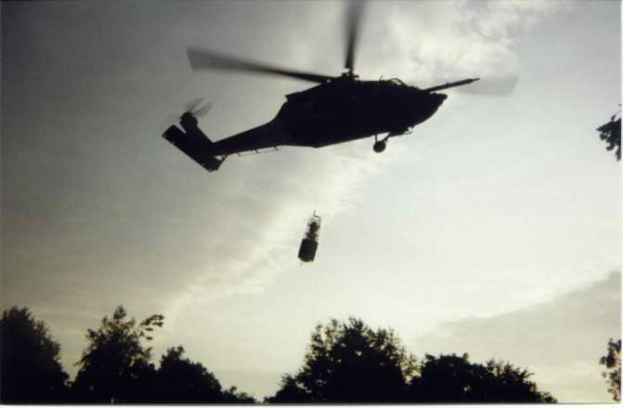
TACEVAC CARE - Hoisting
Rigid Litters Only When Hoisting!
Check and double-check rigging
Notes:
40
Stokes or basket-type litters should be used for hoisting casualties into helos.
Secure the casualty – check and double-check the rigging.

Slide 42
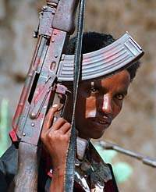
TACEVAC Care for Wounded Hostile Combatants
Principles of care are the same for all wounded combatants
Rules of Engagement may dictate evacuation process
Restrain and provide security
Remember that each hostile
casualty represents a potential
threat to the provider and the
unit and take appropriate
measures
They still want to kill you.
Notes:
We talked about this in TFC.
Maintain proper prisoner handling procedures.

Slide 43
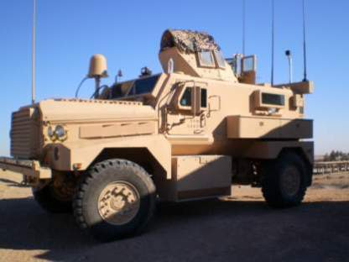
Tactical Evacuation Care Summary of Key Points
Evacuation time is highly variable
Thorough planning is key
Similar to Tactical Field Care guidelines but with some modifications
Notes:
Read the text.

Slide 44
Convoy IED Scenario
Recap from TFC
The last medical interventions during TFC were:
Placed tourniquet on both bleeding stumps
Disarmed
Placed NPA
Pelvic binding device applied
Established IV
Administered 1 gm TXA and 1 unit whole blood
IV antibiotics
Provided hypothermia prevention
Your helo has now arrived at the HLZ
Notes:
Read the text.
OK – let’s go back to our scenario that we started in Care Under Fire.
Your element was in a five-vehicle convoy moving through a small Iraqi village when a command-detonated IED exploded under the second vehicle. The person next to you sustained bilateral mid-thigh amputations. He had heavy arterial bleeding from the left stump, and the right stump was only mildly oozing blood. The care you rendered during Tactical Field Care is shown here. The time in flight to the hospital will be 30 minutes.

Slide 45
Convoy IED Scenario
What’s Next?
Casualty is now conscious, but is confused.
Reassess casualty for ABCs
NPA still in place
Tourniquets, pelvic binding device in place, no significant bleeding
Attach electronic monitoring to casualty
Heart rate 140; systolic BP 70
O2 sat = 90%
Notes:
Read the text.

Slide 46
Convoy IED Scenario
What’s next?
Supplemental oxygen
Why?
Casualty is still in shock
What’s next?
Continue fluid resuscitation with whole blood or plasma and RBCs in a 1:1 ratio.
Why?
Casualty is still in shock
Notes:
Read the text.

Slide 47
Convoy IED Scenario
What’s next?
Inspect and dress known wounds and search for additional wounds
What’s next?
Try to remove tourniquets and use hemostatics?
No
Why? THREE reasons:
Short transport time - less than 2 hours from application of tourniquets
No distal extremities to lose
Casualty is in shock
Notes:
Read the text.

Slide 48
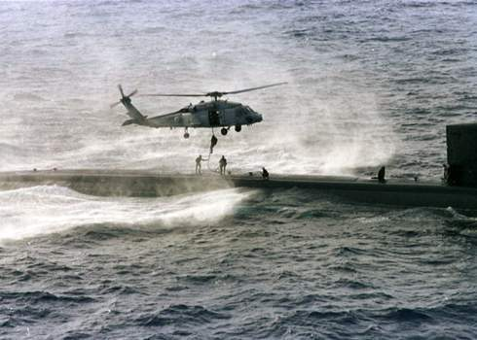
Questions/Comments?

