Slide 1
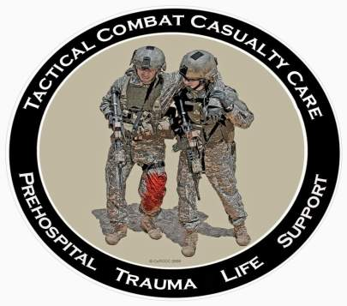
Direct from the Battlefield: Tactical Combat Casualty Care Performance Improvement Items
Tactical Combat Casualty Care for Medical Personnel August 2017 (Based on TCCC-MP Guidelines 170131)

Slide 2
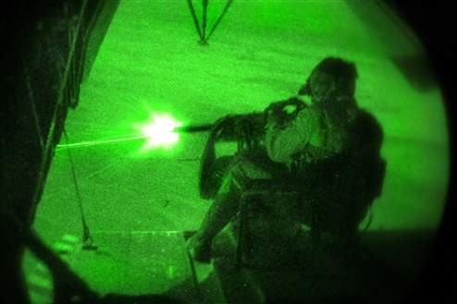
Sources of TCCC Opportunities to Improve:
Reports from Joint Trauma System (JTS) weekly Trauma Telecons – every Thursday morning
Worldwide telecon to discuss every serious casualty admitted to a Role 3 hospital from that week
Published medical reports
Armed Forces Medical
Examiner’s System
Theater AARs
Feedback from doctors,
PAs, corpsmen, medics,
and PJs
Notes:
Opportunities to improve TCCC flow to the CoTCCC from a number of sources.

Slide 3
The Forgotten Tourniquet
Notes:
Tactical Combat Casualty Care (TCCC)
9/15/2017
DRAFT
3

Slide 4
The Forgotten Tourniquet
There was an adverse outcome from a tourniquet that was left in place for approximately 8 hours.
Be aggressive about putting tourniquets on in Care Under Fire for any life-threatening extremity hemorrhage BUT
Reassess the casualty in Tactical Field Care – remove it if it is not needed unless the casualty is in shock.
Always re-evaluate tourniquets at two hours and remove if possible.
Notes:
Read the text .

Slide 5
Tourniquet Mistakes to Avoid!
Not using a tourniquet when you should
Using a tourniquet for minimal bleeding
Leaving the TQ too high--if placed "high and tight" during Care Under Fire, move to just above the wound during TFC
Not taking it off when indicated during TFC
Taking TQ off when the casualty is in shock or has only a short transport time to the hospital
Not making it tight enough – the tourniquet should both stop the bleeding and eliminate the distal pulse if the distal extremity is intact
Notes:
Read text

Slide 6
Tourniquet Mistakes to Avoid!
Not using a second tourniquet if needed
Waiting too long to put the tourniquet on
Periodically loosening the tourniquet to allow blood flow to the injured extremity
Failing to reassess to make sure the bleeding is still stopped
Not attempting to convert a tourniquet if it has been on for two hours.
Notes:
Read the text.

Slide 7
Opioid Analgesics for Casualties in Shock
Notes:
Tactical Combat Casualty Care (TCCC)
9/15/2017
DRAFT
7

Slide 8
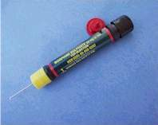
NO Opioid Analgesia for Casualties in Shock
Narcotics (morphine and fentanyl) are CONTRAINDICATED for casualties
who are in shock or who are likely to
go into shock; these agents may worsen
their shock and increase the risk of death
Four casualties in two successive weekly telecons were noted to have received narcotics and were in shock during transport or on admission to the MTFs
Use ketamine for casualties who are in shock or at risk of going into shock but are still having significant pain
Notes:
Read the text.

Slide 9
JTS Case Report 2017
Casualty injured in a dIED attack
CPR in progress on arrival at forward surgical capability
Multiple abdominal and pelvic injuries
Severe liver laceration (requiring packing)
Splenic laceration
Significant mesenteric bleeding
Left iliac vein injury
Pelvic fracture
Zone 1 REBOA placed with return of VS
Notes:
Read the text.

Slide 10
JTS Case Report 2017
Re-operated at Role 3 hospital several times
Stormy course but stabilized and was off pressor medications at time of transport
Private transport to a NATO partner hospital
On Precedex & ketamine at the Role 3, but changed to fentanyl and midazolam by the flight team
Casualty became hypotensive and was treated with escalating dose Levophed drip
Arrived at coalition partner hospital unstable
Died shortly thereafter of multi-organ failure
Notes:
Read the text.

Slide 11
Untreated Pain on the Battlefield
Notes:
Tactical Combat Casualty Care (TCCC)
9/15/2017
DRAFT
11

Slide 12
Slide courtesy of MAJ
John Robinson
Data from JTS/JTTS
TCCC AARs and PHTR
Notes:
Almost 2/3 of these seriously wounded casualties got no pre-hospital treatment for pain.
Furthermore, several of them received IM morphine which is clearly not the contemporary standard of care.
Gerhardt RT, Reeves PT, Kotwal RS, Mabry RL, Robinson JB, Butler F. Analysis of Prehospital Documentation of Injury-Related Pain Assessment and Analgesic Administration on the Contemporary Battlefield. Prehosp Emerg Care. 2016;20(1):37-44. doi: 10.3109/10903127.2015.1051683.

Slide 13
Case Report
Male casualty with GSW to thigh
Bleeding controlled by tourniquet
In shock – alert but hypotensive
Severe pain from tourniquet
Repeated pleas to PA to remove the tourniquet
PA did not want to use opioids because of the shock
Perfect candidate for ketamine analgesia
Ketamine not fielded at the time with this unit
50 mg ketamine autoinjectors would help - but approval from the FDA is needed to use ketamine in that mode
Notes:
Read the text.

Slide 14
Opioid Analgesics Given in Combination with Benzodiazepines
Notes:
Tactical Combat Casualty Care (TCCC)
9/15/2017
DRAFT
14

Slide 15
Warning: Opioids and Benzos
Ketamine can safely be given
after a fentanyl lozenge
Some practitioners use
benzodiazepine medications
such as midazolam to avoid
ketamine side effects BUT
Midazolam may cause respiratory depression, especially when used with opioids
Avoid giving midazolam to casualties who have previously gotten fentanyl lozenges or morphine
Notes:
15
Read the text.
There is a black box warning from the FDA about midazolam causing respiratory depression and arrest even when used as a single agent. This effect is potentiated when midazolam is used in conjunction with opioids.

Slide 16
Penetrating Eye Injuries
Notes:
Tactical Combat Casualty Care (TCCC)
9/15/2017
DRAFT
16

Slide 17
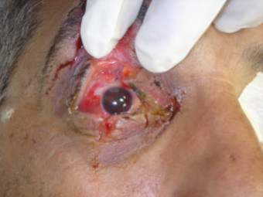
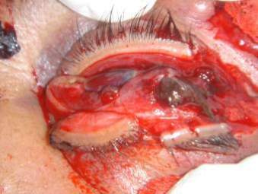
Penetrating Eye Trauma
Rigid eye shield for obvious or suspected eye wounds - often not being done – SHIELD AND SHIP!
Not doing this may cause permanent loss of vision – use a shield for any injury in or around the eye.
Eye shields are not always in IFAKs. You can use eye pro instead.
IED + no eye pro + facial wounds = Suspected Eye Injury!
Shield after injury
No shield after injury
Notes:
The eye on the left has a good chance of recovering vision.
The eye on the right will have to be surgically removed.

Slide 18
Patched Open Globe
Shrapnel in right eye from IED
Had rigid eye shield placed
Reported as both pressure patched and as having a gauze pad placed under the eye shield without pressure
Extruded uveal tissue (intraocular contents) noted at time of operative repair of globe
Do not place gauze on injured eyes! COL Robb Mazzoli: Gauze can adhere to iris tissue and cause further extrusion when removed even if no pressure is applied to eye.
At least two other known occurrences of patching
open globe injuries
Notes:
COL Robb Mazzoli was formerly the Army Surgeon General’s Consultant for Ophthalmology.
Reminder: Rigid eye shields are GOOD, and pressure patches are BAD for eye trauma.
You should put no gauze underneath the shield at all – may cause problems as noted here.

Slide 19
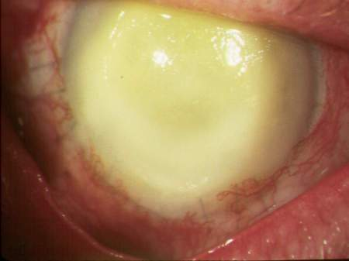
Antibiotics after Eye Injuries
2010 casualty with endophthalmitis (blinding infection inside the eye)
Reminder – shield and moxifloxacin in the field
for penetrating eye injuries – use combat pill pack!
Also –moxi, both topically
and systemically, should
be continued in MTFs
Many antibiotics do not
penetrate well into the
eye
Notes:
Eye infections can cause permanent loss of vision after eye injury.
Give antibiotics in the Combat Pill Pack to help prevent them!

Slide 20
Tension Pneumothorax
Notes:
Tactical Combat Casualty Care (TCCC)
9/15/2017
DRAFT
20

Slide 21
The Missed Tension
Pneumothorax
One U.S. combat fatality in 2014 was found to have
died with a tension pneumothorax
NO evidence of attempted needle decompression
Monitor anyone with torso trauma or polytrauma
for respiratory distress – perform needle
decompression when indicated
ALWAYS do bilateral NDC for a casualty with
torso trauma who loses vital signs on the battlefield
– this may be lifesaving
Notes:
Read the text.

Slide 22
Combat Gauze
Notes:
Tactical Combat Casualty Care (TCCC)
9/15/2017
DRAFT
22

Slide 23
External Hemorrhage – No Combat Gauze
Casualty with gunshot wound in the left infraclavicular area with external hemorrhage
“Progressive deterioration”
External hemorrhage noted to increase as casualty resuscitated in ED
No record of Combat Gauze use
All injuries noted to be extrapleural
Lesson learned: see following slide
Notes:
Read the text.

Slide 24
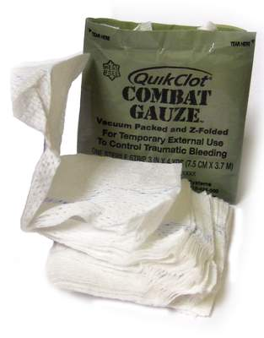
Combat Gauze
It doesn’t work if you don’t use it.
Notes:
Read the text.

Slide 25
Junctional Hemorrhage
Notes:
Tactical Combat Casualty Care (TCCC)
9/15/2017
DRAFT
25

Slide 26
Junctional Hemorrhage
A U.S. casualty in 2013 sustained a GSW to the
inguinal area.
The CASEVAC platform did not have junctional
tourniquets aboard.
The subsequent junctional hemorrhage was only
partially controlled with Combat Gauze.
Casualty went into hemorrhagic shock and had to
be transfused.
Notes:
Read the text.

Slide 27
IED Blast Injury
3 of 5 casualties had complex blast injuries.
All 3 had high traumatic LE amputations and reported difficulty with hemorrhage control despite tourniquet use.
Combat Gauze was reportedly not used.
All 3 would have been excellent candidates for a junctional tourniquet – none were fielded with this unit.
All 3 casualties required massive transfusions upon arrival at the Role 2 MTF.
Notes:
Read the text.

Slide 28
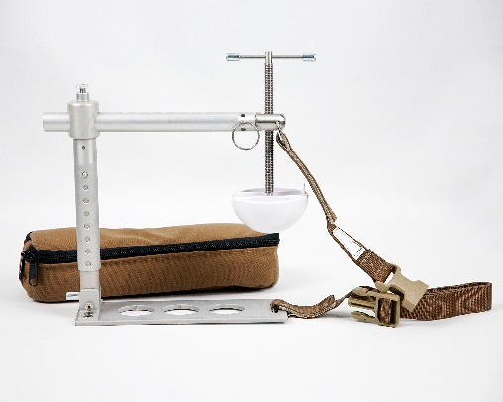
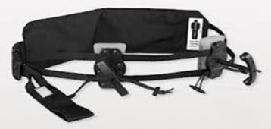
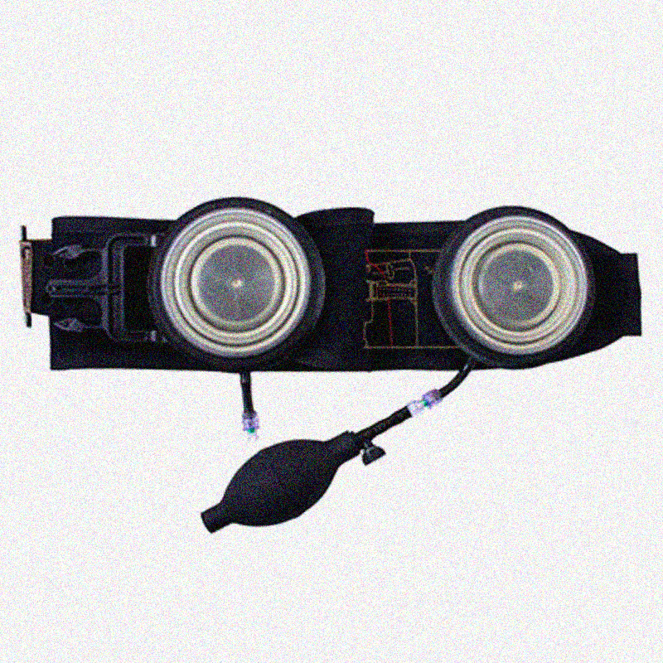
Junctional Tourniquets
Combat Ready Clamp JETT Sam Junctional Tourniquet
Junctional tourniquets: They don’t
work if your unit doesn’t have them.
Notes:
Read the text.

Slide 29
TCCC Training
Notes:
Tactical Combat Casualty Care (TCCC)
9/15/2017
DRAFT
29

Slide 30
Issues with Current TCCC Training
There is significant variation among TCCC courses, both military and commercial.
Some segments of the DoD have had no TCCC training.
Some TCCC courses contain inappropriate training.
Notes:
Read the text.
Tactical Combat Casualty Care (TCCC)
9/15/2017
DRAFT
30

Slide 31
Problems with Non-Standard TCCC Courses
Incorrect messaging
Instructor drift
“Never take off a tourniquet in the field”
Inappropriate training
Vendor-supplied training is expensive
Notes:
The recommended curriculum in TCCC is the one developed and continually updated by the Committee on Tactical Combat Casualty Care and approved by the Joint Trauma System. Any deviation from this curriculum cannot claim to be TCCC. Problems like these occur when training vendors and independent military training centers are not held to the standard curriculum.

Slide 32
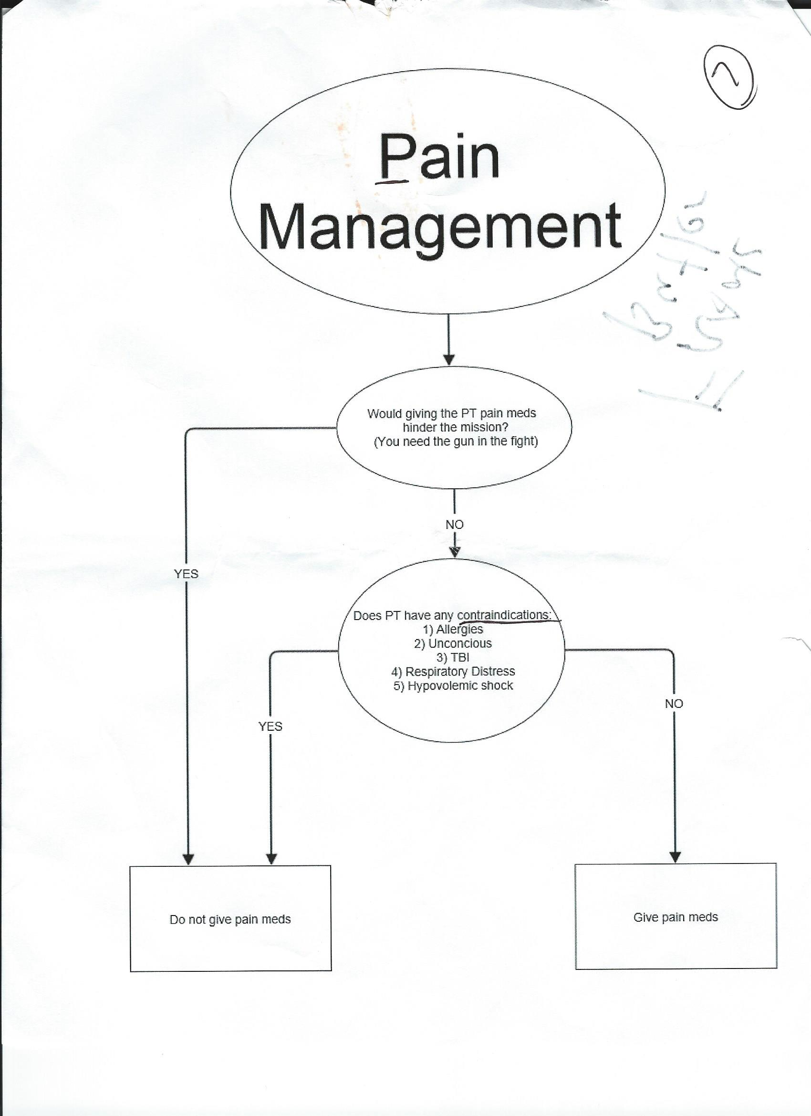
Instructor Drift in a
“TCCC” course, 2015
TBI does not contrain-
dicate ketamine.
Shock does not contra-
indicate ketamine.
No one is likely to be
allergic to both keta-
mine and opioids.
Notes:
This algorithm is from a TCCC course put on by a service trauma training center. It departs from TCCC Guidelines at a number of points:
It ignores the analgesic option that can be used even if the tactical scenario is likely to revert to Care Under Fire (meloxicam and acetaminophen).
It appears to discourage indicated analgesics even in Tactical Field Care.
Neither TBI nor hemorrhagic shock is a contraindication to the use of ketamine.
It is unlikely that any individual would be allergic to both ketamine and opioids.
This is not the triple-option analgesia recommended in TCCC guidelines. It is an excellent example of instructor drift.

Slide 33
Inappropriate Training
“Shock labs”
“Cognition labs”
Insertion of intraosseous devices on course attendee volunteers
Regional nerve blocks by non-medical personnel
Central venous catheter placement by prehospital providers
Arterial blood draws
Notes:
These are examples of inappropriate training that have been identified in some vendor-supplied “TCCC” courses.
In “shock labs”, volunteers are given hypotensive medications so that they can experience the signs and symptoms of hypovolemic shock.
In “cognition labs”, volunteers are given mind-altering substances like ketamine and tested on tasks like manual dexterity.

Slide 34
NAEMT TCCC Courses: Advantages
JTS recommends that TCCC should be a credential-producing training program for the MHS.
NAEMT TCCC courses and instructor courses follow the CoTCCC-developed/JTS-approved curriculum without deviation.
NAEMT TCCC instructors undergo Quality Assurance evaluation.
The recommended TCCC training provided through the NAEMT educational system costs much less than equivalent training purchased from for-profit TCCC vendors.
Notes:
The TCCC curriculum as taught by NAEMT adheres to the CoTCCC guidelines and is updated as the CoTCCC curriculum is updated. This course is internationally recognized and provides a TCCC card with the logos of the groups that have endorsed the concepts that the course contains: the American College of Surgeons Committee on Trauma, the JTS, the CoTCCC and the NAEMT. This course is currently the best option available to ensure consistent and high-quality training in TCCC across the DoD.

Slide 35
NAEMT TCCC Courses: Advantages
The NAEMT system issues and tracks certification for instructors and students.
Cards and registries
The NAEMT system for establishing training sites is working very well for military commands using it.
NAEMT TCCC courses do not include live tissue training with its associated expense and logistic burden.
NAEMT TCCC courses are endorsed by the ACS-COT.
Additional training such as trauma lanes, field exercises, and live tissue training could be added to supplement the basic TCCC curriculum as unit time and resources allow.
Notes:
Read the text.

Slide 36
TCCC Training for ALL combatants: Self and buddy aid should be part of the Warrior Culture in all combat units.
Notes:
Read the text.
Tactical Combat Casualty Care (TCCC)
9/15/2017
DRAFT
36

Slide 37
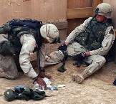
Eliminating Preventable Death on the Battlefield
Kotwal et al – Archives of Surgery 2011
All Rangers and docs trained in TCCC
U.S. military preventable deaths: 24%
Ranger preventable death incidence: 3%
Almost a 90% difference in preventable deaths
Notes:
The 75th Ranger Regiment achieved the lowest preventable death rate ever recorded. They did this by training all their soldiers in TCCC, not just their medics.

Slide 38
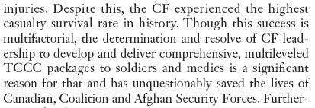
TCCC in Canadian Forces Savage et al: Can J Surg 2011
Notes:
Canadian Forces use TCCC, and credit it with helping achieve the highest casualty survival rate in their history. They also train both medics and soldiers in TCCC.

Slide 39
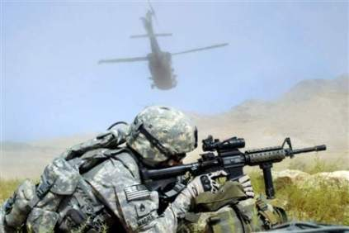
Train ALL Combatants in TCCC
Service medical departments are responsible for training combat medical personnel only.
Line commanders must take the lead to have an effective TCCC training program for all combatants.
The Ranger First Responder Course is the best model.
Notes:
The JTS also recommends the TCCC for All Combatants curriculum as the minimum standard for TCCC training for non-medical personnel. This training could also be provided via an NAEMT/MHS/JTS program like TCCC for Medical Personnel. All the services should train medics and soldiers, sailors, airmen, and marines in TCCC like the 75th Rangers do.

Slide 40
Documentation of TCCC Care
Notes:
Tactical Combat Casualty Care (TCCC)
9/15/2017
DRAFT
40

Slide 41
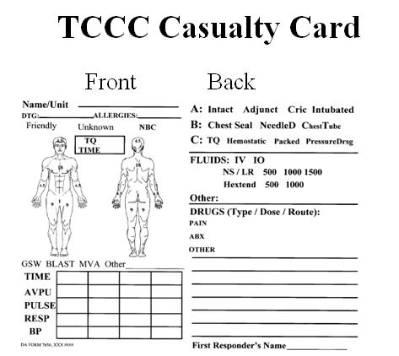
TCCC Card – Fill It Out!
You haven’t finished taking care of your casualty until this is done.
Mission Commanders – this is a leadership issue!
Notes:
Read the text.

Slide 42
New TCCC Card
Notes:
This shows both sides of the TCCC Card

Slide 43
New TCCC AAR
http://usaisr.amedd.army.mil/pdfs/POI_TCCC_AAR_26Apr2013.pdf
43
Notes:
The AAR can be downloaded from the Joint Trauma System website.

Slide 44
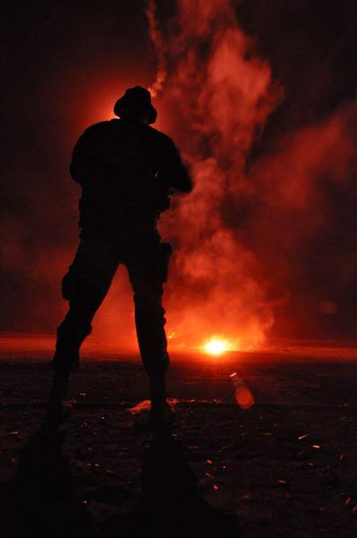
Questions?
Questions?

