Slide 1
CeloxTM Gauze User Training

Slide 2
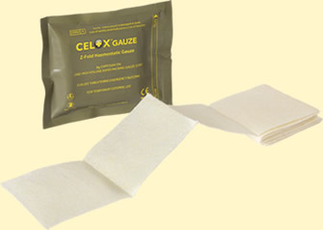
What is Celox Z-fold Gauze?
Hemostatic Gauze
To treat moderate to severe external hemorrhage;
Gauze with Celox granules bonded to surface;
FDA cleared Medical Device - not a drug;
Celox granules are Chitosan-based;
Chitosan is a highly purified derivative of shrimp shells.
Available as 5 and 10 foot z-folded gauze.

Slide 3
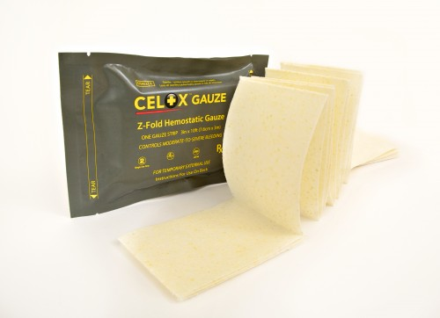
What is Celox Gauze used for?
Celox Gauze is indicated for external use to control moderate to severe bleeding (hemorrhage).
CoTCCC Guideline approval is for junctional areas where a tourniquet is not effective.

Slide 4
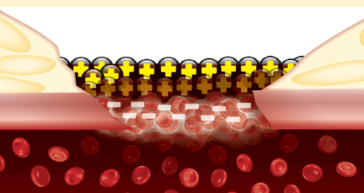
How it works
Celox absorbs fluid from blood, swells and forms a gel.
Positively charged Celox attracts negatively charged red blood cells, locking them together in a gel-like plug.
The adherent gel plug seals the wound.

Slide 5
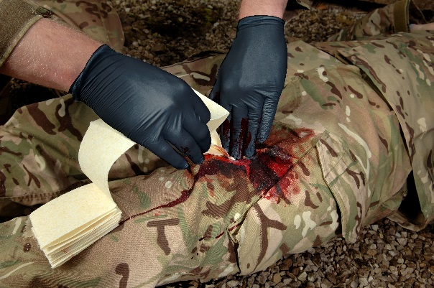
Using Celox gauze (1)
Apply gloves. Tear open pack. Take out the Celox Z-fold Gauze and take hold of one end with the other hand.
Tightly pack the unfolding Celox Z-fold Gauze directly to the source of bleeding. Pack remaining wound cavity with Celox Z-fold Gauze or standard gauze. Excess Celox can be torn or cut if necessary.

Slide 6
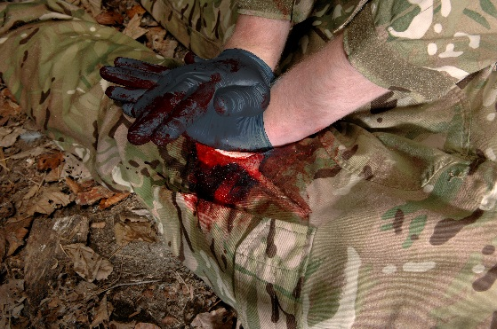
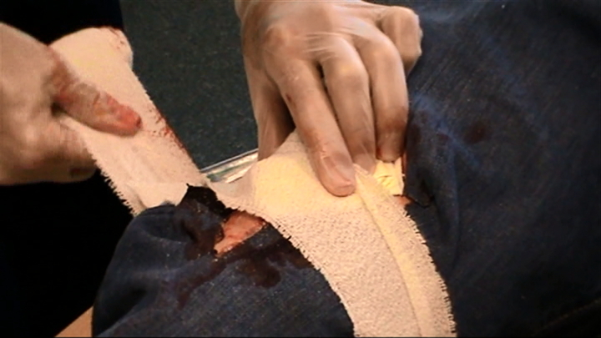
Using Celox gauze (2)
Apply FIRM pressure directly to the wound for 3 minutes. If bleeding persists apply direct pressure for an additional 3 minutes.
Wrap and tie with a bandage so as to maintain pressure on the wound.

Slide 7
Use two-person technique where possible
Operator 1
Operator 2
Apply pressure into the wound through a dressing.
Open a fresh bandage
Open Celox Gauze
Now work closely together
Remove dressing
1
2
Insert Celox Gauze, packing wound tightly
Apply pressure through bandage for 3 minutes.
3

Slide 8
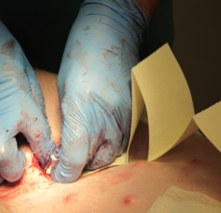
Packing Technique
Open product pack before getting gloves bloody.
Pack directly onto source of
bleeding maintaining pressure
on bleed point.
For larger wounds, pack out remaining wound space above the Celox with plain gauze or other available material.
Bandage over the gauze to keep in place and keep pressure on.
Pack in to the wound, – don’t wrap around.

Slide 9
Final steps....
Transfer patient to medical help as soon as possible.
Show the pack to the receiving team – attach it to the patient if possible.
Leave the gauze in place until reaching Role 2 / OR.

Slide 10

Celox Gauze Training Video
Notes:
(Link to Celox Gauze moulage training May 2014.mp4 in the Celox Gauze module.)
Click on the video window to show the video.

Slide 11
How do you remove Celox from the wound?
Do not remove the Celox. Leave in place until the casualty reaches the surgical team.
For Surgical team use:
Remove the gauze. Irrigate if necessary.
Remove any loose surface granules.
Irrigate liberally with saline.

Slide 12
Safety
Not thrombogenic.
No heat.
Removable.
Residuals metabolized.
Shellfish origin material has been allergy tested. Non-allergenic.

Slide 13
Product Cautions
Device not intended for surgical use.
Do not eat. If ingested, drink water to avoid any discomfort.
Do not apply over eyes. If eye irritation occurs flush with water for five minutes.
Re-use could result in cross-infection and reduced performance.
Contains chitosan from shellfish. Allergy studies show no adverse reaction.
Sterile: single patient use: loss of sterility potentially poses a risk of infection.
Do not re-sterilize. This may affect performance.

Slide 14

Summary
Identify bleeding point.
Remove excess blood.
Pack onto the bleeding -
DO NOT WRAP around.
Apply FIRM pressure for 3 minutes.
Bandage over the dressing.
Leave the dressing in place and evacuate.

