Slide 1
Combat Gauze

Slide 2
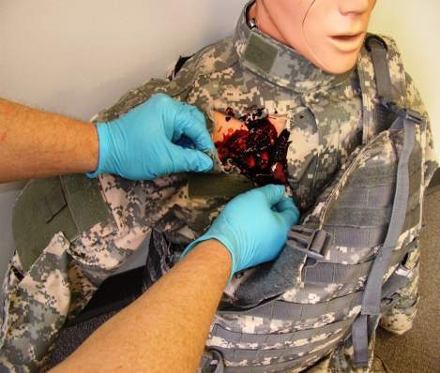
Combat Gauze Directions (1)
Expose Wound & Identify Bleeding
Open clothing around the wound.
If possible, remove excess pooled blood from the wound while preserving any clots already formed in the wound.
Locate the source of the most active bleeding.
Combat Medical Systems, LLC, Tel: 910-426-0003, Fax: 910-426-0009, Website: www.combatgauze.com
Notes:
2
2
Read Text

Slide 3
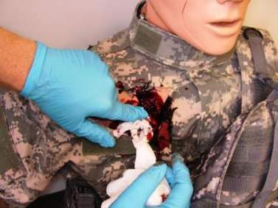





Combat Gauze Directions (2)
Pack Wound Completely
Pack Combat Gauze tightly into wound and directly onto the source of bleeding.
More than one gauze may be required to stem blood flow.
Combat Gauze may be re-packed or adjusted in the wound to ensure proper placement.
Combat Medical Systems, LLC, Tel: 910-426-0003, Fax: 910-426-0009, Website: www.combatgauze.com
Notes:
3
3
Pack CG into wound just like you would plain gauze.
If more than one roll is needed, pack in more CG until the wound is full.

Slide 4
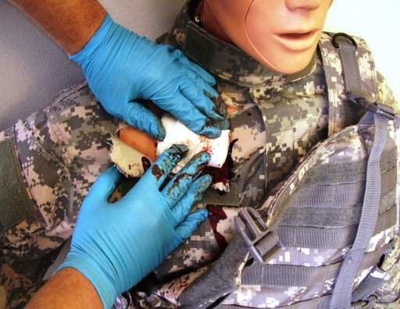
Combat Gauze Directions (3)
Apply Direct Pressure
Quickly apply pressure until bleeding stops.
Hold continuous pressure for 3 minutes.
Reassess to ensure bleeding is controlled.
Combat Gauze may be repacked or a second gauze used if initial application fails to provide hemostasis.
Combat Medical Systems, LLC, Tel: 910-426-0003, Fax: 910-426-0009, Website: www.combatgauze.com
Notes:
4
4
Although the Combat Gauze may become saturated during the initial application process, continue to hold firm pressure for at least three minutes. The kaolin will continue to leach into the wound area and help form a clot even though the bandage is soaked through.

Slide 5
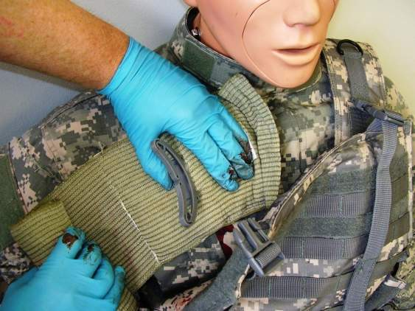
Combat Gauze Directions (4)
Bandage over Combat Gauze
Leave Combat Gauze in place.
Wrap to effectively secure the dressing in the wound.
Although the Emergency Trauma Bandage is shown in this picture, the wound may be secured with any compression bandage, Ace wrap, roller gauze, or cravat.
Combat Medical Systems, LLC, Tel: 910-426-0003, Fax: 910-426-0009, Website: www.combatgauze.com
Notes:
5
5
Carefully observe for blood continuing to flow from under the gauze to determine if bleeding has been controlled. Once you are sure the bleeding has stopped, apply a pressure bandage over the Combat Gauze.

Slide 6
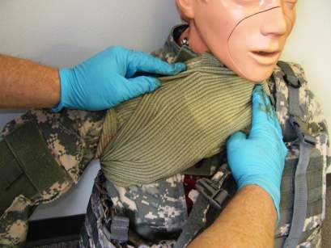
Combat Gauze Directions (5)
Transport & Monitor Casualty
Do not remove the bandage or Combat Gauze.
Transport casualty to next level of medical care as soon as possible.
Combat Medical Systems, LLC, Tel: 910-426-0003, Fax: 910-426-0009, Website: www.combatgauze.com
Notes:
6
6
Re-check the dressing frequently, especially while transporting the casualty to next level of care.
Watch for re-bleeding.

Slide 7

Combat Gauze Training Video
Link to Online Video
Notes:
(Link to Combat Gauze.wmv in the Combat Gauze module.)

