Slide 1
Improvised Pelvic Binders
Improvised techniques must be carefully trained or they may not be effective.
Commercial devices are preferred.
Notes:
Read the text.

Slide 2
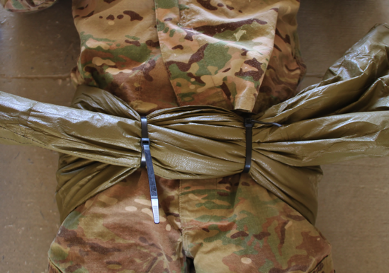
Improvised Pelvic Binders
A pelvic binder can be improvised with a sheet at the level of the greater trochanters.
With two rescuers, pull to tighten the sheet and then secure with zip ties or clamps.
With one rescuer, tie sheet and tighten with a windlass.
This method of circumferential pelvic compression has been found in studies to be effective.
Notes:
Read the text.

Slide 3
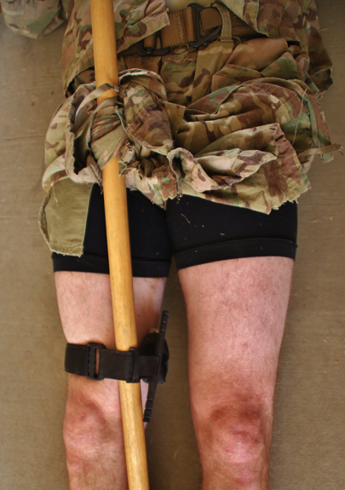
Improvised Pelvic Binders
A pelvic binder can also be improvised by cutting trouser legs up to the level of the greater trochanter.
Secure the cut trouser legs in front of the casualty.
This method has not been proven effective.
It may also increase the potential for hypothermia.
Notes:
Read the text.

