Slide 1

pelvicbinder®
Notes:
The pelvicbinder® is one of three commercial pelvic binders recommended by the CoTCCC.

Slide 2
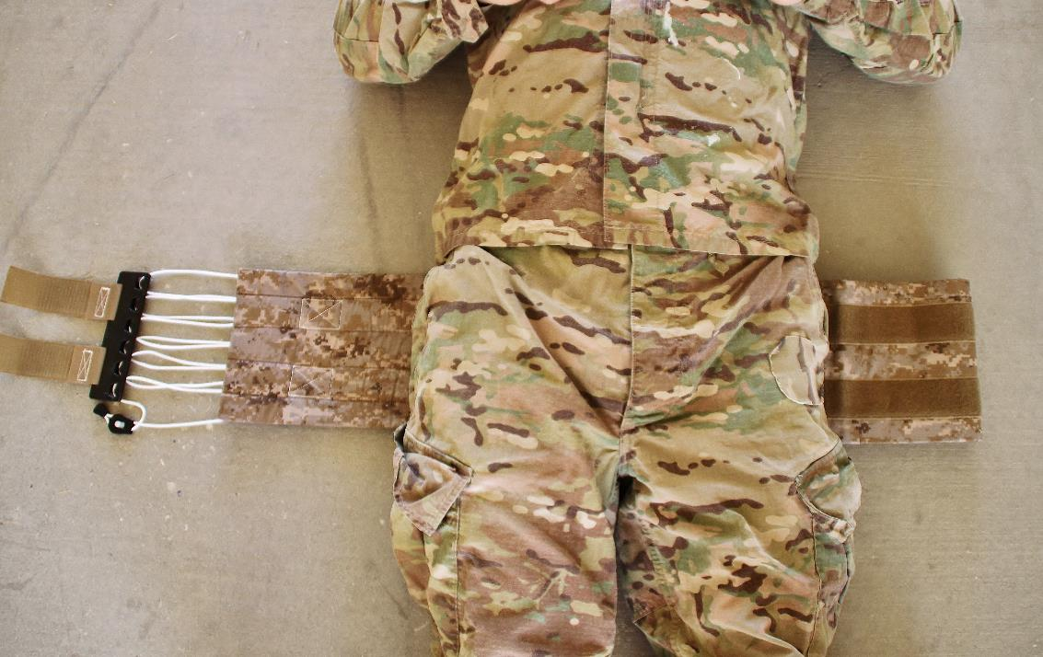
pelvicbinder®
Binder correctly positioned at level of greater trochanters.
Notes:
Pass the pelvicbinder® under the casualty’s thighs, and then slide it up the level of the greater trochanters.

Slide 3
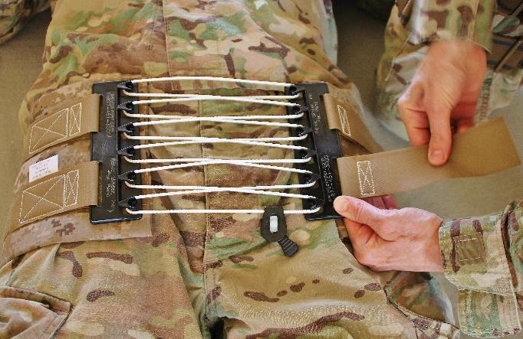
pelvicbinder®
Cut or fold the belt to meet the edge of the plates in front, and then attach the plates to the belt using the Velcro backing.
Notes:
Read the text.

Slide 4
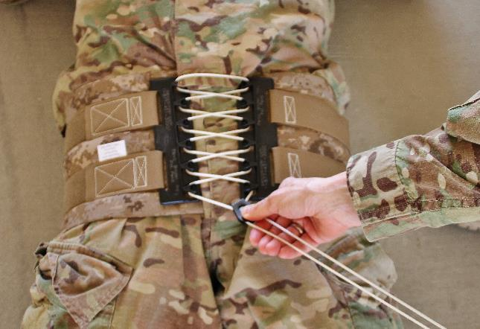
pelvicbinder®
Pull the cord slowly to tighten the belt, then slide the lock into place.
Notes:
Read the text.

Slide 5
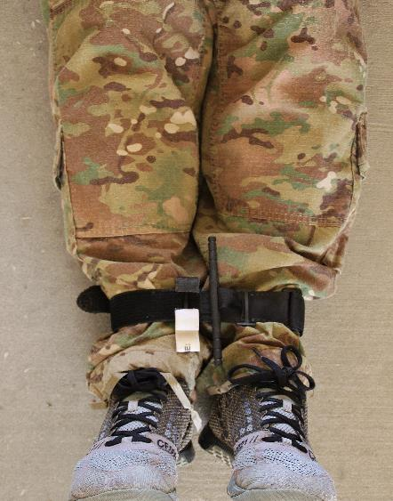
pelvicbinder®
Secure the ankles (but not too tightly).
Notes:
Read the text.
Note the use of a tourniquet here to prevent external rotation of the legs. The ankles and toes can also be taped.

Slide 6
pelvicbinder®
Placeholder for a video.
Notes:
Click the photo to play the video.

