Slide 1
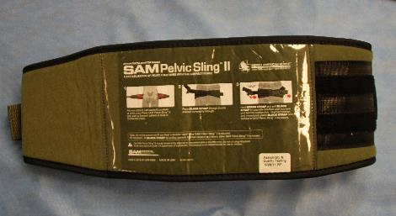
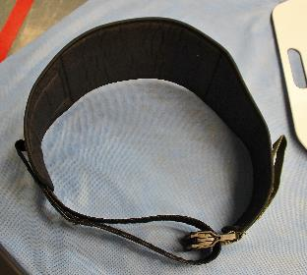
SAM Pelvic Sling II
Notes:
Read the text.

Slide 2
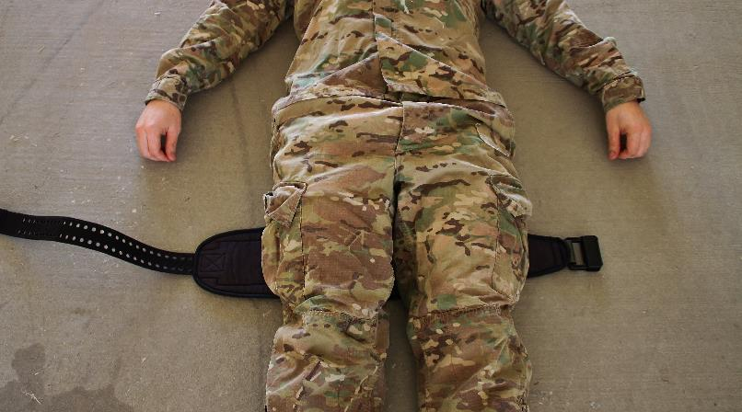
SAM Pelvic Sling II
Step 1:
Empty the casualty’s pockets and remove items attached to his belt.
Notes:
Read the text.

Slide 3
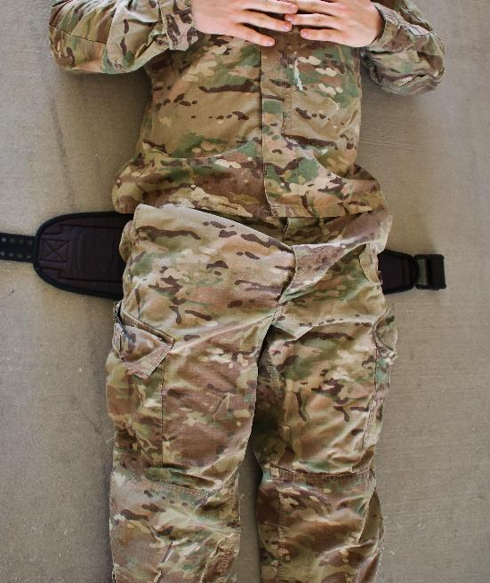
SAM Pelvic Sling II
Step 2:
Pass the binder behind the thighs and slide it upward to the correct position at the level of the greater trochanters.
Notes:
Read the text.

Slide 4
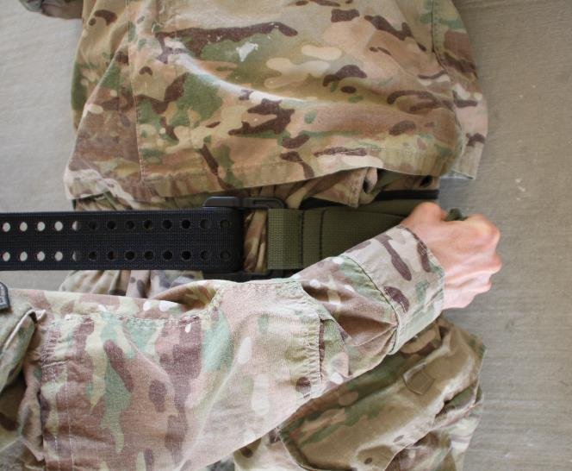
SAM Pelvic Sling II
Step 3:
- Pass the black strap through the buckle and pull to tighten using counter-traction until the device is heard or felt to click.
Notes:
Read the text.

Slide 5
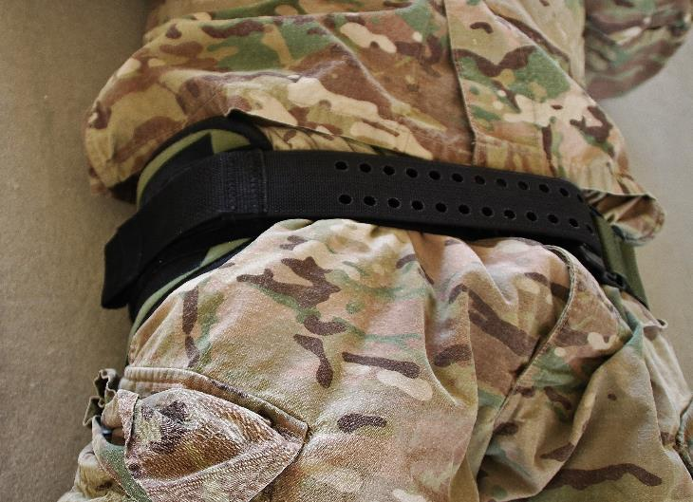
SAM Pelvic Sling II
Step 4:
Maintain tension and attach the Velcro to itself in front.
Notes:
Read the text.

Slide 6
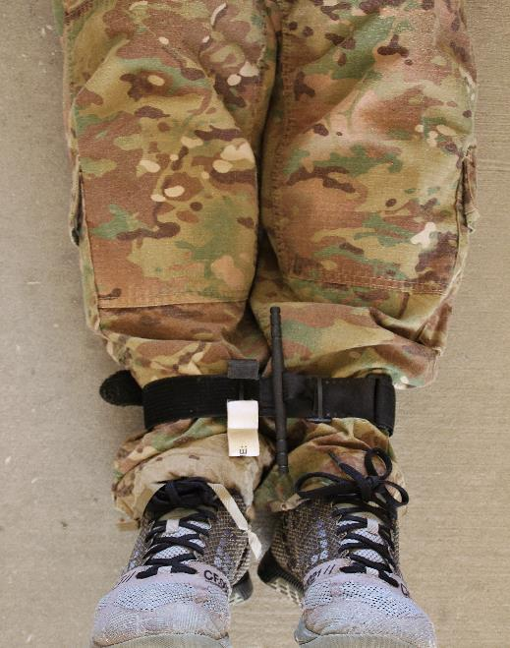
SAM Pelvic Sling II
Step 5:
Secure the ankles - not too tightly. (Note the use of a tourniquet here for this purpose.)
Notes:
Read the text.

Slide 7
SAM Pelvic Sling II
Placeholder for video
Notes:
Click on the photo to play the video.

