Slide 1
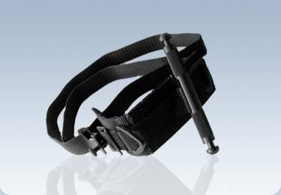
SOF Tactical Tourniquet
Notes:
Some units use the SOF Tactical Tourniquet.
These slides will demonstrate it’s use.
1

Slide 2
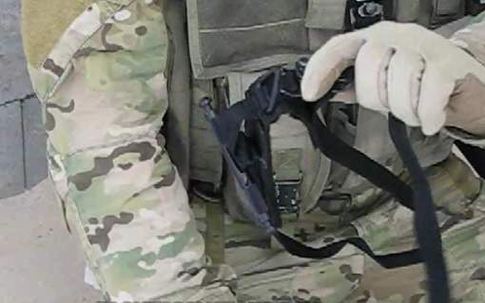
SOFTT One-Handed Application to an Arm
Step 1: Open the tourniquet, exposing the loop of webbing. Grasp the running end of the webbing near the buckle, and slide the tourniquet over the injured extremity.
Notes:
Read text.

Slide 3
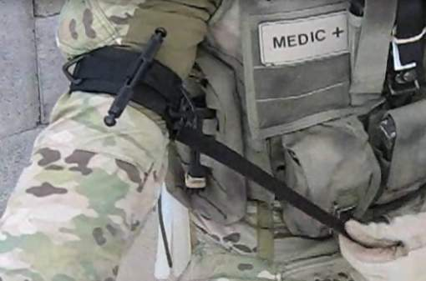
SOFTT One-Handed Application to an Arm
Step 2: Pull the webbing until the tourniquet is tight around the limb.
Notes:
Read text.
It is important to stress here that the webbing should be pulled tight (all slack removed) before tightening the windlass. If you don’t, you may not be able to tighten the tourniquet enough to stop arterial bleeding.

Slide 4
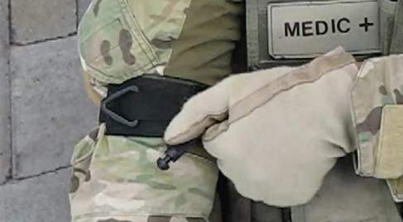
SOFTT One-Handed Application to an Arm
Step 3: Twist the windlass until the bleeding stops.
Notes:
Read text.

Slide 5
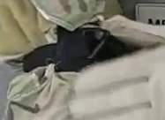
SOFTT One-Handed Application to an Arm
Step 4: To secure the windlass, latch either of its notched ends into one of the triangular rings on the tourniquet base.
Notes:
Read text.

Slide 6
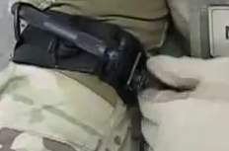
SOFTT One-Handed Application to an Arm
Step 5: Tighten the safety screw to prevent accidental loosening of the tourniquet while moving the casualty. The casualty is now ready for transport.
Notes:
Read text.

Slide 7
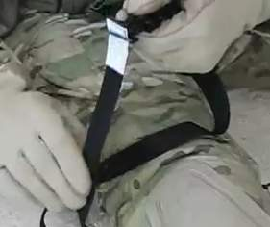
SOFTT Two-Handed Application to a Leg
Step 1: Remove the webbing from the buckle.
Notes:
Read text.

Slide 8
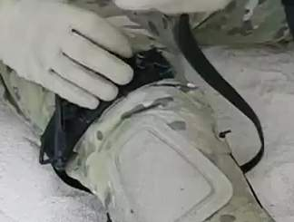
SOFTT Two-Handed Application to a Leg
Step 2: Position the tourniquet base on the injured limb above the wound. Route the webbing around the limb.
Notes:
Read text.

Slide 9
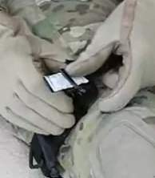
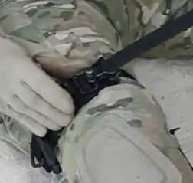
SOFTT Two-Handed Application to a Leg
Step 3: Route the webbing through the buckle and pull until the tourniquet is tight.
Notes:
Read text.
It is important to stress here that the webbing should be pulled tight (all slack removed) before tightening the windlass. If you don’t, you may not be able to tighten the tourniquet enough to stop arterial bleeding.

Slide 10
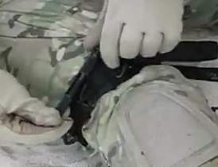
SOFTT Two-Handed Application to a Leg
Step 4: Tighten the windlass until the bleeding stops.
Notes:
Read text.

Slide 11
SOFTT Two-Handed Application to a Leg
Step 5: To secure the windlass, lock either of its notched ends into one of the triangular rings on the tourniquet base.
Notes:
Read text.

Slide 12
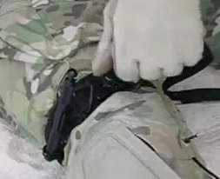
SOFTT Two-Handed Application to a Leg
Step 6: Tighten the safety screw to prevent accidental loosening of the tourniquet while moving the casualty. The casualty is now ready for transport.
Notes:
Read text.

