Slide 1
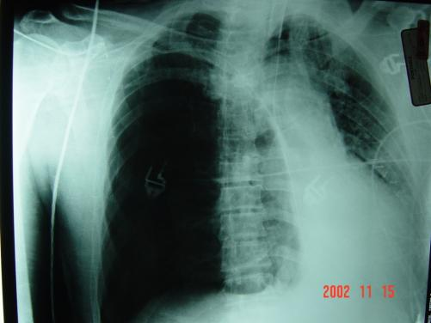
Management of Tension Pneumothorax in TCCC
Photo:
COL Matt Martin
TCCC Interim Change 180121

Slide 2
TFC #1
Start with New Slide 90

Slide 3
TCCC Guidelines: Suspected Tension Pneumothorax
Tactical Field Care and Tactical Evacuation Care
* New Text in red
Respiration/Breathing
a. Assess for tension pneumothorax and treat as necessary
1. Suspect a tension pneumothorax and treat when a casualty has significant
torso trauma or primary blast injury and one or more of the following:
- Severe or progressive respiratory distress
- Severe or progressive tachypnea
- Absent or markedly decreased breath sounds on one side of
the chest
- Hemoglobin oxygen saturation < 90% on pulse oximetry
- Shock
- Traumatic cardiac arrest without obviously fatal wounds
* Note: If not treated promptly, tension pneumothorax may progress from respiratory distress to shock and traumatic cardiac arrest.

Slide 4
TCCC Guidelines: Suspected Tension Pneumothorax
2. Initial treatment of suspected tension pneumothorax:
- If the casualty has a chest seal in place, burp or remove
the chest seal.
- Establish pulse oximetry monitoring.
- Place the casualty in the supine or recovery position unless
he or she is conscious and needs to sit up to help keep the
airway clear as a result of maxillofacial trauma.
- Decompress the chest on the side of the injury with a 14-
gauge or a 10-gauge, 3.25 inch needle/catheter unit.
- If a casualty has significant torso trauma or primary blast
injury and is in traumatic cardiac arrest (no pulse, no
respirations, no response to painful stimuli, no other signs
of life), decompress both sides of the chest before
discontinuing treatment.

Slide 5
TCCC Guidelines: Suspected Tension Pneumothorax
2. (Continued)
Notes:
* Either the 5th intercostal space (ICS) in the anterior axillary line (AAL) or the 2nd ICS in the mid-clavicular line (MCL) may be used for needle decompression (NDC.) If the anterior (MCL) site is used, do not insert the needle medial to the nipple line.
* The needle/catheter unit should be inserted at an angle perpendicular to the chest wall and just over the top of the lower rib at the insertion site. Insert the needle/catheter unit all the way to the hub and hold it in place for 5-10 seconds to allow decompression to occur.
* After the NDC has been performed, remove the needle and leave the catheter in place.

Slide 6
TCCC Guidelines: Suspected Tension Pneumothorax
3. The NDC should be considered successful if:
- Respiratory distress improves, or
- There is an obvious hissing sound as air
escapes from the chest when NDC is
performed (this may be difficult to
appreciate in high-noise environments), or
- Hemoglobin oxygen saturation increases to 90%
or greater (note that this may take several
minutes and may not happen at altitude), or
- A casualty with no vital signs has return of
consciousness and/or radial pulse.

Slide 7
TCCC Guidelines: Suspected Tension Pneumothorax
4. If the initial NDC fails to improve the casualty’s signs/symptoms from the suspected tension pneumothorax:
- Perform a second NDC - on the same side of the
chest - at whichever of the two recommended
sites was not previously used. Use a new
needle/catheter unit for the second attempt.
- Consider - based on the mechanism of injury and
physical findings - whether decompression of the
opposite side of the chest may be needed.

Slide 8
TCCC Guidelines: Suspected Tension Pneumothorax
5. If the initial NDC was successful, but symptoms later recur:
- Perform another NDC at the same site that
was used previously. Use a new
needle/catheter unit for the repeat NDC.
- Continue to re-assess!

Slide 9
TCCC Guidelines: Suspected Tension Pneumothorax
6. If the second NDC is also not successful:
- Continue on to the Circulation section of
the TCCC Guidelines.

Slide 10
TCCC Guidelines: Suspected Tension Pneumothorax
Add a section “e” to the Circulation Section of the TCCC Guidelines:
e. If a casualty in shock is not responding to fluid resuscitation, consider untreated tension pneumothorax as a possible cause of refractory shock. Thoracic trauma, persistent respiratory distress, absent breath sounds, and hemoglobin oxygen saturation < 90% support this diagnosis. Treat as indicated with repeated NDC or finger thoracostomy/chest tube insertion at the 5th ICS in the AAL, according to the skills, experience, and authorizations of the treating medical provider. Note that if finger thoracostomy is used, it may not remain patent and finger decompression through the incision may have to be repeated. Consider decompressing the opposite side of the chest if indicated based on the mechanism of injury and physical findings.

Slide 11
Tension Pneumothorax
Tension pneumothorax is another common cause of preventable death encountered on the battlefield.
It’s easy to treat.
Tension pneumothorax may occur with entry wounds in the chest, abdomen, back, shoulder, or neck.
Blunt (motor vehicle crash) or penetrating trauma (GSW) or primary blast injury may cause tension pneumothorax.
Notes:
Two things about a tension pneumothorax:
- It is a very common cause of preventable death on the battlefield.
- It can be effectively treated by combat medics, corpsmen, and PJs.

Slide 12
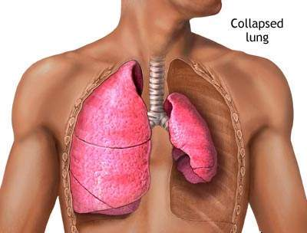
Pneumothorax
Pneumothorax
A pneumothorax is a collection of air between the lung and chest wall due to an injury to the chest wall and/or lung. The lung then collapses as shown above.
Notes:
Normally the lung fills up the entire chest cavity.
With injury, air may get between the chest wall and the lung and cause the lung to collapse.
Air is supposed to be INSIDE the lung.
Here the air is inside the chest but OUTSIDE the lung – this does not help get oxygen to the body and may compress the heart and other lung.

Slide 13
Tension Pneumothorax
Side with
gunshot
wound and
air under
increased
pressure in
pleural space
Photo:
COL Matt Martin
Heart and lung
shifted from
increased pressure
on right side
Injured lung tissue acts as a one-way valve, trapping more and more air between the lung and the chest wall. Pressure builds up and compresses both lungs and the heart.
Notes:
Every breath adds more air to the air space outside the lung.
The air can’t be exhaled because it’s outside the lung – there’s no way for it to escape, so pressure builds up.

Slide 14
When Should You Suspect a Tension Pneumothorax?
1. Suspect a tension pneumothorax and treat when a casualty has significant torso trauma or primary blast injury and one or more of the following:
- Severe or progressive respiratory distress
- Severe or progressive tachypnea
- Absent or markedly decreased breath sounds on
one side of the chest
- Hemoglobin oxygen saturation < 90% on pulse
oximetry
- Shock
- Traumatic cardiac arrest without obviously fatal
wounds

Slide 15
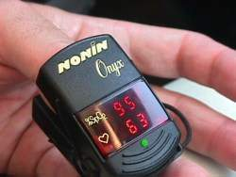
Pulse Oximetry Monitoring
Pulse oximetry tells you how much oxygen is present in the blood.
It shows the heart rate and the percent of oxygenated blood (“O2 sat”) in the numbers displayed.
98% or higher is normal O2 sat
at sea level.
86% O2 sat is
normal at 12,000
feet due to the lower lower atmospheric pressure at that altitude.
Notes:
Here is what a pulse oximeter looks like and what it tells you.
What it actually tells you is the percentage of oxygenated hemoglobin in the blood.

Slide 16
Pulse Oximetry Monitoring
Consider using a pulse ox for these types of casualties:
A casualty with severe penetrating, blunt , or blast
chest trauma at risk for developing a tension
pneumothorax.
TBI – good O2 sat is
very important for a
good outcome
Unconscious
casualty
Reassess often!
Notes:
Hypoxia is associated with worse clinical outcomes in casualties with moderate/severe TBI. Monitoring the O2 saturation in these casualties with a pulse oximeter will help identify hypoxia so that it can be prevented or treated.
Unconscious casualties may experience an airway obstruction.
Chest trauma and blast trauma casualties may not exchange oxygen well in their lungs.

Slide 17
Pulse Oximetry Monitoring
Oxygen saturation values as shown
on pulse ox may be inaccurate in the
presence of:
Hypothermia
Carbon monoxide
poisoning
Very high ambient
light levels
Notes:
A normal reading on a pulse oximeter is NOT a good indicator for the absence of shock.
Even after significant blood loss, the blood remaining in the intravascular compartment may be normally oxygenated.
Readings on a cold limb may be artificially low.
The pulse ox can mistake carbon monoxide for oxygen in burn patients and give a falsely high reading.
To repeat – a decrease in O2 sat is normal at altitude. This drop in O2 sat is REAL.

Slide 18
Tension Pneumothorax
Both lung function and heart function may be
impaired with a tension pneumothorax, causing
respiratory distress and possible shock.
Traumatic cardiac arrest may ensue if the tension
pneumothorax is not treated promptly.
The treatment is to let the trapped air under pressure
in the pleural space escape.
Notes:
One collapsed lung should not kill you, but the elevated air pressure OUTSIDE the collapsed lung in a tension pneumothorax can impair the function of the good lung and the heart by preventing them from functioning normally.
This CAN kill you.

Slide 19
Management of Suspected Tension Pneumothorax
If a chest seal has previously been applied to the casualty – burp or remove the chest seal.
This allows air to escape from the chest.

Slide 20
Tension Pneumothorax
If a tension pneumothorax is suspected and a chest
seal is not present, the treatment is to let the trapped
air under pressure escape by performing needle
decompression or “NDC.”
This is done by inserting a needle into the chest.
The recommended needle size is either a 14 or a 10 -
gauge, 3.25-inch needle/catheter unit.
Notes:
In a study by Dr. Harcke published in Military Medicine in 2008, several casualties died from needles being too short to get through the chest wall.
The old 2-inch needles were too short. 3.25-inch needles will get through the chest wall in 99% of individuals.

Slide 21
Needle Decompression Works
Video courtesy of Dr. Oleksandr Linchevskyy
Medical Director, Patriot Defence
Ukraine
Link to Online Video
Notes:
This video presents a pleuroscopic (inside the chest) view of a needle decompression performed on a trauma victim with tension pneumothorax and a collapsed lung. The re-expansion of the collapsed lung is dramatic. The catheter may inflict minor trauma on the lung, but this is acceptable given the benefit accrued from the removal of air from the pleural space and the returned function of the re-inflated lung and the decompressed heart.
Click on the photo to play the video.

Slide 22
Tension Pneumothorax
Question: “What if the casualty does not have a tension pneumothorax when you do your needle decompression?”
Answer:
If he has penetrating trauma to that side of the chest, there is already a collapsed lung and blood in the chest cavity.
The needle won’t make it worse if there is no tension pneumothorax.
If he DOES have a tension pneumothorax, you will save his life.
Notes:
Note: If the trauma is BLUNT and there is no pre-existing pneumothorax when NDC is performed, a simple pneumothorax may be created by the procedure, but this not life-threatening.
***There have been NO reported life-threatening complications caused by NDC in Iraq or Afghanistan.***

Slide 23
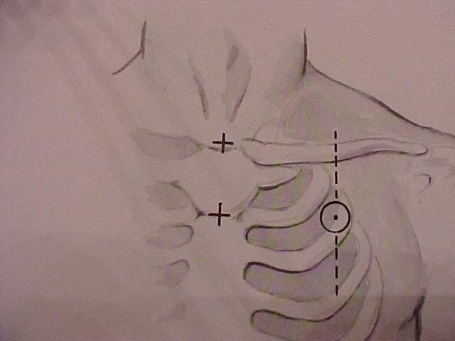
Picture of general location for needle insertion
Anterior Site for Needle Decompression
2nd intercostal space in the
mid-clavicular line
Start at the middle of the
clavicle
Go 2-3 finger widths below
this point
Do NOT insert the needle
medial to the nipple line!
Notes:
The anterior site is an equally acceptable second site for NDC.

Slide 24
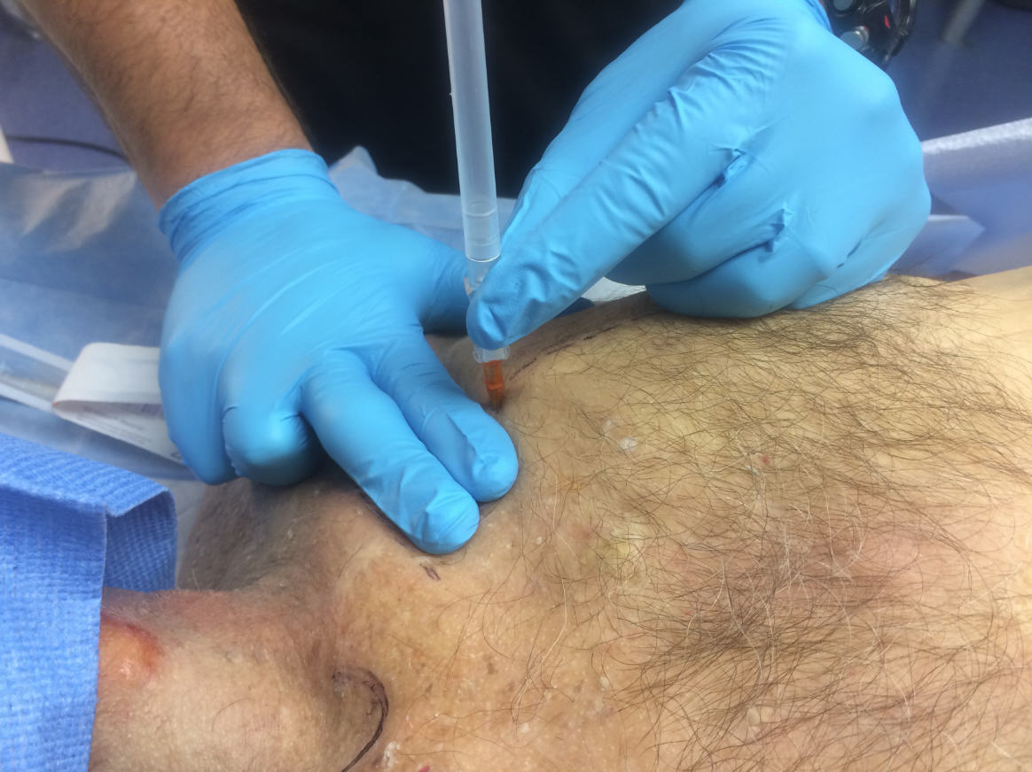
Anterior Site for Needle Decompression
Photo
Courtesy
LTC Mark
Buzzelli
This photo shows NDC being performed at the anterior site.

Slide 25
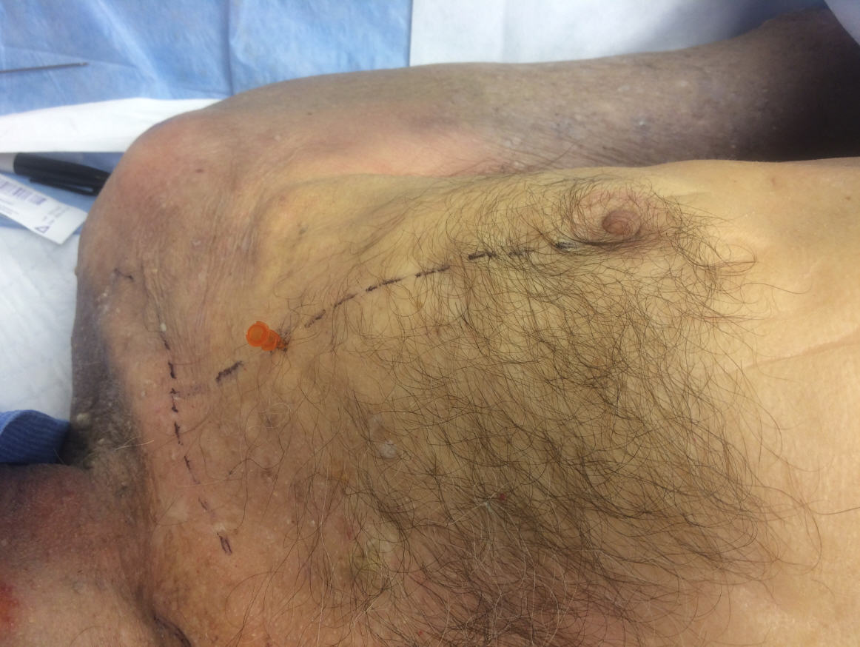
Anterior Site for Needle Decompression
Photo
Courtesy
LTC Mark
Buzzelli
This photo shows NDC being performed at the anterior site
with the needle removed and the catheter left in place.

Slide 26
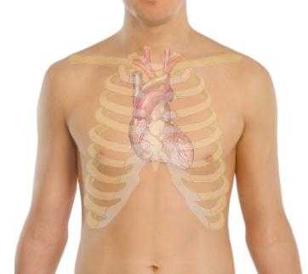
CAUTION!
The heart and great vessels are nearby at the
anterior site.
Never insert the needle medial to the nipple line
Do not point the needle towards the heart.
Notes:
This is an outline of the location of the heart drawn on the surface of the chest.

Slide 27
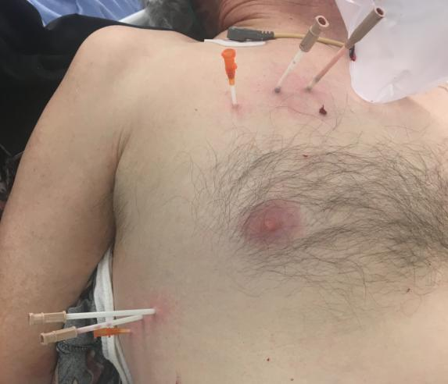
CAUTION!
Photo:
Dr. Warren Dorlac
The two needles circled are TOO MEDIAL!
Notes:
This clinical photo from a civilian trauma center shows multiple needle decompressions in both the anterior and the lateral locations.
Note that two of the needles in the anterior site have been inserted at locations medial to the nipple line. (Photo courtesy Dr. Warren Dorlac)

Slide 28
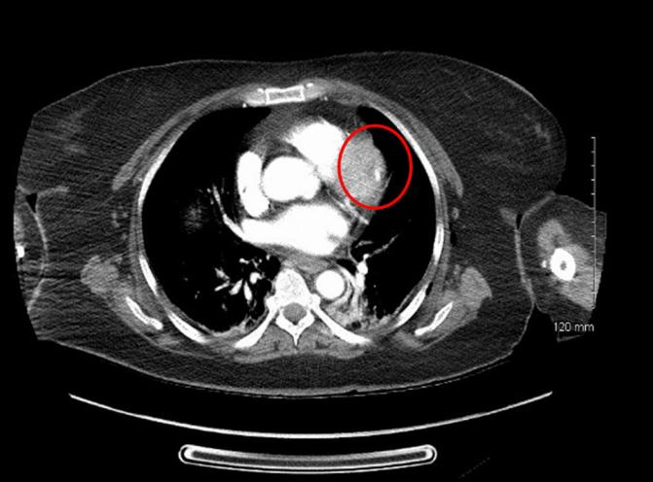
CAUTION!
Photo
Dr. Jay
Johannigman
The circle shows an NDC catheter in the heart.
Again – the NDC was done too medial.
Notes:
This CT image from a civilian trauma center shows a catheter that was used to perform needle decompression located in the myocardium. (Photo courtesy Dr. Jay Johannigman)

Slide 29
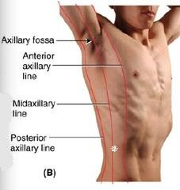
Lateral Site for Needle Decompression - Males
The first site that can be used for NDC is the 5th intercostal space at the anterior axillary line.
The 5th intercostal space is located at the level of the nipple in young, fit males.
The AAL is located at approximately the lateral aspect of the pectoralis major muscle.
Easily located in males.
X
Notes:
The 5th intercostal space at the anterior axillary line is more remote from the heart and great vessels, and using this site may reduce the risk of complications from needle decompression. In a tactical situation, the lateral approach may be faster and safer given body armor configuration and ability to reassess.
The procedure is the same as used at the 2nd intercostal space at the mid-clavicular line.

Slide 30
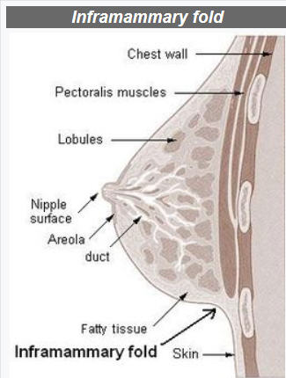
Lateral Site for Needle Decompression - Females
Nipple level is variable in females – but you can lift the breast and use the level of the infra-mammary fold.
Measure four fingers down from the axilla (measure the width of your hand placed under the patient's axilla with their arm down) at the lateral aspect of the breast/pectoral muscle.
Another option - two finger breadths below the bottom of the axillary hairline. Can see even if they just shaved.
Notes:
The 5th intercostal space at the anterior axillary line is more remote from the heart and great vessels, and using this site may reduce the risk of complications from needle decompression. In a tactical situation, the lateral approach may be faster and safer given body armor configuration and ability to reassess.
The procedure is the same as used at the 2nd intercostal space at the mid-clavicular line.

Slide 31
Lateral Site for Needle Decompression
Photo
Courtesy
Maj Andrew
Hall
This photo shows NDC being performed at the lateral site
in a cadaver model.

Slide 32
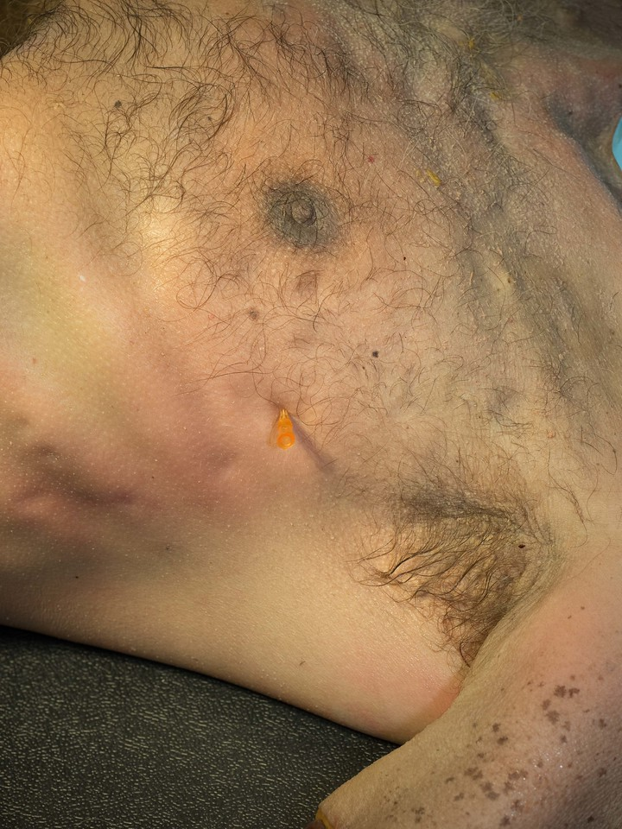
Lateral Site for Needle Decompression
Photo
Courtesy
Maj Andrew
Hall
This photo shows NDC being performed at the lateral site
with the needle removed and the catheter left in place.

Slide 33
NDC Technique (1)
Either the 5th intercostal space (ICS) in the
anterior axillary line (AAL) or the 2nd ICS in the
mid-clavicular line (MCL) may be used for
needle decompression (NDC.)
Insert the needle/catheter unit perpendicular
(90-degree angle) to the chest wall and insert
it just over the top of the lower rib at the
insertion site.
Notes:
If the needle used has a plug in the hub of the needle, that plug should be REMOVED before the procedure is done.

Slide 34
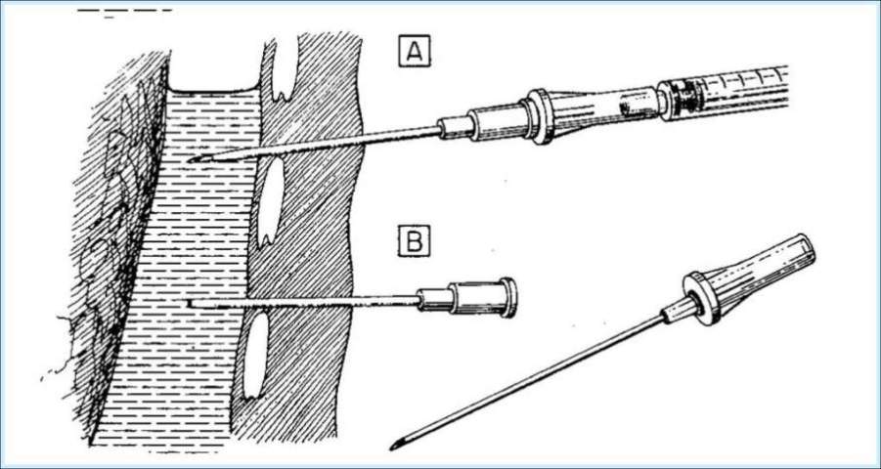
NDC – Enter Just over the Top of the Rib Below
Lung
Air collection
Rib
Chest wall
Needle
Catheter
This avoids the artery and vein on the bottom of the rib above.
Notes:
The needle should make a 90-degree angle to the chest wall, and it should slide in just over the top of the rib. An intercostal artery and vein run along the bottom edge of each rib.
Note that the catheter is not inserted all the way to the hub in the lower needle/catheter unit. It should have been.

Slide 35
NDC Technique (2)
Insert the needle/catheter unit all the
way to the hub.
Hold both the needle and the catheter
in place for 5-10 seconds to allow
full decompression to occur.
After the NDC has been performed, remove
the needle and leave the catheter in
place.
Notes:
Again - if you are using a 14 or 10 gauge needle/catheter unit intended for IVs, it will be necessary to remove the plug from the needle flash chamber before inserting it.

Slide 36
Successful Needle Decompression
The NDC should be considered successful if:
- Respiratory distress improves, or
- There is an obvious hissing sound as air
escapes from the chest when NDC is
performed (this may be difficult to
appreciate in high-noise environments), or
- Hemoglobin oxygen saturation increases to 90%
or greater (note that this may take several
minutes and may not happen at altitude), or
- A casualty with no vital signs has return of
consciousness and/or radial pulse.

Slide 37
Unsuccessful Needle Decompression
If the initial NDC fails to improve the casualty’s signs/symptoms from the suspected tension pneumothorax:
- Perform a second NDC - on the same side of the
chest - at whichever of the two recommended
sites was not previously used. Use a new
needle/catheter unit for the second attempt.
- Consider - based on the mechanism of injury and
physical findings - whether decompression of the
opposite side of the chest may be needed.

Slide 38
Recurrent Tension Pneumothorax
If the initial NDC was successful, but symptoms later recur:
- Perform another NDC at the same site that
was used previously. Use a new
needle/catheter unit for the repeat NDC.
- Continue to re-assess!
Notes:
Even if the catheter is still in place, it may have become plugged.
MUST use a new needle/catheter unit.

Slide 39
If Two NDCs Fail to Produce Improvement
If the second NDC is also not successful:
- Continue on to the Circulation section of
the TCCC Guidelines.
Notes:
After two needle decompressions, do not continue to persevere with NDC – move on to evaluating and treating for shock.

Slide 40
TFC #2
Add the following slide
after present slide # 103

Slide 41
Circulation Section:
Refractory Shock
Add a section “e” to the Circulation Section of the TCCC Guidelines:
e. If a casualty in shock is not responding to fluid resuscitation,
consider untreated tension pneumothorax as a possible cause of
refractory shock. Thoracic trauma, persistent respiratory distress,
absent breath sounds, and hemoglobin oxygen saturation < 90%
support this diagnosis. Treat as indicated with repeated NDC or
finger thoracostomy/chest tube insertion at the 5th ICS in the AAL,
according to the skills, experience, and authorizations of the
treating medical provider. Note that if finger thoracostomy is used,
it may not remain patent and finger decompression through the
incision may have to be repeated. Consider decompressing the
opposite side of the chest if indicated based on the mechanism of
injury and physical findings.

Slide 42
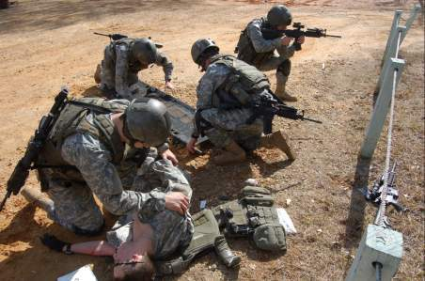
Remember!!!
Tension pneumothorax is a common but
easily treatable cause of preventable death
on the battlefield.
Diagnose and treat aggressively!
Notes:
DO NOT MISS THIS INJURY!

Slide 43
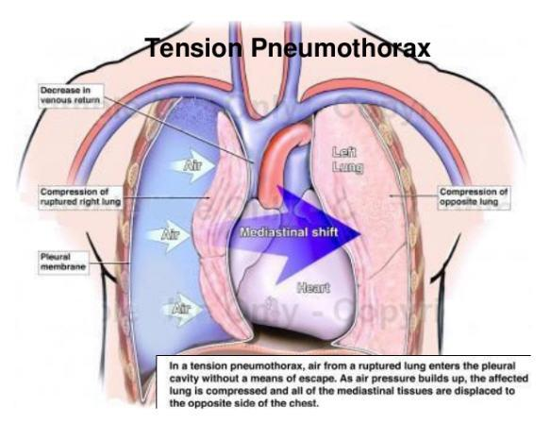
Needle Decompression Practical
Notes:
Needle Decompression Skill Sheet

