Slide 1
i-gel^{O2™} Resus Pack

Slide 2
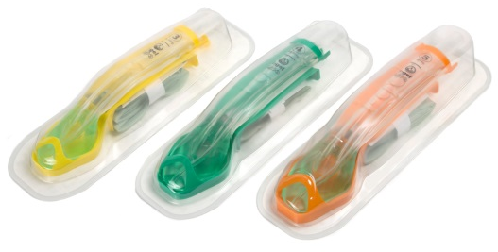
i-gel^{O2™} Resus Overview
A 2nd generation of supraglottic airways made easy
Single use, latex free, with a non-inflating cuff
Manufactured from a soft gel like material
Available in three adult sizes (3, 4 and 5)

Slide 3
The i-gel^{O2™}Supraglottic Airway

Slide 4
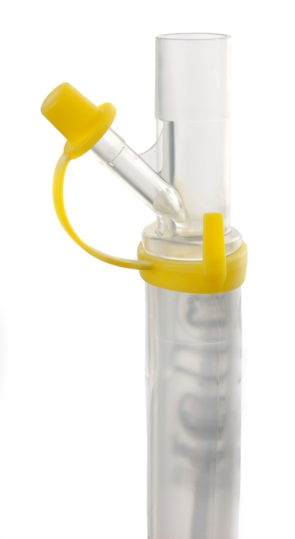
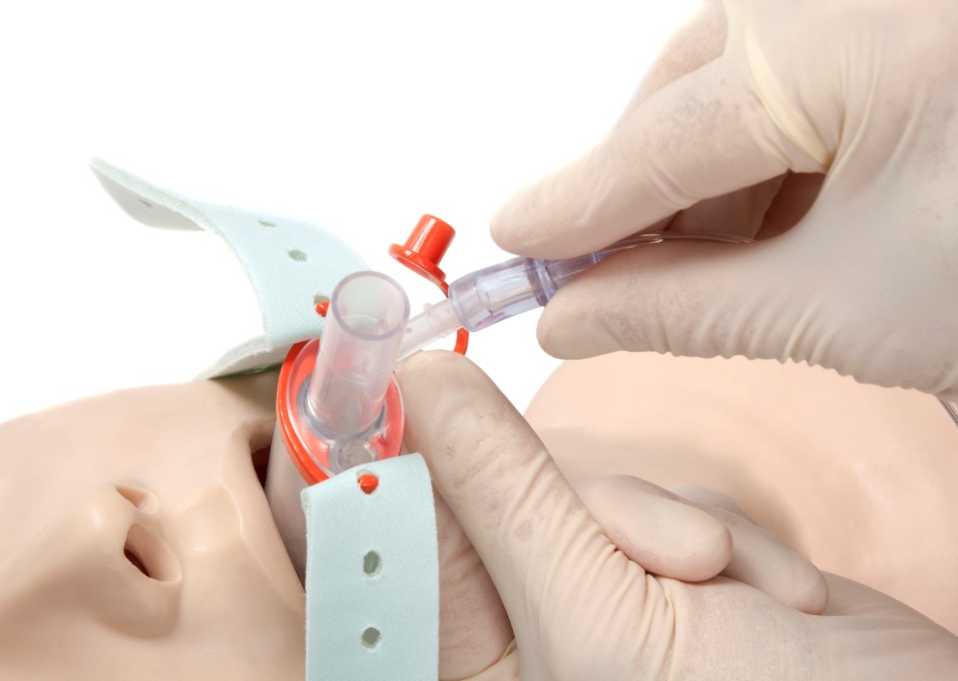
Supplementary Oxygen Port
For the administration of passive oxygenation as a component of a cardiocerebral resuscitation protocol (CCR).
For the provision of supplementary oxygen during post-arrest care and patient transfer.
Always keep the cap in place when not in use.

Slide 5
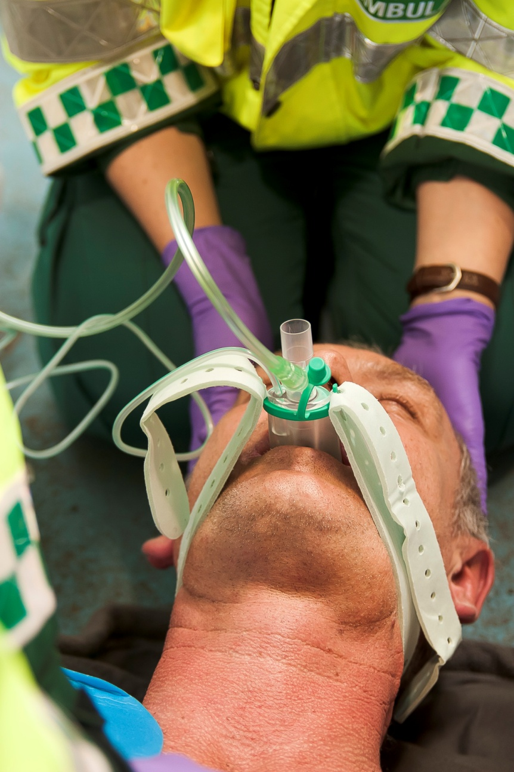
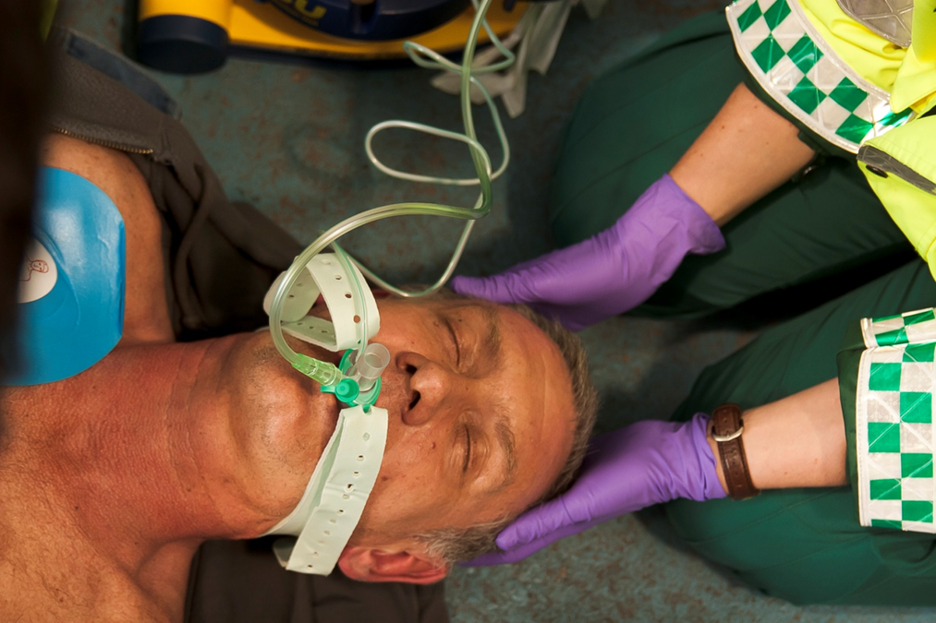
The i-gel^{O2™} being used to deliver passive oxygenation

Slide 6
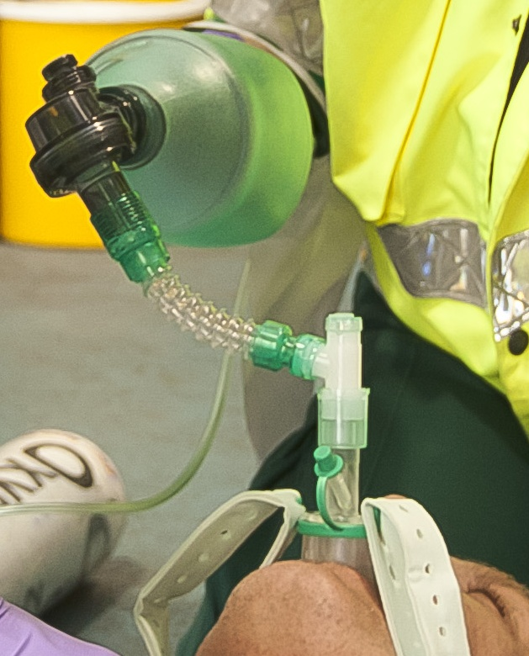
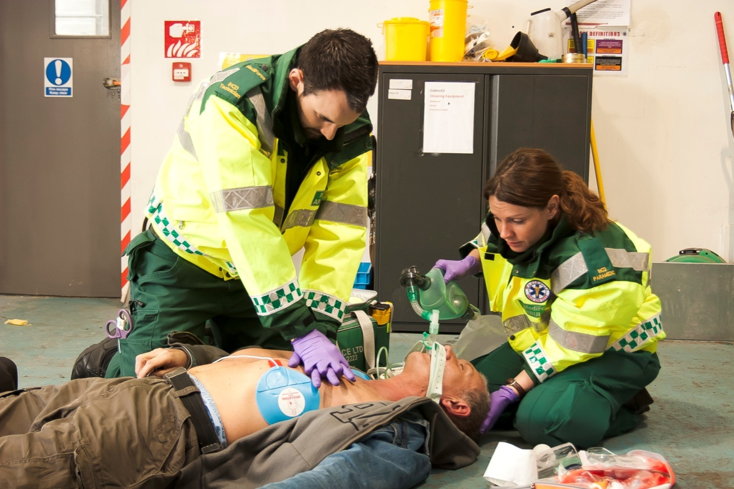
The i-gel^{O2™} being used to deliver standard ventilation

Slide 7
Equipment Preparation
Using the i-gel^{O2™} Resus Pack
Size Selection
Choose the correct size of i-gel^{O2™} Resus Pack for your patient.
Size Patient size Patient weight guidance*
3 Small adult 30-60kg (65-130 lbs)
4 Medium adult 50-90kg (110 -200 lbs)
5 Large adult 90 + kg (200 + lbs)
* While selection on a weight basis should be applicable to the majority of patients, individual anatomical variations mean the weight guidance provided should always be considered in conjunction with a clinical assessment of the patient’s anatomy.
Color coded hook ring to allow quick
and easy identification of size

Slide 8
Using the i-gel^{O2™} Resus Pack
Pre-insertion Preparation
2. Open the packaging and take out the protective cradle containing the device. Remove the accessory pack that includes the support strap and packet of lubricant from the protective cradle and place to one side and within easy reach.

Slide 9
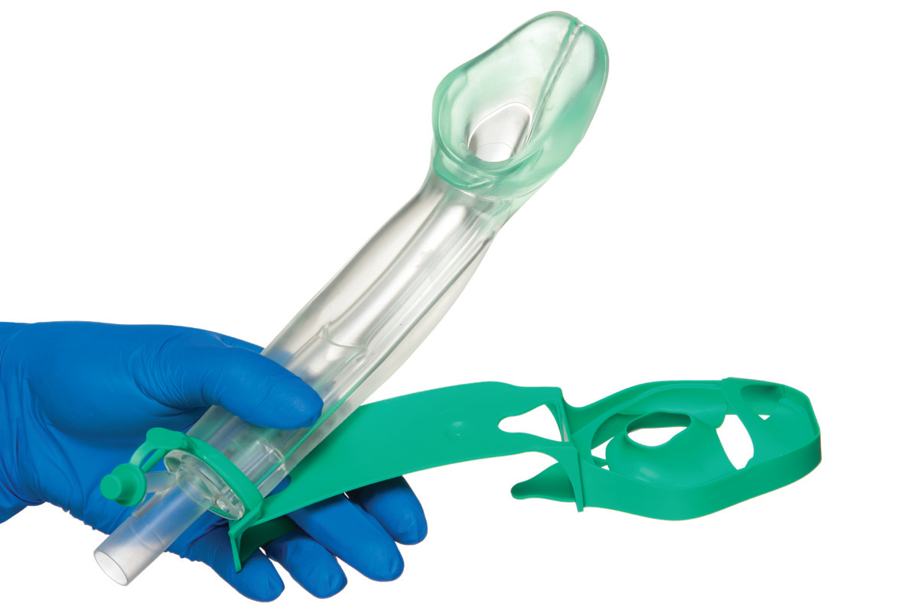
Using the i-gel^{O2™} Resus Pack
Pre-insertion Preparation
3. Remove the i-gel^{O2™} and transfer it to the palm of the same hand holding the protective cradle, supporting the device between the thumb and index finger.

Slide 10
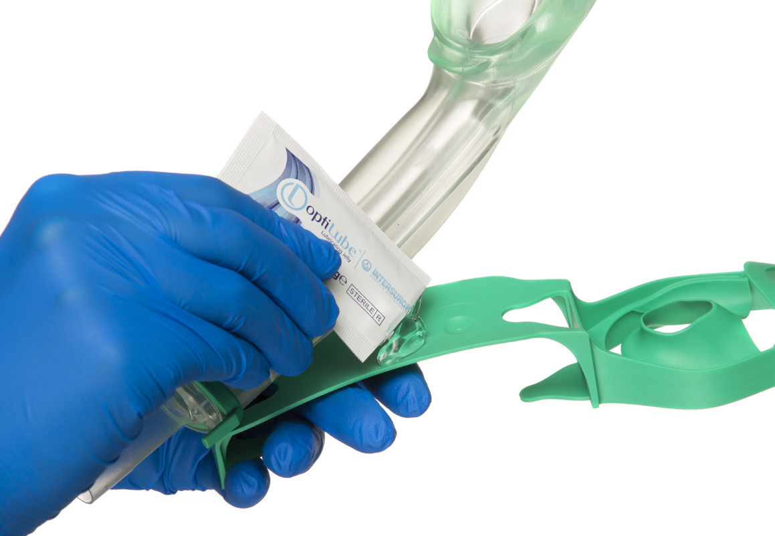
Using the i-gel^{O2™} Resus Pack
Pre-insertion Preparation
3. Place a small bolus of lubricant on the middle of the smooth surface of the protective cradle.

Slide 11
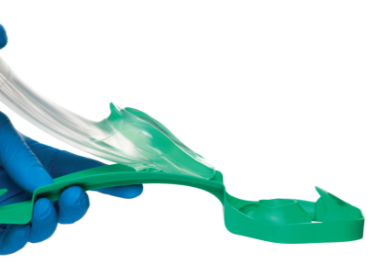
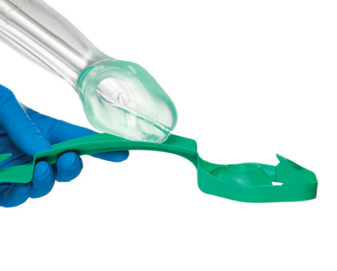
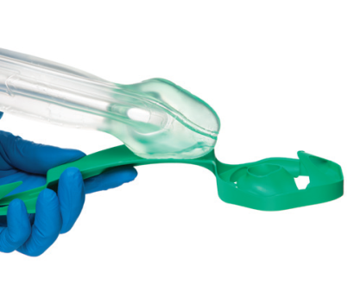
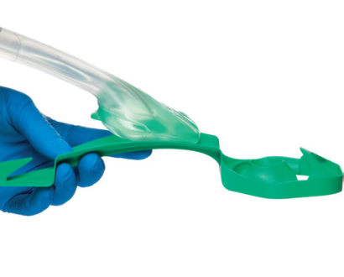
Using the i-gel^{O2™} Resus Pack
Pre-insertion Preparation
4. Grasp the i-gel^{O2™} with the opposite (free) hand along the integral bite block and lubricate the back, sides and front of the cuff with a thin layer of lubricant. (Ensuring any excess is removed prior to insertion.)

Slide 12
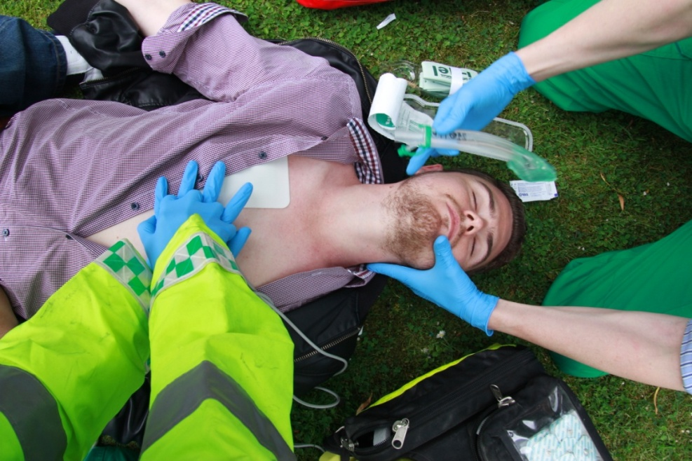
Using the i-gel^{O2™} Resus Pack
Insertion technique
5. Grasp the lubricated i-gel^{O2™} firmly along the bite block. The patient should be in the ‘sniffing the morning air’ position with head extended and neck flexed.

Slide 13
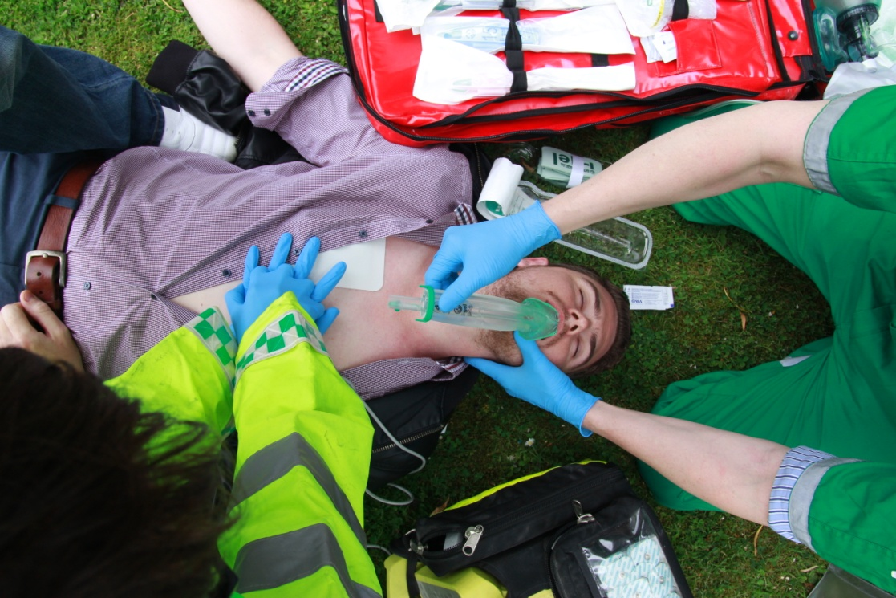
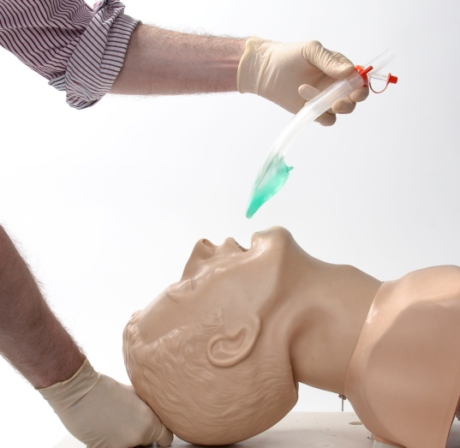
Using the i-gel^{O2™} Resus Pack
Insertion technique
6. Position the device so that the i-gel^{O2™} cuff outlet is facing towards the chin of the patient. Introduce the leading soft tip into the mouth of the patient towards the hard palate.

Slide 14
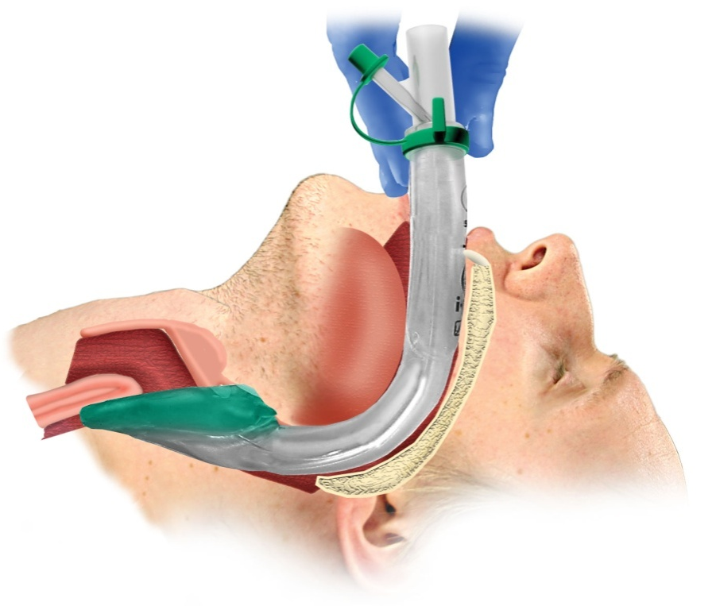
Using the i-gel^{O2™} Resus Pack
Insertion technique
7. Glide the device downwards and backwards along the hard palate with a continuous but gentle push until a definitive resistance is felt.

Slide 15
Using the i-gel^{O2™} Resus Pack
Insertion technique
8. Once insertion has been completed, the tip of the airway should be located into the upper esophageal opening (a), with the cuff located against the laryngeal framework (b). The incisors should be resting on the bite block (c).
b
c
a

Slide 16
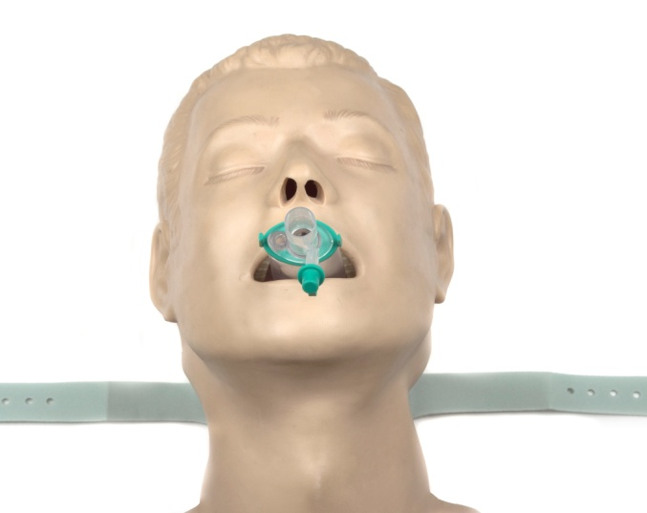
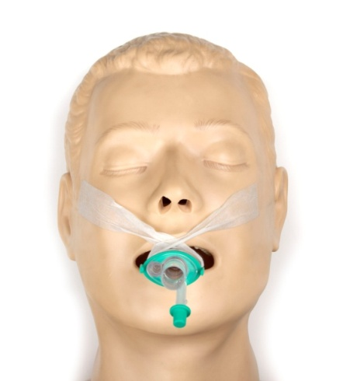
Using the i-gel^{O2™} Resus Pack
Insertion technique
9. Secure the device by sliding the Airway Support Strap underneath the patient’s neck and attaching to the hook ring. Take care to ensure there is sufficient tension to hold the i-gel^{O2™} securely in place, but not excessive tension that may cause trauma. Some adjustment of the strap may be needed to ensure optimal positioning.
Alternatively the device can be secured by taping maxilla to maxilla.

Slide 17
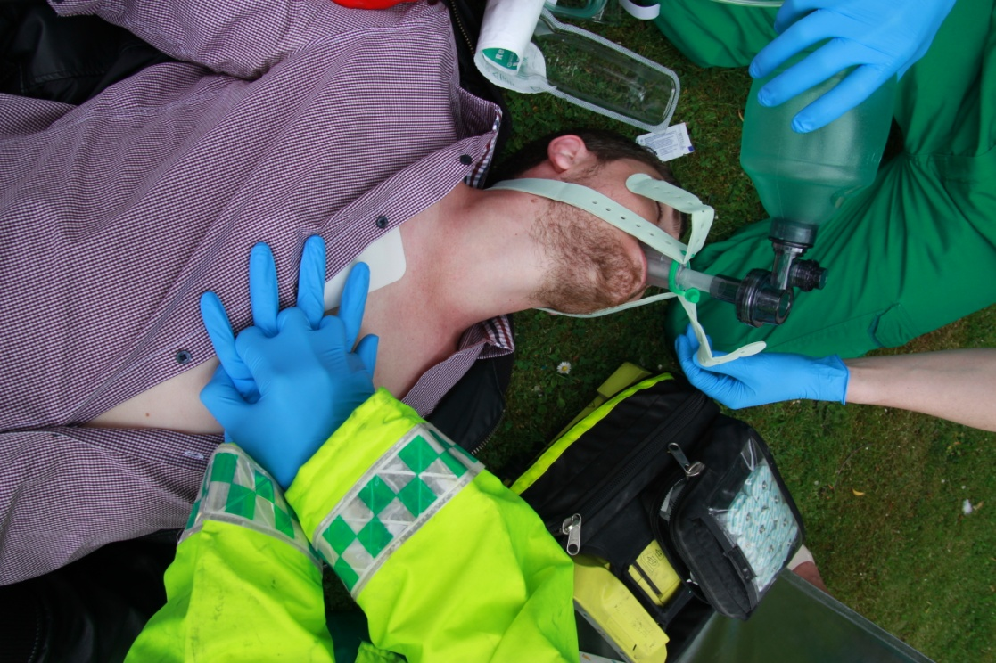
Using the i-gel^{O2™} Resus Pack
Insertion technique
10. Once the i-gel^{O2™} has been correctly prepared, inserted and secured, positive pressure ventilation can commence in accordance with applicable resuscitation guidelines*.

