Slide 1
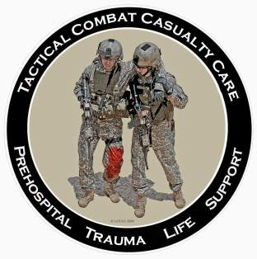
Tactical Combat Casualty Care 28 October 2013
TCCC Scenarios
Notes:
We’ve talked about the basics.
Now we’re going to look at some more scenarios.

Slide 2
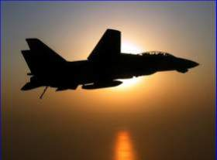
Tactical Casualty Scenarios
If the basic TCCC combat trauma management plan doesn’t work for the specific tactical situation, then for combat medics, corpsmen, and PJs – it doesn’t work.
There are no rigid guidelines for combat tactics – THINK ON YOUR FEET.
Scenario-based planning is critical for success in TCCC
Examples to follow:
Notes:
Read text

Slide 3
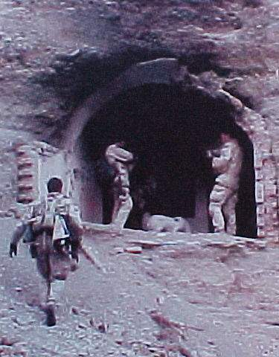
SEAL Casualty - Afghanistan
August 2002
Somewhere in Afghanistan
SEAL element on direct action mission
Story of the casualty as described by the first responder – NOT a
corpsman
Notes:
This is a real story that dramatically illustrates the difficulty of trauma care on the battlefield.

Slide 4
SEAL Casualty - Afghanistan
“There were four people in my team, two had been shot. Myself and the other uninjured teammate low crawled to the downed men. The man I came to was lying on his back, conscious, with his left leg pinned awkwardly beneath him. He was alert and oriented to person, place, time, and event. At that point I radioed C2 (mission control) to notify them of the downed man.”
Notes:
Read text

Slide 5
SEAL Casualty - Afghanistan
“Upon closer inspection, his knee was as big as a basketball and his femur had broken. The patient was in extreme pain and did not allow me to do a sweep of his injured leg. He would literally shove me or grab me whenever I touched his leg or wounds. I needed to find the entrance and exit wound and stop any possible arterial bleeding.”
Notes:
Read text

Slide 6
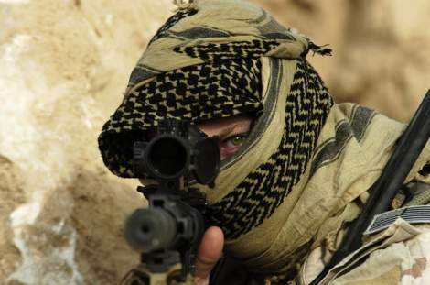
SEAL Casualty - Afghanistan
“But there was zero illumination and he was lying in a wet irrigation ditch. So I couldn’t see blood and I couldn’t feel for blood.”
Notes:
Picture yourself in this situation. You’ve got a casualty who is badly hurt and you can’t see a thing.

Slide 7
SEAL Casualty - Afghanistan
“We were also in danger because our position was in an open field (where the firefight had been) and I had to provide security for him and myself. So, I couldn’t afford to turn on any kind of light to examine his wounds. I told him to point to where he felt the pain. He had to sort through his pains.”
Notes:
Read text

Slide 8
SEAL Casualty - Afghanistan
“He had extreme pain in his knee and where his femur had been shattered as well as a hematoma at the site of the entrance wound (interior and upper left thigh). Finally, he pointed to his exit wound (anterior and upper left thigh). Again, I had no way of telling how much blood he had lost. But I did know that he was nonambulatory.”
Notes:
Read text

Slide 9
SEAL Casualty - Afghanistan
“So I called C2 again. I gave him the disposition of the patient as well as a request for casevac, a Corpsman, and additional personnel to secure my position and assist in moving the patient to the helicopter. I thought about moving the two of us to some concealment 25 meters away, but we were both really low in a shallow irrigation ditch. I felt safer there than trying to drag or carry a screaming man to concealment.”
Notes:
C2 = Command and Control

Slide 10
SEAL Casualty - Afghanistan
“Between providing security and spending a lot of time on the radio I didn’t get to treat the patient as much as I wanted to. I had given him a Kerlix bandage to hold against his exit wound. When he frantically told me that he was feeling a lot of blood, I went back to trying to treat him. I couldn’t elevate his leg. To move it would mean he’d scream in pain, which wasn’t tactical.”
Notes:
Read text

Slide 11
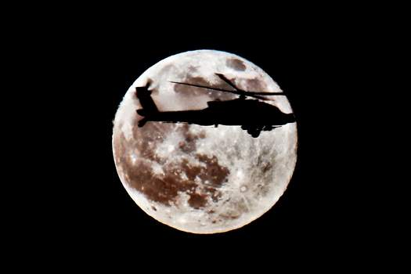
SEAL Casualty - Afghanistan
“There was just no way he would allow me to apply a pressure dressing to the exit wound even if I could locate it and pack it with Kerlix. So, I decided to put a tourniquet on him.”
Notes:
Read text

Slide 12
SEAL Casualty - Afghanistan
“His wounds were just low enough on his leg to get the tourniquet an inch or so above the site. I had a cravat and a wooden dowel with 550 cord (parachute cord) attached to it to use as a tourniquet. I told him to expect a lot of pain as I would be tightening the cravat down.“
Notes:
Note the makeshift tourniquet. When we first started the war in Afghanistan, most U.S. forces were not deploying with issued tourniquets.

Slide 13
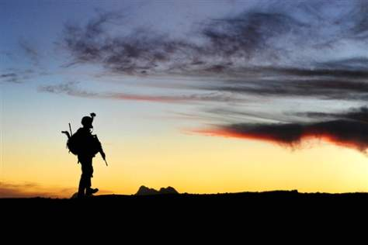
SEAL Casualty - Afghanistan
“At this point he feared for his life so he agreed. Once I got it tightened I had trouble securing it. The 550 cord was hard to get underneath the tightened cravat.”
Notes:
You need to be able to get a tourniquet on a wounded teammate with zero illumination.

Slide 14
SEAL Casualty - Afghanistan
“After over 5 minutes, the Corpsman arrived along with a CASEVAC bird and a security force. Moving the patient was very hard. Four of us struggled to move him and his gear 25 meters to the bird. The patient was over 200 pounds alone and we were moving over very uneven terrain.”
Notes:
Read text

Slide 15
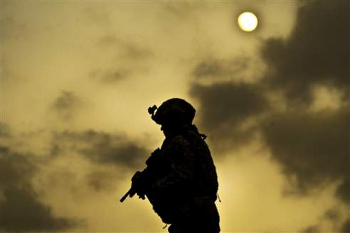
SEAL Casualty - Afghanistan
“We wanted to do a three-man carry with two men under his arms and one under his legs. But again, his leg was flopping around at the thigh and couldn’t be used to lift him.”
Notes:
Experienced combat medical personnel say that moving the casualty is typically the biggest challenge in TCCC.

Slide 16
SEAL Casualty - Afghanistan
“The bird, (a Task Force 160 MH-60) had a 50-cal sniper rifle strapped down, which made it hard for us to get him in. It took us minutes to get him 25 meters into the bird. The Corpsman went with my patient as well as the other downed man in my team and I went back to the op.”
Notes:
Was the tourniquet a good move?
Absolutely – probably saved the casualty’s life.
Would a pressure dressing have been a good idea if tolerated by the patient?
NO – won’t necessarily stop a big bleeder.

Slide 17
Scenario Discussions – Suggested Format
Break up into groups of six
Present the background for the scenario on the screen.
The Instructor will lead the group’s discussion through to the end of the scenario.
10 minutes per scenario
Stop after 10 minutes and present next scenario on screen
Notes:
Here’s is a suggested format for the scenario discussions
Get the class talking and thinking on these!

Slide 18
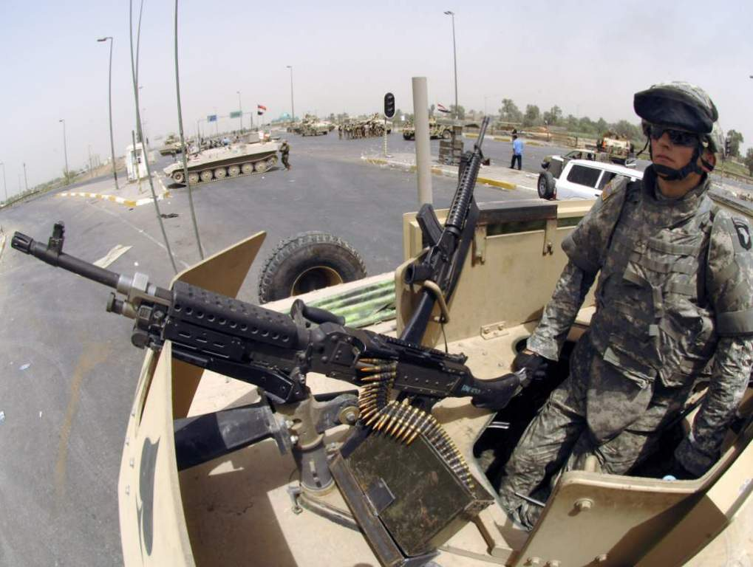
Urban Warfare Scenario
Notes:
Now let’s look at a scenario in urban warfare operations

Slide 19
Real-World Scenario
High-threat urban environment
16-man Ranger team
70-foot fast rope insertion for building assault
One man misses rope and falls
Unconscious on the ground
Bleeding from mouth and ears
Unit taking sporadic fire from all directions from hostile crowds
Notes:
Anybody recognize this casualty?
First Ranger casualty in Mogadishu
Has everyone here seen “Blackhawk Down?”

Slide 20
The Battle of Mogadishu
Somalia – Oct 1993
US casualties 18 dead, 73 wounded
Estimated Somali casualties 350 dead, 500 wounded
Battle 15 hours in length
Notes:
At the time, it was the biggest battle involving U.S. forces since Vietnam

Slide 21
Mogadishu Complicating Factors
Helo CASEVAC not possible because of crowds, narrow streets and RPGs
Vehicle CASEVAC not possible initially because of ambushes, roadblocks, and RPGs
Gunfire support problems
Somali crowds included non-combatants
Somalis able to take cover in buildings
RPG threat to helo fire-support gunships
Notes:
We talked about factors that make evacuation by helicopter hard.
Be sure that you add narrow streets and RPG fire to that list.
There were LOTS of U.S. helos over Mogadishu, but we were not able to evac the casualties with them for these reasons.

Slide 22
Care Under Fire
Return fire?
Move patient to cover right away or wait for long board?
How should he be moved?
Intubation?
IV fluids?
Urgency for evacuation?
Notes:
Should the medic return fire or care for casualty?
Reasonable to have medic or corpsman to attend casualty in this scenario
Why?
Total suppression of hostile fire not possible
Large crowd – can’t kill everybody
Lots of other guns
Critically injured patient
Does that break our rule about shooting first and treating later?
Yes - but that’s OK – it’s the right answer for this particular situation.
What’s next?
Move patient to cover right away or wait for long board immobilization?
Is he at risk for a spinal cord injury if moved? Yes
Also very much at risk of getting shot
Probably DO want to get him to cover immediately – cover available at side of road
How do you want to move him?
Carefully!!
Cradle head with forearms to stabilize neck and drag
Does he need to be intubated?
No
Chin-lift/jaw-thrust and NP airway
Does he need IV fluids?
Only needs fluid resuscitation if internal bleeding and hypovolemic shock
Check radial pulse – give fluids if pulse weak
Urgency for evacuation?
Little that can be done at FST (forward surgical team) for the head injury
Possible ruptured spleen or other internal bleeding may be bigger issue acutely
Tactical commander in Mogadishu split force rather than wait 30 minutes
Does he need antibiotics or analgesia?
No – no open wound noted
Already unconscious
Outcome
Ranger survived his injuries.
End of scenario

Slide 23
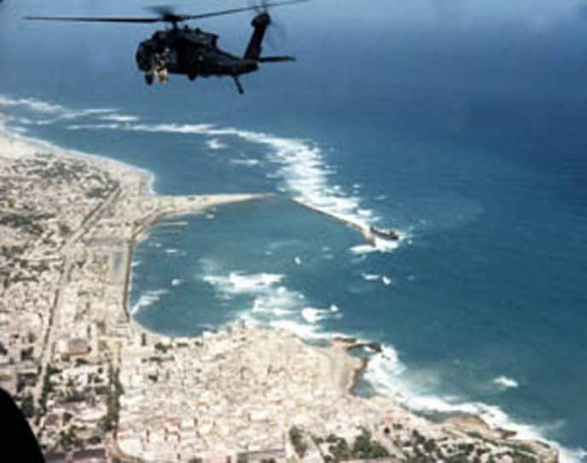
Mogadishu Scenario 2 Helo Hit by RPG Round
Notes:
Second real-world scenario from Mogadishu
Very different tactical situation

Slide 24
Mogadishu Scenario 2 Helo Hit by RPG Round
Hostile and well-armed (AK-47s, RPG) crowds in an urban environment
Building assault to capture members of a hostile clan
Blackhawk helicopter trying to cover helo crash site
Flying at 300 foot altitude
Notes:
Read text

Slide 25
Mogadishu Scenario 2 Helo Hit by RPG Round
Left door gunner with 6 barrel M-134 minigun (4000 rpm)
Hit in hand by ground fire
Another crew member takes over mini-gun
RPG round impacts under right door gunner
Notes:
Read text

Slide 26
Mogadishu Scenario 2 Helo Hit by RPG Round
Windshields all blown out
Smoke filling aircraft
Right minigun not functioning
Left minigun without a gunner and firing uncontrolled
Pilot:
Transiently unconscious - now becoming alert
Notes:
Read text

Slide 27
Mogadishu Scenario 2 Helo Hit by RPG Round
Co-pilot
Unconscious - lying forward on helo’s controls
Crew Member
Leg blown off
Lying in puddle of his own blood
Femoral bleeding
Notes:
Read text

Slide 28
Mogadishu Scenario 2 Helo Hit by RPG Round
YOU are the person providing care in the helo.
What do you do first?
Notes:
What are your options for first actions?
Casualty with femoral bleeding
Unconscious co-pilot
Semi-conscious pilot
Stop the uncontrolled min-gun from firing
Who gets treated first?
Take care of the pilot first
Want to get him back flying the aircraft
Most important thing about medical care in an aircraft is to try to keep the
aircraft in the air
Stimulate pilot by shaking
Smelling salts if available
What’s next?
Casualty with the femoral bleeder is next
Needs a tourniquet
He should be able to provide self-care if conscious
The individual in Mogadishu treated himself
Used an improvised tourniquet
Survived
What can you do for the unconscious co-pilot?
Get him off the controls
Supine position and establish airway with NPA
Check for external bleeding – none seen
Next action?
Check casualty with injured hand
Stop any severe bleeding
What else?
Radio for help
Prepare for impact if crash landing anticipated
After impact – security for weapons and ordnance
End of scenario

Slide 29
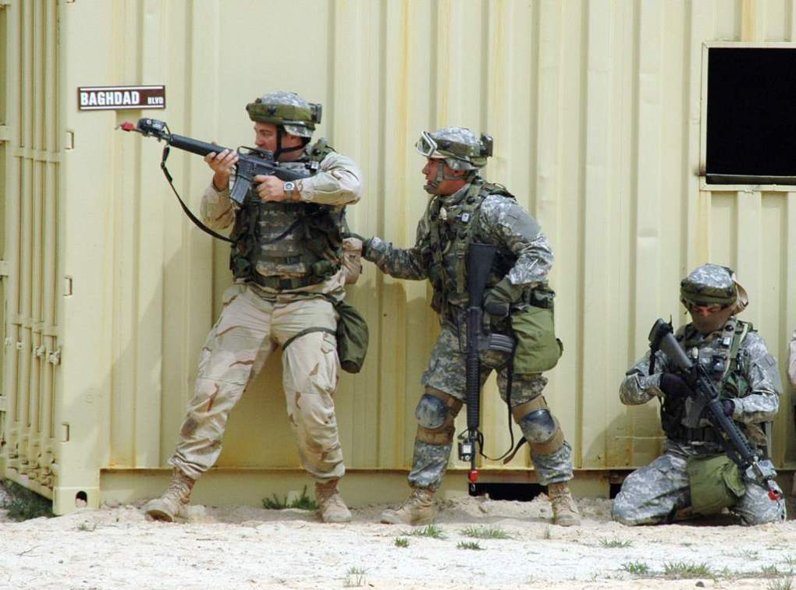
Military Operations in Urban Terrain
Notes:
Now let’s look at a few scenarios that are representative of the kind that we are seeing in Iraq and Afghanistan at present

Slide 30
MOUT Scenario 1
A U.S. ground element is moving on a high-value target in an urban environment
The first two men in a 8-man patrol are shot by an individual with an automatic weapon while moving down a hallway in a building.
The attacker follows this burst with a grenade.
Notes:
Read text

Slide 31
MOUT Scenario 1
One casualty is shot in the abdomen but conscious.
The second casualty is shot in the shoulder with severe external bleeding.
The third person is unconscious from the grenade blast.
The attacker withdraws around a corner.
Notes:
Read text

Slide 32
MOUT Scenario 1
YOU are the person providing medical care.
What do you do?
Notes:
What are the tactical considerations here?
How many other hostiles in are in house?
All pursue hostile – leave casualties for later?
All withdraw to care for casualties?
Set security and treat casualties there?
Split force – have some pursue and others treat?
Split force most often chosen as the best option from previous
groups.
Who gets treated first?
Casualty with Shoulder Injury
Most important to treat immediately – could bleed to death quickly
Stop bleeding with Combat Gauze dressing
Apply with direct pressure for 3 minutes
Airway Management?
OK - conscious
IV?
No – not in shock if take care of bleeding without delay
Combat pill pack?
Yes
Fentanyl?
Careful - may go into shock later from shoulder wound
Ketamine may be a better choice here.
What next?
Unconscious Casualty with Blast Injury
Airway Management?
Chin-lift/jaw thrust
NP airway
Check for other injuries
Find major bleeding in back of thigh from shrapnel wound
Apply tourniquet
IV fluids?
Check radial pulse – strong – not unconscious from hemorrhage
No need for fluids – may make blast lung worse
Unconscious from blast
Pulse ox monitoring
Must prevent hypoxia in TBI casualties
Combat pill pack?
No – needs IV antibiotics – unconscious – medical personnel
administer when feasible
Needs oxygen in CASEVAC phase
Next?
Abdominal Wound Casualty
Airway Management?
OK - conscious
IV fluids?
No, not at present – not in shock
Saline lock a good idea when time permits
May go into shock later
Combat pill pack?
Yes – casualty can self-administer
Abdominal wound should have IV antibiotics – but not the first
priority at this point
End of scenario

Slide 33
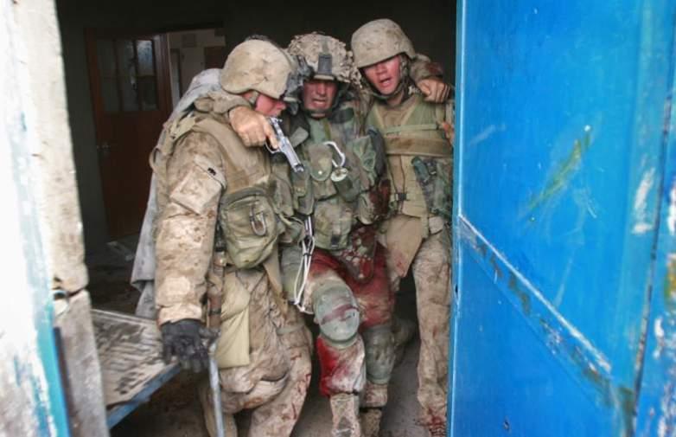
MOUT Scenario 2

Slide 34
MOUT Scenario 2
SCENARIO HISTORY: While on patrol in the city of Tal Afar your platoon receives effective direct small arms fire. A 22-year-old unit member falls to the ground and begins screaming, holding his right leg. The platoon, including you, reacts to the ongoing contact by returning fire.
Notes:
Read text

Slide 35
MOUT Scenario 2
You can see that the casualty is bleeding heavily from his leg wound.
YOU are the person providing medical care for the unit.
What do you do?
Notes:
What phase are you in?
Care Under Fire
What should you do for the casualty?
Yell at him to get under cover if he can.
Tell him to put a tourniquet on his wounded leg.
May have to help him.
Consider movement plan/suppression fire, etc. if you do.
Should he take his Combat Pill Pack meds now?
No. Still in Care Under Fire phase
Priorities are to get to cover and return fire if possible
Scenario continues. Casualty has moved behind a vehicle. All hostiles are eliminated or have retreated. The platoon establishes a secure perimeter. Platoon leader tells you that you have only one casualty, and that you have a few minutes to work on him before the platoon will have to move.
What phase are you in now?
Tactical Field Care
Your casualty is alert, still in severe pain, and clutching his right leg. There is blood all over his leg and hands, and a tourniquet is in place on his right thigh. What is your first concern?
Control of life-threatening bleeding.
What next?
You check the tourniquet.
It is positioned correctly.
The bleeding has been controlled.
You search quickly for any other life-threatening bleeding, and find none.
Should you disarm the casualty?
No. He is alert and wants to stay in the fight.
Next concern?
Airway is patent.
Casualty is conscious and talking – airway is OK.
Next?
Breathing.
Breathing is rapid from pain and the situation, but not labored.
What next?
Check for shock.
Mental status is normal. Radial pulse is strong.
Next?
Assess for other wounds.
You discover a large bruise on his chest and RUQ overlying the liver. You
check his body armor and find corresponding damage compatible with a
bullet strike.
Should you start a saline lock?
Only if you think he is in significant danger of going into shock later.
Does the casualty need IV fluids at this point?
No – not in shock.
Conserve limited IV fluids until they are really needed.
Next?
Prevent hypothermia.
Ready Heat Blanket
Heat Reflective Shell
Next?
Inspect and dress his wound.
Reassess
Platoon leader tells you the unit will move in 10 minutes to a CASEVAC location. No enemy contact is expected. CASEVAC should take about 45-60 minutes.
Should you try to remove the tourniquet and replace with Combat Gauze.
No – less than two hours tourniquet time anticipated. Leave it on.
Casualty has taken his own Combat Pill Pack. He is in significant pain. Should you give him further analgesia?
Mobic and Tylenol were taken 15 minutes ago.
Casualty is not in shock – a fentanyl lozenge is an acceptable choice at this point as long as you are sure the bleeding is controlled and there is little chance the casualty will go into shock later. Otherwise, intramuscular or intranasal ketamine is probably a better option.
May withhold further analgesia if there is a chance of more hostile contact and casualty wants to stay in the fight.
What else?
Reassure
Document care
You have now moved to the CASEVAC site. The platoon establishes security. You check the patient and notice that he is confused and breathing rapidly. You check his thigh wound and find that his tourniquet has become loose and the dressing is soaked with blood.
What next?
Re-tighten first tourniquet. Use a second CAT if needed.
Casualty becomes unconscious from shock. What next?
Establish IV access if not done before.
Administer 1 gm TXA in 100cc NS slow IV push over 10 minutes (SOF units only)(<3 hr. after injury)
Infuse 500cc bolus of Hextend.
What next?
Nasopharyngeal airway - casualty is unconscious.
Recovery position
Transport ASAP
End of scenario

Slide 36
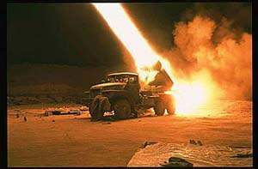
Questions?

Slide 37
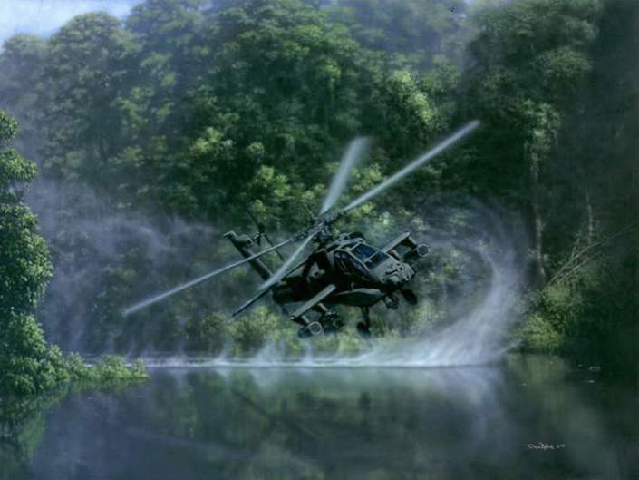
MOUT Scenario 3

Slide 38
MOUT Scenario 3
SCENARIO HISTORY: While on patrol in the city of Mosul, an infantry platoon comes under small arms fire. The point man is hit and falls to the ground. The platoon reacts to the contact, rapidly eliminating the ambushing hostiles. There are no other casualties. The platoon leader tells you take care of the casualty while the others establish a secure perimeter.
Notes:
Read text

Slide 39
MOUT Scenario 3
You move to the casualty, and quickly assess for life-threatening conditions:
GSW
Entrance at right upper back
Exit in right armpit
Heavy, pulsatile bleeding from the exit wound
Breathing OK, though a little fast
No other wounds
YOU are the person providing medical care.
What do you do?
Notes:
It has been about 4 minutes since the casualty was wounded. What is your immediate concern?
Life threatening hemorrhage from the wound in the armpit (axilla)
What phase of care are you in?
TFC
As the first responder caring for this casualty, what do you do next?
Expose the wound.
Push a Combat Gauze bandage into the wound.
Hold direct pressure for a minimum of 3 minutes.
What do you do while holding pressure?
Talk to the casualty
Checks both airway and mental status
External bleeding appears controlled but casualty is drowsy.
What next?
Check for other sources of bleeding
None found
Check left radial pulse.
It is not palpable.
What next?
Check breathing
Slightly fast but not obviously labored
Should you treat for a tension pneumothorax here?
Yes – have a chest wound, rapid breathing, and shock
Needle decompression of right chest done
Either 2nd intercostal space at the midclavicular line or the 4th or 5th intercostal space at the anterior axillary line
No hiss of escaping air.
No improvement
What next?
Start an IV.
In shock:
TXA 1gm slow IV push over 10 minutes (SOF units only)
Hextend 500cc started.
Ten minutes pass. Hextend bolus is going in.
External bleeding is controlled by the Combat Gauze.
Casualty is now unconscious and does not respond to deep pain.
There is no reading for O2 sat displayed on the pulse ox
Carotid pulse is not palpable.
His breathing has stopped.
Arrival of MEDEVAC helicopter is anticipated to take at least an hour.
What next?
Consider bilateral needle decompression of possible tension pneumo
Done
No improvement
Airway is rechecked and opened
Second person confirms no pulse or breathing
What next?
CPR?
No
Why not?
It won’t help. Individuals in cardiac arrest have little chance of surviving more than 10 minutes without advanced medical care, even in the absence of trauma. Inform platoon leader that the casualty has died. Cause of death likely to have been internal hemorrhage from the GSW. Decision now is how and when to transport your teammate’s body off the battlefield.
Document the injuries and the care rendered.
End of scenario

Slide 40
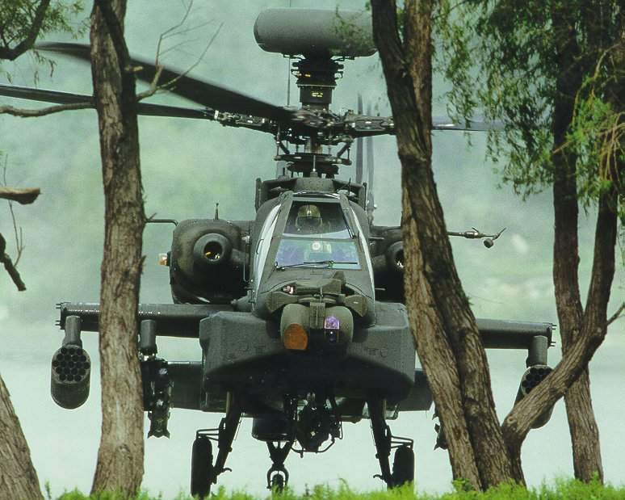
Questions?

Slide 41
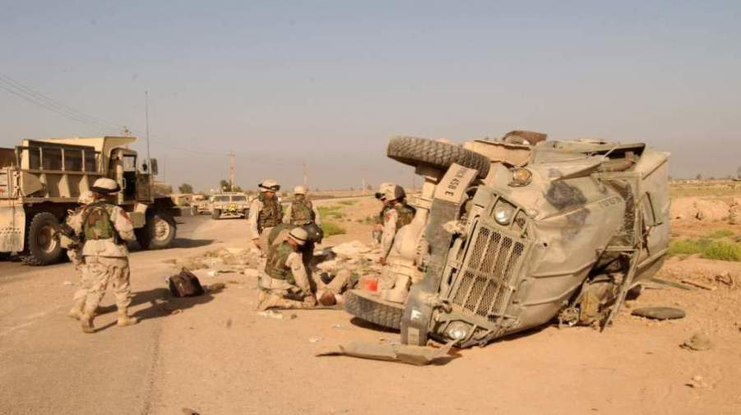
MOUT Scenario 4

Slide 42
MOUT Scenario 4
SCENARIO HISTORY: You are riding with a squad in the back of a cargo Humvee. When you stop at an intersection, a lone attacker fires an RPG at your vehicle. It is poorly aimed, and strikes the ground beside the Humvee. The vehicle sustains moderate damage and is not able to move. Everyone scrambles out of the vehicle. The last person out is complaining of chest pain and shortness of breath. You and the others are uninjured.
Notes:
Read text

Slide 43
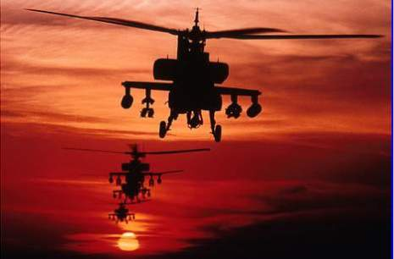
MOUT Scenario 4
Security is set
No further hostile fire
YOU are the person providing medical care.
What do you do?
Notes:
What phase are you in?
Tactical Field Care
You examine the casualty and find:
She is alert, but in great pain
Shrapnel wound in her right lateral chest - no exit wound
Entrance wound is a sucking chest wound
Her right thumb is missing and the wound is oozing a little blood.
No major external bleeding
What next?
Cover the chest wound with an occlusive dressing.
Apply the dressing at end-expiration.
Have her breathe all the way out and put it on before she breathes in again.
This makes the casualty a little more comfortable.
What next?
Thumb wound.
What do you do for the thumb wound?
Bleeding only minimally – just dress it.
You are worried about internal bleeding from the chest wound. What are you going to do about it?
Monitor for changes in radial pulse strength and mental status
Casualty is alert and now breathing OK
Radial pulse is strong.
O2 sat is 95% (this is slightly low, but still OK)
Should you start a saline lock?
Good idea – at risk for going into shock
Would you give IV fluids now?
No. IV fluids are not needed right now. Not in shock.
What next?
Look for other wounds.
You find none.
What next?
Hypothermia prevention.
Casualty says that her pain is very severe. What else do you want to do for the casualty? Can you give her a fentanyl lozenge?
She’s alert with good O2 sat and breathing well. She’s not in shock at this point, BUT – she has a chest injury and probably has internal bleeding. IN or IM ketamine is probably a better choice than fentanyl since internal bleeding may cause shock later. Unlike fentanyl and morphine, ketamine may help improve cardiac output, and is not a respiratory depressant if the speed of administration is controlled. You could go with the fentanyl lozenge, but with great caution. Know where your Narcan is if you give fentanyl.
Monitor oxygen saturation and breathing carefully.
What’s next?
Antibiotics.
Have her take her Combat Pill Pack with moxifloxacin
Casualty is stable. What steps do you take now?
Communicate status to squad leader.
Begin TACEVAC preparations.
Document care on TCCC Casualty Card
You are 8 miles from a CSH. Helicopter will not be available for an hour. By ground vehicle, the trip will take 35 minutes. A mounted patrol is dispatched to take your casualty to the CSH. It has now been about 40 minutes since the RPG attack. You are enroute to the CSH.
The casualty tells you she’s having increasing trouble breathing. What do you do?
Assess her airway. It is clear.
Breathing is rapid and labored.
The dressing on the chest wound is secure.
Her O2 sat has dropped to 80%
What next?
Diagnosis? Presumed tension pneumothorax.
What are you going to do about it?
Lift one side of the occlusive dressing for a few seconds.
There is a rush of air from the wound
The casualty’s respiratory distress is relieved.
O2 sat goes up to 94%
Good job!
Replace the dressing and continue to monitor.
Repeat this maneuver as necessary for recurrence of labored breathing.
End of scenario

Slide 44
Questions?

Slide 45
Tactical Combat Casualty Care
Casualty scenarios on the battlefield usually entail both medical and tactical problems.
Emergency actions must address both.
Medical personnel should be involved in mission planning.
Notes:
Summary
Good tactical medicine HAS to be a combination of good tactics and good medicine.
Bring your leadership into the medical plan.
Combat leaders must understand combat medicine.

Slide 46
Scenario-Based Planning
The TCCC guidelines for combat trauma scenarios are advisory rather than directive in nature.
Rarely does an actual tactical situation exactly reflect the conditions described in planning scenarios.
Unit medics/corpsmen/PJs will typically need to modify the medical care plan to optimize it for that scenario.
Notes:
Read text

Slide 47
The 3 Objectives of TCCC
Treat the casualty
Prevent additional casualties
Complete the mission
Notes:
Once more…..

Slide 48
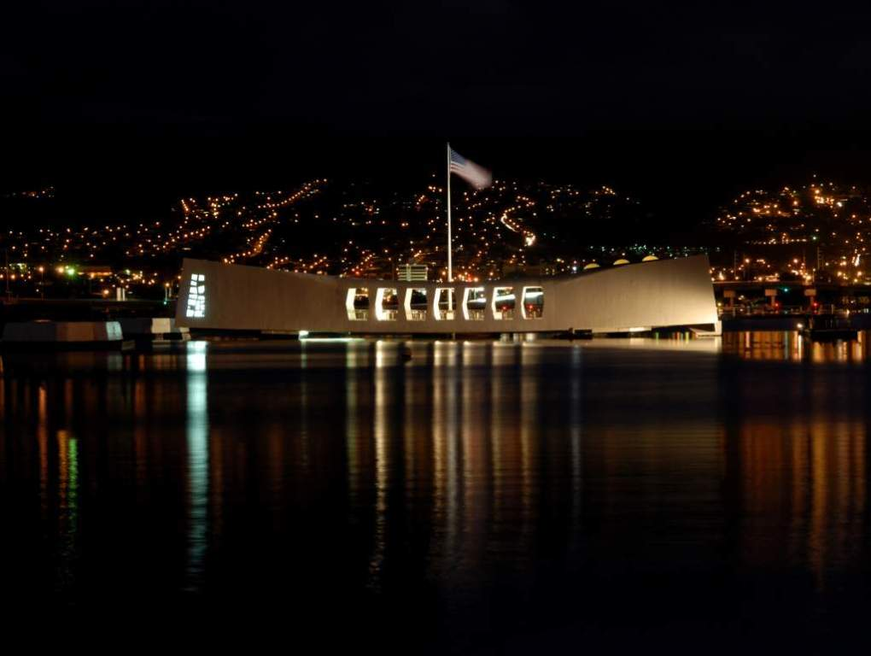
The End

