Slide 1



The New Role of “EMS” in
Healthcare 3.0
Notes:
Intro & Goals:
New Roles for EMS based on the new healthcare economic model

Slide 2
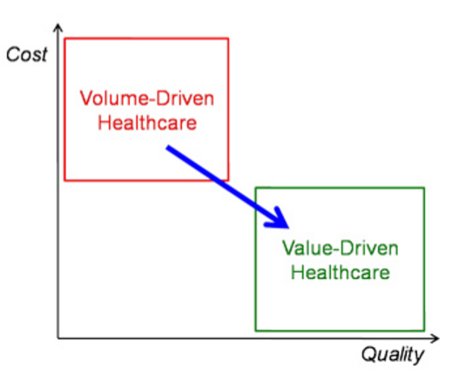


Healthcare is Transforming
Notes:
Old model – the more you DO, the more you can bill
New model – accountable, valuable care

Slide 3

Traditional EMS
9-1-1 safety net access for non-emergent healthcare
  35.6% of 9-1-1 requests no lights/siren response
    12 months Priority 3 calls (44,567 (P3) / 124,925 (Total))¹
Reasons people use emergency services
  Because we taught them to…
  Because they panic…
  Because their professional care givers tell them to…
  Because it’s the only most appropriate option…
EMS = 37 million house calls²
  70% transported
(1) MedStar Mobile Healthcare Data (2016)
(2) 2012 NASEMSO Report
Notes:
We have encouraged people to call 9-1-1 for virtually anything
That is no inherently bad, but we’ve learned that many calls are not “emergencies”

Slide 4
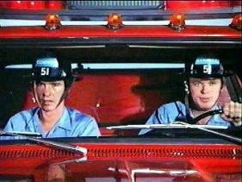
Conundrum…
Misaligned Incentives
  EMS is currently only paid to transport
    “EMS” is a transportation benefit
    NOT a medical benefit
Notes:
We are a SUPPLIER of transportation
Not a PROVIDER of medical care
As a result, we are incentivized to transport patients to the ED in order to be eligible for reimbursement

Slide 5
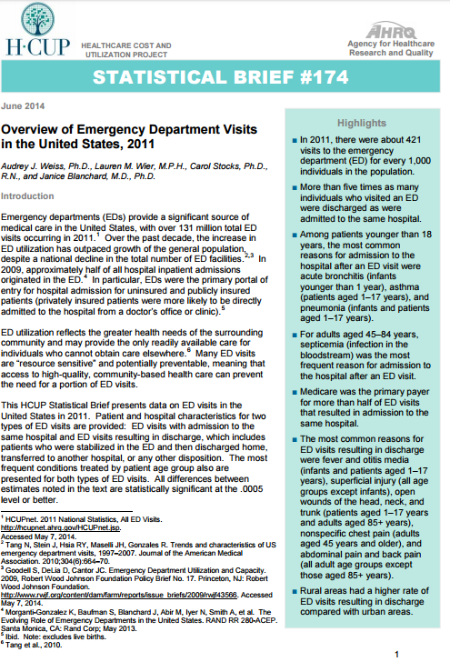
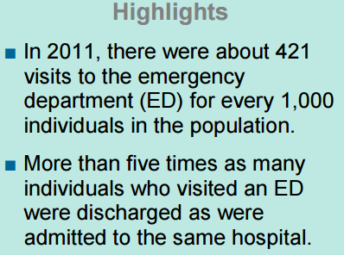
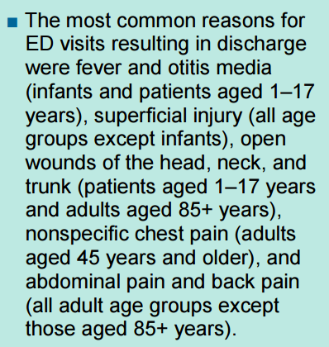
Impact of Misaligned
Economic Model
131 Million ED Visits (2011)
https://www.hcup-us.ahrq.gov/reports/statbriefs/sb174-Emergency-Department-Visits-Overview.pdf
Notes:
Slide Builds:
Let’s look at what that model costs the healthcare system by combining 2 reports, one from the Agency for Healthcare Research and Quality (AHRQ), a division of HHS and one from the American College of Emergency Physicians
Here, AHRQ found there are 421 ED visits for every 1,000 population, most are discharged from the ED and most are for minor medical issues

Slide 6
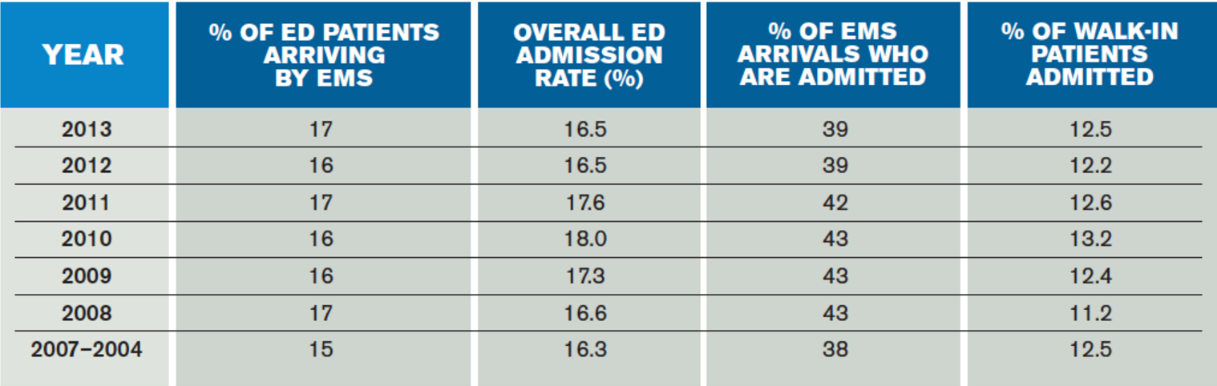
Impact of Misaligned
Economic Model
http://www.acepnow.com/article/emergency-medical-services-arrivals-admission-rates-emergency-department-analyzed/
Notes:
Slide Builds:
ACEP published this report that shows in 2013, 17% of ED visits were by EMS, and 39% of those arrivals got admitted.
This means that 61% of the arrivals by EMS were treated and streeted from the ED… This is the population we may be able to work with!

Slide 7
Impact of Misaligned
Economic Model
ED Expenditure Analysis
All ED Visits (2011) (2) | 131,000,000
Average Expenditure (3) | $ 969
ED Expenditure | $ 126,939,000,000
% EMS ED Arrivals Discharged | 61%
Patients Treated & Streeted | 13,584,700
Average Expenditure (3) | $ 969
Total | $ 13,163,574,300
% EMS ED arrival (1) | 17%
Patient Arrivals | 22,270,000
Average Expenditure (3) | $ 969
EMS ED Expenditure | $ 21,579,630,000
% of EMS patients Alt. Dest. | 15%
ED Patients Referred | 2,037,705
Average Expenditure (3) | $ 969
Potential ED Savings | $ 1,974,536,145
References:
1. http://www.acepnow.com/article/emergency-medical-services-arrivals-admission-rates-emergency-department-analyzed/
2. https://www.hcup-us.ahrq.gov/reports/statbriefs/sb174-Emergency-Department-Visits-Overview.pdf
3. http://www.cdc.gov/nchs/data/hus/hus12.pdf
Notes:
Slide Builds:
Based on these 2 reports, there were 131,000,000 ED visits, and the average Medicare FACILITY payment for an ED visit is $969; meaning that ED expenditures for all payers is $127 billion.
17%, or $21.6 billion are from EMS arrivals
61% of those were treated and streeted, so can we impact the $13.1 billion?
If we could do something else with just 15% of the treated and streeted patients, we could save the healthcare system $2 billion annually!

Slide 8
EMS Can Contribute
EMS can fill gaps in the care continuum with 24/7 medical resources that:
  Improve the patient care experience
  Improve population health
  Reduce healthcare expenditures
This is “EMS 3.0”

Slide 9

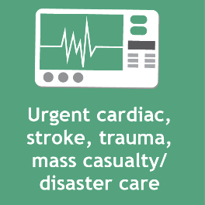


Urgent and Emergent Care Remain Core to EMS
Notes:
Slide Builds:
EMS ‘owns’ this space – it is something we will always do, and is a GAP in the healthcare system we currently fill.

Slide 10




EMS Agencies Offering
Expanded Roles
Notes:
Slide Builds:
Using the same infrastructure, we could do these additional things to help navigate patients through our complex healthcare system.

Slide 11


Value – Added EMS
Core Mission + Expanded Services = Value
Notes:
Slide Builds:
We can demonstrate more value by combining our core mission with the aforementioned additional services.

Slide 12
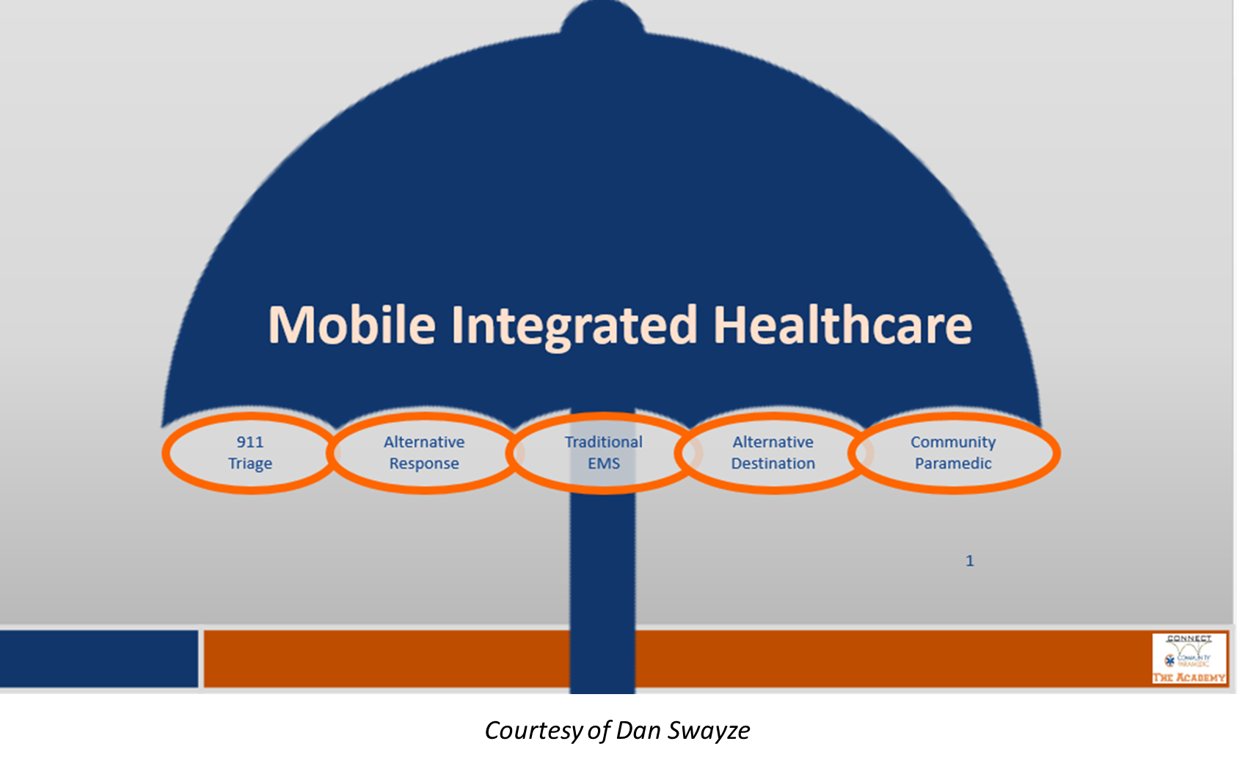
Nomenclature
Notes:
MIH vs. CP clarification. MIH is an umbrella term for a strategy/philosophy about doing 3.0 activities. COMPONENTS of MIH could include the things under the umbrella. An agency could do one or all of these components and have it as part of their MIH strategy.

Slide 13







Innovative Partnerships
Better Care – Reduced Cost
Right Resource
Right Time
Right Patient
Right Outcome
Right Cost
Notes:
This is the explanation of what we are trying to do with EMS 3.0.

Slide 14
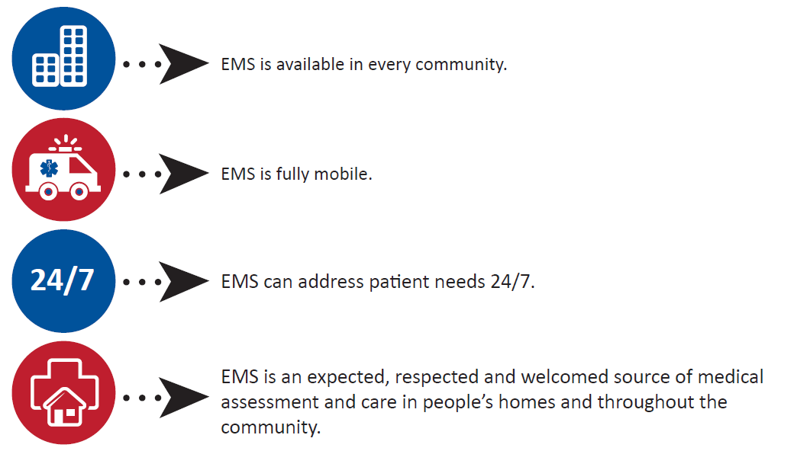
EMS is
Uniquely Positioned to Help
Notes:
Explain each of these… Add that the local EMS provider is often invited into a patient’s home more readily than other, lesser know and lesser trusted providers.

Slide 15
EMS is
Uniquely Positioned to Help
EMS is uniquely positioned to support our nation’s healthcare transformation by assessing and navigating patients to the right care, in the right place, at the right time
EMS 3.0 can help you achieve your healthcare goals
Notes:
Echo the earlier comments.

Slide 16
EMS is
Uniquely Positioned to Help
EMS is provided under the medical direction and oversight of specialized physicians with unique knowledge of the delivery of healthcare in the out-of-hospital environment
EMS medical directors frequently coordinate with physicians of other specialties to enhance patient care
Notes:
Emphasize physician-led

Slide 17
EMS is
Uniquely Positioned to Help
EMS 3.0 agencies fill gaps in patient care:
  Prevent new or recurrent medical episodes
  Reduce ambulance transports
  Reduce emergency department visits
  Reduce hospital admissions and readmissions
Notes:
Part of the new value that payers and even other providers are looking for

Slide 18
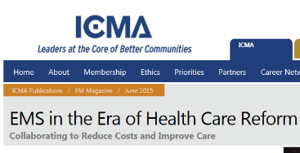
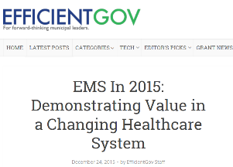


Publications That
Support EMS 3.0
https://icma.org/articles/ems-era-health-care-reform
https://www.phe.gov/ASPRBlog/Lists/Posts/Post.aspx?ID=191
https://efficientgov.com/blog/2015/12/24/ems-in-2015-demonstrating-value-in-a-changing-healthcare-system/
https://www.researchgate.net/publication/256082991_EMS_at_the_healthcare_table

Slide 19
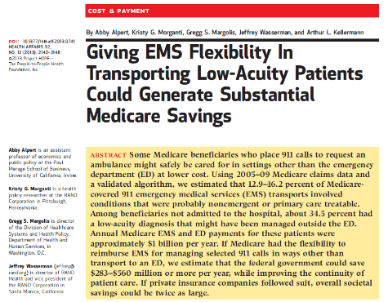
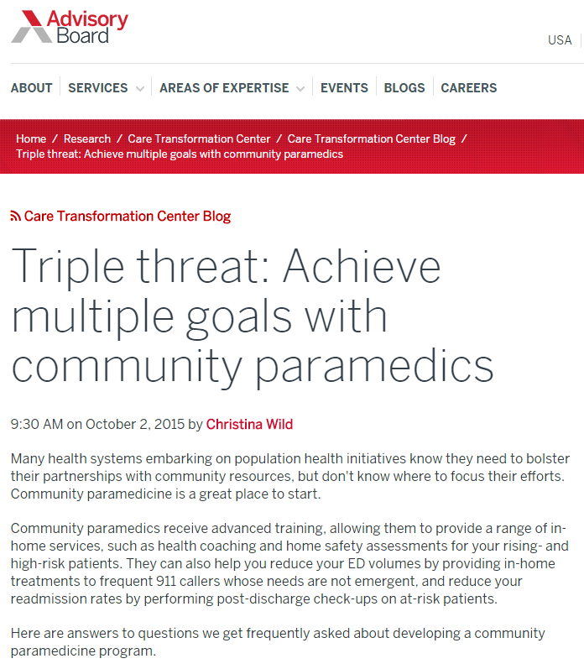
Publications That
Support EMS 3.0
https://www.advisory.com/research/care-transformation-center/care-transformation-center-blog/2015/10/community-paramedicine-webcon-recap
http://content.healthaffairs.org/content/32/12/2142.abstract
Notes:
The Health Affairs report estimated $283-$560 million annual savings to the Medicare program by allowing EMS to take patients with low-acuity issues to places other than the ED.
The Advisory Board Company, now owned by UnitedHealthcare, has writted extensively about the CP benefits to patients and hospitals.

Slide 20
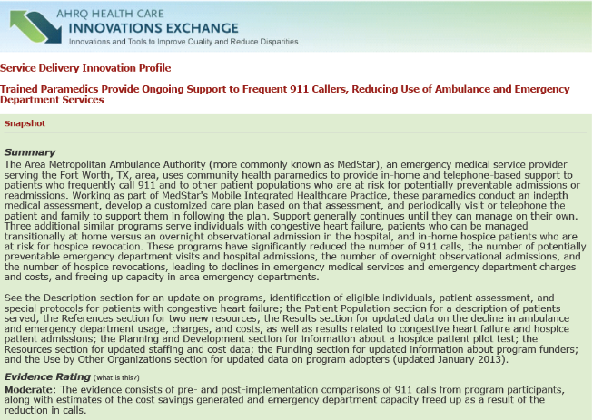
Publications That
Support EMS 3.0
https://innovations.ahrq.gov/profiles/trained-paramedics-provide-ongoing-support-frequent-911-callers-reducing-use-ambulance-and
Notes:
AHRQ has published reports about numerous MIH-CP programs on their Healthcare Innovation Exchange.

Slide 21
Paramedics Aren't Just for Emergencies
Home visits for lab tests, IV medications and hospital follow-up
By Laura Landro
August 17, 2015
Paramedics, who race to emergencies and transport victims to the nearest ER, are taking on a new role: keeping patients out of the hospital.
In this new role, paramedics augment existing programs like visiting nurse services and home care. They also treat patients who don’t meet home-nursing criteria or don’t want someone in their home all the time but still have complex needs, says David Schoenwetter, an emergency physician and head of the mobile health paramedic pilot program at Geisinger Wyoming Valley Medical Center in Wilkes-Barre, Pa., part of Danville, Pa.-based Geisinger Health System.
The programs aim to reduce the high costs of emergency room visits and inpatient hospital stays. Hospitals are facing financial penalties from Medicare and other payers when patients are readmitted to the hospital within 30 days of being discharged.
days among 704 patients who had a home visit from a paramedic, Geisinger calculates. From March 2014 to June 2015, the Geisinger mobile health team prevented 42 hospitalizations, 33 emergency department visits and 168 inpatient he case of heart-failure patients, hospital admissions and emergency-room visits were reduced by 50%, and the rate of hospital readmissions within 30 days fell by 15%. Patient satisfaction scores for the program were 100%.
http://www.wsj.com/articles/paramedics-aren-t-just-for-emergencies-1439832074
Notes:
Series of articles showing that this service line and new role for EMS has been extensively reported in national media outlets and healthcare journals.

Slide 22
The Revolution in EMS Care
Thanks to new technology, new life-saving techniques and new missions, ambulance crews are far from the ‘horizontal taxicabs’ they once were
By Laura Lancro
September 25, 2016
There’s a revolution taking place in emergency medical services, and for many, it could be life changing.
From the increasingly sophisticated equipment they carry and the new lifesaving techniques they use, to the changing roles they play in some communities—providing preventive care and monitoring patients at home—ambulance crews today are hardly recognizable from their origins as “horizontal taxicabs.”
Coming soon: preventive-care teams
In what could amount to a sea change for many EMS workers, health-care policy makers are looking at having so-called community paramedicine teams provide preventive care—and even make regularly scheduled house calls.
In a concept some are calling “EMS 3.0,” ambulance crews with advanced medical training in more communities already are treating patients in their homes, including frail or elderly patients, helping to manage chronic conditions like diabetes, and are checking on recently discharged hospital patients to ensure they are following their care instructions.
http://www.wsj.com/articles/the-revolution-in-ems-care-1474855802
Notes:
Series of articles showing that this service line and new role for EMS has been extensively reported in national media outlets and healthcare journals.

Slide 23

Meet A Paramedic Who Makes House Calls To Keep Patients Out Of The ER
By Lauren Silverman
January 18, 2017
Traditionally, ambulance crews arrive with sirens blaring — ready to rush someone to the hospital. In Fort Worth, some paramedics are doing the opposite and scheduling visits to treat patients in their homes. KERA's Lauren Silverman tagged along with a MedStar paramedic to find out why mobile integrated healthcare is gaining traction.
Last year, Guevara went to the emergency department more than 20 times, occasionally needing a ventilator to breathe.
“My asthma has been going on since I was 14 years old,” she says. “My anxiety triggers it when I go places so I tend to shelter myself and stay home all the time.”
Farris says from the perspective of the doctor in the emergency room, patients like Guevara are labeled as “non-compliant”. They’re seen as patients who won’t follow orders. If you spend time trying to understand the situation, that’s not usually the case, he says.
“The mental health needs that [Guevara] has, tied in with her asthma, tied in with her allergic asthma, tied in with her clotting factor, all of this stuff together, even her dehydration, all of it together is combining factors to make her worse.
http://keranews.org/post/meet-paramedic-who-makes-house-calls-keep-patients-out-er
Notes:
Series of articles showing that this service line and new role for EMS has been extensively reported in national media outlets and healthcare journals.

Slide 24

‘Urgent care on wheels’: Fire departments rescuing patients from costly ER trips
By Lynh Bui and Clarence Williams
February 3, 2017
In the 15 minutes after firefighters and a nurse knocked at Thelma Lee’s Maryland townhouse, they checked her blood pressure, told her what foods would keep her blood sugar from skyrocketing and set up an appointment — and a ride — to visit her primary care physician.
They also changed the battery in her chirping fire alarm and put a scale in her bathroom so she could monitor her weight before rolling out in an SUV to their next house call.
In one of the more established programs, the Phoenix suburb of Mesa, Ariz., added nurses in its 911 center to help assess the urgency of calls and partnered with a hospital to send nurse practitioners with EMS staff on house calls.
A combination of 911 nurse triage and preventive care for 15 cities in the Forth Worth area is credited with saving more than $11.5 million over roughly the past four years in transport costs, emergency department visits and hospital admissions.
Local hospitals cover the costs of the traveling nurses. Patients avoid unnecessary and costly emergency room visits, Zavadsky said, and the sometimes lengthy ER waits.
https://www.washingtonpost.com/local/public-safety/urgent-care-on-wheels-fire-departments-rescuing-patients-from-costly-er-trips/2017/02/02/
Notes:
Series of articles showing that this service line and new role for EMS has been extensively reported in national media outlets and healthcare journals.

Slide 25

Paramedics fight to combat ED visits, readmissions
By Rachael Zimlich, RN
February 27, 2017
One recurring problem payers and providers grapple with is 30-day readmissions, and the financial penalties associated with them. To help address this issue, and improve patient outcomes, more organizations are turning to community paramedic (CP) programs that enlist the services of EMS teams to answer calls and offer short-term interventions that help divert patients away from emergency departments and funnel them back into appropriate care channels.
CP programs work by allowing EMS personnel to answer emergency calls and assess patients’ needs to determine whether less-costly, more beneficial interventions are appropriate. “They can take care of the issue right then and refer the patient for primary care at a future date. Or they can refer patient to a higher level of care more immediately,” McGinnis says. “It’s very powerful. It’s that triage force. You don’t want triage being done in the ED, you want to come out in front of the ED to do that.”
Now, hospitals and payers are using incentives from the ACA earned through lower ED admissions and hospital readmissions to change the reimbursement structure. “Any health system migrating to a population health strategy has to recognize that all their efforts can be thwarted by the patient with a quick call to 911. As systems consider how best to transition to value-based care, they should take a serious look at their local EMS agencies as partners in the process,” Swayze says.
http://managedhealthcareexecutive.modernmedicine.com/managed-healthcare-executive/news/paramedics-fight-combat-ed-visits-readmissions
Notes:
Series of articles showing that this service line and new role for EMS has been extensively reported in national media outlets and healthcare journals.

Slide 26

Call an Ambulance — for Care
New model of mobile integrated health care delivers services where they're needed
April 25, 2017
David Ollier Weber
Fully a third of all the Medicare beneficiaries transported to a hospital emergency department by an emergency medical services ambulance could have been treated safely in an alternative setting, according to recent studies.
If Medicare beneficiaries with low-acuity needs were taken by EMS to a clinic or doctor’s office instead of an emergency department — or, better yet, treated more comfortably and conveniently at home, if appropriate — an estimated $600 million could be saved annually. If the same patient-centered policy were approved by third-party payers as well, estimated annual savings for the health care system could reach $1.2 billion.
They called it mobile integrated health care practice, or MIHP. The P has since been dropped as confusing. But as MIH, it’s an idea that is already recording encouraging results.
Community paramedicine
Reimbursement for ambulance services has been based on the life-support procedures performed and miles driven. But the movement to pay-for-performance rather than fee-for-service throughout the reformed U.S. health care system has changed the focus of EMS as well. The watchword today is "outcomes".
http://www.hhnmag.com/articles/8238-call-an-ambulance-for-care
Notes:
Series of articles showing that this service line and new role for EMS has been extensively reported in national media outlets and healthcare journals.

Slide 27
Call an Ambulance — for Care
New model of mobile integrated health care delivers services where they're needed
EMS — the focal resource
While operating as multiagency community partnerships often led by hospitals or health systems (examples include Beck’s University of Chicago Medicine, Barnes-Jewish Hospital in St. Louis and Banner University Medical Center in Tucson, Ariz.), at the core of most MIH programs is the local EMS provider (examples include American Medical Response in Arlington, Texas, MedStar Mobile Healthcare in Fort Worth, Texas, and Wake County EMS in Raleigh, N.C.).
The EMS agency is an ideal focal resource, Beck explains, because virtually every community has one, it’s linked to all levels of care through its 24/7 capability for mobility and readiness, and its workforce is already expert in planning, coordination and communications.
Moreover, he points out, EMS systems possess a capital-intensive, difficult-to-replicate readiness infrastructure ideally suited to MIH. EMS providers already have vehicle fleets, robust voice and data communications systems and electronic health record systems, and have portable biometric and sophisticated treatment equipment on board. And since much of this infrastructure comes with the redundancies and excess capacity essential to emergency preparedness, EMS systems are well-suited to absorb the additional loads arising from the new mobile health strategy with minimal marginal cost.
Says Beck: “Some hospitals are trying to manage the present. They’re caught up in working their way through the challenges of the near term. Others have a strategy that’s more outward looking. They’re pursuing value-focused care. For them, mobile integrated health is coming into focus pretty quickly. It’s a new iteration of a familiar set of players ... and a pretty exciting new set of menu choices for hospitals and health systems that are thinking holistically.”
http://www.hhnmag.com/articles/8238-call-an-ambulance-for-care
Notes:
Series of articles showing that this service line and new role for EMS has been extensively reported in national media outlets and healthcare journals.

Slide 28

Blue Cross paramedic program cuts ER overuse
By Steve Sinovic / Journal Staff Writer
May 18, 2017
ALBUQUERQUE, N.M. — Getting the people who overuse emergency services under control has been an uphill battle, but one major health insurer has been teaming with metro area emergency medical services agencies for over a year to put a dent in the numbers of ER visits by some of its Medicaid members.
During that time, a handful of Albuquerque paramedics have been making house calls through a program designed to reduce hospital readmission rates while helping discharged patients stay on the road to good health.
It seems to be working.
The insurer saw an almost 62 percent drop in emergency room visits and a 63 percent decrease in ambulance use by frequent flyers, many of whom live alone, have a limited support network, lack transportation or have a housing situation that’s in flux.
The insurer is in contract talks with ambulance and fire agencies to expand the program to other New Mexico communities.
https://www.abqjournal.com/1005425/blue-cross-paramedic-program-cuts-er-overuse.html?__prclt=ifWRWVO1
Notes:
Series of articles showing that this service line and new role for EMS has been extensively reported in national media outlets and healthcare journals.
This one specifically references a third party payer paying for CP services.

Slide 29

‘The Moment We’ve Been Waiting For’:
Anthem to Compensate EMS Care Without Transport
By John Erich Oct 20, 2017
The quest of American EMS providers for more sensible reimbursement will reach a key threshold on January 1, 2018, when Anthem BlueCross BlueShield begins paying for treatment without transport for patients in states where it offers commercial coverage.
The major insurer’s new policy marks a vital step toward the goal of sustaining community paramedicine and mobile integrated healthcare programs that have sometimes struggled to find ongoing financial footing.
“We spend a lot of money in this country on healthcare, and our quality outcomes are not as good as other industrialized countries that spend less,” says Jay Moore, MD, senior clinical director for Anthem in Missouri. “We need to figure out a way to get a handle on that. We want to be able to provide healthcare in a way that’s affordable for people and sustainable for the future, and I think the only way to do that is to involve people at all levels of healthcare. Whether it’s physicians, nurses, paramedics, EMTs, whomever it might be, it’s something all of us are going to have to work together to solve. In my view this is definitely a step in the right direction.”
http://www.emsworld.com/news/218925/moment-weve-been-waiting-anthem-compensate-ems-care-without-transport

Slide 30
MedStar Super-Utilizer Program
1,197 patients referred since October 2013
  309 “internal”
  878 from hospitals//healthcare partners
  10 from others (FDs, community partners)
670 graduated patients with 12 month data pre and post enrollment as of 10/31/18
  During enrollment (30 – 90 days)
    46.1% reduction in 9-1-1 to ED use
  Post Graduation
    46.6% reduction in 9-1-1 to ED use
    67.1% in reduction for “System Abusers”
Notes:
Data from MedStar’s program through July 2017.

Slide 31
MedStar Super-Utilizer Program
Expenditure Savings Analysis (1) | High Utilizer Program - All Referral Sources
Based on Medicare Rates
Analysis Dates: | October 1, 2013 - October 31, 2018
Number of Patients Enrolled (2, 3): | 670
Ambulance Trip to ED Reduction: | -52.8%
 | Utilization Change
Category | Base | Avoided | Savings
Ambulance Payment (4) | $419 | 5,116 | ($2,143,604)
ED Visits (5) | $969 | 2,961 | ($2,869,209)
Admissions (6) | $10,900 | 1,072 | ($11,684,800)
Total Expenditure Savings |  |  | ($16,697,613)
Per Patient Enrolled |  |  | HUG
Expenditure Savings |  |  | ($24,922)
Notes:
1. Comparison for enrolled patients based on use for 12 months prior to enrollment vs.
12 months post program graduation.
2. Patients with data 12 months pre and 12 months post graduation
3. Includes High Utilizer and Designated System Abusers
4. Medicare Tables from CY 2012 as published
5. http://www.cdc.gov/nchs/data/hus/hus12.pdf
6. http://www.hcup-us.ahrq.gov/reports/projections/2013-01.pdf
Notes:
Expenditure savings estimated based on the average Medicare payment for Ambulance, ED facility fees and general payment for an admission.

Slide 32
MedStar Super-Utilizer Program
Patient Self-Assessment of Health Status (1)
As of: | 10/31/2018
 | High Utilizer Group |  |  | Readmission Avoidance
 | Enrollment | Graduation | Change | Enrollment | Graduation | Change
Sample Size | 187 |  |  | 469
Mobility (2) | 2.28 | 2.49 | 9.0% | 2.33 | 2.55 | 9.6%
Self-Care (2) | 2.58 | 2.75 | 6.5% | 2.60 | 2.80 | 7.4%
Perform Usual Activities (2) | 2.27 | 2.61 | 14.8% | 2.32 | 2.61 | 12.6%
Pain and Discomfort (2) | 1.93 | 2.38 | 23.1% | 2.46 | 2.64 | 7.2%
Anxiety/Depression (2) | 2.11 | 2.44 | 15.8% | 2.50 | 2.71 | 8.4%
Overall Health Status (3) | 4.85 | 6.84 | 41.0% | 5.40 | 7.00 | 29.5%
Notes:
1. Average scores of pre and post enrollment data from EuroQol EQ-5D-3L Assessment Questionaire
2. Score 1 - 3 with 3 most favorable
3. Score 1 - 10 with 10 most favorable
Notes:
Changes in the patient’s perception of their health status using enrollment and graduation patient reported surveys using the EuroQol EQ-5D-3L survey.

Slide 33
9-1-1 Nurse Triage
Navigate low-acuity 9-1-1 calls to most appropriate resource
  Warm handoff to specially trained in-house RN
Uses RN education and experience
  With Clinical Decision Support software
Referral eligibility determined by:
  IAED Physician Board
  Local Medical Control Authority

Slide 34
9-1-1 Nurse Triage
MedStar 9-1-1 Nurse Triage Patient Experience Survey
Through: |  | Jun-18
Question |  | Score
How satisfied were you with the way the MedStar 9-1-1 dispatcher handled your call? |  | 4.6
How did you feel about how the nurse handled your call overall? |  | 4.5
Did the nurse understood your medical complaint?
Yes |  | 92.4%
No |  | 7.6%
Were there any problems with the transportation we arranged for you?
Yes |  | 10.9%
No |  | 89.1%
How satisfied were you with the transportation arrangements? |  | 4.4
Do you think your 911 call should have been handled differently?
Yes |  | 14.7%
No |  | 85.3%
Did speaking with the nurse help with your medical complaint?
Yes |  | 87.7%
No |  | 12.3%
Did following our nurse’s suggestion saved you time and money?
Yes |  | 84.6%
No |  | 15.4%
Notes:
1. Rating scale 1 - 5 with 5 most satisfied.
Notes:
Patient experience scores from MedStar’s 9-1-1 Nurse Triage program. Note this is from patient surveys who called 9-1-1 and expected an ambulance to the ED, but got something other than that. High patient satisfaction.

Slide 35
9-1-1 Nurse Triage
Expenditure Savings Analysis | 9-1-1 Nurse Triage Program
Based on Medicare Rates
Analysis Dates: | June 1, 2012 - October 31, 2018
Number of Calls Referred: | 11,262
% of Calls with Alternate Response | 34.0%
% of Calls with Alternate Destination | 25.9%
Category | Base | Avoided (4) | Savings
Ambulance Expenditure (1) | $419 | 3,834 | $1,606,446
ED Expenditure (2) | $969 | 2,919 | $2,828,511
ED Bed Hours (3) | 6 | 2,919 | 17,514
Total Payment Avoidance |  |  | $4,434,957
Per Patient Enrolled |  |  | ECNS
Payment Avoidance |  |  | $1,157
Notes:
1. From Medicare Payment Tables
2. http://www.cdc.gov/nchs/data/hus/hus12.pdf
3. Provided by John Peter Smith Health Network
4. Result of EPAB approved change to allow
locus of care to include ED visit by alternate transportation
Notes:
Estimated expenditure savings using the earlier Medicare estimates for each episode of care. The ED bed hour reduction is the number of bed hours NOT consumed by low-acuity ED visits. Our hospitals told us the patient is generally IN THE BED for 6 hours.

Slide 36
Why are Hospitals Paying EMS to Prevent Hospitalizations?
Increasing financial pressures
  Shared-Risk arrangements
    ACO or other
  CMS bonus and penalties
    Readmits
    Medicare Spending Per Beneficiary post acute care bonus and penalties
  Reduced length of stay
Notes:
More and more, hospitals are in different payment models that financially incentivize them to keep patients out of the hospital. In shared risk/ACO models, there may be a shared savings payment that go to the hospitals for reduced expenditures. CMS imposes penalties to hospitals with excessive readmission, or high cost to Medicare post-discharge. If the hospital on a DRG admission can discharge a patient sooner, they can either save money, or turn the bed sooner and have a DRG bed paid under the previous DRG, while a new DRG payment also covers the same bed day.

Slide 37
Why are Physician IPA’s Paying EMS to Prevent Hospitalizations?
Reduce spending
  In a shared risk contract with 3rd party payer
Improve patient experience
  NCQA Accreditation standards
Improve outcomes
  Fewer hospitalizations
  Fewer Hospital Acquired Conditions (HAC)
Notes:
Many independent practice associations (IPA’s) are in shared-risk contracts with payers and are looking for ways to reduce the spend for these patients, we all as improve accreditation scores.

Slide 38
Why Commercial Payers Paying EMS to Prevent Hospitalizations?
Reduce spending
  Decrease preventable hospital ED visits and inpatient admissions
Improve patient experience
  NCQA Accreditation standards
Improve outcomes
  Fewer hospitalizations
  Fewer Hospital Acquired Conditions (HAC)
Notes:
Many independent practice associations (IPA’s) are in shared-risk contracts with payers and are looking for ways to reduce the spend for these patients, we all as improve accreditation scores.

Slide 39
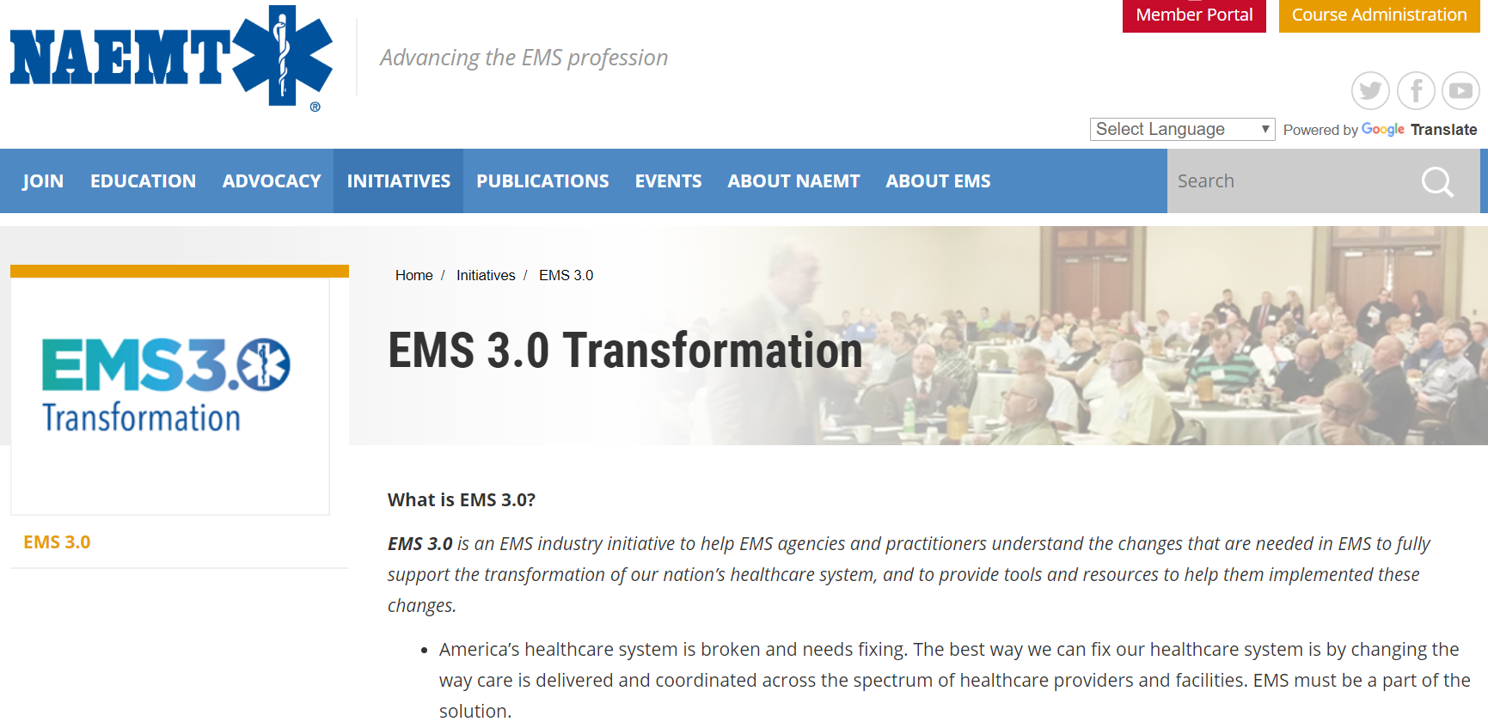
More information?
http://www.naemt.org/initiatives/ems-transformation

Slide 40

EMS
Transformation

