Slide 1
EMS Transformation
Moving our profession to “EMS 3.0”
Notes:
Intro & Goals:
New Roles for EMS based on the new healthcare economic model

Slide 2
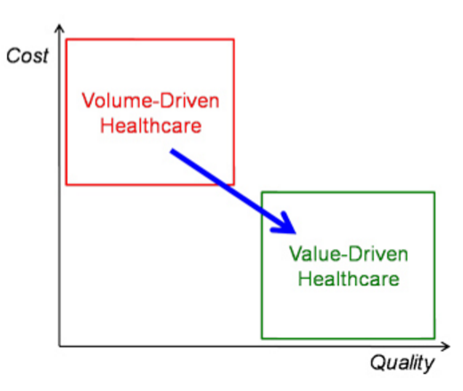
Healthcare 3.0
Notes:
Old model – the more you DO, the more you can bill
New model – accountable, valuable care

Slide 3
EMS Can Contribute
EMS can fill gaps in the care continuum with 24/7 medical resources that:
Improve the patient care experience
Improve population health
Reduce healthcare expenditures
This is “EMS 3.0”

Slide 4
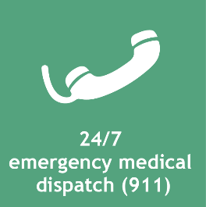
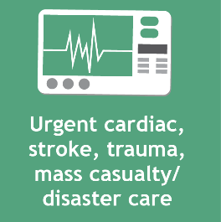
Urgent and Emergent Care Remain Core to EMS
Notes:
Slide Builds:
EMS ‘owns’ this space – it is something we will always do, and is a GAP in the healthcare system we currently fill.

Slide 5
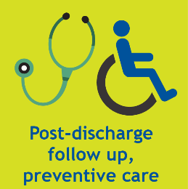
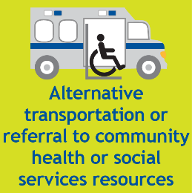
But EMS Should Offer Expanded Roles
Notes:
Slide Builds:
Using the same infrastructure, we could do these additional things to help navigate patients through our complex healthcare system.

Slide 6
EMS Can Contribute
Core Mission + Expanded Services = Value
Notes:
Slide Builds:
We can demonstrate more value by combining our core mission with the aforementioned additional services.

Slide 7
Nomenclature
Notes:
MIH vs. CP clarification. MIH is an umbrella term for a strategy/philosophy about doing 3.0 activities. COMPONENTS of MIH could include the things under the umbrella. An agency could do one or all of these components and have it as part of their MIH strategy.

Slide 8
EMS is Uniquely Positioned to Help
Notes:
Explain each of these… Add that the local EMS provider is often invited into a patient’s home more readily than other, lesser know and lesser trusted providers.

Slide 9
EMS is Uniquely Positioned to Help
EMS is uniquely positioned to support our nation’s healthcare transformation by assessing and navigating patients to the right care, in the right place, at the right time.
EMS 3.0 can help our nation achieve its healthcare goals.
Notes:
Echo the earlier comments.

Slide 10
EMS is Uniquely Positioned to Help
EMS provides highly reliable patient assessment and treatment in response to emergency, urgent or unscheduled episodes of illness or injury.

Slide 11
EMS is Uniquely Positioned to Help
Services provided as part of EMS 3.0 can effectively navigate patients needing urgent or unscheduled care through the healthcare system to ensure they receive the right care, in the right place, at the right time.

Slide 12
EMS is Uniquely Positioned to Help
EMS is provided under the medical direction and oversight of specialized physicians with unique knowledge of the delivery of healthcare in the out-of-hospital environment.
EMS medical directors frequently coordinate with physicians of other specialties to enhance patient care.
Notes:
Emphasize physician-led

Slide 13
EMS is Uniquely Positioned to Help
EMS 3.0 agencies fill gaps in patient care:
Preventing new or recurrent medical episodes
Reduce ambulance transports
Reduce emergency department visits
Reduce hospital admissions and readmissions
Notes:
Part of the new value that payers and even other providers are looking for

Slide 14
EMS is Uniquely Positioned to Help
EMS 3.0 agencies coordinate and collaborate with a variety of community healthcare providers/agencies to deliver a broad spectrum of patient-centered preventive, primary, specialty, and/or rehabilitative care outside of medical facilities.
Notes:
Emphasize that we are GAP fillers, not turf infringers… Key is collaboration.

Slide 15
Shared Vision = Industry Alignment!
National Association of State EMS Officials
National Association of EMTs
National Association of EMS Physicians
National EMS Management Association
National Association of EMS Educators
American Ambulance Association
And, several other national EMS organizations
Notes:
Collaboration – unified message/goals

Slide 16
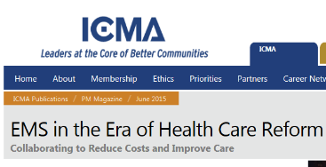
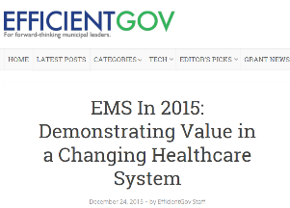
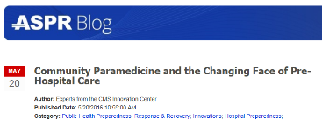
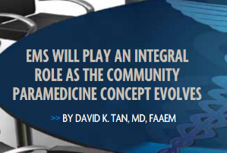
Publications Support the EMS 3.0 Transformation
https://icma.org/articles/ems-era-health-care-reform
https://www.phe.gov/ASPRBlog/Lists/Posts/Post.aspx?ID=191
https://efficientgov.com/blog/2015/12/24/ems-in-2015-demonstrating-value-in-a-changing-healthcare-system/
https://www.researchgate.net/publication/256082991_EMS_at_the_healthcare_table

Slide 17
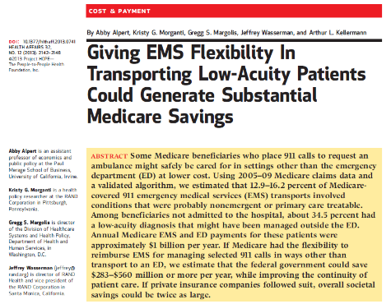
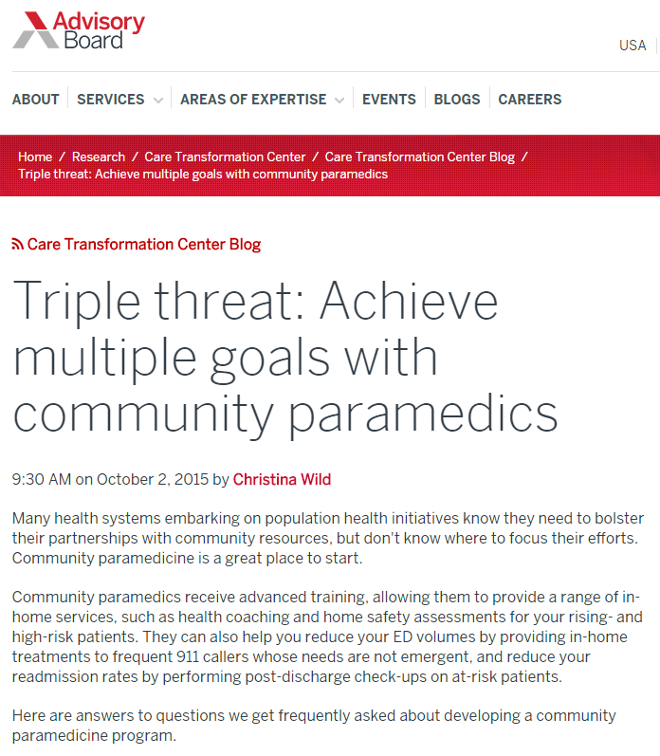
Publications Support the EMS 3.0 Transformation
http://content.healthaffairs.org/content/32/12/2142.abstract
https://www.advisory.com/research/care-transformation-center/care-transformation-center-blog/2015/10/community-paramedicine-webcon-recap
Notes:
The Health Affairs report estimated $283-$560 million annual savings to the Medicare program by allowing EMS to take patients with low-acuity issues to places other than the ED.
The Advisory Board Company, now owned by UnitedHealthcare, has written extensively about the CP benefits to patients and hospitals.

Slide 18
Paramedics Aren't Just for Emergencies
Home visits for lab tests, IV medications and hospital follow-up
By Laura Landro
August 17, 2015
Paramedics, who race to emergencies and transport victims to the nearest ER, are taking on a new role: keeping patients out of the hospital.
In this new role, paramedics augment existing programs like visiting nurse services and home care. They also treat patients who don’t meet home-nursing criteria or don’t want someone in their home all the time but still have complex needs, says David Schoenwetter, an emergency physician and head of the mobile health paramedic pilot program at Geisinger Wyoming Valley Medical Center in Wilkes-Barre, Pa., part of Danville, Pa.-based Geisinger Health System.
The programs aim to reduce the high costs of emergency room visits and inpatient hospital stays. Hospitals are facing financial penalties from Medicare and other payers when patients are readmitted to the hospital within 30 days of being discharged.
days among 704 patients who had a home visit from a paramedic, Geisinger calculates. From March 2014 to June 2015, the Geisinger mobile health team prevented 42 hospitalizations, 33 emergency department visits and 168 inpatient he case of heart-failure patients, hospital admissions and emergency-room visits were reduced by 50%, and the rate of hospital readmissions within 30 days fell by 15%. Patient satisfaction scores for the program were 100%.
http://www.wsj.com/articles/paramedics-aren-t-just-for-emergencies-1439832074
Notes:
Series of articles showing that this service line and new role for EMS has been extensively reported in national media outlets and healthcare journals.

Slide 19
The Revolution in EMS Care
Thanks to new technology, new life-saving techniques and new missions, ambulance crews are far from the ‘horizontal taxicabs’ they once were
By Laura Lancro
September 25, 2016
There’s a revolution taking place in emergency medical services, and for many, it could be life changing.
From the increasingly sophisticated equipment they carry and the new lifesaving techniques they use, to the changing roles they play in some communities—providing preventive care and monitoring patients at home—ambulance crews today are hardly recognizable from their origins as “horizontal taxicabs.”
Coming soon: preventive-care teams
In what could amount to a sea change for many EMS workers, health-care policy makers are looking at having so-called community paramedicine teams provide preventive care—and even make regularly scheduled house calls.
In a concept some are calling “EMS 3.0,” ambulance crews with advanced medical training in more communities already are treating patients in their homes, including frail or elderly patients, helping to manage chronic conditions like diabetes, and are checking on recently discharged hospital patients to ensure they are following their care instructions.
http://www.wsj.com/articles/the-revolution-in-ems-care-1474855802
Notes:
Series of articles showing that this service line and new role for EMS has been extensively reported in national media outlets and healthcare journals.

Slide 20
Meet A Paramedic Who Makes House Calls To Keep Patients Out Of The ER
By Lauren Silverman
January 18, 2017
Traditionally, ambulance crews arrive with sirens blaring — ready to rush someone to the hospital. In Fort Worth, some paramedics are doing the opposite and scheduling visits to treat patients in their homes. KERA's Lauren Silverman tagged along with a MedStar paramedic to find out why mobile integrated healthcare is gaining traction.
Last year, Guevara went to the emergency department more than 20 times, occasionally needing a ventilator to breathe.
“My asthma has been going on since I was 14 years old,” she says. “My anxiety triggers it when I go places so I tend to shelter myself and stay home all the time.”
Farris says from the perspective of the doctor in the emergency room, patients like Guevara are labeled as “non-compliant”. They’re seen as patients who won’t follow orders. If you spend time trying to understand the situation, that’s not usually the case, he says.
“The mental health needs that [Guevara] has, tied in with her asthma, tied in with her allergic asthma, tied in with her clotting factor, all of this stuff together, even her dehydration, all of it together is combining factors to make her worse.
http://keranews.org/post/meet-paramedic-who-makes-house-calls-keep-patients-out-er
Notes:
Series of articles showing that this service line and new role for EMS has been extensively reported in national media outlets and healthcare journals.

Slide 21
‘Urgent care on wheels’: Fire departments rescuing patients from costly ER trips
By Lynh Bui and Clarence Williams
February 3, 2017
In the 15 minutes after firefighters and a nurse knocked at Thelma Lee’s Maryland townhouse, they checked her blood pressure, told her what foods would keep her blood sugar from skyrocketing and set up an appointment — and a ride — to visit her primary care physician.
They also changed the battery in her chirping fire alarm and put a scale in her bathroom so she could monitor her weight before rolling out in an SUV to their next house call.
In one of the more established programs, the Phoenix suburb of Mesa, Ariz., added nurses in its 911 center to help assess the urgency of calls and partnered with a hospital to send nurse practitioners with EMS staff on house calls.
A combination of 911 nurse triage and preventive care for 15 cities in the Forth Worth area is credited with saving more than $11.5 million over roughly the past four years in transport costs, emergency department visits and hospital admissions.
Local hospitals cover the costs of the traveling nurses. Patients avoid unnecessary and costly emergency room visits, Zavadsky said, and the sometimes lengthy ER waits.
https://www.washingtonpost.com/local/public-safety/urgent-care-on-wheels-fire-departments-rescuing-patients-from-costly-er-trips/2017/02/02/
Notes:
Series of articles showing that this service line and new role for EMS has been extensively reported in national media outlets and healthcare journals.

Slide 22
Paramedics fight to combat ED visits, readmissions
By Rachael Zimlich, RN
February 27, 2017
One recurring problem payers and providers grapple with is 30-day readmissions, and the financial penalties associated with them. To help address this issue, and improve patient outcomes, more organizations are turning to community paramedic (CP) programs that enlist the services of EMS teams to answer calls and offer short-term interventions that help divert patients away from emergency departments and funnel them back into appropriate care channels.
CP programs work by allowing EMS personnel to answer emergency calls and assess patients’ needs to determine whether less-costly, more beneficial interventions are appropriate. “They can take care of the issue right then and refer the patient for primary care at a future date. Or they can refer patient to a higher level of care more immediately,” McGinnis says. “It’s very powerful. It’s that triage force. You don’t want triage being done in the ED, you want to come out in front of the ED to do that.”
Now, hospitals and payers are using incentives from the ACA earned through lower ED admissions and hospital readmissions to change the reimbursement structure. “Any health system migrating to a population health strategy has to recognize that all their efforts can be thwarted by the patient with a quick call to 911. As systems consider how best to transition to value-based care, they should take a serious look at their local EMS agencies as partners in the process,” Swayze says.
http://managedhealthcareexecutive.modernmedicine.com/managed-healthcare-executive/news/paramedics-fight-combat-ed-visits-readmissions
Notes:
Series of articles showing that this service line and new role for EMS has been extensively reported in national media outlets and healthcare journals.

Slide 23
Call an Ambulance — for Care
New model of mobile integrated health care delivers services where they're needed
April 25, 2017
David Ollier Weber
Fully a third of all the Medicare beneficiaries transported to a hospital emergency department by an emergency medical services ambulance could have been treated safely in an alternative setting, according to recent studies.
If Medicare beneficiaries with low-acuity needs were taken by EMS to a clinic or doctor’s office instead of an emergency department — or, better yet, treated more comfortably and conveniently at home, if appropriate — an estimated $600 million could be saved annually. If the same patient-centered policy were approved by third-party payers as well, estimated annual savings for the health care system could reach $1.2 billion.
They called it mobile integrated health care practice, or MIHP. The P has since been dropped as confusing. But as MIH, it’s an idea that is already recording encouraging results.
Community paramedicine
Reimbursement for ambulance services has been based on the life-support procedures performed and miles driven. But the movement to pay-for-performance rather than fee-for-service throughout the reformed U.S. health care system has changed the focus of EMS as well. The watchword today is "outcomes".
http://www.hhnmag.com/articles/8238-call-an-ambulance-for-care
Notes:
Series of articles showing that this service line and new role for EMS has been extensively reported in national media outlets and healthcare journals.

Slide 24
Call an Ambulance — for Care
New model of mobile integrated health care delivers services where they're needed
EMS — the focal resource
While operating as multiagency community partnerships often led by hospitals or health systems (examples include Beck’s University of Chicago Medicine, Barnes-Jewish Hospital in St. Louis and Banner University Medical Center in Tucson, Ariz.), at the core of most MIH programs is the local EMS provider (examples include American Medical Response in Arlington, Texas, MedStar Mobile Healthcare in Fort Worth, Texas, and Wake County EMS in Raleigh, N.C.).
The EMS agency is an ideal focal resource, Beck explains, because virtually every community has one, it’s linked to all levels of care through its 24/7 capability for mobility and readiness, and its workforce is already expert in planning, coordination and communications.
Moreover, he points out, EMS systems possess a capital-intensive, difficult-to-replicate readiness infrastructure ideally suited to MIH. EMS providers already have vehicle fleets, robust voice and data communications systems and electronic health record systems, and have portable biometric and sophisticated treatment equipment on board. And since much of this infrastructure comes with the redundancies and excess capacity essential to emergency preparedness, EMS systems are well-suited to absorb the additional loads arising from the new mobile health strategy with minimal marginal cost.
Says Beck: “Some hospitals are trying to manage the present. They’re caught up in working their way through the challenges of the near term. Others have a strategy that’s more outward looking. They’re pursuing value-focused care. For them, mobile integrated health is coming into focus pretty quickly. It’s a new iteration of a familiar set of players ... and a pretty exciting new set of menu choices for hospitals and health systems that are thinking holistically.”
http://www.hhnmag.com/articles/8238-call-an-ambulance-for-care
Notes:
Series of articles showing that this service line and new role for EMS has been extensively reported in national media outlets and healthcare journals.

Slide 25
Blue Cross paramedic program cuts ER overuse
By Steve Sinovic / Journal Staff Writer
May 18, 2017
ALBUQUERQUE, N.M. — Getting the people who overuse emergency services under control has been an uphill battle, but one major health insurer has been teaming with metro area emergency medical services agencies for over a year to put a dent in the numbers of ER visits by some of its Medicaid members.
During that time, a handful of Albuquerque paramedics have been making house calls through a program designed to reduce hospital readmission rates while helping discharged patients stay on the road to good health.
It seems to be working.
The insurer saw an almost 62 percent drop in emergency room visits and a 63 percent decrease in ambulance use by frequent flyers, many of whom live alone, have a limited support network, lack transportation or have a housing situation that’s in flux.
The insurer is in contract talks with ambulance and fire agencies to expand the program to other New Mexico communities.
https://www.abqjournal.com/1005425/blue-cross-paramedic-program-cuts-er-overuse.html?__prclt=ifWRWVO1
Notes:
Series of articles showing that this service line and new role for EMS has been extensively reported in national media outlets and healthcare journals.

Slide 26
How Can EMS Agencies Demonstrate Value to Healthcare Providers and Payers?
Notes:
The following tips will help you change the conversation and culture of the role we should play to enhance care to our communities and the value for our services.

Slide 27
Recruit individuals to your EMS agency who understand and embrace the EMS 3.0 value proposition.
TIP #1

Slide 28
Strengthen competencies in all professional levels within your EMS agency to ensure that it is ready to effectively provide the services that your community needs.
TIP #2
ListServ Subscriptions
NAEMT
AIMHI
NASEMSO
NEMSMA
Notes:
Contact the NAEMT offices about how to join these list servs, or email Mzavadsky@medstar911.org

Slide 29
Embrace continuous quality improvement and strive to adopt "pay for performance/value based purchasing" reimbursement linked to clinical outcomes.
TIP #3

Slide 30
Utilize all opportunities to discuss how EMS 3.0 supports the healthcare transformation.
TIP #4

Slide 31
Clearly articulate the types of services that EMS 3.0 can offer to improve patient outcomes and lower costs.
TIP #5

Slide 32
Advocate for and support college-based education for EMS.
TIP #6

Slide 33
Assess the potential for EMS 3.0 to benefit your community by addressing healthcare gaps.
TIP #7

Slide 34
Use appropriate tools to measure effectiveness in improving patient outcomes and lowering costs.
TIP #8

Slide 35
Integrate all services into a well-coordinated, medically directed and performance-measured EMS 3.0 package of services provided by professionals at basic and advanced levels.
TIP #9

Slide 36
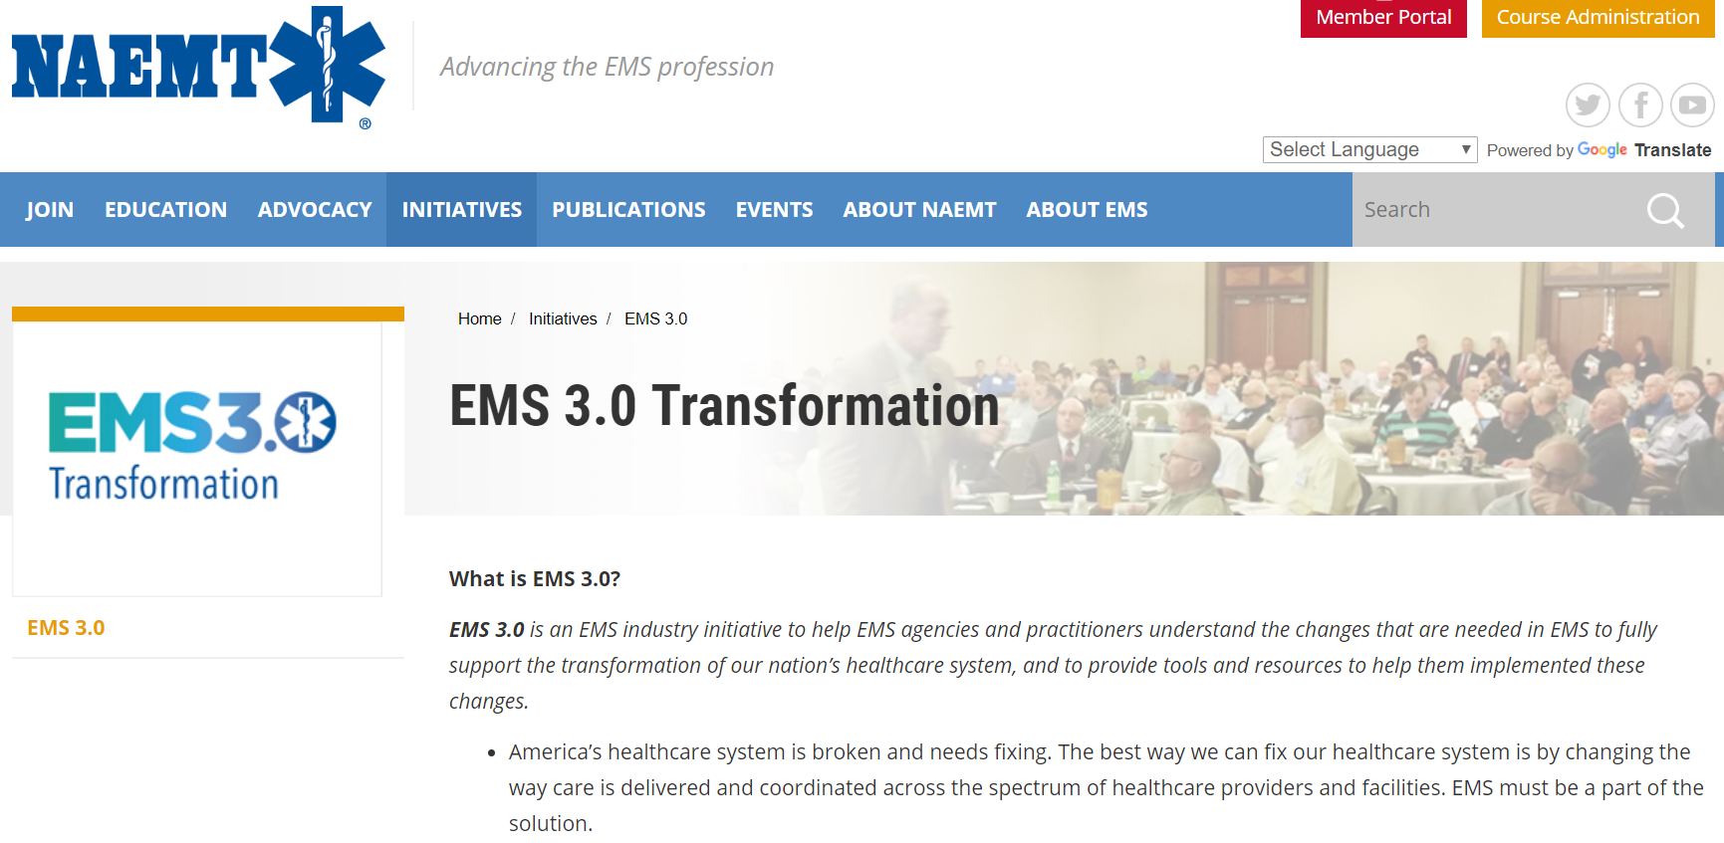
More information?
http://www.naemt.org/initiatives/ems-transformation

Slide 37
EMS Transformation
Moving our profession to “EMS 3.0”

