Slide 1
Mental Health Resilience for EMS Practitioners
Notes:
Instructor Notes
This presentation provides an overview of the challenges that EMS practitioners face on the job, how those challenges impact mental health resilience, and what you can do to build and strengthen your resilience..

Slide 2
What We Will Discuss
The increased risks for stress to EMS practitioners due to the environment in which they work.
The common stressors for EMS practitioners and strategies for managing those stressors.
The signs indicating that an EMS practitioner’s psychological stress requires action.
Notes:
Instructor Notes
The increased risks for stress to EMS practitioners due to the environment in which they work.
The common stressors for EMS practitioners and strategies for managing those stressors.
The signs indicating that an EMS practitioner’s psychological stress requires action.

Slide 3
What About You?
What types of calls bother you?
What parts of the job bother you?
Have you ever felt uncomfortable on a call?
Have you ever been upset after a call?
Have you ever cried after a call?
Notes:
Instructor Notes
Ask participants:
What types of calls bother you?
What parts of the job bother you?
Have you ever felt uncomfortable on a call?
Have you ever been upset after a call?
Have you ever cried after a call?
Gauge whether participants feel comfortable answering these questions aloud or if you should just ask them to consider these questions.

Slide 4
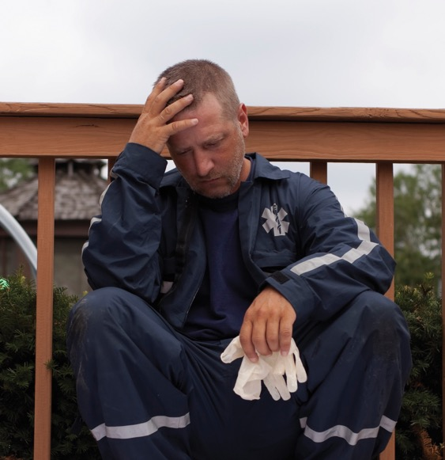
The Prevalence of Psychological Distress in EMS Practitioners
MYTH
EMS practitioners are so tough that they do not need support.
They aren't bothered by the work
they do.
Notes:
Instructor Notes
Unfortunately, the stigma of having a mental health condition or the perception that there is a stigma runs high within the EMS profession.
As healthcare providers, EMS practitioners are trained to provide care to others and feel less comfortable about receiving care themselves. There is an expectation that EMS practitioners should be “tough enough” to absorb all of the pain and suffering that they witness on the job.
Recently, there has been increased recognition and acceptance within EMS agencies that the work carried out by EMS personnel exposes them to a multitude of stressors that can impact their mental health resilience.

Slide 5
The Reality
A 2015 survey by Fitch & Associates’ Ambulance Service Manager Program suggested that mental health struggles and depression among fire and EMS professionals are widespread. In the survey, 37 percent reported contemplating suicide, nearly 10 times the rate of American adults, while 6.6 percent reported having attempted suicide. That’s compared to just 0.5 percent of all adults.
The What’s Killing Our Medics survey produced by Chad Newland, Erich Barber, Monique Rose, and Amy Young in October 2015 found that 37.0% (n=1,383) of respondents reported having contemplated suicide and 6.6% (225) had attempted suicide. These survey results indicate that an average of 3.7% of EMS practitioners have had suicidal thoughts – ten times the rate of the general population, which has an average rate of 0.5%.
Notes:
Instructor Notes
Read slide
Source
2016 National Survey on EMS Mental Health Services, NAEMT, August 2016. http://www.naemt.org/docs/default-source/ems-health-and-safety-documents/mental-health-grid/2016-naemt-mental-health-report-8-14-16.pdf?status=Temp&sfvrsn=0.6396131837346566
An EMS Culture of Personal Resilience and Wellbeing, NAEMT, July 14, 2017. http://www.naemt.org/docs/default-source/advocacy-documents/positions/ems-culture-of-personal-resilience-and-wellbeing-7-14-17.pdf?sfvrsn=f60cf92_4

Slide 6
Critical Stress Incidents
Critical stress incident
  An incident that results in a stress response in EMS practitioners
Has anyone here experienced a critical stress incident?
Notes:
Instructor Notes
A critical stress incident is an incident, such as a mass casualty event, a trauma call involving a child, or a line of duty death, that may cause a high level of stress and impact the resilience of those who respond to the incident.
Remind participants that not every critical stress incident causes lasting psychological trauma. What matters is how severely the stress was felt and how quickly the person’s nervous system returns to normal.

Slide 7
Statistics
General population
  3.7% of the population contemplate suicide
  0.5% attempt suicide
EMS practitioners
  37% of EMS practitioners contemplate suicide
  6.6% attempt suicide
85% of EMS practitioners have experienced a critical incident
Notes:
Instructor Notes
Because of the nature of EMS work,
EMS practitioners are 10 times more likely to contemplate suicide than is the general population.
EMS practitioners are 13 times more likely to attempt suicide than is the general population.
Source
Abbott C, Barber E, Burke B, Harvey J, Newland C, Rose M, Young A. What’s Killing Our Medics? Reviving Responders: Ambulance Service Manager Program. https://static1.squarespace.com/static/555d1154e4b09b430c18fd39/t/5599d2b2e4b0c805c287aa3a/1436144306212/What%27s+Killing+Our+Medics+Final.pdf. Accessed April 17, 2017.

Slide 8
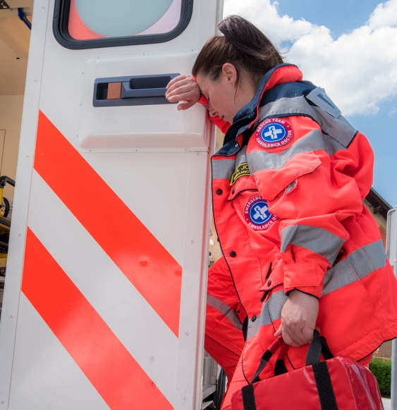
What Are the Stressors That
Impact Resilience?
There are three kinds of stressors
Situational: What happens during the call
Personal: Your feelings during and after the call
Systemic: Problems in the organization you work for
Notes:
Instructor Notes
Expand on the following points:
Many EMS practitioners experience these stressors at various points in their career.
They may experience them all in 1 day or over the span of their career.
Source
Halpern J, Gurevich M, Schwartz B, Brazeau P. What makes an incident critical? Emotional outcomes and implications for interventions. Work and Stress. 2009;23(2):173–189.

Slide 9
What Makes an Incident
Critical for EMS Practitioners?
Research conducted by J. Halpern et al. found that:
Critical incidents are associated most strongly with stressors in the personal category.
39% of practitioners who reported critical incidents had experienced stressors in all three categories.
33% reported experiencing stressors in personal and situational categories.
Systemic stress is associated with burnout but less so with PTSD and depression.
Notes:
Instructor Notes
Expand on the points on the slide. Then ask: “Does this mean that any one stressor is more harmful than the other?”
Answer: No. It all boils down to the individual’s perception.
Although these figures identify trends, they are not absolutely representative of you or your colleagues.
Speak up. Listen. Remember, it’s okay to seek help!
Source
Halpern J, Gurevich M, Schwartz B, Brazeau P. What makes an incident critical? Emotional outcomes and implications for interventions. Work and Stress. 2009;23(2):173–189.

Slide 10
Situational Stressors
What factors are beyond your control?
What have you seen that has shown how people can be cruel or neglectful?
When has it been difficult for you to deal with patients’ friends and family members?
Have you been in situations where the scene has not been safe?
Has a patient’s outcome affected you?
Notes:
Instructor Notes
Expand on the following points:
What factors are beyond your control? Answers may include:
Delays due to traffic or distance
Could not enter building
Incorrect dispatch data
What have you seen that has shown how people can be cruel or neglectful? Answers may include:
Rape
Abuse and neglect of children, older adults, and the disabled
When has it been difficult for you to deal with patients’ friends and family members? Answers may include:
Grief
Anger at EMS practitioners
Difficulty in communication
Lack of cooperation
Have you been in situations where the scene has not been safe? Answers may include:
Patient was emotionally disturbed or had altered mental status
Patient was violent
Chaotic or dangerous scene (traffic, HAZMAT, volatile bystanders)
Has a patient’s outcome affected you? Answers may include:
I felt connected to a patient who had a poor outcome or died.
I wanted to know what happened to the patient but couldn’t find out.
Patient was distressed when I transferred him or her to other caregivers.

Slide 11
EMS System Stressors (1 of 2)
How the call was relayed/treated, for example:
  Wrong address
  System rules prevented efficient patient care
Supervisor’s reaction, for example:
  Criticized for time at scene
  Criticized for patient care decisions or hospital choice
Notes:
Instructor Notes
Expand on the points listed on the slide.

Slide 12
EMS System Stressors (2 of 2)
Post incident problems, such as:
  No downtime before next call
  No time to write up incident
Reactions of peers, such as:
  Dismissive of reactions to the incident
  “It’s part of the job.”
  “You should be able to handle it.”
What other EMS system stressors have you encountered?
Notes:
Instructor Notes
Expand on the points listed on the slide and then ask: “What other EMS system stressors have you encountered?”
Answers might include:
Incorrect priority levels
Poor pay
Stressful hours
Working holidays
Mandated overtime
Educational ceiling
Occupational ceiling
Multiple employers, policies, and system protocols

Slide 13
Personal Stressors
What painful emotions have you felt during a call?
Have you ever felt unappreciated by your employer?
  The patient’s family?
  Hospital personnel?
  Colleagues?
  Anybody else?
What kind of stress have you had in your personal life?
Notes:
Instructor Notes
Ask participants:
What painful emotions have you felt during a call?
Participants may share the following reactions:
I felt helpless.
I felt overwhelmed.
I didn’t do a good enough job.
Fatigue got in the way of doing a good job.
I feel unappreciated.
Have you ever felt unappreciated by your employer? The patient’s family? The hospital personnel? Colleagues? Anybody else?
Participants may share the following reactions:
I’m working too many hours
I’m working more than one job
What kind of stress have you had in your personal life?
Participants may share the following examples of personal stress:
Family illness
Marital problems
Feeling like I’m not enough for my family
Financial stress

Slide 14
Minimize the Effects of
Critical Incidents
EMS practitioners
  Should request post-incident downtime.
  It is recommended that downtime be for at least an hour but not longer than a day.
EMS supervisors
  Should be aware that practitioners may need time after a difficult call to allow their systems to recalibrate.
  Should encourage EMS practitioners to request downtime.
Notes:
Instructor Notes
Expand on the points on the slide. Solicit additional ideas from the participants. Ask them for examples of strategies that have worked and strategies that have not.

Slide 15
Minimize the Effects of
Critical Incidents
Agencies
  Policies need to be in place just as they would be for a needlestick or other on-the-job injury.
Notes:
Instructor Notes
Expand on the points on the slide. Solicit additional ideas from the participants. Ask them for examples of strategies that have worked and strategies that have not.

Slide 16
Minimize the Effects of
Critical Incidents
EMS practitioners should have the opportunity to talk about what happened and their reactions to it.
Not everyone needs to talk about the details of a difficult call.
Notes:
Instructor Notes
Expand on the points on the slide.
Emphasize that EMS practitioners should have the opportunity to talk about what happened and their reactions to it:
Seek out a partner, friend, coworker, supervisor, or trusted advisor—someone who is willing and able and has the time to listen.
Choose a setting with privacy and quiet environment.
Not everyone needs to talk about the details of a difficult call.
Rehashing details should not be required.
EMS practitioners should be encouraged to talk about symptoms and concerns.

Slide 17
Increasing Resilience
Lifestyle changes may help to manage stress, such as:
  Improving your diet
  Exercising
  Practicing relaxation techniques
  Balancing work, recreation, family, and health
Notes:
Instructor Notes
Expand on the points on the slide.
Consider improving your diet.
Do you need to reduce sugar, caffeine, or alcohol intake?
Consider exercising.
Add a small exercise routine to your day.
Practice relaxation techniques such as meditation or visual imagery.
There are apps for that!
Balance work, recreation, family, and personal health.
Every week, there needs to be personal time to read, walk, see a movie, fish, swim, or play. Something that relaxes or rejuvenates you.

Slide 18
Stress Management Strategies
Work on having a cooperative and supportive relationship with your partner and others on the ambulance.
Get help if you are having conflicts with your partner. Speak to colleagues or reach out to a professional for help working on these relationships.
Notes:
Instructor Notes
Expand on the points on the slide. Remind participants that work relationships can make a big difference in whether a critical incident is stressful or manageable and professionally rewarding.

Slide 19
Posttraumatic Growth
Posttraumatic growth refers to the positive changes in people who have been affected by traumatic stress.
Many people who have witnessed or experienced traumatic events report that they feel more connected to others, have a growing sense of their spiritual lives, and find deeper meaning in their pursuits despite having posttraumatic stress symptoms.
Identifying and appreciating these changes in oneself may help to lower stress.
Notes:
Instructor Notes
Expand on the points on the slide. Discuss the benefits of posttraumatic growth.

Slide 20
Posttraumatic Growth
People may grow stronger if they are able to tie a positive response to the event. Examples include:
  Creating a memorial for those in a traumatic event
  Creating an injury prevention program
  Seeking spiritual support
  Raising money to support those harmed by the traumatic event
Notes:
Instructor Notes
Expand on the points on the slide. Ask participants for additional examples of how to tie a positive response to a traumatic event. Additional examples may include:
Working to improve training in that area
Improving safety efforts

Slide 21
Remember
It’s okay to feel bad.
It’s okay to get help if you need it.
Notes:
Instructor Notes
Expand on the points on the slide. Reiterate the points a few times. Repeat it like a mantra.

Slide 22
Seeking Help From Professionals
Our agency can help you identify a counselor.
Or you may prefer to find one privately.
How do you know if a counselor is qualified to treat psychological trauma?
  Ask about the counselor’s experience in treating trauma.
  Ask if the counselor has been trained in specific methods for treating psychological trauma.
Notes:
Instructor Notes
Expand on the points on the slide.

Slide 23
Helping Coworkers With
Critical Stress
When partners, coworkers, or friends ask to speak with you about a difficult call or their feelings and reactions to a critical incident:
  Let them know if you are the person who is willing and able and has the time to truly listen to their concerns.
  If you are also having difficulties and do not feel capable of assisting, refer the person to an alternate individual you feel could be helpful.
  Know your limitations but be willing to point them toward available resources.
Notes:
Instructor Notes
Expand on the points on the slide. Encourage participants to become familiar with the resources available in their area.

Slide 24
How Can We Provide Support?
Acknowledge the validity of their feelings.
Actively listen to their concerns.
Do not minimize or deny when they are emotional.
Encourage them to seek information about additional support through the MHRO.
Notes:
Instructor Notes
Expand on the points on the slide. Solicit additional ideas from the participants. Ask them for strategies that have and haven’t worked.

Slide 25
Helping Our Own
Things you can say to provide support include:
  I can see this has been very difficult for you.
  We all have times when we are suffering inside. I appreciate your sharing this with me.
  It is okay to feel this way. I will stand by you and support you any way I can.
  It is okay to ask for help. I’ve done it myself (if true).
  I can see this is painful for you. How can I help?
  If you feel you need additional support, connect with our MHRO, who can help.
Notes:
Instructor Notes
Expand on the points on the slide. Solicit additional ideas from the participants. As with the previous slide, ask them for strategies that have and haven’t worked.

Slide 26
Hurting Our Own
Sayings that can be detrimental and destructive to your
coworkers include:
  What are you, a rookie?
  Suck it up and get back to work.
  It wasn’t that bad of a call, so what was the problem?
  Joe is a wuss, cries over every little thing.
  I don’t take breaks, it is onto the next call for me and if you can’t take it, find another partner.
  Only crazy people go to shrinks.
  Just have a drink when you get home.
Notes:
Instructor Notes
Expand on the points on the slide. Ask participants why these words are so harmful. Ask if it’s harmful even if it’s done in a joking manner.

Slide 27
When Does a Co-worker need Immediate Care?
Thoughts of harm toward self or others, especially with a specific plan and means
Reckless behavior such as drinking and driving or drug
overdose or excessive use
Impaired ability to perform job functions
Signs of self-neglect
  Malnourished, dehydrated, sleep deprived, profound lack
  of self-care
Notes:
Instructor Notes
Expand on the points on the slide.

Slide 28
When Is Immediate Action Critical?
If you are worried about your partner or other coworker, contact
the MHRO.
If he or she is on shift, notify a supervisor and get immediate help.
Notes:
Instructor Notes
Expand on the points on the slide.

Slide 29
Obstacles to Seeking Help
Reluctance to seek help due to appearance of weakness
The helper becomes the one needing help.
Lack of understanding of the normalcy of stress reactions
  Do not want to feel like they are “crazy”
Concerns for ability to pay for treatment
Feelings of helplessness or depression
Inability to see potential for feeling better
“I am tough” mentality
Notes:
Instructor Notes
Expand on the points on the slide. Solicit additional ideas from participants. Ask for examples of strategies that have worked and those that have not in overcoming these obstacles.

Slide 30
Summary
We need to take care of ourselves.
We need to take care of each other.
Use resilience practices.
Watch out for the warning signs.
Act when warning signs appear.
Traumatic stress is dangerous to our health.
Notes:
Instructor Notes
Expand on the points on the slide.

Slide 31
Questions?
Notes:
Instructor Notes
Ask participants if they have any questions about this presentation.

