Slide 1
Airway Management Practical
Tactical Combat Casualty Care for All Combatants
Notes:
Airway problems on the battlefield account for a small percentage of combat injuries and death. However, you must be prepared to evaluate and manage a casualty’s airway if compromised. Maxillofacial trauma probably accounts for the majority of airway problems.

Slide 2
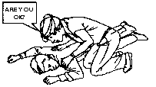
Is the Casualty Responsive?
If the casualty appears to be unconscious, see if he will respond. In a loud, but calm, voice, ask something simple like: “Are you okay?” Also, gently shake or tap the casualty’s shoulder.
If the casualty does not respond, your next move is to make sure he is breathing.
Notes:
Use the AVPU system to determine level of consciousness.

Slide 3
Opening the Airway
If a casualty is not breathing or is having difficulty breathing, open his airway using either the head tilt/chin-lift or jaw thrust maneuver.
  Even if an unconscious casualty is breathing on his own at the moment, protecting his open airway will assure his ability to continue breathing.
Notes:
An unconscious person may not be able to maintain an open airway.

Slide 4
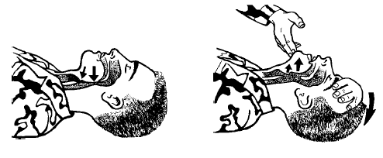
Head Tilt / Chin Lift
Place one hand on the casualty’s forehead and apply firm, backward pressure with the palm to tilt the head back.
Place the fingertips of the other hand under the bony part of the lower jaw and lift, bringing the chin forward.
The fingers should not press deeply into the soft tissue under the chin because this may obstruct the airway.
Notes:
The head tilt / chin lift maneuver is an effective way to open the airway in a casualty who has no injury to his cervical spine.
Read text.
Demonstrate the maneuver on a volunteer student or a manikin.

Slide 5
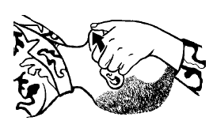
Jaw Thrust
Position yourself at the casualty’s head with your elbows on the surface on which the casualty is lying.
Using both hands, grasp the angles of the casualty’s jaw, and lift the jaw.
Keep the casualty’s head from tilting backwards or moving sideways.
Notes:
The jaw-thrust is the safest first approach to opening the airway of a casualty who has a suspected neck injury because in most cases it can be accomplished without extending the neck.
Read text.
Demonstrate the maneuver on a student volunteer or a manikin.

Slide 6
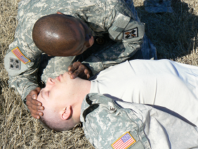
Maintain an Open Airway
Maintain Head-Tilt/Chin-Lift or Jaw Thrust
Look, Listen, and Feel for breathing.
Count respirations for 30 seconds and multiply by 2.
Remove any foreign
matter from mouth.
An NPA is the next step.
Notes:
While keeping the airway open, LOOK for the chest to rise and fall, LISTEN for air escaping during exhalation by placing your ear near the casualty’s mouth, and FEEL for the flow of air on your cheek.
The number of breaths in 30 seconds doubled gives you the casualty’s respiratory rate. The normal respiratory rate for an adult at rest is 12-20 breaths per minute.
This is a good time to look into the casualty’s mouth and remove anything that shouldn’t be in there by sweeping it out with a crooked finger. Be careful not to push anything further back in the casualty’s throat.
The head tilt / chin lift and jaw thrust are temporary measures. They are impossible to maintain while moving the casualty or inside a cramped evacuation platform. A Nasopharyngeal airway (or NPA) is a device that can keep the casualty’s airway open, allowing the person protecting the casualty’s airway to move on to other things.

Slide 7
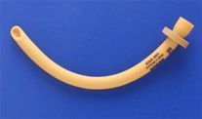
Nasopharyngeal Airway
Notes:
This is a nasopharyngeal airway. The NPA is the primary airway adjunct used in tactical settings. When properly inserted it is very likely to stay in place, and it is unlikely to cause gagging in a semi-conscious casualty.

Slide 8
Nasopharyngeal Airway
Do not use the nasopharyngeal airway (NPA) if there is evidence of head trauma and the roof of the casualty's mouth shows signs of trauma.
Do not use the nasopharyngeal airway if there is evidence of head trauma and clear fluid is coming from the ears or nose.
Notes:
An NPA must be used cautiously in any casualty with head trauma. If the floor of the brain cavity has been fractured, the NPA could be accidentally inserted into the brain.
Before inserting an NPA inspect the roof of the casualty’s mouth, nose and ears. Look for any disruption of the soft and hard palate. Clear liquid leaking from the nose or ears of a casualty with significant head trauma is probably cerebrospinal fluid, and such leakage indicates a skull fracture.

Slide 9
Nasopharyngeal Airway
Place the casualty on his back.
Remove the NPA and its lubricant from the casualty’s JFAK.
Lubricate the tube
Notes:
Position the casualty, lubricate the tube…..

Slide 10
Nasopharyngeal Airway
Insert the tip of the airway into either nostril with the bevel facing the nasal septum.
  Align the NPA perpendicular to the face and go straight in.
  Do not follow the ridge of the nose upward toward the brain.
Advance the NPA until the flange rests against the nostril.
  If you meet resistance, try gently rotating the
  NPA a little.
  If that doesn’t work, try the other nostril.
Tape the NPA in place to prevent
migration.
Notes:
Read text

Slide 11
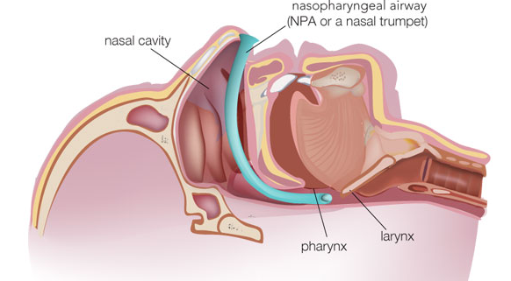
Nasopharyngeal Airway
Notes:
The NPA provides secure air passage behind the soft palate and tongue.

Slide 12
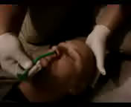
Nasopharyngeal Airway

Slide 13
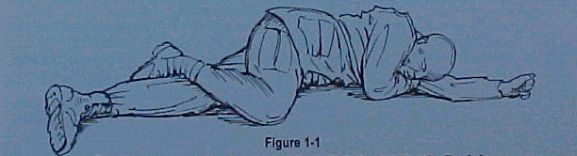
Nasopharyngeal Airway
If you can’t get the NPA to pass fully into either nostril, put the casualty in the recovery position and seek medical help.
A medic or corpsman will have to attempt a more advanced airway.
Notes:
If the NPA won’t go in easily, Do Not Force It. A bloody nose is the most common complication of the NPA, and blood in the throat of an unconscious casualty is not a good thing. Positioning the casualty is the next best way to keep the airway open while you get the attention of a medic or corpsman.

Slide 14
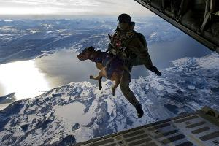
Questions?

