Slide 1
Tactical Combat Casualty Care for All Combatants
Radial Pulse Practical

Slide 2
What is a pulse?
When the heart pumps and forces blood into the arteries, the surge of blood creates a pressure wave that is transmitted along the arteries.
This pressure wave is the pulse.
You can feel these pressure waves with your fingertips.
It is usually easier to feel the pulse if the artery is on top of a bony area such as at the wrist.
You can do this in noisy and/or dark environments.
Notes:
Read text.

Slide 3
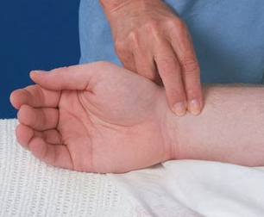
Radial Pulse
On the front of the wrist, on the thumb side.
Next to the first big tendon.
Press gently with your
index and long fingertips.
Count the pulse for 30
seconds and multiply by 2
to get the pulse rate.

Slide 4
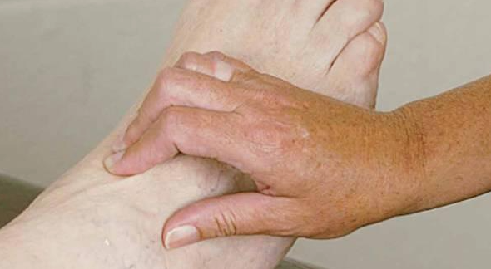
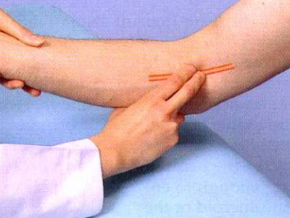
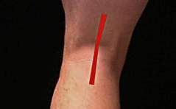
Other Pulses
Dorsalis pedis artery
Brachial artery
Popliteal artery
Notes:
You may need to check these pulses after you apply a limb tourniquet or splint a fracture.

Slide 5
Practice
Divide into groups of four.
Each student determines the radial pulse rate of each other student in the group.
Repeat for other pulses.
Your classmates’ pulses have normal strength.
The pulse of a casualty who has lost a lot of blood will not be this strong.
  If his pulse is weak or you can’t feel it at all-
  He needs a medic!
Notes:
Note: Having the students find the radial pulse on classmates will give them a feel for normal radial pulse strength.

